Slide 1
Preparing for
MAEFAIRS BUDGET
I gotta do WHAT?

Slide 2
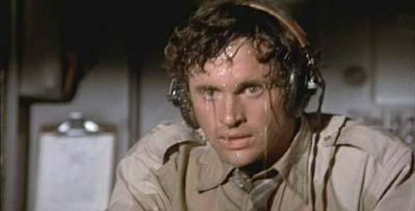
“I just want to tell you good luck, we’re all counting on you!

Slide 3
Resources for Brand New Clerks
Check the district minutes to see if your district ran and passed any levies in the general fund, technology, building reserve, or debt service fund
Find last years’ budget report for reference and comparison
  See what funds have been budgeted by your district.
  When completed, compare budget/levy amounts for large variances that may indicate an error.

Slide 4
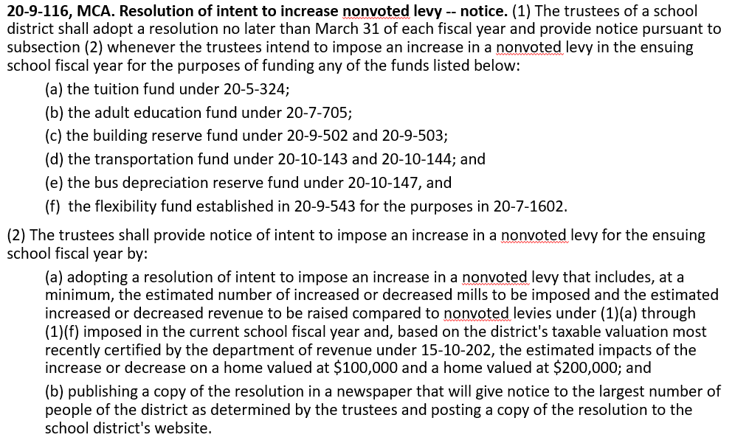
A little discussion on Permissive
(Non-Voted Levies)

Slide 5
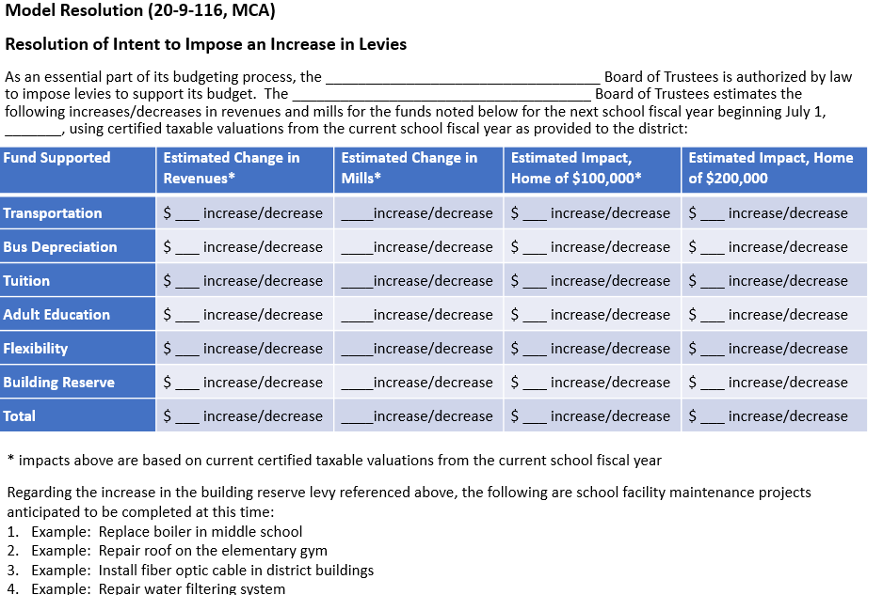
Model Resolution
Always include Each fund
Always ESTIMATE a dollar amount, even if $0.00

Slide 6
WHAT FUNDS ARE INCLUDED IN THE MAEFAIRS BUDGET REPORT?
All funds reported on the Trustees Financial Summary are not necessarily budgeted.

Slide 7
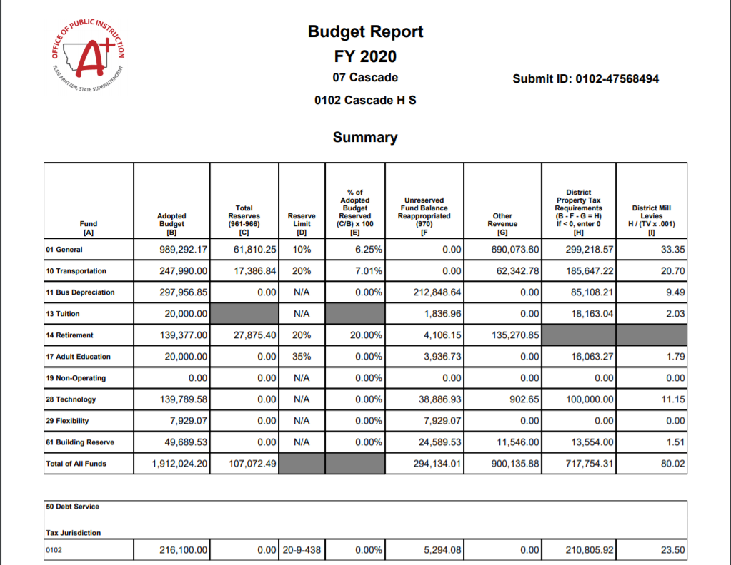

Slide 8
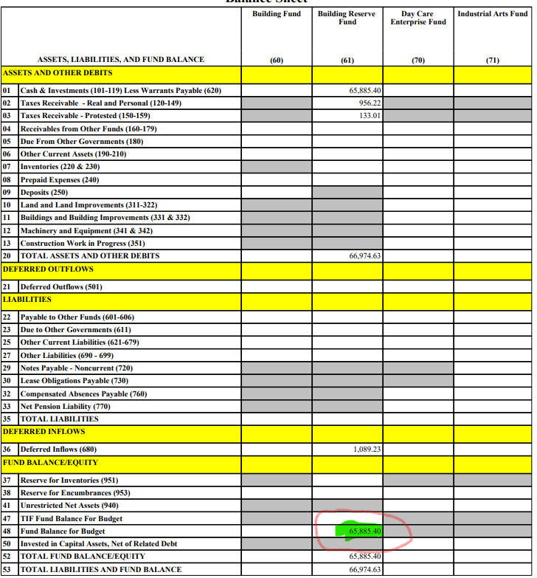
Information from the TFS Balance Sheet

Slide 9
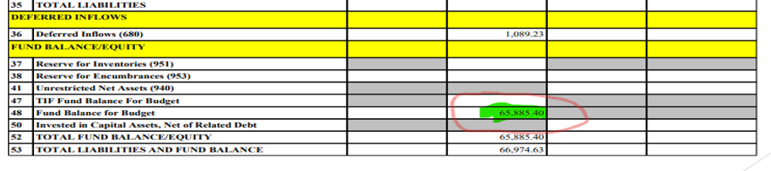

Slide 10
MAEFAIRS BUDGET INSTRUCTIONS
Here is a link to the budget instructions. budget instructions
The items in the table of contents are also links to use.

Slide 11
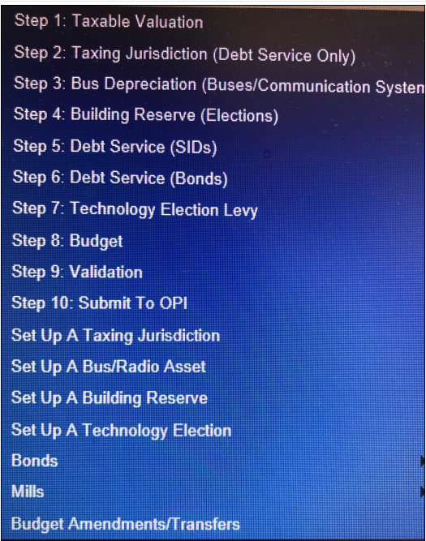

Slide 12
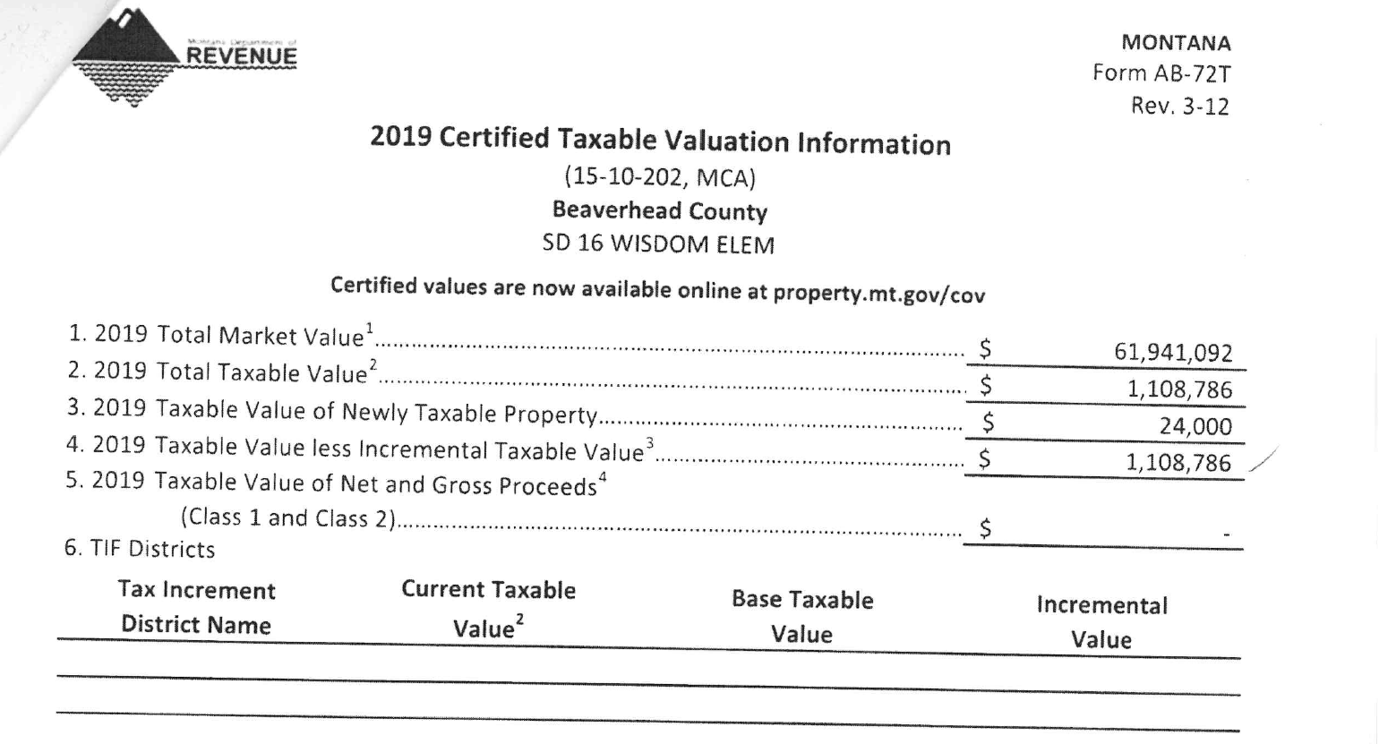
Do you know your taxable valuation yet?
It should be coming soon (Aug. 3)
Hopefully this comes directly to you.
Sometimes it goes to your County Superintendent, stay in touch with them.
Line 4 has the magic number

Slide 13
TAXING JURISDICTION
For Debt Service only
Taxing Jurisdictions for Debt Service may be different than your general fund taxing jurisdiction for instance.
Contact OPI to add or expire a taxing jurisdiction.
If you have more than one taxing jurisdiction, you must enter the fund balance for each taxing jurisdiction and the total of all must equal the total fund balance for Fund 50.

Slide 14
BUS DEPRECIATION
Have all the info on any new bus(es) that your district purchased during the fiscal year.
  The bus title will have the information you need.
  Set up each bus in the Set Up a Bus/Radio section
  You will decide how much to levy per bus in Step 3 of MAEFAIRS
  This fund can also be used to “depreciate” radio systems for transportation.
  There is no actual “depreciation”, this fund is for permissively levying dollars to replace current busses or radios in the future and using a depreciation type schedule to do so.

Slide 15
Building Reserve
Go to step #4 Building Reserve elections and enter the information needed there.
  Election date
  Amount of yearly levy approved by voters
  Number of years approved by voters

Slide 16
STEPS 6 AND 7 DEBT SERVICE
SID’S (Special Improvement Districts)
  Curbs and Roads
BONDS
  Bond schedule

Slide 17
STEP 8 ENTER INDIVIDUAL BUDGET INFORMATION
General Fund
  Preliminary Budget Data Sheet
    Highest Budget Without a Vote
    Highest Budget With a Vote

Slide 18
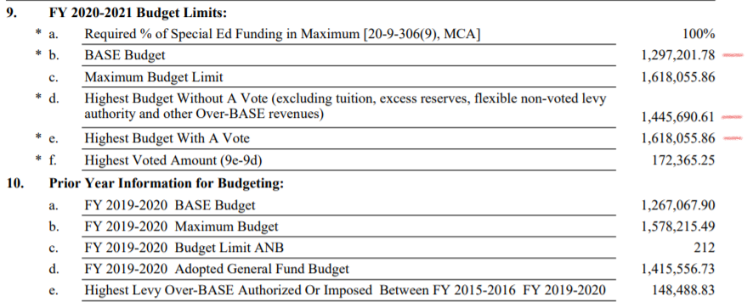
General fund
Preliminary Budget Data Sheet
Page 2

Slide 19
Enter General Fund Levy Amount
There is a data entry point for Levy amounts approved last May.
If you were
  Lucky enough to have passed a general fund levy…..
  You need to enter that levy amount to be able to budget at the “Highest budget with a vote” amount.
  Enter the amount of the approved levy in the appropriate data entry spot(Amount Approved on Ballot by Voters). If you do not, you will not be able to budget at the amount the voters approved.

Slide 20
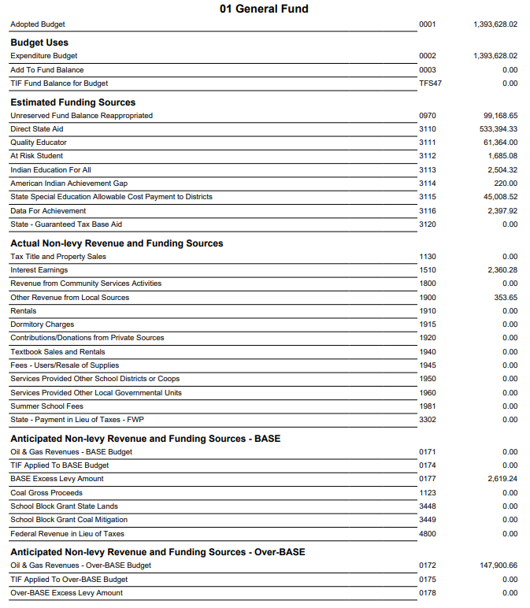

Slide 21
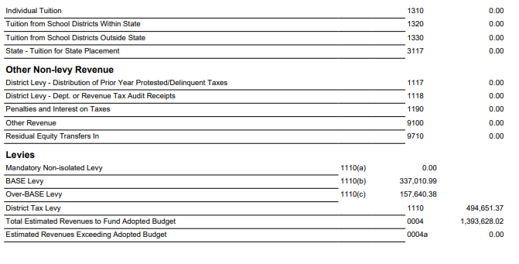

Slide 22
Transportation Fund
Budget all costs associated with Transporting students to and from school only.
Historical costs? Check prior year budgets.
  Fuel
  Administrative costs
  Bus Driver salaries/benefits/training/physicals/tests
  Drug testing
  Insurance
  Repairs/maintenance
  Individual transportation contracts
  Or Bus Contractor costs
Calculating “On-Schedule” costs = State and County Revenues
Total Budget - “On Schedule” – Contingency - Estimated Funding Sources= District Levies

Slide 23
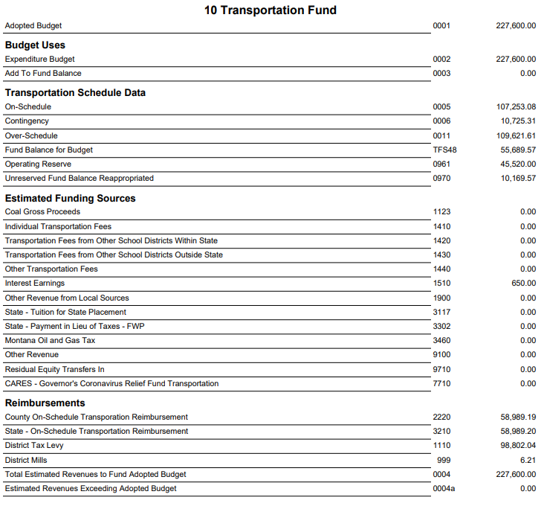

Slide 24
Bus Depreciation Fund
Adopted Budget=
Fund Balance Reappropriated+
Estimated revenues+
District Tax Levy (derived from schedule on next slide)
  Your district may levy up to 20% of the historical cost of each bus for 7.5 years.
  Over its lifetime, the district may levy up to 150% of the historical cost of the bus.
  The district does NOT have to levy the full 20% each year.

Slide 25
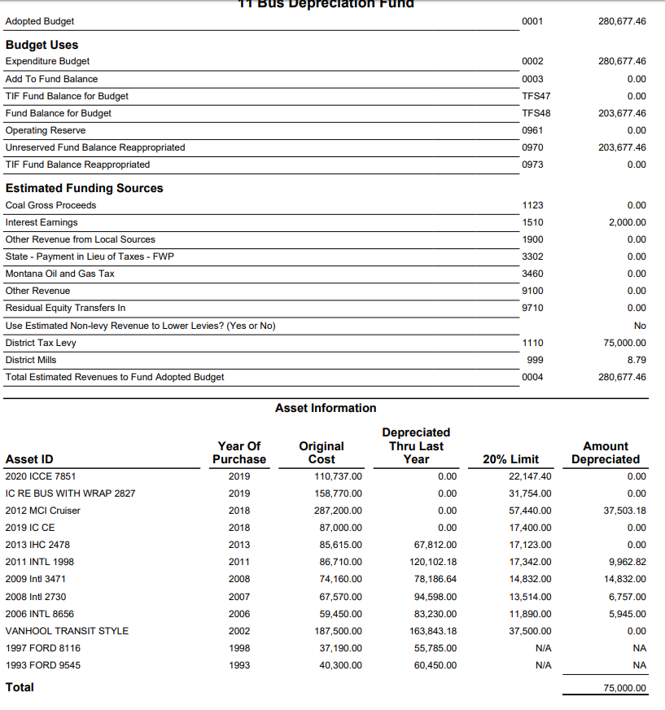

Slide 26
Tuition Fund
May levy permissively to pay tuition for out-of-district attendance of a resident pupil.
May levy an amount necessary to pay for the full costs of providing a free appropriate public education, as defined in 20-7-401, in the district to any child with a disability who lives in the district.
  OPI has a spreadsheet to help determine levy amounts.
  One student per spreadsheet.

Slide 27
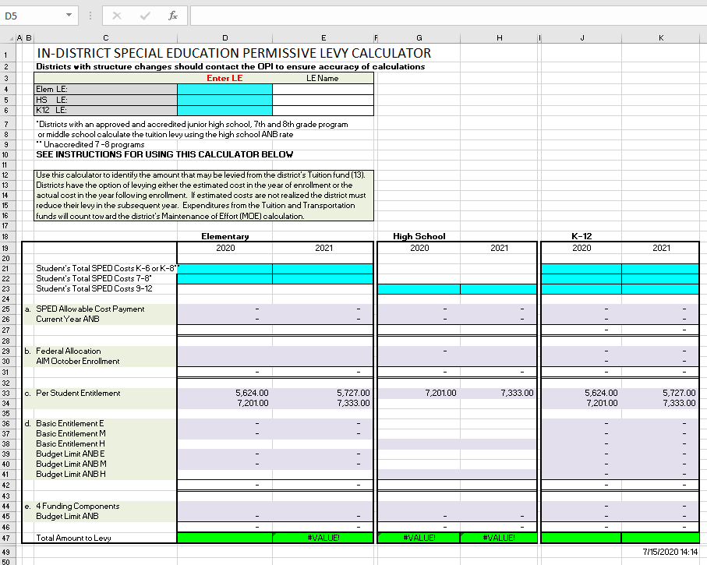
Tuition Levy Spreadsheet

Slide 28
Tuition Fund reserve limit
There is no reserve limit for the Tuition Fund
All fund balance dollars must be reappropriated to lower any potential levy.

Slide 29
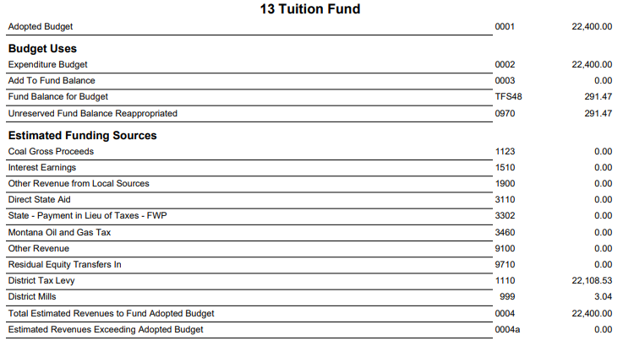

Slide 30
Retirement Fund
Calculate amounts needed for each employee”
  Retirement (TRS and PERS)
  FICA
  Unemployment
Be sure to add extra in case:
  new employees are added or
  if you anticipate any teachers retiring at the end of the year.
Has your district used a spreadsheet?
Has your district used a budget planner from your accounting system?
Has your district budgeted the same amount every year?

Slide 31
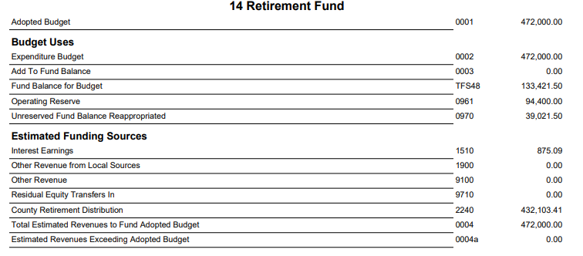

Slide 33
Adult Education
Many districts set the same budget every year.
Do you have an adult ed coordinator? If so, work with them to build the budget.

Slide 34
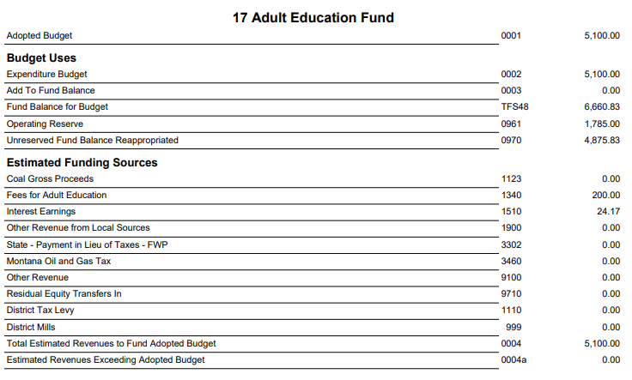

Slide 35
Technology Fund
+Voted Levy
+Other Revenues (State Tech Aid, Interest, oil and gas)
  State Tech Aid can be found on the prefilled data verification sheet you printed at the beginning of the Trustees Financial Summary process.
+ fund balance reappropriated
= Technology Fund Budget

Slide 36
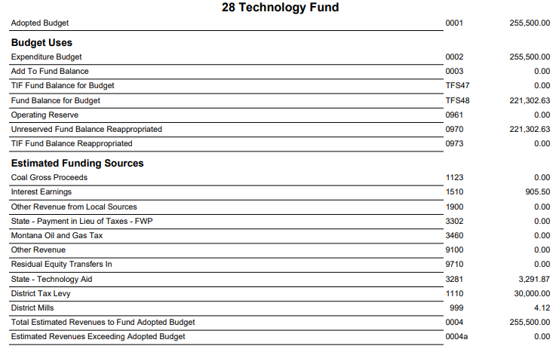

Slide 37
Flexibility Fund
+ Fund balance reappropriated
+ other revenue (interest, oil and gas payments, rental dollars, innovative educational program,transformational learning payment and/or levy)
= budget

Slide 38
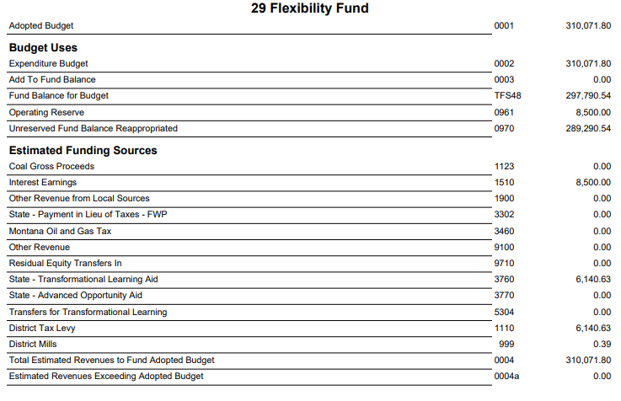

Slide 39
Building Reserve Fund
+Voted and/or
+Permissive Levy
+Other Revenues (State School Major Maintenance, oil and gas, rentals)
+ fund balance reappropriated
= Building Reserve Fund Budget
See OPI General fund budget spreadsheet for School Major Maintenance breakdown by district.

Slide 40
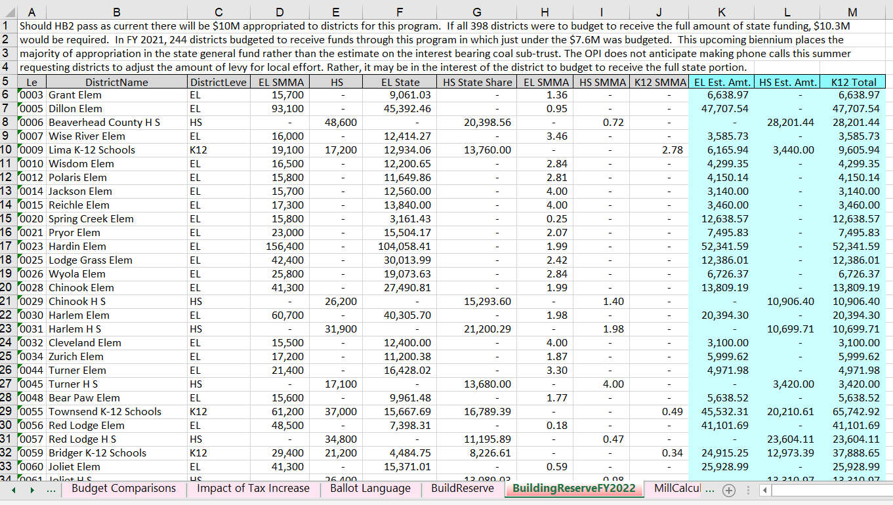

Slide 41
