Slide 1


Key Bills from the 2021 Legislative Session
Veteran Clerks Webinar
December 9, 2021
Denise Williams, MASBO Executive Director

Slide 2
Key Bills from the 2021 Legislative Session
HB143 Provide incentives for increasing starting teacher pay
HB192 Revising laws related to school major maintenance funding
HB233 Revise funding for students with disabilities
HB246 Enhance local control and opportunities for pupils
HB279 Tax credit scholarship and innovative education programs
HB630 Appropriate CARES II Funds (focus on enrollment increases)
HB671 Comprehensive School & Community Treatment (CSCT)

Slide 3
House Bill 143 - Provide incentives for increasing starting teacher pay
TERMINOLOGY
(Note: do not include bonuses, stipends or extended duty contracts)
Teacher Base Pay - the lowest salary for a beginning teacher incorporated in the district’s CBA
First class school district - district has a population of 6,500 or more
Teacher average pay -
          Total compensation paid all teachers
          Total full time equivalent of teachers

Slide 4
House Bill 143 - Provide incentives for increasing starting teacher pay
Effective date: July 1, 2021
Legislative goals for starting teacher pay
  Teacher base pay in the applicable year must be at least 10 times as much as the quality educator payment amount set forth in § 20-9-306, MCA; and
  For first class school districts only, teacher base pay may not be less than 70% of average teacher pay in that school district.

Slide 5
House Bill 143 - Provide incentives for increasing starting teacher pay
FY2022 (July 1, 2021 – June 30, 2022)
  Quality Educator rate = $3,385
  Teacher base pay =
    at least $33,850 (10 X $3,385)
      and, if first class school district
    not less than
    Total compensation paid all teachers
    Total full time equivalent of teachers
  Look at full time equivalent teachers that are in the first three years of the teacher’s teaching career
X 70%

Slide 6
House Bill 143 - Provide incentives for increasing starting teacher pay
Additional FTE for QEC payment
  the number of full-time equivalent teachers that were in the first 3 years of the teacher's teaching career in the previous year
  Meets legislative goals for starting teacher pay
  Reported to OPI by December 1
OPI TEAMS application – Teacher Incentive Program
Contact: Nicole Thuotte, nthuotte@mt.gov or (444-4524)
2021-2022 TEAMS Virtual Works Sessions in September & October

Slide 7
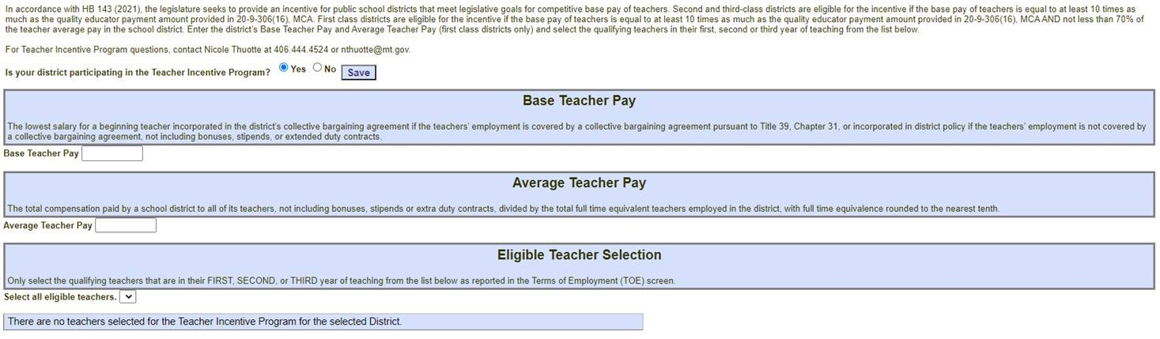
NEW SCREEN IN OPI TEAMS APPLICATION

Slide 8
House Bill 192 Revising laws related to school major maintenance funding
Resolution of Intent to Increase Non-Votes Levies (20-9-116, MCA)
Building Reserve Fund (20-9-502, MCA)
  permissive levy for school major maintenance
    Increases the state major maintenance aid (SMMA) amount
    Increases multiplier used to calculate state major maintenance aid
    Removes requirement to prioritize Facility Condition Inventory issues
    Specifies resolution and notice requirements
  transfers for school and student safety and security
Applies to:
  Notice of Intent Resolution due March 31, 2022
  FY2023 Building Fund permissive levy; state major maintenance aid

Slide 9

House Bill 192 Revising laws related to school major maintenance funding
Resolution of intent to increase nonvoted levy
20-9-116(2)(a), MCA
Dollar and mill increases in nonvoted levies in:
  Transportation Fund
  Bus Depreciation Fund
  Tuition Fund
  Adult Ed Fund
  Building Reserve Fund
  Flexibility Fund
Using prior year taxable value
Impact on $100K and $200K home
Note: these are estimates

Slide 10

House Bill 192 Revising laws related to school major maintenance funding
Building Reserve Fund Resolution 20-9-502(3)(a)(i):
Identify the anticipated improvements or projects for which the funds will be used
Estimate the funding sources:
  Permissive levy
    amount
    estimated mills using district’s most recent taxable value
  deposits and transfers
  anticipated state major maintenance aid
Follow public notice requirements in 20-9-116

Slide 11
House Bill 192 Revising laws related to school major maintenance funding
20-9-116 (2)(b) Notice requirements
Publish the resolutions:
  No later than March 31
  in a newspaper that will give notice to the largest number of people of the district as determined by the trustees, and
  post on the school’s website

Slide 12
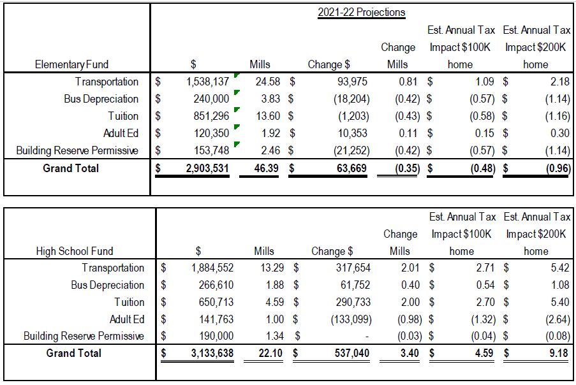

Slide 13
House Bill 192 Revising laws related to school major maintenance funding
20-9-502, MCA |  | OPI Sub-Fund
(1) | Requires sub-funds to ensure separate tracking
(2) | Voted Levy - future construction, equipping, or enlarging of school buildings or for purchasing land | 612
(3) | Permissive Levy - school major maintenance and repairs | 613
(4) | Voted Levy - transition costs to open, close, consolidate, annex or expand a school, including elementary to K-12, if eligible | 614
(5) | Transfers for safety and security per 20-9-236, MCA | 611

Slide 14
  School Major Maintenance Amount (SMMA):
  Max annual contribution amount from ALL revenue sources
  $110
  (budget limit ANB x $100) + $15,000*
Examples:
ANB | Max Annual Contribution
100 | $ 26,000 (100 x $110) + $15,000*)
500 | $ 70,000 (500 x $110) + $15,000*)
1000 | $125,000 (1000 x $110) + $15,000*)
*$30,000 for a K-12 district

Slide 15
House Bill 192 Revising laws related to school major maintenance funding
Revenue sources
School major maintenance amount (SMMA)
  Permissive levy - not more than 10 mills
  Deposits from any lawfully available revenue source
  Transfers from any lawfully available fund
  State major maintenance aid under 20-9-525(3)

Slide 16

House Bill 192 Revising laws related to school major maintenance funding
State Major Maintenance Aid 20-9-525 (3), MCA
State support per dollar of local effort
District’s SMMA X
- District TV
Total statewide taxable valuation
Total statewide SMMAs
X 171 187%
Never mind . . . it’s crazy math!

Slide 17
House Bill 192 Revising laws related to school major maintenance funding
State Major Maintenance Aid 20-9-525 (3), MCA
State support per dollar of local effort
All districts are guaranteed a subsidy calculated with at least 18% of their taxable value
Districts with PY adopted budgets 97% or greater than the PY Maximum GF Budget can receive a greater state subsidy

Slide 18
House Bill 192 Revising laws related to school major maintenance funding
2019 (HB 159) State Major Maintenance Aid
Clarified that the legislature intends funding for the natural resources K-12 facilities payment will be a (state) general fund appropriation to support school major maintenance aid:
  $6.4 million in FY 2020;
  $7.6 million in FY 2021; and
  $10 million in FY 2022 & FY 2023
These amounts are to be appropriated from the state general fund reduced by the amount of projected earnings from the (state) school facilities fund pursuant to 17-5-703, MCA for that fiscal year.

Slide 19
House Bill 192 Revising laws related to school major maintenance funding
Allowable expenditures 20-9-525(2), MCA
Support a basic system of free quality public elementary and secondary schools under 20-9-309, MCA
Improvements related to:
  School and student safety and security (see 20-9-236(1), MCA)
  Facilities – projects designed to produce operational efficiencies
    utility savings
    reduced future maintenance costs
    improved utilization of staff
    enhanced learning environments for students
Includes repayment of an intercap loan for facility project

Slide 20

House Bill 192 Revising laws related to school major maintenance funding
Removed requirement to address the 2008 Facility Condition Inventory (FCI)!

Slide 21
House Bill 192 Revising laws related to school major maintenance funding
20-9-502, MCA |  | OPI Sub-Fund
(1) | Requires sub-funds to ensure separate tracking
(2) | Voted Levy - future construction, equipping, or enlarging of school buildings or for purchasing land | 612
(3) | Permissive Levy - school major maintenance and repairs | 613
(4) | Voted Levy - transition costs to open, close, consolidate, annex or expand a school, including elementary to K-12, if eligible | 614
(5) | Transfers for safety and security per 20-9-236, MCA | 611

Slide 22
House Bill 192 Revising laws related to school major maintenance funding
Transfers for school safety and security 20-9-236, MCA
Must have a current plan pursuant to 20-1-401, MCA
  school safety plan, or
  emergency operations plan
Must certify your plan to OPI
Other reminders:
  Transfers allowed from any budgeted or non-budgeted fund (except Retirement and Debt Service)
  Transfers from budgeted funds do not count against budget authority
  No increase in permissive levies to replenish a transfer
  Unspent funds must be transferred to originating fund after 2 fiscal years

Slide 23
House Bill 192 Revising laws related to school major maintenance funding
School and student safety and security 20-9-236(1), MCA:
Planning for improvements to and maintenance of school and student safety
  Staffing for school resource officers, counselors
  Hiring architects, engineers, consultants
Programs: active shooter training, threat assessments, restorative justice
Updating locking mechanisms at access points
Bullet-resistant windows/barriers
Emergency response systems

Slide 24
HB233 Revise funding for students with disabilities
Effective July 1, 2021
Clarifies definition of “pupil” in 20-1-101, MCA
  an individual who is admitted by the board of trustees pursuant to 20-5-101, MCA
  enrolled in a school established and maintained under the laws of the state at public expense
  eligibility of pupils and calculations for ANB are governed by 20-9-311, MCA
A pupil over age 19 by September 10 is not eligible for ANB, except
  Pupil with disabilities age 19 – 21 years receiving services under 20-7-411(4)(a) who has
    Not graduated, and
    Eligible for special education services and likely to be eligible for adult services for individuals with developmental disabilities due to significance of the disability, and
    Student’s IEP has identified transitions goals that focus on preparation for living and working in the community following high school graduation since age 16 or the student’s disability has increased in significance after age 16
Notes:
20-7-411. Regular classes preferred -- obligation to establish special education program.
4) (a) The board of trustees of a school district or a state-operated adult health care facility providing special education services to its residents may provide or establish and maintain a special education program for a child with a disability who is 2 years of age or under or who is 19 years of age or older and under 22 years of age.
School district is encouraged to collaborate with agencies and programs that serve adults with developmental disabilities in meeting the goals of a student’s transition plan.

Slide 25
HB246 Enhance local control and opportunities for pupils
20-1-101, MCA Definitions
(13) (a) "Minimum aggregate hours" means the minimum hours of pupil instruction that must be conducted during the school fiscal year in accordance with 20-1-301 and includes passing time between classes and, in an offsite instructional setting, includes time spent logging on and off an offsite learning platform
(17) "Pupil instruction" means the conduct of organized learning opportunities for pupils enrolled in public schools while under the supervision of a teacher. The term includes any directed, distributive, collaborative, or work-based or other experiential learning activity provided, supervised, guided, facilitated, or coordinated under the supervision of a teacher that is conducted purposely to achieve content proficiency and facilitate the acquisition of knowledge, skills, and abilities by pupils enrolled in public schools, and to otherwise fulfill their full educational potential.

Slide 26
HB246 Enhance local control and opportunities for pupils
20-1-101, MCA Definitions
(12) "K-12 career and vocational/technical education" means organized educational activities that have been approved by the office of public instruction and that:
  (a) offer a sequence of courses that provide a pupil with the academic and technical knowledge and skills that the pupil needs to prepare for further education and for careers in the current or emerging employment sectors; and
  (b) include competency-based applied learning through advanced opportunities, work-based learning partnerships, and other experiential learning opportunities that contribute to the academic knowledge, higher-order reasoning and problem-solving skills, work attitudes, general employability skills, technical skills, and occupation-specific skills of the pupil.

Slide 27
HB246 Enhance local control and opportunities for pupils
20-3-324, MCA Powers and duties [trustees]
(18) establish and maintain the educational program of the schools of the district in accordance with the provisions of the instructional services, textbooks, K-12 career and vocational/technical education, and special education parts of this title. In undertaking its duties related to the district’s educational program, the board of trustees may:
(a) waive any specific course requirement otherwise required for graduation based on individual student needs and performance levels, age, maturity, interest, and aspirations of the pupil, in consultation with the pupil’s parents or guardians; and
(b) provide credit for a course satisfactorily completed in a period of time shorter or longer than normally required as set forth in 20-9-311(4)(d) or through content proficiency gained through alternative means. Examples of alternative means by which content proficiency may be achieved include but are not limited to correspondence, extension, and distance learning courses, adult education, summer school, work study, work-based learning partnerships, and other experiential learning opportunities, custom-designed courses, and challenges to current courses. Montana schools shall accept units of credit taken with the approval of the accredited Montana school in which the student was then enrolled and which appear on the student's official school transcript.
Notes:
20-9-311. Calculation of average number belonging (ANB) -- 3-year averaging.
4) (a) Except as provided in subsection (4)(d), for the purpose of calculating ANB, enrollment in an education program:
(i) from 180 to 359 aggregate hours of pupil instruction per school year is counted as one-quarter-time enrollment;
(ii) from 360 to 539 aggregate hours of pupil instruction per school year is counted as half-time enrollment;
(iii) from 540 to 719 aggregate hours of pupil instruction per school year is counted as three-quarter-time enrollment; and
(iv) 720 or more aggregate hours of pupil instruction per school year is counted as full-time enrollment.
(b) Except as provided in subsection (4)(d), enrollment in a program intended to provide fewer than 180 aggregate hours of pupil instruction per school year may not be included for purposes of ANB.
(c) Enrollment in a self-paced program or course may be converted to an hourly equivalent based on the hours necessary and appropriate to provide the course within a regular classroom schedule.
(d) A school district may include in its calculation of ANB a pupil who is enrolled in a program providing fewer than the required aggregate hours of pupil instruction required under subsection (4)(a) or (4)(b) if the pupil has demonstrated proficiency in the content ordinarily covered by the instruction as determined by the school board using district assessments. The ANB of a pupil under this subsection (4)(d) must be converted to an hourly equivalent based on the hours of instruction ordinarily provided for the content over which the student has demonstrated proficiency.

Slide 28
HB246 Enhance local control and opportunities for pupils
20-7-1601, Forms of personalized learning – legislative intent
The legislature finds and declares pursuant to Article X, section 1, of the 1972 Montana constitution that forms of personalized learning authorized under Montana law, including but not limited to work-based learning pursuant to [section 8], proficiency under 20-9-311, determinations of course equivalency by an elected board of trustees under 20-3-324(18), offsite instruction under 20-7-118, and transformational learning, are appropriate means of fulfilling the people's goal of developing the full educational potential of each person. The provision of and participation in forms of personalized learning under this part and in compliance with accreditation standards of the board of public education are constitutionally compliant and protected. The legislature declares that any public or private regulation that discriminates against a district or pupil participating in forms of personalized learning referenced in this section is inconsistent with constitutional goals and guarantees under Article X of the Montana constitution.

Slide 29
HB246 Enhance local control and opportunities for pupils
20-7-118, MCA The provision of educational services at an offsite instructional setting by a district is limited to pupils:
  (d) attending school in the nearest district offering offsite instruction that agrees to enroll the pupil when the pupil’s district of residence does not provide offsite instruction in an equivalent course in which the pupil is enrolled.
  A course is not equivalent if the course does not provide the same level of advantage on successful completion, including but not limited to dual credit, advanced placement, and career certification.
  Attendance in these cases is subject to approval of the trustees of the district providing the offsite instruction

Slide 30
HB279 Tax credit scholarship and innovative education programs
Effective Jan. 1, 2022
State income tax credits for cash donations | Student Scholarship Organization – SSO 15-30-3102(9), MCA | Educational Innovative Programs - EIP (public school districts)
Maximum donation per taxpayer per year | $200,000, tax credit can’t exceed tax liability; 3 year carry forward | $200,000, tax credit can’t exceed tax liability; 3 year carry forward
Maximum aggregate donations – Tax Year 2022 | $ 1,000,000 | $1,000,000
Maximum aggregate donations – Tax Year 2023 | $2,000,000 | $2,000,000
Maximum aggregate donations – Tax Year 2024 → | If 80% of previous year’s credits are claimed, increase aggregate amount by 20%; otherwise, aggregate amount same as previous year

Slide 31
HB279 Tax credit scholarship and innovative education programs
Educational Innovative Programs
Donations (a gift of cash) made directly to a public school district
Follow Department of Revenue (DOR) process as described in its November 10 letter to districts (addressed to superintendent)
IMPORTANT: register at DOR’s Education Donations Portal
Portal open for registrations December 15
Tax Credits for Qualified Education Contributions Guide
DOR Contact: Dona Losett
Dona.losett@mt.gov 406-444-1991

Slide 32
HB279 Tax credit scholarship and innovative education programs
Deposit in Miscellaneous Programs Fund (X15) - track using a project reporter code (PRC)
Use donated $$ for “innovative educational program”
  Transformational learning 20-7-1602, MCA
  Advanced opportunity 20-7-1503
  Any program, service instructional methodology or adaptive equipment used to expand opportunity for a child with a disability 20-7-401, MCA
  Any courses provided through work-based learning partnerships or for postsecondary credit or career certification
  Technology enhancements, such as in 20-9-533, MCA

Slide 33
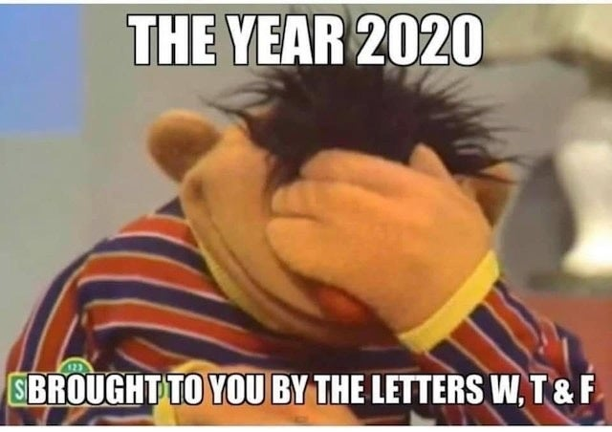
House Bill 630 Appropriate CARES-II funds
Provisions to address enrollment increases:
20-9-166, MCA State financial aid
for budget amendments
20-9-314, MCA Procedures for
determining eligibility and amount
of increased ANB due to unusual
enrollment increase
  Request for additional state aid due to unusual enrollment increases are suspended for FY2022 & FY2023

Slide 34
House Bill 630 Appropriate CARES-II funds
20-9-166, MCA Financial support for transportation budget amendments and covid-19-related enrollment increases
Legislature declares:
  the state is experiencing fiscal challenges in the 2023 biennium that are a direct result of the economic downturn resulting from COVID-19
  school enrollment decreases and subsequent increases are related to the uncertainty created by COVID-19

Slide 35
House Bill 630 Appropriate CARES-II funds
Oct 20/Feb21 enrollment counts decreased
FY2022 Budget limits lower than FY2021
Consider levy election or make cuts
Oct 2021: home school students return to district
FY2022 Adopted budget not enough
Consider budget amendment for enrollment increase
Oct 2022: more students return
FY2023 Adopted budget not enough
Consider budget amendment for enrollment increase

Slide 36
House Bill 630 Appropriate CARES-II funds
20-9-166 (2), MCA
Districts with increases in actual enrollment qualify for additional financial support
  Measured using October enrollment counts
    FY2022 budget: looks at Oct 21 actual enrollment
    FY2023 budget: looks at Oct 22 actual enrollment
  OPI will calculate the difference between
    BASE budget using “budget limit ANB”
    BASE budget using October actual enrollment count converted to ANB

Slide 37
House Bill 630 Appropriate CARES-II funds
AVERAGE NUMBER BELONGING (ANB)
FALL ENROLLMENT
(1ST Monday in October)
Part-time Students = ¼, ½, or ¾
Example:
Oct count = 150
Feb count = 166
(150 + 166)
2
= 158
187
180
= 165 ANB
Oct 2020
Total of 2 counts
divided by 2
180 + PIR Days*
180
= ANB
X
SPRING ENROLLMENT
(1st Monday in February)
Part-time Students = ¼, ½, or ¾
X
Feb 2021
*PIR Days are “pupil instruction related” days for teacher in-service training and recordkeeping

Slide 38
House Bill 630 Appropriate CARES-II funds
AVERAGE NUMBER BELONGING (ANB)
FALL ENROLLMENT
(1ST Monday in October)
Part-time Students = ¼, ½, or ¾
Example:
Oct count = 150
Feb count = 166
(150 + 166)
2
= 158
187
180
= 165 ANB
Oct 2020
Total of 2 counts
divided by 2
180 + PIR Days*
180
= ANB
X
SPRING ENROLLMENT
(1st Monday in February)
Part-time Students = ¼, ½, or ¾
X
FY2022 Current Year ANB
Feb 2021
*PIR Days are “pupil instruction related” days for teacher in-service training and recordkeeping

Slide 39
House Bill 630 Appropriate CARES-II funds
“Budget Limit ANB”
ANB that generates the greatest maximum general fund budget:
  Current Year ANB (CY ANB)
    ANB for the budget unit for the ensuing school year (FY2022 ANB is based on FY2021 enrollment counts)
  3-Year Average ANB
    Add current year ANB to the current ANB for the previous two school fiscal years and divide by 3 (FY2022 ANB is the average of FY2022, FY2021 and FY2020)
(see section 1. Certified ANB on budget data sheet; also found on first page of Budget Report)

Slide 40
House Bill 630 Appropriate CARES-II funds
AVERAGE NUMBER BELONGING (ANB)
FALL ENROLLMENT
(1ST Monday in October)
Part-time Students = ¼, ½, or ¾
Example:
Oct count = 175
(175 X 2)
2
= 175
187
180
= 182 ANB
180 + PIR Days
180
= ANB
Oct 2021 actual
X
X
New budget limit ANB

Slide 41
House Bill 630 Appropriate CARES-II funds
  BASE budget using new budget limit ANB $ XXX,XXX.XX
- BASE budget using old budget limit ANB $ XXX,XXX.XX
= Additional financial support $ XX,XXX.XX
  Funding source(s):
  1st source is up to 10% of the district’s ESSER-II and/or ESSER-III allocation (less ESSER-III restrictions), then
  OPI – first, from federal $$ appropriated for this purpose, then from the BASE aid appropriation in HB2

Slide 42
Elementary & Secondary Schools Emergency Relief (ESSER) | HB 630 ESSER-II | HB 632 ESSER-III
Total to OPI for Montana Schools | $170,099,465 | $382,019,236
90% distributed to schools based on FY20 Title I alloc | $153,089,519 | $343,817,312
.5% to OPI for administrative costs | $850,497 | $1,910,096
Supplemental allocation to school district | $3,400,000 | $3,400,000
Special needs allocation | $2,500,000 | N/A
Targeted support to school districts | $1,200,000 | N/A
Education Leadership in Montana | $939,449 | $555,234
Grants to MT School of Deaf & Blind, Youth Academy, Pine Hills | $120,000 | $120,000
Modernization of all OPI databases | $8,000,000 | $5,475,248
State summer enrichment (1% of total) | N/A | $3,820,192
State afterschool program (1% of total) | N/A | $3,820,192
Restrictions on district ESSER-III funds:
20% must be spent on learning loss programs

Slide 43
House Bill 630 Appropriate CARES-II funds
Notes about the additional financial support:
  District allocations are applied for in E-Grants and accounted for in Fund 15
  Any payment received from OPI for “additional financial support” is deposited and accounted for in Fund 15
  Additional General Fund budget authority = 0
Enrollment Increases Preliminary Allocation
Read this guidance document
Find the link to the allocation table on page 2, 2nd paragraph

Slide 44
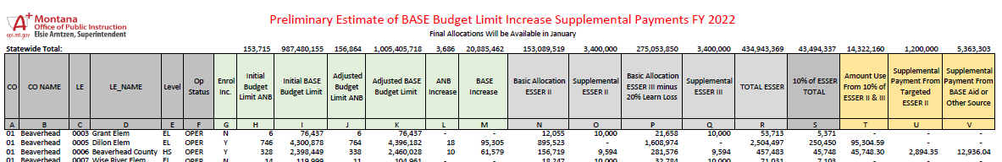
Contact Info
Jeff Kirksey, ESSER Program Manager, 406-444-0783

Slide 45

House Bill 630 Appropriate CARES-II funds
THIS JUST IN
Q: If the school decides not to amend the ESSER II and III funds to use for General fund purposes, do we still receive the Supplemental payment from the state?
A: The legislation allows district the ability to use ESSER II and/or III fund to meet general fund gaps due to enrollment increases. It is not require that you do this. Regardless if you do or do not amend your ESSER funds to meet this need you are still eligible for any further supplemental payment the district qualifies for.
Q: What if we decide to just amend one of the grants, is that OK or do we have to split the costs between ESSER II and III?
A: You do not need to split the cost between ESSER II and III, you could chose to fund the gap out of either or both.
Q: If the grant(s) is amended, is the timeline the same for spending out the grant money and the supplemental payment as it would be for making a budget amendment (i.e., the end of the fiscal year)?
A: Yes, this is correct. The legislation is intended for you to meet needs in the current fiscal year.

Slide 46
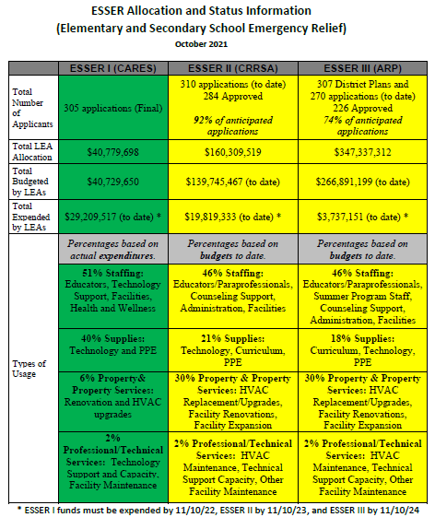

Slide 47
Comprehensive School & Community Treatment (CSCT)
Medicaid pays for covered services provided to:
  Medicaid-enrolled children and adolescents
  Children who have an IEP (Individual Education Plan) under the IDEA (Individuals with Disabilities Education Act)
CSCT is one of several school based health service programs eligible for federal Medicaid reimbursement
CSCT is for school based mental health services
School districts provide the services, typically through contracts with providers such as AWARE, Altacare, Shodair, Intermountain Children’s Home, etc.
  Usually, a room or rooms at the school building(s) is designated solely for this purpose
  Likely involves school district special education staff (manage IEPs, arrange for services, etc.)

Slide 48
Comprehensive School & Community Treatment (CSCT)
Medicaid reimbursements are administered through Montana DPHHS (Dept. of Public Health and Human Services)
Montana DPHHS’ plan is approved by CMS (Centers for Medicare & Medicaid Services – U.S. Dept. of Health & Human Services)
Several rules involved in receiving FFP (federal financial participation), including but not limited to:
  Schools, providers in schools or school-based health centers must meet federal and state requirements for Medicaid providers
  LEA (local education agency, i.e. school) must contribute non-federal dollars to help meet the full cost of the services. This is referred to as the local match.
  DPHHS’ plan must include the methodology used for demonstrating the local match

Slide 49
Comprehensive School & Community Treatment (CSCT)
How do schools meet the local match requirement?
Prior to June 30, 2020 – referred to as “soft match”
  DPHHS sent school a COM (Certification of Match) cover letter with instructions on how certify their local match requirement for the previous fiscal year
  Schools accessed CSCT Match module in MAEFAIRS to enter key information
    # of CSCT students
    Match requirement amount (calculated and provided by DPHHS in the COM)
    Square feet of CSCT room
    Square feet of entire building
  Using TFS expenditure data, a schedule of Eligible Non-Federal Expenditures for CSCT Match is generated

Slide 50
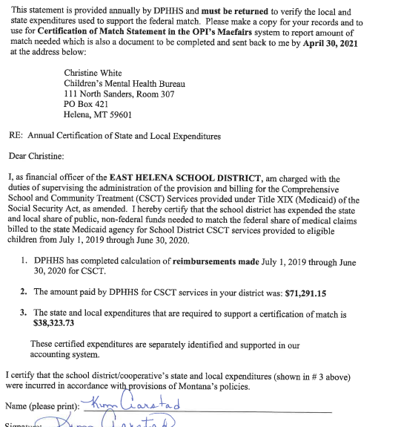
FFP Medicaid funding is roughly 65% of total costs
Local match is roughly 35% of total costs

Slide 51
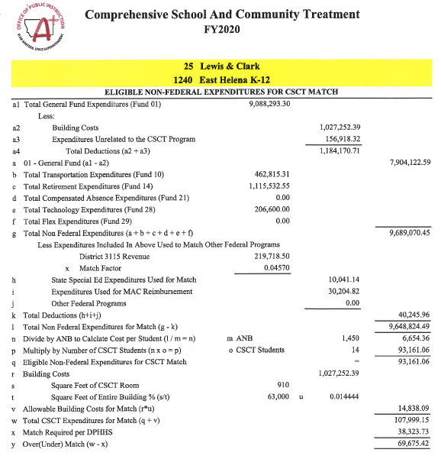
Calculation of local match

Slide 52
Comprehensive School & Community Treatment (CSCT)
Issues
The GAO (U.S. Government Accountability Office) and the OIG (Health and Human Services Office of Inspector General raised concerns about Medicaid billing for school-based services, including CSCT
CMS had to update its guidance and oversight
In 2016, CMS disallowed Montana DPHHS’ methodology for the local match
  DPHHS appealed CMS’ ruling and received forbearance up until CMS stood firm. “Soft match” methodology ended June 30, 2020
  DPHHS had its own state funds and used them as a “hard match” to keep the program running for FY 2021

Slide 53
Comprehensive School & Community Treatment (CSCT)
HB671 (Bedey) includes the following provisions related to CSCT:
OPI and DPHHS charged with collaborating to find a solution
Legislative intent is to minimize administrative burden on school districts
DPHHS must provide technical support to OPI
  Training
  Establishment of provider rates
  Coordination with CMS to ensure federal reimbursement for eligible services
OPI must provide technical support to school districts
  Training
  Accounting guidance
  Collaboration with DPHHS in communicating with school districts

Slide 54
Comprehensive School & Community Treatment (CSCT)
HB671
Created a school-based services account in the state special revenue fund
  Receive matching funds from school districts
  Fulfill financial requirements of the CMS for Medicaid reimbursement
HB2 appropriated approx. $2.2 million as bridge funding, beginning July 1, 2021
OPI and DPHHS working on IGT (Intergovernmental Transfer) process
  District sends local match to OPI
  OPI verifies, administers collection of the $$ and distribution of matching funds
  DPHHS distributes federal funds after OPI verifies local match

Slide 55
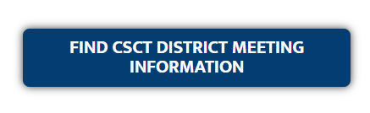
Comprehensive School & Community Treatment (CSCT)
INFORMATION ON THE OPI WEBSITE:
Go to the OPI Home Page
Hover cursor on Families & Students, then click on Suicide Prevention
Scroll down until you find this
Which takes you to the Medicaid Services page
  Past CSCT Meeting Information
  Accounting Guidance
  IGT Overview
  Max Expenditure Detail Form
  Provider Monthly Report
click on it

Slide 56
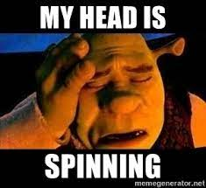
Denise Williams
MASBO
dwilliams@masbo.com
406-461-3659

