Slide 1

TUITION
Nicole Thuotte – School Finance Specialist

Slide 2












TUITION

Slide 3

This means something is “new” or “changed”

Slide 4
The basics of tuition
Tuition applies to every student who is not a resident of the school district, except;
Homeless students: 20-5-101(4), MCA
(4) The trustees shall assign and admit a child who is homeless, as defined in the Stewart B. McKinney Homeless Assistance Act (Public Law 100-77), to a school in the district regardless of residence. The trustees may not require an out-of-district attendance agreement or tuition for a homeless child.

Slide 5
The basics of tuition
A student is not eligible to be included in the district’s ANB calculation unless:
20-9-311(11)(a), MCA
(11) A district may include only, for ANB purposes, an enrolled pupil who is otherwise eligible under this title and who is:
(a) a resident of the district or a nonresident student admitted by trustees under a student attendance agreement and who is attending a school of the district;

Slide 6
The basics of tuition
Tuition scenarios determine whether an agreement is discretionary or mandatory and who is responsible for tuition.
Discretionary: 20-5-320, MCA
Mandatory: 20-5-321, MCA

Slide 7
Discretionary tuition
20-5-320, MCA
(1) A child may be enrolled in and attend a school in a Montana school district that is outside of the child's district of residence or a public school in a district of another state or province that is adjacent to the county of the child's residence, subject to discretionary approval by the trustees of the resident district and the district of choice. If the trustees grant discretionary approval of the child's attendance in a school of the district, the parent or guardian may be charged tuition and may be charged for transportation.

Slide 8


Mandatory Tuition
District of Residence
20-5-321, MCA
(1)(a) Closer to District of Choice:
(a) the child resides closer to the school that the child wishes to attend and more than 3 miles from the school the child would attend in the resident district and the resident district does not provide transportation;
District of Choice

Slide 9
Mandatory Tuition
20-5-321, MCA
(1)(b) Geographic Conditions:
(b) (i) the child resides in a location where, because of geographic conditions between the child's home and the school that the child would attend within the district of residence, it is impractical to attend school in the district of residence, as determined by the county transportation committee based on the following criteria:

Slide 10

Mandatory Tuition
20-5-321, MCA
(1)(b) Geographic Conditions:
(A) the length of time that is in excess of the 1-hour limit for each bus trip for an elementary child as authorized under 20-10-121;
(B) whether distance traveled is greater than 40 miles one way from the child's home to school on a dirt road or greater than a total of 60 miles one way from the child's home to school in the district of residence over the shortest passable route; or
(C) whether the condition of the road or existence of a geographic barrier, such as a river or mountain pass, causes a hazard that prohibits safe travel between the home and school.

Slide 11

Mandatory Tuition
20-5-321, MCA
(1)(c)(i) Elementary Student to High School District:
(c) (i) the child is a member of a family that is required to send another child outside of the elementary district to attend high school and the child of elementary age may more conveniently attend an elementary school where the high school is located, provided that the child resides more than 3 miles from an elementary school in the resident district or that the parent is required to move to the elementary district where the high school is located to enroll another child in high school. A child enrolled in an elementary school pursuant to this subsection (1)(c)(i) may continue to attend the elementary school after the other child has left the high school.

Slide 12

Mandatory Tuition
20-5-321, MCA
(1)(c)(ii) High School Student to Elementary District:
(ii) the child is a member of a family that is required to send another child outside of the high school district to attend elementary school and the child of high school age may more conveniently attend a high school where the elementary school is located, provided that the child resides more than 3 miles from a high school in the resident district or that the parent is required to move to the high school district where the elementary school is located to enroll another child in elementary school. A child enrolled in a high school pursuant to this subsection (1)(c)(ii) may continue to attend the high school after the other child has left the elementary school.

Slide 13

Mandatory Tuition
20-5-321, MCA
(1)(c-d) Out of District Placement by State Agency or Foster/Group Home Placement:
(d) the child is under the protective care of a state agency or has been adjudicated to be a youth in need of intervention or a delinquent youth, as defined in 41-5-103; or
(e) the child is required to attend school outside of the district of residence as the result of a placement in foster care or a group home licensed by the state.

Slide 14
Who pays tuition?
Discretionary
Parent/guardian who is a non-resident of the district of choice.
Parent/guardian who lives in a location where one unified school system is the district of residence for grades K-8 and other unified school system is the district of residence for grades 9-12.
Trustees of the district of residence.
20-5-320(2)(c)(ii), MCA

Slide 15
Who pays tuition?
Mandatory
Parent/guardian who is a non-resident of the district of choice.
Parent/guardian who lives in a location where one unified school system is the district of residence for grades K-8 and other unified school system is the district of residence for grades 9-12.
Trustees of the district of residence.
A state agency.
20-5-321(2)(c)(ii), MCA

Slide 16
Who pays tuition?
The trustees of the district of choice may waive any or all of the tuition rate.
The trustees of the district of choice may waive the tuition for all students whose tuition is required to be paid by one type of entity and may charge tuition for all students whose tuition is required to be paid by another type of entity.
However, any waiver of tuition must be applied equally to all students whose tuition is paid by the same type of entity.
20-5-320(2)(c)(i) and 20-5-321(2)(c)(i)

Slide 17
DO I have to Accept everyone?
NO:
Board policy outlines criteria – cannot systematically exclude a “group” (e.g., special education, one district’s students) – unless the agreement is for educational programs not offered by the district of residence.
In a discretionary situation, “The trustees of the district where the child wishes to attend have the discretion to approve any attendance agreement.” 20-5-320(7)
Even in a “mandatory” situation, the board “may disapprove an out-of-district attendance agreement whenever they find that, because of insufficient room and overcrowding, the accreditation of the school would be adversely affected by the acceptance of the child.“ 20-5-321(4), MCA

Slide 18
Tuition forms
FP-14
Required for every student – may have a supplemental application
Two separate forms
  FP-14.1 Parent or District Student Attendance Agreement
  FP-14.2 Foster and Group Home Student Attendance Agreement
    Group home may only sign in place of a parent/guardian

Slide 19
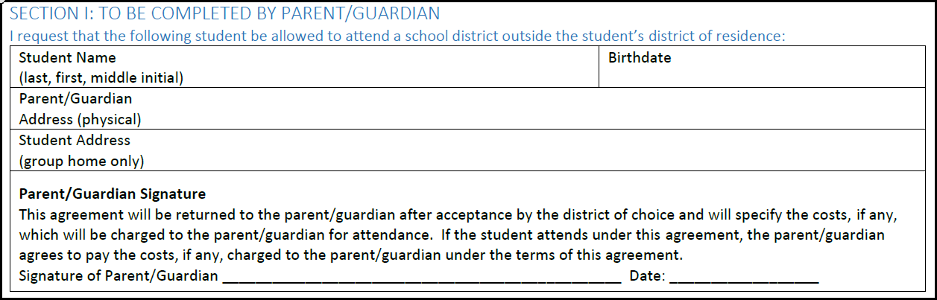
Tuition forms (FP-14.1 Parent/district )

Slide 20
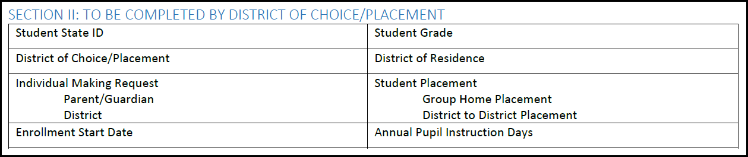
Tuition forms (FP-14.1 Parent/district )

Slide 21
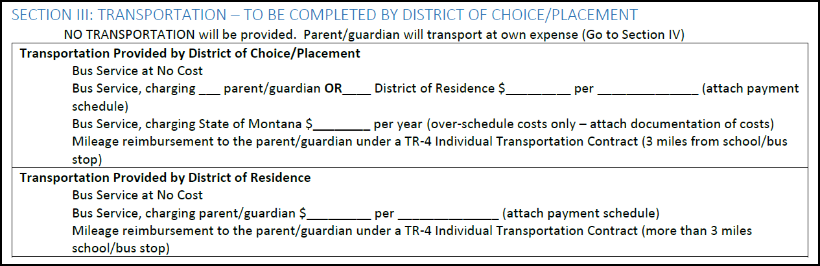
Tuition forms (FP-14.1 Parent/district )

Slide 22
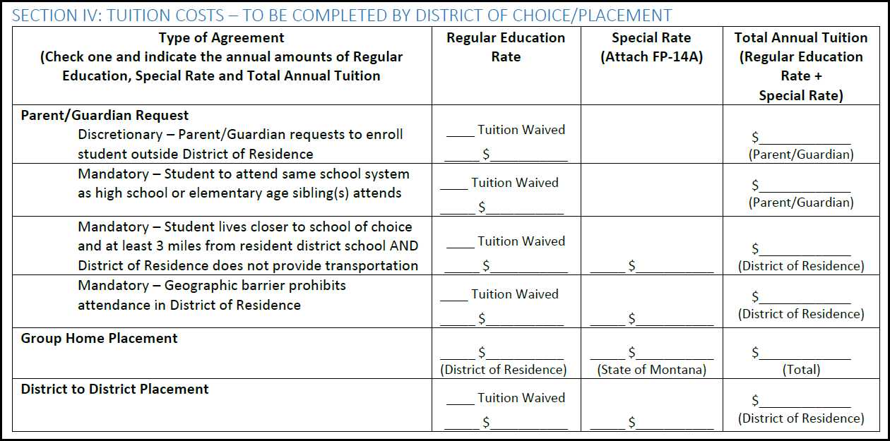
Tuition forms (FP-14.1 Parent/district )

Slide 23
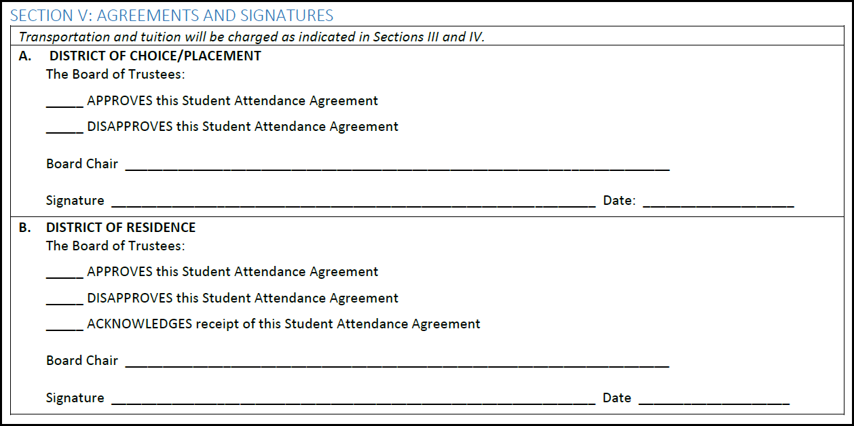
Tuition forms (FP-14.1 Parent/district )

Slide 24
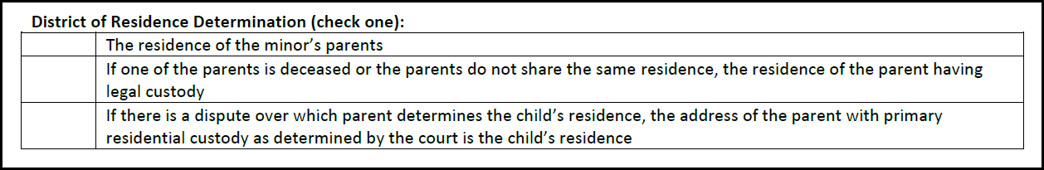
Tuition forms (FP-14.1 Parent/district )

Slide 25
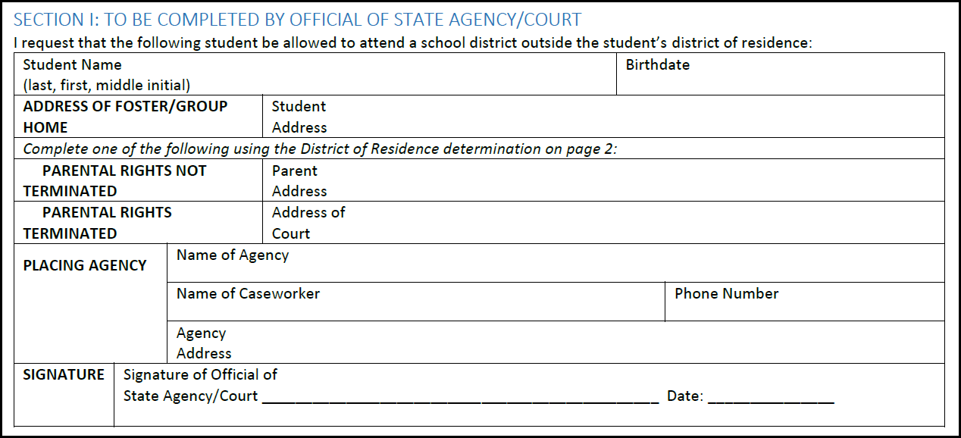
Tuition forms (FP-14.2 Foster/group home)

Slide 26
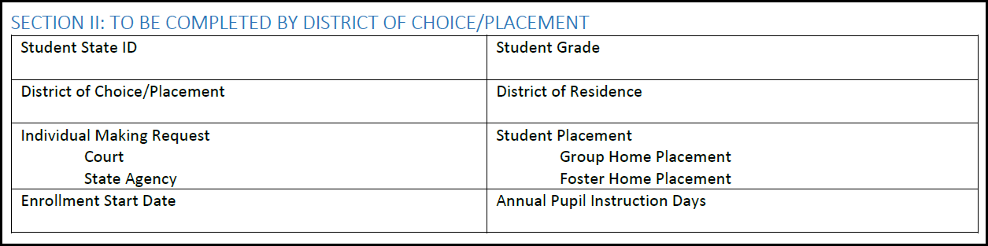
Tuition forms (FP-14.2 Foster/group home)

Slide 27
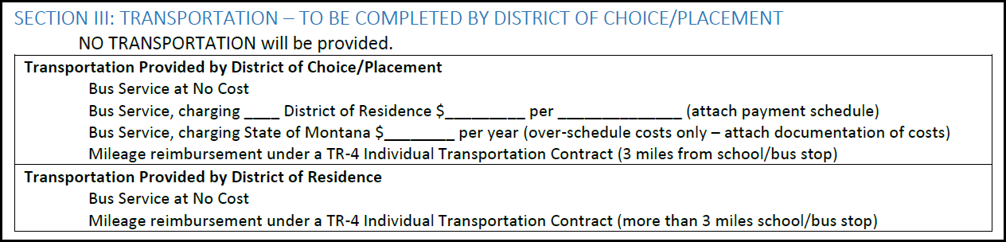
Tuition forms (FP-14.2 Foster/group home)

Slide 28
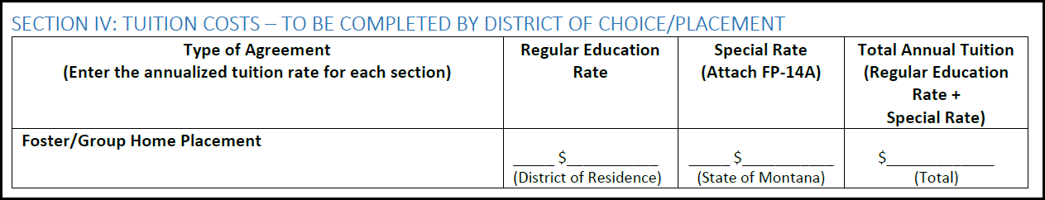
Tuition forms (FP-14.2 Foster/group home)

Slide 29
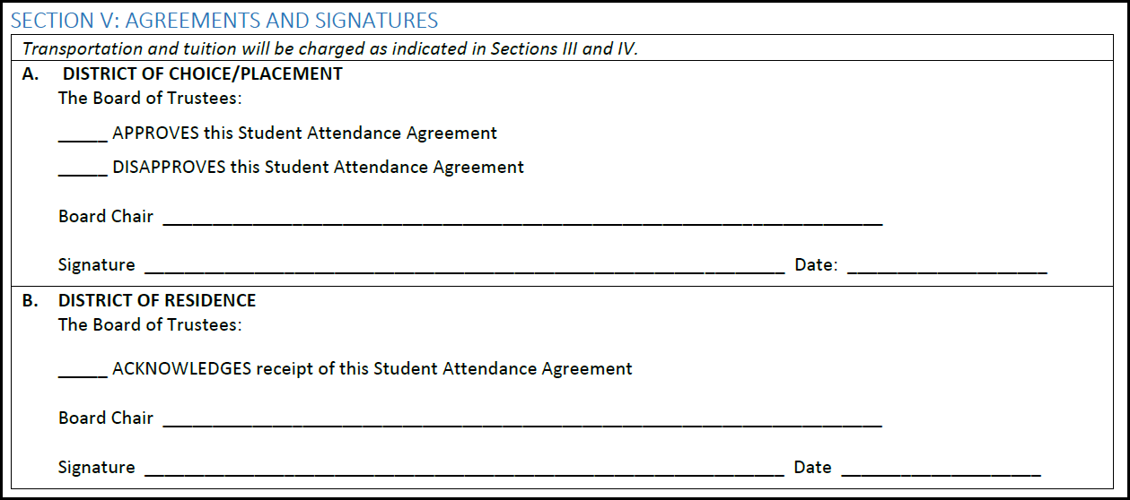
Tuition forms (FP-14.2 Foster/group home)

Slide 30
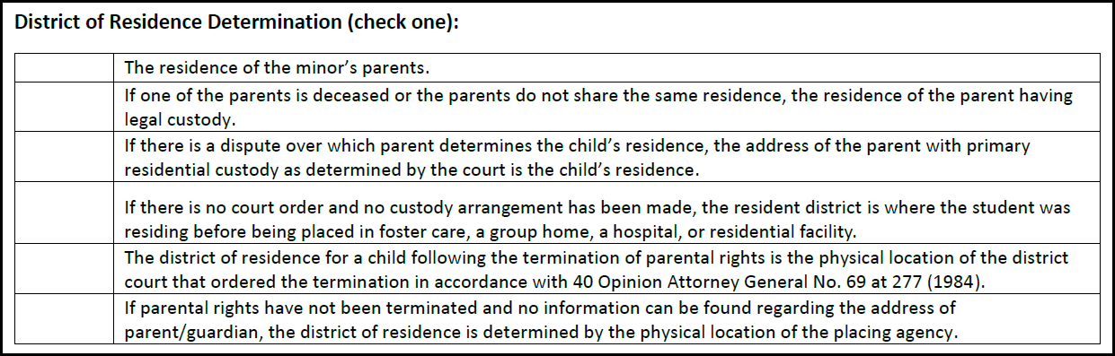
Tuition forms (FP-14.2 Foster/group home)

Slide 31
Tuition forms
FP-14A
Three Options for Special Education
  Option A
  Option B
  Option C
Programs Exceeding Average Cost

Slide 32
Tuition forms
FP-14A
Option A
  Based on the number of hours in the student’s IEP – up to 100% of the tuition rate.
Option B
  Based on the cost of unique special education services – 100% of the cost minus 120% of the Tuition Per-ANB Amount.
Option C
  Based on the cost of a specialized school district program – 100% of the cost minus 120% of the Tuition Per-ANB Amount. *
Programs Exceeding Average Cost
  For students without disabilities in specialized district programs – 100% of the cost minus 120% of the Tuition Per-ANB Amount, up to $2,500 per student.
  *Option C rates require prior OPI approval

Slide 33

Tuition Rates
FIRST: Tuition Per-ANB Amount
Maximum ANB for grade/accreditation of school
The Data for Achievement payment
The Indian Education for All payment
The per-ANB amount of the Instructional Block Grant
The per-ANB amount of the Related Services Block Grant

Slide 34
Tuition Rates
FIRST: Tuition Per-ANB Amount
Components (for SY 21-22) | Amount (Grades K-6 or K-8 unaccredited) | Amount (Grades 7-8 accredited or 9-12)
Maximum ANB | $5,813.00 | $7,443.00
Data for Achievement Payment | $21.73 | $21.73
Indian Education For All Payment | $22.70 | $22.70
Per-ANB Instructional Block Grant | $156.45 | $156.45
Per-ANB Related Service Block Grant | $52.15 | $52.15
TOTAL | $6,066.03* | $7,696.03
*The rate for PK and KH is ½ the K-6 rate ($3,033.02)

Slide 35
Tuition Rates
Second: Tuition for Parent and District Agreements
Up to 20% of the Tuition Per-ANB Amount
Grade | Tuition Per-ANB Amount (SY 21-22) | Max Tuition Rate (SY 21-22)
K-6, K-8 unaccredited | $6,066.03 | $1,213.21
7-8 accredited, 9-12 | $7,696.03 | $1,539.21

Slide 36
State paid tuition (now foster and group home tuition)
20-5-321, MCA
(1)(c-d) Out of District Placement by State Agency or Foster/Group Home Placement:
(d) the child is under the protective care of a state agency or has been adjudicated to be a youth in need of intervention or a delinquent youth, as defined in 41-5-103; or
(e) the child is required to attend school outside of the district of residence as the result of a placement in foster care or a group home licensed by the state.

Slide 37
State paid tuition (now foster and group home tuition)
OLD
Regular Education rate paid by the state.
Special Education student eligible for an additional payment under Option A, B or C.
Regular Education students eligible for an additional payment for Programs Exceeding Average Cost.

Slide 38
State paid tuition (now foster and group home tuition)
NEW
Regular Education rate paid by the resident district (40% of the Tuition Per-ANB Amount).
Special Education student eligible for an additional payment under Option A, B or C paid by the state.
Regular Education students eligible for an additional payment for Programs Exceeding Average Cost paid by the state.

Slide 39
State paid tuition (now foster and group home tuition)
Process
Complete an FP14.2/FP14A upon enrollment.
Enter the FP14.2/FP14A into MAEFAIRS (not later than June 30).
Enter Days Enrolled at the conclusion of the school year and submit the claim to the OPI.
Send a bill to the Resident District by August 15th.

Slide 40

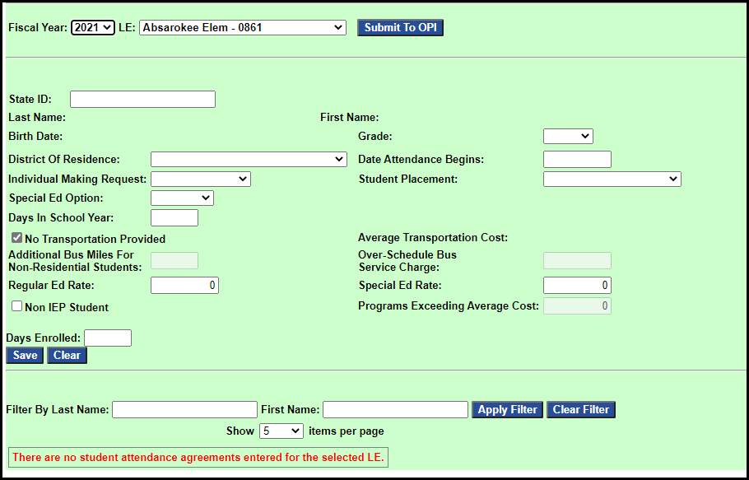
Entering claims in MAEFAIRS
Data Entry>Foster and Group Home Tuition

Slide 41
New tuition collection for
Residential treatment centers
HB 206 (2021)
OLD: State had contract with each facility to pay a daily rate for each eligible child.
NEW:
  State will contract for a portion of the daily rate, based on cost of providing an appropriate educational opportunity (not to exceed 100% of the Tuition Per-ANB Amount divided by 180); and
  District of Residence will pay a portion of the daily rate (40% of the Tuition Per-ANB amount divided by 180).

Slide 42
Tuition payments
Parents pay tuition in accordance with district policy.
Districts pay tuition in the year following attendance (1st half by Dec 31st, second half by June 15th).
The state pays tuition following the submission of claims (as early as August following the year of enrollment).

Slide 43
Tuition payments
Tuition claims may be paid with a permissive levy from the Tuition fund; or
The General Fund; or
Any other legally available fund in the district at the discretion of the trustees.

Slide 44
Tuition payments
May only use the Tuition Fund if the district complies with the notice requirements in 20-9-116, MCA.
(1) The trustees of a school district shall adopt a resolution no later than March 31 of each fiscal year and provide notice pursuant to subsection (2) whenever the trustees intend to impose an increase in a nonvoted levy in the ensuing school fiscal year for the purposes of funding any of the funds listed below:
(a) the tuition fund under 20-5-324;
(b) the adult education fund under 20-7-705;
(c) the building reserve fund under 20-9-502 and 20-9-503;
(d) the transportation fund under 20-10-143 and 20-10-144;
(e) the bus depreciation reserve fund under 20-10-147; and
(f) the flexibility fund established in 20-9-543 for the purposes in 20-7-1602.

Slide 45
Tuition accounting
With limited exception, tuition receipts should be credited to the General Fund and transportation receipts to the Transportation Fund.
General Fund Deposits:
From parent/guardian – X01-1310-XXX
From the OPI – X01-3117-XXX
From another district – X01-1320-XXX
Transportation Fund Deposits:
Regular education – X10-1410-XXX Special Education – X10-1420-XXX

Slide 46
Tuition accounting
Exceptions:
  Tuition receipts for students without disabilities under the care of the state or in foster/group homes that exceed tuition receipts for the prior year;
  Tuition receipts for students with disabilities that exceed tuition receipts for students without disabilities;
  Any other tuition receipts that exceed tuition receipts for the prior year.

Slide 47
Tuition accounting
Exceptions:
  If the tuition receipts meeting the expectations may be deposited into the Miscellaneous Programs Fund;
  A unique project reporter is required.
  X15-1320-XXX

Slide 48

Tuition accounting
Expenditure Codes:
  Tuition Fund Payments:
  In-state, regular education – X13-XXX-1XXX-561
  In-state, special education – X13-280-1XXX-561
  In-state, day treatment/private program* - X13-280-1XXX-320
  Out-of-state, regular education – X13-XXX-1XXX-562
  Out-of-state, special education – X13-280-1XXX-562
  Detention center payments – X13-1XX-1XXX-563
  In-state treatment facilities – X13-XXX-1XXX-564

Slide 49
Tuition accounting
Expenditure Codes:
  Transportation Fund Payments:
  In-state, regular education – X10-XXX-27XX-51X
  In-state, special education – X10-280-27XX-51X
  Out-of-state, regular education – X10-XXX-27XX-512
  Out-of-state, special education – X10-280-27XX-512

Slide 50
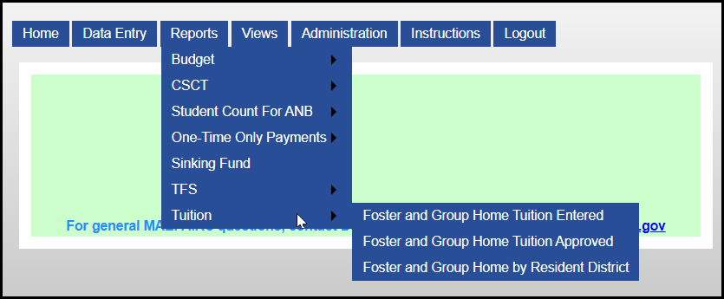
Tuition reports
Reports>Tuition

Slide 51
Tuition Reports
Foster and Group Home Tuition Entered – Shows all the claims entered and the annualized tuition amount(s).
Foster and Group Home Tuition Approved – Shows the actual payment amount for each claim entered based on Days Enrolled.
* These reports are available to the district entering the data

Slide 52
Tuition Reports
Foster and Group Home by Resident District – one page per resident district. May be used for billing at the end of the year with a district letter.
* These reports are available to the district entering the data

Slide 53
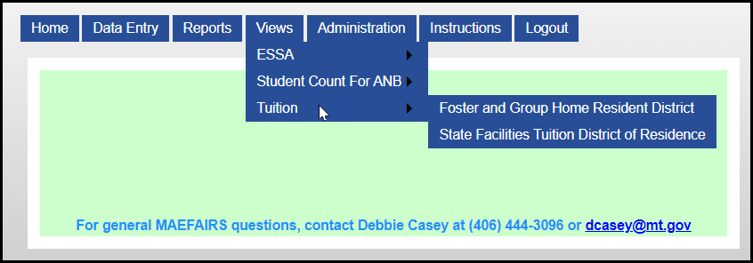
Tuition VIEWS

Slide 54
Tuition VIEWS
Foster and Group Home Resident District
State Facilities Tuition District of Residence
Shows every claim assigned to the LE as District of Residence.

Slide 55
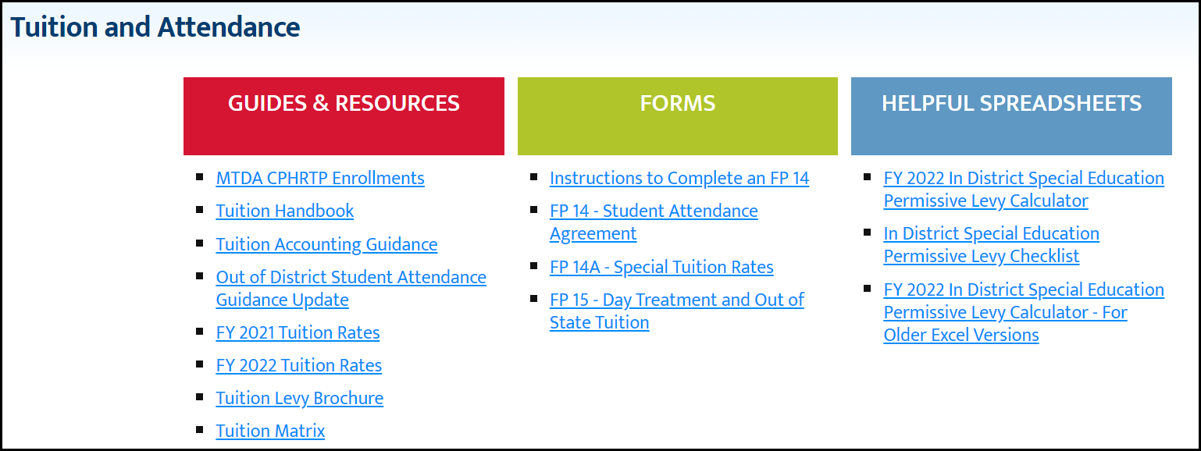
Tuition information
https://opi.mt.gov/Leadership/Finance-Grants/Tuition-and-Attendance
OPI webpage>Leadership>School Finance>Tuition & Attendance

Slide 56
New law information
HB 206: Changes to the calculation of tuition (tuition per-ANB amount), changes to the responsibility for tuition, changes to tuition for residential treatment facilities.
HB 454: Changes to mandatory tuition type, change to “entity” responsible for tuition.

Slide 57
Special education permissive tuition Levy
Levy to pay for special education costs for high needs students;
Levy must be on a per student basis – not the cost of a “program”;
Calculators were updated July 28th. Please use the latest version for an accurate levy amount.

Slide 58
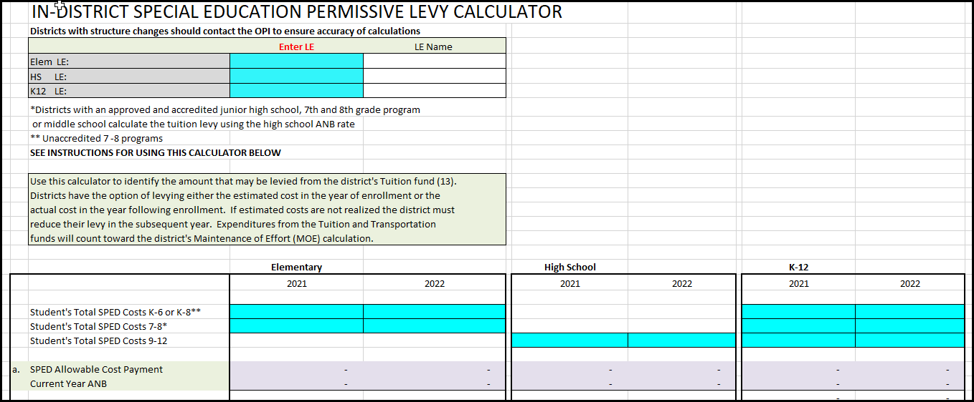
Special education permissive tuition Levy

Slide 59






Questions?

Slide 60
Contact information
Nicole Thuotte – School Finance Specialist
(406) 444-4524
(406) 202-1759 (cell phone)
nthuotte@mt.gov

