Slide 1
It’s not the Destination, It’s the Journey - Ralph Waldo Emerson
2020 MASBO SUMMER "CONFERENCE”
Mike Waterman, Director of Business Services
Bozeman Public Schools
406-589-4027 (c) 406-522-6097 (o) mike.waterman@bsd7.org

Slide 2
Understanding Fund Balance
Beginning Fund Balance
+ Revenue
- Expenditures
Ending Fund Balance

Slide 3
Understanding Fund Balance
Beginning Fund Balance
+ Revenue
- Expenditures
Ending Fund Balance
System designed such that your ending fund balance is lesser of:
Beginning Fund Balance
Maximum Reserves

Slide 4
Understanding Fund Balance Example: Bozeman Schools Transportation Funds
 | 2019-20 Budget | 2019-20 Projected Actual
Beg Balance | $ 1,009,095 | $ 1,009,095
+ Revenues | $ 2,934,290 | $ 3,286,154
- Expenditures | $ 3,286,154 | $ 2,494,828
Ending Fund Balance | $ 657,231 | $ 1,800,421

Slide 5
Understanding Fund Balance Example: Bozeman Schools Transportation Funds
 | 2019-20 Budget | 2019-20 Projected Actual
Beg Balance | $ 1,009,095 | $ 1,009,095
+ Revenues | $ 2,934,290 | $ 2,686,154
- Expenditures | $ 3,286,154 | $ 2,494,828
Ending Fund Balance | $ 657,231 | $ 1,200,421

Slide 6
Understanding Fund Balance Example: Bozeman Schools Transportation Funds
 | 2019-20 Budget | 2019-20 Projected Actual
Beg Balance | $ 1,009,095 | $ 1,009,095
+ Revenues | $ 2,934,290 | $ 2,686,154
- Expenditures | $ 3,286,154 | $ 2,494,828
Ending Fund Balance | $ 657,231 | $ 1,200,421

Slide 7
Understanding Fund Balance Example: Bozeman Schools Transportation Funds
 | 2019-20 Budget | 2019-20 Projected Actual
Beg Balance | $ 1,009,095 | $ 1,009,095
+ Revenues | $ 3,286,154 | $ 3,286,154
- Expenditures | $ 3,286,154 | $ 2,494,828
Ending Fund Balance | $ 1,009,095 | $ 1,800,421

Slide 8
Understanding Fund Balance Example: Bozeman Schools Transportation Funds
 | 2019-20 Budget | 2019-20 Projected Actual
Beg Balance | $ 1,009,095 | $ 1,009,095
+ Revenues | $ 3,286,154 | $ 3,286,154
- Expenditures | $ 3,286,154 | $ 2,494,828
Ending Fund Balance | $ 1,009,095 | $ 1,800,421
Notes:
$70K fuel savings
$700K contract savings

Slide 9
Understanding Fund Balance Example: Bozeman Schools Transportation Funds
 | 2019-20 Budget | 2019-20 Projected Actual
Beg Balance | $ 1,009,095 | $ 1,009,095
+ Revenues | $ 2,934,290 | $ 2,686,154
- Expenditures | $ 3,286,154 | $ 2,494,828
Ending Fund Balance | $ 657,231 | $ 1,200,421

Slide 10
Understanding Fund Balance Example: Bozeman Schools Transportation Funds
 | 2019-20 Budget | 2019-20 Projected Actual
Beg Balance | $ 1,009,095 | $ 1,009,095
+ Revenues | $ 2,934,290 | $ 2,686,154
- Expenditures | $ 3,286,154 | $ 2,494,828
Ending Fund Balance | $ 657,231 | $ 1,200,421

Slide 11
Understanding Fund Balance Example: Bozeman Schools Transportation Funds
 | 2019-20 Budget | 2019-20 Projected Actual
Beg Balance | $ 1,009,095 | $ 1,009,095
+ Revenues | $ 2,934,290 | $ 2,686,154
- Expenditures | $ 3,286,154 | $ 2,494,828
Ending Fund Balance | $ 657,231 | $ 1,200,421
Fund Balance Reappropriated (i.e., tax relief):
FY20: $351,864 FY21: $543,190 (+54%)

Slide 12
Areas of Possible/Likely FY20 Budget Savings
General Fund
Substitutes
Field trips
Athletic travel
Transportation
Fuel
Maintenance
Adult Ed
Others?
Revenue – likely okay

Slide 13
Setting the Stage for the Future
How will next year…and the year after that…look?
Expenditures
Revenue…

Slide 14
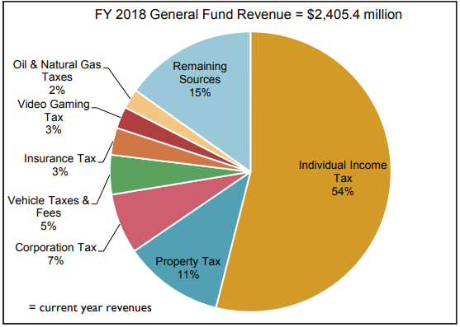
Setting the Stage for the Future

Slide 15
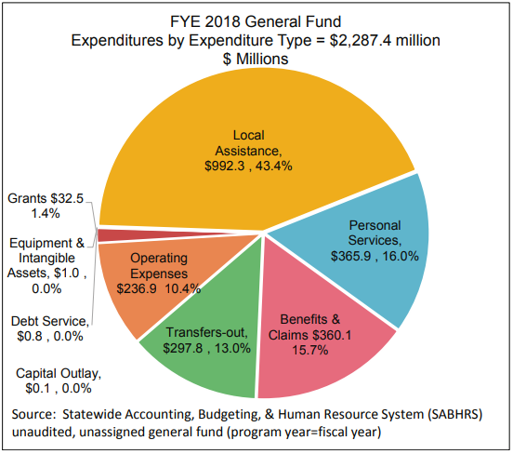
Setting the Stage for the Future

Slide 16
Setting the Stage for the Future
YOUR JOB:
Anticipate where you will end the current year
Consider what might happen in the future
Work with your team to build a financial bridge between the two

Slide 17
Setting the Stage for the Future

Slide 18
Setting the Stage for the Future
Less than expected due
to reduced contract &
fuel costs
No change
Similar to prior year
Similar to prior year

Slide 19
Setting the Stage for the Future
Uses for unspent budget:
You can… | …but only after you’ve…
Increase reserves | Identified your risks and made a plan for them
Save for the future | Set long-term goals and made plans to accomplish them
Provide tax relief | Looked ahead and made a plan to prevent tax yo-yos
An Interlocal Agreement Fund can help you accomplish ALL of these things!

Slide 20
Setting the Stage for the Future
DO YOU HAVE AN INTERLOCAL AGREEMENT IN PLACE?
Yes

Slide 21
Interlocal Agreement Fund (20-3-363, MCA) Proper Care and Feeding
Any fund EXCEPT Debt Service, Retirement,
Compensated Absences and Federal Funds
Interlocal Agreement Fund
Any purpose(s) allowed by Interlocal Agreement

Slide 22
Interlocal Agreement Fund (20-3-363, MCA) Proper Care and Feeding
Any fund EXCEPT Debt Service, Retirement,
Compensated Absences and Federal Funds
Interlocal Agreement Fund
Any purpose(s) allowed by Interlocal Agreement
Expenditures: Pay directly from ILA Fund (recode)
Tax Relief: Transfer money into taxing fund prior to year end (reappropriation) OR anticipate as revenue source in ensuing year budget and make the actual transfer later

Slide 23
Setting the Stage for the Future
Less than expected due
to reduced contract &
fuel costs
Transfer remaining budget to
ILA fund; use to stabilize future
tax levies
No change
Similar to prior year
Similar to prior year

Slide 24
Setting the Stage for the Future
Mike’s suggested method:
Obtain Board approval to make year end transfer without stating amount
Reconcile June books with county, to include all receipts
Determine your desired ending fund balance consistent with long-term goals
Reserves
Fund Balance Reappropriation/Tax Structure
Transfer money WITHIN ADOPTED BUDGET to arrive at desired ending fund balance
Book FY2020 transfer:
Notify County of transfer (“Period 13”) and reconcile Period 13, OR
Book Due To/Due From Other Funds and book cash transfer in July

