Slide 1
MASBO Regional Meetings September 2020
Steve Hamel, Interim Services/Trainer 406-431-0124
Marie Roach, Association Services Coordinator 406-461-8804
Denise Williams, Executive Director 406-461-3659
September 15 @ 10:30 a.m. – Region 1
September 17 @ 10:30 a.m. – Regions 2 & 4
September 18 @ 10:30 a.m. – Regions 3, 5 & 6

Slide 2
Power Point Posted on Website
HOW TO FIND IT??
Write this down!!
MASBO.COM
RESOURCES
CONFERENCES
MASBO ZOOM PRESENTATION SEPT 2020

Slide 3
MASBO Regional Meetings
Important Dates and Deadlines (led by Steve Hamel)
October 5, 2020 Enrollment Counts
Grants that end September 30
Pupil Transportation
Submitting corrections to TFS in MAEFAIRS
Compensation Expenditure Report
MASBO News (led by Marie Roach)
P-card rebate checks
MASBO 2021 Membership Directory
New and improved website
MASBO can now accept credit card payments thru QuickBooks
Legislative and Other (led by Denise Williams)
Update on Fall Conference
MCEL
OPI Letter to Auditors

Slide 4
October 5, 2020 Enrollment Counts
TIPS
Watch for communication from OPI
ANB Count Information
Student Count for ANB Instructions
Coordinate with staff responsible for AIM data
Usually building secretaries, but could be other staff . . . even you
Develop procedures and controls to make sure the count is correct.
Data in AIM must be correct before importing into MAEFAIRS
Do some test runs prior to the count date
Import AIM info into MAEFAIRS and run reports to check for accuracy
Make sure to run and submit after October 5
You can find these on the OPI website: Leadership/School Finance/Student Count for ANB

Slide 5
October 5, 2020 Enrollment Counts
TIPS – special items to check
Students enrolled but absent more than 11 days up to and including count date
Don’t include in the enrollment count
ARM 10.20.102(11) Exceptions due to extenuating circumstances should be communicated to OPI prior to the count date
Students identified as American Indian
Used to calculate the Student Achievement Gap payment for FY2022 GF budget
Run special report in MAEFAIRS and check for accuracy
Overlaps
AIM identifies students enrolled in more than one district
Usually students transferring from one district to another on or near the count date

Slide 6
Grants that end September 30, 2020
IDEA, Part B Regional CSPD IDEA, Preschool IDEA, Part D: MTSS Title I, Part A, Improving Basic Programs Title I, Part A, Schoolwide Title I, Part C, Migrant Education Title I, Part D, Neglected & Delinquent Title I, School Support
Title I, Targeted Support & Improvement Title II, Part A, Improving Teacher Quality Title II, Part A, Improving Teacher Quality (state level) Title II, Part B, Math Science Partnerships Title III, Part A, English Language Acquisition Title III, Part A, Emergency Immigrant Title IV-A, Student Support & Academic Enrichment Title VI, Part B, Rural Low Income Title X, Part C, McKinney-Vento Homeless Education

Slide 7
Grants that end September 30, 2020
September 30 – last day to obligate funds
October 31 – last day to liquidate funds
November 10 – final expenditure report is due

Slide 8
Pupil Transportation
October 1, 2020
TR-4 Individual Transportation Contract – county superintendent verifies and approves
November 1, 2020
TR-1 Bus Routes – district submits in OPI Pupil Transportation System
Board Chair must sign so plan ahead
Keep a paper copy for Auditor
November 10, 2020
TR-1 Bus Routes – county superintendent verifies/approves

Slide 9
Submitting corrections to TFS in MAEFAIRS
Administrative Rules of Montana (ARM) 10.10.504
(6) Material revisions to the annual trustees' financial summary submitted by December 10 shall be accepted, limited to the following types of adjustments:
(a) coding revisions between revenue or expenditure line items providing no change occurs in the fund balance of budgeted funds; and
(b) revisions in balance sheet accounts provided no change occurs in the fund balance of budgeted funds.
DON’T EVEN THINK ABOUT MAKING CORRECTIONS THAT WILL ALTER THE FUND BALANCE OF A BUDGETED FUND!!!!

Slide 10
Submitting corrections to TFS in MAEFAIRS
Print pages that will need to be corrected
Draw a single line through any amounts that need to be changed.
Write in correct numbers adjacent to the amounts that need to be changed.
Sign and date each page that has adjustments.
Send to Renee Richter at the OPI:
Scan and email Richter.Renee@mt.gov (best)
Fax 444-0509 (ok, sure)
Snail Mail (nuff said)

Slide 11
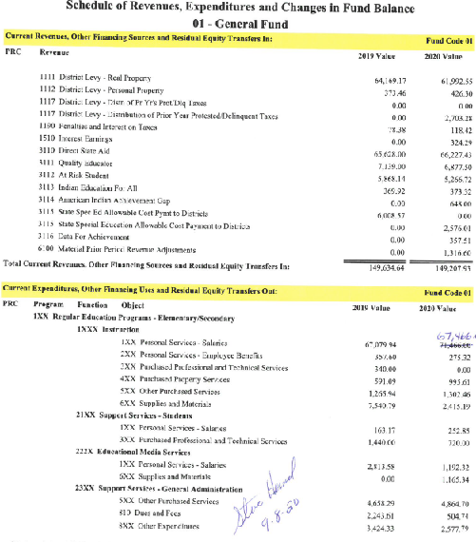

Slide 12
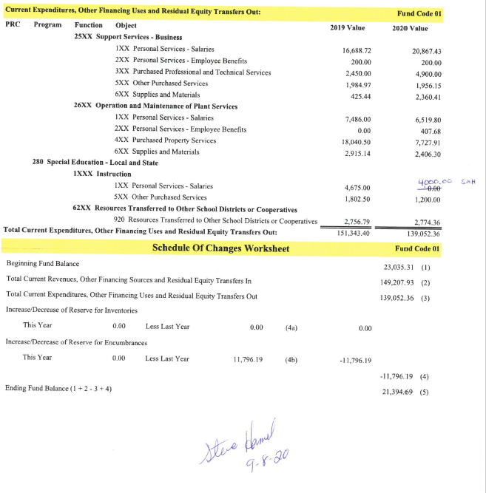

Slide 13
Compensation Expenditure Report
2019-2020 Salary and benefit report for each employee.
The report is part of MAEFAIRS.
Due December 10, 2020
Works in conjunction with the 2019-2020 TEAMS report.
Make sure you have a TEAMS log in and have the correct user roles.
Needed to create/research State Employee Identifier numbers for each employee.
TEAMS SECURITY FORM
Linda Vrooman Peterson, Division Administrator, 406.444.5726
Amber Zietz, Administrative Specialist, 406.444.1852
Renee Richter of the OPI will be conducting a detailed ZOOM presentation on this topic in Mid-October, the specific date has yet to be determined.

Slide 14
MASBO News
P-Card Program
Rebate checks were mailed July 27. Please cash asap.
IMPORTANT: Monthly payments must get to BMO in <27 days. BMO wont give an annual rebate to districts with a monthly payment average >27 days at the end of the rebate year (April 2020-March 2021.)
Contact your bank or County Treasurer to set up ACH Pull or ACH Push and help get your payment to BMO faster!
2021 Membership Directory
Please email Marie a current picture.
Printed MASBO Membership Directory will be free to our members this year.
Pre-Order thru the link on masbo.com home page.
Directories will be mailed starting in late October.
MASBO website – new look
This fall the MASBO website will be updated.
Items will be found in the same tabs to make the transition as easy as possible.
Credit Card Payments to MASBO
Members can pay QB invoices online now. No more phone calls for credit card payments!

Slide 15
Update on MASBO Fall Conference
Scheduled for November 2 – 3, 2020 in Helena
Abbreviated conference format (like summer conference, only smaller)
COVID-19 rules may limit participation to 50 or less
We may postpone until November 2021
Zoom workshops:
Technology
Elections

Slide 16
Montana Conference of Education Leadership (MCEL)
October 15 – 16, 2020 - Virtual Conference format
Opening session – candidates forum
All candidates were invited; these responded they will participate:
Steve Bullock Kathleen Williams
Mike Cooney Greg Gianforte
Elsie Arntzen Kevin Leatherbarrow Melissa Romano
Clinic Sessions – 3 one-hour sessions; 4 choices each hour
MASBO Tract:
Best Practices for Managing District Credit Cards
Review of Funding During the Pandemic
Crowdfunding Best Practices for K-12 School Business Officials
Best Practices for Planning and Managing School District Budgets

Slide 17
OPI Letter to Auditors
For FY2020 Audits
Found at opi.mt.gov/School Finance/Auditing/Information to Auditors
Purpose:
To provide auditors with general information and updates on issues that affect FY2020 school audits
List special items OPI wants auditors to review for compliance with state law and administrative rules
Remind auditors to use the Enrollment Schedule

Slide 18
OPI Letter to Auditors
Other Supplemental Information – School Year 2019-2020
Enrollment / ANB Schedule (Appendix A)
Compares district records to MAEFAIRS
Aggregate Hours Schedule (Appendix B)
Using the school calendar
For grades K-3, 4-6, 7-8 and 9-12:
July 1, 2019 – March 15, 2020 (pre-closure period)
March 16, 2019 – May 6, 2020 (aggregate hours requirement waived)
May 7, 2020 – end of the school year (board resolution on path used to finish out school year)
Has anyone done this? What documentation did you have for the auditor?

Slide 19
OPI Letter to Auditors
Management Discussion & Analysis – add these items
Was your district assessed as High Risk or as Watch status based on your FY2019 audit? If so . . .
state ramifications that resulted from the assessment, and
state what progress has been made since the assessment
Disclose any changes in key personnel or accounting software changes since the FY2019 audit

Slide 20
OPI Letter to Auditors
Corrective Action Plan Requirements
Responses to audit findings must include:
Person responsible to complete the action
A timeline of actions to be taken with specific dates of expected completion
Specific actions to be taken by the responsible person
Type E Bus Analysis – provide cost analysis to auditor

Slide 21
OPI Letter to Auditors
Other items OPI is asking auditors to review:
Debt Service Fund (50) operating reserve
Notice of Intent to Increase Non-Voted Levies
Transportation Fund (10) – ensure levy was not increased to compensate for loss of the transportation block grant

Slide 22
Power Point Posted on Website
HOW TO FIND IT??
MASBO.COM
RESOURCES
CONFERENCES
MASBO ZOOM PRESENTATION SEPTEMBER 2020

