Slide 1
Preparing for MAEFAIRS BUDGET

Slide 2
Here is where we left off yesterday

Slide 3
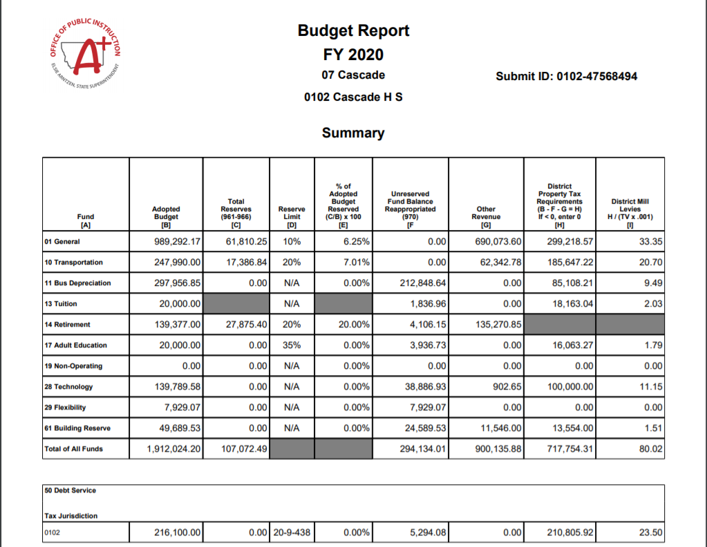

Slide 4
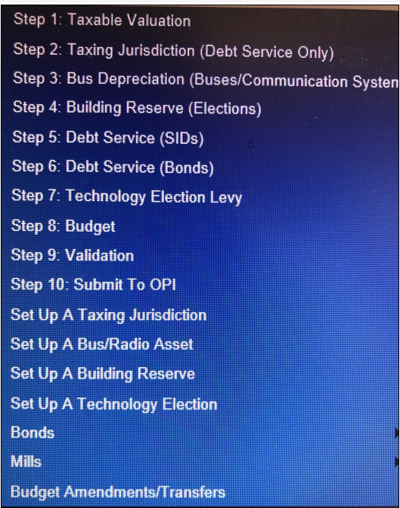

Slide 5
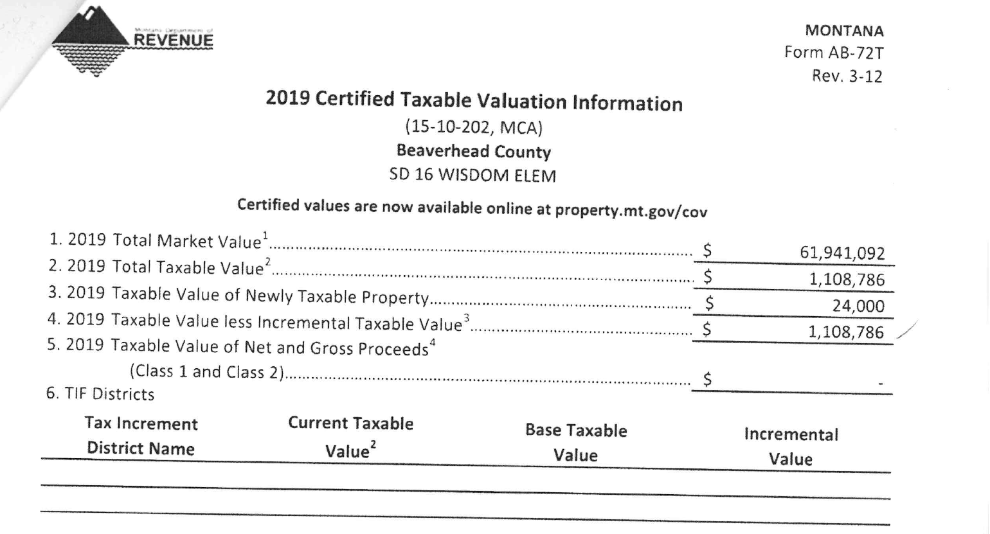
Do you know your taxable valuation yet? It should be coming soon (Aug. 3)
Hopefully this comes directly to you.
Sometimes it goes to your County Superintendent, stay in touch with them.
Line 4 has the magic number

Slide 6
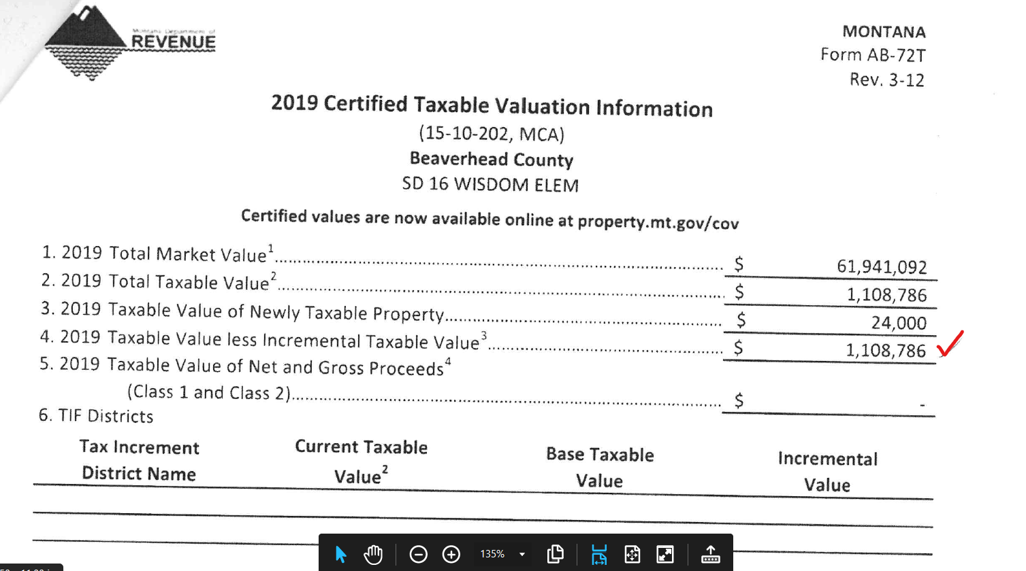

Slide 7
TAXING JURISDICTION
For Debt Service only
Taxing Jurisdictions for Debt Service may be different than your general fund taxing jurisdiction for instance.
Contact OPI to add or expire a taxing jurisdiction.
If you have more than one taxing jurisdiction, you must enter the fund balance for each taxing jurisdiction and the total of all must equal the total fund balance for Fund 50.

Slide 8
BUS DEPRECIATION
Have all the info on any new bus(es) that your district purchased during the fiscal year.
The bus title will have the information you need.
Set up each bus in the Set Up a Bus/Radio section
You will decide how much to levy per bus in Step 3
This fund can also be used to “depreciate” radio systems for transportation.
There is no actual “depreciation”, this fund is for permissively levying dollars to replace current busses or radios in the future.

Slide 9
Building Reserve
Go to “set up a building reserve” and enter any information needed.
Go to step #4 Building Reserve elections and enter the information needed there.

Slide 10
STEPS 6 AND 7 DEBT SERVICE
SID’S (Special Improvement Districts)
Curbs and Roads
BONDS
Bond schedule
LOOK TO LAST YEAR’S BUDGET MANY TIMES NOTHING CHANGES.

Slide 11
STEP 8 ENTER INDIVIDUAL BUDGET INFORMATION
General Fund
Preliminary Budget Data Sheet
Highest Budget Without a Vote
Highest Budget With a Vote

Slide 13
General fund Preliminary Budget Data Sheet Page 2

Slide 14
Transportation Fund
Budget all costs associated with Transporting students to and from school only.
Historical costs?
More Bus Routes needed for social distancing???
Calculating “On-Schedule” costs = State and County Revenues
Steve, show them the spreadsheet on the OPI Transportation website.
Total Budget – “On Schedule” = District Levies

Slide 15
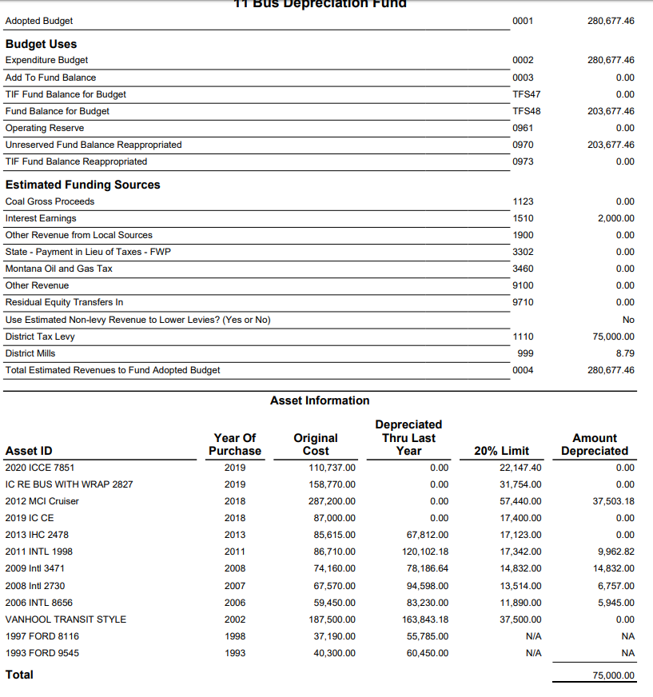

Slide 16
Tuition Fund
May levy permissively to pay tuition for out-of-district attendance of a resident pupil.
May levy an amount necessary to pay for the full costs of providing a free appropriate public education, as defined in 20-7-401, in the district to any child with a disability who lives in the district.
OPI has a spreadsheet to help determine levy amounts.
One student per spreadsheet.

Slide 17
Tuition Levy Spreadsheet

Slide 18
Tuition Fund reserve limit
There is no reserve limit for the Tuition Fund
All fund balance dollars must be re-appropriated to lower any potential levy.

Slide 19
Retirement Fund
Calculate amounts needed for each employees”
Retirement (TRS and PERS)
FICA
Unemployment
Be sure to add extra in case new employees are added or if you anticipate any teachers retiring at the end of the year.
Has your district used a spreadsheet?
Has your district used a budget planner?
Has your district budgeted the same amount every year?

Slide 20
Adult Education
Many districts set the same budget every year.
Do you have an adult ed coordinator? If so, work with them to build the budget.

Slide 21
Technology Fund
+Voted Levy
+Other Revenues (State Tech Aid, Interest, oil and gas)
+ fund balance re-appropriated
= Technology Fund Budget

Slide 22
Flexibility Fund
+ Fund balance reappropriated
+ other revenue (interest, oil and gas payments, rental dollars)
= budget

Slide 23
Building Reserve Fund
+Voted and/or Permissive Levy
+Other Revenues (School Major Maintenance, oil and gas, rentals)
+ fund balance re-appropriated
= Building Reserve Fund Budget

