Slide 1
Preliminary Budget Data Sheets
Or, show me the money

Slide 2
SHOW ME THE MONEY!!
Calculates each districts general fund budget limits for the upcoming year.
Sets the amounts a district may levy if they so choose.
If you are a member of a special ed co-op it calculates the amount your district will need to budget to pay that co-op next year.
Also calculates each district’s potential State Major Maintenance amount for the building reserve fund.

Slide 3
WHERE DO I FIND THE DATA SHEET?
You should be receiving an email announcing that the Data Sheets are available.
Current and Prior year sheets are always available at: Preliminary Budget Data Sheets
Grouped by county
Show Cascade County and Great Falls revisions
Open your county and scroll down to find your district.

Slide 4
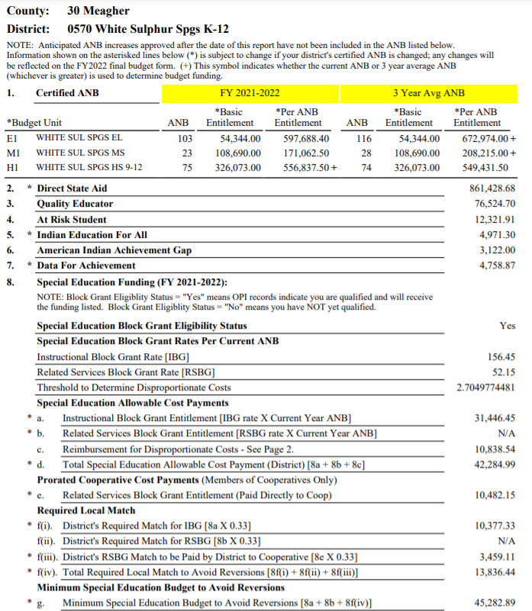

Slide 5
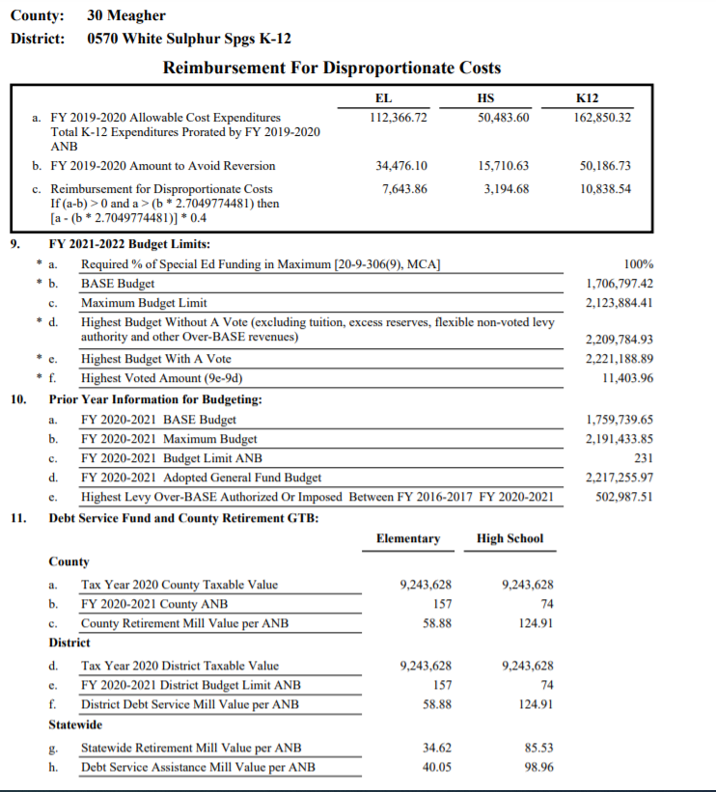

Slide 6
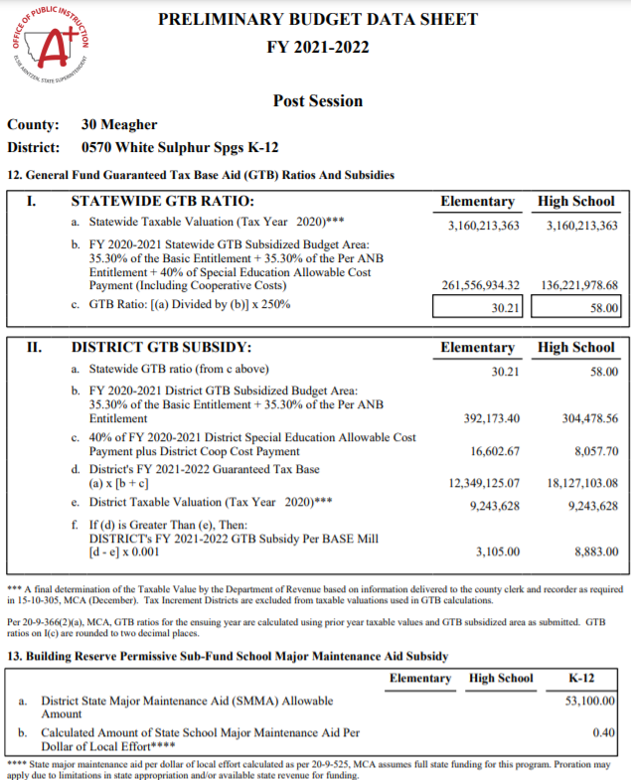

Slide 7
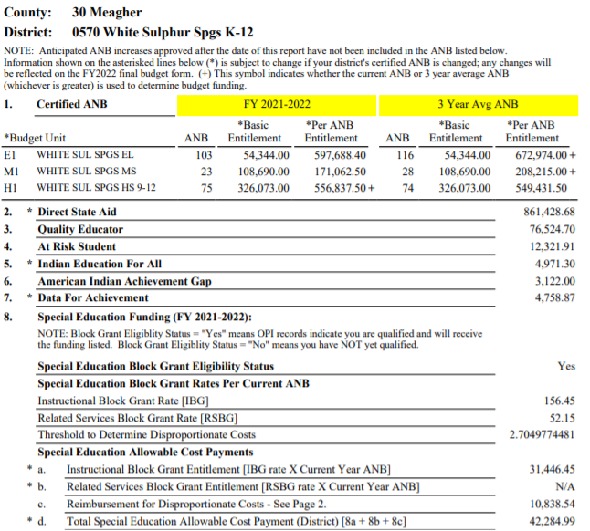
General Fund revenue components 3XXX revenues you have been entering

Slide 8
General Fund Special Education Information Keep in mind for later
If you belong to a special ed. Co-Op you will know in March the minimum amount you will have to send to the Co-op.
It also tells you how much you have to spend on special education to avoid reversion (losing state money next year)

Slide 9
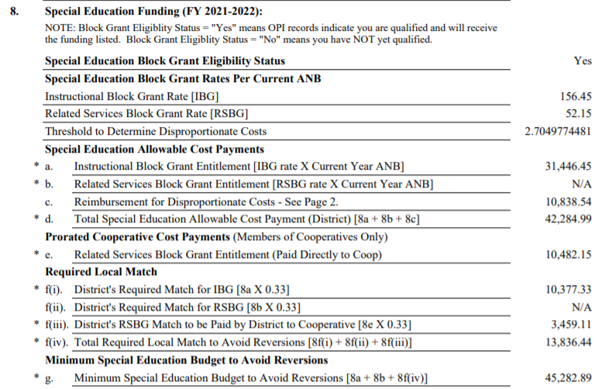
General Fund Special Education Information Keep in mind for later Part 2

Slide 10
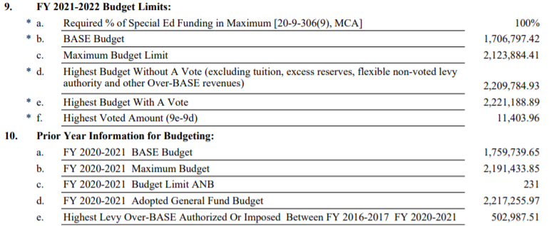
The Main information as of March 1 Page 2
Will you need/want/try to run a levy and if so,
How much can it be.
Doesn’t have to b the full amount. (f)

Slide 11
Does your district qualify for Guaranteed Tax Base aide (GTB)
Another state payment to the General Fund
Your district qualifies if its taxable value<average taxable value
A state “equalization” mechanism, don’t ask.
Are you receiving it now
Have you coded revenue 3120 in your General fund?
YES, you are.
NO, so sorry

Slide 12
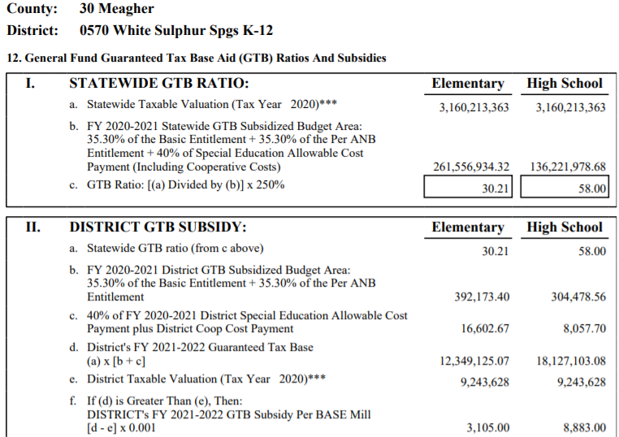
GTB = A fairly complicated calculation
Found on page 3 of your Data Sheet

Slide 13
District Major Maintenance Amount (SMMA) "Box" Found in the Building Reserve Fund (X61)
Calculation: $15,000 per district+(prior year ANB X $110)
For K-12 Districts the Calculation is $30,000+(prior year ANB X $110)

Slide 14
Confused yet? Join the Crowd
Your first focus is on the budget limitations on Page 2.
Does your district need to run a levy to get to the highest budget with a vote General Fund Budget amount?
Some districts don’t:
Sometimes the possible levy amount is so small an election would cost more than the levy.
History: Some districts have never been able to pass a levy.
Politics: I won’t go there but, talk to administration or Board Members. The Board makes the final decision.

Slide 15
Are the March 1 Data sheets final?
In legislative years, many times NO.
Until recently, educational funding bills were some of the last addressed. The last few sessions, they have been some of the first addressed.
If any educational funding bills are passed and signed by the governor after March 1, the OPI will reissue the data sheets. They will usually be titled “Post Session”
In non-legislative years, usually YES.

