Slide 1
Pupil Transportation
New Clerk Academy Webinar
September 17, 2021
Denise Williams, MASBO Executive Director

Slide 2
PUPIL TRANSPORTATION
AGENDA
Overview
State and County Reimbursement
OPI Pupil Transportation System
Bus Routes
The Bus
The Route
The Bus Driver
Individual Transportation Contracts

Slide 3
Overview
Transportation Fund (X10)
20-10-101 and 20-10-143, MCA
To finance the operation of a program to transport students to and from home and school
Methods of transportation:
Bus Routes
Individual contracts
Parent or guardian drive them
Reimbursement for room and board
Providing supervised correspondence study or supervised home study

Slide 4
Overview
TRANSPORTATION FUND EXPENDITURES
Run Your Own Program
Buy and maintain buses
Bus barns
Fuel
Bus driver salaries, benefits, training
Insurance
Contract Out
Bus service contract
- Salaries/benefits for aides
- % of clerk and administrative salaries/benefits
- Reimburse parents (individual contracts)
- Crossing guards

Slide 5
Overview
TRANSPORTATION FUND REVENUE
Fund Balance Reappropriated
State Transportation Reimbursement
County Transportation Reimbursement
Non-Levy Revenue (interest, oil & gas $$)
Local Property Taxes

Slide 6
State and County Reimbursement
Bus Routes
Route is approved by county transportation committee
Route bus passes inspection
Route driver is certified for all days route is driven
Individual Transportation Contracts
District invites parents to fill out form
Parents complete, sign and submit to district
All forms approved by school board (signed by chair)
All forms entered in OPI Pupil Transportation system and submitted on time

Slide 7
State and County Reimbursement

Slide 8
State and County Reimbursement
Approvals and Requirements:
District generates form from system and prints
Board Chair signs original paper copy
District keeps a copy
District sends a copy to county superintendent
County superintendent electronically marks these forms received and/or approved in the system
Note: County Superintendent needs their copy before they can mark TR’s received or approved

Slide 9
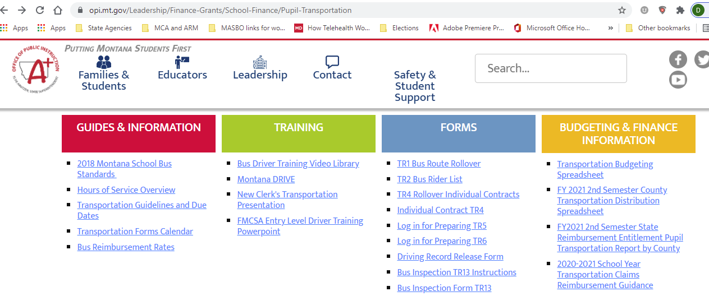
www.opi.mt.gov
Leadership
School Finance
Pupil Transportation
OPI website
Scroll down to find Pupil Transportation System Login Link

Slide 10
Pupil Transportation System
Request Username
School Finance Access Form is available on School Finance main page (scroll down to find link). E-mail completed form to D.Casey@mt.gov
System login link is on School Finance main page or Pupil Transportation page
Do NOT share login information. The user is responsible for the information entered under their assigned login.

Slide 11
Bus Routes – the Route
Form TR-1 Bus Route
ALL bus routes must be approved annually
ARM 10.7.101
County transportation committee (CTC) meets to approve or not approve all bus routes established by districts
*District creates a TR-1 form for each approved route in the Pupil Transportation System
District sends a signed paper copy to the county superintendent
County superintendent must electronically receive and approve TR-1s
* Routes from the previous year can be rolled over into the new year

Slide 12
Bus Routes – the Route
MAXIMUM REIMBURSEMENT MILEAGE RATES (20-10-141, MCA)
Type E School Bus | 50 cents/mile
Bus w/ rated capacity of < / = 49 passenger seating positions | 95 cents/mile
Bus w/ rated capacity of 50 to 59 passenger seating positions | $1.15/mile
Bus w/ rated capacity of 60 to 69 passenger seating positions | $1.36/mile
Bus w/ rated capacity of 70 to 79 passenger seating positions | $1.57/mile
Bus w/ rated capacity of > / 80 passenger seating positions | $1.80/mile
*Nonbus mileage | 50 cents/mile
*Nonbus mileage is for a vehicle driven by a bus driver to and from an overnight location of a school bus when the location is more than 10 miles from the school.
Route miles per day X Rate per mile X # of days operated = Reimbursement

Slide 13
Bus Routes – the Route
Data Entry>Bus Route>TR-1 Bus Route
Add A Route
Route (Name of Route and Route #)
Length of Route (as approved by the CTC)
Type of Service (Regular, Non-Bus, or SPED)
Bus VIN
Distribution (% of Elem and HS)
Riders (# of Riders and type of riders)

Slide 14
Bus Routes – the Route
The system calculates a daily rate; if it’s .00, check:
Verify the rated capacity of the bus
Distribution must be 100%
Passengers – must have at least one eligible transportee
See definition of “eligible transportee” in 20-10-101(2), MCA

Slide 15
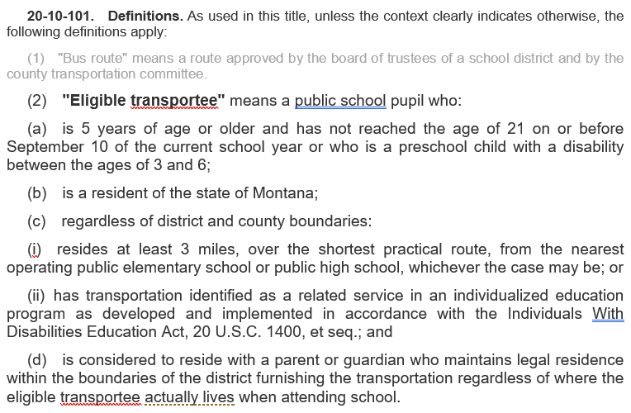

Slide 16
Bus Routes – the Route
“Sister Routes”
If the total # of miles traveled on a route is not consistent, set up a separate TR-1 form
Same bus, same driver, different # of miles
Example:
Route 1a travels 80 miles on M, W, F
Route 1b travels 110 miles on T, Th
Total days operated between the two routes should never exceed the number of days in the semester.

Slide 17
Bus Routes – the Bus
Montana School Bus Standards
Montana Board of Public Education (BPE) 20-10-111, MCA
Adopts and enforces policies to provide uniform standards and regulations for the design, construction and operation of school buses in the state of Montana
Must be consistent with motor vehicle laws
Montana Dept. of Justice and OPI advise the BPE
OPI Pupil Transportation Director:
Donell Rosenthal
444-3024
drosenthal@mt.gov

Slide 18
Bus Routes – the Bus
TR-13 Bus Inspection 61-9-502, MCA; ARM 10.7.118(8)
Montana Highway Patrol (part of the MT Dept. of Justice) performs school bus inspections semi-annually
First semester – at least 30 days prior to start of term
Second semester – by January 31
Note: a school bus that fails the initial inspection must be re-inspected and approved by the inspecting officer by these deadlines
School district is responsible to contact MHP for bus inspections.
Only school buses that pass inspection may
be used to transport students, and
receive state and county transportation reimbursement

Slide 19
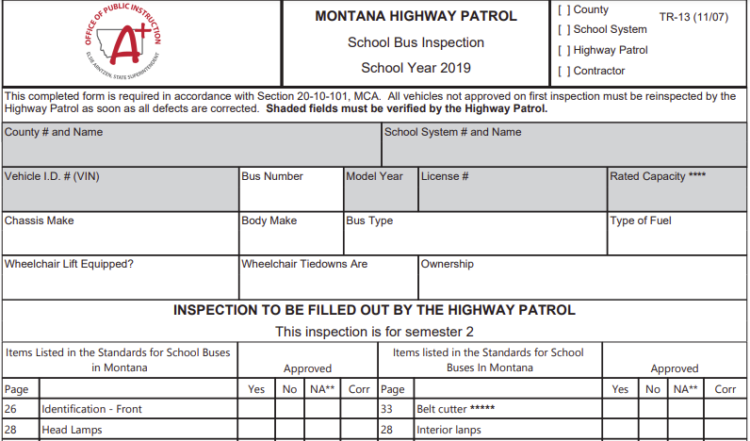

Slide 20
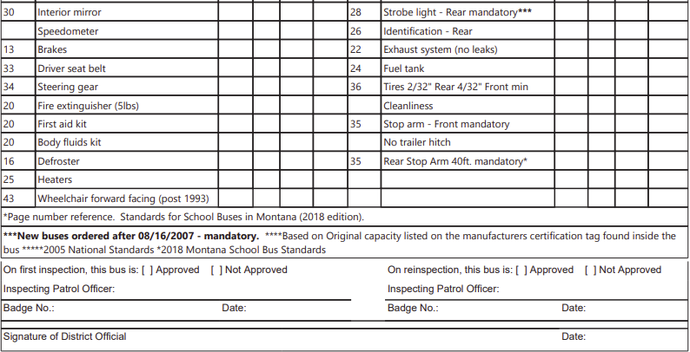
Board chair signs form

Slide 21
Bus Routes – the Bus
TR-13A Inspection for Type E School Bus
20-10-101(4)(a)(ii) Definition of “school bus”
is district-owned,
is designed to carry 10 or few passengers,
has an overall safety rating of five stars from the national highway safety administration at the time of purchase, and
is insured in according with minimum coverage requirements
Also in (4)(a)(iii) purchased on or after July 1, 2017
Montana School Bus Standards – 2018 (pages 48-50)
General Vehicle Requirements
Recommended Guidelines
Operational Requirements

Slide 22
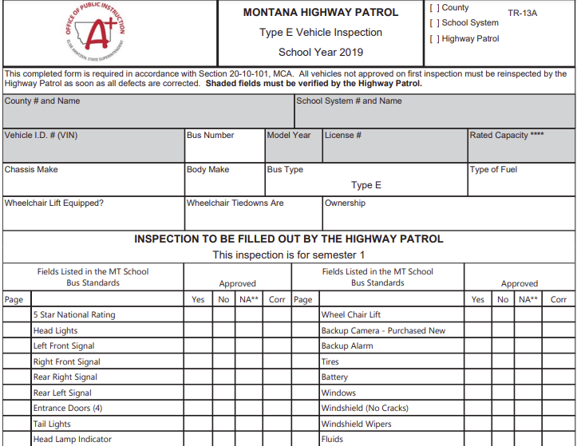

Slide 23
Bus Routes – the Driver
Bus driver qualifications 20-10-103, MCA
Not less than 18 years of age,
Is of good moral character
Driver’s license
Commercial driver’s license (CDL) to operate a school bus designed to carry more than 10 passengers, or
MT driver’s license to operate a Type-E bus (10 or fewer passengers)
Filed a satisfactory medical exam report
Completed basic first aid course
Has complied with other qualifications established by the BPE, and
Has filed a certification form with the county supt (TR-35)

Slide 24
Bus Routes – the Driver
Additional qualifications established by BPE to obtain a MT school bus driver certificate ARM 10.64.201
Licensed driving experience – minimum 5 years
Criminal background check showing no record of criminal offenses indicating they may be dangerous to children
Satisfactory report of physical examination
Current first aid certificate
Properly endorsed CDL with continuing compliance with all requirements of that license, and
Safe driving record, with no evidence of:
More than one moving traffic violation within any 12-month period of the preceding 36 months, and
Any conviction of DUI within preceding 36 months, and
Conviction resulting in mandatory revocation or suspension of license in previous 5 years

Slide 25
Bus Routes – the Driver
Additional requirements – 2018 School Bus Standards (pages 54 - 56)
Drug and alcohol testing
Training
at least 15 hours annually
MT Association of Pupil Transportation (MAPT) conference (June)
Workshops hosted an individual schools (Malta, Laurel)
Federal Motor Carrier Safety Administration (FMCSA)
CDL applicants on or after Feb. 7, 2022
Entry-level driver training

Slide 26
Bus Routes – the Driver
Criminal History Check
Get prior to initial employment
Can do more checks at your discretion
Can use existing process for obtaining criminal background checks and fingerprinting used for other employees
Need help? Contact MT Department of Justice (DOJ)
Montana Criminal Records
P.O. Box 201403
Helena, MT 59620-1403
E-mail: dojitsdpublicrecords@mt.gov
Phone: (406) 444-3625

Slide 27
Bus Routes – the Driver
Medical Examiner’s Certificate (MEC)
Required to maintain CDL
Drivers are responsible to ensure MVD has received a new MEC before the expiration of the current card on file
Failure to keep MEC current with MVD, CDL is downgraded to a base Class D license
DOJ sends MEC status to OPI ; OPI uploads to Pupil Transportation System
MVD contact information:
Email: cdlhelpdesk@mt.gov
Help Desk phone: (406) 444-3244.
FAX: (406) 444-1987

Slide 28
Bus Routes – the Driver
First Aid Certificate ARM 10.7.111(3)
Must include instruction in adult and pediatric CPR
Must be signed by a certified instructor, and be received after an initial in-person training of at least four hours
Must be renewed every two years
Renewal course may be in-person or online.

Slide 29
Bus Routes – the Driver
TR-35 Bus Driver Certification
Data Entry>Driver>TR-35 Bus Driver Certification
ALL drivers on a route must be certified with a valid/current
CDL (or driver’s license for a Type-E bus)
Medical Examination Certificate (MEC)
First Aid and CPR
New drivers have a 60-day grace period to obtain First Aid and CPR, if necessary
A driver may NOT drive if their CDL, Medical Certificate, First Aid or CPR is expired

Slide 30
Bus Routes – the Driver
TR-35 Bus Driver Certification
Board chair signs the certificate
District retains a copy, and files a copy with the county superintendent
Bus driver must receives hard copy of the certificate, which must be carried at all times while driving a school bus

Slide 31
Bus Routes – the Driver
KEY POINTS
TR-35 Bus Driver Certificate remains valid until the earliest expiration date of
the CDL endorsement, and/or
the first aid and CPR certificate, and/or
Medical examination certificate (MEC)
Issue a new TR-35 when any of the above items expires and is renewed
A route driven by a driver with an expired TR-35 means no state or county reimbursement

Slide 32
Individual Transportation Contracts
Individual Transportation Contract 20-10-124(4), MCA
A contract between a parent or guardian of an eligible transportee and a district
Must in quadruplicate; copies to:
Parent or guardian
District
County superintendent of schools
OPI (electronic)
Signed by board chair and parent or guardian
Parent or guardian attests to eligible transportee(s)’ place of residence

Slide 33
Individual Transportation Contracts
Reimbursement for Individual Transportation
20-10-142, MCA
Based on each day of school attendance
Generally, may not be less than 35 cents/day
Determine actual miles between home and school (or bus stop), multiply by 2, then subtract 6
Example: Miles between home and school = 10
10 miles X 2 = 20 – 6 = 14 miles X .35 = $4.90 per day

Slide 34
Individual Transportation Contracts
Reimbursement for Individual Transportation – Isolation 20-10-142, MCA(3)
Request for increase in reimbursement rate due to
Excessive distances
Impassable roads
other special circumstances of isolation
If approved, must be 1 ½ times calculated rate
Example: Miles between home and school = 10
10 miles X 2 = 20 – 6 = 14 miles X .35 = $4.90 per day
Isolation rate, if approved = $4.90 X 1.5 = $7.35

Slide 35
Individual Transportation Contracts
Reimbursement for Individual Transportation – Isolation 20-10-142, MCA(3)
Must be approved by:
District
County transportation committee
OPI
County superintendent must check the county approval box on the TR-4 form before the increased rate will be applied

Slide 36
Individual Transportation Contracts
Form TR-4 Individual Transportation Contract
*District creates a TR-4 form for each approved contract in the Pupil Transportation System
District sends a signed paper copy to the county superintendent
County superintendent must electronically receive and approve TR-4s
* TR-4 contracts from the previous year can be rolled over into the new year

Slide 37
PUPIL TRANSPORTATION

