Slide 1


Compensation Expenditure Report
New Clerk Academy Webinar
September 17, 2021
Steve Hamel, MASBO

Slide 2
AGENDA
OVERVIEW OF THE REPORT
RELATIONSHIP TO TEAMS
IMPORTING A FILE
FIXING ERRORS
MAUALLY ENTERING A FILE
VALIDATION ISSUES
QUESTIONS
  HOLD QUESTIONS TILL THE END OR ENTER THEM IN THE CHAT BOX PLEASE

Slide 3
Compensation Expenditure Report
2020-2021 Salary and benefit report for each employee.
The report is part of MAEFAIRS.
Due December 10, 2021
Works in conjunction with the TEAMS report.
  Make sure you have a TEAMS log in and have the correct user roles.
  Needed to create/research State Employee Identifier(SEID) numbers and to create TOE record for each employee
  TEAMS SECURITY FORM
  Nathan Miller, Accreditation Program Director 444-4317
    At this point, Nathan is the only employee listed in his department so, be patient. Your best bet is emailing him.

Slide 4
TEAMS REPORT ?????
Terms of Employment, Accreditation, and Master Schedule
A Report done every fall that lists every employee, their job type, accreditation (certified staff), and the district’s schedule.
New employees hired after the TEAMS report is submitted must also be added before they can be recognized by the compensation expenditures report. New employees cannot be added between November 1 and March 30.
Notes:
You will be logging into this years’ TEAM’s page but entering employees hired after October 30 of 2020…..if they haven’t already been entered.

Slide 5
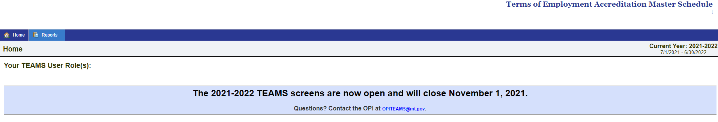
If you have questions on how to enter the TOE or SEID numbers into the TEAMS System, there are helpful tools on the TEAMS Help page.
Quick Links:
TEAMS Security Form
TEAMS Help Page
Notes:
If the FY22 TEAMS report is due before the compensation expenditures report, why are we focusing on it instead of TEAMS? OPI will be doing extensive training on the FY22 TEAMS (see next slide). We are mentioning TEAMS because the FY21 TEAMS needs to be updated with post FY21 submission hires before the compensation expenditures report will work.

Slide 6
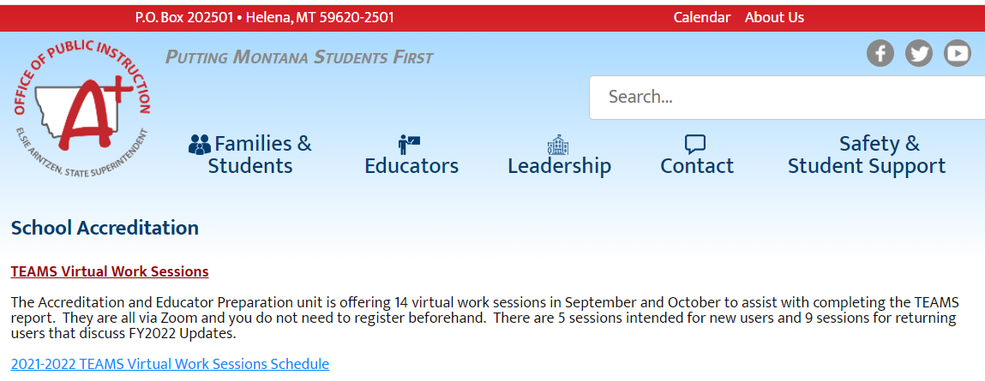
Check your email.
Denise Williams sent an email Wednesday detailing all the work sessions that are scheduled.
There are several specific for new users.

Slide 7
Notes:
2 types of Data entry.
File Import
Manual

Slide 8
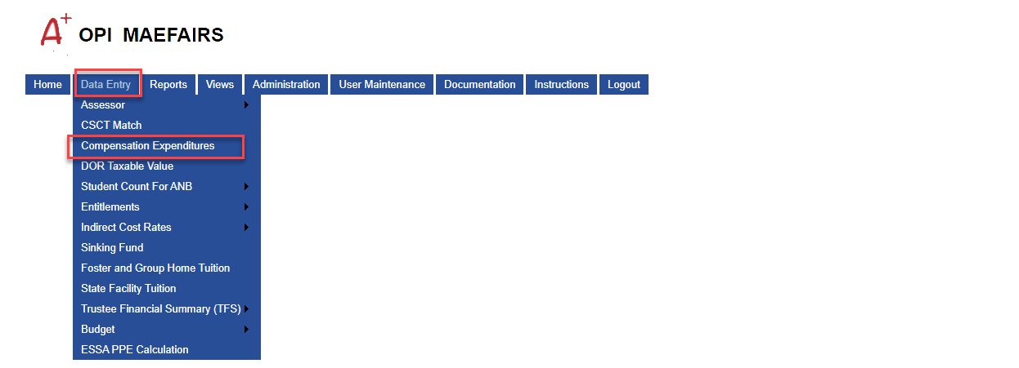
OPI/LEADERSHIP/SCHOOL FINANCE/MAEFAIRS/DATA ENTRY/COMPENSATION EXPENDITURES

Slide 9
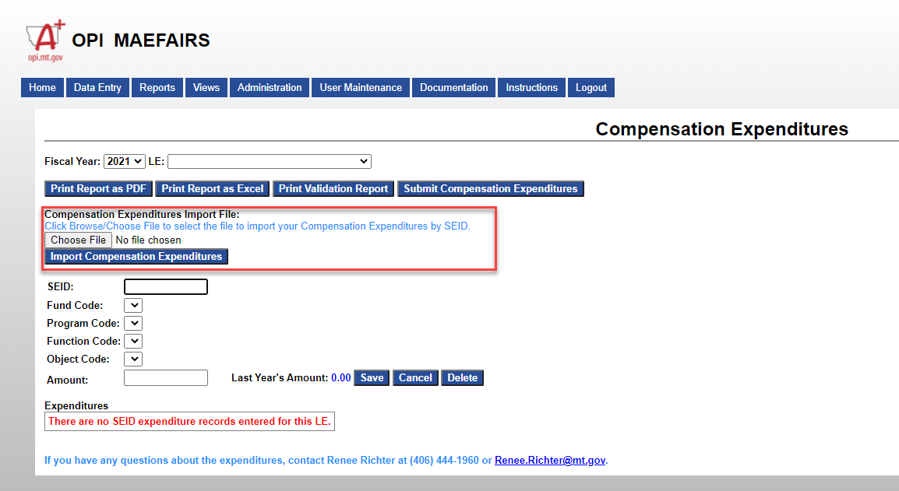

Slide 10
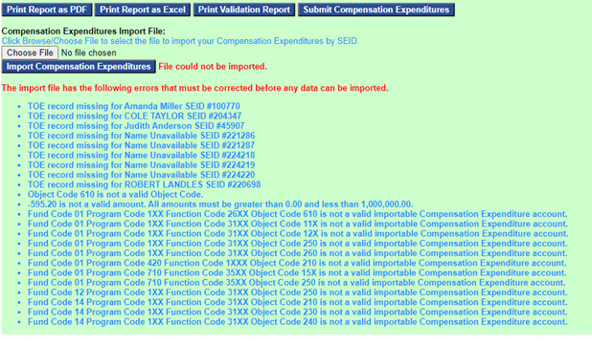
Possible Issues that arise, or, let’s put the cart before the horse
Notes:
Only 1XX and 2XX object codes should be in this report. Delete the 610.

Slide 11
ERROR MESSAGES REGARDING MISSING TOE RECORDS
If you have error messages regarding missing TOE records for employees you recognize, log into the TEAMS system. Once in, navigate to the Compensation Expenditure TOE screen. The screen can be found by hovering over the “System” menu and clicking on the “2020-2021 Compensation Expenditure TOE” menu (now located at the bottom of the menu).
If you do not know who the employee is, you, or your predecessor, have entered a wrong SEID number for an employee, and it is pulling up an actual person with that SEID number.
  Do a search on your software to determine what employee has the wrong number and fix the error
  It is usually just 1 digit that is wrong

Slide 12
TERMS OF EMPLOYMENT (TOE)
TOE Record Fields
School
SEID
Position Code
Employment Start Date
Employment End Date
Employment FTE
Employment Hours Code (full time or part time)
Itinerant Employee Flag (yes or no)

Slide 13
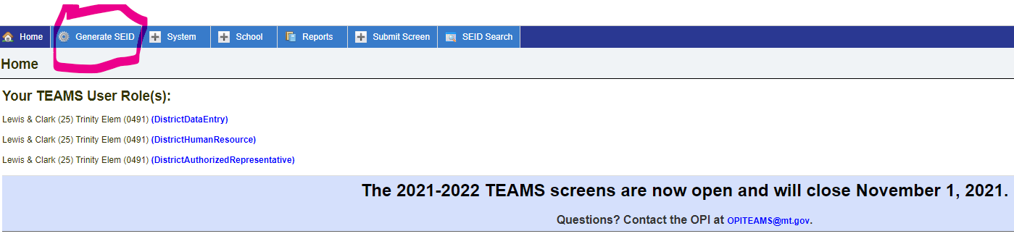
Need to create or research an SEID?

Slide 14
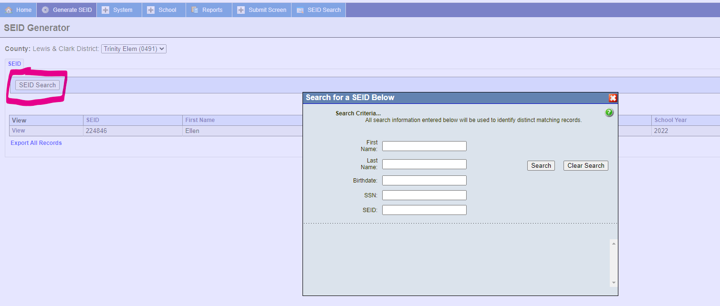
Click on SEID Search then search by any of the data points in the search box

Slide 15
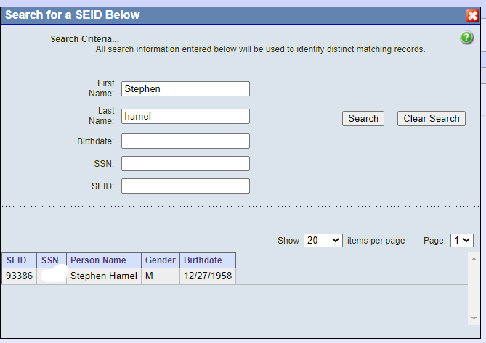
I FOUND ME!
Notes:
Searching by Social or Birthdate would bring up too many other folks and their identifiable information so I chose not to show you.

Slide 16
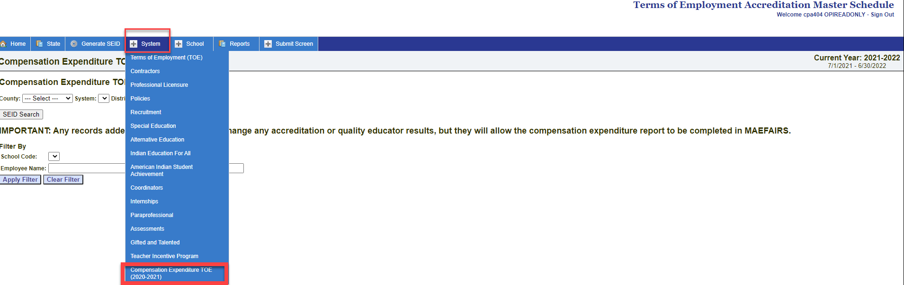
This is the TEAMS home screen for inputting your compensation expenditure TOE records.

Slide 17
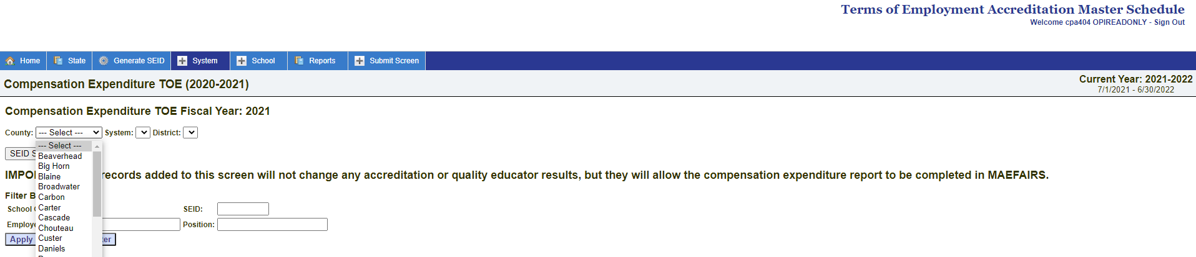
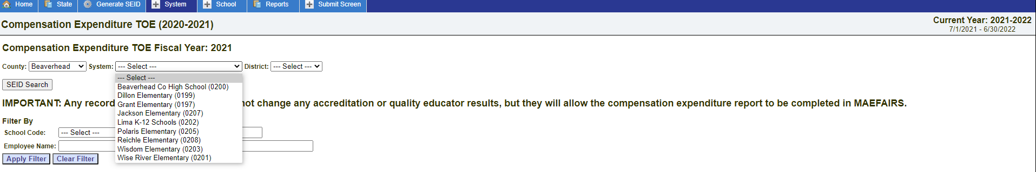

Slide 18
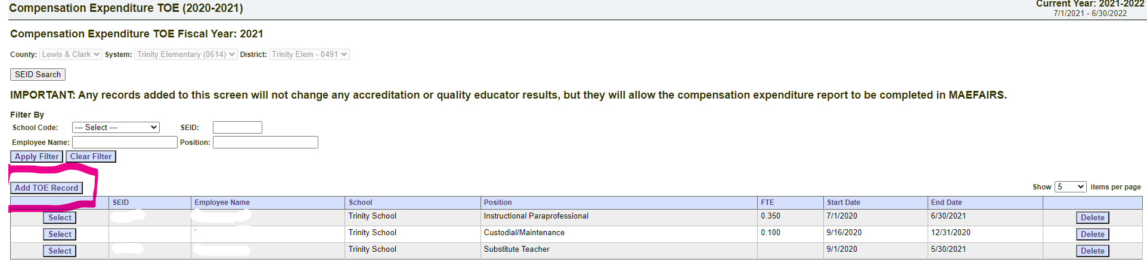
Click on “Add TOE Record”

Slide 19
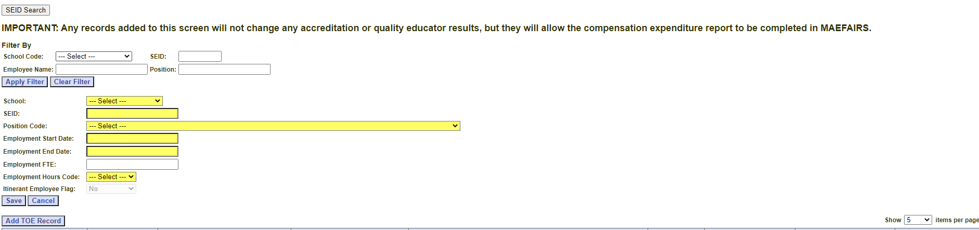
Enter the individual’s info here

Slide 20
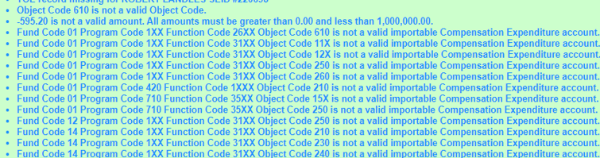
Dealing with coding issues

Slide 21
CHECK WITH YOUR SOFTWARE VENDOR
C & C (Foxie Lady) has a tab on the file creation page that will allow you to make changes.
Black Mountain, not aware of a change area
Tyler, crosswalk feature??
OR

Slide 22
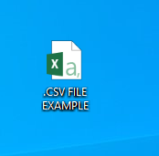
MAKE CHANGES ON THE FILE YOU ARE UPLOADING
IN .CSV FORMAT
IN EXCEL

Slide 23
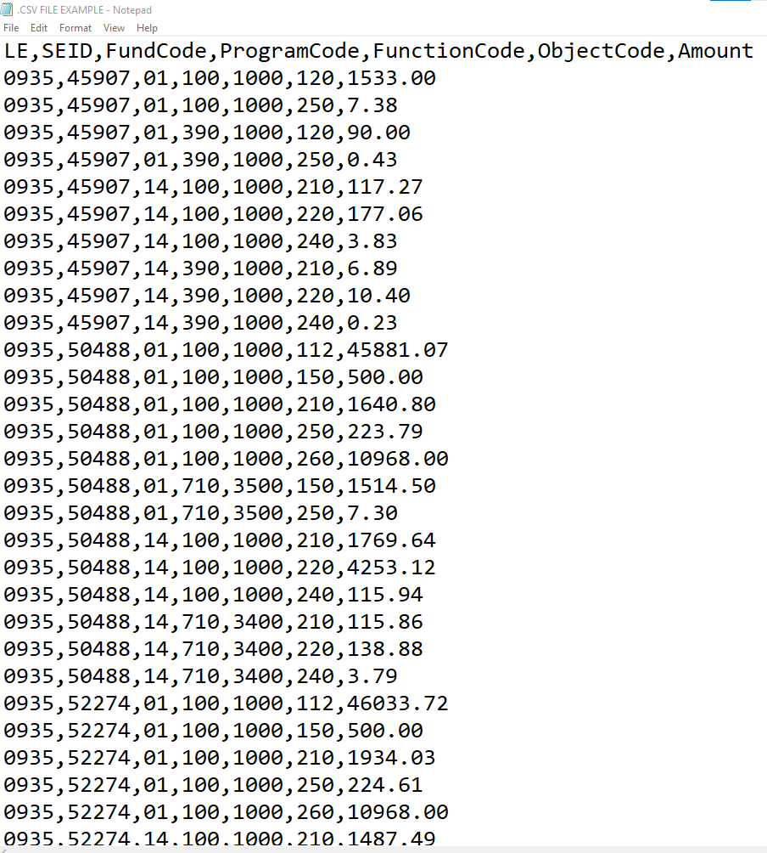
COMPARISON
.CSV - EXCEL
OPENED IN .CSV FILE FORMAT
OPENED IN EXCEL FORMAT
LE | SEID | FundCode | ProgramCode | FunctionCode | ObjectCode | Amount
935 | 45907 | 1 | 100 | 1000 | 120 | 1533
935 | 45907 | 1 | 100 | 1000 | 250 | 7.38
935 | 45907 | 1 | 390 | 1000 | 120 | 90
935 | 45907 | 1 | 390 | 1000 | 250 | 0.43
935 | 45907 | 14 | 100 | 1000 | 210 | 117.27
935 | 45907 | 14 | 100 | 1000 | 220 | 177.06
935 | 45907 | 14 | 100 | 1000 | 240 | 3.83
935 | 45907 | 14 | 390 | 1000 | 210 | 6.89
935 | 45907 | 14 | 390 | 1000 | 220 | 10.4
935 | 45907 | 14 | 390 | 1000 | 240 | 0.23
935 | 50488 | 1 | 100 | 1000 | 112 | 45881.07
935 | 50488 | 1 | 100 | 1000 | 150 | 500
935 | 50488 | 1 | 100 | 1000 | 210 | 1640.8
935 | 50488 | 1 | 100 | 1000 | 250 | 223.79
935 | 50488 | 1 | 100 | 1000 | 260 | 10968
935 | 50488 | 1 | 710 | 3500 | 150 | 1514.5
935 | 50488 | 1 | 710 | 3500 | 250 | 7.3
935 | 50488 | 14 | 100 | 1000 | 210 | 1769.64
935 | 50488 | 14 | 100 | 1000 | 220 | 4253.12
935 | 50488 | 14 | 100 | 1000 | 240 | 115.94
935 | 50488 | 14 | 710 | 3400 | 210 | 115.86
935 | 50488 | 14 | 710 | 3400 | 220 | 138.88
935 | 50488 | 14 | 710 | 3400 | 240 | 3.79
935 | 52274 | 1 | 100 | 1000 | 112 | 46033.72
935 | 52274 | 1 | 100 | 1000 | 150 | 500
935 | 52274 | 1 | 100 | 1000 | 210 | 1934.03
935 | 52274 | 1 | 100 | 1000 | 250 | 224.61
935 | 52274 | 1 | 100 | 1000 | 260 | 10968
935 | 52274 | 14 | 100 | 1000 | 210 | 1487.49

Slide 24
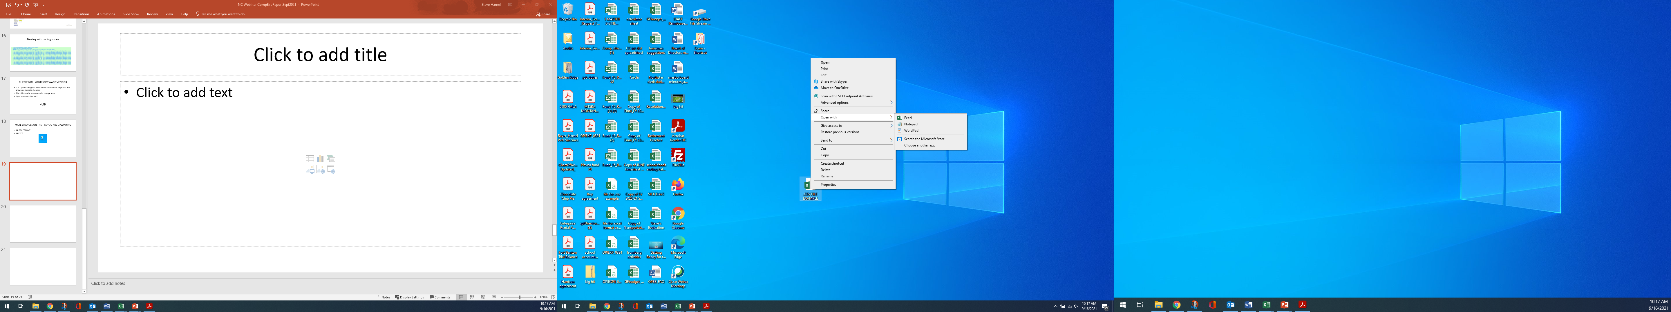
For .csv format:
CLICK ON THE ICON ONCE WITH YOUR RIGHT MOUSE BUTTON
CLICK ON “OPEN WITH”
CLICK ON “NOTEPAD”

Slide 25
For excel format
Double click the icon!!

Slide 26
WE WILL NOW WORK WITH BOTH

Slide 28
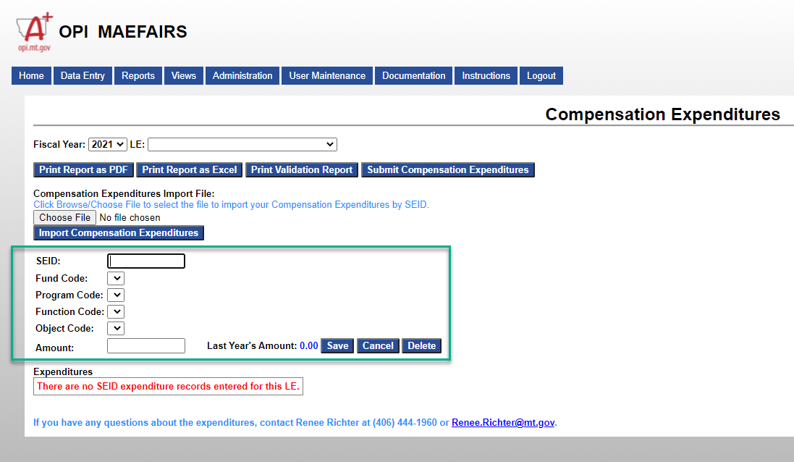

Slide 29
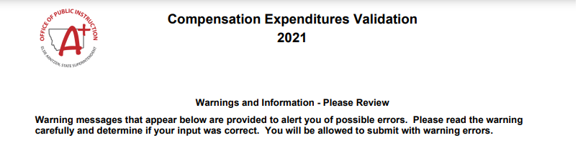
The 1** amounts entered into the TFS (49,291.80) for LE XXXX, are different from the 1** amounts entered into the compensation expenditures (38,568.88) by more than 10%. (CE-W01)
The 2** amounts entered into the TFS (10,453.18) for LE XXXX, are different from the 2** amounts entered into the compensation expenditures (14,481.07) by more than 10%. (CE-W02).

Slide 30


Slide 31
QUESTIONS

