Slide 1
Governmental Accounting
New Clerk Academy Fall 2021
September 22 – Great Falls
September 23 – Missoula
September 30 – Billings
December 7 – Via Zoom
Denise Williams
MASBO Executive Director

Slide 2
FUND ACCOUNTING
What is a fund?
self-balancing set of accounts
Cash and other financial resources
Liabilities
Residual equities or fund balances
segregated for the purpose of carrying on specific activities or attaining certain objectives
in accordance with special regulations, restrictions, or limitations (GAAP, state law, GASB)

Slide 3
TYPES OF FUNDS
Governmental Fiduciary
General - Trust
Special revenue - Custodial
Permanent
Debt Service
Capital Projects
Proprietary
Enterprise
Internal Service
Fund Codes have 3 digits (XXX)
First digit is the school structure:
1 = elementary district
2 = K-12 or high school district
3 = special education cooperative
Next two digits = fund number

Slide 4
BUDDGETED FUNDS | FUND # | FUND NAME | FUND TYPE
 | 01 | General | General
 | 10 | Transportation | Special Revenue
 | 11 | Bus Depreciation | Special Revenue
 | 13 | Tuition | Special Revenue
 | 14 | Retirement | Special Revenue
 | 17 | Adult Education | Special Revenue
 | 19 | Non-Operating | Special Revenue
 | 28 | Technology | Special Revenue
 | 29 | Flexibility | Special Revenue
 | 50 | Debt Service | Debt Service
 | 61 | Building Reserve | Capital Projects

Slide 5
NON-BUDDGETED FUNDS | FUND # | FUND NAME | FUND TYPE
 | 12 | School Foods | Special Revenue
 | 15 | Miscellaneous Programs | Special Revenue
 | 18 | Traffic Education | Special Revenue
 | 20 | Lease Rental Agreement | Special Revenue
 | 21 | Compensated Absences | Special Revenue
 | 24 | Metal Mines Tax Reserve | Special Revenue
 | 25 | State Mining Impact | Special Revenue
 | 26 | Impact Aid | Special Revenue
 | 27 | Litigation Reserve | Special Revenue
 | 45 | Permanent Endowment | Permanent
 | 60 | Building | Capital Projects
 | 70-72 | Enterprise | Proprietary
 | 73-79 | Internal Service | Proprietary
 | 82 | Interlocal Cooperative | Fiduciary or General
 | 81-85 | Other Trust Funds | Fiduciary

Slide 6
Fiduciary Funds X82 and X84
The activity in these funds will typically be reported on the financial statements as governmental activity (not fiduciary)
X82 Interlocal Agreement Fund
multi-district agreements
X84 Student Activity Fund
Focus on who has control over the money and how it is spent

Slide 7
FUND ACCOUNTING
Account:
an accounting record of increases and decreases in a specific asset, liability, revenue, expenditure or fund balance item
In its simplest form an account consists of 3 items:
TITLE
Debit side
Credit side

Slide 8
Example
CASH
Debit side
Credit side
The type and title of an account will dictate how transactions are recorded

Slide 9
ACCOUNT TYPES
Assets – what is owned
Cash and investments
Taxes Receivable
Due From Other Governments
Liabilities – what is owed
Accounts payable
Due to Other Governments

Slide 10
ACCOUNT TYPES
Revenue – resources coming in during fiscal year
Direct State Aid and other state funding
Property taxes
Interest earnings
Expenditures – resources paid out during the fiscal year
Salaries and benefits
Supplies, utility bills, insurance, repairs

Slide 11
BASIC FINANCIAL STATEMENTS
Balance Sheet (ongoing balances as of a given date)
Assets
Liabilities
Fund Balance (equity)
Revenues, Expenditures & Changes in Fund Balance (activity for a fiscal year)
Revenues
Expenditures
Difference in revenues vs. expenditures is “closed out” to fund balance

Slide 12
Recording Transactions
Account:
an accounting record of increases and decreases in a specific asset, liability, revenue, expenditure or fund balance item
In its simplest form an account consists of 3 items:
TITLE
Debit side
Credit side

Slide 13
Recording Transactions
Accounts that normally have Debit Balances
Assets
Expenditures
Accounts that normally have Credit Balances
Liabilities
Fund Balance
Revenues

Slide 14
Recording Transactions
Account Type | Normal Balance | Effect of a Debit entry | Effect of a Credit Entry
ASSET | Debit | Increase | Decrease
LIABILITY | Credit | Decrease | Increase
FUND BALANCE | Credit | Decrease | Increase
REVENUE | Credit | Decrease | Increase
EXPENDITURE | Debit | Increase | Decrease

Slide 15
Recording Transactions
ASSET
*Debit side
(increase)
Credit side
(decrease)
LIABILITY
Debit side
(decrease)
*Credit side
(increase)
*normal balance

Slide 16
Recording Transactions
REVENUE
Debit side
(decrease)
*Credit side
(increase)
EXPENDITURE
*Debit side
(increase)
Credit side
(decrease)
*normal balance

Slide 17
Recording Revenue
Transaction 1
Received Direct State Aid from OPI: $200,000
CASH
Debit side
(increase)
$200,000
REVENUE
Credit side
(increase)
$200,000

Slide 18
Recording Expenditures
Transaction 2-A
Received utility bill $5,000
ACCOUNTS PAYABLE
Credit side
(increase)
$5,000
EXPENDITURE
Debit side
(increase)
$5,000

Slide 19
Recording Expenditures
Transaction 2-B
Paid utility bill $5,000
CASH
Credit side
(decrease)
$5,000
ACCOUNTS PAYABLE
Debit side
(decrease)
$5,000

Slide 20
Recording Transactions
Journalizing the transactions
Date of the transaction
Accounts and amounts to be debited and credited
Brief explanation of the transaction
Each transaction must balance debits to credits (double entry accounting)

Slide 21
Journalizing the Transactions
Transaction 1:
Account Debit Credit
Cash $200,000
Revenue $200,000
Received Direct State Aid from OPI

Slide 22
Journalizing the Transactions
Transaction 2-A:
Account Debit Credit
Expenditure $5,000
Accounts Payable $5,000
Record utility bill claim $5,000

Slide 23
Journalizing the Transactions
Transaction 2-B:
Account Debit Credit
Cash $5,000
Accounts Payable $5,000
Paid utility bill claim $5,000

Slide 24
Recording Transactions
CASH
Transaction 1
$200,000
Transaction 2-B
$5,000
Balance = $195,000
REVENUE
Transaction 1
$200,000
Balance = $200,000

Slide 25
Recording Transactions
EXPENDITURE
Transaction 2-A
$5,000
Balance = $5,000
ACCOUNTS PAYABLE
Transaction 2-A
$5,000
Transaction 2-B
$5,000
Balance = .00

Slide 26
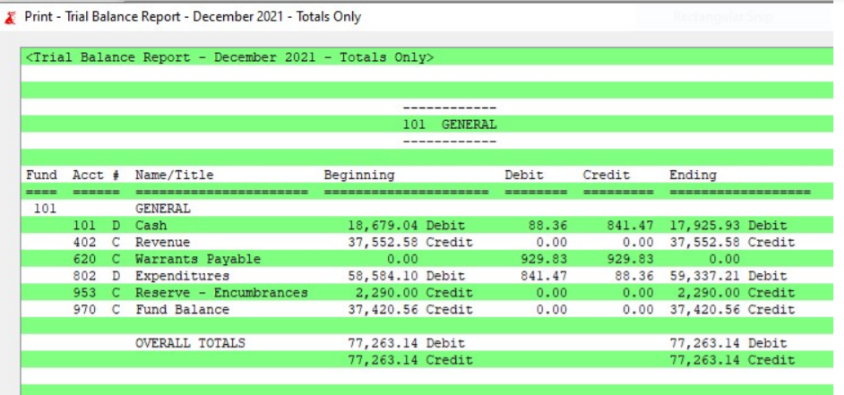

Slide 27
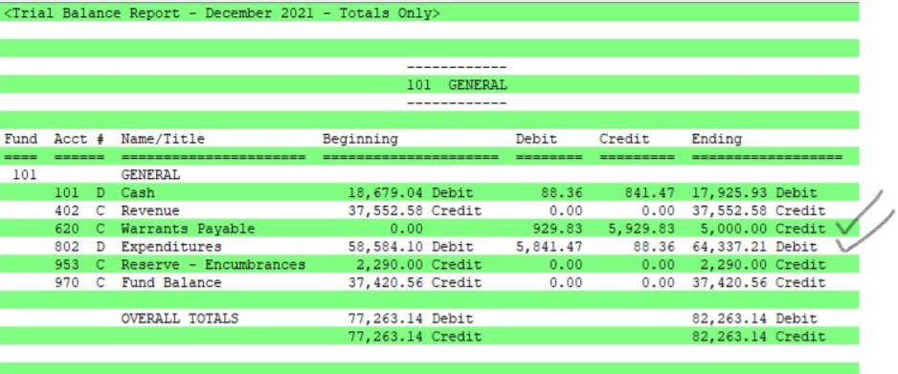

Slide 28
OPI CHART OF ACCOUNTS
Posted on the OPI website (opi.mt.gov)
Leadership/School Finance
Accounting
Guidance & Manuals
Chart of Accounts

Slide 29
OPI CHART OF ACCOUNTS
Balance Sheet Account Structure:
X X X X X X
District/Fund Balance Sheet Account
100 - 399 Assets and Other Debits
600 - 699 Liabilities, Deferred Inflow, and Other Credits
900 - 999 Equity

Slide 30
OPI CHART OF ACCOUNTS
Revenue/Other Financing Account Structure:
X X X X X X X X X X
District/Fund Subsidiary Source Project Reporter
1000 – Revenue from Local Sources
2000 – Revenue from County Sources
3000 – Revenue from State Sources
4000 – Revenue from Federal Sources
5000 – Other Financing Sources
6000 – Adjustments to Beginning Fund Balance

Slide 31
OPI CHART OF ACCOUNTS
Project Reporter Code:
X X X X X X X X X X
District/Fund Subsidiary Source Project Reporter
Use a project reporter code to keep track of grants or other special pots of money within a fund
001 - 899 To be assigned by districts
910 - 949 Assigned by the OPI for budget amendments
950 - 959 Assigned by the OPI for budget transfers

Slide 32
OPI CHART OF ACCOUNTS
Expenditure/Other Financing Uses Account Structure:
X X X X X X X X X X X X X X X X
District/Fund Program Function Object Project Reporter
100 Regular Programs 500 Non-Public School Programs
200 Special Programs 600 Adult Education Programs
300 State Grants 700 Extracurricular Programs
400 Federal Grants 800 Community Services Programs
900 Enterprise Programs

Slide 33
OPI CHART OF ACCOUNTS
Expenditure/Other Financing Uses Account Structure:
X X X X X X X X X X X X X X X X
District/Fund Program Function Object Project Reporter
1000 Instruction
2000 Support Services (SS)
2100 SS – Students 2500 SS – Business Services
2200 SS – Instructional Staff 2580 SS – Admin Tech Services
2300 SS – General Administration 2600 SS – Operations & Maint
2400 SS – School Administration 2700 SS – Student Transportation

Slide 34
OPI CHART OF ACCOUNTS
Expenditure/Other Financing Uses Account Structure:
X X X X X X X X X X X X X X X X
District/Fund Program Function Object Project Reporter
3000 Non-Educational Services (NES)
3100 NES – Food Services
3200 NES – Other Enterprise Services
3300 NES – Community Services
3400 NES – Extracurricular Activities
3500 NES – Extracurricular Athletics

Slide 35
OPI CHART OF ACCOUNTS
Expenditure/Other Financing Uses Account Structure:
X X X X X X X X X X X X X X X X
District/Fund Program Function Object Project Reporter
4000 Facilities Acquisitions
5000 Debt Service
6000 Other Financing Uses

Slide 36
OPI CHART OF ACCOUNTS
Expenditure/Other Financing Uses Account Structure:
X X X X X X X X X X X X X X X X
District/Fund Program Function Object Project Reporter
100 Personal Services—Salaries
200 Personal Services—Employee Benefits
300 Purchased Professional and Technical Services
400 Purchased Property Services
500 Other Purchased Services
600 Supplies and Materials
700 Property and Equipment Acquisition
800 Other Expenditures

Slide 37
OPI CHART OF ACCOUNTS
Expenditure/Other Financing Uses Account Structure:
X X X X X X X X X X X X X X X X
District/Fund Program Function Object Project Reporter
Adjustments to Beginning Fund Balance:
892 Material Prior Period Expenditure Adjustments
Other Uses of Funds:
900 Other Uses of Funds

Slide 38
Journalizing the Transactions
Transaction 1:
Account Debit Credit
101-101 Cash $200,000
101-3110 Direct State Aid $200,000
Received Direct State Aid from OPI

Slide 39
Journalizing the Transactions
Transaction 2-A:
Account Debit Credit
101-100-2600-410 Utilities $5,000
101-621 Accounts Payable $5,000
Record utility bill claim $5,000

Slide 40
Journalizing the Transactions
Transaction 2-B:
Account Debit Credit
101-101 Cash $5,000
101-621 Accounts Payable $5,000
Paid utility bill claim $5,000

Slide 41
Commonly Used Balance Sheet Accounts
Code | Title
101 | Cash
120 | Taxes Receivable – Real Property
130 | Taxes Receivable – Personal Property
160 | Interfund Loan/Receivable from Other Funds
170 | Due from Other Funds
180 | Due from Other Governments
240 | Prepaid Items
250 | Deposits
501 | Deferred Outflows

Slide 42
Commonly Used Balance Sheet Accounts
Code | Title
601 | Interfund/Loan Payable to Other Funds
606 | Due to Other Funds
611 | Due to Other Governments
620 | Warrants Payable
621 | Accounts Payable
670 | Payroll Deductions & Withholdings Payable
680 | Deferred Inflows
953 | Fund Balance Reserved for Encumbrances
970 | Unreserved Fund Balance

Slide 43
Commonly Used Revenue Accounts
Code | Title
1111 | District Tax Levy – Real Property
1112 | District Tax Levy – Personal Property
1190 | Penalties and Interest on Taxes
1310 | Individual Tuition
1311 | Drivers Education Fees
1510 | Interest Earnings
1611 | School Nutrition Lunch Sales - reimbursable
1700 | Student Extracurricular Activity Receipts
1900 | Other Revenue

Slide 44
Commonly Used Revenue Accounts
Code | Title
2220 | County Transportation Reimbursement
2240 | County Retirement Distribution
3110 | Direct State Aid
3111 | Quality Educator Payment
3112 | At-Risk Student Payment
3113 | Indian Education for All Payment
3114 | American Indian Achievement Gap Payment
3115 | State Special Education Allowable Cost Payment
3116 | Data for Achievement Payment
3120 | Guaranteed Tax Base Aid (GTB)

Slide 45
Commonly Used Revenue Accounts
Code | Title
3210 | State Transportation Reimbursement
3220 | State School Nutrition Match
3233 | State Special Education–Direct Payment to Cooperatives
3234 | State Quality Educator Payment to Cooperatives
3250 | Montana Digital Academy
3260 | State Driver’s Education Reimbursement
3281 | State Technology Aid
3283 | State School Major Maintenance Aid (SMMA)
3290 | Other State Grants
3460 | Montana Oil and Gas Tax

Slide 46
Commonly Used Revenue Accounts
Code | Title
4100 | Federal Miscellaneous Grants – direct from Fed Govt
4120 | Title V, Part B – Small Rural Schools (SRS)
4200 | Title I, Part A Improving Basic Programs
4300 | Title II, Part A Supporting Effective Instruction
4510 | Carl Perkins
4540 | Adult Basic and Literacy Education (ABLE)
4550 | Federal School Nutrition Reimbursement
4560 | IDEA, Part B Special Education
4650 | Miscellaneous Federal Grants – passed thru OPI
4700 | Miscellaneous Federal Grants – thru other state agencies

Slide 47
Commonly Used Revenue Accounts
Code | Title
4820 | Federal Impact Aid
5110 | Sale of Bonds
5200 | Sale or Compensation for Loss of Assets
5300 | Operating Transfers from Other Funds
5301 | Transfers for School Safety & Security
5302 | Transfers for Building Reserve Permissive Sub-Fund
5700 | Resources Transferred from Other School Districts
5710 | Special Educ Resources Trsfrd from Other School Districts
6100 | Material Prior Period Revenue Adjustments
9710 | Residual Equity Transfers In

Slide 48
Commonly Used Expenditure Program Codes
Code | Title
1XX | Regular Education - Elementary/Secondary
170 | Distance Learning
180 | Summer School
280 | Special Education
329 | Other State Grants
365 | Indian Education for All
390 | State Career and Technical Education (CTE)
410 | Miscellaneous Federal Grants
4XX | Note: drop the 4th digit from revenue source code (example: 4200 Title I expenditure program code is 420)

Slide 49
Commonly Used Expenditure Program Codes
Code | Title
710 | School Sponsored Extracurricular Activities
720 | School Sponsored Athletics
998 | Transfers for School Safety and Security
999 | Residual Equity Transfers Out
 | Operating Transfers Out
 | Transfers for Building Reserve Permissive Sub-Fund
 | Resources Transferred to Other School Districts
 | Resources Transferred to Special Education Cooperatives
 | Material Prior Period Expenditure Adjustments

Slide 50
Commonly Used Expenditure Function Codes
Code | Title
1000 | Instruction
2100 | Support Services - Students
2220 | Support Services – Educational Media
2300 | Support Services – General Admin (supt’s office)
2400 | Support Services – School Admin (principal’s office)
2500 | Support Services – Business Services
2600 | Support Services – Operations and Maintenance
2700 | Support Services – Student Transportation
3100 | Food Services

Slide 51
Commonly Used Expenditure Function Codes
Code | Title
3400 | Extracurricular - Activities
3500 | Extracurricular - Athletics
4000 | Facilities Acquisition and Construction Services
5100 | Debt Service – Bonds, Special Assessments, SIDS, Interest
5200 | Capital Leases or INTERCAP Loans
6100 | Operating Transfers to Other Funds
6200 | Resource Transfers to Other School Districts or Special Education Cooperatives
9999 | Residual Equity Transfer Out
 | Material Prior Period Expenditure Adjustments

Slide 52
Commonly Used Expenditure Object Codes
Code | Title
111 | Salaries - Administrative
112 | Salaries – Certified Teaching Staff
113 | Salaries – Other Certified Staff
114 | Salaries – Custodial/Maintenance
115 | Salaries – Office/Clerical/Technology
116 | Salaries - Cooks
117 | Salaries – Para Educators
118 | Salaries – Bus Drivers
119 | Salaries – Other Supervisory (Transp/Food/AD/Building)
150 | Stipends

Slide 53
Commonly Used Expenditure Object Codes
Code | Title
210 | Employer Contributions – social security and medicare
220 | Employer Contributions – TRS
230 | Employer Contributions – PERS
240 | Employer Contributions – Unemployment insurance
250 | Employer Contributions – Workers compensation
260 | Employer Contributions – Health insurance
270 | Employer Contributions – Life and disability
280 | Employer Contributions – Other employee benefits
351 | Contracted Services with other School Districts
354 | Contracted Services with Cooperatives

Slide 54
Commonly Used Expenditure Object Codes
Code | Title
410 | Gas and electricity
420 | Water/Sewage
430 | Cleaning Services
440 | Repair and Maintenance Services
450 | Rentals
460 | Minor Construction Services
513 | Student Transportation Services – Private Bus Contractors
520 | Insurance (other than employee benefits
581 | Travel In-District
582 | Travel Out-of-District/In-service Training

Slide 55
Commonly Used Expenditure Object Codes
Code | Title
610 | Supplies
624 | Vehicle/Equipment Fuel
630 | Food
640 | Books
660 | Minor Equipment
725 | Major Construction Services
730 | Major Equipment - New
810 | Dues and Fees
840 | Principal on Debt
850 | Interest on Debt

Slide 56
Commonly Used Expenditure Object Codes
Code | Title
870 | Student Scholarships
892 | Material Prior Period Expenditure Adjustments
910 | Operating Transfers to Other Funds
911 | Transfers for School Safety and Security
912 | Transfers for Building Reserve Permissive Sub-Fund
920 | Resource Transfers to Other School Districts or Cooperatives
971 | Residual Equity Transfers Out

Slide 57
SUMMARY OF CODE STRUCTURES
Balance Sheet: XXX – XXX - PRC
X X X X X X
District/Fund Account
Revenue/Other Financing: XXX – XXXX - PRC
X X X X X X X X X X
District/Fund Source Project Reporter
Expenditure/Other Financing Uses: XXX – XXX – XXXX – XXX - PRC
X X X X X X X X X X X X X X X X
District/Fund Program Function Object Project Reporter

Slide 58
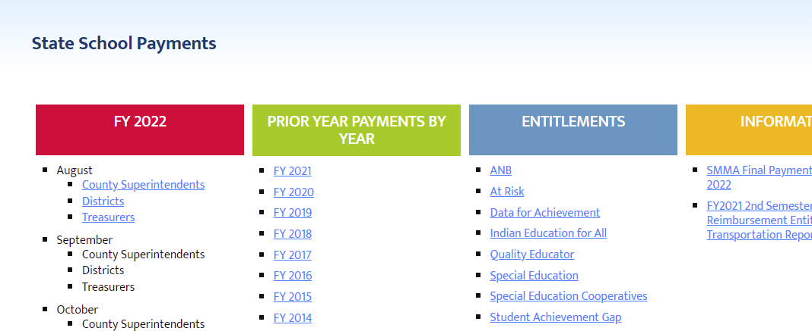
EXAMPLES – Recording Revenue
OPI State School Payments
Leadership/School Finance/State School Payments/FY2022
Current Fiscal Year by Month and in PDF files by County

Slide 59
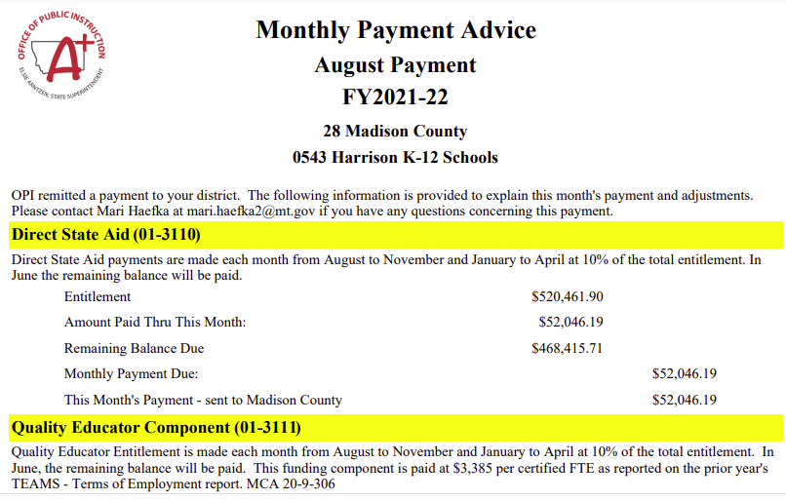
Fund and revenue codes provided

Slide 60
EXAMPLES – Recording Revenue
Record August state payments from OPI
Account Debit Credit
201-101 Cash $58,924.49
201-3110 DSA $52,046.19
201-3111 Quality Educator $ 4,204.17
201-3112 At Risk Student $ 288.33
201-3113 Indian Education for All $ 227.00
201-3116 Data for Achievement $ 217.30
201-3114 Amer. Indian Achievement Gap $ 22.30
201-3115 Special Education $ 1,919.20

Slide 61
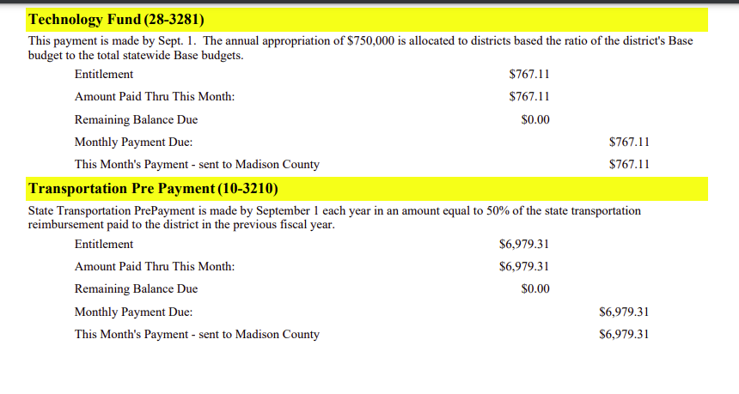

Slide 62
EXAMPLES – Recording Revenue
Record August state payments from OPI
Account Debit Credit
228-101 Cash $767.11
228-3281 State Technology Aid $ 767.11
210-101 Cash $6,979.31
210-3210 State Transp. Reimb. $ 6,979.31

