Slide 1
MASBO ESSER II & III Session July 29, 2021
Jeff Kirksey, OPI ESSER Program Manager
Mindi Askelson, OPI Grants Management Systems Analyst

Slide 2
Session Purpose
Provide an overview of ESSER II & ESSER III (ARP) Funds including how they are different.
Review of time-lines for ESSER II & III
Review allowable uses for ESSER II & III funding.
Dig Deeper into ESSER III plan requirements
Explore Frequently Asked Questions specifically related to:
Construction and Capital Expenditures including Thresholds and Pre-approval processes
Clarifying use of Object Codes
Management Requirements for Non-capitalized Electronic Equipment

Slide 3
Session Details
The requirements in section 2001(i) of the ARP Act relating to the ARP ESSER funds are published in the Federal Register and also outlined by the Department in the ESSER and GEER FAQ document.
The OPI has developed a FAQ document to provide LEAs information about the grant, including eligibility, and grant requirements.
ESSER II and ESSER III guidance documents are available on the OPI website, which outlines allowable uses for the grant.
Disclaimer: Similar to the FAQ document issued by the USED on ESSER and GEER, “the contents of this document do not have the force and effect of law and are not meant to bind the public in any way. The information is subject to change as additional information is released by the USED.

Slide 4
OPI Presenter
Introductions
WELCOME!
4

Slide 5
OPI Staff
Jeff Kirksey, ESSER Program Manager
Jeffrey.Kirksey@mt.gov
(406) 444-0783
Mindi Askelson, Program Analyst
Mindi.Askelson@mt.gov
(406) 444-0768

Slide 6
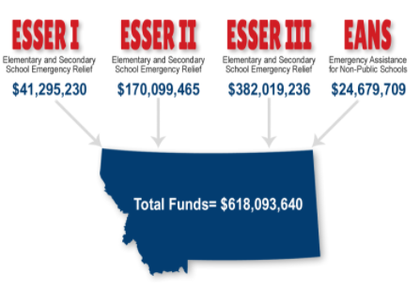
ESSER Summary
Elementary and Secondary School Emergency Relief Fund (ESSER):
3 Rounds of ESSER funds have been authorized by Congress in response to COVID-19 pandemic.

Slide 7
Key Dates
June 24, 2021. Districts must make publicly available the Return to In-Person Instruction and Continuity of Services Plan.
July 1, 2021. The District ARP ESSER Plan template opened in TEAMS
August 3-5, 2021. Regional Summit for all schools in Comprehensive Status. There will be designated times for school leadership teams to meet, plan, and coordinate programming and funding .
August 24, 2021. Districts must submit the ARP ESSER Plan to the OPI through TEAMS.
September 1, 2021. Due date to complete and submit ESSER II and ESSER III applications in the E-grants system.

Slide 8
Discerning the ESSERs
What is the biggest difference between ESSER I, ESSER II, and ESSER III funds?
Answer: ESSER III contains two planning requirements, a 20% set-aside for funding to be expended for lost instructional time type activities and has the new Maintenance of Equity provisions.
A full ESSER I, II, & III Comparison is available on the OPI website.

Slide 9
Allowable Use of Funds
Where can LEAs find information about Allowable Uses for ESSER II & III?
Answer: Please reference the Elementary and Secondary School Emergency Relief Funding (ESSER II & ESSER III) guidance document located on the OPI webpage and the ESSER and GEER FAQ produced by the USED. The ESSER and GEER Use Funds FAQ developed by the Department provides an overview of how the funds can be used. It emphasizes that the ESSER resources are available for a wide range of activities to address diverse needs arising from and exacerbated by the COVID-19 pandemic, and to emerge strong post pandemic
Reminder: As is the case with all activities charged to ESSER, costs must be reasonable and necessary to meet the overall purpose of the program, which is “to prevent, prepare for, and respond to” COVID-19. (See 2 CFR §§ 200.403-200.404.)

Slide 10
Allowable Use of Funds
How do you determine if an activity is an allowable use of funds?
Answer: Generally, in determining whether an activity is an allowable use of funds, a State or LEA must determine:
Is the use of funds intended to prevent, prepare for, or respond to the COVID-19 pandemic, including its Impact on the social, emotional, mental health, and academic needs of students?
Does the use of funds fall under one of the authorized uses of ESSER funds?
Is the use of funds permissible under the Uniform Administrative Requirements, Cost Principles, and Audit Requirements for Federal Awards (Uniform Guidance, 2 CFR Part 200)? In particular, is it necessary and reasonable for the performance of the ESSER or GEER award?

Slide 11
Allowable Use of Funds
Do we need to articulate how our proposed budget expenses connect to COVID prevention, preparation, and response?
Answer: Yes, In E-Grants you should make the expenditures connection to COVID clear in your budget descriptions.
An example could be: "____________ salary to hire specialist to help support students whose learning was adversely impacted by the pandemic in order to help students reach grade level expectations." OR “Purchasing ____________ to enable the district to easily transition to online learning as part of our COVID preparation strategy.”

Slide 12
Allowable Use of Funds
Are there recommended uses of ESSER II & III funds that will assist LEAs to address the impact of the COVID pandemic and disruptions leading lost instructional time?
Answer: The LEA should use their local data, conduct a gap analysis, and a comprehensive needs assessment process to determine the best uses of funds for their students and staff.

Slide 13
Allowable Use of Funds
Are there strings attached to the funds?
Answer: Yes, specifically in ESSER III including Safe Return to In-Person Plan, to be updated every six months, the LEA plan, to be updated every six months, and data collection and monitoring of the use of funds. In addition, there is a 20% set aside with specific uses.

Slide 14
Allowable Use of Funds
Can districts innovate on the use of funds?
Answer: Yes, and it is strongly encouraged that districts use these unprecedented funding allocations to innovate and implement the improvements that have been aspirations for your students.

Slide 15
Allowable Use of Funds
Are agencies that provide out of school time or other general support to LEAs able to apply for ESSER III funds?
Answer: No, this is a change for ESSER III, organizations other than LEAs are not eligible for the formula ESSER III funding. Organizations who can provide eligible services to LEAs should reach out to those LEAs to identify if their services meet the LEA’s identified needs.

Slide 16
Return to In-Person Instruction and Continuity of Services Plan
What is required in the Return to In-Person Instruction and Continuity of Services Plan?
Answer: The LEA’s plan must include how it will maintain the health and safety of students, educators, and other school and LEA staff, the extent to which it has adopted policies, and a description of any such policies on each of the CDC’s safety recommendations.
The plan must also describe how the LEA will ensure continuity of services, including but not limited to services to address students’ academic needs and students’ and staff social, emotional, mental health and other needs, which may include student health and food services.

Slide 17
Return to In-Person Instruction and Continuity of Services Plan
Is it a requirement for a district to adopt CDC guidance as part of the development of the Return to In-Person Instruction and Continuity of Services Plan?
Answer: No, the Interim Final Rule (IFR) clarifies that: “the requirement does not mandate that an LEA adopt the CDC guidance, but only requires that the LEA describe in its plan the extent to which it has adopted the key prevention and mitigation strategies identified in the guidance.”

Slide 18
Return to In-Person Instruction and Continuity of Services Plan
When and where does the Return to In-Person Instruction and Continuity of Services Plan need to be developed and made publicly available.
Answer: ESSER III requires LEAs to submit a plan to return to in-person instruction, gather public comment on that plan, and post it on the district or school’s public website within 30 days of receiving ESSER III funds [Sec. 2001(i)]. This will require LEAs to post their return to in-person instruction plans within 30 days of receiving their ESSER III award. In Montana, districts were awarded funds on May 24, 2021 thus the return to in-person instruction and continuity of service plan needs to be posted no later than June 24, 2021.
Each LEA will be required to submit the website address that links directly to the plan to the OPI through the ESSER III-E-grant Application.

Slide 19
District ARP ESSER Plan
What is required in the District ARP ESSER (ESSER III) Plan?
Answer: The requirements for the district ARP ESSER (ESSER III) plans, must include at a minimum:
The extent to which and how funds will be used by the District to implement prevention and mitigation strategies,
How the District will use the mandatory 20% set-aside for to address the academic impact of “lost instructional time” through the implementation of evidence-based interventions,
How the District will use the remaining ARP ESSER funds consistent with statutory requirements,

Slide 20
District ARP ESSER Plan
Continued: What is required in the District ARP ESSER (ESSER III) Plan?
How the District will ensure that the ARP ESSER funded interventions, including but not limited to the 20% set-aside, will respond to the academic, social, emotional, and mental health needs of all students, and particularly those students disproportionately impacted, and
Consultation with a wide variety of stakeholders when developing the plan.
The LEA ARP ESSER plan should be clear, in a uniform format, and available to all, which may require written or oral translations for non-English speakers or providing the document in an accessible format for individuals with disabilities, and
It should also be available on the LEA website.

Slide 21
District ARP ESSER Plan
Will the District ARP ESSER Plan be a PDF document emailed to OPI?
Answer: No. LEAs must submit an ARP ESSER Plan to the OPI through the Terms of Employment, Accreditation, and Master Schedule (TEAMS). The District ARP ESSER Plan template opened July 1st and will close on August 24th in TEAMS.
The OPI will continue to release information on the OPI website under the ESSER Info page, so that LEAs can begin work in anticipation of the opening of the template in TEAMs.

Slide 22
TEAMS Login: http://opi.mt.gov/Leadership/Assessment-Accountability/School-Accreditation

Slide 23
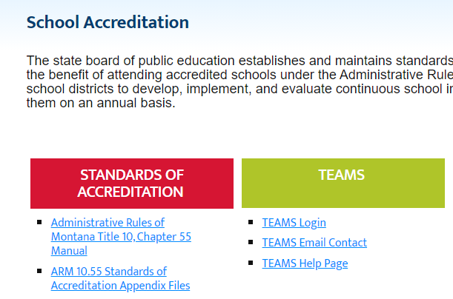
TEAMS Login: OPITEAMS@mt.gov

Slide 24
TEAMS Login: http://opi.mt.gov/Leadership/Assessment-Accountability/School-Accreditation

Slide 25
Pre-planning
What should be considered before crafting the plan?
Answer: Prior to beginning your school district ARP ESSER plan, consider the following:
Has your district and/or individual schools within the district completed a Gap Analysis to assist in identifying the top needs due to COVID 19? If no, click on Gap Analysis.
What kinds of data assisted you in identifying the gaps?
What were the needs you identified in your student subgroups?
Did you meet with all stakeholders to get input on needs and possible solutions to formulate a plan for the funds? (Parents, Students, Teachers, Staff, Community Members, Tribal Members, School Board, etc.…) If not, how will you make this happen prior to creating your plan?

Slide 26
While completing your school plan
What should be considered while crafting the plan?
Answer:
Ask questions like: What would you like to achieve before the funding ends in September of 2024? What goals will need to be established in order to get there?
You may need to leave and come back to this form as you formulate your plan.
You will still need to complete the eGrants application for ESSER III that is due September 1, 2021. It is important that your school district ARP ESSER plan aligns with the budget amounts reported in eGrants.

Slide 27
Resources
Are there resources that will aid in crafting the plan?
Answer: Yes!
Curriculum Selection
Acceleration Guidance
ESSA Tiers of Evidence
Gap Analysis Tool
U.S. Department of Education FAQ - ESSER/GEERS
FAQ’s of Maintenance of Equity Requirements
Montana Office of Public Instruction ESSER website
SEL Priorities

Slide 28
Next steps
What happens after the plan is submitted?
Answer:
The OPI will confirm your submission via the email you provide at the start of your plan.
The OPI will reach out with questions and support as needed. Districts will need to set up their own monitoring which needs to be paired with implementation.
Districts will be able to answer these same question every 6 months. The OPI created this temporary form as a means to meet the federal timelines; it will be put in a more permanent location where you can access and update your plan.
The OPI will use this form to collect best practices to share with other districts.

Slide 29
District ARP ESSER Plan
Will more guidance be provided from the OPI on developing the District ARP ESSER Plan?
Answer:
The OPI has hosted three ARP ESSER Webinars during the month of July to assist districts in developing and submitting District ARP ESSER Plans. The webinars were recorded and posted for viewing on the OPI webpage.
Note: Additional Q & A sessions, technical assistance and webinars will be conducted as needed.

Slide 30
ESSER III Requirements
Must the LEA submit a grant application to the OPI through the E-grant Management System to receive the ARP ESSER III funds?
Answer: Yes, the LEA must submit the grant application to OPI by September 1, 2021. Each LEA must also submit by August 24, 2021, the District ARP ESSER Plan to the OPI for approval. As a reminder, the plan and budget are separate.
Notes:
Time-line Clarity. Pause Here for Question before Transitioning into Construction.

Slide 31
Construction and Capital Costs
What is the guidance on construction costs?
Answer: The ESSER and GEER FAQ addresses uses of ESSER and GEER funding for construction. (See section B-6 & B-7).

Slide 32
Construction and Capital Costs
Is Construction an allowable use of ESSER Funds?
Answer: Construction is authorized under Title VII of the ESEA (Impact Aid) and therefore is an allowable use of GEER and ESSER funds under sections 18002(c)(3) and 18003(d)(1) of the CARES Act, sections 312(c)(3) and 313(d)(1) of the CRRSA Act and section 2001(e)(2) of the ARP Act.
The broad Impact Aid definition of “construction” includes new construction as well as remodeling, alterations, renovations, and repairs under which many activities related to COVID-19 would likely fall.
However, the Department discourages LEAs from using ESSER and GEER funds for new construction. This use of funds may limit an LEA’s ability to support other essential needs or initiatives. Remodeling, renovation, and new construction are often time-consuming, which may not be workable under the shorter timelines associated with ESSER and GEER funds. These types of activities are also subject to several additional Federal requirements, as detailed below.

Slide 33
Construction and Capital Costs
What is the federal definition for construction?
Answer: The Impact Aid program statute defines “construction” as “(A) the preparation of drawings and specifications for school facilities; (B) erecting, building, acquiring, altering, remodeling, repairing, or extending school facilities; (C) inspecting and supervising the construction of school facilities; and (D) debt service for such activities.”
As is the case with all construction contracts using laborers and mechanics financed by Federal education funds, an LEA that uses ESSER or GEER funds for minor remodeling, renovation, repair, or construction contracts over $2,000 must meet all Davis-Bacon prevailing wage requirements.

Slide 34
Construction and Capital Costs
Who determines if a construction project is an allowable use of funds?
Answer: While construction is generally allowable, it is the responsibility of a Governor, SEA, LEA, or other subgrantee to assure that individual costs:
1) comply with the Cost Principles in 2 CFR Part 200, subpart E (e.g., the cost must be “necessary and reasonable” (2 CFR §§ 200.403-200.404));
2) meet the overall purpose of the CARES Act, CRRSA Act, or ARP Act programs, which is “to prevent, prepare for, and respond to” COVID-19; and
3) are consistent with the proper and efficient administration of those programs.
Note: Under these general principles, any construction activities, including renovations or remodeling, that are necessary for an LEA to prevent, prepare for, and respond to COVID-19 could be permissible, though the burden remains on grantees and subgrantees to maintain the appropriate documentation that supports the expenditure.

Slide 35
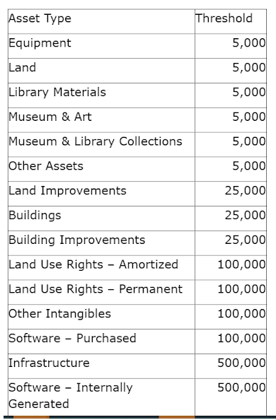
Construction and Capital Costs
What capital costs must be pre-approved?
Answer: If your planned ESSER funded capital expenditures meet or exceed these State Asset Thresholds you will need pre-approval. Items less than these thresholds still must meet allowable use criteria.

Slide 36
Construction and Capital Costs
How does an LEA request preapproval of Construction costs from the OPI?
Answer: The LEA needs to submit the Capital Expenditure Pre-approval Form in E-Grants. This is a simple google form that includes a review of Federal Requirements and District Specific content.

Slide 37
Construction and Capital Costs
Where can I find the ESSER Capital Expenditure Pre-approval form?
Answer: The form can be found on the Property and Equipment Budget page in E-Grants (show below) or you can access the link directly.

Slide 38
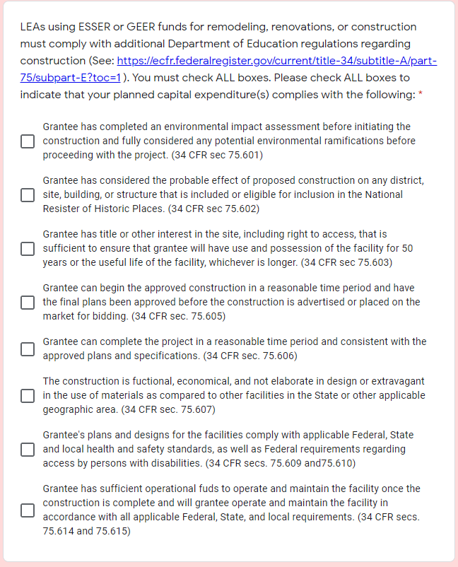
Construction and Capital Costs
What are the primary elements of the pre-approval form?
Answer :

Slide 39
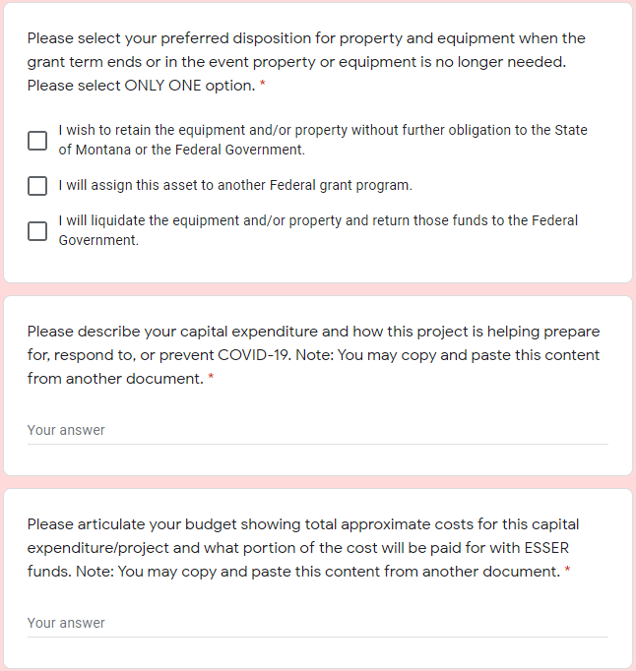
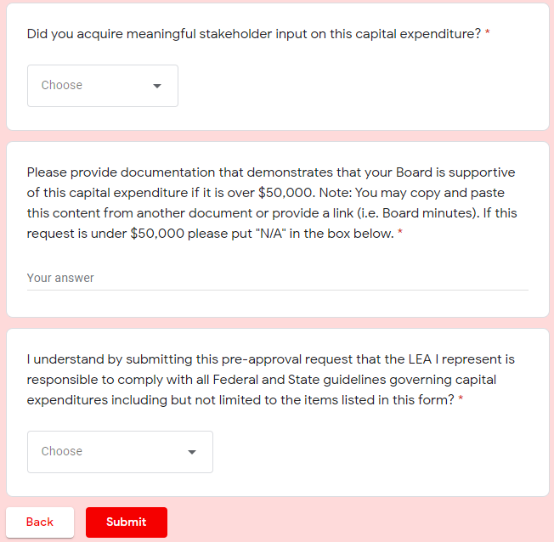
Construction and Capital Costs
What are the primary elements of the pre-approval form (cont.)?
Answer:

Slide 40
Construction and Capital Costs
Can ESSER Funds be used for new construction?
Answer: YES, provided that pre-approval and all the federal guidelines are met in the project and that the new construction meets the primary purposes of the ESSER funding.

Slide 41
Construction and Capital Costs
Can ESSER Funds be used for renovations?
Answer: Yes, provided that the renovations meet the primary purposes of the ESSER funding (i.e., prepare, prevent and respond to COVID-19.)

Slide 42
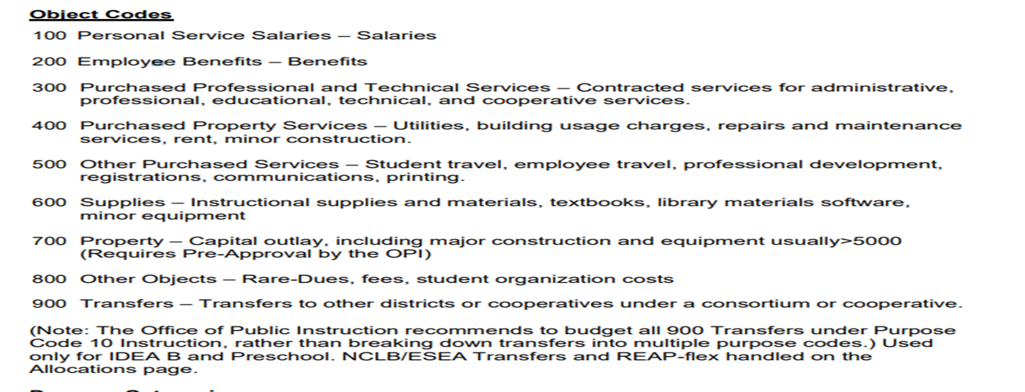
Capital Costs and Object Codes
What object codes should/shouldn’t I use for capital expenditures?
Answer:

Slide 43
Managing Non-Capital Assets
Do we have to do any special tracking for non-capital assets?
Answer: Yes, specifically technology purchased with ESSER dollars must be inventoried and tabbed.

Slide 44
Cash Request and E-Grants Budget
Should my cash request align with my E-Grants budget?
Answer: Yes. If expenses you are requesting cash for do not align with budget that was approved in E-Grants, you should complete a budget amendment to correct the alignment before submitting your cash request.

Slide 45
Open Questions
What questions do you have?
Do you have any clarifying questions about the responses we have provided?

Slide 46
Resources
OPI Website:
opi.mt.gov

Slide 47
Thank you!
For questions or additional information please contact
Jeff Kirksey: Jeffrey.Kirksey@mt.gov (406)444-0783
Notes:
Are there any questions from this presentation?

