Slide 1
Getting Ready for the Trustees Financial Summary (TFS) For FY20

Slide 2
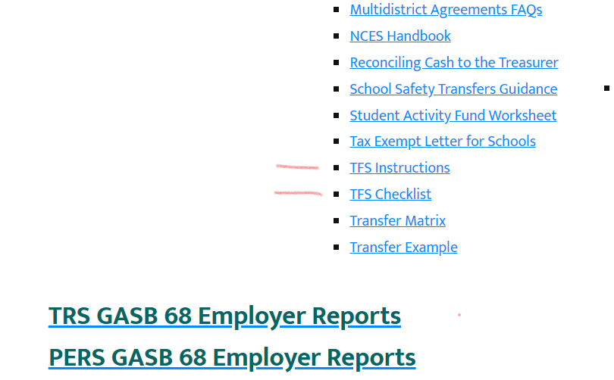
THE OPI HAS POSTED THE TFS INSTRUCTIONS ON THEIR WEBSITE
Leadership/Finance/Accounting/Guidance and Manuals

Slide 3
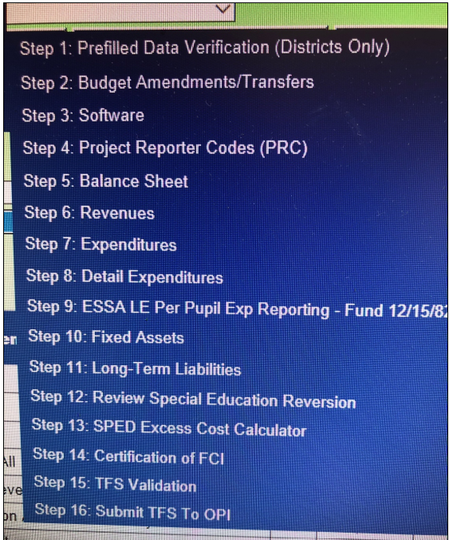

Slide 4
Budget amendments
Step 2 Budget Amendments.
Make sure any budget amendment your Board approved is in this step.
Every year there are districts who do all the local procedures but fail to send the documents to OPI.
Call Nica Merala at OPI and she will get you set up if you can document the amendment was approved.
Amendments are assigned Project Reporter Codes by OPI (910 through 919) these are supposed to be used for all expenditures of the monies that are spent from the amendment.

Slide 5
Step 4: Project reporter codes (prc’s)
Have all your info ready to input PRC’S. If they are NOT entered in the TFS before you input corresponding revenue or expenditure codes, those entries will not be allowed.
MAEFAIRS will remember the PRC’S you used in the previous year’s TFS so you can copy those to the current year’s TFS, if they are used for the same purpose.
Any new PRC’s will need to be hand entered.
YOU decide what numbers to use for the PRC’s (except for 910-999 reserved for the OPI)

Slide 6
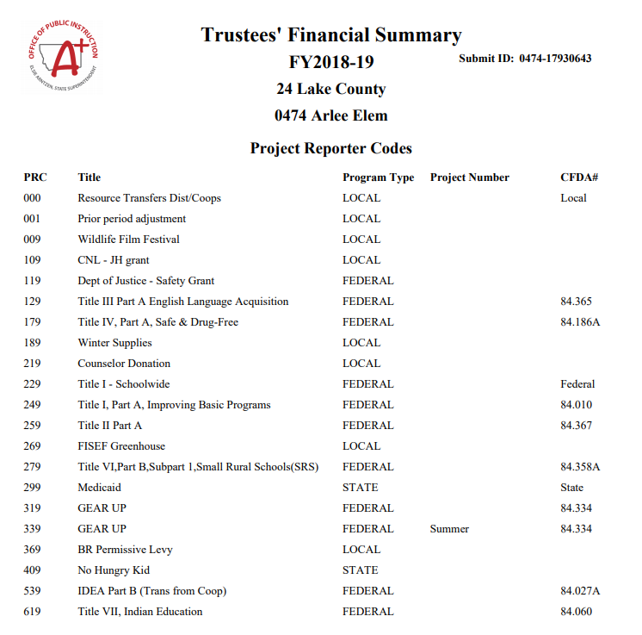

Slide 7
Balance all funds with the treasurer!!
You may have the treasurer’s report by now, if not, you should have it soon.
Some Treasurer’s will allow you to make adjustments well into July.
Some won’t.
Talk to your treasurer about this.
If not, you can always make adjusting entries to be carried out in July or August.
Make sure each fund’s cash balances with the treasurer’s cash.
Clearing funds (X86 and X87) make sure the outstanding warrant total for each fund matches that fund’s cash total.
Don’t forget your Activity Account, get that balanced.

Slide 8
Enter all your revenues/expenditures/balance sheet information. Steps 5,6, and 7.
Hand enter your balance sheet numbers. Check Previous years TFS.
Two options for revenues and expenditures
1. create a file to upload from your accounting software (recommended)
2. hand calculate and hand enter each line item.
Each specific revenue
Expenditures rolled up by object code

Slide 9
Example: how to “roll Up” all 600 level expenditure codes for teaching items to create 201-1xx-1xxx-6xx

Slide 10
STATE revenues
Compare your accounting system State revenues (3XXX) with OPI’s schedule of payments (on their website), they should match, if not, call OPI.
The state revenues will be prefilled on the TFS.

Slide 11
Are any “tweaks” needed?? Tweaks=adjusting entries
It is July 15th and the Treasurer’s books are closed and you realize there are transfers that you can’t make, don’t panic,
Let’s look at some potential adjusting entries that you might need.

Slide 12
PAYROLL
Were all June salaries paid? (June 30 Grant Salaries especially)
If not, record as payables on your balance sheet and expenditures in the current year with a journal voucher (JV)
Were the 2nd quarter taxes and benefits paid?
If not, record as payables on your balance sheet and expenditures in the current year with a JV.
Common example is worker’s compensation

Slide 13
Local Revenues
Compare what 1XXX revenues you received to what was budgeted.
Taxes not paid may be:
Delinquent (Not yet paid)
Protested
Regarding your general funds…some taxes received this year may have been prior year delinquent taxes or prior year protested taxes but, they usually aren’t identified as such on your county treasurer sheet.
Call your Treasurer and ask if any of this year’s general fund tax revenue was from prior year collections.
If so, you can re-code those from revenue code 1111 to revenue code 1117. These revenues can be held as “excess reserves” over your 10% limit. If you are under the 10%, then you cannot hold these as excess reserves.
Wait till you are working on your General Fund Budget to recode local revenue. If your general fund is significantly under the 10% reserve limit, you cannot hold excess reserves, researching prior year revenue would then be a waste of you time…..and the treasurers.

Slide 14
Recording “Due from” revenues
It is July and you may be expecting revenues from the state for things like:
Driver’s education reimbursement (Fund X18)
State hot lunch match (Fund X12)
Federal grants (Title I, Title II, Title IV, etc. – Fund X15)
In your 2019-20 accounting software, do a journal voucher (or your software may have a specific “enter due from” capability)
Debit XXX-180 (Due From other Governments)
Credit XXXX- the appropriate revenue account (for example Title I = 4200)
In your 2020-21 when you receive the revenue record it thusly:
Debit XXX-101(Cash)
Credit XXX-180 (Due From other Governments)

Slide 15
Refunding revenues (or Recording “Due to”) For grants ending June 30
It is July and for some reason, your district needs to return grant revenue received during 2019-20.
You will enter a JV (or use the accounting software feature) that lowers revenue, do not code it as an expenditure.
Debit the Revenue code used when receiving the money (X15-4510 Carl Perkins)
Credit X15-611 “Due to Other Governments”
When you write the warrant in July, code it as:
Debit X15-611 “Due to Other Governments”
Credit X15-101 “Cash”

Slide 16
Recording deferred inflow for grants Ending September 30.
For some reason, your district received grant monies in 2019-20 that exceeded the amount spent but, those dollars can be used in 2020-21. The excess needs to be coded as deferred inflows. On your 2019-20 books:
Reduce (debit) the amount of revenues in excess of the expenditures
Example: X15-4200 for example
Increase (credit) the balance sheet account 680 Deferred Inflows (X15-680)
In your 2020-21 books, immediately:
Reduce (debit) X15-680 Deferred Inflows
Increase (credit) the revenue account (X15-4200)
Mostly an issue with federal grants.
Federal revenue and expenditures should always be equal on June 30th, using this tool will accomplish that.

Slide 17
An example from fY 2018-19 fund 15 Project reporter code summary

Slide 18
Clearing out old encumbrances
Unpaid or underpaid encumbrances from a prior year need to be removed from your accounting system.
The next slide shows an example of a district that had 2 outstanding encumbrances that were entered in June of 2019.
Check your school accounting manual for procedures, your software may do the accounting for you automatically, if not, call your software vendor or your mentor for JV procedures.
Chose the proper revenue code for the adjusting entry:
1900 (Miscellaneous Revenue) for amounts that are not considered “material”
6100 (Material Prior Period Revenue Adjustments) for amounts that are considered “material”.
Call your auditor for materiality amounts.

Slide 19
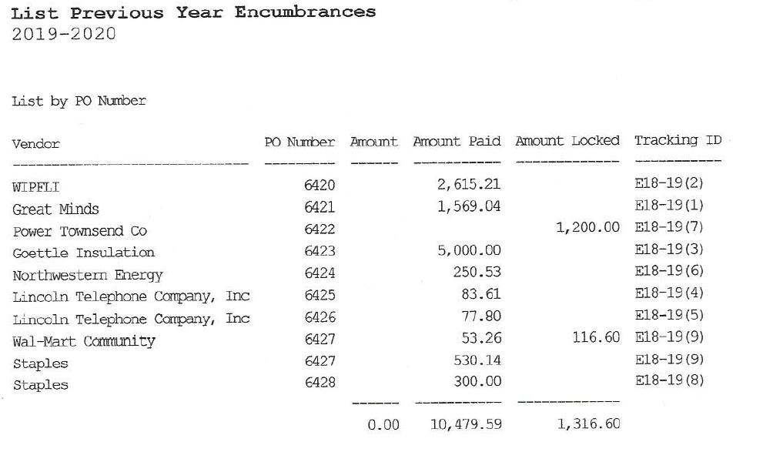

Slide 20
Calculating and posting Taxes Receivable
Every month your county Treasurer reports taxes receivable and protested taxes. (See next two slides)
When you receive the June report, add all the taxes receivable.
This county report has the taxes receivable, (labeled as “deferred) totaled by type on the 2nd page. This district can just add those 3 numbers to get total taxes receivable…..in this case $24,799.63 which is also the total of all the individual entries on the 2 pages. Other county reports might not have that recap.
This district does not show any protested taxes, it did last year.

Slide 21
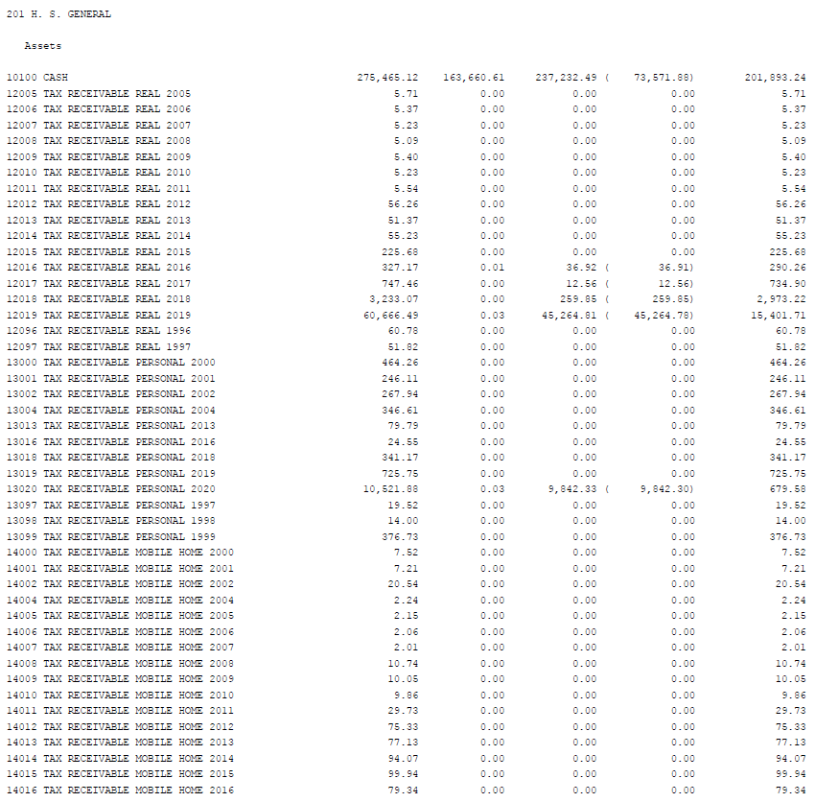

Slide 22
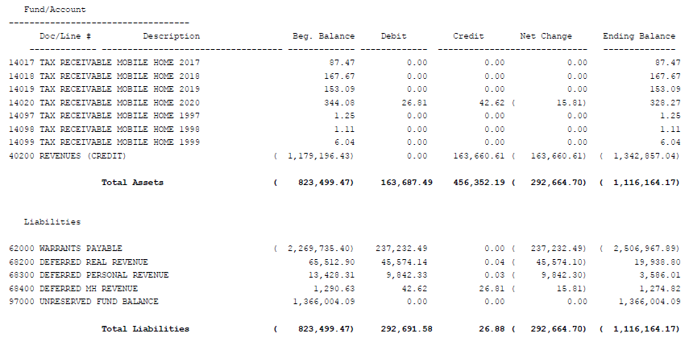

Slide 23
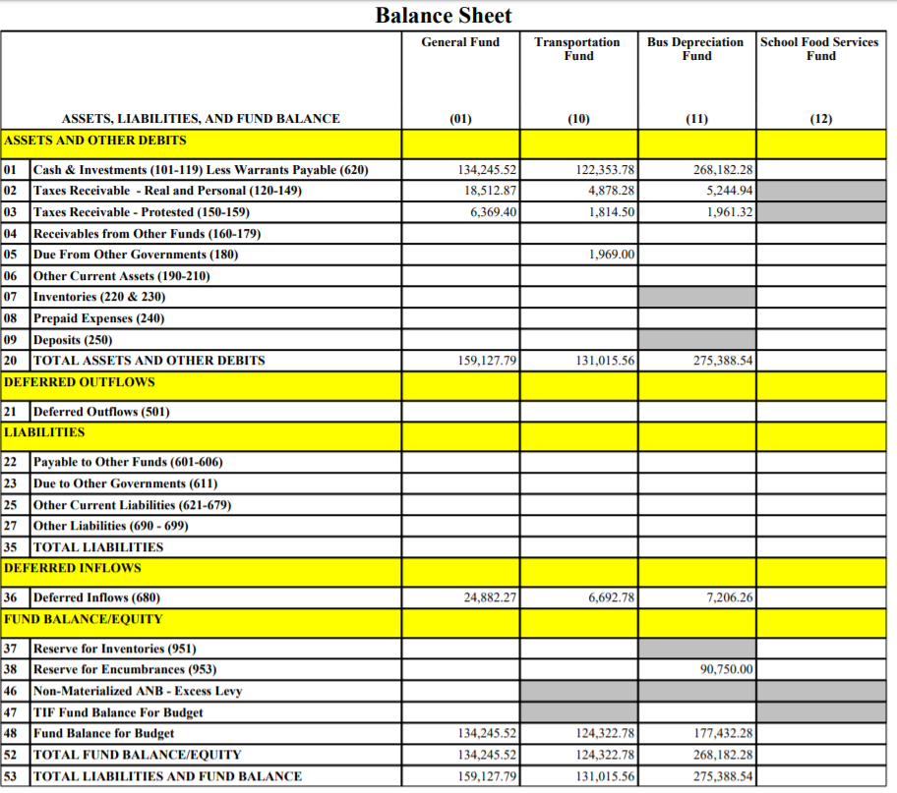

Slide 24
Compensated Absences fund transfer needed/wanted?
20-9-512, MCA. Compensated absence liability fund.
(1) The trustees of a school district may establish a compensated absence liability fund for the purpose of paying: (a) any accumulated amount of sick leave that a nonteaching or administrative school district employee is entitled to upon termination of employment with the district in accordance with the provisions of 2-18-618; and (b) any accumulated amount of vacation leave that a nonteaching or administrative school district employee is entitled to upon termination of employment with the district.
(2) The compensated absence liability fund may be used only for the stated purpose of this section.
(3) The trustees may transfer money from the general fund, within the adopted budget, to establish and maintain the compensated absence liability fund.
(4) The maximum amount in a reserve fund established under the provisions of subsections (1) and (3) may not exceed 30% of: (a) the total school district liability for accumulated sick leave of nonteaching and administrative school district employees on June 30 of the current school fiscal year; and (b) the total school district liability for accumulated vacation leave of nonteaching and administrative school district employees on June 30 of the current school fiscal year.
(5) For the purposes of this section, "administrative school district employee" means a school district employee who is employed in an administrative position and who accrues vacation leave as part of the employee's contract with the school district.

Slide 25
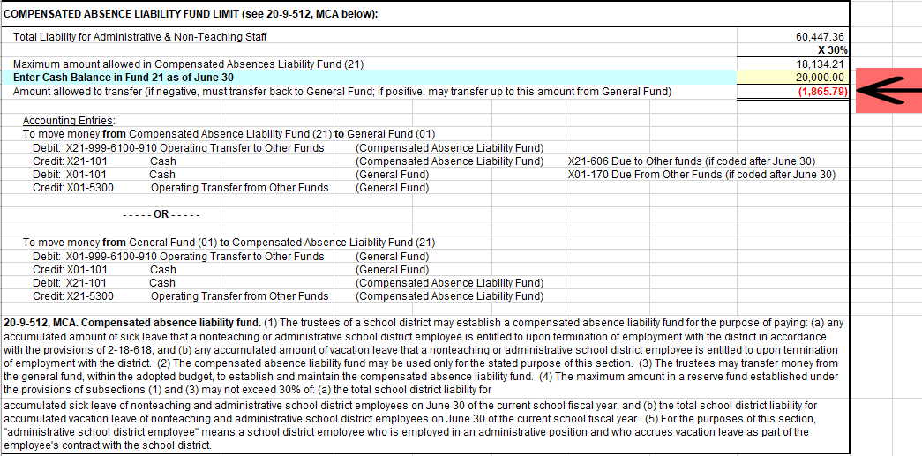

Slide 26
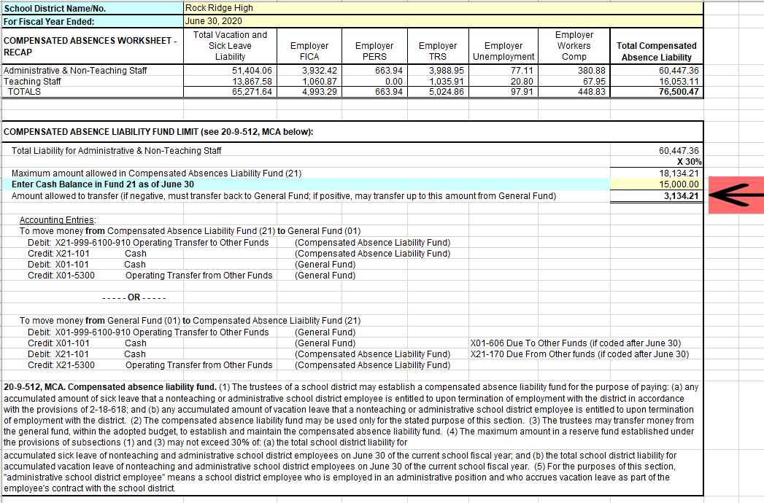

Slide 27
Rental fund transfer to the general fund
June 30 Fund Limits for Lease-Rental fund
K-8 districts $10,000
9-12 districts $10,000
K-12 districts $20,000
Any excess funds must be transferred to the General Fund

Slide 28
Coding the rental fund transfer
June entries
Debit X20-999-9999-971(Residual Equity Transfer Out)
Credit X20-606 (Due to other funds)
Debit X01-170 (Due from other funds)
Credit X01-9710 (Residual Equity Transfer In)
July entries
Debit X20-606 (Due to other funds)
Credit X20-101 (Cash)
Debit X01-101 (Cash)
Credit X01-170 (Due from other funds)

Slide 29
Special Education Reversion
Make sure that all special education expenditures are coded with program code 280.
The TFS is checking to see if your district spent enough special education dollars to justify the amount the state sent you in your general fund.
If you didn’t spend enough on special education, the district will have to “revert” some state monies. No money is sent back, the reversion amount is subtracted from your next year’s allocation.
Reversion usually only happens to K-8 districts who have all special education services provided by a co-op.

Slide 30
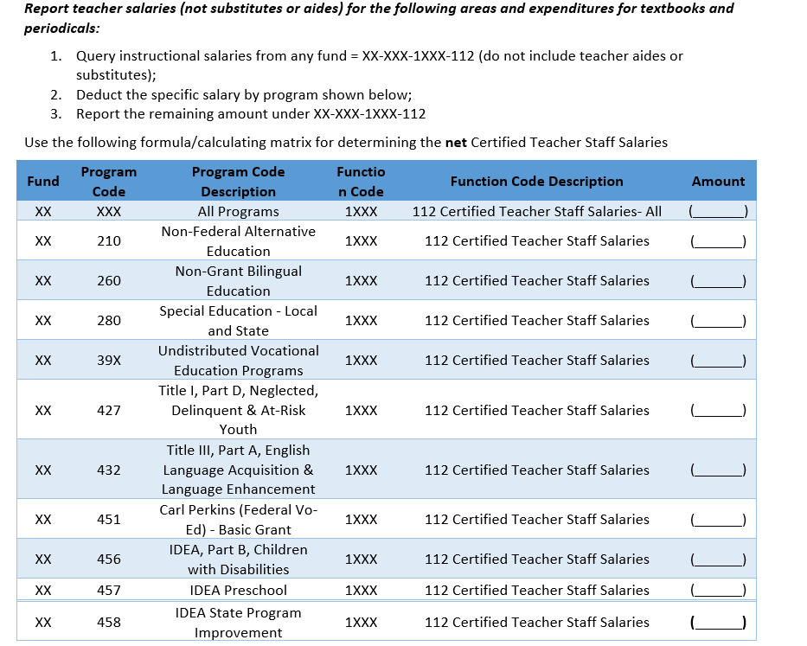
Step 8: Detailed expenditure report
Some expenditures need to be reported in more detailed fashion.
Run a “user defined report” or “query” for any line items you may have used.
Teacher salaries are a big part of the report.
Run a report asking for all object 112 expenditures. (XX-XXX-1XXX-112)
Run reports for the other 112 codes but filter them by the different program codes that might apply to your district (program 280 and 39X are the most common)
Enter those amounts on this report but subtract them from the first overall total, the remainder is what you put on the line that asks for XX-XXX-1XXX-112.

Slide 31
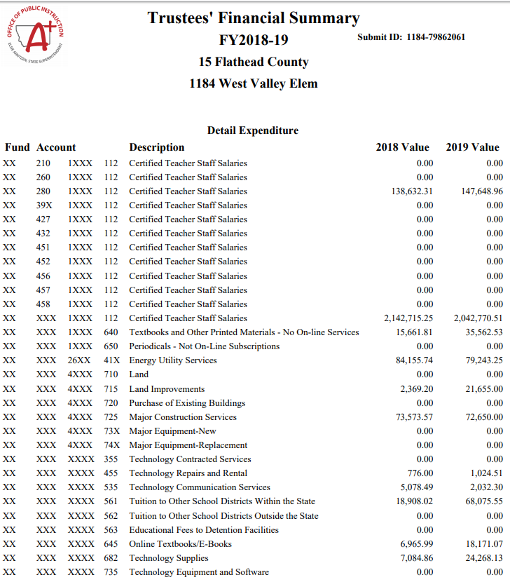

Slide 32
Step 9: Essa per pupil reporting
Renee Richter will address this when she does a TFS Zoom training…..
The Date? To Be Announced.
OPI personnel are VERY busy testing MAEFAIRS, trust me, that is priority #1 right now.
Been there, done that.

Slide 33
Long term liabilities page
Calculate the Compensated Absences
Calculated for all staff with vacation and sick leave accruals.
Don’t forget to include benefits in the calculation.
Leases, check your lease agreements
Loans Payable (Intercap most common)
Special Improvement Districts (SID’s)
Bonds, which are Prefilled for you!
Other Post Employment Benefits (OPEB)
Your auditor or an outside firm may have done this calculation
Your district may have done this calculation
Research to find out who did and if it needs to be redone.

Slide 34
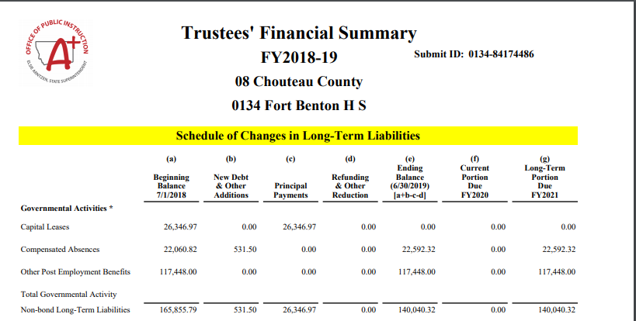

Slide 35
Spreadsheet From the OPI Website

Slide 36
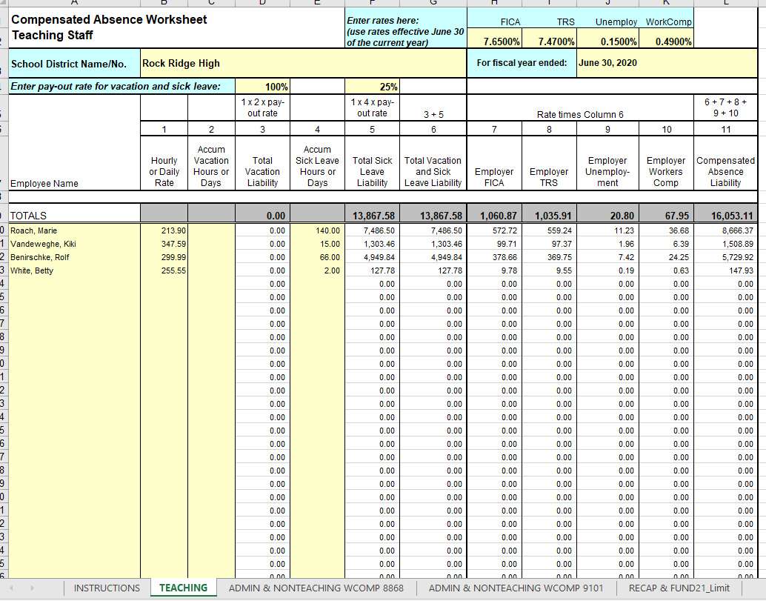

Slide 37
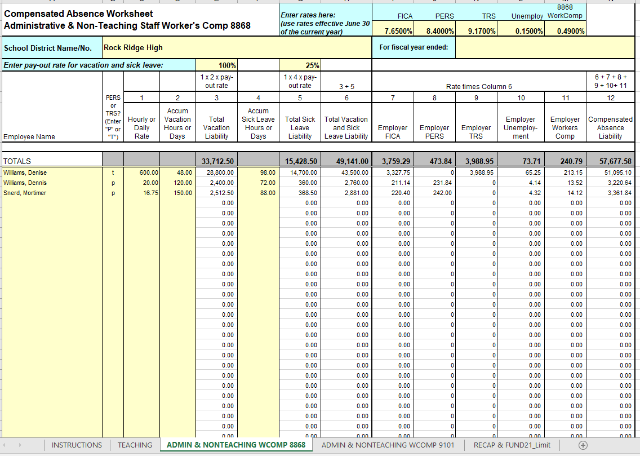

Slide 38
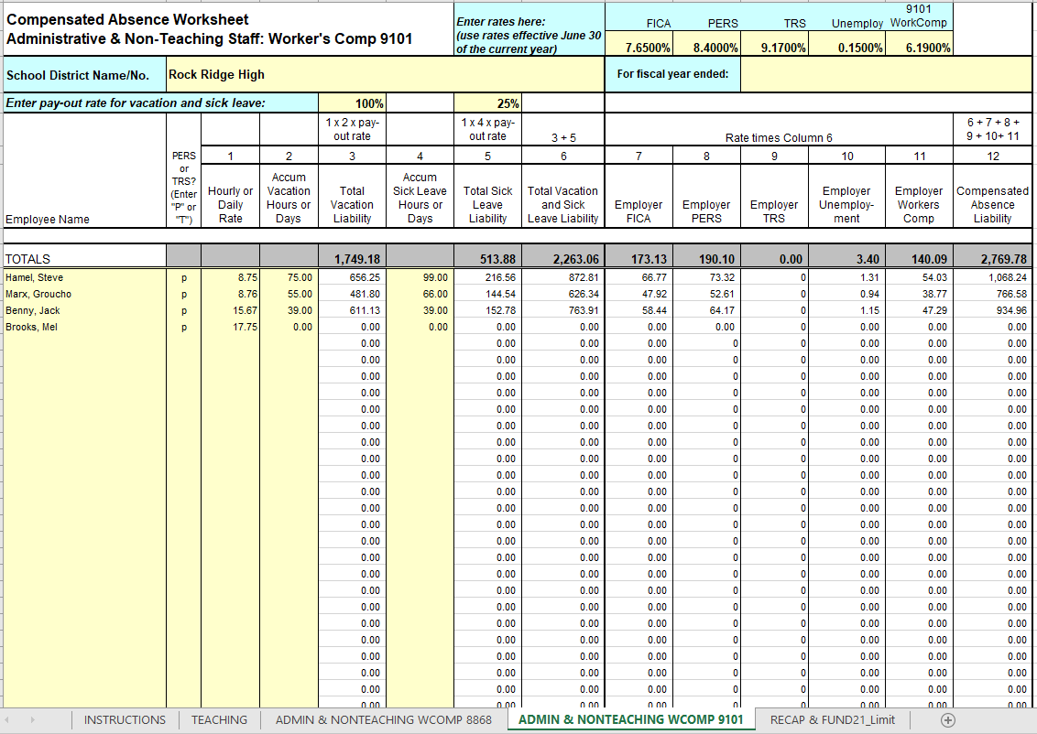

Slide 39
Fixed Assets
Fixed asset = any individual item that costs over $5,000.
Fixed asset = coded with a 7XX object code.
Search your accounting system for all 7XX purchases
There “should” be a spreadsheet listing all fixed assets somewhere. It should show historical cost, date of purchase, useful life, yearly depreciation, etc.
On the Trustees Report:
“Adjustment column is where you fix prior year mistakes.
A negative number can be entered here.
Additions column: enter the total value of all new fixed assets by category.
Removals column: enter the value of all the fixed assets no longer owned by the district….this is also done by category.

Slide 40
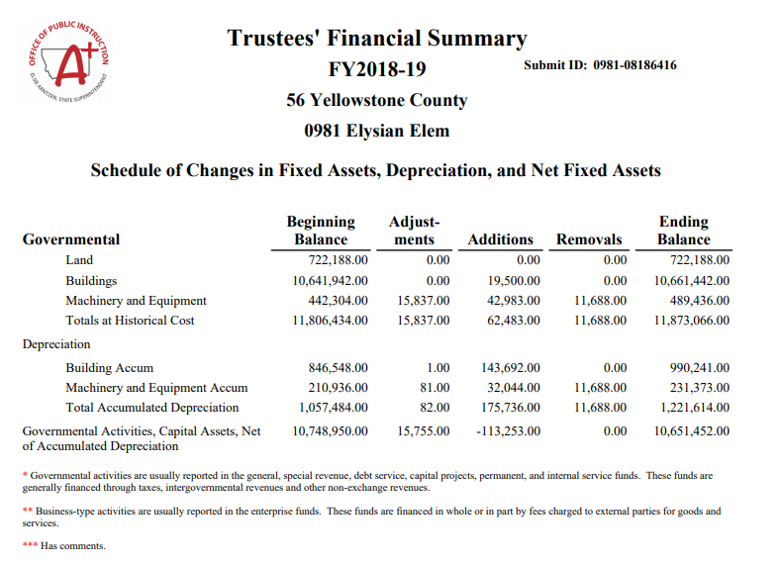

Slide 41
Net Pension Liability
This amount is calculated for each school system by each retirement system, you will get this off of their website, hopefully before you submit.
Teachers Retirement
Public Employees Retirement
There are links on the OPI website School Finance/Accounting
For School systems containing multiple districts (K-8 and 9-12), one way of distributing the amount is to calculate the ratio of how much each district paid to each retirement system and apply that ratio to the total Net Pension number provided

Slide 42
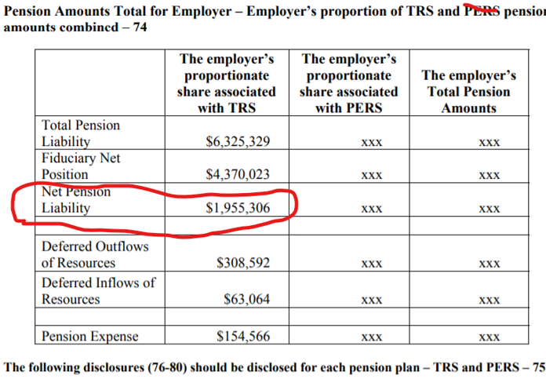
Example of the Teachers Retirement Report
I cannot find the PERS reports on the MPERA website…..stay tuned.

Slide 43
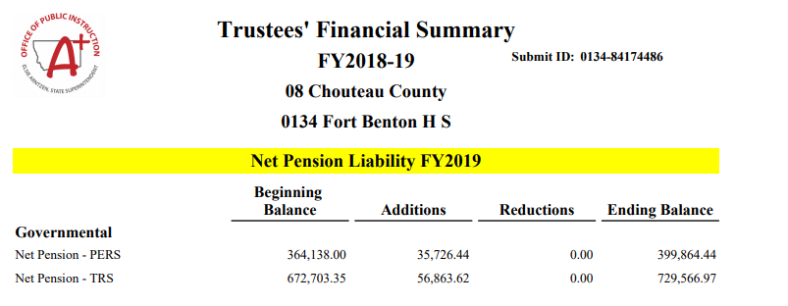

Slide 44
No sweat, right!!!

