Slide 1
MASBO Regional Meetings February 2021
Steve Hamel, Interim Services/Trainer 406-431-0124
Marie Roach, Association Services Coordinator 406-461-8804
Denise Williams, Executive Director 406-461-3659
February 11 @ 2:00 p.m.
February 17 @ 11:00 a.m
February 19 @ 10:00 a.m.

Slide 2
AGENDA
Legislative Update
ESSER–II Funding
MASBO Programs and Announcements
P-card
Certification
Mentor
MASBO Elections
Using the OPI General Fund Spreadsheet to Project Budgets

Slide 3
Legislative Update
HB15 Implement K-12 Inflation
HB181 Reauthorizing the e-rate broadband program
HB143 Provide incentives for increasing starting teacher pay

Slide 4
House Bill 15 - Basic Entitlement Rates
Entitlements | FY2021 | FY2022 * (HB15) | FY2023* (HB15)
Elementary Basic | $ 53,541 | $ 54,344 | $ 55,741
For every 25 Elem ANB over 250 | $ 2,678 | $ 2,718 | $ 2,788
Middle School Basic | $ 107,084 | $ 108,690 | $ 111,483
For every 45 MS ANB over 450 | $ 5,354 | $ 5,434 | $ 5,574
High School Basic | $ 321,254 | $ 326,073 | $ 334,453
For every 80 HS ANB over 800 | $ 16,063 | $ 16,304 | $ 16,723
*HB15 increases FY2021 by inflation of 1.5% for FY2022 and 2.57% for FY2023.

Slide 5
House Bill 15 - Per-ANB Entitlement Rates
Entitlements | FY2021 | FY2022 * (HB15) | FY2023* (HB15)
Elementary per-ANB | $ 5,727 | $5,813 | $ 5,962
High School per-ANB | $ 7,333 | $ 7,443 | $ 7,634
*HB15 increases per-ANB entitlements by 15% for FY2022 and 2.57% in FY2023.
Each student after the first ANB is decreased by a reduction factor (decrement) per ANB:
Elementary ANB decrement is $.20 per ANB
High school & 7th - 8th accred ANB decrement is $.50 per ANB

Slide 6
House Bill 15 - Funding Components
 | FY2021 | FY2022 * (HB15) | FY2023* (HB15)
Quality Educator | $3,335 | $3,385 | $3,472
At-Risk Student | $5,641,973 | $5,726,603 | $5,873,777
Indian Education for All (per ANB) | $22.36 ($100 min.) | $22.70 ($100 min.) | $23.28 ($100 min.)
Am Indian Student Achievement Gap | $220 | $223 | $229
Data for Achievement (per ANB) | $21.41 | $21.73 | $22.29
*HB15 increases these payments 1.5% for FY2022 and 2.57% in FY2023.

Slide 7
HB181 Reauthorizing the e-rate broadband program
Amends 20-9-534, MCA Statutory appropriation for school technology purposes
State Technology Aid to schools
Fund X28 Technology; revenue source 3281
$1 million distributed statewide to schools each year in July
Suspended for FY2022 and FY2023
Funding is redirected to e-rate broadband program to be used as matching funds

Slide 8
House Bill 143 - Provide incentives for increasing starting teacher pay

Slide 9
House Bill 143 - Provide incentives for increasing starting teacher pay
Effective date: July 1, 2021
Legislative goals for starting teacher pay
Teacher base pay (starting teacher salary) in the applicable year must be at least 10 times as much as the quality educator payment amount set forth in § 20-9-306, MCA; and
For first class school districts only, teacher base pay may not be less than 70% of average teacher pay in that school district.
20-6-201, MCA. Elementary district classification.
(1) Each elementary district shall have a classification of:
(a) first class, if it has a population of 6,500 or more;

Slide 10
House Bill 143 - Provide incentives for increasing starting teacher pay
Additional QEC payment for
the number of full-time equivalent teachers that were in the first 3 years of the teacher's teaching career in the previous year
Reported to OPI by December 1
Meets legislative goals for starting teacher pay
Timing:
Effective July 1, 2021 would be FY2022
Report to OPI by Dec. 1, 2021
Additional QEC is for FY2023 General Fund Budget

Slide 11
ESSER-II
Consolidated Appropriations Act of 2021 (CRRSA)
Elementary & Secondary Schools Emergency Relief (ESSER)
OPI is referring to it as ESSER-II:
Total to OPI for Montana schools $170,099,465
90% to be distributed to schools (based on FY20 Title I) $153,089,518
10% to OPI for addressing issues related to COVID $ 17,009,947
.5% of total grant to OPI for admin costs $ 850,497
Remainder under discussion $16,159,450

Slide 12
ESSER-II
Will be administered through E-Grants
Information posted on OPI website:
ESSER-II Grant Guidelines
ESSER-I and II District Allocations
ESSER-II Coding
Fund X15 Miscellaneous Programs and use a unique PRC
Revenue source code 7750
Expenditure program code 775
NOTE: Subject to legislative approval in HB2

Slide 13
MASBO PROGRAMS AND ANNOUNCMENTS
P-card
Certification
Mentor
MASBO Elections

Slide 14
P-Card Program
Sending copies of your annual audits to BMO is no longer required
If your account is delinquent BMO may ask for a copy of your audit
Electronic payments are best practice
On average your payments need to be posted <27 days each month for you to be eligible for your annual rebate
Contact Marie at mroach@masbo.com for more information on the P-Card Program or see the P-Card page on the MASBO website (click here)

Slide 15
Certification Program
Consider getting your MCSBO if:
You have 3 years experience as the Clerk, Business Manager, Business Specialist, or a person involved in the business administration/management of a Montana school district
120 continuing education hours in last 4 years
Testing for MCSBO Certification:
Study guides for test 1, 2 and now test 3 available
Find study guides at masbo.com/professional development/certification
Schedule testing with Marie
Testing options include:
In Person workshops
MASBO Helena office
MCSBO committee member may proctor a test in your area
Contact Marie at mroach@masbo.com for more information or see the Certification page on the MASBO website (click here)

Slide 16
Mentor Program
MASBO Mentor Program is a 1-2 year partnership
We recommend checking in with each other once a month
Are you a new clerk with less than 3 years experience?
MASBO can match you with a mentor
Are you a veteran clerk with more than 5 years experience?
Please consider becoming a MASBO Mentor
MASBO Mentors answer questions, direct mentee to proper entity or resource, and/or refer mentee to another MASBO member or MASBO staff
MASBO Mentors do not provide onsite help
Contact Marie at mroach@masbo.com for more information or see the Mentor Program page on the MASBO website (click here)

Slide 17
Board Election – Vice President
Nominations now being accepted:
2-year term beginning July 1, 2021
Vice President automatically succeeds to the office of President, also for a 2-year term
President automatically succeeds to the office of Past President; also for a 2-year term
The total time commitment for this level of leadership is 6 years
Nominations may be made one of the following ways:
Email Denise at dwilliams@masbo.com
At your spring regional workshop during the MASBO business meeting
At the 2021 MASBO Summer Conference business meeting
Please visit with the person you intend to nominate so they can consider the time commitment

Slide 18
Board Election – Region Directors
Nominations now being accepted: Region 1 - Lacey Porrovecchio was appointed to serve term vacated by Noreen Anderson
Need an election for the new term: July 1, 2021-June 30, 2024
Region 2: - Belinda Klick’s term ends June 30, 2021
Need an election for new term: July 1, 2021-June 30, 2024
Region 6 - Stacy Montgomery was appointed to serve the term vacated by Nicole Buerkle
Need an election for the remainder of term: July 1, 2021- June 30, 2023
Nominations may be made one of the following ways:
Email Denise or the applicable Region Director prior to spring workshop
From the floor during the business portion of the spring workshop
Please visit with the person you intend to nominate so they can consider the time commitment

Slide 19
Estimating FY22 General Fund Budget Limits
Featuring Paul Taylor’s General Fund spreadsheet

Slide 20
Download the Spreadsheet to your computer

Slide 21
Enter your District(s) Legal Entity Number on the Inputs tab.

Slide 22
I will Pick on Havre High You use your own LE numbers
When you enter a Legal Entity number (LE), the corresponding budget limits will populate in columns Q (Elementary K-8), S (High School), or U (K-12).
Below the LE entry area you will see your districts ANB for each of the past 3 years AND your districts 3-year average ANB.

Slide 23
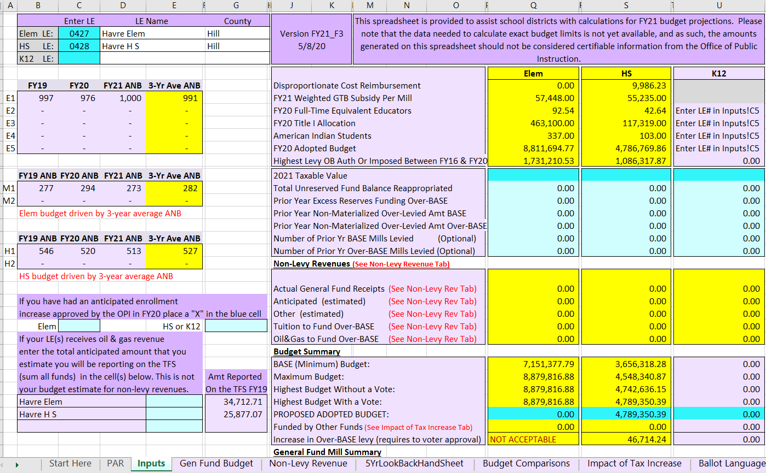

Slide 24
These are the current FY21 budget limits
The budget limits on the previous slides are the current year (FY21) budget limits, we need to adjust the spreadsheet to receive an estimate for FY22 budget limits.
Step 1 Click on the tab labeled “PAR”, this tab is at the bottom of the spreadsheet.
See next 2 slides

Slide 25
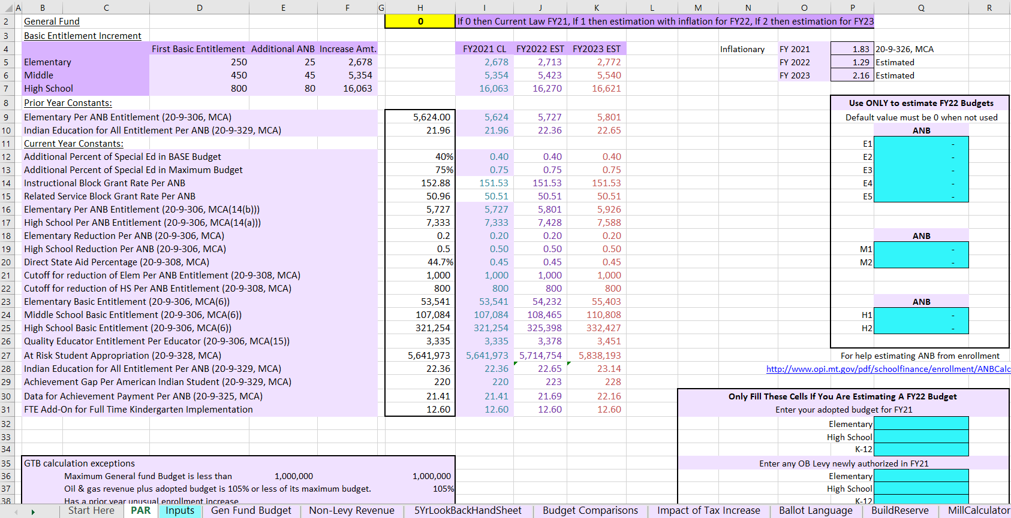

Slide 26
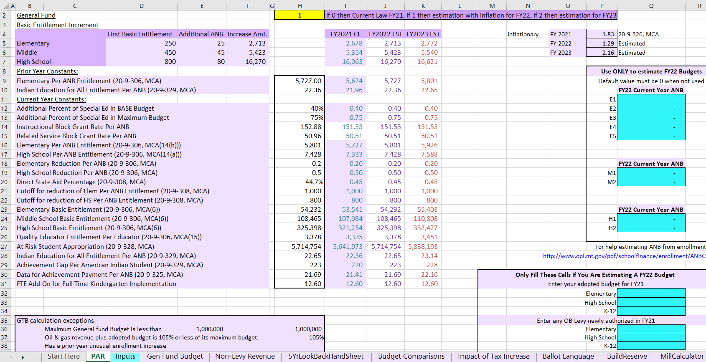

Slide 27
Enter Your New ANB Numbers from your Spring Count
Enter the appropriate amounts in AT LEAST the E1 and/or M1…and H1 areas in Column Q.
(E2, E3, etc. are for other K-6 budget units. The most common examples are outlying Hutterite Schools. Certain requirements must be met for these budget units to be established.)
If you use this spreadsheet before the spring count use estimated ANB numbers. For example, some folks use their fall count, or you could do a mid year count.

Slide 28
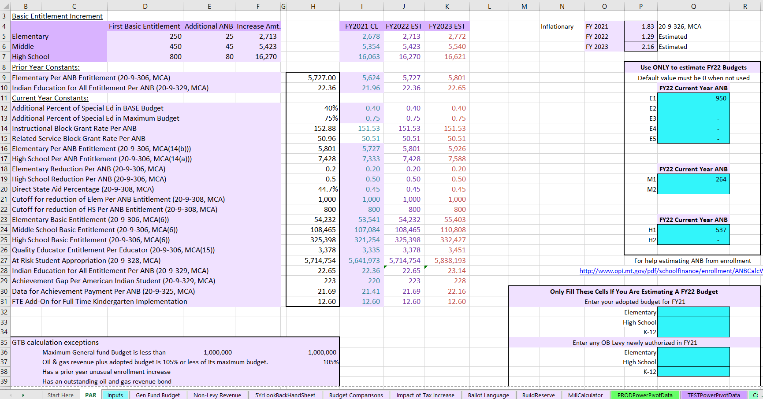

Slide 29
Enter The Budgets Your District Adopted, and any overbase levy approved, for the Current Fiscal Year (FY21)
Find your current year Adopted General Fund, Voter Approved Levy amounts.
MAEFAIRS Budget Pages Link to FY21 Budgets
The Adopted Budget amounts will need to be entered in cells:
Q32 for Elementary Districts
Q33 for High School Districts
Q34 for K-12 Districts
Any Voter Approved Levies will need to be entered in Cells:
Q36 for Elementary Districts
Q37 for High School Districts
Q38 for K-12 Districts

Slide 30
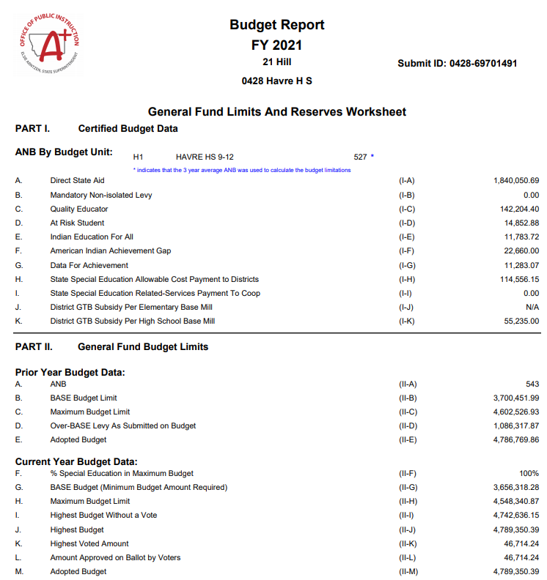

Slide 31
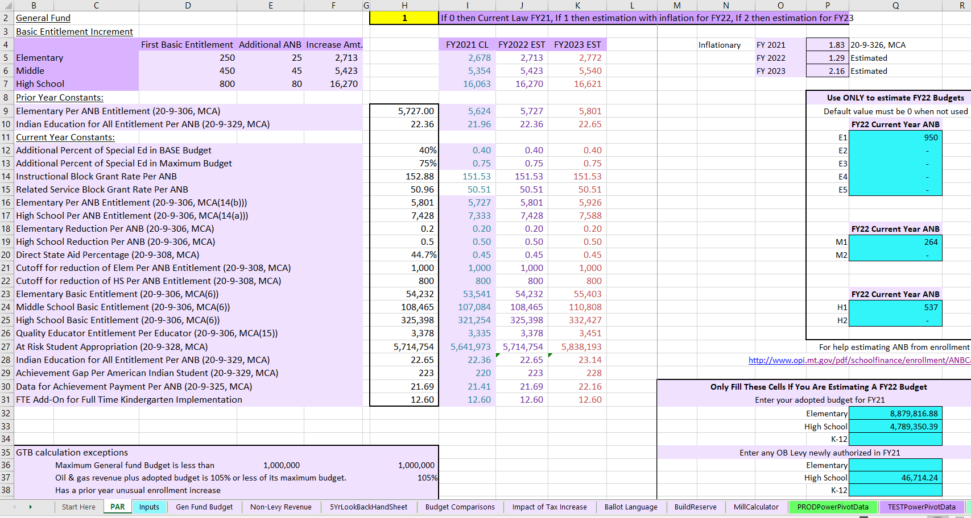

Slide 32
Statutory Inflationary factors can be adjusted
See Cells P4, P5, and P6.
Cell P4 shows the current fiscal years inflationary factor that was approved during the 2019 legislative session.
The inflationary factors are being decided during the current legislative session. Preliminary numbers in the Governor’s proposed budget are different than the estimates shown.
FY22 1.50
FY23 2.57

Slide 33
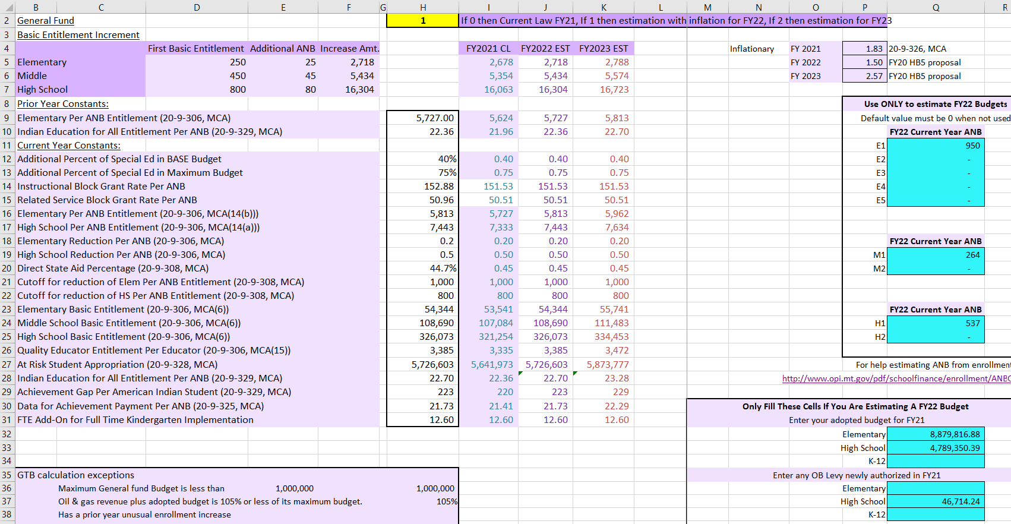

Slide 34
Click on the Inputs Tab so see estimated budget limits for FY22
ANB numbers now reflect the estimated FY22 numbers entered on the PAR tab.
In this case Havre High will by using FY22 actual ANB for budget calculations but, Havre Elementary will use the 3 year average.
Columns Q and S reflect budget limits.
Havre Elementary may need to have a voted levy to get to the estimated “highest budget with a vote”
Havre High may not need a vote since the estimated “highest budget with a vote” and Highest Budget Without a Vote” amounts are the same.

Slide 35
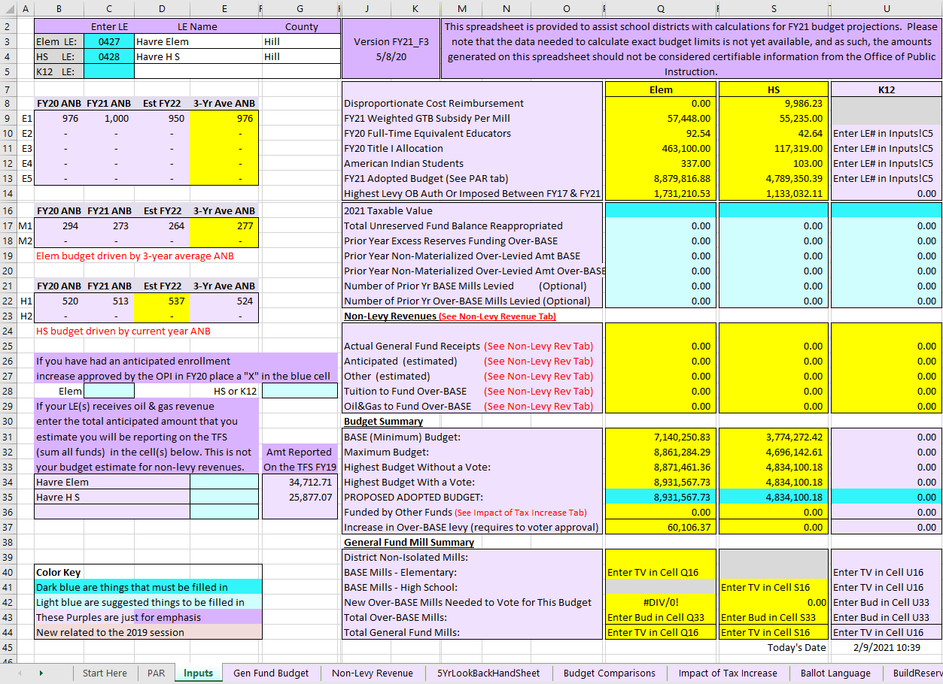

Slide 36
Are these numbers final and official?
NO
As long as the legislature is in session and the governor has not signed any bills, everything is fluid.

Slide 37
Thus endeth today’s presentation
Any questions?
Thanks for the spreadsheet Paul

