Slide 1

School Elections
Nicole Thuotte – School Finance Specialist
Office of Public Instruction
Notes:
NOTE:
To change the image on this slide, select the picture and delete it. Then click the Pictures icon in the placeholder to insert your own image.

Slide 2

Welcome and Introductions
Where can children vote?
    In swing states
Where do poll workers get trained?
    At the Electoral College
Why did the school trustee fall asleep?
    He was a bored member

Slide 3
Agenda
Election Overview
Election Process
Mail Ballot Elections
Voter Accessibility
Election Day and Beyond

Slide 4
School Elections
What is a school district election?
When are school elections held?
Who/what governs school elections?
What is a school board and how is it composed?
Who are the key players in a school election?
Where do I go for help?

Slide 5
School District Elections
Montana Code Annotated:
20-1-101, MCA
  Election by a school district or community college district
20-20-105, MCA
  First Tuesday after the first Monday in May
  One election per year for the general fund – must be held on school election day unless the legislature meets to consider funding
  May hold other elections on other days
20-20-102, MCA
  Title 13 governs elections, except where Title 20 says otherwise
  The superintendent of public instruction has rule making authority

Slide 6
Trustee Election
School District Types:
EL: Elementary
HS: High School
K-12: Elementary and High School

Slide 7
Trustee Election
Elementary Districts
EL #1: Independent, outlying EL that feeds into a high school district
EL #2: Unified with a county high school where the EL is located
EL #3: Independent, located with a county high school

Slide 8
Trustee Election
High School Districts
HS #1: Unified with an EL where the HS is located
HS #2: County HS
K-12 Districts
K-12 #1: Unified EL and HS, contiguous boundaries

Slide 9
School District Elections
Trustees
General Fund Levy
School Bonds
Building Reserve Fund Levy
Technology Fund Levy
District Consolidation/Annexation
Creation or Dissolution of a Joint District
Opening a Junior High/High School Operates a County High School
County High School Unification
Joint Interstate School Agreements
Transfers From a Budgeted Fund to Another Budgeted Fund
Acquiring Real Property
School Safety Levy

Slide 10
Trustee Election
Elementary trustees govern all HS school districts, except:
County High Schools have independent school boards; and
Outlying elementary districts may request additional representation

Slide 11
Trustee Election
County High Schools
Four (4) trustees from the elementary district where the county high school is located; and
Three additional trustees from nominating districts established by the county superintendent
  Additional positions are elected from outside the elementary district where the county high school is located;
  Boundaries should be coterminous with elementary district boundaries where possible

Slide 12
Trustee Election
Outlying Elementary Representation
Majority of the elementary districts without representation must petition the county superintendent for representation
  County superintendent compares taxable valuation of the EL to the taxable valuation of the unrepresented HS area
  Maximum of 4 in a first- or second-class district and 2 in a third-class district
20-3-352, MCA

Slide 13
Trustee Election
Elementary District Classification
First Class Districts: Population greater than 6,500
Second Class Districts: Population between 1,000 and 6,499
Third Class Districts: Population less than 1,000

Slide 14
Trustee Election
Elementary District Classification
County Superintendent is responsible for district classification;
May not be changed more than once in a 5 year period;
Affects number of trustee positions and requirement to report campaign finance activity

Slide 15
Trustee Election
Elementary District Classification (20-3-341, MCA)
First Class Districts: 7 trustees (cannot increase or decrease)
Second Class Districts: 5 trustees (can increase to 7)
Third Class Districts: 3 trustees (can increase to 5)
May increase on a majority vote of the board at the next election if action is taken prior to January 1 or decrease upon receiving a petition from at least 10 qualified electors of the district.

Slide 16
Trustee Election
Trustee Term (20-3-301, 303, 307, 309, MCA)
A usual term is 3 years;
Appointments for vacancy serve until the next election;
Vacancies are elected for the remainder of the term
Exception: If a successor is not elected or appointed, the originally elected trustee may continue to serve until a successor is elected or appointed.

Slide 17
Trustee Election
Staggered Election (20-3-302, MCA)
Should never elect a majority of 3-year trustee positions at any one election:
7 Trustees: 2, 2, 3
5 Trustees: 1, 2, 2
3 Trustees: 1, 1, 1

Slide 18
Trustee Election
AND…
Additional HS Positions
  First or Second Class Districts: Not more than 2 (1-1-2, 1-1-1, 1-1-0, 1-0-0)
  Third Class Districts: Not more than 1 (1-1-0 or 1-0-0)
County High Schools
  In the elementary district: 1, 1, 2
  Outside the elementary district: 1, 1, 1

Slide 19
Voted v. Permissive Levies
Voted Levies: Require Voter Approval
  Most are limited in duration
  For a specific project or purpose
Permissive Levies: Do Not Require Voter Approval
  Annual levies
  Authorized by statute

Slide 20
Permissive Levies
The trustees of a school district shall adopt a resolution no later than March 31 of each fiscal year and provide notice whenever the trustees intend to impose an increase in a nonvoted levy in the ensuing school fiscal year for the purposes of funding any of the funds listed below:
  Tuition Fund
  Adult Education Fund
  Transportation Fund
  Bus Depreciation Fund
  Flexibility Fund
20-9-116, MCA

Slide 21
Key Players in School Elections
County Superintendent of Schools
County Election Administrator
Secretary of State’s Office (SOS)
Office of Public Instruction (OPI)
Montana Association of School Business Officials (MASBO)
Commissioner of Political Practices (COPP)
County Attorney/District Court

Slide 22
County Superintendent of Schools
Classifies districts in accordance with state law
Determines and establishes nominating districts for additional high school positions
Administers the oath of office to trustees or can designate someone to administer the oath
Potential resource and liaison with county election administrator

Slide 23
County Election Administrator
Registers voters in the county
  Prepares the registration list for the election
  Posts notice of close of regular registration
  Registers voters during the late registration period
  Maintains permanent absentee voter list
Hires and trains election judges for elections run by the county
Upon request may conduct school elections for the district
  Districts must ask by June 1 for next fiscal year’s elections (district is responsible for cost)
Provides and assists districts with use of electronic voting systems
  Cost estimate provided upon request

Slide 24
Secretary of State’s Office
Chief election officer of the state
Establishes forms and rules governing elections
Advises and assists election administrators on the implementation and operations of the National Voter Registration Act of 1993
Trains county election administrators and their staff
Prepares and distributes training materials for election administrators and judges
Approves written plans for mail ballot elections

Slide 25
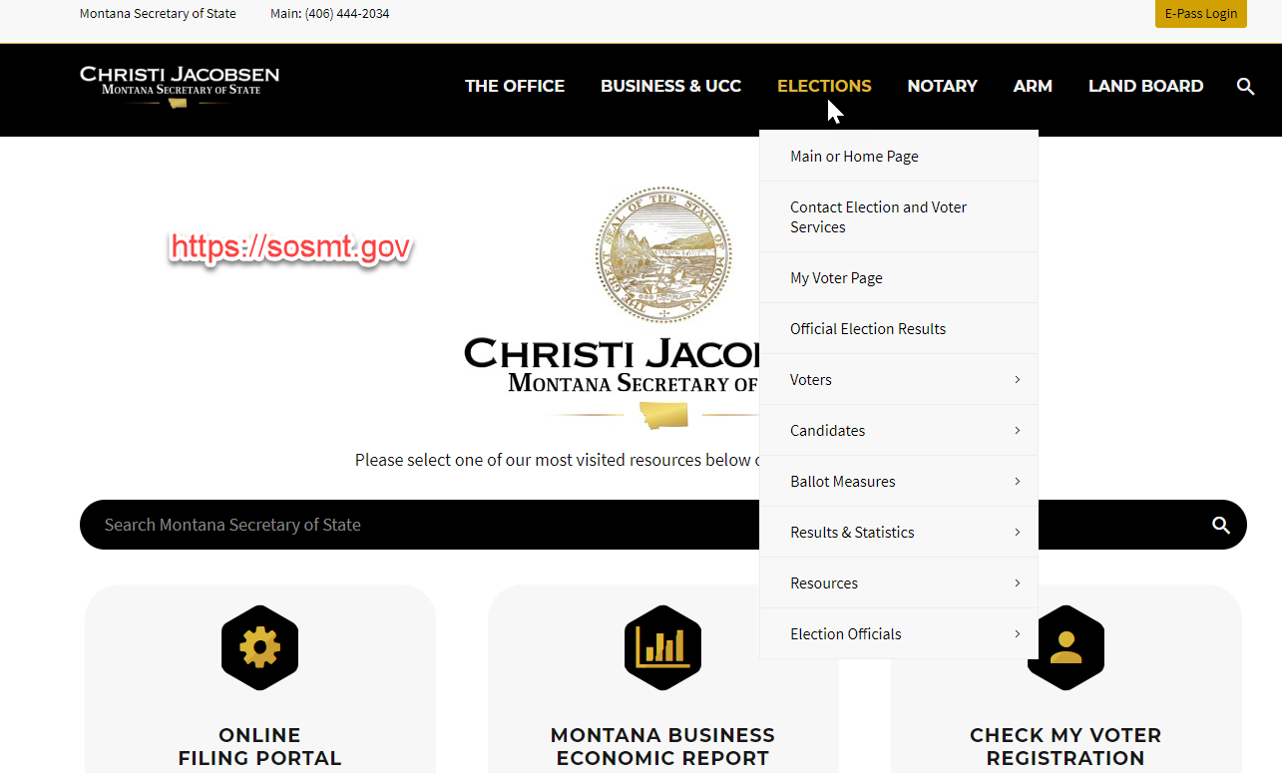
Secretary of State’s Office

Slide 26
Office of Public Instruction
Implements and enforces the provisions of Title 20
Has rulemaking authority to clarify Title 13 provisions for school elections
Collaborates with MASBO, MTSBA and SOS to maintain and update the School Elections Manual
Provides technical assistance on school election questions and issues
Collects school district classification data from county superintendents for use in school elections
Works with the legislature to advocate for school elections

Slide 27
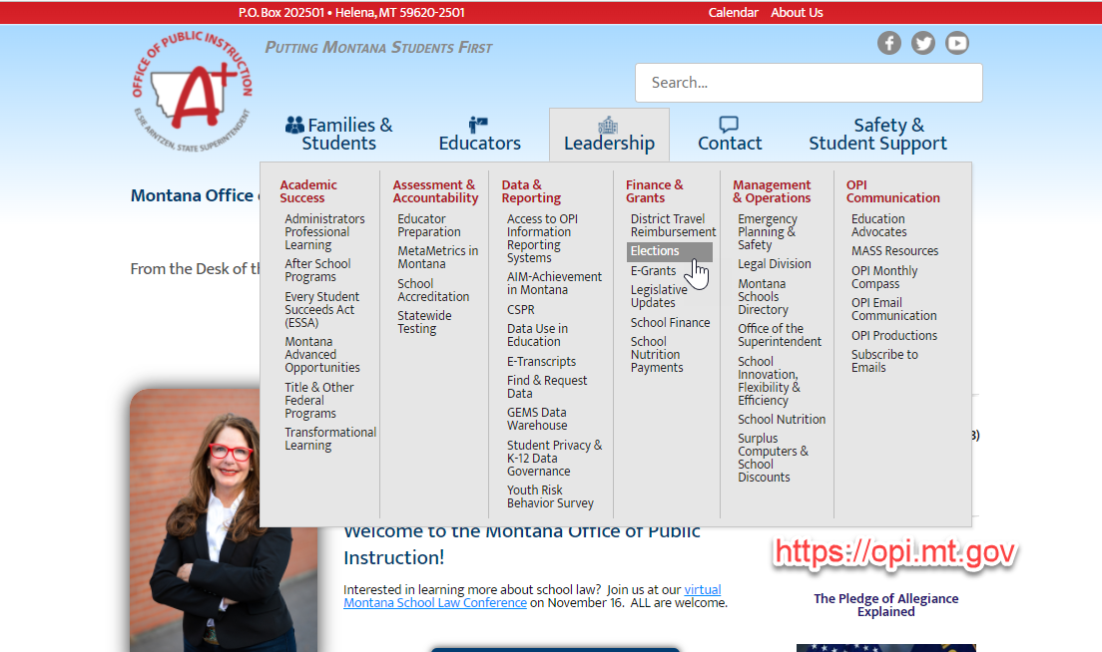
Office of Public Instruction

Slide 28
Montana Association of School Business Officials
Provides training on all aspects of school finance, including elections
Works with the OPI to publish the Election Handbook
Coordinates election workshops in November
Maintains resources on their website

Slide 29

Montana Association of School Business Officials

Slide 30
Commissioner of Political Practices (COPP)
Created in the 1975 legislative session
Establishes full disclosure and reporting of all money and sources used to influence Montana elections
Responsible for investigation of all alleged violations of laws related to election and campaign practices
Maintains the Campaign Electronic Reporting System (CERS)

Slide 31
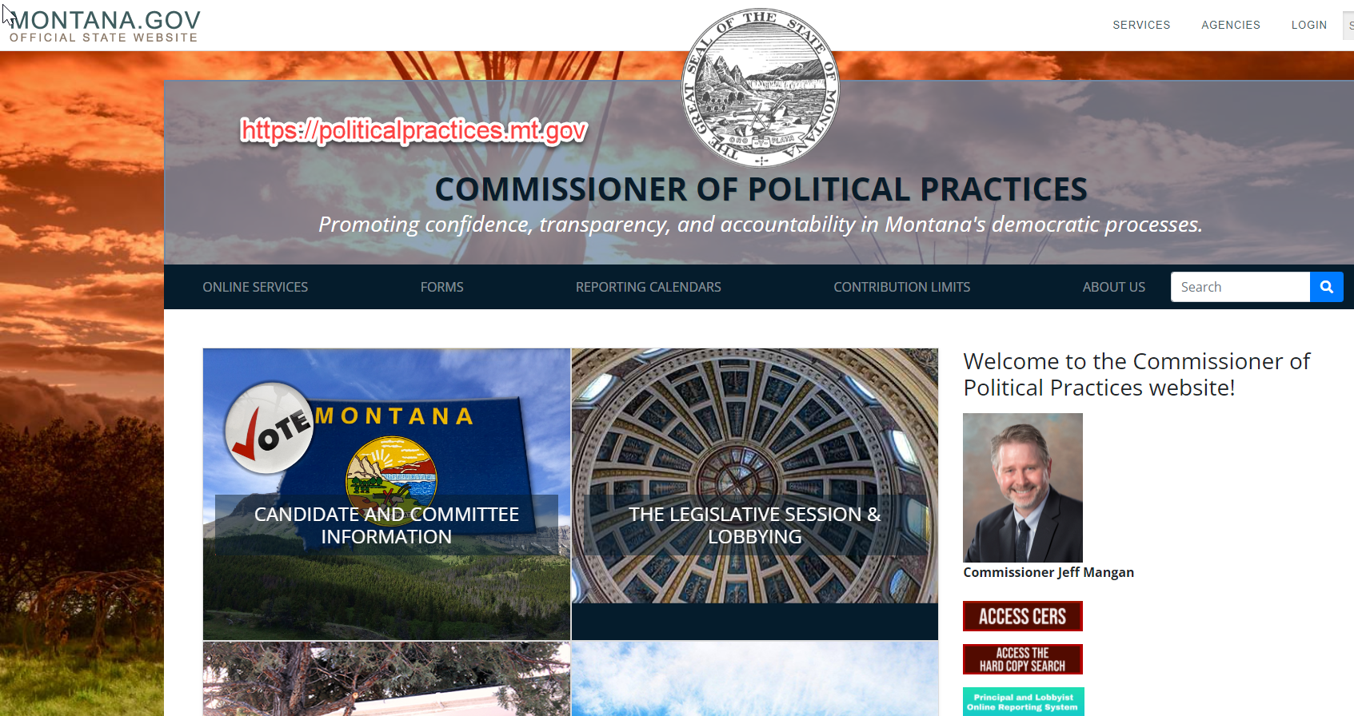
Commissioner of Political Practices (COPP)

Slide 32
County Attorney/District Court
Court Having Jurisdiction Of Proceedings
13-36-103. Court having jurisdiction of proceedings. An application for filing a statement, payment of a claim, or correction of an error or false recital in a filed statement or an action or proceeding to annul and set aside the election of any person declared elected to an office or to remove or deprive any person of the person's office for an offense mentioned in this title or any petition to excuse any person or candidate in accordance with the power of the court to excuse, as provided in 13-36-209, must be made or filed in the district court of the county in which the certificate, declaration, or acceptance of the person's nomination as a candidate for the office to which the person is declared nominated or elected is filed or in which the incumbent resides.
Title 13, Chapter 36 CONTESTS

Slide 33
Reporting Requirements in Other Elections
Campaign Finance Committees
Incidental Committee – not specifically organized to support or oppose a ballot issue but becomes a political committee by receiving money or making an expenditure
  Must report contributions or expenditures of more than $500
  Required for 1st class districts in counties with populations greater than 15,000
  Any school district may register and report contributions/expenditures
Ballot Issue Committee – organized to support or oppose a specific ballot issue
  Must report contributions or expenditures of more than $500
  Required for 1st class districts in counties with populations greater than 15,000

Slide 34
Reporting Requirements in Other Elections
Electioneering Communication
A paid communication that is publicly distributed by radio, tv, cable, satellite, internet website, newspaper, periodical, billboard, mail, or other distribution of printed material
Made within 60 days of initiation of voting in an election
Does not support or oppose a candidate or ballot issue
Can be received by more than 100 recipients in the district voting on the candidate or ballot issue

Slide 35
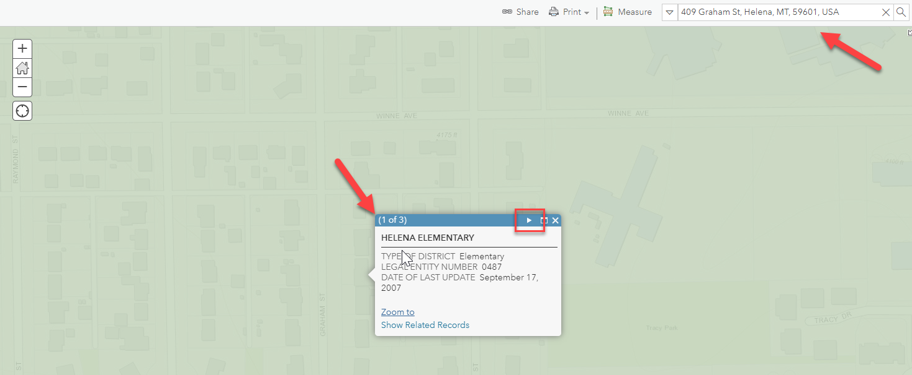
ArcGIS School District Map
ArcGIS - Montana Schools and School Districts

Slide 36
Election Process
CALENDAR
Candidates
Resolution
Electors
Registration
Notices
Election Judges
Ballots/Ballot Certification

Slide 37
Candidates
Who can be a candidate?
  Must be qualified to vote in a district
    Registered as required by law;
    18 years of age or older;
    Resident of the state of Montana and of the county in which the person offers to vote for at least 30 days;
    A US citizen;
    Not currently serving a sentence in a penal institution; and
    Not adjudicated to be of unsound mind
Exception: Single member districts (Hardin, Billings, Wolf Point)
  Must be qualified to vote in a district, (as above) AND
  Must be a resident of the trustee district for at least 1 year prior to becoming a candidate

Slide 38
Candidates
Candidates may be:
Employed by the school district (must not be employed at the time they are seated)
Relatives of an employee of the district
Relatives of another school board member
Candidates may not:
Run for more than one public office at the same time

Slide 39
Candidate Filing
Notice of opening and closing of candidate filing is not required
Recommended to “advertise” that the district has openings and filing dates:
  Public locations
  School newsletter
  Local newspaper
  District social media (website, Facebook, Instagram, etc.)
  Other?

Slide 40
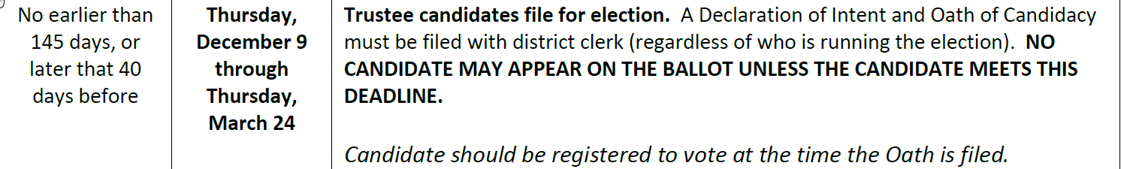


Candidates – Regular

Slide 41
Candidate Types
Regular Candidate – Declaration of Intent and Oath of Candidacy:
Clearly identify the position
  Elementary trustee
  Outlying trustee AND boundaries of that position
Clearly identify the term
  One (1) year
  Two (2) year
  Three (3) year
Name as it should appear on the ballot
  May not include any qualifiers (MD, JD, etc);
  May not be identified as an incumbent

Slide 42
Candidate Types
Regular Candidate – Declaration of Intent and Oath of Candidacy:
Residential address required
Notarized OR signed in front of the district clerk (no notary required)
Verify voter registration, address, signature with county election administrator
NOTE: Candidate filing forms must always be returned to the school district clerk by the filing deadline

Slide 43
Candidates – Write-In

Slide 44
Candidate Types
Write-In Candidate – Declaration of Intent and Oath of Candidacy for Write-In Candidates:
Clearly identify the position
  Elementary trustee
  Outlying trustee AND boundaries of that position
Clearly identify the term
  One (1) year
  Two (2) year
  Three (3) year

Slide 45
Candidate Types
Write-In Candidate – Declaration of Intent and Oath of Candidacy for Write-In Candidates:
Residential address required
Notarized OR signed in front of the district clerk (no notary required)
Verify voter registration, address, signature with county election administrator
Candidate may include as many variations on spelling for first and last name as they want

Slide 46
Candidate Types
Write-In Candidate – Declaration of Intent and Oath of Candidacy for Write-In Candidates:
Votes will not count unless what is written in matches a variation provided
Candidate may prepare and disseminate labels, but the vote will not count unless an “X” is indicated or the oval is filled in, depending on ballot style (county may request a business card in lieu of a label for use in a vote count machine)
NOTE: Candidate filing forms must always be returned to the school district clerk by the filing deadline

Slide 47
Candidate Types
Write-In Candidate – Declaration of Intent and Oath of Candidacy for Write-In Candidates:
Anyone who meets candidate qualifications may run as a write in candidate
Must file by 5:00 pm the day before ballot certification

Slide 48
Candidates – Withdrawal

Slide 49
Candidate Withdrawal
Candidates may withdraw from the election if they submit a written statement of withdrawal to the election administrator (in person, regular mail, fax, email)
Must submit a statement of withdrawal prior to the deadline or the name will still appear on the ballot
  If the candidate wins may accept by filing the Oath of Office or reject by not filing the Oath of Office
Verify that the statement of withdrawal was filed by the candidate (verify signature, follow up with phone call)

Slide 50
Candidate Reporting
Forms must be filed electronically (no paper forms)
If I won’t receive or spend money, do I still need to file?
  Yes – all candidates must file, regardless of intended financial activity
  If you do not intent to raise or expend money list yourself as treasurer and the name and address of your personal bank for campaign depository information
What’s the difference between a “B” or “C” candidate?
  B candidates do not expect total contributions or expenditures to exceed $500 and are not required to file campaign finance reports
  C candidates expect to receive or expend more than $500 and will need to file campaign financial reports according to schedule

Slide 51
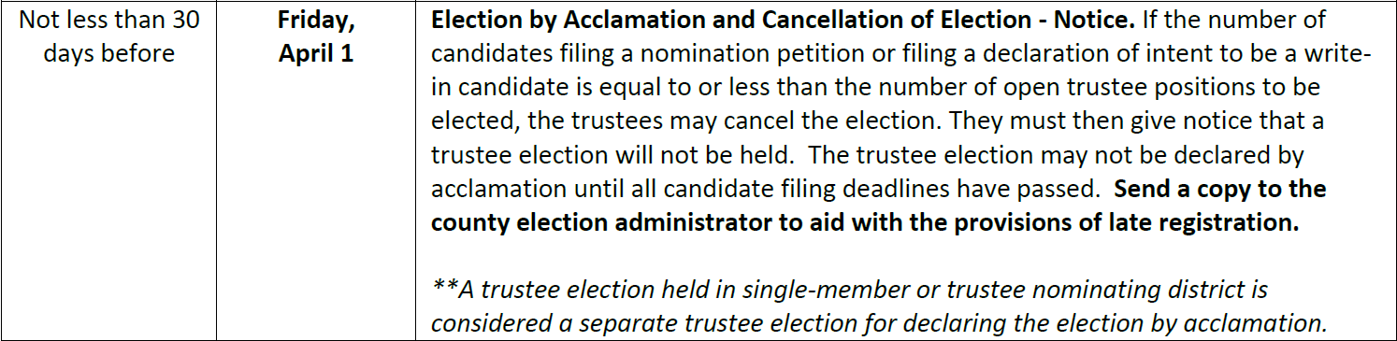
Candidates – Acclamation

Slide 52
Election by Acclamation
The number of candidates filing a nomination petition or filing a declaration of intent to be a write-in candidate is less than or equal to the number of open positions:
The election may be cancelled, and a certificate of election issued without an election
Must post a notice that the election will not be held
Certificates of election are issued after the canvass (which occurs at the first regular or special meeting after election day)
Certificates are issued and oath given in the same manner as an elected trustee candidate

Slide 53
Election by Acclamation
May cancel an election, but not a race:
Two elementary trustee positions for different terms – must both go on the ballot or must both be cancelled
One elementary trustee position, one outlying HS trustee position – may cancel one and run the other
One elementary trustee position, one elementary levy – may cancel the trustee election and hold the levy election (or vice-versa)

Slide 54
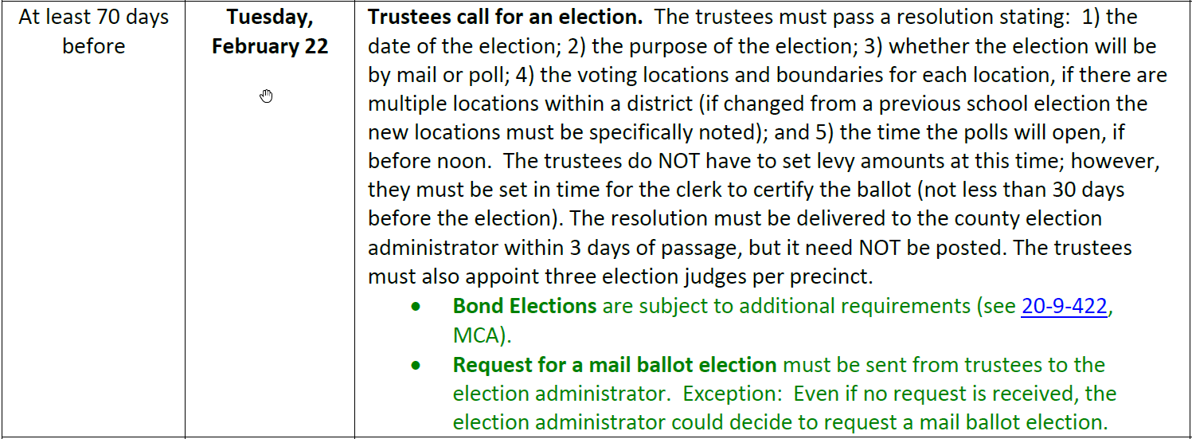

Election Resolution

Slide 55
Election Resolution
Election resolution must be adopted at least 70 days prior to election day and include:
The date and purpose of the election
How the election will be conducted (mail/poll)
The time at which the polls must be open, if before noon
The polling location(s) for each election
  If multiple, the boundaries for each site
  If changed, special reference to the new location(s)
The names of at least 3 election judges

Slide 56
Election Resolution
20-20-203. Resolution for poll hours, polling places, and judges. (1) At the trustee meeting when a school election is called, the trustees shall:
(a) except as provided in 20-20-106(3), establish the time at which the polls are to open if in their discretion they determine that the polls must be open before noon;
(b) establish the polling places for the election, using the established polling places for general elections within the district wherever possible; and
(c) appoint at least three judges for each polling place.
(2) There must be one polling place in each district unless the trustees establish additional polling places. If more than one polling place is established, the trustees shall define the boundaries for each polling place so that the boundaries for each polling place are coterminous with county precinct boundaries existing within a district. If the site of a polling place is changed from the polling place site used for the last preceding school election, special reference to the changed site of the polling place must be included in the notice for the election.

Slide 57
Election Resolution
No requirement to post the election resolution
  Resolution is adopted at a properly noticed board meeting
If the district is running a levy election it must be included in the resolution (or an amendment) prior to the resolution deadline
An election held outside the regular school election date must still meet all statutory deadlines
Levy amounts do not have to be included in this resolution, but must be finalized prior to ballot certification

Slide 58
Election Resolution
Should have separate election resolutions for separate legal entities (LE’s)
  Elementary trustees
  Outlying high school trustees
Clearly identify the number of open positions, the terms, and the boundaries for each open position
  Example: One elementary trustee for a three-year term, one elementary trustee for a two-year term, one outlying high school trustee to be elected by Elementary District #1 for a three-year term
There is no provision in law to reschedule a trustee election if you make a mistake on the election resolution

Slide 59
Election Resolution
Consider language that allows the election administrator to cancel the election
  Trustees elected by acclamation
  Levy proposition no longer necessary
  Other contingency
  County election administrator or the district clerk may cancel
If there’s no provision to cancel the election the board must hold a properly noticed meeting prior to the election deadline

Slide 60
Bond Election Resolution
In addition to the regular requirements for an election resolution:
Type of bond (general obligation, oil & gas, impact aid)
Exact amount of the bond;
Maximum number of years to be repaid (up to 30); and
Estimated school facilities advance

Slide 61
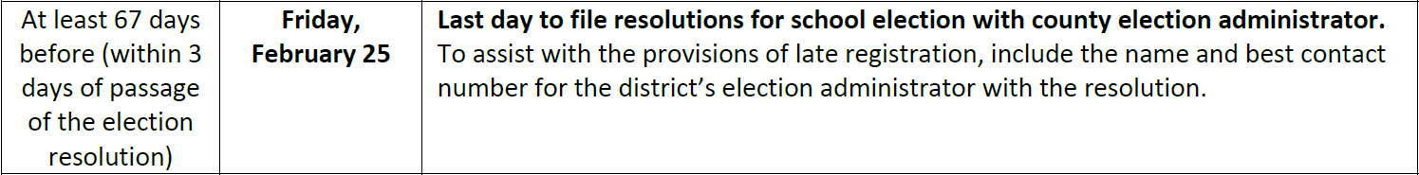
Election Resolution
County election administrators need to know you are having an election. They can help with a variety of tasks, especially voter registration, signature verification, and more!
Send to each county in which the district has electors (territory)

Slide 62
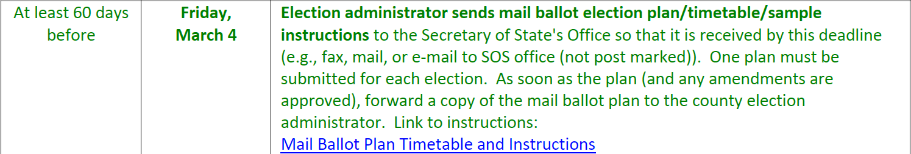
Mail Ballot Plan

Slide 63
Electors and Registration

Slide 64
Regular Registration
Notice of Close of Regular Registration
Title 13, Chapter 2 – Election administrator is specifically the county election administrator
County election administrator publishes notice of close of regular registration
  Three (3) times in the four (4) weeks preceding the election
  Must be published in each county in which the district is located
Check in with the county election administrator in each county prior to the deadline for publication

Slide 65
Electors and Counties
399 separate legal entities (includes legal entities that are in non-operating status)
352 are in a single county
37 are located in two (2) counties
9 are located in three (3) counties

Slide 66
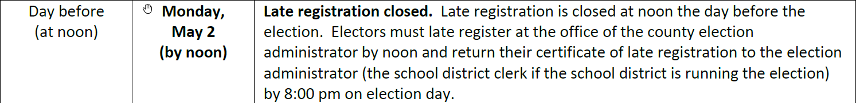
Electors and Registration

Slide 67
Late Registration
Begins the day after the close of regular registration
Electors must late register at the county election office
Late registration closes at noon on the day before election day (new as of the 2021 election)
Late registrants obtain a certificate from the county election office
  Vote at the county election office (if the county election administrator is running the election); or
  Present the late registration certificate to the district clerk (if the school district is running the election)

Slide 68
Late Registration
District clerk must verify that the elector has not already received another ballot prior to issuing a regular ballot
  Certificate will state “new registrant”; or
  “Transfer registrant” (and prior registration information)
An elector must register before noon on the day before the election, but may present a certificate and receive a ballot at any time before the close of polls on election day

Slide 69
Electors in School District Elections
Who can vote in a school district election?
If an electors owns property in the district but does not reside there, they are not eligible to vote in a school district election
Part time residents who maintain permanent residency in the district are eligible to vote in a school district election (1-1-215, MCA)
If an elector’s property is in two separate school districts, contact the county election administrator for assistance

Slide 70
Montana Absent Uniformed Services and Overseas Voter Act
13-21-105, MCA
Elections covered. (1) The voting procedures in this chapter apply to:
(a) a general, special, presidential preference, or primary election for federal office;
(b) a general, special, recall, or primary election for statewide or state legislative office or state ballot measure.
(2) Nothing in this section prohibits the application of the voting procedures in this chapter to any other elections.

Slide 71
Montana Absent Uniformed Services and Overseas Voter Act
Does not automatically apply to school elections;
Have the option to follow
Questions:
If you choose to send ballots to these electors, are your required to follow the procedural timelines in the Act?
  Sending ballots not later than 45 days before the election
  Sending electronic ballots
  Other requirements of Title 13, Chapter 21, Part 2

Slide 72
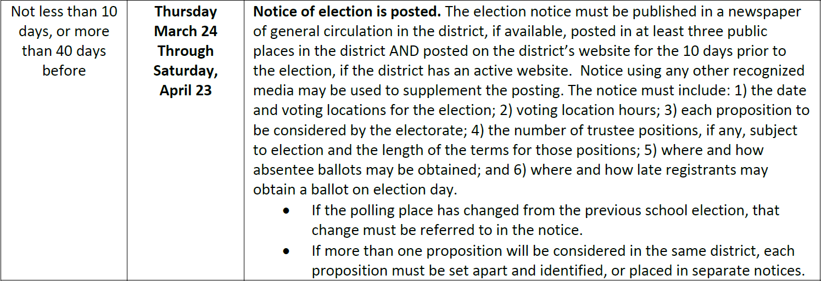
Election Notices

Slide 73
Election Notice
Publication Requirements
Newspaper of general circulation, if there is one;
At least 3 public places
On the district website, if the district has one (for the 10 days before the election)
May supplement with radio, television, social media

Slide 74
Election Notice
Notice Requirements
Date of election;
Election type (mail/poll);
Polling location(s) and hours;
Each proposition to be considered;
  If more than one proposition will be considered in the same district, each proposition must be set apart and identified or placed in separate notices

Slide 75
Election Notice
Notice Requirements
The number of trustee positions and the length of terms;
Where and how absentee ballots may be obtained; and
Where and how late registrants may obtain a ballot.

Slide 76
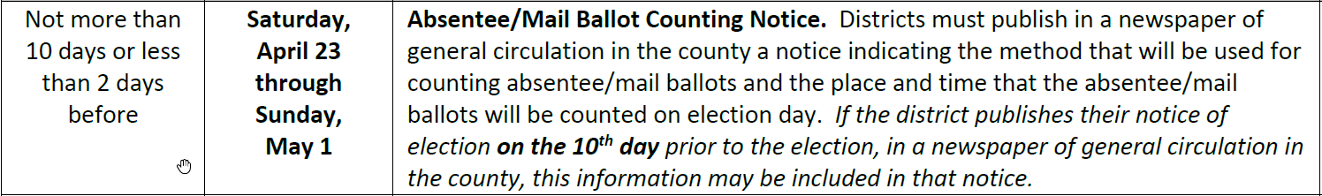
Election Notices

Slide 77
Election Notices
Must be published in a newspaper of general circulation in the county
Must include where, how, and when absentee or mail ballots will be counted on election day
May be combined with the general election notice ONLY if both notices are published exactly on the 10th day prior to the election
May be combined with the new polling place accessibility notice

Slide 78
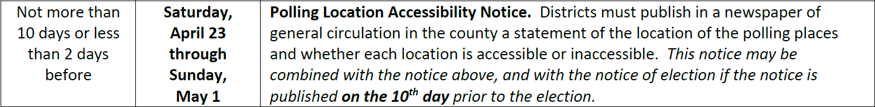
Election Notices

Slide 79
Election Notices
**NEW: Polling Location Accessibility Notice (Poll Elections ONLY)
Districts must publish a statement of accessibility for each polling location
  Notice must state whether the site is accessible or inaccessible
  Must be published in a newspaper of general circulation
May be combined with the general election notice ONLY if both notices are published exactly on the 10th day prior to the election
May be combined with the absentee/mail ballot counting notice

Slide 80
Election Notices

Slide 81
Election Judges
Must be registered voters in the county and district
Must meet training and certification requirements in Title 13
Judge Training – Montana Secretary of State – Christi Jacobsen (sosmt.gov)
Must be paid at least the greater of state or federal minimum wage
Pay for both training time and election time
May not be a candidate or related to a candidate:
  Spouse
  Brother or sister of candidate or candidate’s spouse
  Ascendant or descendant
  Spouse of any of the above
  See chart in Section V of the School Election Manual

Slide 82
Election Judges
Must appoint at least 3 election judges per polling place
Must include names on the election resolution
Must notify at least 30 days prior to the election
Contact county election administrator for list of trained election judges
In case of emergency can use untrained judges, but still must be a resident of the school district
  Law was changed to allow judges within the county, but that does not apply to school districts

Slide 83
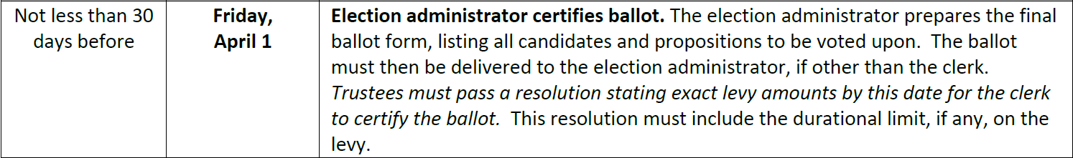
Ballots

Slide 84
Ballot Certification
Ballot certification occurs not less than 30 days before the election
Certify means:
  Ballot is in its final form
  Changes not permitted after the ballot is certified
  Final levy amounts approved by the trustees
Print enough ballots for registered voters, plus extra for spoiled ballots and/or late registrants
Must be sequentially numbered with a perforated stub (no stub required for mail ballots, but may be printed with stubs for reconciliation purposes only)

Slide 85
Ballot Certification
Levy Propositions (15-10-425, MCA)
Specific purpose for which the money will be used;
Specific amount of money and approximate mills OR specific number of mills and approximate amount of money;
The number of years the amount will be levied (or permanent, if applicable);
The tax impact on a home valued at $100,000 and $200,000 in terms of actual dollars in additional property taxes

Slide 86
Ballot Certification
Recent Questions
Can I print “Official Ballot” on my ballots?
No, must be stamped (13-13-116, MCA)
Is it an “X” or “Fill in the Oval”?
SOS ballot guidelines use “Fill in the Oval”,
Title 20 says “Mark the X” – either is ok

Slide 87
Ballot Layout
Candidates
List alphabetically by surname
Name should be exactly as it appears on the candidate filing form
Check box and write-in lines equal to the number of open positions
If in 1st class district in counties with a population of 15,000 or more, contact the COPP to ensure that all candidates have filed
  Cannot be on the ballot if they have not complied with COPP requirements

Slide 88
Ballot Layout
Ballot Layout
Trustee positions first
  Longest term to shortest term (three-year, two-year, one-year)
  Clearly identify number of vote for (vote for one, vote for two)
Ballot issues listed after trustee positions
Separate headers for separate jurisdictions
  Clearly identify “elementary” and “high school” issues
Keep issues on the same page, in the same column
If more than one column/side indicate that the ballot is not complete
  Vote in next column
  Vote both sides

Slide 89
Ballot Errors
Check, double check, check again the ballots both before and after you send to the printer
What do you do if you discover a mistake?
  Reprint ballots
  Send out postcards
  Story in the paper
  Posting to the website

Slide 90
Electronic Ballots
13-13-246. Electronic ballots for disabled persons -- procedures -- definition -- rulemaking. (1) (a) Upon a written or an in-person request from a legally registered or provisionally registered elector with a disability, an election administrator shall provide the elector with an electronic ballot.
(b) The request may be made by electronic mail.
There’s a form for that…
https://sosmt.gov/Portals/142/Elections/Documents/Officials/Absentee-Application-for-Electronic-Ballot-for-Individual-with-Disability.doc

Slide 91
Electronic Ballots
As with other absentee ballot request forms, if a form is received by the district clerk, send a copy to the county election administrator
If an elector has made a prior request the county election administrator will notify you
Process:
Email the elector a ballot in fillable PDF format and instructions
Send absentee ballot materials for the return of the electronic ballot (secrecy envelope, signature envelope, return envelope)
Ballot must be received by 8:00 pm on election day

Slide 92
Electronic Ballots
When separating the absentee ballots from the secrecy envelopes, (on the day before or on election day) the electronic ballots must be transcribed to regular ballots:
No fewer than 3 election officials
An electronically transmitted ballot identifying number shall be written on the original transcribed ballot, the envelope containing the voted ballot and the electronically transmitted ballot and in the official transcription log
Signature of the election official (doing the actual transcription) on the official log.

Slide 93
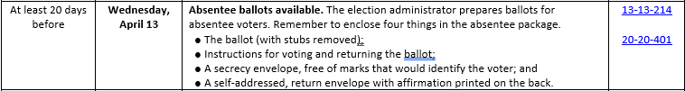
Absentee Ballots

Slide 94
Absentee Ballots
Absentee electors
  At the same address as the elector’s registration; OR
  At a different address than the elector’s registration
Process
May request an absentee ballot at any time up to noon on the day before election day
Complete form with the election administrator (if school clerk, send to county election administrator)
  May be “absentee” for one election or all elections (no longer requires a confirmation every 2 years)
  Verify the signature on the absentee application
May vote the ballot at the time of application (if available), take and return the ballot (if available), or receive a ballot in the mail

Slide 95
Absentee Ballots
Absentee Packets
Ballot (stub removed, stamped “official ballot”)
Instructions
Secrecy envelope, return envelope
No requirement to send on a specific date or to send all at the same time

Slide 96

QUESTIONS?

Slide 97
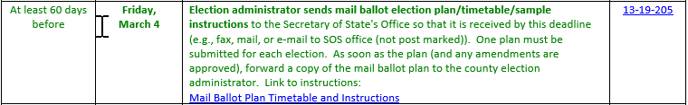
Mail Ballot Elections

Slide 98
Mail Ballot Elections
Why a Mail Ballot Election?
Don’t have to staff or man polls
Already a large number of absentee voters
One process
Post election process is faster – can start counting earlier
Don’t have voter turnout thresholds for bond elections
Others?

Slide 99
Mail Ballot Elections
How to Initiate a Mail Ballot Election
Select “mail ballot” as your election type in the resolution
Complete a mail ballot plan and submit to the Secretary of State’s Office by the deadline
Must have one plan “per election”
  EL trustee
  Outlying HS trustee
  EL levy/proposition
  HS levy/proposition

Slide 100
Mail Ballot Elections
Mail Ballot Plan
https://sosmt.gov/Portals/142/Elections/Documents/Officials/Mail-Ballot-Plan-Timetable-and-Instructions.docx
Fillable Word document
Submit directly to the Secretary of State by email, fax, regular mail, personal delivery not later than the close of business on the date due

Slide 101
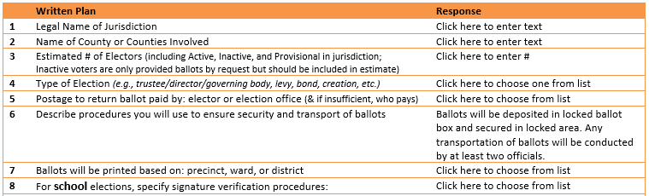
Mail Ballot Elections
Legal Name of Jurisdiction – separate plans for separate LE’s
Name of County or Counties Involved
Estimated # of Electors – County election administrator can help!
  Know who gets what ballots
  EL trustee/outlying HS trustee/EL levy/HS levy – all separate groups of electors!
Type of Election (choose from list)
Postage to Return Ballot (choose from list)
Transport Procedure (choose from list)
Ballots Printed Based On (choose from list)
Verification Procedures (choose from list)

Slide 102
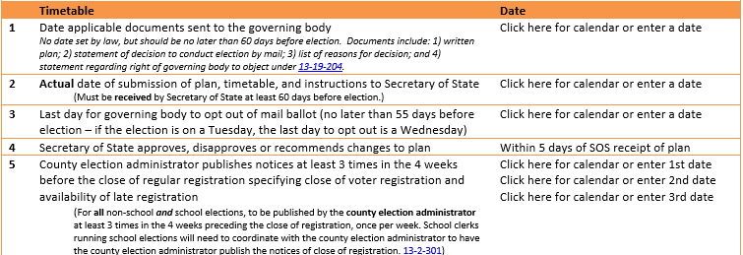
Mail Ballot Elections
Date Applicable Documents Sent to the Governing Body – Date of election resolution
Actual Date of Submission – Date mail ballot plan submitted
Last Day to Opt Out – 55 days before the election
Close of Regular Registration Notice – Contact county for dates

Slide 103
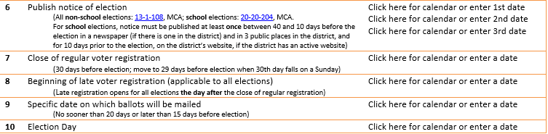
Mail Ballot Elections
Notice of Election – Date of publication (only 1 required)
Close of Regular Voter Registration
Beginning of Late Registration
Date Ballots Mailed – Must ALL be mailed on this date!
Election Day

Slide 104
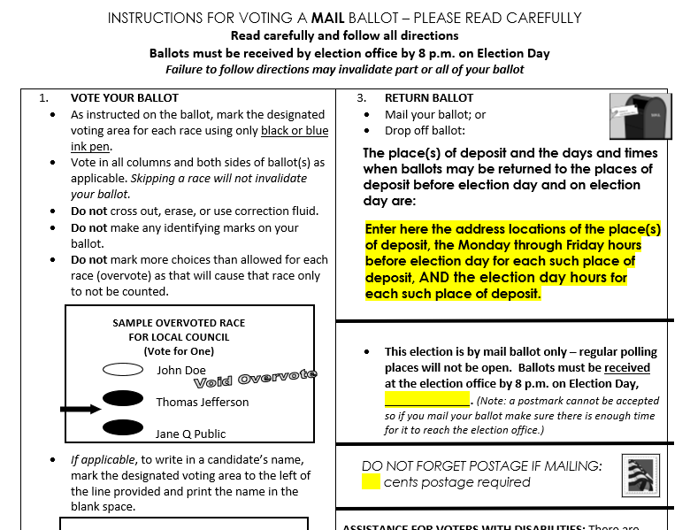
Mail Ballot Elections
May use your own instructions, but must contain essentially the same information
Address, and hours for place of deposit both before and on election day
Include the election date
Include the amount of postage required to return the ballot
Contact information for election administrator

Slide 105
Mail Ballot Packets
Ballot (stamped “Official Ballot”), no stubs, to all active and provisionally registered electors
Instructions
Secrecy envelope
Return (signature) envelope (contains information to identify elector – barcode, number, etc.)
Must all be mailed on the same day, on the date stated in the mail ballot plan
Not forwardable
Sufficient postage

Slide 106
Handling Mail/Absentee Ballots
Ballots Returned to the Election Administrator
Have a plan and a schedule to process returned ballots
Ensure that all places of deposit are appropriately staffed
Ballot boxes should be secured at all times
Staff should be available to receive ballots at the times indicated in the mail ballot plan
Staff should be available at reasonable times to receive absentee ballots or to assist electors
  If working at alternative worksites or at irregular days/times have a plan for election coverage

Slide 107
Handling Mail/Absentee Ballots
If the signatures match:
Match signatures on the return envelope to the signature on the absentee ballot application or the elector’s voter registration form
If the signature matches and the elector is provisionally registered, the election official or an election judge can open the outer signature envelope to see if information necessary to remove the individual from the provisional list is included
Separate the signature envelope and the secrecy envelope into two separate ballot boxes

Slide 108
Handling Mail/Absentee Ballots
If the signatures DO NOT match:
Contact the elector by the “most expedient means available”
If unable to contact, mail a confirmation notice to the election by forwardable, first class mail with a postage-paid, return addressed notice
If the confirmation notice is returned, send to the county election administrator to place the elector on the inactive list

Slide 109
Odd Situations
Ballot is returned without a secrecy envelope
  Place the ballot in a secrecy envelope and process as usual
One signature, two ballots
  Contact the elector to resolve
Two signatures on one return envelope, two ballots
  Verify both signatures and process as usual

Slide 110
Ballot Interference Prevention Act (BIPA)
Passed by referendum in the November 2018 general election
Required election administrators to log receipt of ballots and limited the number of ballots returned by an individual
Person returning a ballot on behalf of another had to meet specific relationship standards and sign a registry form
Has been permanently enjoined and the legislature
failed to pass a new version

Slide 111
Election Accessibility
SB 15 (2021)
Effective for all elections on or after January 1, 2022
Availability of Voter Interface Devices
Applicability of Accessibility Provisions to All Elections

Slide 112
Election Accessibility
Revised Definition of Disability (13-1-101(12), MCA:
(12) Disability means a temporary or permanent mental or physical impairment such as:
Impaired vision;
Impaired hearing;
Impaired mobility. Individuals having impaired mobility include those who require use of a wheelchair and those who are ambulatory but are physically impaired because of age, disability, or disease.
Impaired mental or physical functioning that makes it difficult to participate in the process of voting.

Slide 113
Election Accessibility
Includes language that references applicability of the:
Americans with Disabilities Act of 1990;
Voting Rights Act of 1965;
Voting Accessibility for the Elderly and Handicapped Act of 1984; and
Help America Vote Act of 2002.

Slide 114
Voter Interface Devices
At least one voter interface device at each polling place
At all locations appropriate to provide accessibility for disabled electors in mail ballot elections
Exceptions:
If there are fewer than 200 registered electors eligible to vote in the election

Slide 115
Voter Interface Devices
Population Information
399 LE’s:
46 – less than 200 in population
24 – between 200 and 300
27 – between 300 and 400
29 – between 400 and 500
273 – over 500

Slide 116
Voter Interface Devices
County to Provide Voter Interface Devices to School Districts
Cannot charge for purchase or routine maintenance but may charge for the cost of programming a device and for replacement, repairs or maintenance required for misuse of the machine
If the county is conducting the election, the cost will be included with the agreement to conduct the election
A school district may request an estimate of cost from the county and the county will provide an estimate within 30 days

Slide 117
Voter Interface Devices
Use of Voter Interface Devices
Must have specialized thumb drives for use in the machines
Must have a portal account to upload election information
Must have specialized paper for use in the machine
Recommendation:
Contact your county election administrator immediately to discuss the implementation of these requirements

Slide 118
Voter Interface Devices
Because of timing issues district will have to purchase the thumb drives, set up a portal account, order paper and pay for programming – even if the election is later cancelled by acclamation

Slide 119
Applicability of Accessibility Provisions
Districts are Required to Comply with the Following:
Survey of polling places to determine whether it meets the standards for accessibility under 13-3-206, MCA
Notice of accessibility of polling places between 2 and 10 days before the election

Slide 120
Applicability of Accessibility Provisions
"13-3-206. Survey of polling places to determine accessibility -- procedures. (1) The election administrator in each county shall conduct an onsite survey of each polling place used in an election to determine whether it meets the standards for accessibility established under 13-3-205"13-3-206. Survey of polling places to determine accessibility -- procedures.
(1) The election administrator shall conduct an onsite survey of each polling place used in an election to
determine whether it meets the standards for accessibility established under 13-3-205.
(2) Each election administrator shall conduct the survey in a manner that represents the path of travel
that an elector would reasonably be expected to take in order to reach the polling place on election day.
(3) A polling place that has been surveyed pursuant to this section need not be surveyed again unless:
  the conditions of accessibility change; or
  the initial survey results are inaccurate.

Slide 121
Applicability of Accessibility Provisions
Formal survey of polling places is only required for poll elections
  If using a location also used for general elections, check with the county to see if/when a formal survey has been done
  If using a different location, the school district will need to complete a formal survey
New survey is required only if there are significant changes in location or accessibility from a prior election
  Move the polling location to a new location in the school
  Addition or remodel
Recommend an informal survey of locations where a voter interface device will be located

Slide 122
Election Day and Beyond
Election Day
The Count
Provisional Ballots
Canvass and Recounts
Asking the County to Conduct Elections
Appointment of Trustees
MT Recall Act

Slide 123
Election Day Preparation
Obtain voter registration lists and absentee voter lists from the county election administrator
Print ballots, envelopes and instructions
Prepare and mail absentee ballots (at least 20 days prior)
Prepare and mail “mail” ballots as indicated in your mail ballot plan (15-20 days prior)
Log receipt and signature verification of voted absentee/mail ballot plans received
Determine where you will deal with election issues, accepting ballots, challenges, etc.

Slide 124
Election Day Preparation
Organize polling place materials
Check in with election judges
Check in with polling locations/contacts
Deliver materials to polling locations
Get final list of registered electors
Prepare lists of write-in candidates for election judges
Have ballots and official ballot stamp ready
Print additional instructions for voters
Prepare sample ballot (one required, poster sized if possible)

Slide 125
Election Day Preparation
Early Ballot Preparation
Option 1:
8,000 or more registered electors or 5,000 or more absentee electors
  Up to 3 business days before the election may separate the secrecy envelopes and the ballot
  Not allowed on a Saturday or Sunday
  Must be a public process

Slide 126
Election Day Preparation
Early Ballot Preparation
Option 2:
Fewer than 8,000 registered electors or fewer than 5,000 absentee electors
  Up to 1 business days before the election may separate the secrecy envelopes and the ballot
  Not allowed on a Saturday or Sunday
  Must be a public process

Slide 127
Non-Electors on Election Day
Election process should be open and transparent
No person may obstruct the polling location or interfere with a voter’s access to the polls or the election process
Three types of “non-electors”:
  Observers – persons interested in the various parts of the voting process
  Poll Watchers – persons who want to know who has not yet voted so they can call and remind them to vote (cannot be a candidate whose name is on the ballot in that voting location)
  Signature Gatherers – persons who are gather signatures for a petition unrelated to the voting process

Slide 128
Non-Electors on Election Day
Guidelines for Non-Electors
Must be reasonable, fairly applied, and documented
Vary from jurisdiction to jurisdiction
Should be communicated openly and prior to election, where possible, and include:
  Location: Where can they be?
  Security: Who is responsible for them?
  Questions: Who is available to answer questions?
Restrict any activity that undermines the security, accuracy,
or integrity of the election process

Slide 129
Non-Electors on Election Day
Electioneering
Solicitation of support or opposition to a candidate or issue to be voted upon at the election or polling place
  Personal persuasion
  Display of campaign materials
  Food, drink, or other freebies (even if not overtly soliciting support or opposition)
Cannot take place less than 100 feet from the entrance to the polling place or within the building itself (bumper stickers on cars in the parking lot is okay, if they are on vehicles of individuals participating in the election process)

Slide 130
Election Day
Election Judges
Take Oath
  Select a chief election judge who takes the oath
  Chief election judge administers the oath to the remaining judges
Set up Polls
  Table(s) for signing in and obtaining a ballot
  Voting booths (arrange to ensure privacy)
  Table(s) for voters to return voted ballots
  Post instructions, sample ballot, notices

Slide 131
Election Day
Election Judges
Announce Opening of Polls
Monitor the Election
  No more than 1 person may occupy a voting booth at one time
  Check to see that stickers or campaign materials are not left in a voting booth
  Verify that sample ballot(s) are not marked
  Deal with special situations (challenges, inactive voters, voters with disabilities, election observers, etc.)
Close of polls
  Shortly before 8 pm proclaim that the polls will close soon
  Proclaim close of polls at 8 pm (those in line may continue to vote)

Slide 132
Election Day
Election Judges
Ballot Counting Prior to Close of Polls
  Election judges and observers must take an oath not to disclose results
  Must be open to the public
Ballot Counting After the Close of Polls
  Begin immediately after the close of polls
  Continue until all ballots have been counted

Slide 133
Election Day
Ballot Counting Process
One judge reads the ballot, two judges tally
  If tallies do not match, count again
Judges determine if a ballot is counted – scenarios:
  Stray marks
  Spill or smudges
  Erasing and remarking
  Crossing out/scribbling out
  Additional comments
Note:
  May separate into groups of equal number for counting
  May NOT separate by vote for counting

Slide 134
Election Day
Closing Procedures
Compare tally sheets
Enter total number of votes cast in poll book
Complete poll book reconciliation form
Sign certificates in poll/tally book
Seal in separate envelopes (across seal)
  Voted ballots, ballots not counted/rejected, detached stubs
  Ballots not issued (stubs attached)
  Poll books, tally books, precinct register
Enter hours worked on time sheets

Slide 135
Provisional Ballots
Why is a ballot provisional?
The voter’s identity has not been confirmed
  This is most likely to come from issues with voter registration, unless the election administrator has determined that all electors must present identification to vote
The voter’s eligibility to vote in the election has not been confirmed

Slide 136
Provisional Ballots
Scenarios
Elector maintains they are eligible to vote in this jurisdiction, but is not on the rolls
Requests a new ballot because the original is not received, lost or spoiled
Late registrant from another district that has already issued a ballot
Came to the polls to vote, but didn’t have the proper identification (in elections where ID is required)
Received an absentee or mail ballot without a signature or the signature did not match

Slide 137
Provisional Ballots
Handling
Any ballots that were returned as undeliverable, unsigned, or with mismatched signatures become provisional if not resolved by 8:00 pm on election day
An elector has until 5:00 pm on the day following election day to resolve provisional ballot issues
  May resolve in person, by fax, or by email
If the issue is resolved by mail, must be postmarked by the day after election day and received by 3:00 pm on the 6th day following the election

Slide 138
Provisional Ballots
Handling
Keep ballots separate with the appropriate provisional documentation:
https://sosmt.gov/elections/official-forms/#provisional-voting-and-id-forms
When an elector provides information to resolve a provisional ballot, verify the information, then move the ballot to the regular ballot box

Slide 139
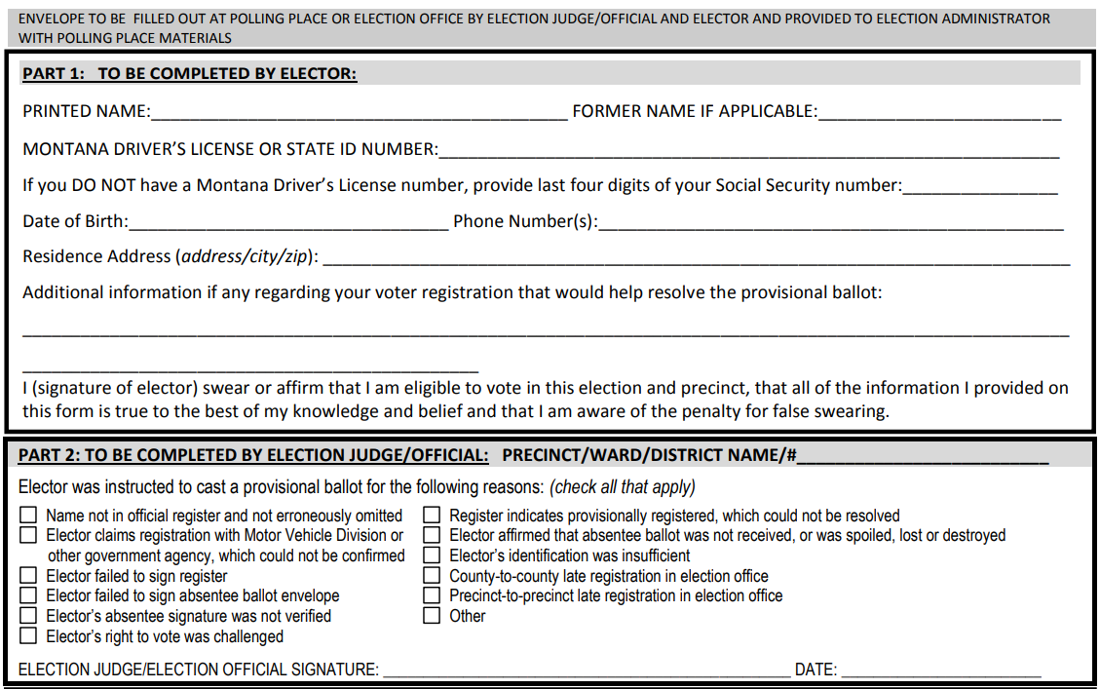
Provisional Ballots
Process
Must complete a cover sheet for every provisional ballot

Slide 140
Provisional Ballots
Process
Part 1: Information about the elector
  To be competed/signed by the elector if they are claiming eligibility to vote
  To be completed/signed by an election judge or the election administrator if a ballot is unsigned or the signatures don’t match
Part 2: Information about provisional status
  Identifies why the ballot is provisional

Slide 141
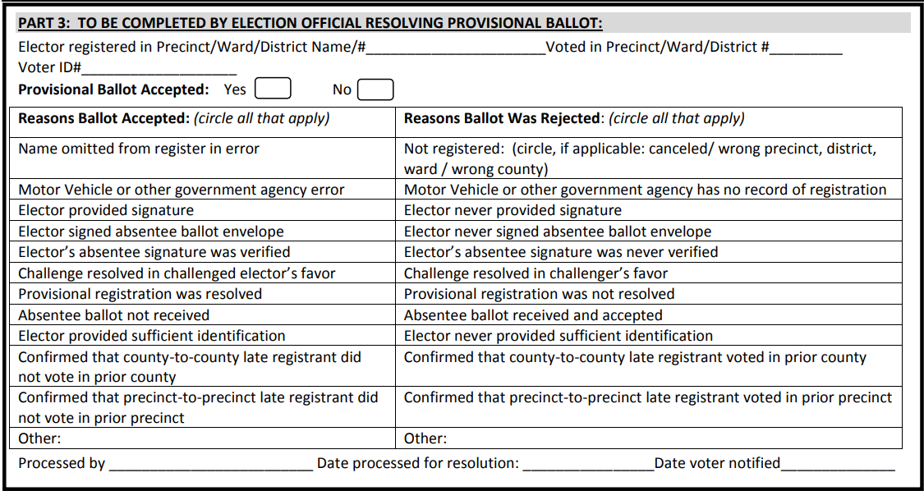
Provisional Ballots
Process
Part 3 – Resolution of the Provisional Ballot

Slide 142
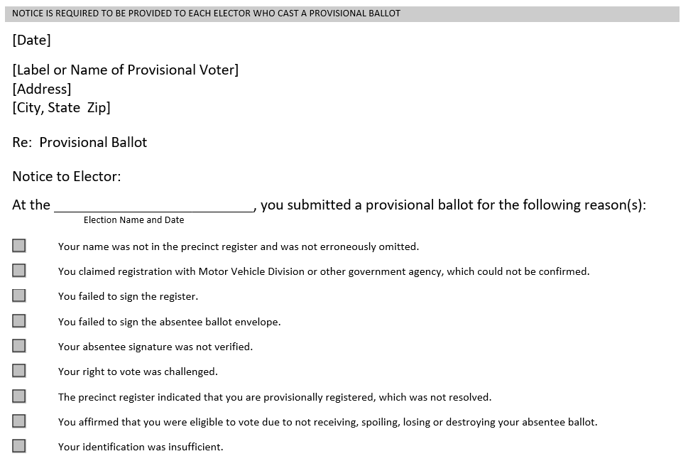
Provisional Ballots
Resolution
Must send EVERY elector a notice indicating if the ballot was counted/not counted and why/why not

Slide 143
Canvass
The canvass is conducted at the first regular or special meeting after the election
Official acceptance of election results or an election by acclamation
Review the tally sheets, poll books for discrepancies
Accept the results and issue certificates of election
Cannot occur until all provisional ballots are counted
Must occur within 25 days of the election
Publish official results immediately after the canvass

Slide 144
Canvass
Certificates of Election
Trustees issue certificates of election to the newly elected trustees
Must take the oath and file with the county superintendent within 15 days
The oath is administered by the county superintendent, their designee, or any notary

Slide 145
Organizational Meeting
The organizational meeting occurs at the next meeting of the board of trustees
May occur on the same night as the canvass, but must be a separately noticed meeting
Purpose of the organizational meeting
  Elect the chair (and other officers)
  Appoint a clerk

Slide 146
Recounts
Recounts occur when there is a tie vote or when there is a request for a recount in elections with a specific margin of victory
Tie Votes
  Recount is automatic
  Must occur at a separate meeting within 5 days
Margin Less Than ¼ of 1% of Total Votes Cast or 10 Votes (Whichever is Greater)
  Must file a petition signed by at least 10 electors within 5 days
Margin Between ¼ of 1% and ½ of 1% of Total Votes Cast
  Must file a petition within 5 days
  Must post a bond sufficient to cover the cost of the recount

Slide 147
Recounts
Procedure
Board chair appoints 3 trustees to serve on the recount board
Recount must be public
Must invite both (all) candidates
Election administrator provides unopened envelopes with all ballots
Recount board opens, counts, re-seals ballot and determines a winner
  Decision of the recount board is final (no additional recount)
  If the final decision is a tie the board determines who will fill the position until the next election (ballot initiatives fail)

Slide 148
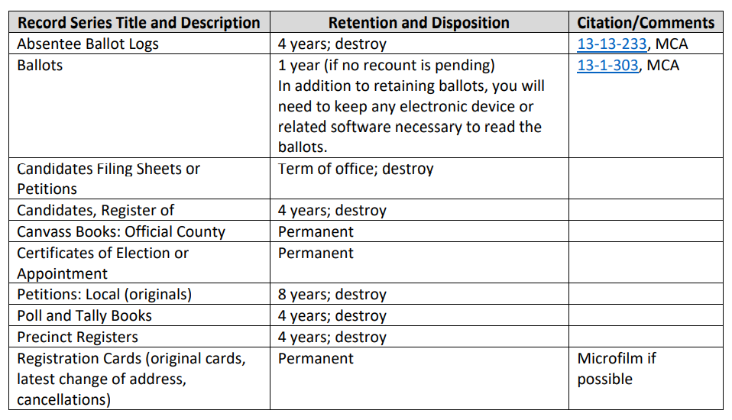
Records Retention

Slide 149
County to Conduct Elections
School districts may request that the county conduct their elections for the following fiscal year
The request must be made by board resolution not later than June 1
  The district may request the county run one or all of the school district’s elections
The county may charge the school district for the conduct of their elections
The county may charge the school district for the use of a voter interface device even if the school district is conducting its own election

Slide 150
Appointment of Trustees
Process:
Trustee submits resignation
  Prior to the deadline for passing an election resolution – trustee serves until the May election
  After the deadline for passing an election resolution – trustee serves until the next May election
The trustee serves for the remainder of the term
Appointee is selected according to the process in district policy

Slide 151
Appointment of Trustees
Timeline:
Clock starts when the trustees declare the position vacant
The trustee have 60 days to appoint a new trustee
If the trustees are unable to appoint a successor in 60 days, the county superintendent appoints
Note: The appointment should not be made at the same meeting where the position is declared vacant

Slide 152
Montana Recall Act (Title 2, Chapter 16, Part 6)
Applies to the recall of all publicly elected officials – including school board members (either elected or appointed)
May be recalled by the qualified electors entitled to vote for the elective officer’s successor
May be recalled for only the following reasons:
  Physical or mental lack of fitness
  Incompetence
  Violation of the oath of office
  Official misconduct
  Conviction of a felony offense in Title 45
Cannot be recalled for performing a mandatory duty of the office that the person holds or for not performing an act that would subject the person to prosecution for official misconduct

Slide 153
Montana Recall Act (Title 2, Chapter 16, Part 6)
Process
Recall petitions must be filed with the school district clerk (regardless of who conducted the election)
  A recall petition may not be approved until a trustee has held office for two months
  A recall petition may not be filed against an officer who has been the subject of a recall in the past 2 years, unless the expenses from the first election have been reimbursed
The school district clerk must approve/deny the petition
  Approval/denial based on reasons in law
  If approved the petitioner may circulate for signatures
  If denied the petitioner must appeal to the court

Slide 154
Montana Recall Act (Title 2, Chapter 16, Part 6)
Process
Once approved the petitioner gathers the required signatures
A petition must be signed by at least 20% of registered electors registered to vote at the preceding election
Signed circulation sheets must be submitted to the officer responsible for the registration of electors in the county in which the signatures were obtained within 3 months of the date the form of the petition was approved

Slide 155
Montana Recall Act (Title 2, Chapter 16, Part 6)
Process
The county election official will notify the district clerk of any certified recall petitions
The school district clerk must give immediate notice to the official named in the petition
  Notice that a petition has been filed
  The reasons contained in the petition
  Notification that the trustee has the right to prepare a statement to be printed on the ballot (200 words or less) – must be received within 10 days
The remaining trustees must give immediate notice that a recall election will be held

Slide 156
Montana Recall Act (Title 2, Chapter 16, Part 6)
Process
The election must be conducted using regular school district election timelines and rules
Electors vote “For” or “Against” the recall
The school district must pay for the cost of the election
If the recall is successful or the trustee subject to recall resigns, a new trustee is appointed in the usual manner

Slide 157

Questions?
Nicole Thuotte – Office of Public Instruction
(406) 444-4524 or (406) 202-1759 or nthuotte@mt.gov
Denise Williams – MASBO
(406) 461-3659 or dwilliams@masbo.com

