Slide 1
Cybersecurity 101 MASBO Technology Workshop Autumn 2021

Slide 2
Today’s Agenda
Become more cyber aware!
Protect your privacy
Beware of social engineering
Yes, you must manage your passwords
Pay attention to Wi-Fi networks

Slide 3
Protect Your Privacy

Slide 4
Beware of Social Engineering

Slide 5
Phishing Basics
Email is NOT secure.
See Rule #1.
Are you asked to engage(take action)? VERIFY
Is money involved? VERIFY
Are there hyperlinks? VERIFY What does hovering tell you?

Slide 6
Hovering – Red Flag Test

Slide 7
Practice Spotting Phishing Emails
https://phishingquiz.withgoogle.com/

Slide 8
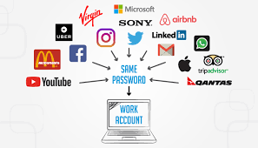
Manage Those Passwords I

Slide 9
Manage Those Passwords II
www.haveibeenpwned.com
Check Email Addresses
Check Passwords
Sign up for notifications

Slide 10
Manage Those Passwords III
https://youtu.be/7Ay94Q2f0VE

Slide 11
Wi-Fi Networks
Public Networks are NOT secure
See Rule #1
Never EVER touch PII
Instead, consider these options:
Use a Virtual Private Network
Get an unlimited data plan for mobile devices

Slide 12
Intended Takeaways
Privacy Matters – be proactive and repeat
Do Not Trust Email – hover and verify
Do Not Reuse Passwords
Do Use Encrypted Internet Connections

Slide 13
Dianne Burke CyberMontana/University of Montana dianne.burke@mso.umt.edu

