Slide 1
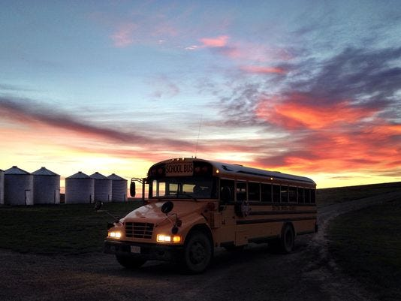

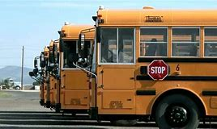
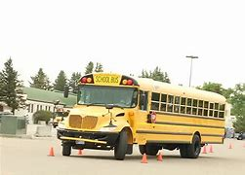
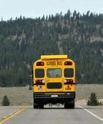
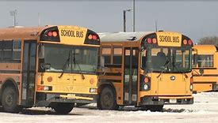
Pupil transportation
Donell Rosenthal
State Director of Pupil Transportation
School Finance Division
DRosenthal@mt.gov
(406) 444-3024

Slide 2
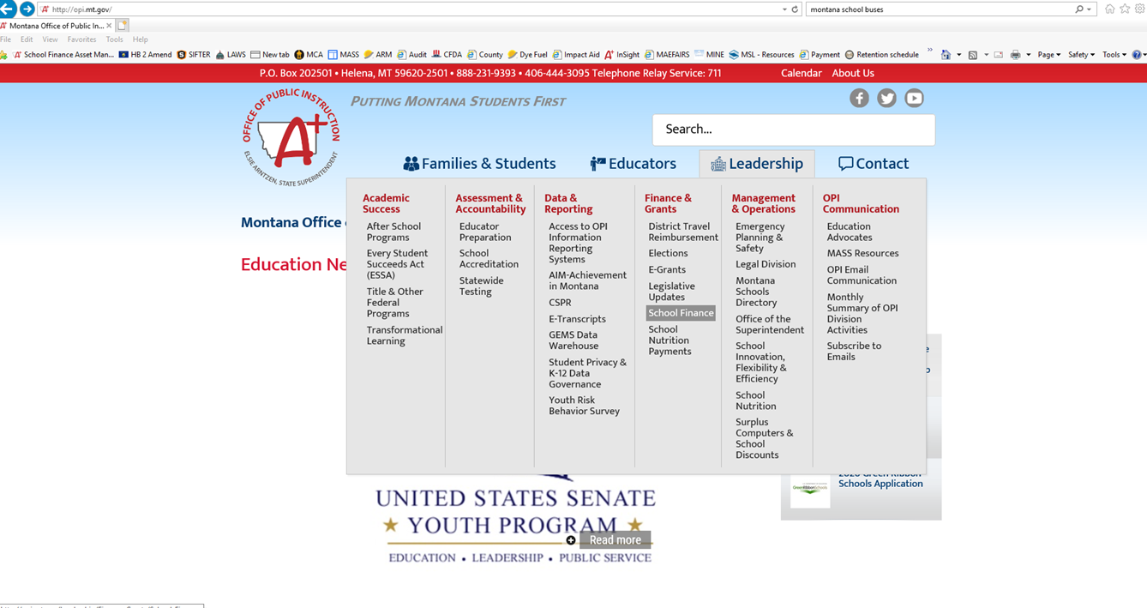

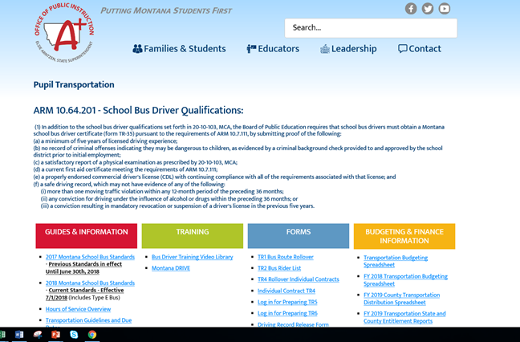
Website Resources
www.opi.mt.gov
Leadership & Support
  School Finance
    Pupil Transportation
Instructions
Forms
Trainings
Montana School Bus Standards

Slide 3
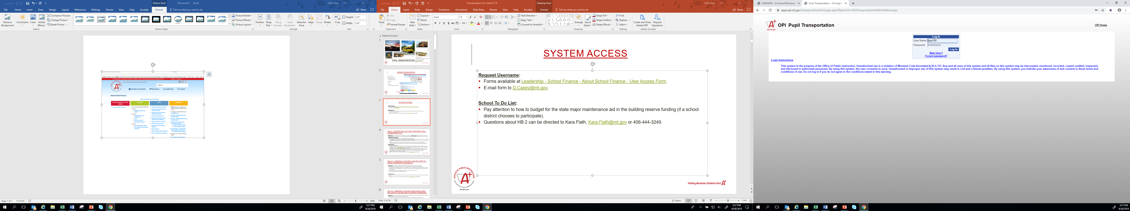
System Access
Request Username:
Forms available at Leadership - School Finance - About School Finance - User Access Form.
E-mail form to D.Casey@mt.gov.
System login found on School Finance main page or Pupil Transportation page under School Finance.
Do NOT share login information. The user is responsible for the information entered under their assigned login.

Slide 4
Transportation Forms
Forms found in the Pupil Transportation program:
Bus Routes (TR-1)
Individual Contracts (TR-4)
Bus Inspections (TR-13)
Bus Driver Certificates (TR-35)
Bus Route Reimbursement Claims (TR-6)
Individual Contract Reimbursement Claims (TR-5)
Approvals and Requirements:
Board Chair signs paper copy, district keeps a copy, district sends copy to county superintendent.
Your county superintendent is required to electronically mark these forms received and/or approved.
Note: County Superintendent needs a copy before they can mark TR’s received or approve.

Slide 5
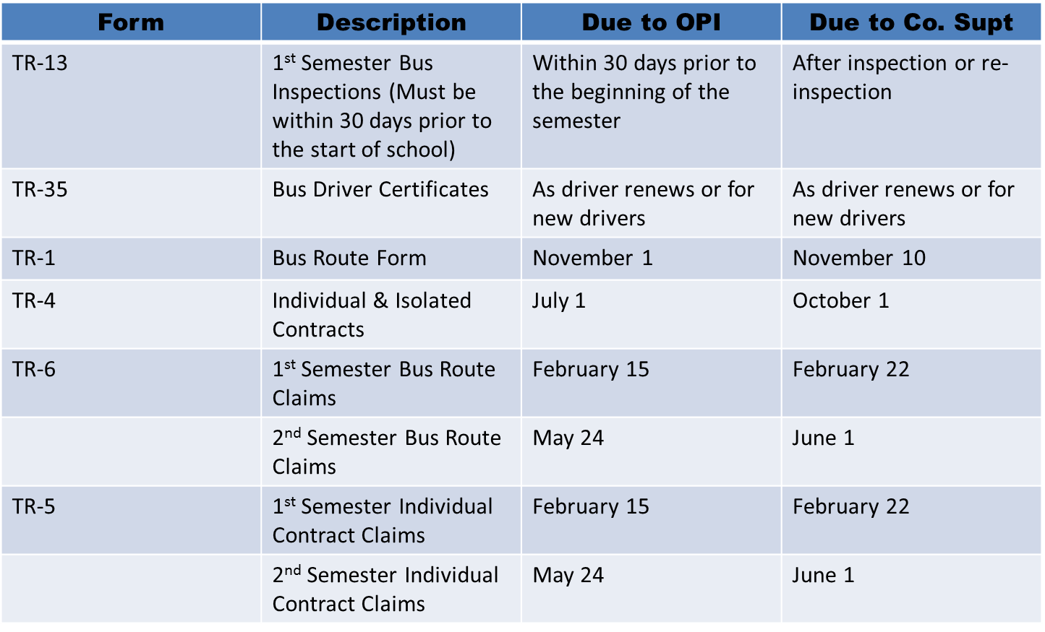
Form Due Dates

Slide 6
Bus driver qualifications
MCA, 20-10-103 requires that school bus drivers must obtain a Montana School Bus Driver Certificate (form TR-35) pursuant to the requirements of ARM 10.7.111, by submitting proof of the following:
(a) a minimum of five years of licensed driving experience;
(b) no record of criminal offenses indicating they may be dangerous to children, as evidenced by a criminal background check provided to and approved by the school district prior to initial employment;
(c) a satisfactory report of a physical examination(MEC)
(d) a current first aid and CPR certificate meeting the requirements of ARM 10.7.111;
(e) a properly endorsed commercial driver's license (CDL
(f) a safe driving record, which may not have evidence of any of the following:
(i) more than one moving traffic violation within any 12-month period of the preceding 36 months;
(ii) any conviction for driving under the influence of alcohol or drugs within the preceding 36 months; or
(iii) a conviction resulting in mandatory revocation or suspension of a driver's license in the previous five years.

Slide 7
Required background checks
Criminal History Check:
A criminal background check must be obtained on a driver prior to initial employment, and performed annually.
Districts may also perform a background check upon their discretion as deemed appropriate.
Some districts may already have a process in place for obtaining criminal background checks and fingerprinting.
However, if a district does not have a process, we recommend contacting the Department of Justice (DOJ) for their assistance.
    Montana Criminal Records
    2225 11th Avenue
    P.O. Box 201403
    Helena, MT 59620-1403
    E-mail: dojitsdpublicrecords@mt.gov
    Phone: (406) 444-3625
Annual Drivers License Check:
A yearly check of all drivers license records should be completed to ensure compliance with 20-10-103, MCA.

Slide 8
Medical Examiner’s Certificate (MEC)
Medical Examiner’s Certificate (MEC) Valid for 15-days:
  Drivers must provide the MVD with a copy of their MEC before 14 days of receiving it.
  If a driver fails to keep their MEC status information current with the state, it will result in a downgrade of their CDL to a base, Class D license, which renders the driver illegal to operate a commercial motor vehicle in Montana.
  This information is sent to OPI by the DOJ, which then are entered into the Pupil Transportation Program.
Drivers are ultimately responsible to make sure the (MVD) has received a new Medical Examiner’s Certificate (MEC) before the expiration of the current card on file.
However, if a driver fails to do so and continues to operate buses in a district, the district’s state and county transportation reimbursements will be reduced for every day the driver was downgraded.
To verify the status of a driver, please contact the MVD at (406) 444-3244. A copy of the MEC can also be faxed to (406) 444-1987.

Slide 9
Bus driver Mandatory Training
2018 Bus Standards:
Pre-service training program includes but is not limited to:
The essentials of a crash prevention program, including the uniform school bus crash reporting criteria
A system to communicate procedures between administrators and parents, and between contractors and drivers, including student discipline procedures and compliance.
Emergency procedures and/or contingency plans to be followed in the event of a crash, unexpected school closing or unforeseen route change.
The appropriate use of special lighting and signaling equipment.
The opportunity to participate in workshops, conferences and meetings where drivers can work with and learn from a group of their peers. (MAPT is encouraged).
Prior to transporting students with disabilities, the driver should receive appropriate training in compliance with Individuals with Disabilities Education Act (IDEA) and proper use of adaptive equipment
A continuing education program for school bus drivers providing at least 15 hours of in-service training annually, which is the approved coursework in the 2018 Bus Standards.
Drivers shall receive drug and alcohol education. (This is audited!)

Slide 10
Tr 35: bus driver certification
The TR 35 form is found in the Pupil Transportation program at Data Entry>Driver>TR-35 Bus Driver Certification:
Board chair signs the certificate which is issued to a driver, assuring that the driver is qualified to drive a school bus pursuant to all applicable rules, regulations and laws.
District retains a copy, and files a copy with the county superintendent.
The bus driver receives hard copy of the certificate, which must be carried at all times while driving a school bus.
The CPR certificate required by ARM 10.64.201 must include instruction in adult and pediatric CPR certification.
Needs to be signed by a certified instructor, after an initial in-person training of at least four hours.
  Renewal is every two years.
ALL drivers on a route MUST be certified with:
  Valid CDL
  Valid Medical Certificate (MEC)
  Valid First Aid (signed by a certified instructor)
  Valid CPR (signed by a certified instructor)
  If necessary, NEW Drivers have a 60 day grace period to obtain First Aid and CPR
A driver may NOT drive if their CDL, Medical Certificate, First Aid, or CPR is expired.
  This will put your state and county transportation reimbursement at risk; meaning for everyday your driver drove on a route with a credential expired, the district will lose those days of reimbursement.

Slide 11
Key points
A school bus driver certificate remains valid until the earliest expiration date of the commercial vehicle operator's endorsement, the first aid certificate, and/or physical examination.
A new certificate must be issued to the driver when any of the above items expires and is renewed.
An expired driver means no state or county reimbursement.

Slide 12
Bus Inspections (TR-13)
Key Points:
Montana Highway Patrol must perform the first semiannual inspection of school buses within at least 30 days prior to the beginning of the 1st semester. (ARM 10.7.101) (MCA 61-9-502)
Montana Highway Patrol must perform bus inspections by January 31 for the 2nd semester.
Only school buses that pass inspection may be used to transport students and only school buses that pass inspection will receive state and county transportation reimbursement.
A school bus that fails will need to be re-inspected and approved by the inspecting officer.
The school district is responsible for contacting the Montana Highway Patrol for bus inspections.

Slide 13
Type E Montana School Bus Standards
Information on Type E is found in the 2018 Bus Standards
With the approval of HB 355 in the 2017 Legislative Session, the OPI has updated the School Bus Standards to comply with the changes in law. The law allows for a new school bus Type E and removes the requirement of a CDL endorsement to drive the new school bus type. (Codified into law under 20-10-101, MCA.)
A district must make the purchase of the Type E bus after July 1st, 2017
The district must have completed an analysis of a “traditional "school bus versus the new Type E bus and keep the documentation on file for review.
The rate charged is $0.50/ per mile.
Type E bus still requires bus inspection – TR 13A (found in system).
Type E bus drivers do not require a CDL; however, all requirements of a CDL are required: For example, Medical Examination, training, and CPR.
Please read the 2018 Bus Standards to ensure the full compliance with the requirements.

Slide 14
Bus routes TR-1
Key Points:
ALL bus routes must be approved yearly.
ARM 10.7.101
  By the fourth Monday in July a county transportation committee (CTC) must act to approve or not approve all bus routes established by districts.
  By November 1 a district sends a copy to the county superintendent, and enters the (TR-1) electronically to the Pupil Transportation Program.
  By November 10 the county superintendent must electronically receive TR-1’s entered by the district.
Once you enter your (TR-1’s) make sure you have a daily rate.
Are there 0.00 Rates? Then there is a problem. Check into it.
Questions: Call Donell at (406) 444-3024
A New TR-1 is Required When……
There has been a change in bus on the route
There has been a change in the driver
There has been a change in mileage
Do not edit the existing TR-1. The district must report the legs as separate parts of a single route (e.g., Route 1A, 1B and 1C) by submitting a separate form for each change.

Slide 15
Individual Contracts (TR-4)
Key Points:
For TR-4 Individual Contracts (ARM 10.7.101) States the following:
BY July 1 a district must complete and sign transportation contracts (three copies) for the ensuing year
Send to the county superintendent copies of all completed individual contracts
Submit individual transportation contracts electronically to the Pupil Transportation Program
The districts are prohibited from issuing warrants on the transportation budget in the absence of a contract.
State reimbursement is paid only on claims supported by valid contracts.(ARM 10.7.105)
Forms are accessed through the Pupil Transportation Program
Individual Contract/Isolation Increased Rate Approval
If isolation has been requested and approved through the board and CTC, the county superintendent must check the county approval box before the increased rate will be applied.

Slide 16
Key points
An invalid inspection or no inspection will result in no state or county reimbursement.

Slide 17
Claim Procedures
First Semester:
By February 15 school districts must provide the county superintendent with one complete copy of the first semester transportation claim using forms provided electronically in the Pupil Transportation Program.
By February 22 the county superintendent must review each district's claim for completeness and accuracy, and electronically approve each district's first semester transportation claim.
Second Semester:
By May 24 school districts must provide the county superintendent with one complete copy of the second semester transportation claim using forms provided electronically in the Pupil Transportation Program. The district claims must be signed by the chairman of the board of trustees and a copy must be retained on file at the district for audit purposes.
By June 1 the county superintendent must review each district's claim for completeness and accuracy, and electronically approve each district's second semester transportation claim.
The district claims must be signed by the chairman of the board of trustees and a copy must be retained on file at the district for audit purposes.

Slide 18
STATE TRANSPORTATION REIMBURSEMENT
Pursuant to MCA 20-10-145
The superintendent of public instruction reimburses each school district according to the following schedule:
By September 1 of each year, the superintendent of public instruction shall make a payment equal to 50% of the state transportation reimbursement paid to the district in the previous school year.
By March 31 of each year, the superintendent of public instruction shall make a payment to the district equal to the approved amount of state reimbursement for first semester transportation claims less the amount distributed to the district under subsection.
By June 30 of each year, the superintendent of public instruction shall make a payment to the district to pay the balance of the approved amount due to the district for first and second semester transportation.
The county superintendent should initiate the county obligation for each semester’s claims.

Slide 19
Desk audits
The OPI will be performing yearly desk audits of transportation claims.
The compliance items will include:
Bus Driver Requirements
  Criminal background check, new drivers
  Drivers license checks – yearly
  Alcohol and drug testing
  Compliance with training hours with documentation
  Proper drivers license endorsements
Signed documents on file – from county transportation committee
The district is responsible to ensure all proper documents are collected, regardless if contracting bus services.
Non compliance with the requirements may result in a collection of state payments from the year audited.

Slide 20
Budgeting -TRANSPORTATION FUND (10)
PURPOSE: The Transportation Fund can be used to support the costs of transporting students between home and school, including:
costs of school bus purchase, repair, maintenance and operations;
safety activities related to bus driver training, crosswalk attendants, etc.;
bus barn facilities and maintenance; and
payments to parents for individual transportation contracts.
Costs of field trips, travel costs related to extracurricular activities and athletics, and staff travel costs are NOT ALLOWABLE costs of the Transportation Fund (10).
Claims for Reimbursement:
State funding is paid based on semi-annual claims to the OPI in February for first semester and in May for second semester. The state sends a prepayment entitlement in August. The prepayment entitlement is equal to 50% of the average of the prior year's entitlements. The OPI and county treasurer pay the district their portions of the funding in March for the 1st semester and in June for the 2nd semester per §20-10-146, MCA.
State funding is disbursed in the following three payments:
August – 50% of the prior year’s unadjusted entitlement (Referred to as the pre-payment)
March – 1st semester entitlement payment less the pre-payment amount received in August
June – 2nd Semester entitlement payment
VOTING REQUIREMENTS: The transportation fund tax levy is permissive. Consequently, it is not subject to voter approval. However, projected mill increases in this fund are subject to voter notification by March 31st per §20-9-116, MCA. This fund may budget the ‘On-Schedule’ costs of bus routes, individual contracts and any ‘Over-Schedule’ amounts of operating the transportation program.

Slide 21
BUS DEPRECIATION FUND (11)
PURPOSE: This fund is a reserve fund used to levy taxes for the following:
Replace, remodel or convert yellow school buses and activities/athletics buses owned by the district;
Replace communication and safety devices used in the transportation program;
Purchase additional yellow school buses to be used on bus routes; and
Purchase and install video cameras for security on buses.
The district can accumulate ("depreciate") a reserve to:
Yellow school buses owned by the school district or vehicles meeting the legal definition of a school bus (such as a Type E bus) and used as a school bus;
Coach buses (like a Greyhound-type) used for athletics/activities; and
Communication and safety devices used in the transportation program.
The fund cannot be used:
To purchase or replace vehicles which are not buses. (§20-10-147, MCA, and ARM 10.10.311)); or
To purchase or replace cell phones, which do not qualify as communication devices. Since this is a reserve fund, there is traditionally no set aside operating reserve.
VOTING REQUIREMENTS: The Bus Depreciation Fund (11) tax levy is permissive up to the statutory limits. Consequently, it is not subject to voter approval. However, projected mill increases in this fund are subject to voter notification by March 31st per §20-9-116, MCA.

Slide 22
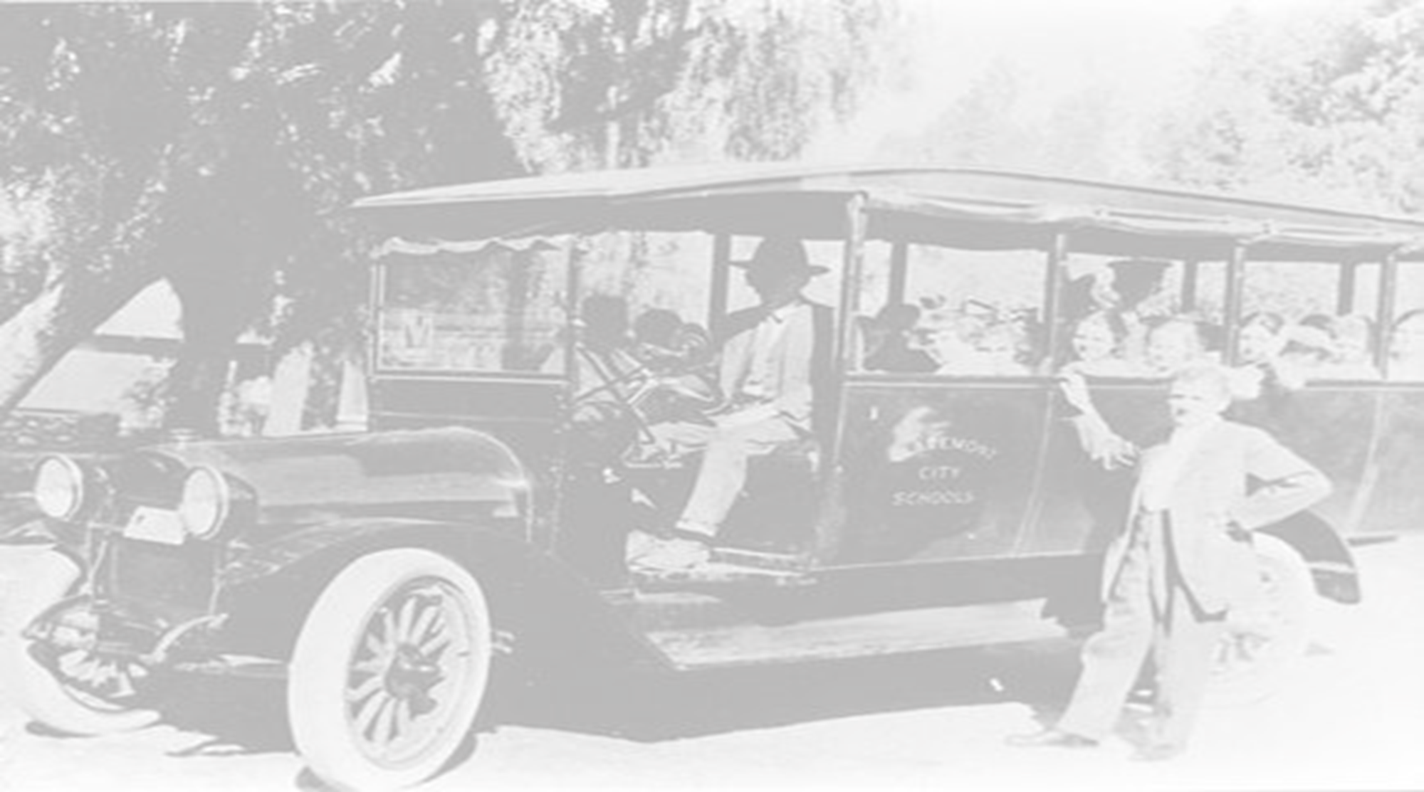
Questions or comments?
Thank you!
Donell Rosenthal
Pupil Transportation Director
Montana Office of Public Instruction
P.O. Box 202501 or 1227 11th Avenue
Helena, MT 59620-2501
Phone: 406-444-3024
DRosenthal@mt.gov

