Slide 1
Pupil transporTation reports New Clerk Training January 14 and 20 STEVE HAMEL 431-0124 Denise Williams 461-3659
Need OPI assistance?
Contact Donnell Rosenthal at drosenthal@mt.gov or 444-3024

Slide 2
Transportation Reports Calendar

Slide 3
New since the calendar on the previous slide
TR13A inspection for for type E busses (approved SUV’s)
Same deadline as the normal bus inspection form

Slide 4
Bus Inspections (TR-13)
Key Points:
Montana Highway Patrol must perform the first semiannual inspection of school buses within at least 30 days prior to the beginning of the 1st semester. (ARM 10.7.101) (MCA 61-9-502)
Montana Highway Patrol must perform bus inspections by January 31 for the 2nd semester.
Only school buses that pass inspection may be used to transport students and only school buses that pass inspection will receive state and county transportation reimbursement.
A school bus that fails will need to be re-inspected and approved by the inspecting officer.
The school district is responsible for contacting the Montana Highway Patrol for bus inspections.

Slide 5
TR-13 Highway Patrol inspection form

Slide 6
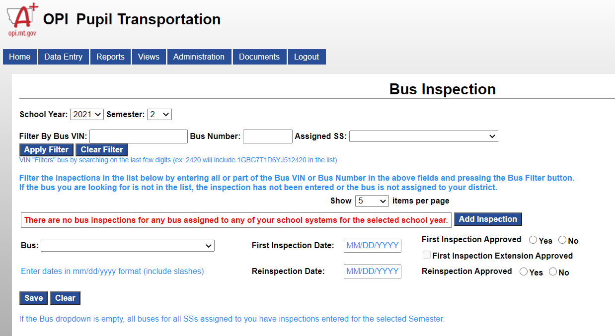
Where to enter your bus inspection reports School Finance
Enter both TR13 and TR13A on this screen

Slide 7
Claim Procedures
First Semester:
By February 15 school districts must provide the county superintendent with one complete copy of the first semester transportation claim using forms provided electronically in the Pupil Transportation Program.
By February 22 the county superintendent must review each district's claim for completeness and accuracy, and electronically approve each district's first semester transportation claim.
Second Semester:
By May 24 school districts must provide the county superintendent with one complete copy of the second semester transportation claim using forms provided electronically in the Pupil Transportation Program. The district claims must be signed by the chairman of the board of trustees and a copy must be retained on file at the district for audit purposes.
By June 1 the county superintendent must review each district's claim for completeness and accuracy, and electronically approve each district's second semester transportation claim.
The district claims must be signed by the chairman of the board of trustees and a copy must be retained on file at the district for audit purposes.

Slide 8
Individual transportation contract reimbursement

Slide 9
TR-5 Data Entry

Slide 10
Route Reimbursement instructions

Slide 11
TR-6 Data Entry

