Slide 1
Student Enrollment Counts
New Clerk Academy January 2021
January 14
January 20

Slide 2
Student Enrollment Counts
Agenda
Why?
Where?
What?
When?
How?

Slide 3
Why do an enrollment count?
Staffing
Facility needs
Texbooks, supplies, etc.
Rates of achievement, graduation, etc.
Accreditation standards
Budgets and Funding
Calculate ANB (Average Number Belonging)
Student Child Count

Slide 4
General Fund - ANB
AVERAGE NUMBER BELONGING (ANB)
FALL ENROLLMENT
(1ST Monday in October)
Part-time Students = ¼, ½, or ¾
Example:
Oct count = 150
Feb count = 166
(150 + 166)
2
= 158
187
180
= 165 ANB
Total of 2 counts
divided by 2
180 + PIR Days*
180
= ANB
X
SPRING ENROLLMENT
(1st Monday in February)
Part-time Students = ¼, ½, or ¾
X
*PIR Days are “pupil instruction related” days for teacher in-service training and recordkeeping

Slide 5
General Fund - ANB
Use the ANB that generates the greatest maximum general fund budget:
Current Year ANB (CY ANB)
ANB for the budget unit for the ensuing school year (FY2020 ANB is based on FY2019 enrollment counts)
3-Year Average ANB
Add current year ANB to the current ANB for the previous two school fiscal years and divide by 3 (FY2020 ANB is the average of FY2019, FY2018 and FY2017)

Slide 6
Where does the info come from?
1. DISTRICT
Power School, Infinite Campus DE, others
Usually maintained by building secretaries or other staff
2. OPI - AIM
Achievement in Montana
OPI data collection using Infinite Campus SE
Districts upload enrollment, attendance and demographic information for each student into AIM
3. OPI - MAEFAIRS
Montana Automated Education Financial and Accounting Information Reporting System
MAEFAIRS imports certain data from AIM
MAEFAIRS generates Student Count for ANB for budgeting and funding purposes

Slide 7
DATA ELEMENT | AIM | MAEFAIRS
Enrollment Count by Grade | X | X
Part Time Enrollment Data | X | X
19 Year Old Enrollment | X | X
Job Corps Enrollment | X | X
MT Youth ChalleNGe | X | X
MT Digital Academy | X | X
Early Graduation (spring only) | X | X
Pre‐Kindergarten Enrollments (Special Education) | X
Kindergarten Enrollments | X | X
Exclude from Fall & Spring ANB count – 10 day rule | X | X
American Indian Students (SAG payment) fall only | X | X
Aggregate Hours | X | X
Attendance on count date | X
Program participation data | X

Slide 8
What are we counting?
To be included in the MAEFAIRS Student Count for ANB, students must:
Be enrolled on the count date
October 5, 2020
February 1, 2021
Have aggregate hours marked (N, Q, H, T, or F)
Have a service type of Primary or Secondary for grades K-12 in AIM

Slide 9
What are we counting?
Students enrolled in an education program
Grade level
Enrollment start and end dates
Minimum aggregate hours
American Indian students (October count)

Slide 10
What are we counting?
Students enrolled in an education program
Full time students
Part time students ( ¼, ½, ¾ )
Proficient students
Special high school data
19-year old enrollment
Job Corps
Montana Youth ChalleNGe Academy
Early graduates
Aggregate hours of instruction for purposes of ANB counts

Slide 11
What are we counting?
Aggregate hours of instruction 20-9-311, MCA
Hours of pupil instruction for a course or program
Doesn’t include lunchtime or unstructured recess
Status for ANB count | Annual aggregate hours of pupil instruction | Designation in AIM
0 time | 0 < 179 hours | N
1/4 time | 180 to 359 hours | Q
1/2 time | 360 to 539 hours | H
3/4 time | 540 to 719 hours | T
Full time | > 720 hours | F

Slide 12
What are we counting?
Use annualized aggregate hours of pupil instruction as of the count date.
Count date | # days | Hours per day | Total hours | Calculation | Annualized hours
Fall | 90 | 5 hours/day | 450 | 450 X 2 | 900
Spring | 90 | 5 hours/day | 450 | 450 X 2 | 900
Totals | 180 |  | 900
Fall count = full time
Spring count = full time

Slide 13
What are we counting?
Use annualized aggregate hours of pupil instruction as of the count date. The student attends 2 fewer hours per day as of February Count Date.
Count date | # days | Hours per day | Total hours | Calculation | Annualized hours
Fall | 90 | 5 hours/day | 450 | 450 X 2 | 900
Spring | 90 | 3 hours/day | 270 | 270 X 2 | 540
Totals | 180 |  | 720
Fall count = full time
Spring count = 3/4 time

Slide 14
What are we counting?
Use annualized aggregate hours of pupil instruction as of the count date.
Count date | # days | Hours per day | Total hours | Calculation | Annualized hours
Fall | 90 | 3 hours/day | ____ | ____ X 2 | ____
Spring | 90 | 4 hours/day | ____ | ____ X 2 | ____
Totals | 180 |  | ____
Fall count = ____ time
Spring count = ____ time

Slide 15
What are we counting?
Use annualized aggregate hours of pupil instruction as of the count date.
Count date | # days | Hours per day | Total hours | Calculation | Annualized hours
Fall | 90 | 3 hours/day | 270 | 270 X 2 | 540
Spring | 90 | 4 hours/day | 360 | 360 X 2 | 720
Totals | 180 |  | 630
Fall count = 3/4 time
Spring count = full time

Slide 16
What are we counting?
Concurrent Enrollment
Student attends two different school districts
One school is designated as primary in AIM.
Other school(s) designated as secondary in AIM.
Total student count for ANB cannot exceed 1.0 full time between the two schools.
Advice: contact the other school and coordinate the proper designation in AIM

Slide 17
What are we counting?
Concurrent Enrollment – use annualized aggregate hours as of the count date for each school:
School | # days | Hours per day | Total hours | Calculation | Annualized hours
A | 90 | 3 hours/day | 270 | 270 X 2 | 540
B | 90 | 2 hours/day | 180 | 180 X 2 | 360
Totals | 180 |  | 630
School A = 3/4 time or .75 (T)
School B = 1/2 time or .50 (H)
1.25
No can do

Slide 18
What are we counting?
Proficient Students 20-9-311(4)(d), MCA
School may include in its ANB calculation a student enrolled in a program providing fewer than the required aggregate hours of instruction
Student has “ . . . demonstrated proficiency in the content ordinarily covered by the instruction as determined by the school board using district assessment.”
More information in OPI Guidance

Slide 19
What are we counting?
19 year olds 20-5-101, MCA
Student reaches age 19 on or before September 10 of the current school year.
Include in enrollment count for the grade level the student is in
Will also appear in the “Other Enrollment” section
Do not include in part-time enrollment counts
Does not count toward ANB (see pg 9 of Instructions)

Slide 20
What are we counting?
Job Corp Program and MT Youth ChalleNGe Students
District must have interlocal agreement with JC or MTYC
Must be enrolled in district of residence
Credits require approval of resident district
Credits must meet graduation requirements of district
Credits must be taught by instructor with MT high school certification
Credits must be reported by JC or MTYC to student’s resident school district

Slide 21
What are we counting?
Early Graduates 20-9-313(6), MCA
Can apply for increased ANB under the following circumstances/requirements:
Students who graduated from high school early, at the end of their 7th semester
Enrolled on October count date; but not enrolled on February count date
Completed graduation requirements at end of 1st semester of the current school year
Not age 19 on or before September 10
See page 11 of Enrollment Instructions

Slide 22
What are we counting?
Kindergarten Students
Half Time Program (KH)
Full Time Program (KF)
Program must provide 360 or more aggregate hours of instruction per school year
Enrolled students count as ½ time for ANB purposes
Program must provide 720 or more aggregate hours of instruction per school year
Enrolled students receive 720 or more aggregate hours of pupil instruction to count as full time for ANB purposes

Slide 23
What are we counting?
Special Circumstances - “10-day Rule”
If enrolled student is absent 11 or more consecutive days prior to and including the count day, DO NOT COUNT for purposes of ANB
Exceptions:
homebound students (see ARM 10.20.102(8))
Extenuating circumstances for a student being absent beyond the 10th consecutive day prior to count date. Apply to OPI prior to the official count date for approval to include the student in the enrollment count.

Slide 24
What are we counting?
Special Circumstances - Enrollment End Dates
Students leaving your district
Request for records from the new school
Notice from parent or student or OPI
End date in AIM is the last day the student was present
It can be argued that the end date could be the date you received notice
Students who are absent and you don’t know their status and haven’t received a notice of transfer
follow district policy
if absent for 11 or more consecutive days up to and prior to count date, you still cannot count them for ANB

Slide 25
What are we counting?
American Indian Students
Student Achievement Gap (SAG)
One of the General Fund funding components
# of American Indian students as of the fall enrollment count date drives the amount each district will receive for SAG in the ensuing year.
Run a “Students Imported from AIM in SAG” report and review it for accuracy.
Corrections must be submitted by December 31, 2020.

Slide 26
General Fund - ANB
IMPORTANT!
Enrollment counts submitted in MAEFAIRS must match supporting documentation.
Auditors are required to audit enrollment counts and report any differences.

Slide 27
How do we submit enrollment counts?
AIM data must be correct (see AIM User Guides)
Enrollment dates
Aggregate hours of pupil instruction codes
N, Q , H, T, F
Primary; Secondary
Kindergarten codes: KH and KF
Other applicable checkboxes and codes

Slide 28
How do we submit enrollment counts?
2. MAEFAIRS/AIM Instructions pages 8 – 9
Print blank forms
Import Student Count for ANB Data from AIM
Run MAEFAIRS Student Count for ANB Reports
School Summary
District Summary
List of students imported
List of students not imported
Students Imported from AIM in SAG

Slide 29
How do we submit enrollment counts?
Review for accuracy
Make corrections in AIM
Re-import from AIM to MAEFAIRS
Re-run Student Count for ANB Reports
Review and repeat as necessary
7. Run final reports and submit

Slide 30
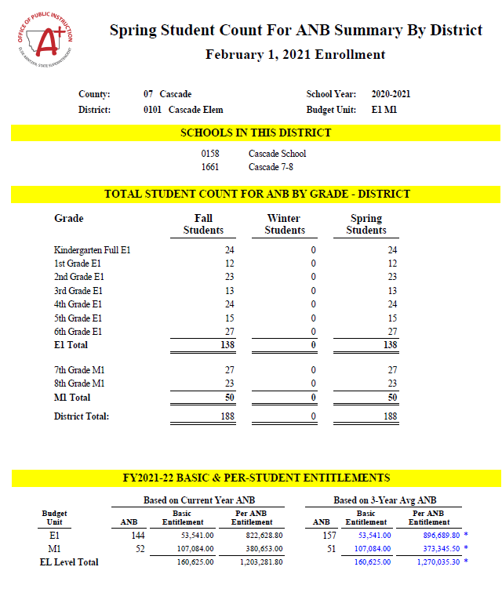

Slide 31
