Slide 1
Instructions for Resolution/Notice of Intent to Increase Non-voted Levies for FY2022 Budgets
20-9-116, MCA. Resolution of intent to increase non-voted levy -- notice.
Deadline: March 31, 2021

Slide 2
Agenda
BACKGROUND INFORMATION
Senate Bill 307 (2017 session)
House Bill 351 (2019 session)
RESOLUTION SPREADSHEET
Purpose and information needed
Steps for completing the spreadsheet
Resolution/Notice
Minimum Requirements
All funds using projected taxable value
All funds using prior year taxable value

Slide 3
Background: SB307
Senate Bill 307 (2017 legislative session)
Transparency in the levying process
Trustees must adopt a resolution in the Spring each year estimating the increase/decrease in revenue and mills from permissive (non-voted) levies in each of the following funds: Tuition, Adult Education, Building Reserve, Transportation and Bus Depreciation
New permissive (non-voted) levy authority to address school facilities maintenance and repair
Track in Building Reserve Fund
School facility maintenance amount

Slide 4
Background: House Bill 351
House Bill 351 (2019 legislative session)
Transformational learning as a means to fulfilling the people’s goal of developing the full educational potential of each person
Creating incentives for transformational learning programs
Application process (OPI)
Approval by board of public education
Eligible for a 4-consecutive year provision of transitional funding and flexibilities
Transformation learning aid payment (state-funded)
Permissive levy in the Flexibility Fund up to the amount of TLA
Transfers from state and local revenue from any budgeted or non-budgeted fund (except Debt Service and Retirement)

Slide 5
Background: Resolution
20-9-116, MCA. Resolution of intent to increase nonvoted levy -- notice. (1) The trustees of a school district shall adopt a resolution no later than March 31 of each fiscal year and provide notice pursuant to subsection (2) whenever the trustees intend to impose an increase in a nonvoted levy in the ensuing school fiscal year for the purposes of funding any of the funds listed below:
(a) the tuition fund under 20-5-324;
(b) the adult education fund under 20-7-705;
(c) the building reserve fund under 20-9-502 and 20-9-503;
(d) the transportation fund under 20-10-143 and 20-10-144; and
(e) the bus depreciation reserve fund under 20-10-147, and
(f) the flexibility fund established in 20-9-543 for the purposes in 20-7-1602.
(2) The trustees shall provide notice of intent to impose an increase in a nonvoted levy for the ensuing school fiscal year by:
(a) adopting a resolution of intent to impose an increase in a nonvoted levy that includes, at a minimum, the estimated number of increased or decreased mills to be imposed and the estimated increased or decreased revenue to be raised compared to nonvoted levies under (1)(a) through (1)(f) imposed in the current school fiscal year and, based on the district's taxable valuation most recently certified by the department of revenue under 15-10-202, the estimated impacts of the increase or decrease on a home valued at $100,000 and a home valued at $200,000; and
(b) publishing a copy of the resolution in a newspaper that will give notice to the largest number of people of the district as determined by the trustees and posting a copy of the resolution to the school district's website.

Slide 6
Notice of Intent to Increase Non-voted Levies
Resolution/Notice requirements:
Dollar and mill increases in nonvoted levies in:
Transportation Fund
Bus Depreciation Fund
Tuition Fund
Adult Ed Fund
Building Reserve Fund
Flexibility Fund
Using prior year taxable value
Impact on $100K and $200K home
Publish notice in newspaper by March 31
Note: these are estimates

Slide 7
Sample Resolution and Notice*
Model Resolution (20-9-116, MCA)
Resolution of Intent to Impose an Increase in Levies
As an essential part of its budgeting process, the __________________________________ Board of Trustees is authorized by law to impose levies to support its budget. The _____________________________________ Board of Trustees estimates the following increases/decreases in revenues and mills for the funds noted below for the next school fiscal year beginning July 1, _______, using certified taxable valuations from the current school fiscal year as provided to the district:
Fund Supported | Estimated Change in Revenues* | Estimated Change in Mills* | Estimated Impact, Home of $100,000* | Estimated Impact, Home of $200,000
Transportation | $ ___ increase/decrease | ____increase/decrease | $ ___ increase/decrease | $ ___ increase/decrease
Bus Depreciation | $ ___ increase/decrease | ____increase/decrease | $ ___ increase/decrease | $ ___ increase/decrease
Tuition | $ ___ increase/decrease | ____increase/decrease | $ ___ increase/decrease | $ ___ increase/decrease
Adult Education | $ ___ increase/decrease | ____increase/decrease | $ ___ increase/decrease | $ ___ increase/decrease
Flexibility | $ ___ increase/decrease | ____increase/decrease | $ ___ increase/decrease | $ ___ increase/decrease
Building Reserve | $ ___ increase/decrease | ____increase/decrease | $ ___ increase/decrease | $ ___ increase/decrease
Total | $ ___ increase/decrease | ____increase/decrease | $ ___ increase/decrease | $ ___ increase/decrease
* impacts above are based on current certified taxable valuations from the current school fiscal year
Regarding the increase in the building reserve levy referenced above, the following are school facility maintenance projects anticipated to be completed at this time:
Example: Replace boiler in middle school
Example: Repair roof on the elementary gym
Example: Install fiber optic cable in district buildings
Example: Repair water filtering system
*MTSBA recommended format

Slide 8
Budgeted Funds – Permissive and Voted Levies
Budgeted Fund | Permissive Levy? | Voted Levy?
General Fund (01) | Y | Y
Transportation Fund (10) | Y | N
Bus Depreciation Fund (11) | Y | N
Tuition Fund (13) | Y | N
Retirement Fund (14) | N/A | N
Adult Ed Fund (17) | Y | N
Technology Fund (28) | N | Y
Flexibility Fund (29) | Y | Y
Debt Service Fund (50) | Y | Y
Building Reserve Fund (61) | Y | Y
Notice required per 20-9-116, MCA

Slide 9
Timeline:
Date/Deadline | Event
March 1 | OPI releases estimate of maximum state funding for ensuing year on preliminary budget data sheet
March 31 | Resolution of Intent to Increase Levies published, to include: Funding sources Funds & mills to be raised by levy Projects expected to be pursued
Last working day in May | State funding, if any will be distributed to the permissive levy sub-fund in Building Reserve (61)
June 30 | End of fiscal year
August | Budgets adopted; levies set

Slide 10
RESOLUTION SPREADSHEET
Purpose of spreadsheet:
Complete budget projections
Finalize the resolution/notice
Information needed:
Taxable values for F2019 – FY2021
Found on cover page of Budget Reports
Estimated Taxable value for FY2022
Use FY2021 value or estimate
FY2021 Budget Report
FY2022 Budget Data Sheet (OPI provides March 1)

Slide 11
RESOLUTION SPREADSHEET
Notice of Intent to Increase Permissive Levies
Questions to consider:
What is transparency in your district?
When your constituents read the notice, what message(s) do you want them to hear?
In the end, would you prefer this notice to err on the high or low side with regard to tax impact?
What is your strategy for managing the repercussions?

Slide 12
RESOLUTION SPREADSHEET - STEPS
Cells needing input are yellow
1. Start Here tab:
Enter district name
Enter taxable values for FY2018 – FY2022
2. Resolution Detail tab:
Using FY2021 Budget report (page 2, Summary):
Enter taxes levied for each fund (col. H)
Enter mills levied for each fund (col. I)

Slide 13
RESOLUTION SPREADSHEET - STEPS
Cells needing input are yellow
3. Individual Budgeted Fund tabs
Red tabs are the funds required to appear on the Notice of Intent to Increase Non-voted Levies
Remember, you are projecting your FY2022 expenditure budget and funding sources
You can use the amounts on your FY2021 Budget Report as a guide, then fine-tune for FY2022 projections

Slide 14
RESOLUTION SPREADSHEET - STEPS
Cells needing input are yellow
4. Go back to the Resolution Detail tab:
The projections you made on the individual fund tabs are carried over into three different charts:
All Funds Using Projected Taxable Value
All Funds Using Prior Year Taxable Value
Required Resolution to Increase Levies Notice
Mills are calculated using the prior year taxable value
Only funds supported by a permissive levy and required to be reported are listed

Slide 15
Budgeted Funds – Permissive and Voted Levies
Budgeted Fund | Permissive Levy? | Voted Levy?
General Fund (01) | Y | Y
Transportation Fund (10) | Y | N
Bus Depreciation Fund (11) | Y | N
Tuition Fund (13) | Y | N
Retirement Fund (14) | N/A | N
Adult Ed Fund (17) | Y | N
Technology Fund (28) | N | Y
Flexibility Fund (29) | Y | Y
Debt Service Fund (50) | Y | Y
Building Reserve Fund (61) | Y | Y
Levies with tax impact;
notice not required per SB307
Notice required per SB307

Slide 16
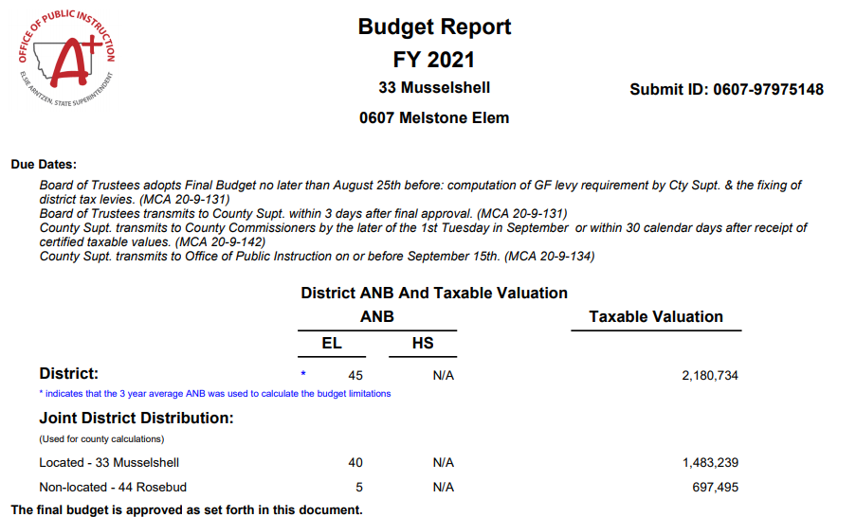
Calculating Mills
Taxable Value is basis for mill calculation:

Slide 17
Calculating Mills
A mill is 1/1,000 of taxable value (TV/1000)
Levied mills: Amount needed to raise / mill value
Tax impact on a property: levied mills x property’s taxable value / 1000
Example:
Taxable value = $3,500,000
Amount needed to raise = $33,250
Mill = $3,500,000 / 1,000) = $3,500
Levied mills = $33,250 / $3,500 = 9.5 mills
Tax impact on $200,000 property:
Taxable value of property = $200,000 X .0135 = $2,700
(9.5 mills X $2,700) / 1,000 = $25.65

Slide 18
Fund Balance Reappropriated
Methods for estimating Fund Balance Reappropriated:
Averaging/trend analysis
Actual/calculated:
Beginning Fund Balance (FY2021 ending fund bal)
+ Current Year Receipts
- Current Year Expenditures
Ending Fund Balance
- Reserves (consider reserve limits)
Fund Balance Reappropriated
Being conservative? Recommend estimating low

Slide 19
Tips: Transportation Fund
Estimate FY2022 transportation expenditure budget
Calculate an estimate of FY2022 state and county reimbursement revenue (on-schedule) using the OPI Transportation Spreadsheet
Contact Donnell Rosenthal at drosenthal@mt.gov or 444-3024 for assistance with the spreadsheet
Subtract the estimated on-schedule revenue from the estimated expenditure budget, the remainder is estimated permissive tax levy

Slide 20
Transportation Fund Spreadsheet go to OPI/Leadership-Finance/Budgets

Slide 21
Tips: Bus Depreciation Reserve Fund
Find the Asset Information schedule on your FY2021 Budget Report
Figure the maximum amount you can levy for each bus
Up to 20% of the total cost of the bus, and
Up to 150% of the cost of the bus over time
Add any new buses or equipment purchased in FY2021
Estimate the total levy for FY2022
If you added no new buses during the year you may not have an increase in the levy from FY2021

Slide 22
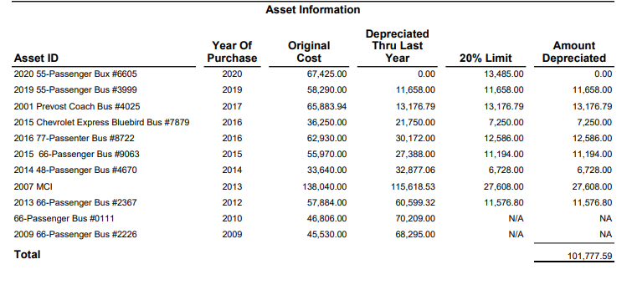
Max amt to depreciate
Cost $57,884.00
150%
$86,826.00
Depreciated thru FY2019
Levied in FY2021
Depreciated thru FY2021
Levy for FY2022
$ 60,599.32
$ 11,576.80
$ 72,176.12
?

Slide 23
This is an Asset Information List from a FY2021 Budget.
Ending Fund balance = $100,506.94
What are some observations you can make about this information?
What are the options this district has when estimating FY2022 levy amounts?
Notes:
What can we say about the information we see on this Asset List?
No tax levy in FY2021
None of the buses are fully depreciated.
If they decide to levy in this fund for FY2022, they will have an increase.

Slide 24
Finalizing the Notice
Next steps:
Decide what to include in notice
Minimum requirements
All funds
Develop notice language
Get Board approval, post notice as required
Refine numbers through fiscal year end
Make year-end spending decisions with ending fund balance and ensuing year taxes in mind

Slide 25
RESOURCES
MASBO
Denise Williams 406-461-3659
Steve Hamel 406-431-0124
OFFICE OF PUBLIC INSTRUCTION
Renee Richter 406-444-1960
Building Reserve Fund Guidance Document 2018

