Slide 1
Quarterly & Annual Payroll Reporting
September/October 2018

Slide 2
Quarterly Timeline
First Quarter:
January, February, March – Due April 15/30
Second Quarter:
April, May, June – Due July 15/31
Third Quarter:
July, August, September – Due October 15/31
Fourth Quarter:
October, November, December – Due January 15/31

Slide 3
HINTS
Wage Base Reconciliation – find your payroll errors before you finish payroll.
Keep copies of monthly deposits/printouts to reconcile with quarterly reports.
Be aware of deadlines. Being on time will save you penalties and headaches.
Run the quarterly BEFORE running the next payroll.

Slide 4
Federal 941
Submit quarterly.
Always check for updated forms.
Follow instructions provided with the form.
Pay particular attention to recording the correct liability dates on Schedule B, if applicable. Refer to IRS Publication 15, Circular E to determine your specific deposit schedule (semi-weekly, monthly, or quarterly depending on your total deposits for the look-back period). Note quarterly filing deadline.
INCORRECT dates can cause a fine to be assessed by the IRS.

Slide 5
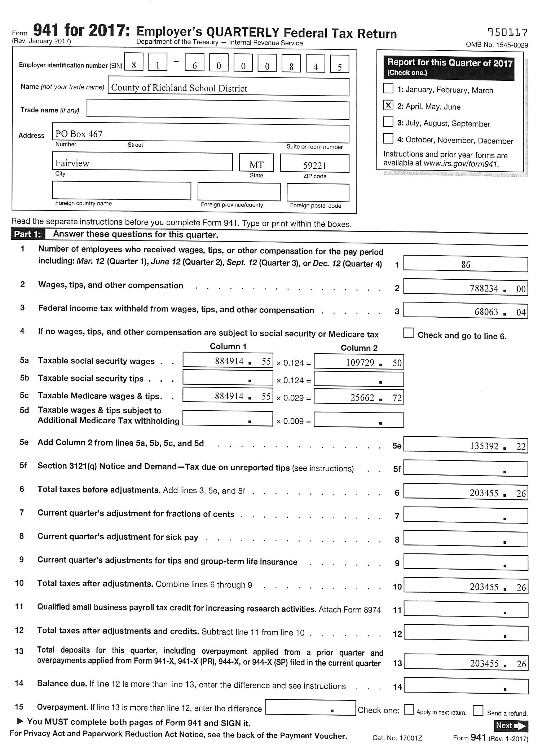
Put 941 here

Slide 6
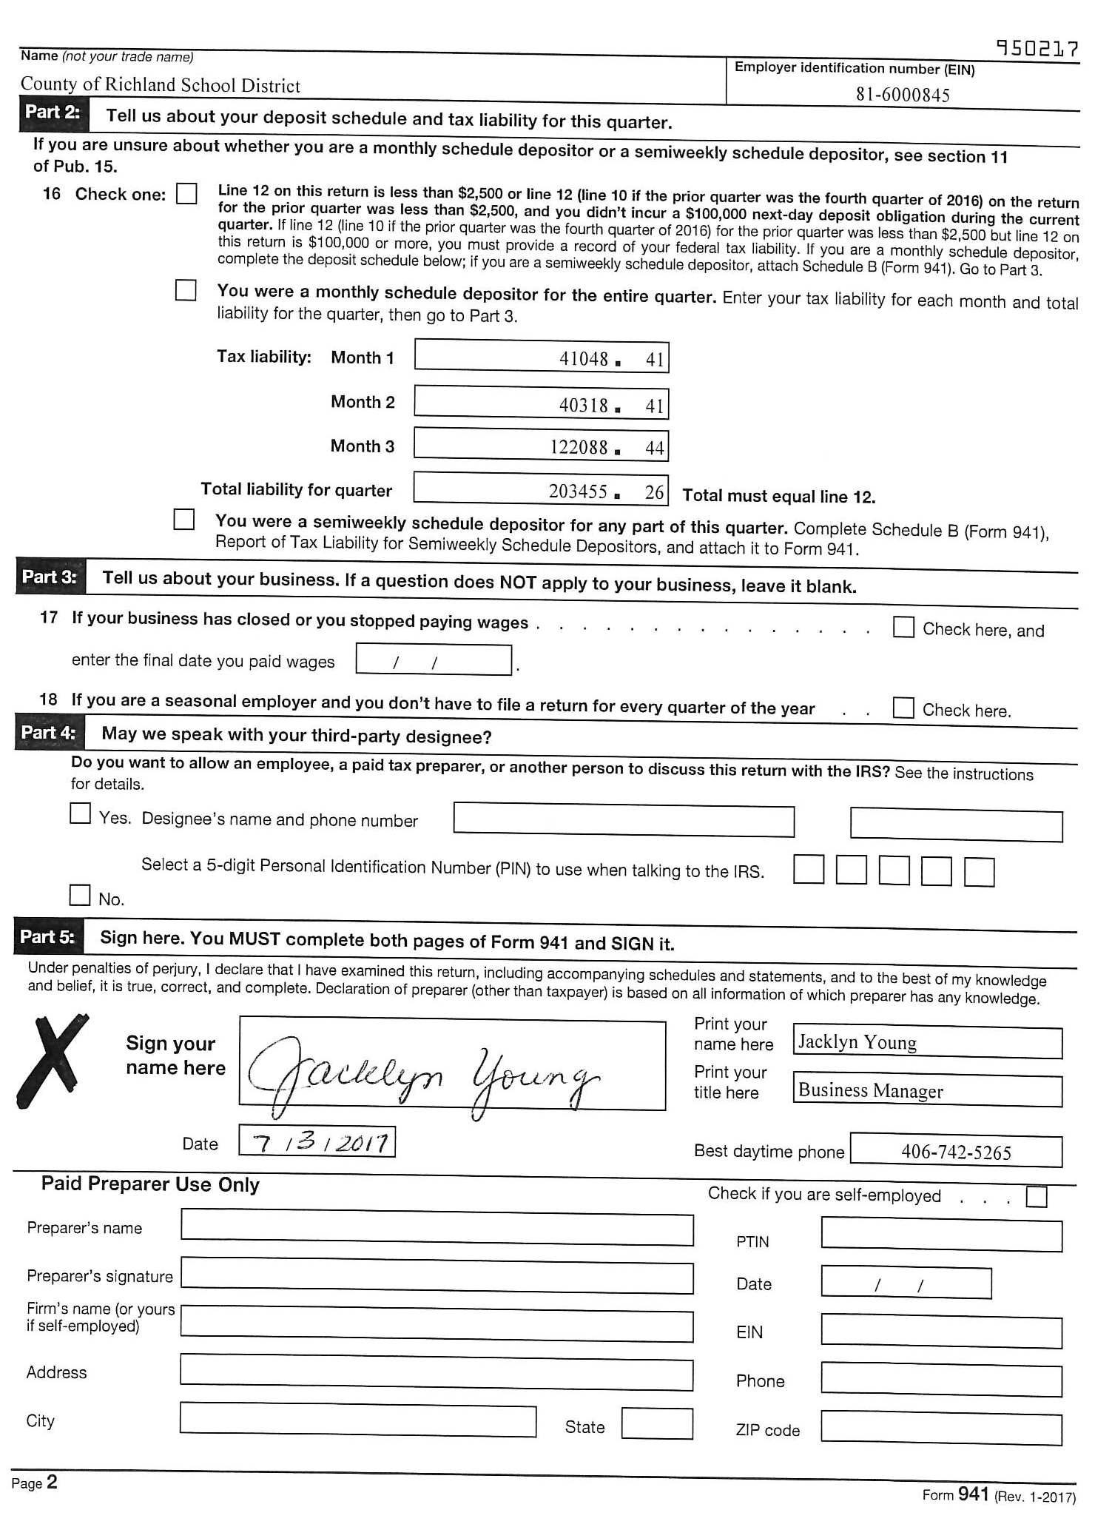

Slide 7
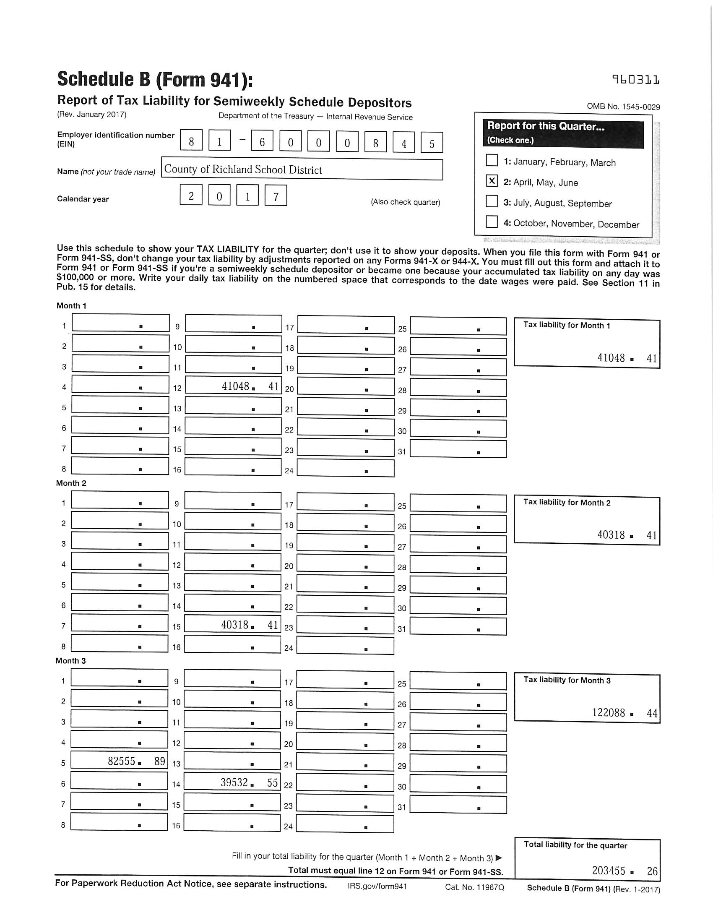

Slide 8
Unemployment
These checks may be written each pay period or quarter through your payroll system.
Unemployment insurance may be purchased through the State of Montana or Montana Schools Unemployment Insurance Program (MTSUIP).
Be sure to meet reporting deadlines in order to maintain coverage.

Slide 9
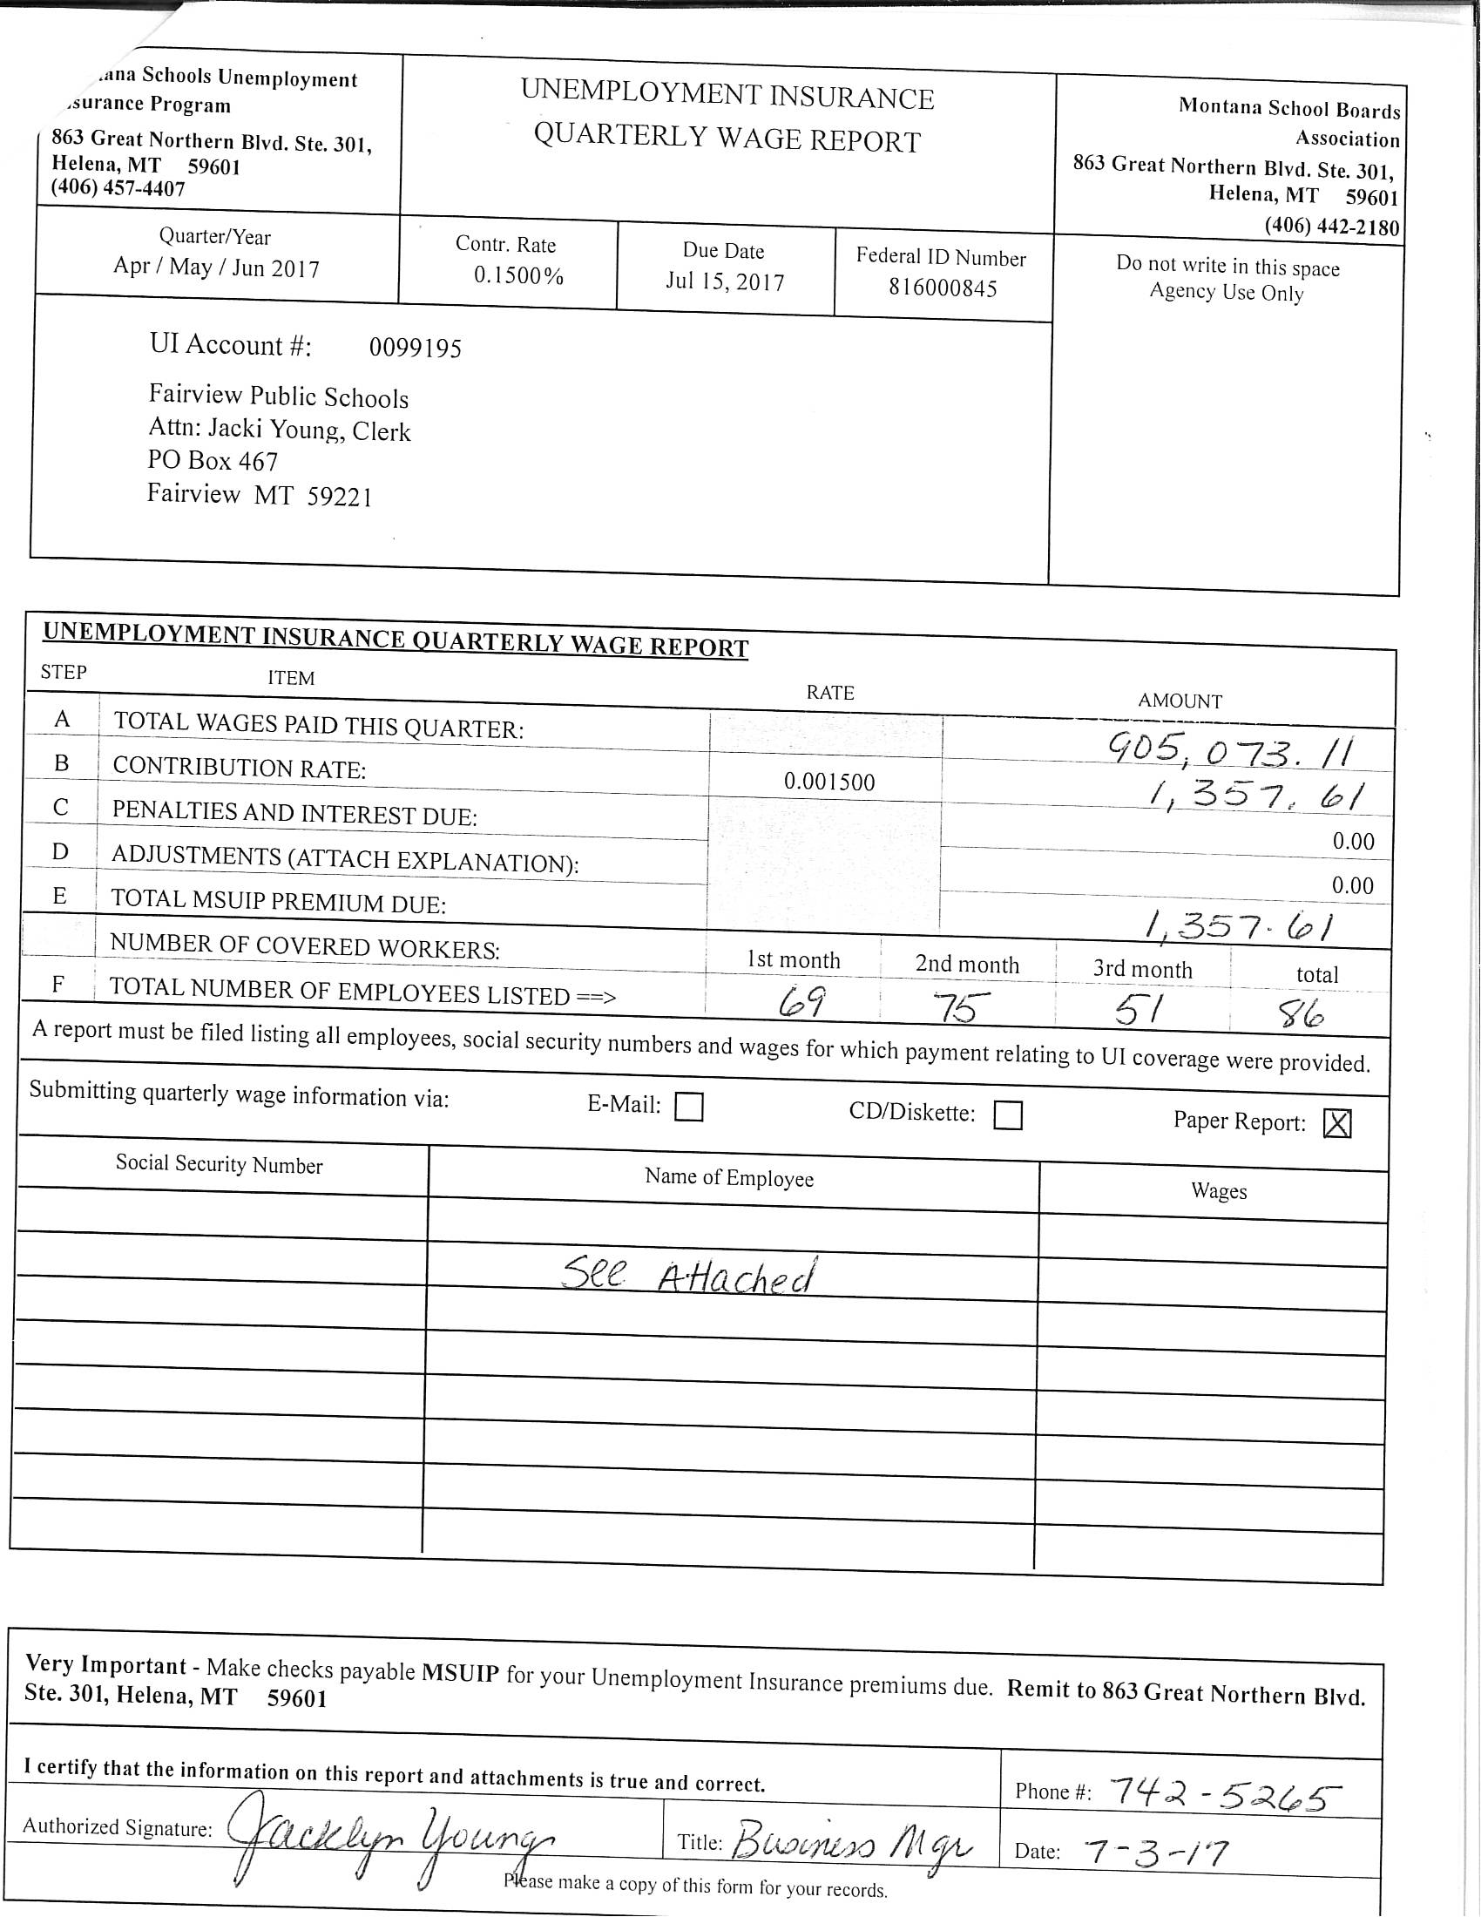
Unemployment form

Slide 10
Workers’ Compensation
These checks may be written each pay period or quarter through your payroll system.
Workers’ compensation insurance may be purchased through a private provider, the State of Montana, or the Workers’ Compensation Risk Retention Program (WCRRP).
Be sure to meet reporting deadlines in order to maintain coverage.

Slide 11
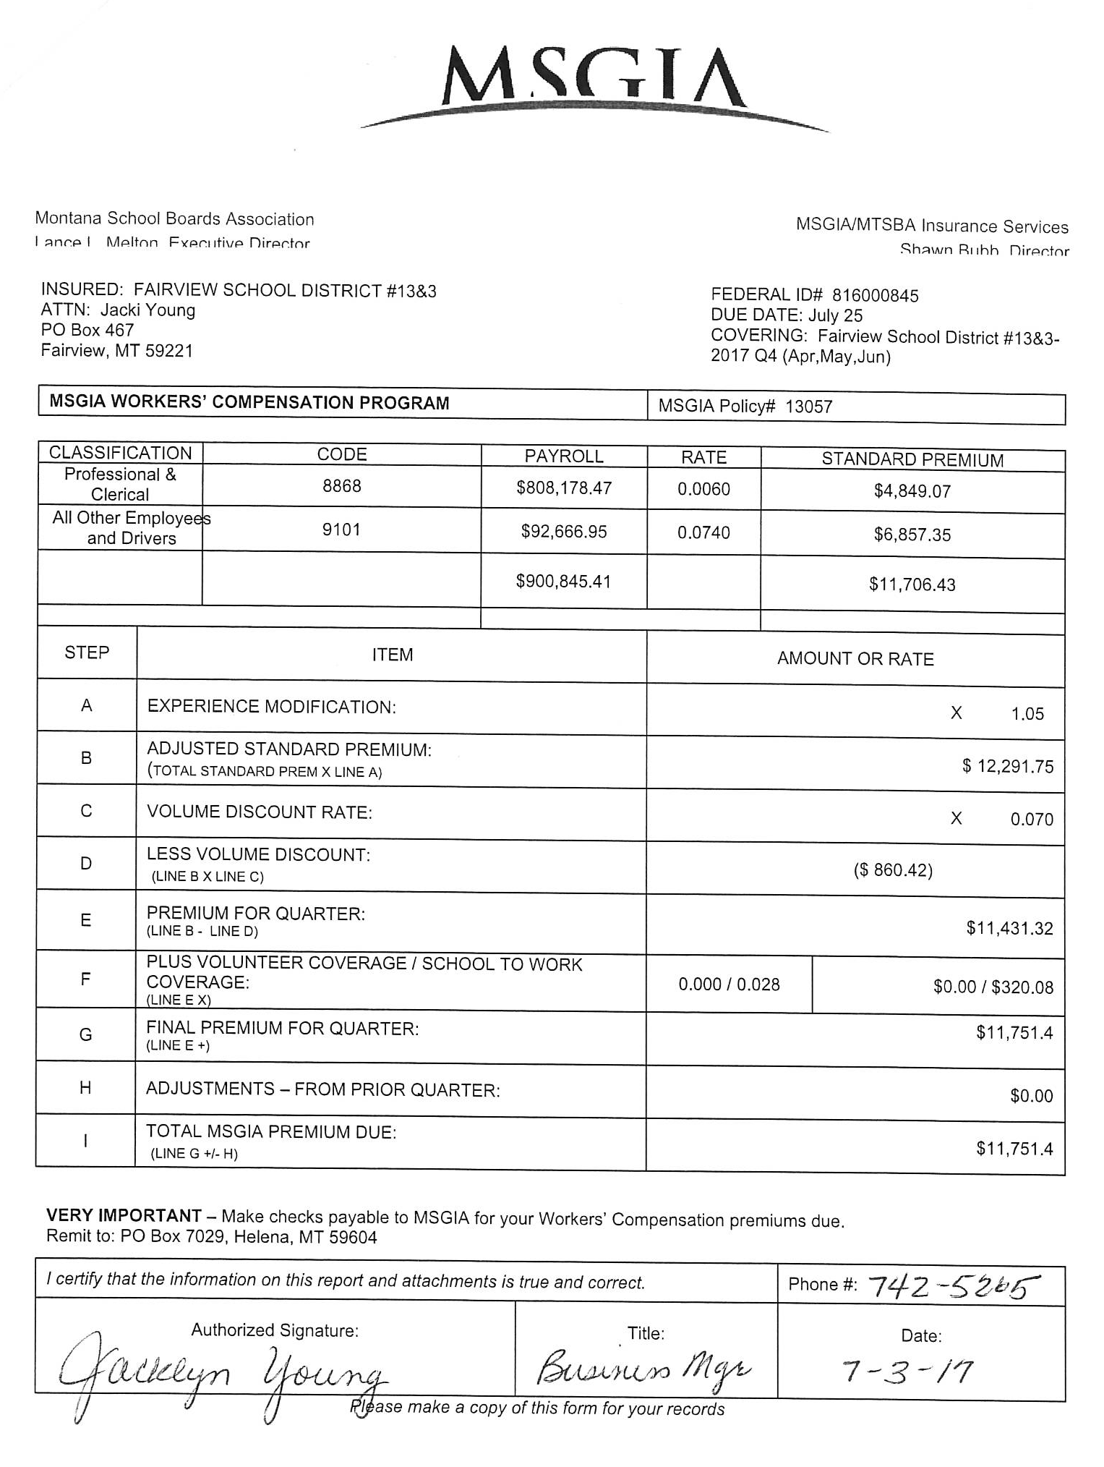
WC form

Slide 12
Annual Timeline
W-2/1099 are due by January 31 to:
Federal Government
State Government
Employee
ACA 1094/1095 are due to:
Employee – January 31, 2019
Federal – paper filing by February 28, 2019
Federal – electronic filing by April 1, 2019
MW-3
Montana Annual W-2/1099 Withholding Tax Reconciliation – due by January 31.

Slide 13
W-2 Forms
The Wage and Tax Statement is required by the Social Security Administration, IRS, and the Montana Department of Revenue.
You must furnish a form W-2 annually to each employee (see IRS “Instructions for Forms W-2 and W-3, Cat. No. 25979S).

Slide 14
Tips for W-2/1099
Create end of calendar year file to house 941, W-2, 1099 etc.
Order W-2 and 1099 forms in October or November so that you have them when you are ready to start. Contact your check company, accounting software vendor, IRS, or local accounting firm.
Employee W-2’s include copy for Federal tax return, State tax return and copy for employee.
Employer W-2’s include copy for IRS/SSA, MT Department of Revenue and employer.

Slide 15
Don’t submit your 4th quarter 941 until you have reconciled your W-2’s.
Prior to printing W-2’s, print W-2 reconciliation report. Compare with quarterly reports or balancing spreadsheets to verify totals.
Make sure the 941 Quarterly reports can be reconciled to the amounts on the W2 Summary and the amounts you report on the W3.
If balances don’t match, re-run payroll summaries for each quarter until you find something that is off.
If you find a quarter off, re-run each month and determine which month is off.

Slide 16
Now look at each employee for that month and find what is wrong.
Changes in someone’s taxable status mid-year will affect the balances.
Check to be sure that W-2 boxes 7-14 are identified properly, amounts reported correctly, and taxed appropriately.
Do not print final W-2’s until you are confident that all totals are accurate and verified.

Slide 17
Paper Filing – W-2/1099
Label 3 manila envelopes with the following addresses:
Montana Department of Revenue
PO Box 5835
Helena, MT 59604-5835
Social Security Administration
Data Operations Center
Wilkes-Barre, PA 18769-0001
Department of the Treasury
Internal Revenue Service Center
PO Box 219256
Kansas City, MO 64121-9256

Slide 18
Envelope 1: Montana Department of Revenue
Form W-2 Wage and Tax Statement.
Form 1099 Miscellaneous Income, State copy or extra file copy.
A photo copy of completed 1096 Form, Annual Summary and Transmittal of US Information Returns.
Form MW3 -starting 2016, this form is online @mt.gov (Revenue Forms).
Due Date: JANUARY 31 – both electronic and paper.

Slide 19
Envelope 2: Social Security Administration
Red Copy – Form W-2 wage and tax statement, copy A for Social Security Administration – send this entire page, do not tear apart.
Red Copy – Form W-3, Transmittal of Wage and Tax Statements, to Social Security Administration, photo copies are NOT acceptable.
Mail by January 31 (Check dates on the W-3)

Slide 20
Envelope 3: Internal Revenue Service
Red Copy of Form(s) 1099, Copy A for Internal Revenue Service Center.
Both parts of Form 1096 Annual Summary and Transmittal of US Information Returns
Mail by January 31 (Check dates on the 1096)

Slide 21
Electronic Filing – W-2/1099
Montana Department of Revenue – W-2/1099
Sign up for the TransAction Portal (TAP).
Upload files securely with TAP.
After file is successfully transmitted, keep copies of transmission.
Fast and easy!
Internal Revenue Service (1099) – FIRE
Sign up for Transmitter Control Code (TCC) using Form 4419.
Upload files using FIRE (Filing Information Returns Electronically).
Check back periodically to make sure file transmits without error.
Keep copies of successful transmission.
Social Security Administration (W-2) – BSO (Business Services Online)
Register for BSO.
Upload files or create W-2’s online.
After successful transmission, keep copies for your file.

Slide 22
Electronic Filing of W-2’s
File your W-2’s online with the Social Security Administration.
In order to complete online submission of W-2’s you must have a password with the Social Security Administration. You will also have a PIN (Personal Identification Number) assigned.
You can apply for a password and PIN at their website: www.ssa.gov/bso.
This website also has manuals and instructions for filing your W-2’s on-line.

Slide 23
Ensure you have completed your quarterly reports, balanced all quarters for the year to a yearly register and know that all payroll reports balance to the W-2’s you have prepared.
Create a social security verification file using your payroll software to submit to AccuWage Online on the SSA site. Use the resulting report to check for potential errors with social security numbers.
Select the option through your payroll software to create the W-2 file that will be submitted. This may be saved to a cd, desktop, etc.
When you are ready to submit your W-2’s you will log-on to the SSA site, browse to locate your payroll file and then choose to submit it. You will receive a confirmation that your file was received.
Keep copies for your files.
Problems: call SSA for assistance: 1-800-772-6270.

Slide 24
W-2 Summary
Your totals should reconcile with the amounts calculated from the full year payroll summary.
Multiply the Social Security and Medicare base wages by the withholding rates - should match the amount withheld (might be slightly off due to rounding)
If the numbers don’t reconcile, run 941 reports for all 4 quarters and compare the amount reported to the amount on the year payroll summary. Any differences may be explained by a paycheck adjustment or W-2 adjustment.

Slide 25
If no Social Security exempt employees, compare the local deduction report for Social Security and Medicare - these bases should equal.
Possible reasons why the Social Security base may not equal to the Medicare base:
Social Security was not withheld on some employees.
There may be employees who have met the Social Security wage ceiling.
W-2 adjustments have been done on one base but not the other.

Slide 26
E-filing with Montana – W-2/1099
Use the TransAction Portal (TAP) system to upload your W-2 and 1099 forms.
Use your accounting software to prepare the W-2 and 1099 files.
Log on to TAP and upload your files.
Keep copies of the successful transmission for your files.
Problems: call MDOR at 406-444-6900.

Slide 27
Federal E-filing of 1099’s
This is not technically a payroll form since it is derived from accounts payable or claims information.
This form is issued to a non-incorporated individual, partnership, or business (independent contractor) for payment of services rendered for $600 or more.
Prior to paying for services rendered, determine eligibility using the “reasonable basis” test reference in Circular E.

Slide 28
I’m On FIRE For 1099’s
To federal e-file 1099’s use the FIRE (Filing Information Returns Electronically) system with the IRS.
Use your accounting software to create the 1099 file.
Gather your Transmitter Control Code and passwords and log on the FIRE site.
Upload the file.
Keep copies of the successful transmission in your files.
Problems: call FIRE at 1-866-455-7438.

Slide 29
Retain For Your Files
School’s copy of W-2’s.
School’s copy of W-3.
Any reports you use to prepare W-2’s.
School’s copy of 1099’s.
Photo copy of 1096.
Photo copy of MW3.
Any W-9 forms that you have received.

Slide 30
W-9 Forms
Obtain a W-9 from all vendors.
Use this form to determine the tax classification of your vendors.
It is important to find this out – IRS penalties can be substantial if you do not file a 1099 when you should.

Slide 31
ACA – 1094/1095
If you are a large employer (at least 50 full-time or “full-time equivalents”), you are required to send annual 1095 forms to every employee.
If you have a fully funded insurer (i.e. BCBS), they send the notices for you.
If you have a trust (MUST, JPT), you may have to send these forms.
Contact your accounting software provider for help in setting up your software to produce these forms. Or contract with someone who will provide these forms for you.
DUE DATE: Generally January 31. However, the IRS has extended this date every year since these forms have had to be provided to the employee.

Slide 32
Contacts
MASBO Payroll Committee
Co-Chairs:
Brigette Clark – Geraldine – 406-737-4371
Jane Knudsen – Malta – 406-654-1871
Committee Members:
Charlene Aberg – Cut Bank – 406-873-2229 x113
Ginger Martello – Ennis – 406-682-4258
Laurie Noonkester – Lockwood – 406-252-6022 x4
Carrie Ruff – Bonner – 406-258-6151
Jodi Williams – Richey – 406-773-5523

