Slide 1


Special Education Funding
New Clerk Academy Fall 2021
September 22 – Great Falls
September 23 – Missoula
September 30 – Billings
Denise Williams
MASBO Executive Director

Slide 2
SPECIAL EDUCATION FUNDING
AGENDA
Funding Sources
Allowable Expenditures
Reversion and Maintenance of Effort

Slide 3
Funding Sources
STATE and LOCAL
  Special Education Allowable Costs
  Reimbursement for Disproportionate Costs
  Tuition Fund Levy (local)
  Tuition revenue from other districts
FEDERAL
  IDEA Part B and Preschool
  Medicaid
  Impact Aid

Slide 4
Funding Sources - State
Eligibility (ARM 10.16.3810)
A district has a special education program if it:
  has at least one resident student in its current fiscal year special ed child count ; -- or --
  Participates in a cooperative; -- or --
  Has a written agreement with another school district or cooperative to provide a special ed program if a student in need enrolls

Slide 5
Funding Sources - State
Eligibility (ARM 10.16.3810) - continued
The following are not eligible if providing education services under contract with OPI:
  Residential treatment facilities
  Children’s psychiatric hospital

Slide 6
Funding Sources - State
Special Education Cooperative
full service education cooperative or joint board (20-7-451, MCA) to provide special education services
eligible for member districts’ RSBG and admin & travel costs if requirements in 20-7-457, MCA are met
Allowable costs same as districts plus additional costs of operating the cooperative

Slide 7
Funding Sources - State
General Principles (ARM 10.16.3804)
Funding based on legislative appropriation and current year ANB
Local contributions (match) is required
Expenditure of funds limited to certain allowable costs to provide services to children with disabilities, ages 3–21
Block grant system allows flexibility in methods within allowable cost guidelines
OPI uses annual TFS to make determinations (coding is important)

Slide 8
Special Education Allowable Costs
 | FY2021 | FY2022 | FY2023
Current ANB per fiscal note to HB46 | N/A | 155,258 | 156,295
*Rate per ANB | N/A | $287.93 | $286.02
Total for special education allocation | $44,702,880 | $44,703,436 | $44,703,496
*20-9-306(17), MCA: “ . . . the greater of the amount resulting from multiplying [the rates shown above] by the statewide current ANB or the amount of the previous year’s total special education allocation. 20-9-326(1), MCA amended to include the per-ANB rates for special education allocation in calculations for annual inflation-related adjustments for general fund components.
Notes:
FY2019 Base = $43,291,924
FY2019 Base X .91% = $393,957
FY2020 distribution = $43,903,428 ($43,509,471 + $393,957)
FY2019 Base + HB638 approp for FY2020 = $43,685,881
$43,685,881 X 1.83% = $799,452
FY2021 distribution = $44,702,880 (FY2020 distribution $43,903,428 + $799,452)
HB638 approp for FY2021: $44,702,880 – (HB2 approp) $43,509,471 = $1,193,409

Slide 9
Special Education Allowable Costs
Distribution of legislative appropriation
(20-9-321, MCA and ARM 10.16.3811)
52.5% to Instructional Block Grants
  Paid to school districts only*
17.5% to Related Services Block Grants
  Paid to school districts or cooperatives*
25% to Disproportionate Cost Reimbursements
  Paid to school districts only
5% to Admin & Travel
  Paid to cooperatives only
*Subject to reversion
(1/3 local match required)

Slide 10
Special Education Allowable Costs | Rate for FY2022 | Who receives payment? | Local Match required
8a. Instructional Block Grant (ISB) | $156.45 per current year ANB | District | $1 of local match for every $3 (ISB X .33)
8b. Related Services Block Grant (RSBG) If district is in a co-op, see 8e. | $ 52.15 per current year ANB | - To district, if district operates its own program - To special education cooperative if district is a member of the co-op | $1 of local match for every $3 (RSBG X .33) Districts in a co-op send their local match to the co-op
8c. Reimbursement for Disproportionate Costs | See PDBS pg 2 for calculation | District | no

Slide 11
Funding Sources - State
Quality Educator Payment (20-9-327, MCA)
  Based on # of full-time equivalent educators
    Licensed educators
    Licensed professionals
  Distributed to:
    School Districts
    Special Education Cooperatives
    MT School for the Deaf & Blind
    State youth correctional facilities
    Montana Youth Challenge Program

Slide 12
Funding Sources – Tuition Fund Levy
Tuition Fund (13)
permissive levy for in-district special education student costs
Student must have an individual education plan (IEP)
Estimate costs identified in IEP
Subtract state and federal funding sources
Remainder may be raised by the local levy
OPI Resources:
Special Education Tuition Levy Calculator
Nicole Thuotte, nthuotte@mt.gov 406-444-4524

Slide 13
Funding Sources – Tuition Revenue
Tuition Revenue from Other Districts
Your district is providing services to a student who resides in a different district
Use OPI Tuition forms
  FP-14.1 Student Attendance agreement form
  FP-14A Special Tuition rates
OPI Resources:
Nicole Thuotte, nthuotte@mt.gov 406-444-4524
OPI Tuition and Attendance webpage

Slide 14
Funding Sources – Federal
IDEA Part-B
Medicaid Reimbursements
Impact Aid

Slide 15
IDEA Part-B
Federal program
“IDEA” = Individuals with Disabilities Education Act
Coops receive allocations on behalf of member districts
Application and payments done in E-Grants

Slide 16
Medicaid Reimbursements
Administered by Dept. of Public Health & Human Services (DPHHS)
DPHHS Contact: Laurie Nelson
Available programs
  Direct Services or Direct Care
  Medicaid Administrative Claiming (MAC)
  Comprehensive School & Community Treatment (CSCT)

Slide 17
Impact Aid
Flat allocation based on CWD count, LOT percentage
Must spend for special ed purposes
Funds may be accumulated from year to year
Counts toward reversion spending
Does not count toward IDEA Part B MOE
May access Retirement Fund (14) for employer share of retirement costs for employees paid with Impact Aid funds

Slide 18
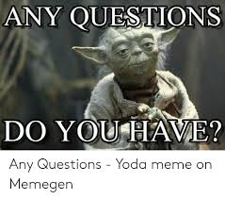
Special Education Funding Sources

Slide 19
SPECIAL EDUCATION FUNDING
AGENDA
Funding Sources
Allowable Expenditures
Reversion and Maintenance of Effort

Slide 20
Special Education Allowable Costs
Allowable costs (costs for special education programs)
  See 20-7-431, MCA
    Instructional services
    Related services
  ARM 10.16.3806 instructional services
  ARM 10.16.3807 related services
  ARM 10.16.3808 cooperatives

Slide 21
Special Education Allowable Costs
Allowable costs do not include the entire cost of operating a special education program
ARM 10.16.3805 excludes:
    - Employer contributions to TRS, PERS, FICA, and unemployment insurance
    - Admin, teachers or aides necessary to meet accreditation
    - Transportation (see also ARM 10.16.3820)
    - Most administrative support personnel
    - Overhead costs

Slide 22
State Special Education Funding - Reversion
Coop member districts:
Instructional Block Grant
+ 1/3 Instructional Block Grant
+ 1/3 Related Services Block Grant
= Minimum Sp Ed Expenditures to Avoid Reversion
Non-member districts:
Instructional Block Grant
+ Related Services Block Grant
+ 1/3 Instructional Block Grant
+ 1/3 Related Services Block Grant
= Minimum Sp Ed Expenditures to Avoid Reversion
Notes:
This is a diagram representing the minimum Sped Expenditures to avoid reverting money back to the state for both Coop members and non-members. You see the IBG in both, and the local match represented in both. What is the difference between the two?

Slide 23
Difference between Coop and Non-Coop
Coop member districts:
Instructional Block Grant
+ 1/3 Instructional Block Grant
+ 1/3 Related Services Block Grant
= Minimum Sp Ed Expenditures to Avoid Reversion
Non-member districts:
Instructional Block Grant
+ Related Services Block Grant
+ 1/3 Instructional Block Grant
+ 1/3 Related Services Block Grant
= Minimum Sp Ed Expenditures to Avoid Reversion
Coop Member?
Yes: RSBG Paid to Coop
No: RSBG paid to and budgeted for at the district level
Notes:
The big thing to notice here is that the RSBG is not something that needs to be spent by Coop members. Remember, the RSBG associated with the district goes directly to the Coop if the district is a coop member. Then, the coop has the responsibility to spend it on behalf of the district. Member districts are still responsible to make the RSBG match, which will need to be sent to the coop. ***Member districts can also send their IBG to the coop as well.

Slide 24
Difference between Coop and Non-Coop
Coop member districts:
Instructional Block Grant
+ 1/3 Instructional Block Grant
+ 1/3 Related Services Block Grant
= Minimum Sp Ed Expenditures to Avoid Reversion
Non-member districts:
Instructional Block Grant
+ Related Services Block Grant
+ 1/3 Instructional Block Grant
+ 1/3 Related Services Block Grant
= Minimum Sp Ed Expenditures to Avoid Reversion
ALL Districts must match IBG and RSBG
Notes:
BOTH districts need to match both grants. Coop members must match the RSBG, even though they don’t directly receive the RSBG. They will make their match by transferring to the coop.

Slide 25
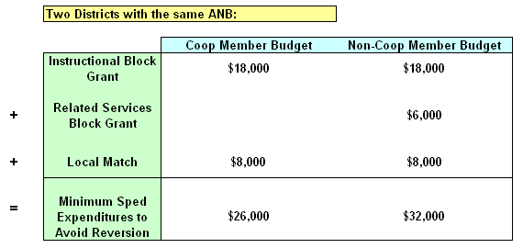
Difference between Coop and Non-Coop
Notes:
This is a numerical example of two districts with the same ANB (one coop, one non-member). IBG is the same. Non-Coop member doesn’t receive the RSBG. Both districts still need to match both grants. The difference in each district’s expenditures to avoid reversion is simply the amount that went to the coop.

Slide 26
Difference between Coop and Non-Coop
Where is the RSBG?
Notes:
This is a numerical example of two districts with the same ANB (one coop, one non-member). IBG is the same. Non-Coop member doesn’t receive the RSBG. Both districts still need to match both grants. The difference in each district’s expenditures to avoid reversion is simply the amount that went to the coop.

Slide 27
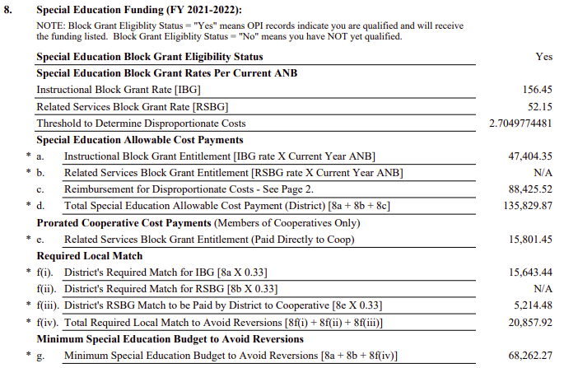
Coop Member Prelim. Budget Data Sheet:
IBG always paid to district
Coop member:
RSBG Paid directly to Coop. District Still Matches RSBG
Notes:
This is an example of a coop-member’s PBDS. The top circle is the IBG, which every district receives. The Prorated Cooperative Cost Payment is the RSBG for each district, but it goes directly to the coop. Under the local match area, you’ll notice that the coop member must still match the RSBG, but they send it directly to the Coop.

Slide 28
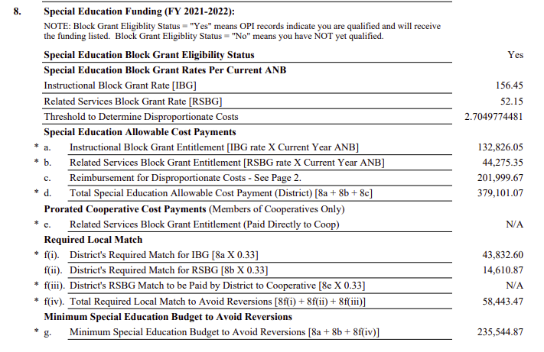
Non-Coop Member
Prelim. Budget Data Sheet:
Non-Coop Member:
RSBG Paid to District
(RSBG Rate x ANB)
Notes:
A non member’s PBDS looks almost exactly the same, except that they receive the RSBG directly. Their match is not transferred to anyone.

Slide 29
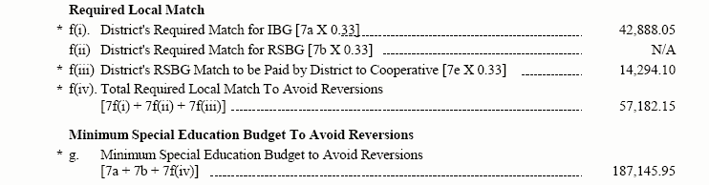
Prelim. Budget Data Sheet
Instructional Block Grant
+ Related Services Block Grant (if NOT in coop)
+ 1/3 Instructional Block Grant
+ 1/3 Related Services Block Grant
Minimum Expenditures to Avoid Reversion
Local Match
Notes:
Remember to point out that the amount to avoid reversion can be much lower that the amount of the BASE represented by SPED (it comes down to that 40% of the allowable cost payments, basically because of Disproportionate Costs. (the convo with Janelle)
Minimum sped expenditures to avoid reversion are very similar, except that the Coop members don’t budget in the RSBG.

Slide 30
Reversion Expenditures
Listed in 20-7-431, MCA
Picked up from following funds:
  General (01)
  Tuition (13)
  Metal Mines (24)
  State Mining Impact (25)
  Impact Aid (26)
Expenditure codes counting toward reversion:
  280 1XXX 1XX - 7XX
  280 21XX 1XX – 7XX
  280 221X 1XX - 7XX
  280 222X 1XX - 7XX
  280 24XX* 1XX - 2XX
  280 62XX 920
  * Salaries and benefits under function 24XX are only allowed if a certified special education director is employed.
Notes:
Expenditures that count toward reversion are defined in 20-7-431. They are picked up from the four funds listed above (ARM 10.16.3813). The expenditure codes that are picked up are all program 280
Function codes:
1XXX = Instructional
21XX = Support Services
221X = Improvement of Instruction Services
222X = Educational Media Services
24XX = Certified Sped Director employed (Salaries and Benefits only)
62XX = Payment to the Coop
Object Codes:
1XX = Salaries
2XX = Benefits
3XX = Purchased Professional and Technical Services
4XX = Purchased Property Services
5XX = Other Purchased Services
6XX = Supplies and Materials
7XX = Property and Equipment Acquisition

Slide 31
Reversion Expenditures
Listed in 20-7-431, MCA
Picked up from following funds:
  General (01)
  Tuition (13)
  Metal Mines (24)
  State Mining Impact (25)
  Impact Aid (26)
Expenditure codes counting toward reversion:
  280 1XXX 1XX - 7XX
  280 21XX 1XX - 7XX
  280 221X 1XX - 7XX
  280 222X 1XX - 7XX
  280 24XX* 1XX - 2XX
  280 62XX 920
  * Salaries and benefits under function 24XX are only allowed if a certified special education director is employed.
NOTE: Money and match sent to the coop is “Allowable Cost!”
Notes:
The Money and match that is required to be sent is counted toward reversion.

Slide 32
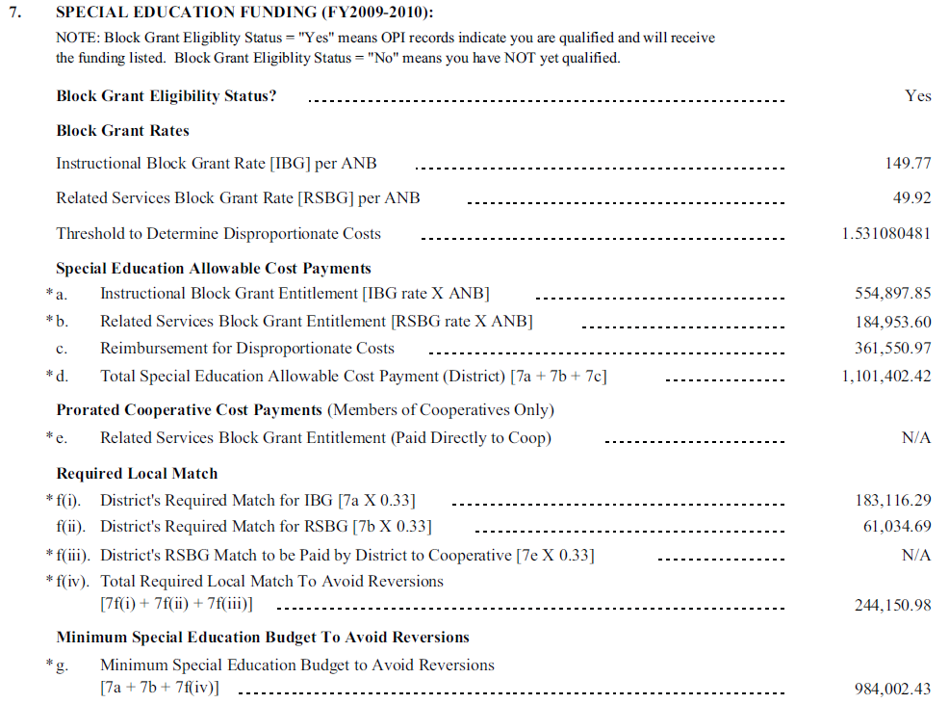
Prelim. Budget Data Sheet
ONE MORE THING . . . .
Reimbursement for Disproportionate Costs are NOT included in Minimum Sped Expenditures to avoid Reversion
Notes:
Obviously a district has already spent funds on sped two years earlier to get the reimbursement. The reimbursement does not count toward expenditures to avoid reversion.

Slide 33
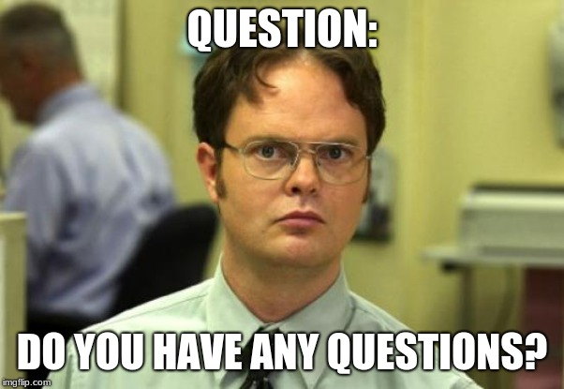
State Special Education Reversion

Slide 34
IDEA Part B Funds
Maintenance of Fiscal Effort
Basic Requirement
*IDEA Part B Funds may not be used to
reduce the level of state/local or local fund
expenditures for special education below the
level of expenditures for the preceding fiscal year.
Notes:
Supplement vs. Supplant: 300.203
IDEA B funds are not to be used to reduce state/local expenditures. This is why the Feds have a MOE calculation.

Slide 35
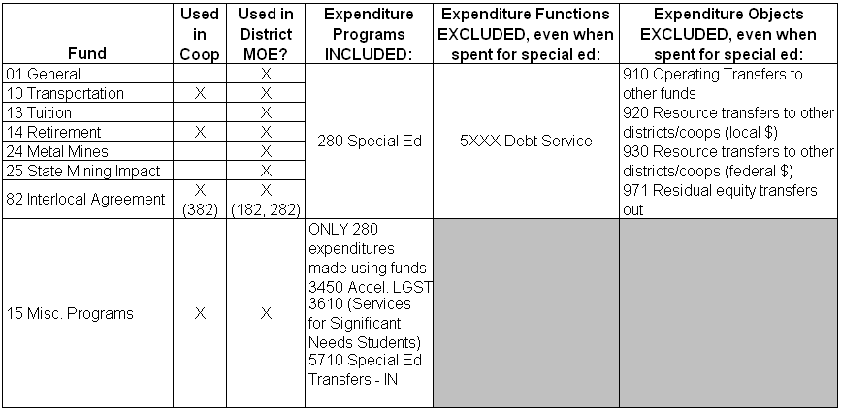
Maintenance of Effort Expenditures

Slide 36
How Does An Applicant Know If They Maintained Effort?
OPI calculates MOE using the Trustees’ Financial Summary (TFS)
OPI sends two reports to the Part B applicant
  Preliminary and Final
Both Reports show
  expenditures for state/local funds
  allowed reduction and decrease in enrollment (calculates per capita)
Notes:
OPI will send a preliminary report around Thanksgiving. If a district is informed that they did not maintain effort, they may need to look back at their expenditures and recode to special ed (if appropriate). They may also apply for an allowable exception, which we’ll talk about soon. TFS’ are not finalized until December 20th.
When you get the final report in the spring, it will break down the expenditures of state/local funds. It will also detail allowable reductions, if they are any.
It is important to note that when MOE is calculated, it is a roll-up for all of the districts participating in the application. It is wise for districts which are pare of a consortium of special education coop under IDEA, to keep the prime applicant informed about any potential changes to their MOE

Slide 37
Maintenance of Fiscal Effort
Allowed Exceptions
Voluntary departure, by retirement or otherwise, or departure for just cause of special education personnel *
Decrease in enrollment of children with disabilities
Termination of the obligation of the district to provide a special education program to a particular child that is exceptionally costly (e.g., student left the district; no longer requires the special education program) *
4. Long-term purchases (i.e., equipment/ facilities)
* District must document to OPI
Notes:
Common sense reasons…..300.204
When you get the preliminary report and letter from OPI, you’ll need to document these to OPI if they are the reasons for not maintaining effort. #2 is already addressed because OPI has that on record with the child count. OPI also excludes calculations for costly expenditures for long term purchases, therefore these exceptions have already been considered. Documentation is needed for 1 and 3, and the form is available on the website.
The previous regulation for #1 included language which stated “and are replaced by lower salaried personnel”. This specific language is no longer present in the new regulation. Refer to 34CFR300.203(a).

Slide 38
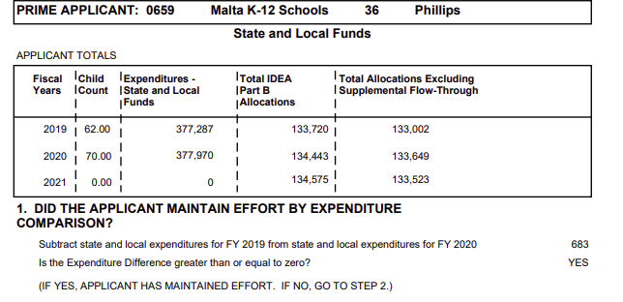
Maintenance of Effort Report
From TFS report
Notes:
You’ll get a preliminary one in November. This is what the report looks like. You’ll notice that the prime applicant is listed at the top. The important information is in bold right at the top. The first box details how much the applicant can reduce their level of state/local expenditures for the current year. (Keep in mind that when you get the report, the current FY is almost over) Notice the allowable reduction amount, it allows a district to decrease their amount of local expenditures.
Remember, this report shows whether or not a district maintained effort during the previous FY. The expenditures come off the TFS. Final report (comes out in April) is used for completing the upcoming IDEA Part B application.

Slide 39
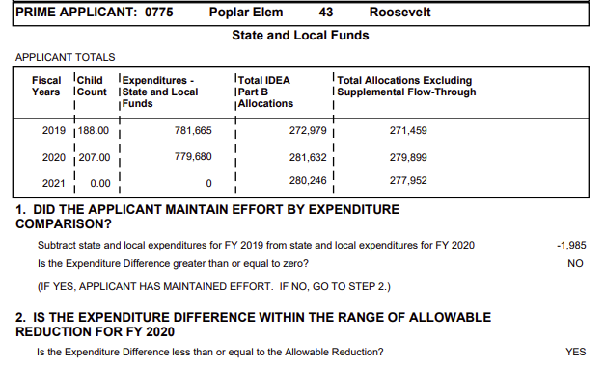
Maintenance of Effort Report
Allowable reduction = 50% of increase in allocation (excluding supplemental flow-through)
From TFS report
Notes:
You’ll get a preliminary one in November. This is what the report looks like. You’ll notice that the prime applicant is listed at the top. The important information is in bold right at the top. The first box details how much the applicant can reduce their level of state/local expenditures for the current year. (Keep in mind that when you get the report, the current FY is almost over) Notice the allowable reduction amount, it allows a district to decrease their amount of local expenditures.
Remember, this report shows whether or not a district maintained effort during the previous FY. The expenditures come off the TFS. Final report (comes out in April) is used for completing the upcoming IDEA Part B application.

Slide 40
IDEA Part B Maintenance of Effort
Allowable Reduction:
If IDEA B allocation exceeds prior year allocation, applicant may treat as local funds up to 50% of the difference
Must spend on qualifying Elementary and Secondary Education Act (ESEA) activities or Early Intervening Services (EIS)
Not available to applicants that are not meeting FAPE (determined by OPI)
Notes:
Federal Register #300.205
If the allocation exceeds the amount from the prior year, an applicant can treat up to 50% as local funds. However, the funds must still be spent on ESEA activities or EIS.
Not available to those not meeting FAPE, as determined by OPI.

Slide 41
Allowable Reduction Example
FY20 IDEA, Part B Grant: $279,899
FY19 IDEA, Part B Grant: $271,459
Difference: $ 8,440
x 50%
Allowable reduction: $ 4,220
FY19 MOE expenditures: $ 781,665
Allowable reduction: $ 4,220
FY20 MOE requirement: $777,445
FY20 MOE TFS Total $779,680
Notes:
This is an example for how allowable reductions works. In FY08, your grant was $100K, and your MOE expenditures were $80K. In FY09, your grant increases by $50K. You will be allowed to treat 50% of that increase as local expenditures. Therefore, your FY09 MOE requirements will drop to $55K.

Slide 42
Allowable Reduction…..Effect on Budget
FY22 IDEA-B Grant: $150,000
FY21 IDEA-B Grant: $100,000
Difference: $ 50,000
x 50%
Allowable reduction: $ 25,000
FY21 MOE expenditures: $ 80,000
Allowable reduction: $ 25,000
FY22 MOE requirement: $ 55,000
FY21 Special Ed Budget:
IDEA Grant $100,000
State/Local $ 80,000
Total $180,000
FY22 Special Ed Budget:
IDEA Grant $150,000
State/Local $ 55,000
Total $205,000
Notes:
Let’s look at the effect it has on a theoretical budget. In FY08, the budget was $180K. In FY09 after the grant increase, the district has the ability to contribute $25K less in state/local funds, while still meeting the requirements for MOE.

Slide 43
IDEA Part B Maintenance of Effort
  Determining required spending level to maintain effort:
  Prior year state and local expenditures
  Less: Allowable Reductions
  Less: Exceptions
  = Required state & local spending levels
Notes:
From TFS or MOE reports. During FY09, to figure out required spending level, you must look at what you spent in 08. 3 things you need to get on your own to determine your required spending level in 09.

Slide 44
Similarities between Reversion and MOE
Both look at state and local special education expenditures
Expenditures are tracked for both via Trustees’ Financial Summary (TFS)
Failure to meet requirements results in less special education funds for the district
Notes:
Both are about state and local spending requirements. Reversion is an expenditure level required by the state, while MOE is designed to ensure that school districts aren’t supplanting state and local dollars with federal funds.
Both levels are tracked by the TFS from year to year, which makes it absolutely vital to code everything properly.

Slide 45
 | REVERSION *STATE Requirement | MOE *FEDERAL Requirement
Affected fund(s) | General (01) | General (01) Misc Programs (15)
Tracked by | District | District and Coop
Purpose | Ensure local funds match state dollars (state law) | Ensure federal funds are not used to supplant state/local funds
Inadequate spending results in | Reduced state special ed allowable cost payment in ensuing year | Repayment to OPI with local funds and OPI Repays Feds
Basis for determination | ANB, legislative appropriation (Block Grants) | Prior year state and local expenditures
Notes:
This chart just shows what Reversion and MOE are. IDEA MOE is not a match at all, but based on prior years state and local expenditures. (If your IDEA grant increases, your state and local dollars don’t have to increase and they may in fact decrease if you can take an allowable reduction)

Slide 46
Timeline
2nd Mon in Sept: TFS due
November 20: OPI calculates preliminary MOE and notifies schools
December 10: Last date for TFS changes
January – February: OPI reduces state payment by reversion amount
March: OPI reports final MOE status
Notes:
Here’s a basic timeline for the MOE process.
The TFS is due in September.
By November 20, OPI calculates preliminary MOE and notifies the districts. At this point, it might be possible that a district did not meet MOE. A district has another month to make changes to their TFS, if appropriate, by recoding some expenditures to program 280.
After December 20, this option is no longer available.
Jan-Feb
In March, the final MOE reports are issued.

Slide 47

Special Education Funding
This Photo by Unknown Author is licensed under CC BY-SA

