Slide 1
June cleaning!!!!
By popular demand!!!

Slide 2
Agenda
June deadline review
Suggestions for closing out the year

Slide 3
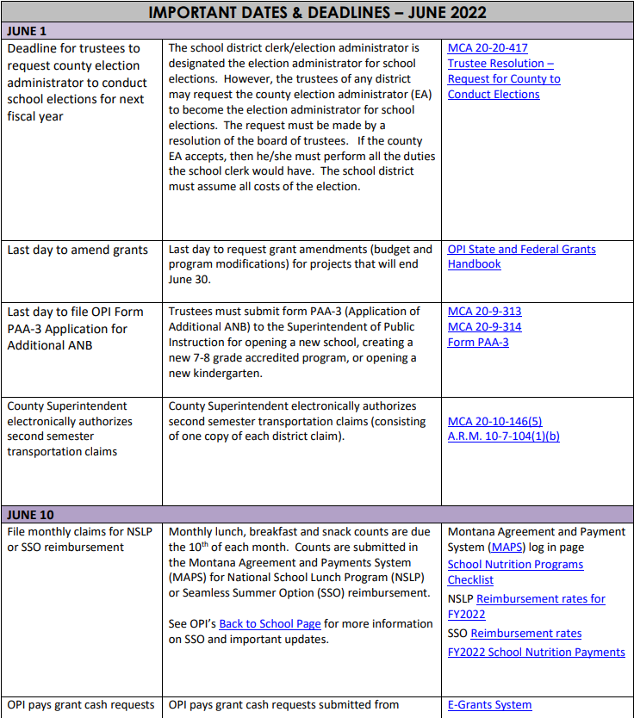
June deadlines per montana code annotated 2021

Slide 4
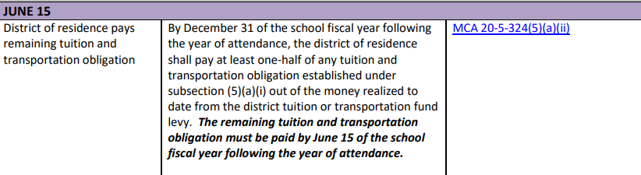
June 15, 2022 2nd tuition payment due

Slide 5
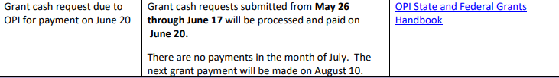
June 17, 2022 2nd June cash request on e-grants

Slide 6
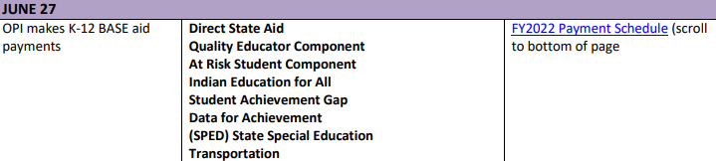
June 27, 2022 K-12 Base Aid payments
All are double payments, except transportation

Slide 7
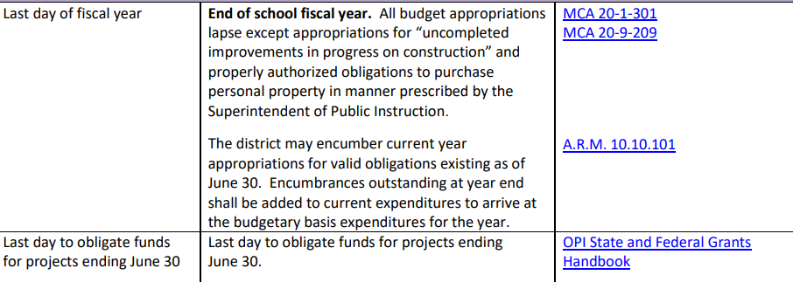
June 30, 2022 last day to “obligate” funds

Slide 8
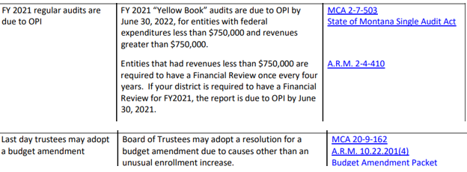
June 30, 2022 Audits and budget amendments

Slide 9
Suggestions for June cleaning
MAKE SURE YOUR CASH BALANCES WITH THE TREASURER’S CASH
Cancel stale warrants
Cancel un-used/under-used purchase orders
Make sure all cash and checks are deposited with the treasurer/bank
Calculate your compensated absences for possible transfers
Check your fund balances for possible expenditure recoding
Confirm any fixed assets purchased/removed

Slide 10
Balanced????
Of course you are balanced through May.
  Your accounting software cash agrees with the treasurer’s cash balance for each fund
  Your accounting software cash agrees with your bank statement
    For those of you who do not bank with the treasurer
If not, stop everything and get balanced!!!

Slide 11
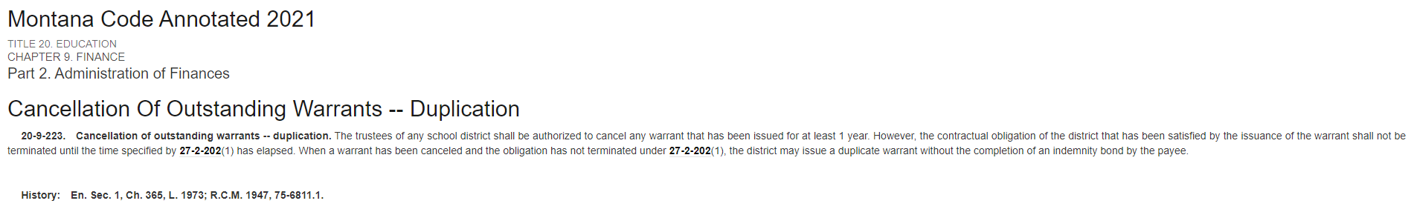
Cancel stale warrants

Slide 12
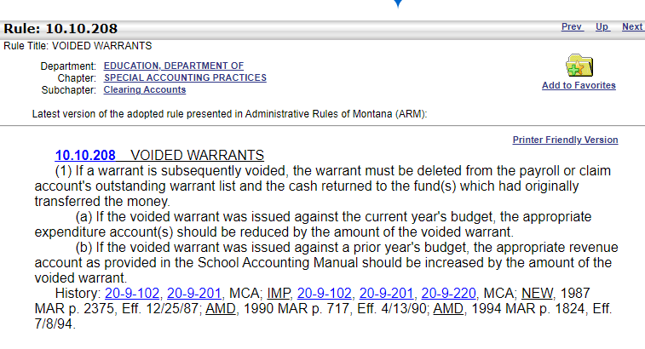
Cancel stale warrants

Slide 13
How do you do this with your software?
Each software handles this a little differently, ask tomorrow. Heck, they might bring it up!

Slide 14
Make sure all cash and checks are deposited by year end.
Deposit any activity cash withdrawn at the start of the year for gate/concessions boxes.
Don’t let checks written to your district sit in your drawer, research why they were sent.
  Reimbursement – code against the expenditure line item
  Refund -- code against the expenditure line item
  Donation -- code as a revenue
  Insurance proceeds – code as revenue
  Capital Credit Check from electrical or telephone co-op -- code as a revenue

Slide 15
Calculate your compensated absences and adjust the compensated absences fund (x21).
Fund X21 is only funded by transfers from the general fund and interest earned.
Fund X21 is limited to 30% of the district year end total compensated absences.
  If under, transfer from 101 to 121 to get the fund balance up to the 30% limit.
  If over, transfer from fund 121 to 101 to get the fund balance down to the 30% limit.
This is optional if:
  Your district does not have a compensated absences fund.
  Your compensated absences fund is under the limit but you don’t have general fund monies to transfer.

Slide 16
Check for re-coding needs
Is a budgeted fund over budget?
  Retirement fund (X14) for example
Is a cash fund in a negative cash position?
  Lunch fund (X12) for example
Expenditures can be re-coded to a different fund if the expenses could have been originally-legally coded to that fund.

Slide 17
Review expenditures to identify fixed assets, recode if needed
Items that cost over $5,000 are considered “capital expenditures” or “fixed assets” and need to be recorded on your fixed asset list.
Review your yearly expenditure list for claims that cost $5,000 or more.
  Each software vendor has different terminology for doing this, ask yours tomorrow.
Review the results to determine if the $5,000 threshold was for one item…or multiple items.
  If an item costs more that $5,000 then it should be coded with a 7XX object code. If it wasn’t originally coded that way then write a journal voucher to recode the amount.
  If a payment of $10,000 was for 5 desktop copiers that cost $2,000 each, they do not qualify as fixed assets

Slide 18
Make legal transfers (optional)
Besides the compensated absences fund, there are other legal transfers available that can be done on or before June 30. They should have Board approval.
  School Security sub-fund in the Building Reserve Fund (X61)
    Districts may transfer dollars to the building reserve fund for security purposes, these dollars must be spent within 2 years.
  Multi-district agreement transfers.
    If you belong to a multi-district agreement, you can transfer from any fund except funds 14, 15 (federal dollars), and 50 into the multi-district agreement.
    The originating budgeted funds must have budget authority as the transfers are considered expenditures.

Slide 19
Spend???
If you have Board approval, pay claims through June 30 to:
  Spend down remaining budget authority.
  Avoid having to code accruals.
    Accrual = an expense realized in one fiscal year but the check isn’t written until the next fiscal year.
      Example, the July electricity bill received in early July for electricity used in June.

Slide 20
Others???????
Anyone? Anyone? Bueller? Bueller?
Many adjusting entries can be done in July.
  Taxes receivable for example

Slide 21

Some of you are too young to get this

