Slide 1
Welcome to 2021 New Clerks Training Link to all the conference powerpoint presentations
Hope this year is better than the last one, whose name will not be mentioned.

Slide 2
Today’s Agenda
1. Introductions
Enable that video…..and audio. Talk to us! ☺
2. Board Minutes
3. February Enrollment count
4. Preliminary Budget Data Sheets
5. Pupil Transportation Forms
6. Notice of Intent to Increase Non-Voted (Permissive)Levies
7. Elections
8. Your questions

Slide 3
Board Minute Requirements As Per…………… THE LAW dun, dun, dun…….
20-3-323 MCA details what is to be included in Board Meeting Minutes:
Wording of motions:
Voting records of each trustee present
No abstaining unless related to someone or affecting the board members business.
Detailed statement of all expenditures
Other pertinent information…..WHAT THE HECK DOES THAT MEAN?
What members are attending and which ones are not, if there is a quorum
What time late members arrive.
Names of other attendees
Location of meeting
Time the meeting started and ended
Time the Board went into and came out of closed session, if any.
Other regular “pertinent information” you include?

Slide 4
Board Minute Requirements As Per…………… Board Policy
Review your district’s Board Policy
If you use the MTSBA Board Policy service, it will be Policy 1420 (see next 2 slides)

Slide 5
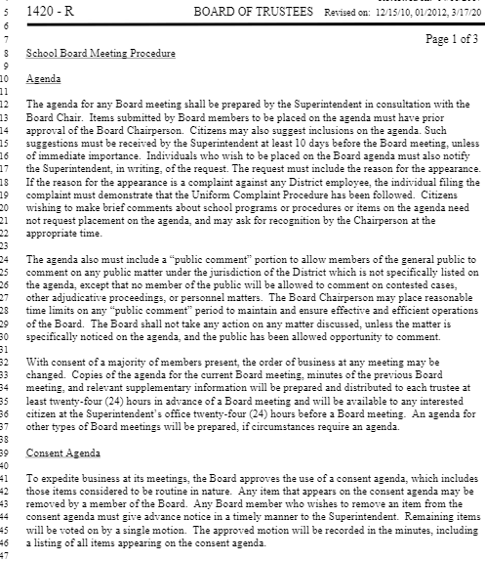

Slide 6
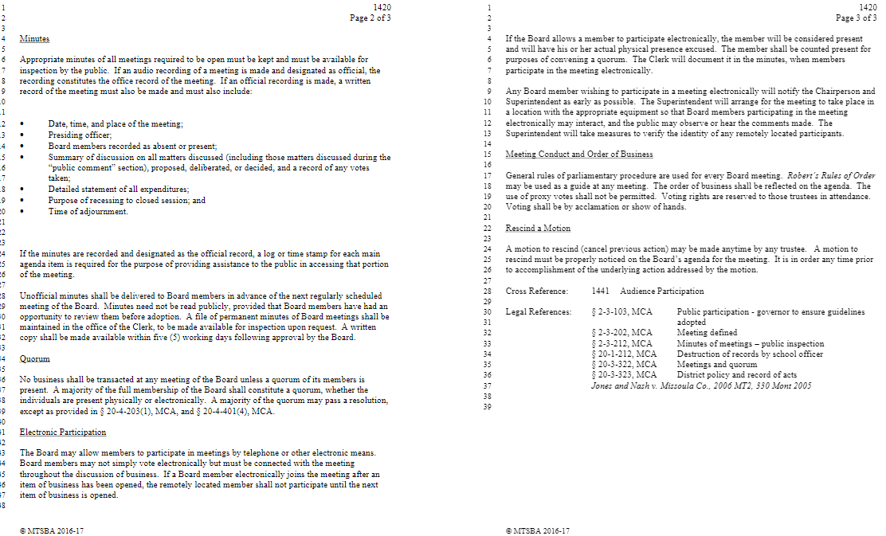

Slide 7
Discussion Detail
For each agenda item, write a short statement of each action taken by the board, along with a brief explanation of the rationale for their decision.
If there are extensive arguments, write a succinct summary of the major arguments.
Record discussions objectively, avoiding inflammatory remarks and personal observations. A good way to do this is by avoiding adjectives and adverbs whenever possible.

Slide 8
Discussion Detail In Other Words
Summarize discussion, don’t record them word-for-word.
DO record motions word-for-word
Do not include your emotions
DO NOT be afraid to ask questions
Make sure you get the exact wording of the motions and seconds.
Make sure you correctly record who made the motion and second.
If you aren’t sure, ask how everyone voted.
If your Board uses voice votes, ask for a roll-call vote.

Slide 9
Minute taking Templates
No “right way” to take minute notes.
You can hand-write your notes.
You can type your notes.
Do whatever works for you.
Have a backup plan if you can’t be there and a sub had to take notes.
Here are some examples:

Slide 10
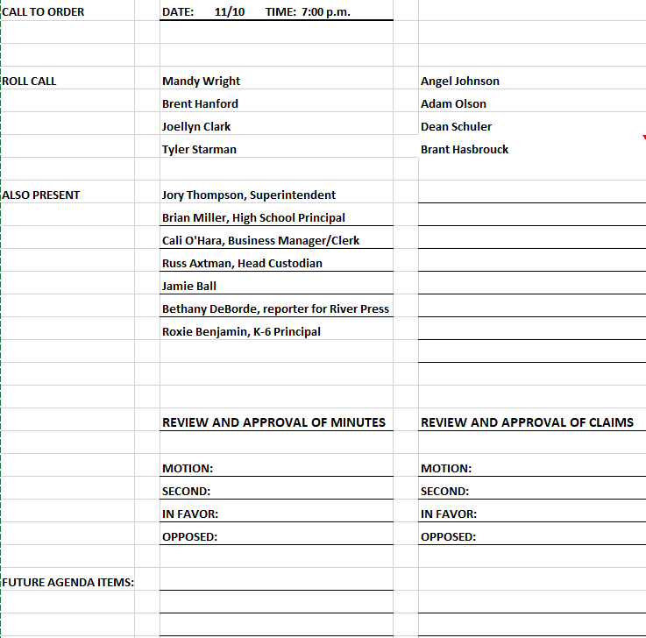

Slide 11
BUSINESS:
MOTION:__________
SECOND:__________
DISCUSSION
IN FAVOR:
OPPOSED:
BUSINESS:
MOTION:__________
SECOND:__________
DISCUSSION
IN FAVOR:
OPPOSED:

Slide 12
Sunburst Schools’ Substitute Template Thank you Peggy

Slide 13
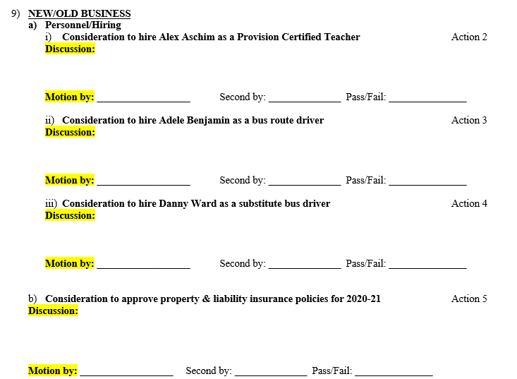

Slide 14
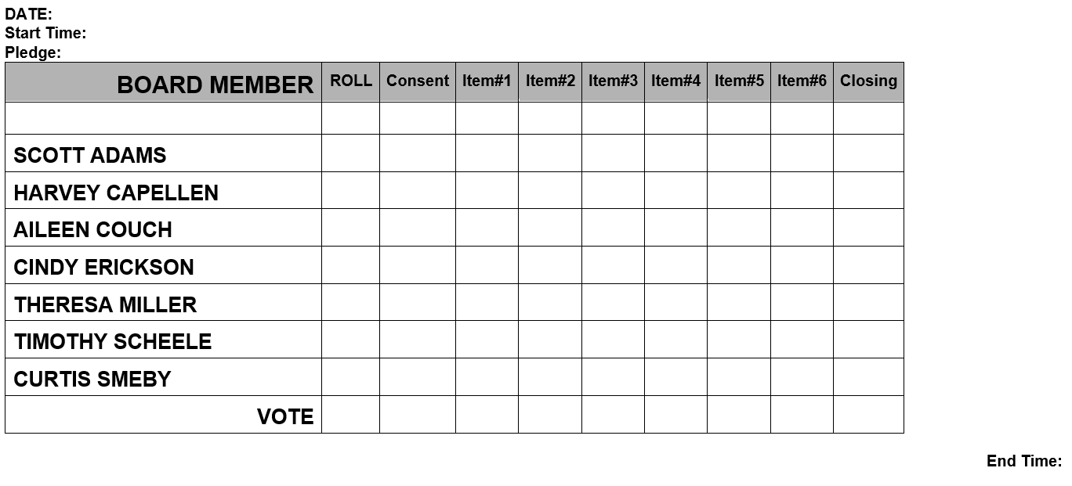
Or, you can use a grid to record votes

Slide 15
Examples of Minutes
Nevada Board minutes
Indicates who was attending remotely
During discussion they identify regular members by first name only
Uses a consent agenda
Has 2 public comment opportunities

Slide 16
Special Ed Co-op Minutes
Regular Meeting of the Trustees
Any Special Services Cooperative
Tuesday, November 33, 2525
A regular meeting of the Board of Trustees of the Any Special Services Cooperative was held Tuesday, November 33, 2525, via Zoom. The meeting was called to order by Chair John Kennedy at 11:00 a.m.
Members present: Nathan Elder – Joe Schmoe Schools; I.B. Rude – Jellystone Schools; John Kennedy – Red Acres Schools; Axle Rose – Nirvana Schools: Phillip Williams – West Weasel Schools; and Richard Harris – Camelot. Members absent: Bobby Fischer – Checkerboard. A quorum was present.
Director Dean Martin and Clerk Jerry Lewis were present for the entire meeting.
Also present: Will Smith
Agenda Additions - none.
Correspondence
None.
Consent Agenda
Nathan Elder asked about a couple bills – East- Central dues paid twice and more detail the Toga Insights claim. Director Dean Martin replied that Toga Insight bill was for testing protocols. A motion was made by Richard Harris, seconded by Phillip Williams to approve the minutes of September 8th , 2020 and to approve the bills for payment. Motion passed unanimously.

Slide 17
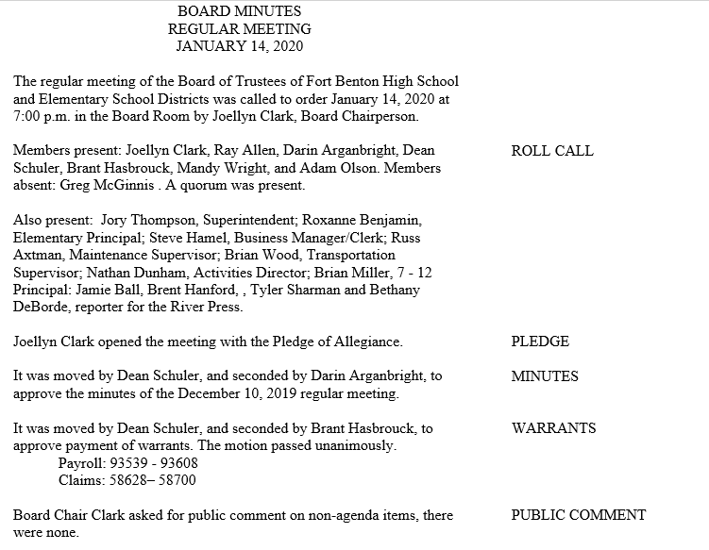

Slide 18
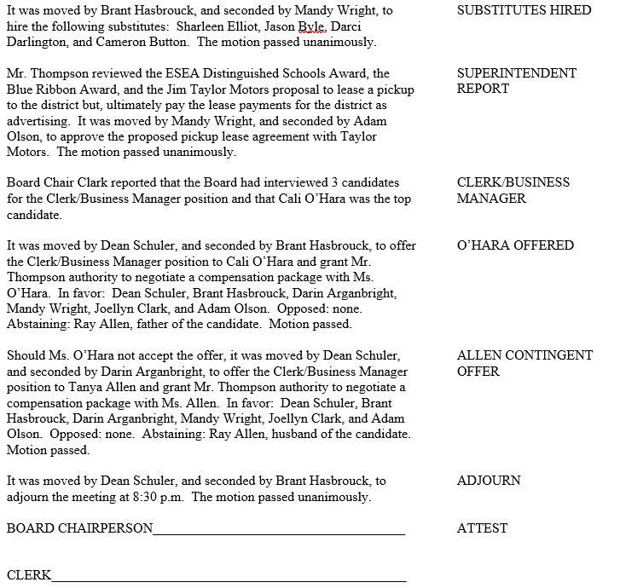

Slide 19
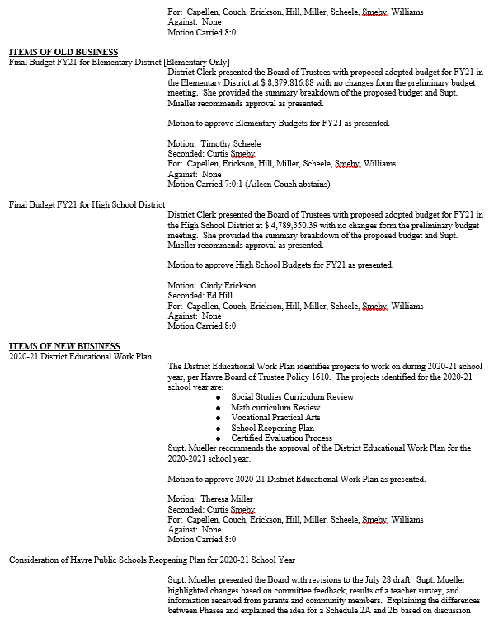

Slide 20
Two more good resources
If you are an MTSBA member
Montana Education Law Review
Available to members on the MTSBA site
Designed for new Board Members but a good tool for anyone in school administration.
MASBO CLERK/SUPERINTENDENT DUTY LIST

