Slide 1


School Facilities Planning
&
Financing Workshop
FUNDING CONSIDERATIONS
September 27, 2021

Slide 2
Participants
Bridget Ekstrom
Senior Vice President, D.A. Davidson & Co.
bekstrom@dadco.com or (406) 581-9820
Dan Semmens & Courtney Ellis
Bond Counsel, Dorsey & Whitney LLP
semmens.dan@dorsey.com & ellis.courtney@dorsey.com
(406) 721-6025
Louise Welsh
Sr. Bond Program Officer, Montana Board of Investments
lwelsh@mt.gov or (406) 444-0891

Slide 3

Sample School Debt Limitation
Three Forks Elementary and High School Districts General Obligation Bonds
GREATER OF CALCULATION 1 OR 2: | Elementary | High School
CALCULATION 1:
100% of Taxable Valuation (2020/21) | $11,869,478 | $11,684,831
CALCULATION 2:
2020/21 Statewide Average Taxable Valuation Per ANB | $39,230 | $96,830
X School District’s ANB for 2020/21 | _ 547 | 231
Total | $21,458,810 | $22,367,736
X Debt Limit Rate of 100% | 1.00 | 1.00
Maximum Debt Capacity | $21,458,810 | $22,367,736
The Debt Calculation is the greater of calculation 1 or calculation 2.

Slide 4
Sample Bond Issue Mill Levy Impact

Slide 5
Sample Top Taxpayers
Three Forks High School
District
Anderson
Elementary
District
Total Taxable Value $11,127,369 Taxpayer | % of total 2019/20 Tax Base
Northwestern Energy | 16.6%
Quest/CenturyLink | 6.9
GCC Three Forks LLC | 6.9
Montana Rail Link | 4.8
Luzenac America Inc. | 3.7
CHS Inc. | 2.1
Oldcastle Materials Cement Holdings | 0.9
Wheat Montana Farms Inc. | 0.9
Grey Cliffs Ranch LTD | 0.8
Rocking L LLC | 0.6
TOTAL | 44.2%
Total Taxable Value $4,528,465 Taxpayer | % of total 2019/20 Tax Base
Wolf, Walter Revocable Trust | 1.4%
Foreman, Bruce & Alora | 0.9
Tri H Stables LLC | 0.9
Northwestern Energy | 0.8
Pederson, Gregory | 0.7
Hubbard, Mathew & Kara | 0.6
Andrikopoulos Family Trust | 0.6
Howard, Michael & Margaret Family Trust | 0.5
Tyler, Nancy | 0.5
Shanahan Lynn Connolly Trustee | 0.5
TOTAL | 7.4%

Slide 6
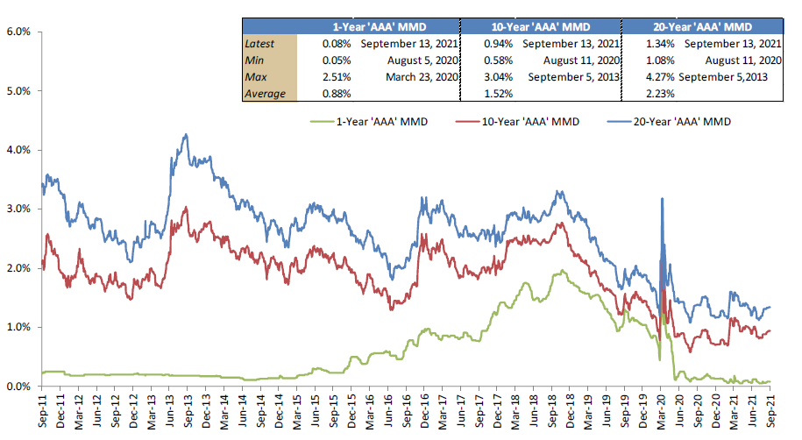

Bond Market Update
“AAA” Municipal Trends for 1-Year Maturity, 10-Year Maturity, 20-Year Maturity
Source: © 2021 Thomson Reuters. All rights reserved. (P3). MMD SEC Filing Privacy Policy Trademarks clientservice@tm3.com

Slide 7
Sample Bond Market Rates Based on Rating
Municipal Market Data Benchmark Information – September 13, 2021
 |  | "AAA" | PRE-RE | INSURED | "AA"
1 | 2022 | 0.08 | 0.08 | 0.14 | 0.10
2 | 2023 | 0.11 | 0.13 | 0.19 | 0.13
3 | 2024 | 0.17 | 0.18 | 0.26 | 0.21
4 | 2025 | 0.28 | 0.29 | 0.37 | 0.32
5 | 2026 | 0.41 | 0.43 | 0.49 | 0.46
6 | 2027 | 0.54 | 0.56 | 0.66 | 0.64
7 | 2028 | 0.66 | 0.69 | 0.79 | 0.76
8 | 2029 | 0.77 | 0.79 | 0.91 | 0.89
9 | 2030 | 0.86 |  | 1.04 | 0.98
10 | 2031 | 0.94 |  | 1.12 | 1.06
11 | 2032 | 1.00 |  | 1.18 | 1.12
12 | 2033 | 1.05 |  | 1.23 | 1.18
13 | 2034 | 1.09 |  | 1.27 | 1.22
14 | 2035 | 1.13 |  | 1.31 | 1.27
15 | 2036 | 1.16 |  | 1.34 | 1.31
16 | 2037 | 1.19 |  | 1.37 | 1.34
17 | 2038 | 1.23 |  | 1.41 | 1.38
18 | 2039 | 1.27 |  | 1.46 | 1.42
19 | 2040 | 1.31 |  | 1.50 | 1.46
20 | 2041 | 1.34 |  | 1.53 | 1.49
Sample Yield Curves
Sample Credit Spreads
Source: © 2021 Thomson Reuters. All rights reserved. (P3). MMD SEC Filing Privacy Policy Trademarks clientservice@tm3.com

Slide 8
Rating Agency
Financial Management Assessment
As part of the credit rating review process, S&P conducts a Financial Management Assessment (FMA) during the rating review process by determining what management policies and practices are in place, according to the following seven categories. Before issuing Bonds it will be worth the District’s effort to review the following and consider adopting some of the policies and practices that the rating agency views as favorable.
Revenue/Expenditure Assumptions for Annual Budgeting
  How many years of history do you use when forecasting trends?
  What outside sources of information do you use or consult?
  What methodology do you use for budgeting (line item, zero base, etc.)?
Budget Amendments & Updates
  As the fiscal year progresses, how often do you review your main revenues and expenditures?
  How many times per year do you provide the board or council with budget-to-actual reports?
  In case of an emergency, how quickly could an amendment to the budget be made?
Long-Term Financial Planning
  Is any type of multiple-year financial forecasting utilized?
  How frequently are these projections updated?
  If projections are done, are the results shared with the board or council and used for decision-making?
Long-Term Capital Planning
  Is a written, multiple-year capital improvement plan maintained? If so, how frequently is the plan updated?
Investment Management Policies
  Is there a formally approved investment management policy, or are the state guidelines simply followed when making investments?
  How frequently is the board or council provided with information on the investment portfolio? (Specifically investment earnings and portfolio holdings)
Debt Management Policies
  Is there an approved debt management policy that goes beyond statutory limitations to restrict the structure or amount of debt issued?
Reserve and Liquidity Policies
  Has the board or council approved a formal fund balance or reserve policy?
  If so, what is the minimum level of mandated reserves and why was that particular level chosen?
  If no formal policy exists, is there a particular goal or target reserve level which the board keeps in mind?

Slide 9
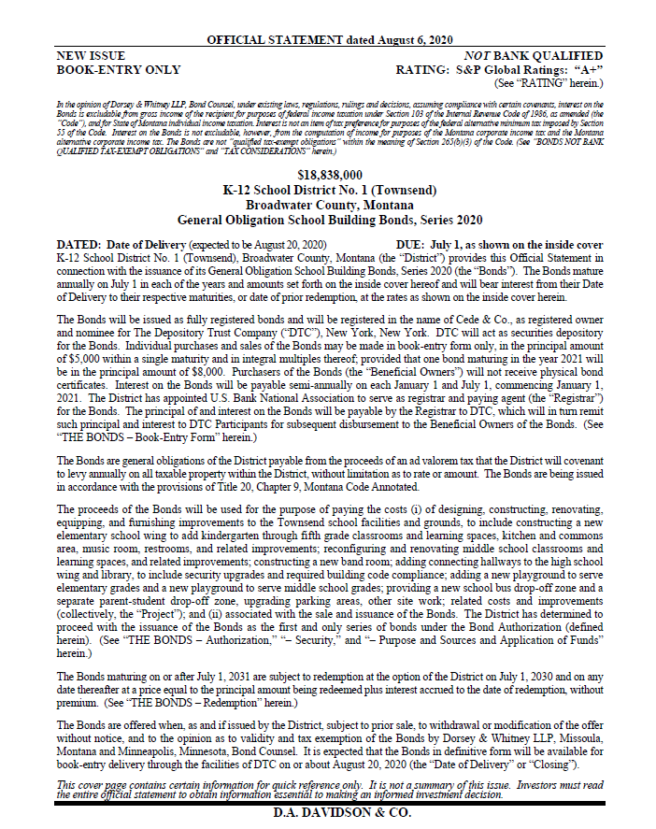
Official Statement Excerpt
Townsend K-12 Series 2020 Bonds

Slide 10
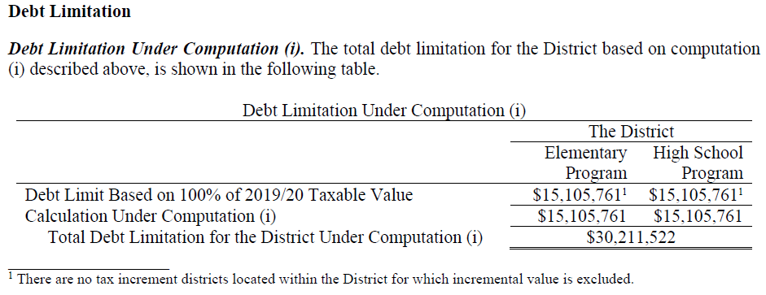
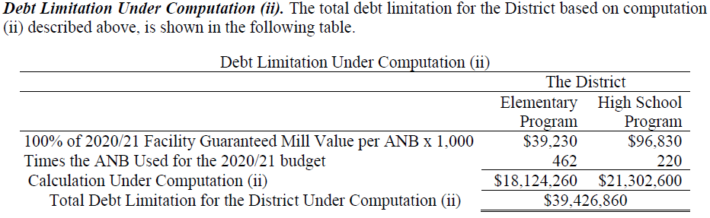
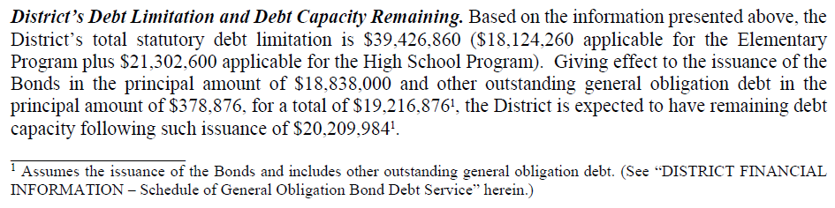
Official Statement Excerpt
Townsend K-12 Series 2020 Bonds

Slide 11
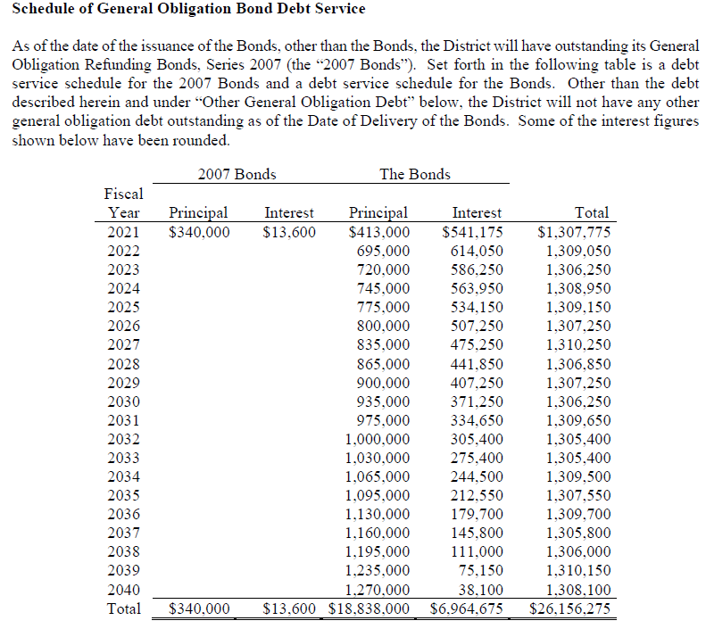
Official Statement Excerpt
Townsend K-12 Series 2020 Bonds

Slide 12
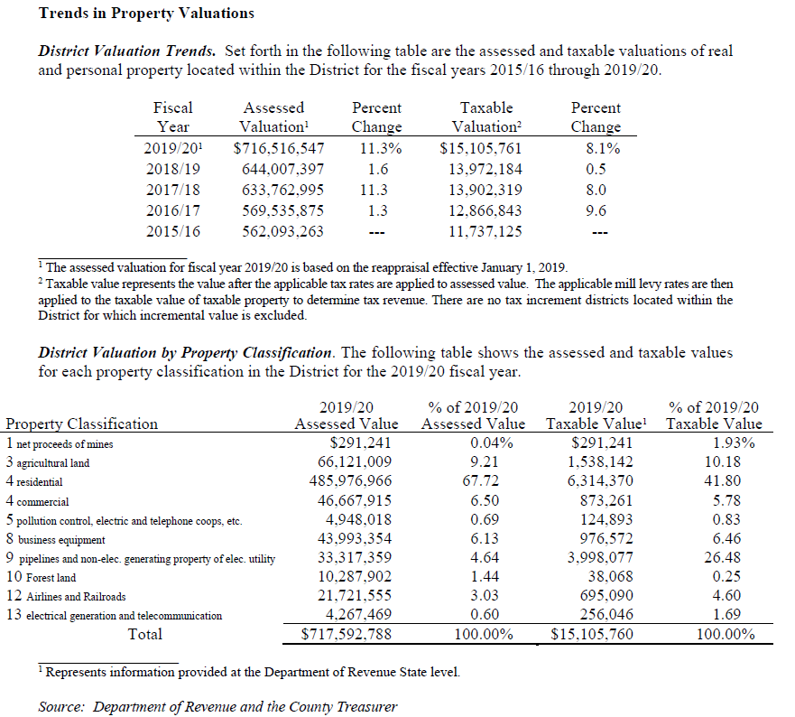
Official Statement Excerpt
Townsend K-12 Series 2020 Bonds

Slide 13
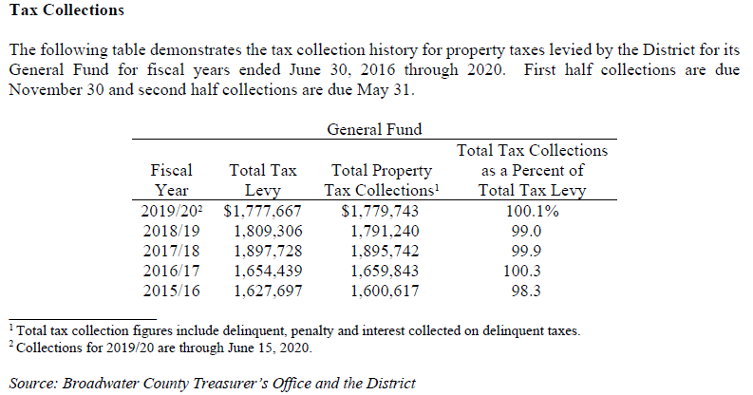
Official Statement Excerpt
Townsend K-12 Series 2020 Bonds

Slide 14
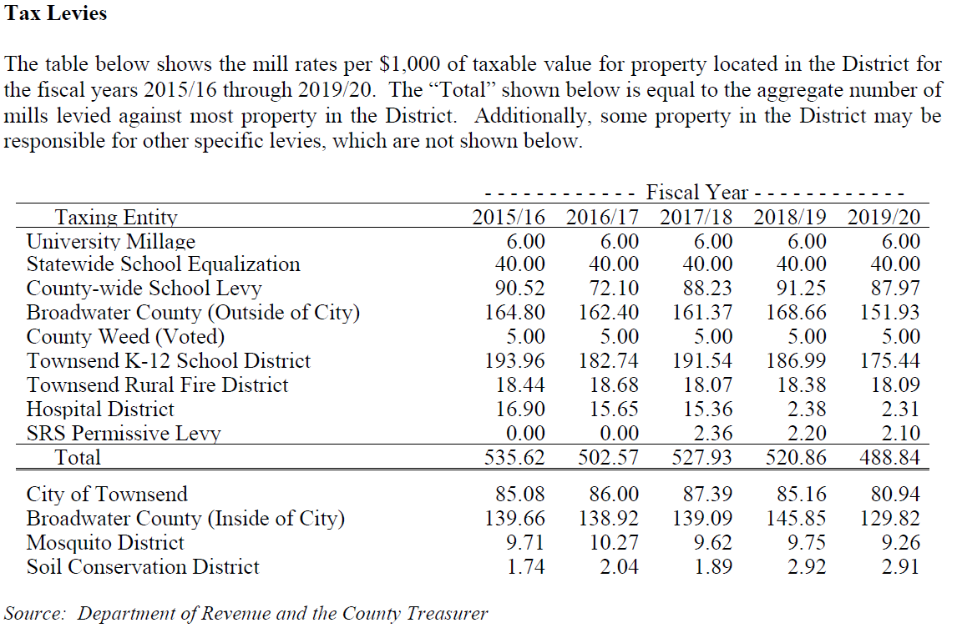
Official Statement Excerpt
Townsend K-12 Series 2020 Bonds

Slide 15
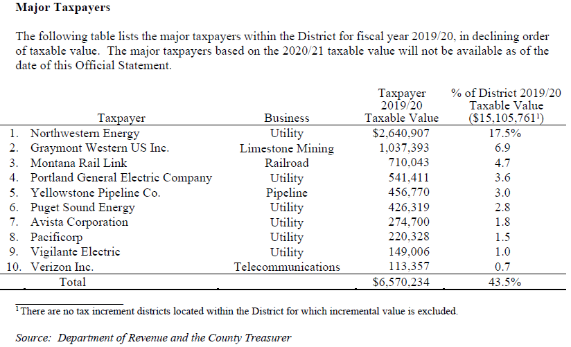
Official Statement Excerpt
Townsend K-12 Series 2020 Bonds

Slide 16
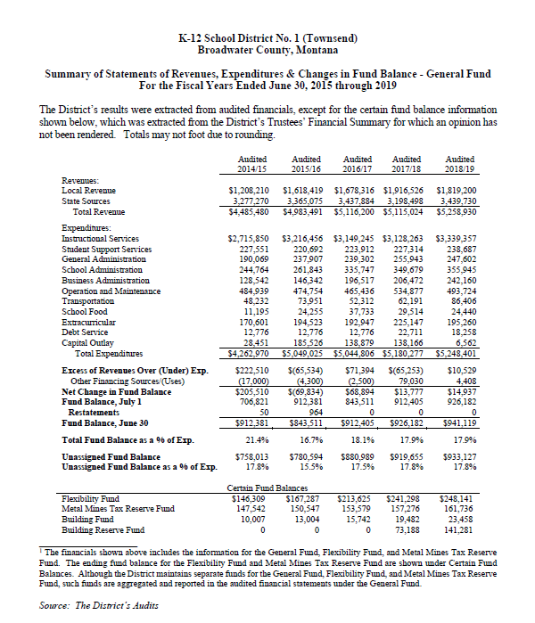
Official Statement Excerpt
Townsend K-12 Series 2020 Bonds

Slide 17
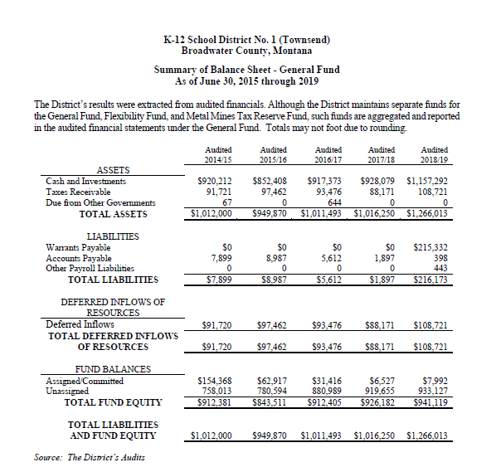
Official Statement Excerpt
Townsend K-12 Series 2020 Bonds

Slide 18
Townsend K-12 Mill Levy Impact

Slide 19
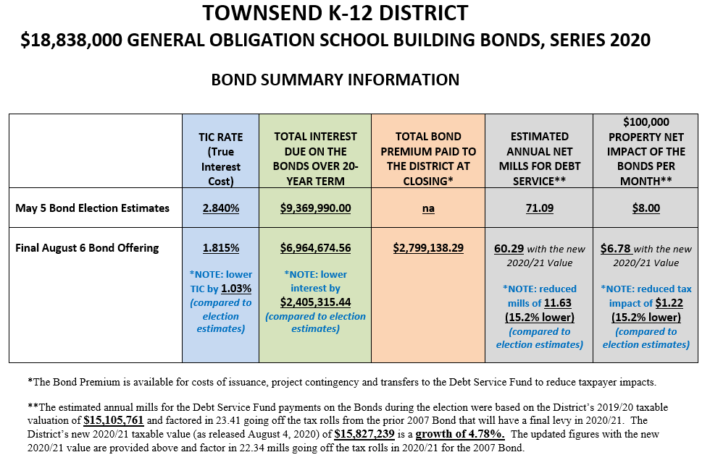
Townsend K-12 Bond Summary

Slide 20

Primary Funding Mechanisms for
Capital Projects
General Obligation Bonds
Building Reserve Levy (Not Building Reserve Levy Loan)
INTERCAP Loan
Funding Mechanism Factors for Consideration:
Urgency of need of funding (immediate or future) | Funding resources (eligible for State aid)
Election requirements | Cash flow of resources
Term limits on debt | Spending restrictions
Dollar limits on debt | Payment schedule

Slide 21
Primary Funding Mechanisms for
Capital Projects
INTERCAP Loan | Building Reserve Levy (Note: Information below is for a Levy only - not for a Building Reserve Loan secured by the Levy as discussed later) | GO Bonds
Election not required under certain circumstances; capital project in nature of vehicles, equipment or rehabilitation | Election required | Election required
Not eligible for State debt service aid | Not eligible for State debt service aid | Eligible for State debt service aid
Full or partial cash draws | Cash received over time | Often advanced all at one time
Maximum term of 15 years | Maximum term of 20 years, with couple of exceptions | Maximum term of 30 years
Loan repayment can be made from any legally available fund | Financial transactions are made from building reserve fund only | Project costs are paid from the Building Fund. Debt payments are made from Debt Service Fund
Debt capacity limitations apply | Debt capacity limitations do not apply | Debt capacity limitations apply
Dollar amount is limited to debt capacity; if used for other than rehabilitation, additional limitations | Dollar amount is not limited to debt capacity | Dollar amount is limited to debt capacity
Principal and interest payments made semiannually. Variable interest rates | No principal or interest payments | Usually interest payments made semiannually and principal payments made annually; usually fixed rate

Slide 22
Building Reserve Loans
Two General Options
INTERCAP Loan
Building Reserve Loans
  Secured by Voted Building Reserve Levy
  Up to 15 Years under 20-9-503(2)(a) MCA
  OR
  Where the Credit Analysis of the Board of Investments under 20-9-471 MCA takes into account amounts in or available to Building Reserve Sub-fund for School Major Maintenance repairs 20-9-502(3) and 20-9-525 MCA

Slide 23
Procurement
Traditional Low Bid Delivery of Project.
Energy Performance Contracts.
Alternative Project Delivery Contracts.
  Design-Bid
  General Contractor Construction Management
  Other
Have Owner’s Representative?
  Include Costs in Budget
Using In-house Expertise.

Slide 24

INTERCAP
Low-Interest Loan Program
Variable Interest Rate
  Rates change every February 16
  Average rate over last 15 years: 2.37%
  Current rate: 1.65%
15-year Loan Term or useful life of project or statutory limit
Over 200 different school districts have utilized INTERCAP
Nearly 355 school loans of $58 million have been financed
www.investmentmt.com

Slide 25
20-9-471 MCA – School may finance through INTERCAP without a vote for the following…
  New and used vehicles and equipment
  Remodel or Renovate within existing walls
  Energy retrofit projects
  Construction of bus barns or modular classrooms
New construction and purchase of real property must be voter-approved
Finance using
  General Obligation Bonds
  General Fund Loan
    Building Reserve (Permissive Levy)
www.investmentmt.com

Slide 26
General Obligation Bonds
  Title 20 Chapter 9 Part 4 MCA
  15-year term or useful life of the project, whichever is less
  Must be within District’s legal debt limit
  Provide copy of Resolution calling for bond election
    20-9-421 and 20-20-201 MCA
  Copy of the Ballot
  Notice of Election
    Include when and where it was posted and published
  Copy of Certificate of Election
  Bond Counsel required at borrower’s expense
www.investmentmt.com

Slide 27
Building Reserve Fund Loans
  Title 20 Chapter 9 Part 502 MCA
  Statute sets a 15-year limit for pledging the fund
  Loan maturity date will match levy expiration
  For loan to be repaid with NEW levy, provide:
    Copy of Resolution calling for the election
    Copy of ballot, notice of election, where and when posted/published and certificate of election
  For loan to be repaid with an EXISTING levy, provide:
    Copy of Resolution calling for the election
    Previous and current years’ balance sheet and income statements for the building reserve fund
    Next year’s budget for the building reserve fund
www.investmentmt.com

Slide 28
General Fund Loans
  Title 20 Chapter 9 Part 471 MCA
    Update 2019 Session, HB247. First right of refusal
  15-year term, or useful life of project
  Equipment, vehicles, renovation within existing building, bus barns, modular classrooms for instruction
    Provide previous and current years’ balance sheet and income statements for general fund
  New construction and real property acquisition
    Election information
    New portion of building cannot constitute more than 20% of existing square footage
    20% may not be exceeded within any 5-year period
www.investmentmt.com

Slide 29
General Fund Loans continued
  20-9-471, MCA “any other legally available funds”
    Building Reserve (Permissive Levy) 20-9-502(3) MCA
  Application process
    Current Facility Condition Inventory (FCI) report with application.
    Credit analysis of the General Fund and Building Reserve Permissive Levy Fund as the supplement repayment source
    Non-levy resources such as Impact Aid, Oil & Gas, or PILT on case by case basis
  Additional conditions ensuring:
    Steps to impose annual levy are followed
    No new debt or projects encumber levy revenue without written permission from INTERCAP
www.investmentmt.com

Slide 30
100% financing
No up-front costs
No pre-payment penalty
Variable interest rate – currently 1.65%
Maximum loan amount depends on legal debt authority
Loan term maximum is 15 years, the useful life of the project, or other statutory limit
Application on website www.investmentmt.com
  Under $1 million, staff approved
  Over $1 million, Board of Investments Loan Committee approved at quarterly meeting
www.investmentmt.com

Slide 31
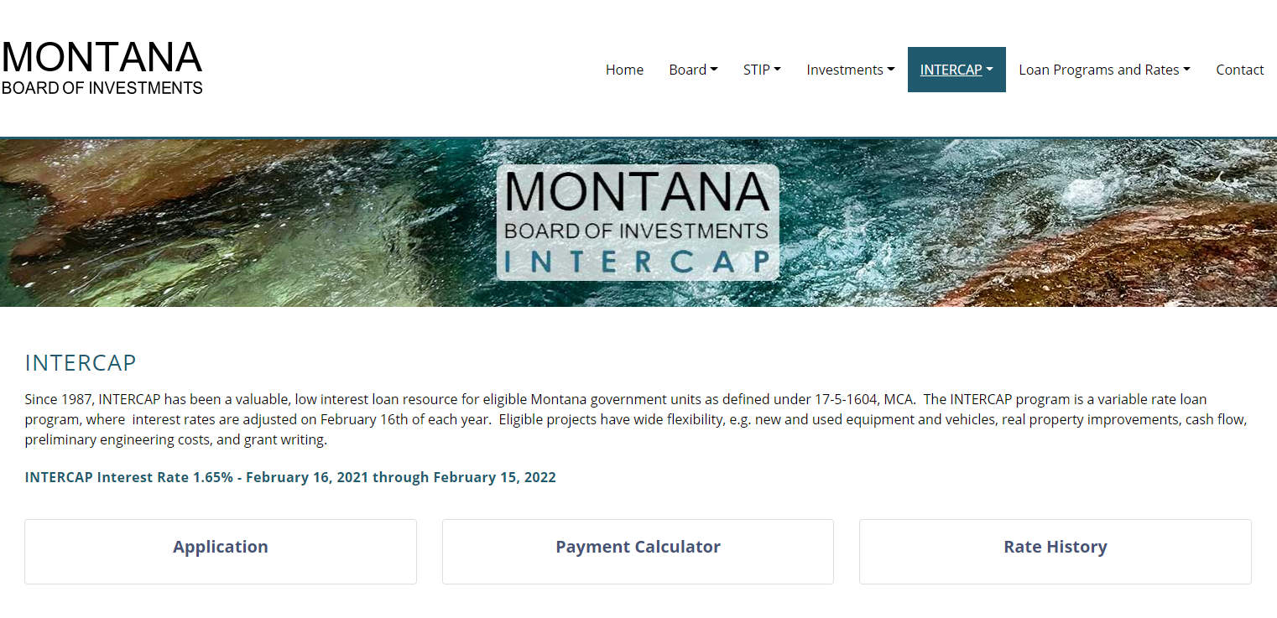

Slide 32
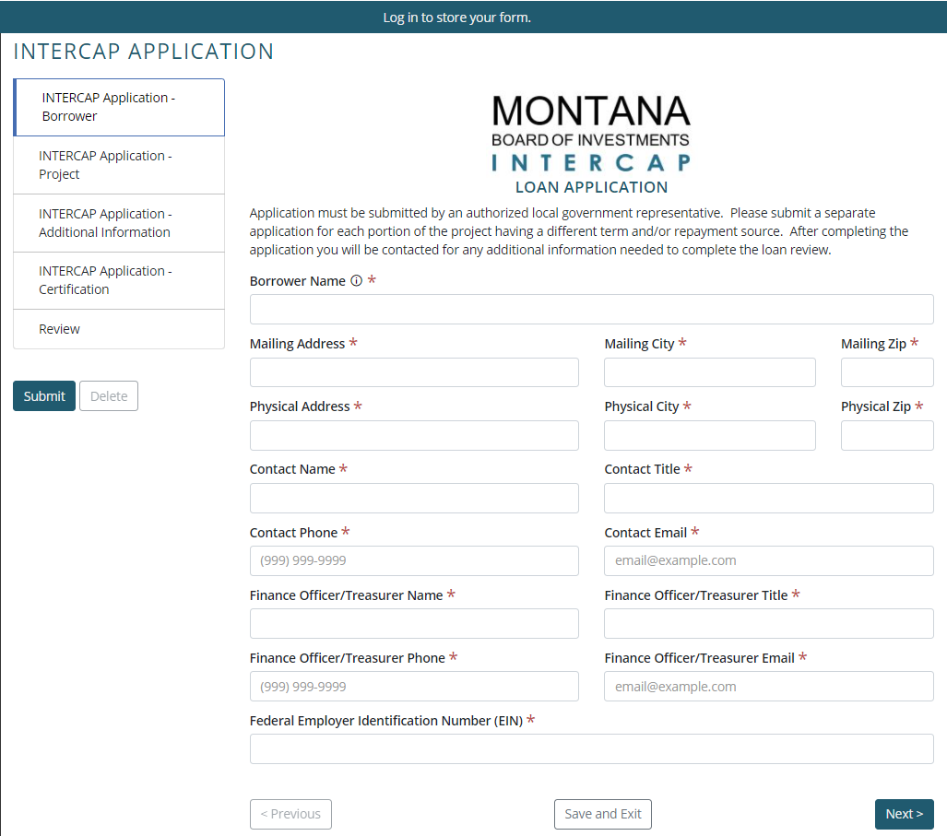

Slide 33
