Slide 1
MASBO School Facilities Financing Leveraging ESSER II & III Funds
Jeff Kirksey, OPI ESSER Program Manager
September 28, 2021

Slide 2
Session Purpose
Review of time-lines for ESSER Funding
Provide an overview of ESSER II & ESSER III (ARP) Funds including how they are different.
Review allowable uses for ESSER II & III funding.
Explore Frequently Asked Questions specifically related to:
Construction and Capital Expenditures including Thresholds and Pre-approval processes
Clarifying use of Object Codes
Workforce Stabilization Uses

Slide 3
Session Details
The requirements in section 2001(i) of the ARP Act relating to the ARP ESSER funds are published in the Federal Register and also outlined by the Department in the ESSER and GEER FAQ document.
The OPI has developed a FAQ document to provide LEAs information about the grant, including eligibility, and grant requirements.
ESSER II and ESSER III guidance documents are available on the OPI website, which outlines allowable uses for the grant.
Disclaimer: Similar to the FAQ document issued by the USED on ESSER and GEER, “the contents of this document do not have the force and effect of law and are not meant to bind the public in any way. The information is subject to change as additional information is released by the USED.

Slide 4
OPI Presenter
Introductions
WELCOME!
4

Slide 5
OPI Staff
Jeff Kirksey, ESSER Program Manager
Jeffrey.Kirksey@mt.gov
(406) 444-0783

Slide 6
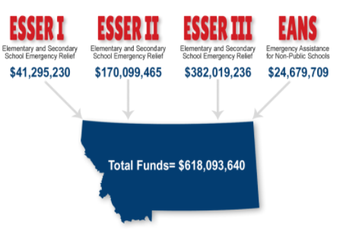
ESSER Summary
Elementary and Secondary School Emergency Relief Fund (ESSER):
3 Rounds of ESSER funds have been authorized by Congress in response to COVID-19 pandemic.

Slide 7
Key Dates
June 24, 2021. Districts must make publicly available the Return to In-Person Instruction and Continuity of Services Plan.
August 24, 2021. Districts must submit the ARP ESSER Plan to the OPI through TEAMS and make plan publicly available.
September 1, 2021. Due date to complete and submit ESSER II and ESSER III applications in the E-grants system.
September 30, 2022 and November 10, 2022. All ESSER I funding must be obligated by 9/30/22 and expended by 11/10/22.
September 30, 2023 and November 10, 2023. All ESSER II funding must be obligated by 9/30/23 and expended by 11/10/23.
September 30, 2024 and November 10, 2024. All ESSER I funding must be obligated by 9/30/24 and expended by 11/10/24.

Slide 8
Discerning the ESSERs
What is the biggest difference between ESSER I, ESSER II, and ESSER III funds?
Answer: ESSER III contains two planning requirements, a 20% set-aside for funding to be expended for lost instructional time type activities and has the new Maintenance of Equity provisions.
A full ESSER I, II, & III Comparison is available on the OPI website.

Slide 9
Allowable Use of Funds
Where can LEAs find information about Allowable Uses for ESSER II & III?
Answer: Please reference the Elementary and Secondary School Emergency Relief Funding (ESSER II & ESSER III) guidance document located on the OPI webpage and the ESSER and GEER FAQ produced by the USED. The ESSER and GEER Use Funds FAQ developed by the Department provides an overview of how the funds can be used. It emphasizes that the ESSER resources are available for a wide range of activities to address diverse needs arising from and exacerbated by the COVID-19 pandemic, and to emerge strong post pandemic
Reminder: As is the case with all activities charged to ESSER, costs must be reasonable and necessary to meet the overall purpose of the program, which is “to prevent, prepare for, and respond to” COVID-19. (See 2 CFR §§ 200.403-200.404.)

Slide 10
Allowable Use of Funds
How do you determine if an activity is an allowable use of funds?
Answer: Generally, in determining whether an activity is an allowable use of funds, a State or LEA must determine:
Is the use of funds intended to prevent, prepare for, or respond to the COVID-19 pandemic, including its Impact on the social, emotional, mental health, and academic needs of students?
Does the use of funds fall under one of the authorized uses of ESSER funds?
Is the use of funds permissible under the Uniform Administrative Requirements, Cost Principles, and Audit Requirements for Federal Awards (Uniform Guidance, 2 CFR Part 200)? In particular, is it necessary and reasonable for the performance of the ESSER or GEER award?

Slide 11
Allowable Use of Funds
Do we need to articulate how our proposed budget expenses connect to COVID prevention, preparation, and response?
Answer: Yes, In E-Grants you should make the expenditures connection to COVID clear in your budget descriptions.
An example could be: "____________ salary to hire specialist to help support students whose learning was adversely impacted by the pandemic in order to help students reach grade level expectations." OR “Purchasing ____________ to enable the district to easily transition to online learning as part of our COVID preparation strategy.”

Slide 12
Allowable Use of Funds
Are there recommended uses of ESSER II & III funds that will assist LEAs to address the impact of the COVID pandemic and disruptions leading lost instructional time?
Answer: The LEA should use their local data, conduct a gap analysis, and a comprehensive needs assessment process to determine the best uses of funds for their students and staff.

Slide 13
Allowable Use of Funds
Are there resources available to help LEAs address lost instructional time?
Answer: Yes!
USED Lost Instructional Time Guidance
COVID Relief Playbook

Slide 14
Allowable Use of Funds
Can districts innovate on the use of funds?
Answer: Yes, and it is strongly encouraged that districts use these unprecedented funding allocations to innovate and implement the improvements that have been aspirations for your students.

Slide 15
Construction and Capital Costs
What is the guidance on construction costs?
Answer: The ESSER and GEER FAQ addresses uses of ESSER and GEER funding for construction. (See section B-6 & B-7).

Slide 16
Construction and Capital Costs
Is Construction an allowable use of ESSER Funds?
Answer: Construction is authorized under Title VII of the ESEA (Impact Aid) and therefore is an allowable use of GEER and ESSER funds under sections 18002(c)(3) and 18003(d)(1) of the CARES Act, sections 312(c)(3) and 313(d)(1) of the CRRSA Act and section 2001(e)(2) of the ARP Act.
The broad Impact Aid definition of “construction” includes new construction as well as remodeling, alterations, renovations, and repairs under which many activities related to COVID-19 would likely fall.
However, the Department discourages LEAs from using ESSER and GEER funds for new construction. This use of funds may limit an LEA’s ability to support other essential needs or initiatives. Remodeling, renovation, and new construction are often time-consuming, which may not be workable under the shorter timelines associated with ESSER and GEER funds. These types of activities are also subject to several additional Federal requirements, as detailed below.

Slide 17
Construction and Capital Costs
What is the federal definition for construction?
Answer: The Impact Aid program statute defines “construction” as “(A) the preparation of drawings and specifications for school facilities; (B) erecting, building, acquiring, altering, remodeling, repairing, or extending school facilities; (C) inspecting and supervising the construction of school facilities; and (D) debt service for such activities.”
As is the case with all construction contracts using laborers and mechanics financed by Federal education funds, an LEA that uses ESSER or GEER funds for minor remodeling, renovation, repair, or construction contracts over $2,000 must meet all Davis-Bacon prevailing wage requirements.

Slide 18
Construction and Capital Costs
Who determines if a construction project is an allowable use of funds?
Answer: While construction is generally allowable, it is the responsibility of a Governor, SEA, LEA, or other subgrantee to assure that individual costs:
1) comply with the Cost Principles in 2 CFR Part 200, subpart E (e.g., the cost must be “necessary and reasonable” (2 CFR §§ 200.403-200.404));
2) meet the overall purpose of the CARES Act, CRRSA Act, or ARP Act programs, which is “to prevent, prepare for, and respond to” COVID-19; and
3) are consistent with the proper and efficient administration of those programs.
Note: Under these general principles, any construction activities, including renovations or remodeling, that are necessary for an LEA to prevent, prepare for, and respond to COVID-19 could be permissible, though the burden remains on grantees and subgrantees to maintain the appropriate documentation that supports the expenditure.

Slide 19
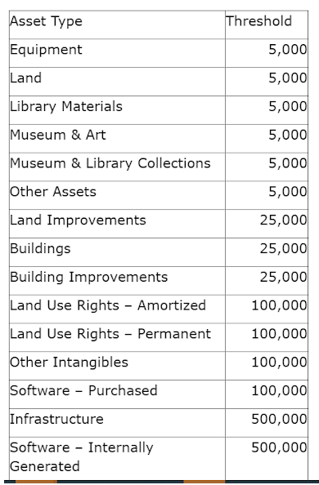
Construction and Capital Costs
What capital costs must be pre-approved?
Answer: If your planned ESSER funded capital expenditures meet or exceed these State Asset Thresholds you will need pre-approval. Items less than these thresholds still must meet allowable use criteria.

Slide 20
Construction and Capital Costs
How does an LEA request preapproval of Construction costs from the OPI?
Answer: The LEA needs to submit the Capital Expenditure Pre-approval Form in E-Grants. This is a simple google form that includes a review of Federal Requirements and District Specific content.

Slide 21
Construction and Capital Costs
Where can I find the ESSER Capital Expenditure Pre-approval form?
Answer: The form can be found on the Property and Equipment Budget page in E-Grants (show below) or you can access the link directly.

Slide 22
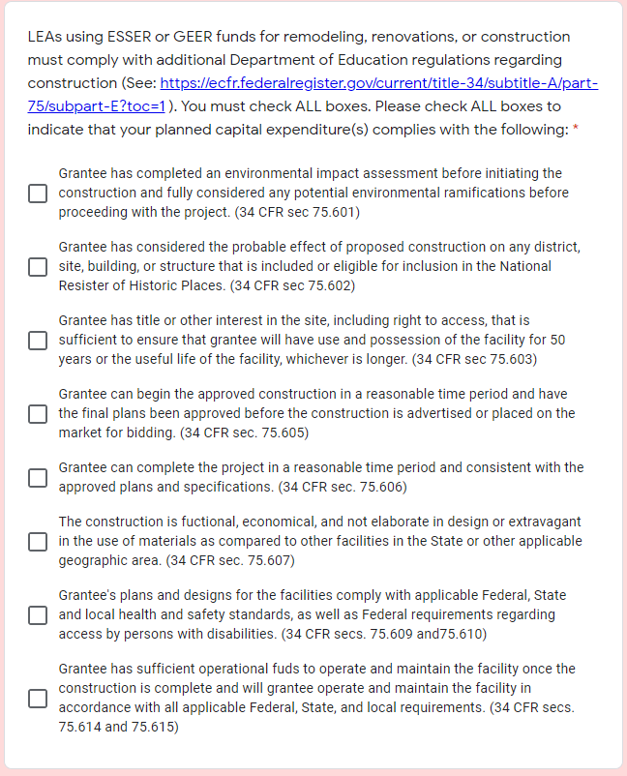
Construction and Capital Costs
What are the primary elements of the pre-approval form?
Answer :

Slide 23
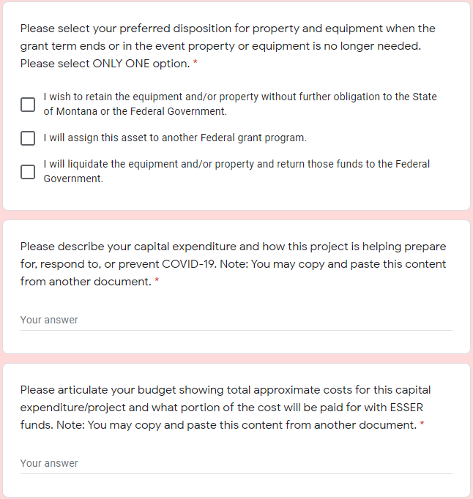
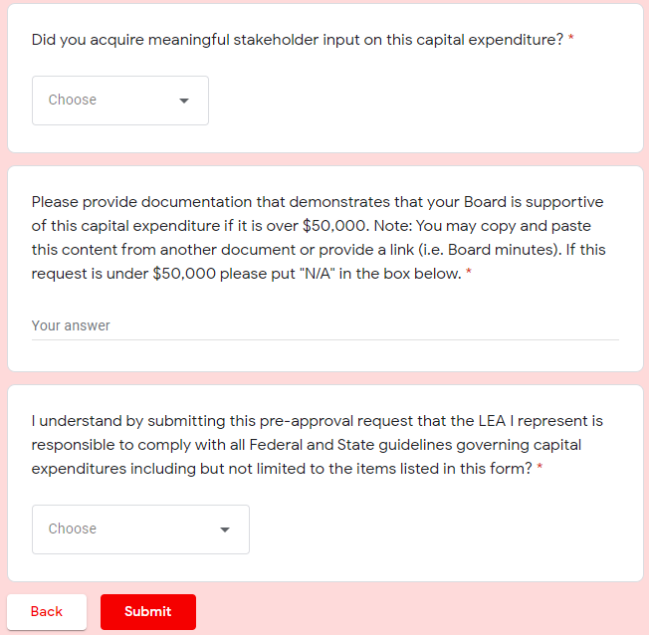
Construction and Capital Costs
What are the primary elements of the pre-approval form (cont.)?
Answer:

Slide 24
Construction and Capital Costs
Can ESSER Funds be used for new construction?
Answer: YES, provided that pre-approval and all the federal guidelines are met in the project and that the new construction meets the primary purposes of the ESSER funding.

Slide 25
Construction and Capital Costs
Can ESSER Funds be used for renovations?
Answer: Yes, provided that the renovations meet the primary purposes of the ESSER funding (i.e., prepare, prevent and respond to COVID-19.)

Slide 26
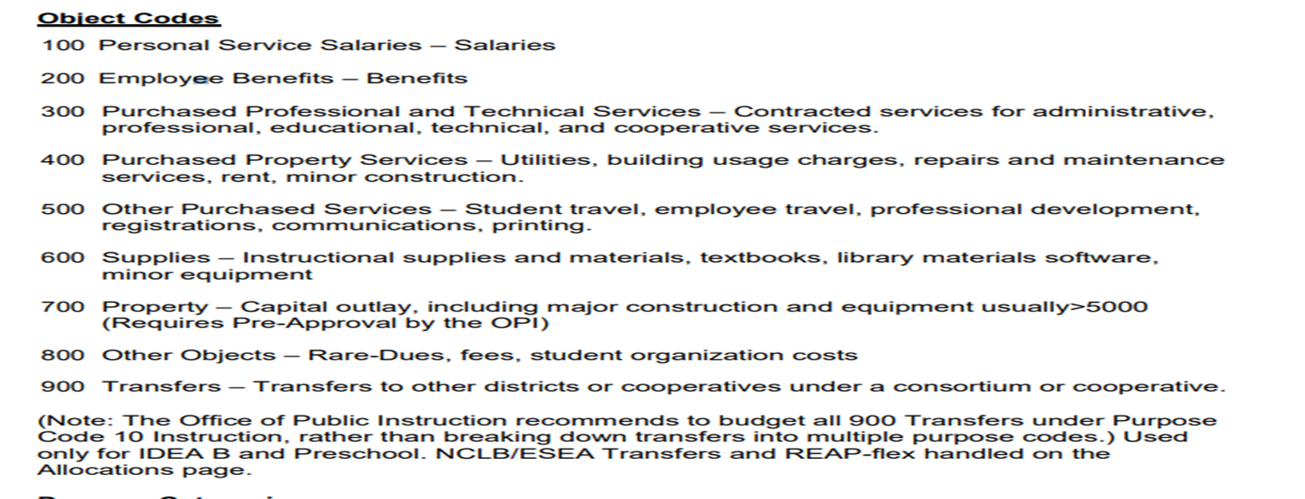
Capital Costs and Object Codes
What object codes should/shouldn’t I use for capital expenditures?
Answer:

Slide 27
Managing Non-Capital Assets
Do we have to do any special tracking for non-capital assets?
Answer: Yes, specifically technology purchased with ESSER dollars must be inventoried and tabbed.

Slide 28
Workforce Stabilization
Can ESSER dollars be used to recruit and retain employees?
Answer: Yes. An LEA may use ESSER funds to stabilize and support the educator workforce and to support the conditions that will allow schools to return to in-person instruction. This may include using funds to pay teacher salaries and avoid layoffs. Funds may also be used to address educator shortages exacerbated by the pandemic by hiring new teachers, including expanding student access to a well-prepared and diverse educator workforce.

Slide 29
Workforce Stabilization
May an LEA use ESSER and GEER funds to pay overtime to its salaried custodians and other staff in order to prepare for a safe reopening of schools and sustain safe school operations?
Answer: Yes. Paying custodians or other staff overtime to safely reopen schools and to keep the schools safely open is allowable under ESSER and GEER.

Slide 30
Workforce Stabilization
Can ESSER dollars be used to provide additional pay (premium pay) to employees?
Answer: Yes. Premium pay must be reasonable and necessary and consistent with 2 CFR § 200.430(f), and given
pursuant to an established plan (which could be established in response to the COVID-19 pandemic), consistent with applicable collective bargaining agreements and other relevant policies and requirements.

Slide 31
Workforce Stabilization
Where can I find more information on using ESSER fund for workforce stabilization?
Answer: The ESSER and GEER FAQ addresses uses of ESSER and GEER funding for construction. (See section D).

Slide 32
Open Questions
What questions do you have?
Do you have any clarifying questions about the responses provided here today?

Slide 33
Resources
OPI Website:
opi.mt.gov

Slide 34
Thank you!
For questions or additional information please contact
Jeff Kirksey: Jeffrey.Kirksey@mt.gov (406)444-0783
Notes:
Are there any questions from this presentation?

