Slide 1
Welcome MASBO
ERIC
Enrollment and Final Payout Tips
B R O U G H T TO B Y M P E R A
E D U C A T I O N

Slide 2
Let's dive right in!
STARTING WITH ENROLLMENTS

Slide 3
Q. Who should be reported to MPERA?
A. Everyone!
This is a requirement per the MCA 19-2-506 (3) (a) which states: The board shall prescribe by rule the procedure for submitting employer reports. The reports must include data about the member and nonmember employees who work for the employer

Slide 4
Some examples of Optional Members
under 960
SCHOOL BUS DRIVERS OFFICE WORKERS
CUSTODIANS

Slide 5
Examples of who isn't an Optional Member under 960
A Coach or Athletic Director Helping in a classroom ( Para- Educator or supervising children in lunchroom/ playground
Full- time Students employed at/ attending
same school, college or unit of the state university system

Slide 7
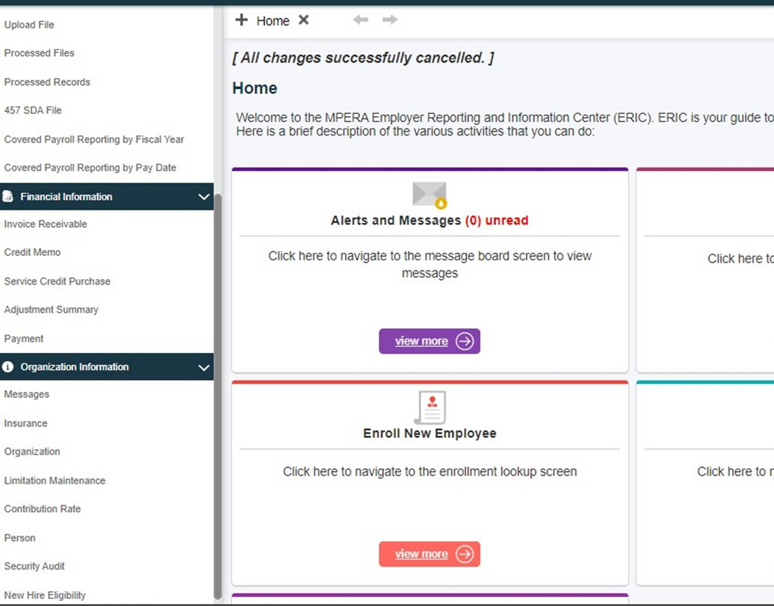
New Hire Eligibility

Slide 8
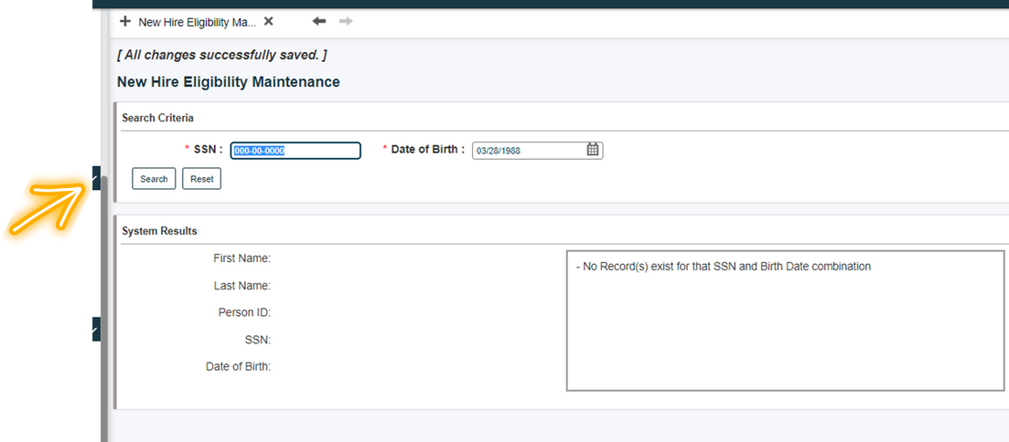
Enter the new hire's social and birth and click "search"

Slide 9
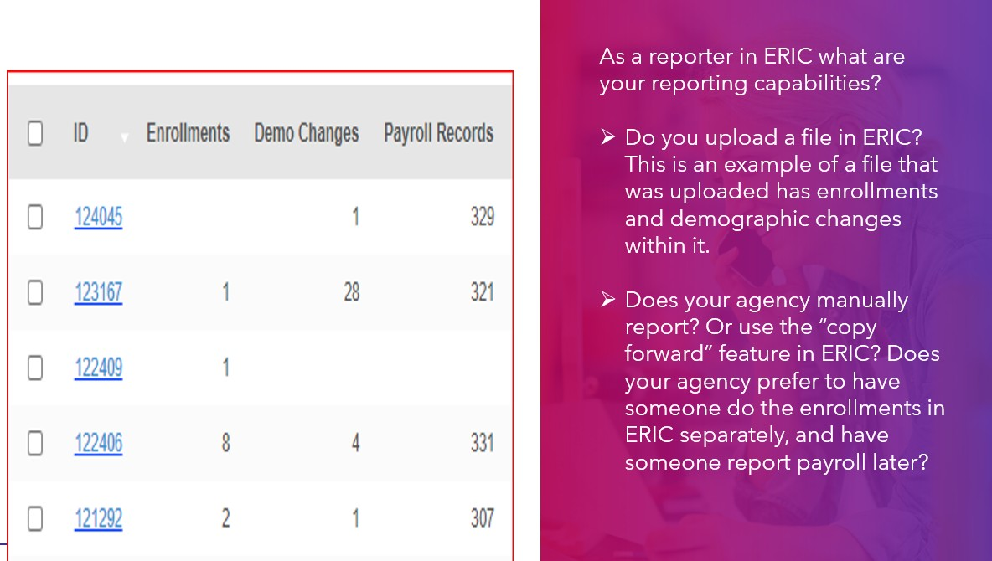
Enrolling in ERIC

Slide 10
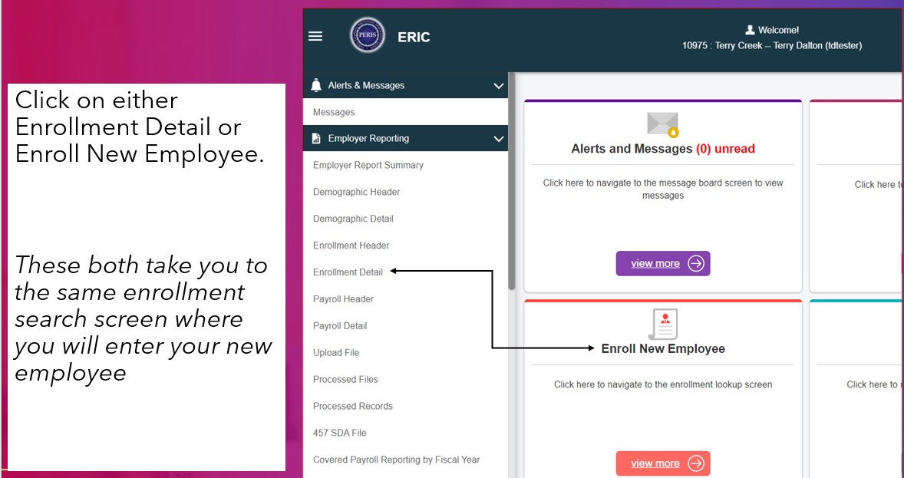
When manually reporting

Slide 11
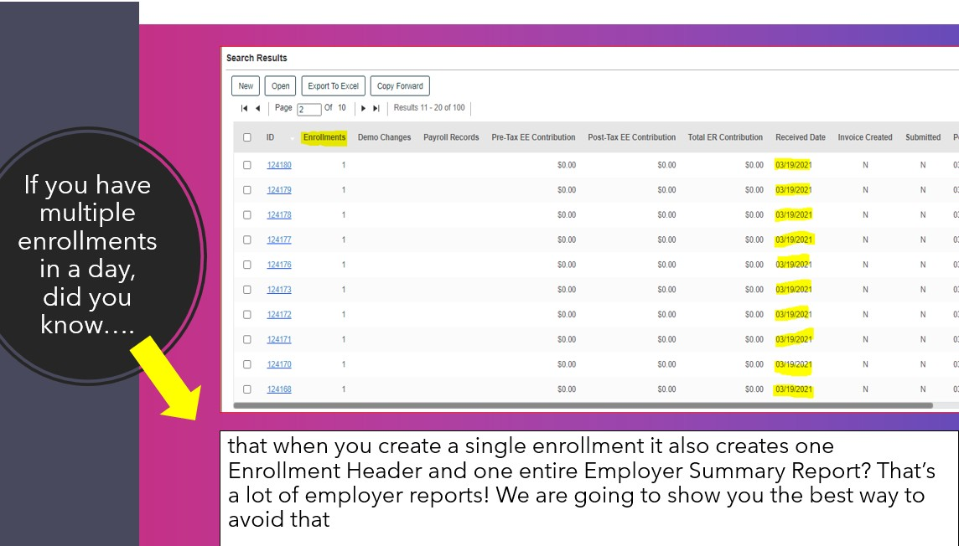
If manually reporting more than one at a time

Slide 12
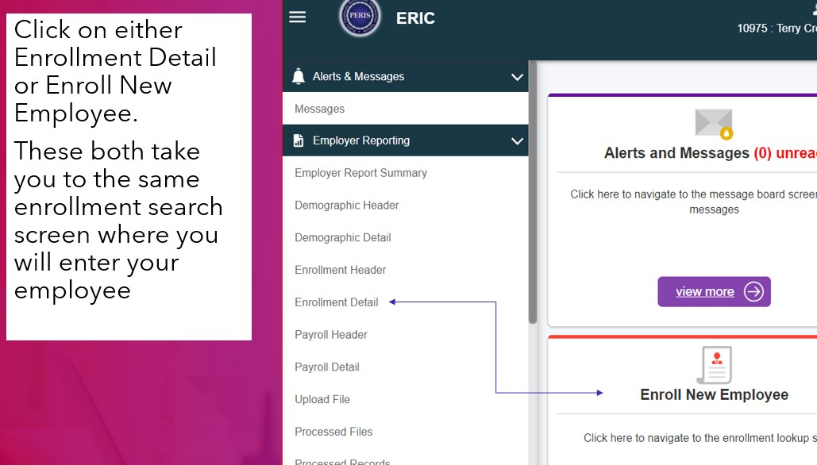

Slide 13
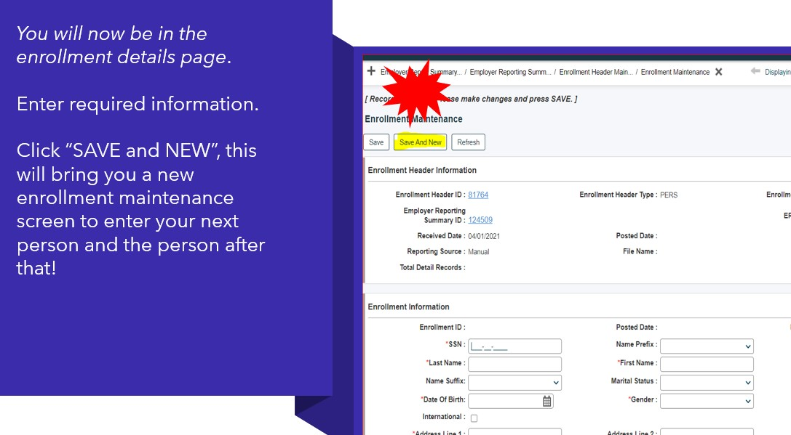

Slide 14
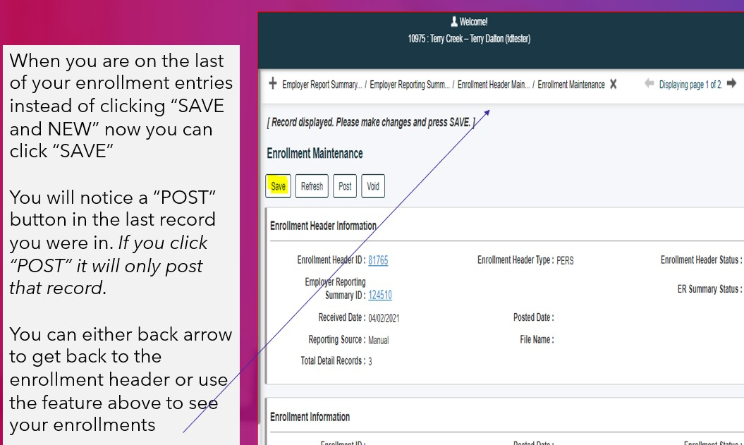

Slide 18
Let's talk terminations and Final Payout

Slide 19
Reasons you may have to terminate employee in ERIC
Retiring Resigning
Was terminated
Deceased while still employed
Termination Information required in ERIC in the employee's final payroll record must include
Employment status
Employment status date
Termination of employment date
Last day worked
Final pay
When terminating an employee, it is important the last day worked is accurate as it starts the 30 day leave from employment required for retirement and refund eligibility.

Slide 20
Final Payouts
Report final payouts for any employee leaving employment permanently Final payouts are to be reported on the employee’s final payroll detail record in ERIC by selecting the final pay check box
What should individual payroll detail records contain?
Sick leave payouts Annual leave payouts Compensatory time
This information allows us to accurately calculate a member’s highest average
compensation at retirement.

Slide 21
Reminders
DON'T "MIX"
PAYROLL DETAILS FOR EMPLOYEE
WITH 2 JOB
CLASSIFICATIONS
ALWAYS DOUBLE CHECK SOCIAL SECURITY
NUMBERS WHEN ENROLLING
THERE SHOULD NOT BE HOURS REPORTED FOR SHIFT
DIFFERENTIAL
ALWAYS INCLUDE TERM DATES ON THE PAYOUT SO YOUR EMPLOYEE RECEIVES CREDIT AND YOU DON'T HAVE TO DO AN ADJUSTMENT LATER

