Slide 1
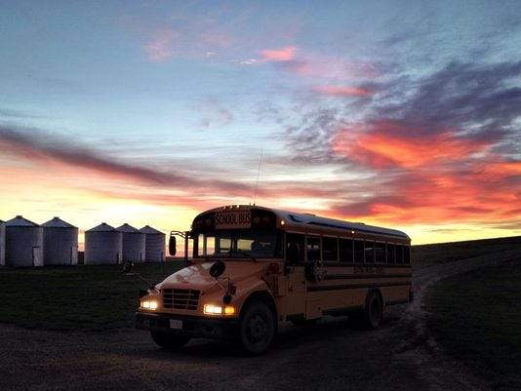
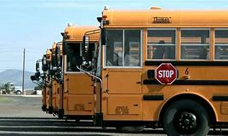
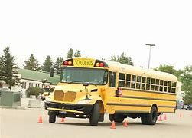
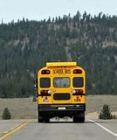
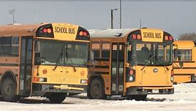
Pupil transportation
Donell Rosenthal
State Director of Pupil Transportation
School Finance Division
DRosenthal@mt.gov
(406) 461-9316

Slide 2
Website Resources
www.opi.mt.gov
Leadership & Support
School Finance
Pupil Transportation
Guides and Information
Forms
Trainings
Budgeting and Finance Information
Pupil Transportation System Login Link (Secured Access. Username and Password Required)

Slide 3
System Access
Request For Access:
Forms available at Leadership - School Finance - About School Finance - User Access Form.
E-mail form to drosenthal@mt.gov
System login found on School Finance main page or Pupil Transportation page under School Finance.
Do NOT share login information. The user is responsible for the information entered under their assigned login.

Slide 4
Transportation Forms
Forms Accessed in the Pupil Transportation system:
Bus Routes (TR-1)
Individual Contracts (TR-4)
Bus Inspections (TR-13) and (TR13A)
Bus Driver Certificates (TR-35)
Bus Route Reimbursement Claims (TR-6)-Electronically submitted for reimbursement.
Individual Contract Reimbursement Claims (TR-5)-Electronically submitted for reimbursement.
Approvals and Requirements:
Board Chair signs paper copy, district keeps a copy, district sends copy to county superintendent.
County superintendent is required to electronically receive these forms and/or approve.
Note: County Superintendent must receive a copy before they electronically receive or approve all TR’s.

Slide 5
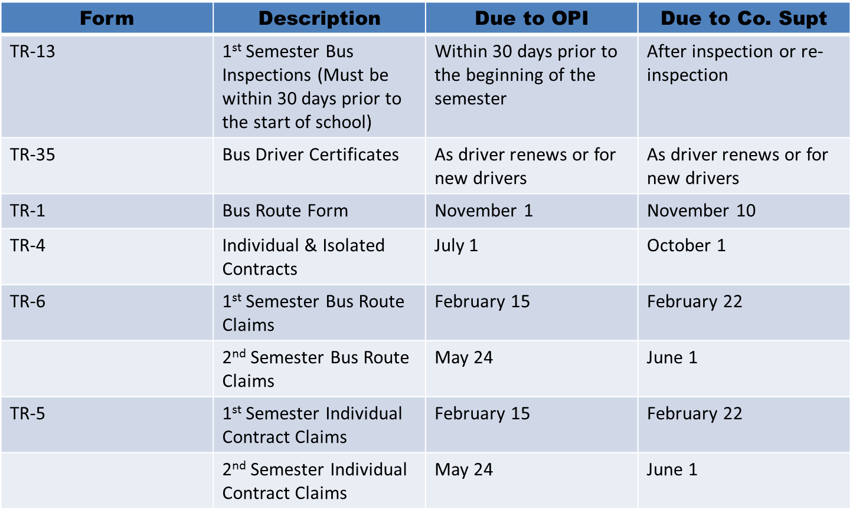
Form Due Dates
TR13A (E Buses)

Slide 6
Bus driver qualifications
MCA, 20-10-103 requires that school bus drivers must obtain a Montana School Bus Driver Certificate (form TR-35) pursuant to the requirements of ARM 10.7.111, by submitting proof of the following:
(a) a minimum of five years of licensed driving experience;
(b) no record of criminal offenses indicating they may be dangerous to children, as evidenced by a criminal background check provided to and approved by the school district prior to initial employment;
(c) a satisfactory report of a physical examination(MEC)
(d) a current first aid and CPR certificate meeting the requirements of ARM 10.7.111;
(e) a properly endorsed commercial driver's license (CDL)-Except for Type E Bus Drivers
(f) a safe driving record, which may not have evidence of any of the following:
(i) more than one moving traffic violation within any 12-month period of the preceding 36 months;
(ii) any conviction for driving under the influence of alcohol or drugs within the preceding 36 months; or
(iii) a conviction resulting in mandatory revocation or suspension of a driver's license in the previous five years.

Slide 7
Required background checks
Criminal History Check:
A criminal background check must be obtained on a driver prior to initial employment.
Districts may also perform a background check upon their discretion as deemed appropriate.
Some districts may already have a process in place for obtaining criminal background checks and fingerprinting.
However, if a district does not have a process, we recommend contacting the Department of Justice (DOJ) for their assistance.
Montana Criminal Records
2225 11th Avenue
P.O. Box 201403
Helena, MT 59620-1403
E-mail: dojitsdpublicrecords@mt.gov
Phone: (406) 444-3625
Annual Drivers License Check:
A yearly check of all drivers license records must be completed to ensure compliance with 20-10-103, MCA.

Slide 8
Bus driver Mandatory Training
2022 Montana School Bus Standards:
Pre-service training program includes but is not limited to:
The essentials of a crash prevention program, including the uniform school bus crash reporting criteria
A system to communicate procedures between administrators and parents, and between contractors and drivers, including student discipline procedures and compliance.
Emergency procedures and/or contingency plans to be followed in the event of a crash, unexpected school closing or unforeseen route change.
The appropriate use of special lighting and signaling equipment.
Railroad Procedures
The opportunity to participate in workshops, conferences and meetings where drivers can work with and learn from a group of their peers. (MAPT is encouraged).
Prior to transporting students with disabilities, the driver should receive appropriate training in compliance with Individuals with Disabilities Education Act (IDEA) and proper use of adaptive equipment
A continuing education program for school bus drivers providing at least 15 hours of in-service training annually, which is the approved coursework in the 2022 Montana School Bus Standards. (This is audited!)

Slide 9
Tr 35: bus driver certification
The TR 35 certificate is accessed in the Pupil Transportation system under Data Entry>Driver>TR-35 Bus Driver Certification:
Board chair signs the certificate which is issued to a driver, assuring that the driver is qualified to drive a school bus pursuant to all applicable rules, regulations and laws.
District retains a copy, and files a copy with the county superintendent. The bus driver is also given a hard copy of the certificate, which must be carried at all times while driving a school bus. ARM 10.7.111(2)
The CPR certificate required by ARM 10.64.201 must include instruction in adult and pediatric CPR certification.
Needs to be signed by a certified instructor, after an initial in-person training of at least four hours.
Renewal is every two years.
ALL drivers on a route MUST be certified with:
Valid CDL
Valid Medical Certificate (MEC)
Valid First Aid (signed by a certified instructor)
Valid CPR (signed by a certified instructor)
If necessary, NEW Drivers have a 60-day grace period to obtain First Aid and CPR
A driver may NOT drive if their CDL, Medical Certificate, First Aid, or CPR is expired.
This will put your state and county transportation reimbursement at risk; meaning for everyday your driver drove on a route with a credential expired, the district will lose those days of reimbursement.

Slide 10
Bus Inspections (TR-13)
Semi-Annual Bus Inspections:
Montana Highway Patrol must perform the first semiannual inspection of school buses within at least 30 days prior to the beginning of the 1st semester. (ARM 10.7.101) (MCA 61-9-502)
Montana Highway Patrol (MHP) must perform bus inspections by January 31 for the 2nd semester.
Only school buses that pass inspection may be used to transport students and only school buses that pass inspection will receive state and county transportation reimbursement.
A school bus that fails inspection must be re-inspected and approved by the inspecting officer.
The school district is responsible for contacting the Montana Highway Patrol in a timely fashion for bus inspections.

Slide 11
Montana School Bus Standards-Extended Stop Arm
2022 Montana School Bus Standards—Extended Stop Signal Arm
Extended Stop Arm (Page 40) --Effective July 1, 2022
When a school bus route includes a bus stop that requires a child to cross a roadway, the school bus must be equipped with an extended stop arm that partially obstructs the roadway.
A school child may not cross a roadway to enter or exit from a school bus unless the roadway has been partially obstructed by the extended stop arm. 61-8-351, MCA.
Extended Stop Arm must:
Be equipped with additional flashing red lights as specified in 61-8-351(5)(b) and 61-9-402, MCA.
Be capable of extending a distance of at least 54 inches from the school bus.
Be at a height of not less than 36 inches.
Extended Stop Arm should have an additional illuminated stop sign located at the furthest distance from the school bus.
These new requirements and modifications will have an impact when performing the semi-annual school bus inspections by Montana Highway Patrol Officers. In addition, the TR-13 Bus Inspection Form is in the process of being fully revised and will be available by the effective date of July 1, 2022.
For questions regarding the new requirements and bus standards, please contact Donell Rosenthal at (406) 461-9316.

Slide 12
Montana School Bus Standards-Additional Flashing Red Lights
2022 Montana School Bus Standards—Additional Flashing Red Lights
Additional flashing red lights may be installed at the rear of the school bus and at the front of the school bus.
The following specifications apply:
• Mounted at a height of at least 36 inches and not more than 72 inches from the ground.
• Be automatically energized in the same manner as the original red lights.
• Must flash in synchronization with the top red lights and must match the red color of the top red lights.
• Must be LED lights.
• May be a round, rectangle, or oblong shape.
• Cannot be a strobe light and cannot be light strip.
The TR-13 Bus Inspection Form has been fully revised to include the extended stop arm and additional flashing red lights and can be accessed in the Pupil Transportation system.
For questions regarding the new requirements and bus standards, please contact Donell Rosenthal at (406) 461-9316.

Slide 13
Montana School Bus Standards-Summary
2022 School Bus Standards Summary of Revisions
Title Page: Up-dated
Acknowledgments: Up-dated
Table of Contents: Up-dated
Formatting: Up-dated
Introduction: Establishes guiding principles, Applicability, and OPI Assistance. Clearly outlines the responsibility of OPI in providing guidance and an understanding of the Montana School Bus Standards specifically relating to the design, construction, and operations of school buses.
First Aid/Body Fluids Inspection Form: Removed MHP Signature.
Extended Stop Signal Arm: Implementation of new law 61-8-351, MCA.
Lamps and Signals: Added language creating standardization for additional flashing red lights on school buses. 20-10-111, MCA and 61-9-402, MCA.
Seat Lap and Shoulder Belts: Updated to reflect that if a lap/shoulder belt is installed, the child sitting in that seat must be properly restrained. Updated to specify exemption from lap/shoulder belts 61-9-420, MCA.
Operational Requirements: Up-dated safety precautions
Limiting the Use of Electronic Devices: Added Sections Prohibiting Texting, using a hand-held device, using earphones to listen to music. Complying with state and federal laws.
Railroad Procedures: Added railroad procedures to comply with Montana law and best practices.
Designated Stops: Added language for bus stops requiring a student to cross the roadway must be approved by the board of trustees.
Glossary: Definitions up-dated.
Hiring New Employees: Clarifies responsibilities for bus driver hiring decision as a local control. OPI has no authority for the hiring and firing of a bus driver.

Slide 14
Entry Level Driver Training
Entry Level Driver Training (FMCSA Regulation)
The Federal Motor Carrier Safety Administration (FMCSA) established new minimum training standards for certain individuals applying for a Class A or Class B commercial driver’s license (CDL) for the first time; an upgrade of their CDL (e.g., a Class B CDL holder seeking a Class A CDL); or a passenger (P), or school bus (S) endorsement on their CDL for the first time.
These first-time license seeking individuals are subject to the entry level driver training requirements and must complete a prescribed program of theory (knowledge) and behind-the-wheel (BTW) (range and public road) instruction provided by an entity that is listed on FMCSA’s Training Provider Registry.
The final rule does not include any minimum hours for behind the wheel training.
Theory training requirements include no minimum number of theory training hours.
A proficiency standard must be met.
No refresher course training required for CDL holders who lose their licenses, get suspended or revoked.
The entry-level driver training Final Rule has a compliance date of February 7, 2022.
For additional information please visit the Federal Motor Carrier Safety Administration (FMCSA) website: https://www.fmcsa.dot.gov/registration/commercial-drivers-license/eldt/faqs

Slide 15
FMCSA Drug and Alcohol Clearinghouse
The Clearinghouse is a secure online database that gives employers, the Federal Motor Carrier Safety Administration (FMCSA), State Driver Licensing Agencies (SDLAs), and State law enforcement personnel real-time information about commercial driver’s license (CDL) and commercial learner’s permit (CLP) holders’ drug and alcohol program violations.
The Clearinghouse will contain records of violations of drug and alcohol prohibitions in 49 CFR Part 382, Subpart B, including positive drug or alcohol test results and test refusals. When a driver completes the return-to-duty (RTD) process and follow-up testing plan, this information will also be recorded in the Clearinghouse.
The employer must use the Clearinghouse to:
Conduct a full query of the Clearinghouse as part of each pre-employment driver investigation process.
Conduct limited queries at least annually for every driver they employ.
Request electronic consent from the driver for a full query, including pre-employment queries.
Report drug and alcohol program violations.
Record the negative return-to-duty (RTD) test results and the date of successful completion of a follow-up testing plan for any driver they employ with unresolved drug and alcohol program violations.
FAQ's: https://clearinghouse.fmcsa.dot.gov/FAQ
About: https://clearinghouse.fmcsa.dot.gov/About
Register: https://clearinghouse.fmcsa.dot.gov/Register

Slide 16
Bus routes TR-1
Key Points:
ALL bus routes must be approved yearly.
ARM 10.7.101
By the fourth Monday in July a county transportation committee (CTC) must act to approve or not approve all bus routes established by districts.
By November 1 a district sends a copy to the County Superintendent and enters the (TR-1) electronically to the Pupil Transportation system.
By November 10 the county superintendent must electronically receive TR-1’s entered by the district.
Once you enter your (TR-1’s) make sure you have a daily rate.
Are there 0.00 Rates? Then there is a problem. Check into it.
Questions: Call Donell at (406) 461-9316 or email drosenthal@mt.gov
A New TR-1 is Required When……
There has been a change in bus on the route (Does not have to go through transportation committee for approval)
There has been a change in the driver (Does not have to go through transportation committee for approval)
There has been a change in mileage (Does have to go through the transportation committee for approval)
Do not edit the existing TR-1 after the semester has started. The district must report the legs as separate parts of a single route (e.g., Route 1A, 1B and 1C) by submitting a separate form for each change.

Slide 17
Individual Contracts (TR-4)
Key Points:
For TR-4 Individual Contracts (ARM 10.7.101) States the following:
BY July 1 a district must complete and sign transportation contracts (three copies) for the ensuing year
Send to the county superintendent copies of all completed individual contracts
Submit individual transportation contracts electronically to the Pupil Transportation system.
The districts are prohibited from issuing warrants on the transportation budget in the absence of a contract.
State reimbursement is paid only on claims supported by valid contracts.(ARM 10.7.105)
Forms are accessed through the Pupil Transportation system.
Individual Contract/Isolation Increased Rate Approval
If isolation has been requested and approved through the board and CTC, the County Superintendent must check the county approval box by editing the TR4 contract before the increased rate will be applied.

Slide 18
Individual Contracts (TR-4)
When making an individual transportation contract with the district, the parent, legal guardian or emancipated minor must sign an affidavit attesting to the place of residence of the student.
If the distance from the student's home to the nearest bus stop or school decreases during the term of the individual contract, the district must amend the contract to reflect the lower mileage.
No person other than the student's parent, legal guardian or an emancipated minor may enter into an individual contract for transportation or receive the transportation reimbursement. Transportation must be provided by a licensed driver in an insured vehicle.
Key Point:
Individual transportation rates outlined in 20-10-142, MCA may not be altered by any authority other than the legislature.

Slide 19
Claim Procedures
First Semester:
By February 15 school districts must provide the county superintendent with one complete copy of the first semester transportation claim using forms provided electronically in the Pupil Transportation Program.
By February 22 the county superintendent must review each district's claim for completeness and accuracy, and electronically approve each district's first semester transportation claim.
Second Semester:
By May 24 school districts must provide the county superintendent with one complete copy of the second semester transportation claim using forms provided electronically in the Pupil Transportation Program. The district claims must be signed by the chairman of the board of trustees and a copy must be retained on file at the district for audit purposes.
By June 1 the county superintendent must review each district's claim for completeness and accuracy, and electronically approve each district's second semester transportation claim.
The district claims must be signed by the chairman of the board of trustees and a copy must be retained on file at the district for audit purposes.

Slide 20
Key Points
If school districts experience unplanned school closures, or routes were not run anytime within the semester, districts may not claim reimbursement for those days.
Individual transportation contract claims will be reimbursed for each day of school attendance for the student and for actual miles transported.

Slide 21
STATE TRANSPORTATION REIMBURSEMENT
Pursuant to MCA 20-10-145
The superintendent of public instruction reimburses each school district according to the following schedule:
By September 1 of each year, the superintendent of public instruction shall make a payment equal to 50% of the state transportation reimbursement paid to the district in the previous school year.
By March 31 of each year, the superintendent of public instruction shall make a payment to the district equal to the approved amount of state reimbursement for first semester transportation claims less the amount distributed to the district under subsection.
By June 30 of each year, the superintendent of public instruction shall make a payment to the district to pay the balance of the approved amount due to the district for first and second semester transportation.
Upon receipt of electronic state payment notice the county superintendent orders the disbursement of county reimbursement. The county superintendent should initiate the county obligation for each semester’s claims.

Slide 22
Transportation Desk audits
Annual desk audits of transportation reporting
The compliance items will include, but not limited to:
Bus Driver Requirements
Criminal background check, new drivers
Drivers license checks – yearly
Bus Routes approved by board of trustees and county transportation committee
Bus Inspections
Compliance with training hours with documentation
Proper drivers license endorsements, first aid and CPR, medical certifications, and valid TR35 certificates
Signed documents on file – from County Transportation Committee
The district is responsible to ensure all proper documents are collected, regardless if contracting bus services.
Noncompliance with the requirements may result in a collection of state payments from the year audited.

Slide 23
Programming Changes
TR6 Bus Route Reimbursement Claims Screen
Ability to select one or more drivers for a single route.
When a district has a change in a bus driver mid semester, a new TR1 no longer must be added. This is only for multiple drivers on a route. An additional TR1 must still be reported when there is a change in bus on a route and change in mileage.
Estimated to be completed before entry of semester 1 bus route reimbursement claims
TR13 Bus Inspection Form
TR13 Bus Inspection form includes new laws
Revised to include the Additional Flashing Red Lights and the Extended Stop Arm.
Programming is completed
TR13 Bus Inspection Screen
Date of Inspection
Future Inspection dates cannot be entered and saved.
Programming is completed

Slide 24
Budgeting -TRANSPORTATION FUND (10)
PURPOSE: The Transportation Fund can be used to support the costs of transporting students between home and school, including:
costs of school bus purchase, repair, maintenance and operations;
safety activities related to bus driver training, crosswalk attendants, etc.;
bus barn facilities and maintenance; and
payments to parents for individual transportation contracts.
Costs of field trips, travel costs related to extracurricular activities and athletics, and staff travel costs are NOT ALLOWABLE costs of the Transportation Fund (10).
Claims for Reimbursement:
State funding is paid based on semi-annual claims to the OPI in February for first semester and in May for second semester. The state sends a prepayment entitlement in August. The prepayment entitlement is equal to 50% of the average of the prior year's entitlements. The OPI and county treasurer pay the district their portions of the funding in March for the 1st semester and in June for the 2nd semester per §20-10-146, MCA.
State funding is disbursed in the following three payments:
August – 50% of the prior year’s unadjusted entitlement (Referred to as the pre-payment)
March – 1st semester entitlement payment less the pre-payment amount received in August
June – 2nd Semester entitlement payment
VOTING REQUIREMENTS: The transportation fund tax levy is permissive. Consequently, it is not subject to voter approval. However, projected mill increases in this fund are subject to voter notification by March 31st per §20-9-116, MCA. This fund may budget the ‘On-Schedule’ costs of bus routes, individual contracts and any ‘Over-Schedule’ amounts of operating the transportation program.

Slide 25
Transportation Fund (10)
The Transportation Fund (10) can be used to pay a portion of the clerk's salary and the superintendent's salary.
Be aware that it can significantly complicate the accounting and budgeting processes. If salaries are charged to the transportation fund, you must be able to demonstrate that the cost allocation is valid. That is, if the clerk spends 2% of his or her time on transportation issues, it would not be appropriate to charge 50% of the clerk's salary to the program.
To allocate salaries to transportation, you should:
Have a method of tracking and documenting time and effort spent on the program.
Have the allocation officially approved by the trustees.
Apply the method consistently from year to year.
Having processes in place will provide an auditor the documentation needed to see that the allocation is an appropriate use of the fund.

Slide 26
BUS DEPRECIATION FUND (11)
PURPOSE: This fund is a reserve fund used to levy taxes for the following:
Replace, remodel or convert yellow school buses and activities/athletics buses owned by the district;
Replace communication and safety devices used in the transportation program;
Purchase additional yellow school buses to be used on bus routes; and
Purchase and install video cameras for security on buses.
The district can accumulate ("depreciate") a reserve to:
Yellow school buses owned by the school district or vehicles meeting the legal definition of a school bus (such as a Type E bus) and used as a school bus;
Coach buses (like a Greyhound-type) used for athletics/activities; and
Communication and safety devices used in the transportation program.
The fund cannot be used:
To purchase or replace vehicles which are not buses. (§20-10-147, MCA, and ARM 10.10.311)); or
To purchase or replace cell phones, which do not qualify as communication devices. The fund may not be used for the maintenance or parts for school buses or activity buses. Since this is a reserve fund, there is traditionally no set aside operating reserve.
VOTING REQUIREMENTS: The Bus Depreciation Fund (11) tax levy is permissive up to the statutory limits. Consequently, it is not subject to voter approval. However, projected mill increases in this fund are subject to voter notification by March 31st per §20-9-116, MCA.

Slide 27
Cost Analysis (Type E Bus)
The trustees of a district may not purchase and operate a type E school bus as defined in 20-10-101(4)(a)(ii) until the trustees have:
Conducted an analysis of the costs associated with the purchase and operation of the school bus compared to the costs associated with purchase or contract and operation of a school bus designed to carry more than 10 passengers.
(2) Adopted a written finding that the purchase and operation of a school bus as defined in 20-10-101(4)(a)(ii) is the most cost-effective means of transporting eligible transportees on the bus route or routes to which the school bus will be assigned.
Key Point:
The cost analysis must be on file for review.

Slide 28
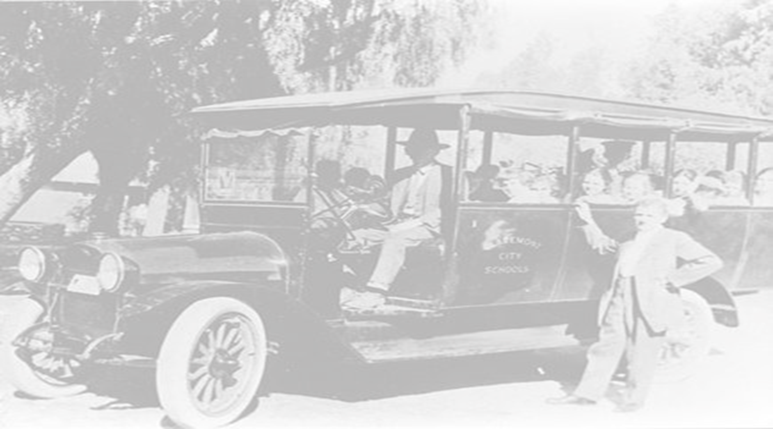
Thank you!
Donell Rosenthal Pupil Transportation Director Montana Office of Public Instruction Phone: 406-461-9316 DRosenthal@mt.gov

