Slide 1
Design-Build & Maximizing Your ESSER Funds
June 13 - 17, 2022
Halvor Kamrud
Tim Tolman
Butte, MT

Slide 2
Agenda
Introductions-McKinstry Montana
What is Design-Build & How does it Work?
Design-Build & ESSER Integration
Additional Funding Mechanisms
Market Updates
Escalating Construction Costs
Current Delivery Timelines

Slide 3
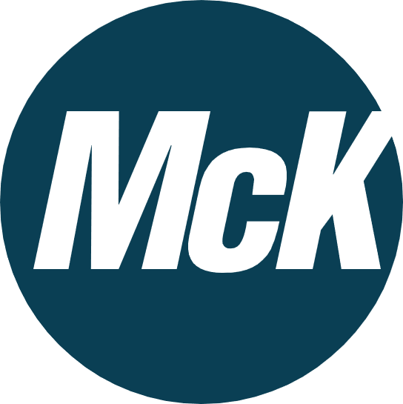
Introductions - McKinstry Montana
MISSOULA
Office
BOZEMAN
Office
BILLINGS
Office
Notes:
Montana Overview
2009
$100 Million total
Over $35 million K-12

Slide 4
What is Design-Build?
Design-Build Overview —Statute
Alternative project delivery contract includes design-build contracts and are permitted under Montana Code Annotated 18-2-502 if two of three of the following criteria are met:
1
The project has schedule ramifications where Design-Build is necessary.
2
Design-Build will result in significant cost savings.
3
The project presents significant technical complexities where Design-Build is necessary.

Slide 5
How does Design-Build Work?
Structure
Traditional Project Delivery
Design-Build Delivery
School District
School District
Architect
Owner’s Rep
Contractor
Design-Build Partner
Sub
Sub
Sub
Sub
Sub
Sub
Sub
Sub
Sub
Sub
Sub
Sub
Notes:
Procurement method allows us to co-select right bid not just low bid
No change orders to the District unless they request it
WA and MSU study references – Both compared DB and DBB and DB cheaper

Slide 6
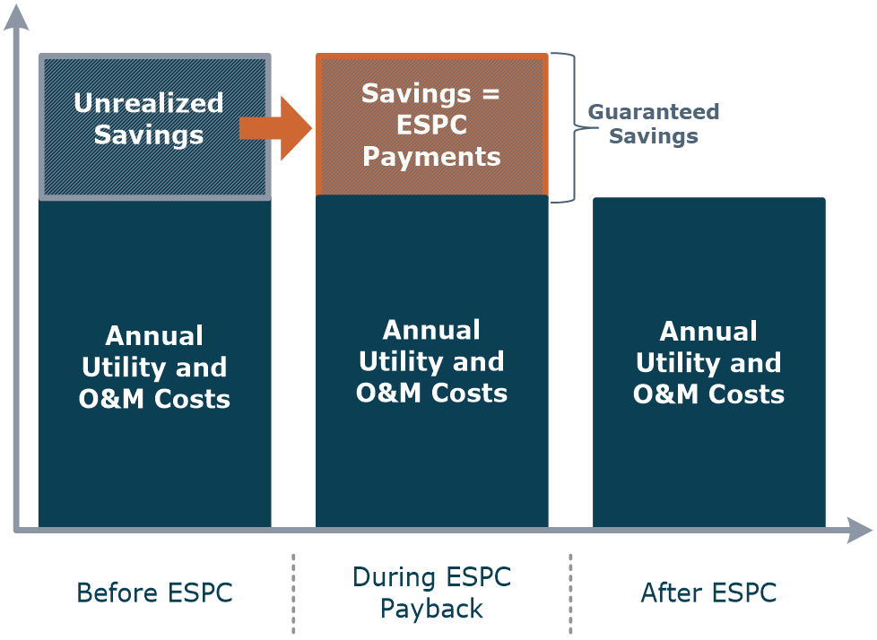
How does Design-Build Work?
Design-Build with Guaranteed Savings (or ESPC)
Notes:
Important to state we guarantee Costs/minimizing risk

Slide 7
Design-Build & ESSER Integration
What Work Qualifies for ESSER Funding?
ESSER III Guidance from Montana OPI clarified allowable uses of relief funds, including provisions for facility improvements:
School facility repairs and improvements to enable
operation of schools to reduce risk of virus transmission and exposure to environmental health hazards, and to support student health needs.

Slide 8
Design-Build & ESSER Integration
This can include…
Notes:
Discuss Lead sampling potable water

Slide 9
Client Funding Sources
McKinstry has secured over $400 million in grants for our clients!
Utility Rebates
Maximize available utility incentives
Grants
Federal
State
Utility Savings
Guaranteed utility savings
Operational Savings
Guaranteed operation & maintenance savings
Capital Funding
Leverage available capital: bonds, endowments, etc.
Rebates
Grants
Utility Savings
O&M Savings
Capital Funding
Notes:
Tim

Slide 10
Market Updates

Slide 11
Escalating Material Costs
Current Supply Chain Trends
Additional 10-12% cost increase in commodity equipment above the 30% year over year increases to date
Circuit boards and controls supply chain bottleneck driving 28-40 week delivery for HVAC equipment
Notes:
This represents an increase

Slide 12
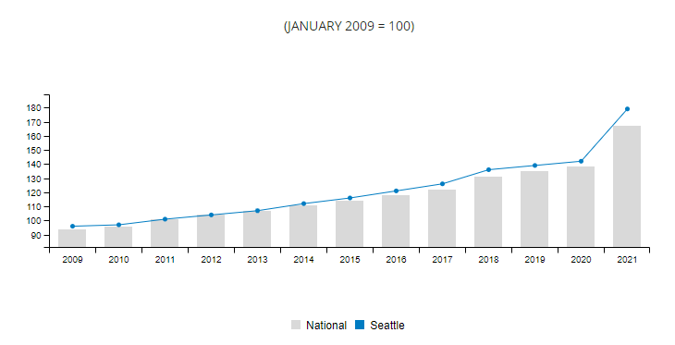
Escalating Material Costs
Industry-Wide Escalation
2.9% single quarter cost increase nationally
4.3% single quarter cost increase in Seattle
21.5% annual cost increase nationally
26.1% annual cost increase in Seattle
Source: Mortenson Construction Index
Notes:
Give UM Knowles Hall example
Stats:
According to the AGC, construction material prices increase nearly 20% in 2021
2.9% single quarter increase in construction costs nationally (Mortenson)
4.3% single quarter increase in construction costs in Seattle (Mortenson)
21.5% cost increase in last 12 months nationally (Mortenson)
26.1% cost increase in last 12 months in Seattle (Mortenson)

Slide 13
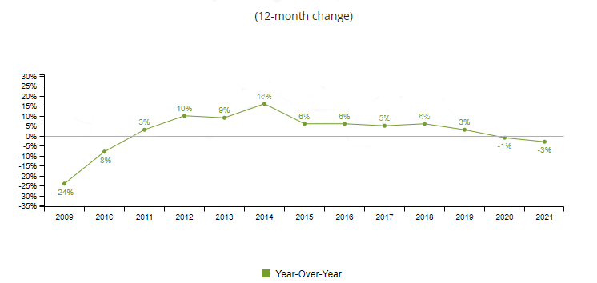
Labor Constraints
Industry-Wide Labor Constraints
3% loss of construction employees in Seattle metro region from 2020 to 2021
Labor availability will continue to be a top concern in 2022.
Source: Bureau of Labor Statistics
Notes:
Stats:
3% loss of construction employees in Seattle metro region from 2020 to present
Construction employment totaled 26,800 in December 2021
This is 800 fewer employees than in December 2020

Slide 14
Current Delivery Timelines
 | JUL-22 | AUG-22 | SEP-22 | OCT-22 | NOV-22 | DEC-22 | JAN-23 | FEB-23 | MAR-23 | APR-23 | MAY-23 | JUN-23 | JUL-23 | AUG-23 | SEP-23
Preliminary Development
Scope Development
Initial Estimating
Project Approval
Design Development
Design Finalization
Early Equipment Release
Procurement
Equipment Procurement
Contractor Procurement & Bids
Construction
Implementation
Closeout
Notes:
Bidding in late fall / early winter to secure labor for summer 2023. ie summer 2022 already full by end of March

Slide 15
Design-Build vs. Design-Bid-Build
Design-Bid-Build
Design-Build
Notes:
Brings all Subs together at once
Allows us to reduce cost and schedule and procure equipment sooner

Slide 16
How Design-Build Maximizes ESSER Dollars
Reduces Delivery Schedule
Reduces Cost
Increases Quality
Minimizes Risk for Owner
Notes:
Risk – Guarantee
Schedule – Bring Subs in up front
Cost – WA and MSU Study
Quality – Bring entities together and no low bid

Slide 17
Thank You!
Halvor Kamrud
Business Development Manager—MT
406.529.3333
HalvorK@mckinstry.com
Tim Tolman
Business Development Manager—MT
406.214.3501
TimT@mckinstry.com

