Slide 2
MASBO
School Nutrition Programs
Back to Basics
June 16, 2022
11:00 - 12:00
1:40 - 2:40

Slide 3
AGENDA
School Nutrition Programs Refresher
Introduction and Overview of SNP
What to Expect in SY22-23
Nonprofit School Food Service Account
CEP and DCA
Free/Reduced Applications

Slide 4
Introduction

Slide 5
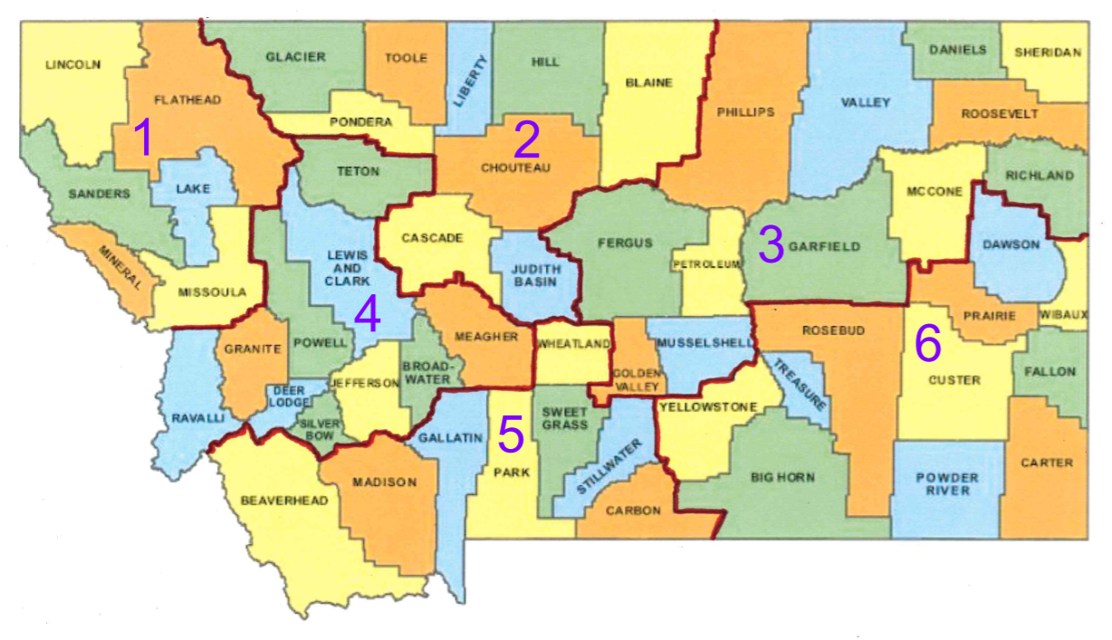
Who is MT OPI SNP?
Montana
Office of Public Instruction
School Nutrition Programs
OPI SNP Contact Info

Slide 6
MT SCHOOL NUTRITION PROGRAMS
National School Lunch Program
School Breakfast Program
Fresh Fruit and Vegetable Program
Afterschool Snack Program
Special Milk Program
USDA Foods
DOD Fresh
Seamless Summer Option
Montana Team Nutrition
Summer Food Service Program
Programs Administered:
Notes:
Ten programs administered by OPI SNP currently. Not all are available to all sponsors – please contact us if you have questions about some of these.

Slide 7
PROGRAM STRUCTURE + FUNDING

Slide 8
What to Expect SY22-23

Slide 9
Back to “normal”
Charging paid/reduced prices
Collecting free/reduced applications
Conducting verification
Waivers expiring
Adding some new waivers
Back to NSLP reimbursement rates
Why? – Congressional waiver authority for USDA is expiring June 30th. Conditional state waivers granted.

Slide 10
SNP Checklist
This is your roadmap to success over the school year!
SNP Checklist

Slide 11
Other updates for SY22-23
More communication via Broadcast Email function in MAPS
*Add to safe senders list to avoid missing information
Meal pattern changes:
Whole grain/whole grain-rich requirement: 80%
Flavored low-fat milk allowed permanently
Sodium targets changed slightly
mtopihelpdesknoreply@cnpus.com
Procurement:
“Micro” purchase threshold
$0-10,000 $0-50,000
“Must” “Should” be equitably distributed

Slide 12
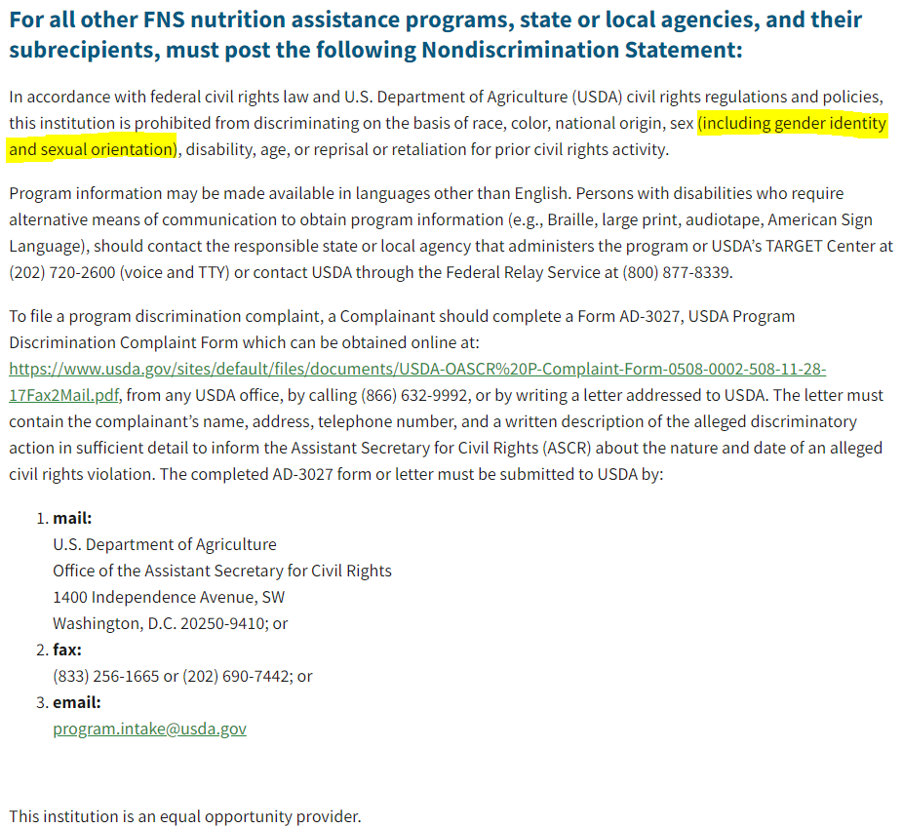
Nondiscrimination statement update

Slide 13
Daily Meal Counts
Friendly Reminder:
Meals counts are taken at the
Point of Service.
No exceptions.
Recommend schools use their normal Point of Service (POS) software to accurately track daily meal counts.
If no POS software, ensure daily paper meal count forms are completed and maintained on file for 3 years plus current year. Also consolidate correctly for the monthly claim based on students benefit status (F/R/P).
Ensure privacy: that students are not identified based on their benefit status that others may see.

Slide 14
Nonprofit School Food service Account
A La Carte Sales
Nonprogram Revenue

Slide 15
Paid Lunch Prices
NOTE: Paid Lunch Equity Tool not required unless nonprofit school foodservice account is negative.
Annual USDA Memo
$3.31 ($3.75-$0.44) – SY 21-22
Notes:
Ensure sufficient funds are provided to the nonprofit school food service account for meals served to students not eligible for F/R. Two ways to do this- either though price charged for “paid” meals or through other non-Federal sources provided to the NSFSA.
“Under Section 752, of Division A of the Appropriations Act, for SY 2022-2023, only an SFA that had a negative balance in the nonprofit school food service account as of December 31, 2021, shall be required to establish a price for paid lunches served through the National School Lunch Program (NSLP) in accordance with section 12(p) of the Richard B. Russell National School Lunch Act (42 U.S.C. 1760(p)). FNS will be providing additional guidance for SFAs that are required to comply with the paid lunch equity provision during SY 2022-2023.”

Slide 16
Adult meal Prices
It’s Required!
Annual Adult Meal Price Memo
Updated July/Aug when the new SY Reimbursement Rates are released
Factor in serving size
SY 2021-2022
Breakfast $1.97
Lunch $3.98
Notes:
Adult Meal Prices
Revenue from NSLP and SBP cannot be used to subsidize adult meals. If SFA decide to subsidize meals for teachers, admin, custodians and other adults, the subsidy should be identified as an employee benefit and as a source of revenue in the School food Service budget.
$3.98 lunch; $1.97 breakfast [lunch = free reimbursement, value of commodities ($.26), state match (.0564)
Annual Adult Meal Price Memo for SY 22-23 will be updated in July or Aug when the new reimbursement rates are released by USDA.

Slide 17
Meal Charge Policy
Required at schools charging students Paid/Reduced meal costs
Define process for delinquent and bad debt.
Communicate in writing.
Resources
Montana School Board Association Policy Template
USDA-SP 23-2017 Unpaid Meal Charges: Guidance Q&A
USDA-Overcoming the Unpaid Meal Challenge
Notes:
Meal Charge Policy:
Must develop and implement an SFA-level policy.
Policy must be provided in writing to all household at the start of each school year and to transfer students.
Work with families. Do not punish the child. Alternate meals may single children out with unpaid meal charges.
Charge all available reimbursable meals to the child’s account
Charge a limited number or type of meals to the child’s account
Receive an alternate meal
Neither charge a meal nor receive an alternate meal (p 11 of overcoming doc)
Policies must include process SFA follows for delinquent and bad debt (uncollectable).
“Delinquent”- when payment is overdue as defined by local policy. It is considered delinquent as long as it is considered collectable and efforts are being made to collect it. Must make reasonable effort to collect. Cost of collect efforts is an allowable us of NSFSA funds. A debt owed to the NSFSA remains on accounting docs until it is either collected or is determined uncollectable and written off. Can be carried over to next school year.
“Bad” Debt: When further collection for delinquent debt are useless or too costly, the debt must be re-classified as “bad” debt. Once considered “bad” debt, it must be written off as an operating loss. NSFSA resources may not be used to cover costs related to the bad debt, such as continued legal and collection costs. MUST BE RESORED using NON-FEDERAL funds- General fund, local contributions from community orgs, revenue from catering or contracting services that operate using an account other than the NSFSA.
If child has $ to buy meal but has outstanding meal charge debt, the SFA cannot require payment and refuse to provide the child a meal.
Good Practices- pre-payment, payment plans, online payment, online applications.
Resources
MTSBA policy (hard copies)-
Overcoming the Unpaid Meal Challenge
Show checklist in Overcoming the Unpaid Meal Challenge Document (pg 52-57)

Slide 18
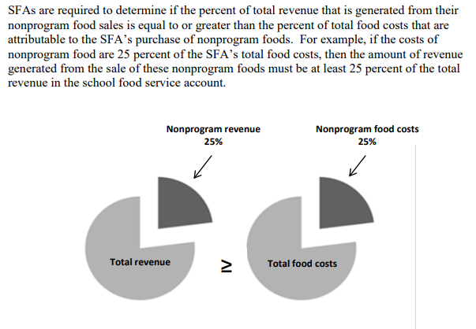
Revenue from Nonprogram Foods
Examples of Nonprogram Revenue:
A la carte
Adult meals
Catering
Vended meals (to other schools)
Vending machines
Fundraisers
School stores

Slide 19
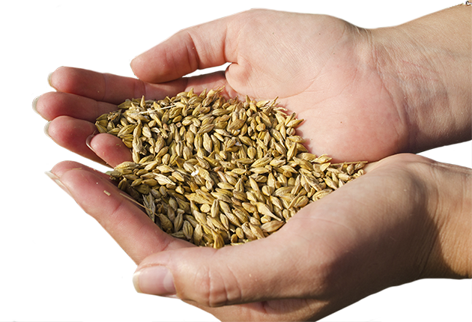
A la carte
Minimum
Track a la carte milks and second entrees.
Best Practice
Charge for a la carte items.

Slide 20
3-Month operating expenditures limit
What is this?
Contributing Factors
What happens?
Spend
Down
Plan
Higher Reimbursement SY20-21 &
SY21-22
Supply Chain Assistance Funds
Covid-19
Emergency Operations Funds

Slide 21
Benefit Issuance
DCA
F/R Applications
CEP

Slide 22
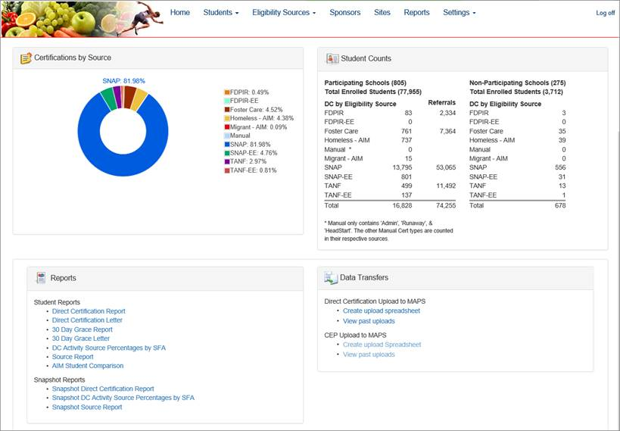
DCA
Notes:
First and foremost, please know that your login information will be the same (common login) for both the MAPS and DCA systems.
MAPS is the new CNP Web for Montana.
Note: as the login information is the same for MAPS and DCA, if one password expires, both are expired.
Gaining access to the system is the first step. You can find user access forms located on the main page of the OPI School Nutrition Programs website.
*NEW DCA*

Slide 23
What is Direct Certification?
Data obtained directly from the State or Local Agency to ensure students enrolled in assistance programs and other categorically eligible programs are automatically approved to receive school meals at no cost without an application.
Assistance Programs
Other Categorical Sources
SNAP
Supplemental Nutrition Assistance Program
TANF
Temporary Assistance for Needy Families
FDPIR
Food Distribution Programs on Indian Reservations
Foster Care
Homeless
Migrant
Notes:
In Montana, we use the Direct Certification Application (DCA) to conduct direct certification to identify eligible students in the following categories: SNAP, TANF, FDPIR, Foster Care, Homeless, Migrant, Runaway.

Slide 24
Why is Direct Certification Important?
Improves student access to school meals
Reduces application processing paperwork
Decreases meal charges for students that are eligible
Helps Montana families balance tight budgets
Reduces the pool of household applications subject to verification
Helps schools qualify for Community Eligibility Provision
*It’s required*
Notes:
Direct certification improves student access to school meals
It helps Montana families balance tight budgets – if they already qualify for assistance in some way, DCA streamlines that assistance for school meals
Direct cert reduces the pool of applications subject to verification (there will be another in-depth webinar about verification alone October 4)
It also is the system we use to identify schools that might qualify for Community Eligibility Provision (CEP) – because direct certification (by way of the DCA system) are what we use to find schools eligible for CEP, it is vital your information in the DCA system is up-to-date and accurate throughout the school year

Slide 25
DCA Map
State Level AIM
State Assistance Program Data
DCA
Student Data
Update POS
School District Student Data
Export DCA Report
Directly Certified Students
Notes:
How DCA works:
1) Student information is uploaded from the school to the state level AIM system – Do you know how often this is done at your school? DCA runs a match every night, but it won’t affect your data if AIM isn’t current at the state level with OPI.
2) State assistance program data from DPHHS is collected
3) In DCA the two sets of information are combined and matched
4) The direct certification report from DCA can be exported
5) Update school meals point of service (POS) to ensure students eligible are receiving free school meal benefits – This can be done by an export/import from DCA to the schools POS system if one is used. Otherwise, the information from DCA needs to be transferred accurately by hand.

Slide 26
Direct Certification Activities
Best Practices - Before School Starts
Conduct Direct Certification
Notify Directly Certified Households of their Eligibility
Mail F/R Applications to Households not already Directly Certified
This reduces the number of applications needing processed and verified
USDA Frequency Requirement
Conduct Direct Certification Activities a Minimum of 3 Times During the SY
Notes:
Conduct Direct Certification – we walked through this process on the previous slide (ensure AIM data is uploaded before you conduct direct cert, after you get your direct cert list, update the POS system).
Notify Households – let families know they are already approved for free meals – they do NOT need to submit a paper application – this reduced duplication of efforts on behalf of the school and the household. Letters for households can be generated from the DCA system to reduce your workload.
Distribute F/R Applications to Households NOT Directly Certified – schools cannot require students/families/households to complete F/R applications.
Schools are required to conduct Direct Certification 3 times per year. Feel free to do this process as often as needed, especially if students are moving in and out of district often.

Slide 27
Free & Reduced-Price Meal Applications
Notes:
SURVEY ROOM
+ HOW MANY DO F/R applications?

Slide 28
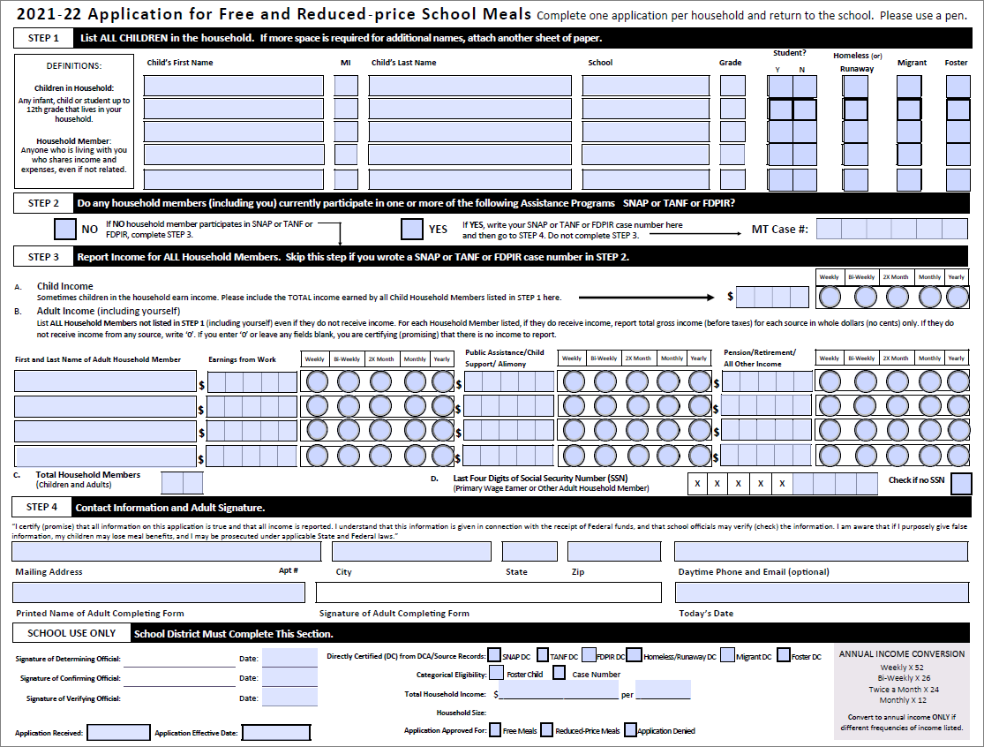
Application Highlights
Timeframe
Zero Income
Edits to Application
Error Prone
Signatures
SSN
30 Day Drop
Notes:
Timeframe – USDA requires applications are processed within 10 days
Zero Income – OK! $0 or nothing written
Edits to Application – Make these with a different color ink and initial/date on application itself
Error Prone – within $100 monthly of income guidelines or $1,200 annually
Error prone applications must be used during verification if less than 80% of HH responded during verification the previous school year – it’s a good practice to note an “error prone application” when you come across them so you don’t have to go back and figure that out twice. OPI SNP will let you know if you need to use error prone applications.
Signatures – required, plain and simple
SSN – required, call and get this information
30 Day Drop – don’t forget after 30 days of the school year, any student with a Free or Reduced status from the previous school year must be moved back to Paid status if a current application is not received by the district. Students that were approved for free meals through DCA but are no longer on the direct cert list must also be moved to Paid status if a current application is not received or they do not show up on the DCA list. Run 30 day report to see which students these are.

Slide 29
Documenting Categories of Eligibility Benefits
Free Eligible Program Certifications (Exempt from Verification)
SNAP Directly Certified in DCA (Supersedes all categories)
Other Source Categorical Direct Cert Programs in DCA:TANF, FDPIR, Foster, Homeless & Migrant
SNAP Agency Letter Only - Not in DCA (If active in DCA, override as SNAP DC)
Free & Reduced Eligible per Household App (Subject to Verification)
Free Categorical Program - Non-Direct Cert/Not in DCA - Case# or Prog listed on App
Free Income/Household Eligible
Reduced Income/Household Eligible
Paid / Denied / Incomplete
No current SY application received (or)
Didn’t qualify or was incomplete (Keep on file)
Notes:
A Benefit Issuance Roster List should be maintained or as an available report if using an operating system to track f/r eligibility.
It’s recommended to file F/R applications within these categories for the verification report. Your district may not have applications on file for direct certifications which is perfectly fine. Just be sure to update the Benefit Issuance Roster List or software system with the most current determination to track paid/free/reduced meals served and report on the monthly reimbursement claim.
Direct Certifications override all other determinations and SNAP direct certs supersede all types.
When an application is received that lists a case number, check DCA to determine if directly certified and if so there’s no need to process the application any further or indicate the direct cert status in the ‘School Use Only’ section but keep on file.

Slide 30
F/R process overview
Conduct Direct Certification
Send Direct Cert Household Notifications
Send Applications
Process Applications
Best Practice – Date Stamp the day received
Determine Eligibility within 10 days
Send Household Notifications
Repeat – Ongoing

Slide 31
OPI Electronic application
FREE for schools to use!

Slide 32
Applications: tips for success
Don’t start until July 1
Communicate EARLY and OFTEN!
Reiterate how information is CONFIDENTIAL
Consider sending an accessory letter detailing the OTHER IMPACTS of your F/R rate
Send PAPER and ELECTRONIC versions
Remind families they can SUBMIT AGAIN if their situation changes
Remind about the INCOME ELIGIBILITY GUIDELINES
Peer sharing: What are your tips for success?

Slide 33
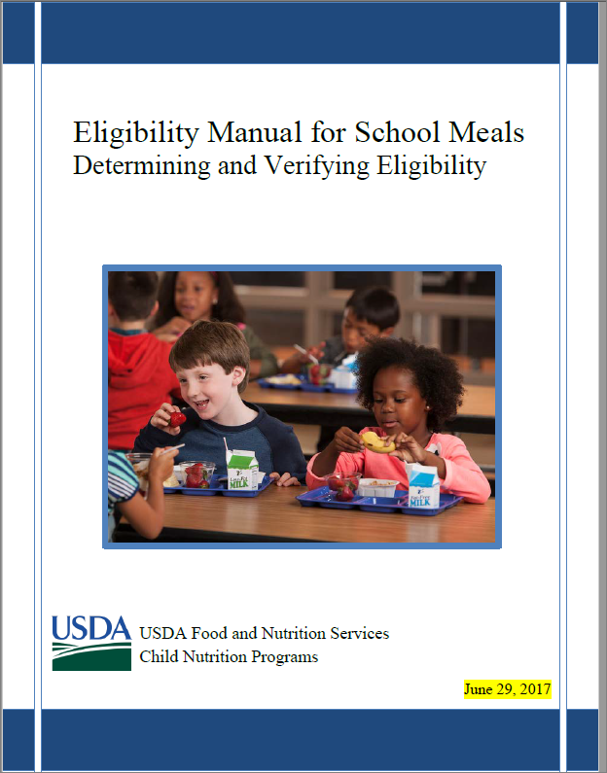
Resource: Eligibility manual for school meals

Slide 34
Verification
Free and Reduced-Price Applications
Notes:
PASS OUT FNS 742 FORM

Slide 35
What is verification?
Process of validating household eligibility information for 3% of the approved applications on file as of Oct 1st.
Notes:
School meal program integrity.
Reported to USDA.
Districts operating CEP district-wide are exempt from the verification process but should still complete and submit sections 1-2 of the verification report in MAPS

Slide 36
 | Summary and Timeline of Verification Activities
Oct 1 | Record approved application counts in each category as of Oct 1 (Sect 4) of the verification report
Oct 1 thru Nov 15 | Calculate the 3% - Number of apps to verify (Round all decimals up) Randomly select applications for verification Conduct confirmation review of selected apps (double check/document) Attempt to Directly Verify selected apps using DCA Send household notification of selection – allow at least 10 days Collect information from households…follow up multiple ways (call, email, mail) Review documentation returned from households Send household notification of results, update POS if needed
Oct 31 | Record approved student counts in each category as of Oct 31 (Sect 1-4)
Nov 15 | USDA Deadline to confirm household’s documentation and send notification results
Nov 30 | Deadline to submit the Verification Report in MAPS

Slide 37
Example of How to Calculate 3% of the Applications to Verify
Total Applications in section 4 (Column A) = 42
Multiplied by 3% X 00.03 (3%)
Round all decimals up = 1.26 ( 2 )
In this example 2 Applications should be randomly selected for the verification process
Notes:
Do not include directly certified applications in the pool of applications subject to verification. Their eligibility has already been confirmed. Therefore, the number of categorical applications listed in 4-1 should be very few to none as most will be confirmed as directly certified in DCA and counted in section 3.

Slide 38
Verification Method
Dependent on the percent of households that responded to last year’s verification process
3% Random (Alternate One)
At least 80% household applications responded to verification in the previous year
Applications selected randomly from entire pool of those subject to verification
Most common method of verification
3% Error-Prone (Standard)
Required if less than an 80% of the household applications responded to verification
Applications selected randomly from error prone applications
Less common method
Notes:
Random
Equal to or greater than an 80% response rate from households in the previous year.
Applications for verification chosen at random from entire pool subject to verification.
Error Prone
Less than an 80% response rate from households in the previous year.
Applications for verification chosen at random from error prone applications.

Slide 39
Community Eligibility Provision
School Meals FREE for all enrolled students
Eliminates Free and Reduced-Price Applications
Omits counting by Free, Reduced & Paid categories
Simplifies process - count and claim total meals served
Meal charges and money handling are eliminated
Simplifies meal reimbursement claiming

Slide 40
CEP - What data is used to Qualify
School Percentages of Directly Certified Students determine CEP eligibility
Must have a direct certification percent of 40% or higher

Slide 41
Questions?

Slide 42
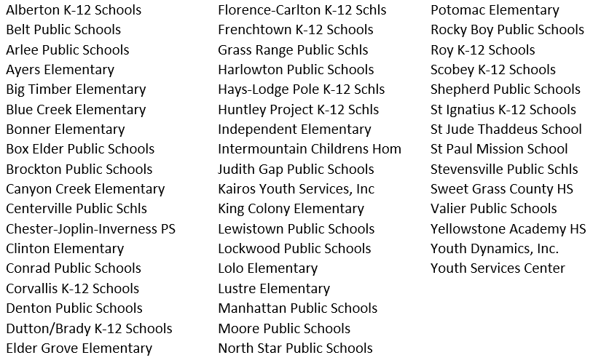
Who is on review 2022-2023

