Slide 1
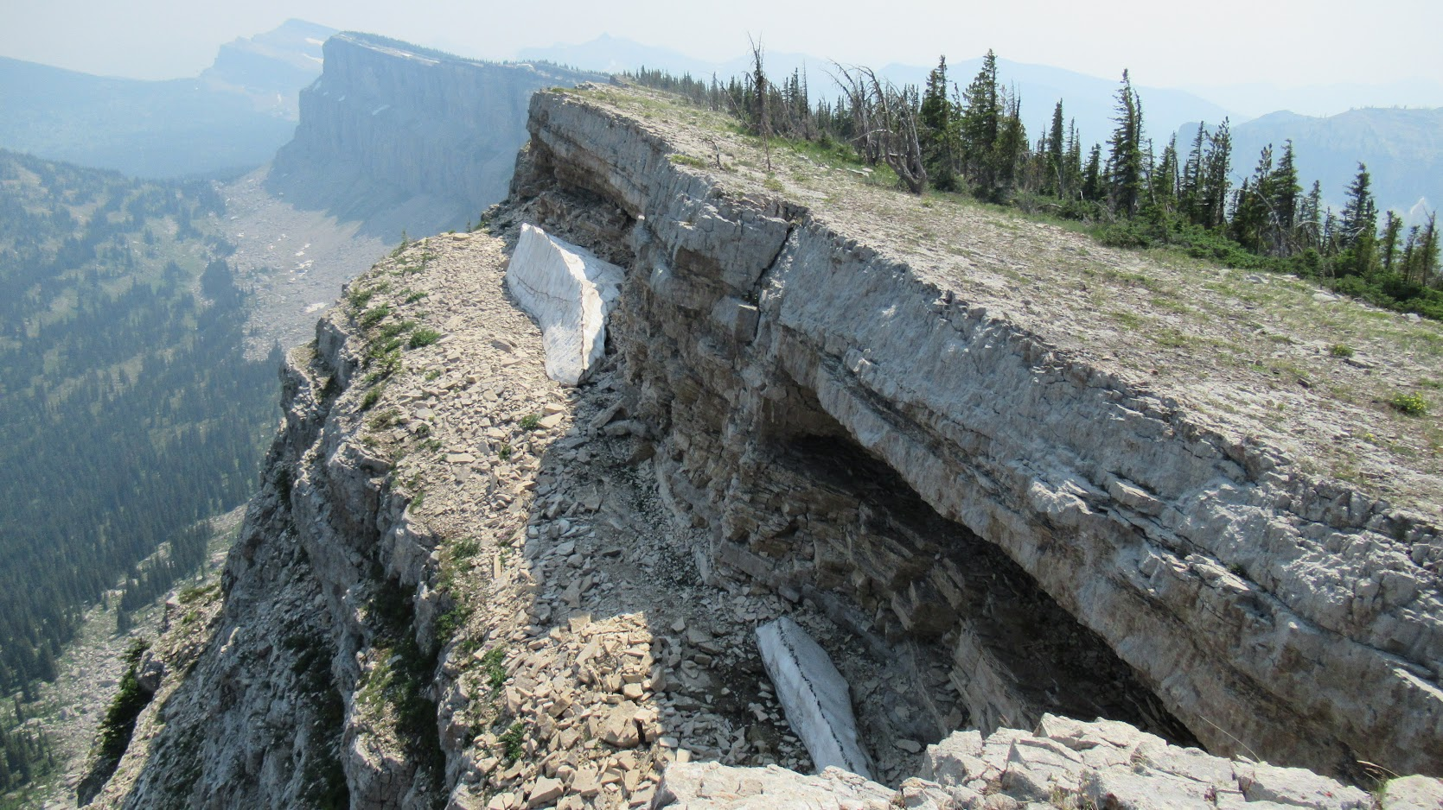
Let’s Review Things
MASBO Summer Conference 2022

Slide 2
Before we begin!
Lead levels need to be tested in school drinking water.
DPHHS School Administrative Rules (mt.gov)

Slide 3
What’s new on the GF Spreadsheet? (Hour 1)
The PAR tab:
20-9-326, MCA rates (a reflection back to Anderson HB15)
Enter your adjusted FTE counts (a review of Jones HB143)
Rates for SMMA are different (let’s discuss Reksten HB192)
The ANB Calculation will be changed!?! (Anderson HB233 & Regier SB72)
All bills listed refer to the 2021 legislative session

Slide 4
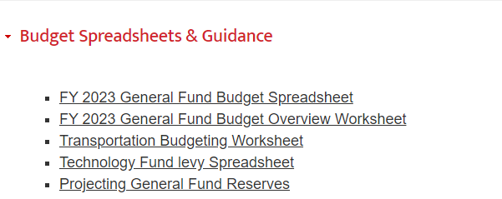
Location:
https://opi.mt.gov/

Slide 5
20-9-326, MCA rates (Anderson HB15) 20-9-306, MCA

Slide 6
20-9-326, MCA rates (Anderson HB15) 20-9-306, MCA
20-9-326. Annual inflation-related adjustments to basic entitlements and per-ANB entitlements. (1) In preparing and submitting an agency budget pursuant to 17-7-111 and 17-7-112, the superintendent of public instruction shall determine the inflation factor for the basic and per-ANB entitlements, the data-for-achievement payment, the per-ANB amount used to calculate the total special education allocation in 20-9-306, and the general fund payments in 20-9-327 through 20-9-330 in each fiscal year of the ensuing biennium.

Slide 7
Enter your adjusted FTE counts (Jones HB143) 20-9-324, MCA
HB 143 provides additional quality educator component payments for districts that meet legislative goals for competitive base pay of teachers.
These goals are separated for class of school as defined in Title 20, chapter 6.
2022 District Classification Report

Slide 8
Enter your adjusted FTE counts (Jones HB143) 20-9-324, MCA
To qualify, class 2 & 3 districts are required to offer a base teacher pay that is equal to at least 10 times as much as the quality educator payment amount provided in 20-9-306(16).
Districts defined as class 1, to qualify, would be required to offer a teacher base pay that is not less than 70% of the teacher average pay in the school district.

Slide 9
Enter your adjusted FTE counts (Jones HB143) 20-9-324, MCA
Section 20-9-306(16), MCA is amended to modify the total quality educator payment for a school district meeting the legislative goal for competitive base pay of teachers to include the number of full-time equivalent teachers that were in the first three years of the teacher's teaching career in the previous year.

Slide 10
Enter your adjusted FTE counts (Jones HB143) 20-9-324, MCA
Example:
-Hire 1 new teacher in FY2023 that is in one of there first 3 years of there teaching career.
-Your district is a class 2 district, and the district steps and lanes starts at $34,800.
-Enter data into TEAMS the requested information for the TEACH Act before December 1.
-The total FTE of the district is 10.
-Assuming a 2.8% increase In FY2024 the QEC entitlement will be:
(10 X $3,566) + 3,566 = $39,226

Slide 11
Rates for SMMA are different (Reksten HB192)
State Aid
$10,000,000
Section 20-9-502, MCA, is modified to increase the “school major maintenance amount” from $100 to $110 per budget limitation ANB, beginning budget year FY 2023.
The amount of state support per dollar of local effort of the applicable elementary and high school program by adjusting the school major maintenance amount multiplier from 171% to 187%, beginning budget year FY 2023.
Local Effort
$12,000,000
$22,000,000

Slide 12
Rates for SMMA are different (Reksten HB192)
State Aid
$12,000,000
Section 20-9-502, MCA, is modified to increase the “school major maintenance amount” from $100 to $110 per budget limitation ANB, beginning budget year FY 2023.
The amount of state support per dollar of local effort of the applicable elementary and high school program by adjusting the school major maintenance amount multiplier from 171% to 187%, beginning budget year FY 2023.
Local Effort
$12,000,000
$24,000,000

Slide 13
Rates for SMMA are different (Reksten HB192)
Appropriation Information (20-9-635, MCA)
 | Source | Approp. | Request | Revenue
FY 2022 | State GF | 7,727,000 |  | 5,419,847 | Remainder 2,307,153
 | Coal SSR | 2,273,000 |  | 2,273,000
 | Total | 10,000,000 | 7,692,847
FY 2023 | State GF | 7,461,000
 | Coal SSR | 2,539,000
 | Total | 10,000,000
FY 2024 | 20-9-635 | 10,270,000 |  |  | Approp over $10M adds CPI
FY 2025 | 20-9-635 | 10,564,749 |  |  | Approp over $10M adds CPI

Slide 14
Rates for SMMA are different (Reksten HB192)
What occurred for FY 2022 SMMA
 | LE Count | %
Filled Box With Levy Only | 3 | 1%
Over-Levied | 42 | 11%
Maximized | 181 | 45%
Under Filled the Box | 32 | 8%
Not Participating | 142 | 36%

Slide 15
Noticing Permissive Levy Increases (Reksten HB192)
Section 20-9-116, MCA, the requirement to notice a resolution of intent to increase non-voted levies is modified to specify that a resolution for the permissively levied sub-fund of the building reserve fund is to include the following under 20-9-502(3)(a)(i), MCA:
Identify the anticipated improvements or projects for which the proceeds of the levy will be used; and
Estimate a total dollar amount of money to be raised by the levy, and the resulting estimated number of mills to be levied using the district's taxable valuation most recently certified by the department of revenue under 15-10-202.

Slide 16
ANB Calculation (Anderson HB233 & Regier SB72)
Revise funding for students with disabilities, Anderson HB233 amends sections 20-1-101 & 20-9-311, MCA
Revise school laws related to participation in extracurricular activities, Regier SB72 amends section 20-9-311, MCA

Slide 17
ANB Calculation (Anderson HB233) 20-9-311, MCA
Section 20-9-311, MCA, the calculation of average number belonging (ANB), is modified to include a pupil with disabilities who is over 19 years of age and has not yet reached 21 years of age by September 10 of the school year and who is receiving special education services from a school district pursuant to 20-7-411(4)(a) may be included in the ANB calculations if:

Slide 18
ANB Calculation (Anderson HB233) 20-9-311, MCA
(i) the student has not graduated.
(ii) the student is eligible for special education services and is likely to be eligible for adult services for individuals with developmental disabilities due to the significance of the student's disability.
(iii) the student's individualized education program has identified transition goals that focus on preparation for living and working in the community following high school graduation since age or the student's disability has increased in significance after age 16.

Slide 19
ANB Calculation (Regier SB72) 20-9-311, MCA
Revises the calculation of average number belonging (ANB) to include allowing certain students who participate in extracurricular activities to be included as partial enrollment for ANB calculations.
A district may, for ANB purposes, include in the October and February enrollment counts an individual who during the prior school year met the following criteria:
Resided in the district.
Was not enrolled in the district or was not enrolled full time.
Completed an extracurricular activity with a duration of at least 6 weeks.

Slide 20
ANB Calculation (Regier SB72) 20-9-311, MCA
Each completed extracurricular activity may be counted as one-sixteenth enrollment for the individual, but the individual may not be counted as more than one full-time enrollment for ANB purposes. Additionally, each completed extracurricular activity lasting longer than 18 weeks may be counted as one-eighth enrollment. SB 72 defines "extracurricular activity" as the following:
A sport or activity sanctioned by an organization having jurisdiction over interscholastic activities, contests, and tournaments.
An approved career and technical student organization, pursuant to 20-7-306, MCA.
A school theater production.

Slide 21
Before we begin!
Lead levels need to be tested in school drinking water.
DPHHS School Administrative Rules (mt.gov)

Slide 22
Other Things (Hour 2)
My General Fund GTB keeps growing. (Kassmier HB303 & Ler HB663)
State Technology Aid payment wiggled, why? (Zolnikov HB181)
Catching up on the SPED allowable cost payment. (Bedey HB46)
A discussion about the Mill Calculator Tab. Let’s make this what you need it to be.
A reminder that the Miscellaneous Programs Fund (15) spreadsheet still exists.
A long time ask made especially for Gwyn.

Slide 23
GF GTB (Kassmier HB303 & Ler HB663)
As a general overview, HB 303 increases the class eight business equipment tax exemption from $100,000 to $300,000 provided for in 15-6-138(4), MCA. Additionally, HB 303 provides a reimbursement to school districts by increasing the district general fund guaranteed tax base aid (GTB) multiplier in 20-9-366, MCA from 232% to 236% beginning in FY 2023.

Slide 24
GF GTB (Kassmier HB303 & Ler HB663)
HB 663 amends section 20-9-366, MCA by increasing the district general fund guarantee tax base aid (GTB) multiplier from 232% to 250% beginning in FY 2022 and linking additional increases to revenue generated by marijuana taxes beginning in FY 2024 and beyond by further increasing the GTB multiplier. These subsequential increases are based on a measure that is the difference in marijuana revenue transferred to the state general fund when compared to the same revenue transferred in the prior year.

Slide 25
GF GTB (Kassmier HB303 & Ler HB663)
General Fund GTB multiplier:
FY 2022 = 232% FY 2023 = 250% + 4% 254%
FY 2024 = Add Annually %

Slide 26
GF GTB (Kassmier HB303 & Ler HB663)
(i) for fiscal years 2024 through 2031, if the revenue transferred to the state general fund pursuant to 16-12-111 in the prior fiscal year is at least $1 million more than the revenue transferred in the fiscal year 2 years prior, then:
(A) multiply the amount of increased revenue transferred to the state general fund pursuant to 16-12-111 in the prior fiscal year above the amount of revenue transferred in the fiscal year 2 years prior by 0.25, divide the resulting product by $500,000, and round to the nearest whole number; and
(B) increase the multiplier for the prior fiscal year by the number derived in subsection (5)(a)(i)(A) as a percentage point increase;
(ii) for fiscal years 2024 through 2031, if the revenue transferred to the state general fund pursuant to in the prior fiscal year is less than $1 million more than the revenue transferred in the fiscal year 2 years prior, then the multiplier is equal to the multiplier used for the prior fiscal year; and
(iii) for fiscal years 2032 and subsequent fiscal years, the multiplier is equal to the multiplier used for fiscal year 2031.

Slide 27
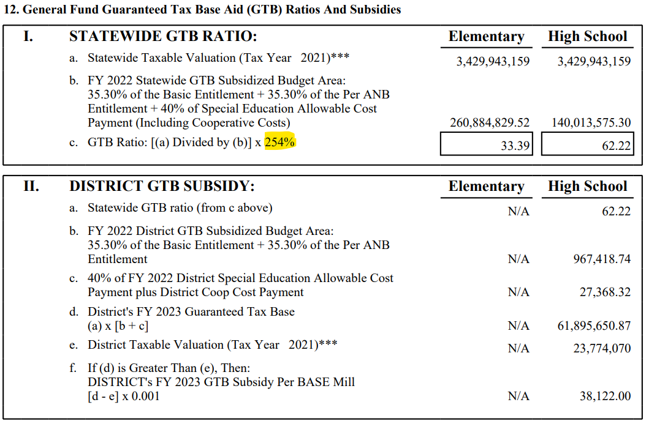
GF GTB (Kassmier HB303 & Ler HB663)

Slide 28
State Technology Aid (Zolnikov HB181)
In FY 2022, twenty-five percent of the $1 million statutory appropriation provided in 17-7-502, MCA is to be for providing funds for schools to use as state matching funds for special construction under the federal e-rate broadband program pursuant to 47 CFR 54.505. The remaining seventy-five percent is to be distributed to a district’s technology acquisition and depreciation fund under the previously determine methodology described in 20-9-534, MCA.

Slide 29
State Technology Aid (Zolnikov HB181)
The same proportions are to be applied for FY 2023 however, any remaining funds not expended from the 25% portion in FY 2022 are to be distributed with the previously determine methodology described in 20-9-534, MCA in FY 2023. HB 181 terminates June 30, 2023
 | FY 2022 | FY 2023 | FY 2024
Tech Payment (Base) | $750,000 | $750,000 | $1,000,000
Tech Payment (Remainder) | $0 | $250,000
Total Tech Payment | $750,000 | $1,000,000 | $1,000,000
E-Rate Broadband | $250,000 | $250,000 | $0

Slide 30
SPED Allowable Cost Payment. (Bedey HB46)
HB 46 amends sections 20-9-306 and 20-9-326, MCA, to include the special education allowable cost payment as a part of the definition of BASE and to describe the calculation for determining the size of the "total special education allocation.“ The “special education allocation” is determined by the amount resulting from multiplying $287.93 for fiscal year 2022 and $286.02 for each succeeding fiscal year by the statewide current year ANB or the amount of the previous year's total special education allocation, whichever is greater. The distribution calculation for determining the special education allowable cost payment to districts is not changed.

Slide 31
SPED Allowable Cost Payment. (Bedey HB46)
Section 20-9-326, MCA is amended to include the special education allocation as part of the annual inflation-related adjustments to basic entitlements and per-ANB entitlements in preparing and submitting an agency budget.

Slide 32
SPED Allowable Cost Payment. (Bedey HB46)
(17) "Total special education allocation" means the state payment distributed pursuant to 20-9-321 that is the greater of the amount resulting from multiplying $287.93 for fiscal year 2022 and $286.02 for each succeeding fiscal year by the statewide current year ANB or the amount of the previous year's total special education allocation.

Slide 33
SPED Allowable Cost Payment. (Bedey HB46)
 | IBG | RSBG | SPED Approp/Allocation
FY2021 | 152.88 | 50.96 | 44,628,655 & 44,702,880
FY2022 | 156.45 | 52.15 | 44,702,880
FY2023 | 152.47 | 50.82 | 44,702,880

Slide 34
Non-Legislative Items
A discussion about the Mill Calculator Tab. Let’s make this what you need it to be.
A reminder that the Miscellaneous Programs Fund (15) spreadsheet still exists.
A long time ask made especially for Gwyn.

