Slide 1
The legislative trio
Nicole Thuotte
School Finance Specialist

Slide 2
Agenda
Three new pieces of legislation from the 2021 legislative session
HB 143 Teacher Base Pay Incentive
HB 233 Revising ANB Eligibility
SB 72 Extracurricular Participation

Slide 3
HB 143 Teacher Base pay
Teacher
20-9-324, MCA Incentives for School Districts Meeting Legislative Goal for Competitive Base Pay of Teachers in Public School Districts - Definitions

Slide 4
HB 143 Teacher Base pay
Teacher
“…holds a current class 1, 2, 4, 6 or 7 license”; and
“…in an instructional position requiring teacher licensure.”

Slide 5
HB 143 Teacher Base pay
Teacher Base Pay
“…the lowest salary for a beginning teacher incorporated in the district’s collective bargaining agreement”; or
“…or incorporated in district policy…”
“…not including bonuses, stipends or extended duty contracts.”

Slide 6
HB 143 Teacher Base pay
Teacher Average Pay
“…the total compensation paid by a school district to all of its teacher, not including bonuses, stipends, or extended duty contracts, divided by the total full-time equivalent teachers employed in the district, with the full-time equivalence rounded to the nearest tenth.”

Slide 7
HB 143 Teacher Base pay
Eligibility
All districts: Base pay equal to at least 10 times as much as the quality educator payment amount in the applicable year.
If a Class 1 district: Base pay must also be not less than 70% of the teacher average pay.

Slide 8
HB 143 Teacher Base pay
Eligibility
Incentive applies to full-time equivalent teachers that are in the first 3 years of the teacher’s teaching career in the current year.

Slide 9
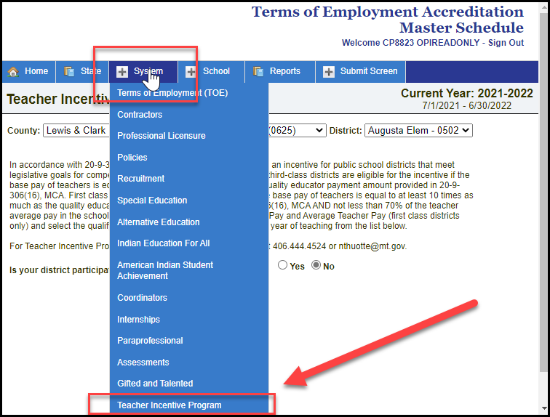
HB 143 Teacher Base pay
Data Entry in TEAMS
System/Teacher Incentive Program

Slide 10
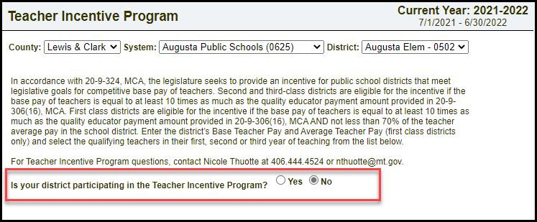
HB 143 Teacher Base pay
Data Entry in TEAMS
Question 1: Is your district participating in the Teacher Incentive Program (defaults to “No”).

Slide 11
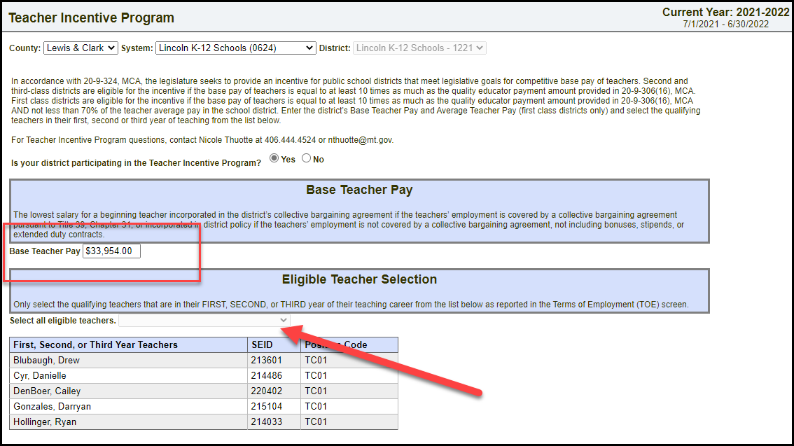
HB 143 Teacher Base pay
Data Entry in TEAMS
Question 2: Base Teacher Pay (if at least 10x QEC, select eligible teachers).

Slide 12
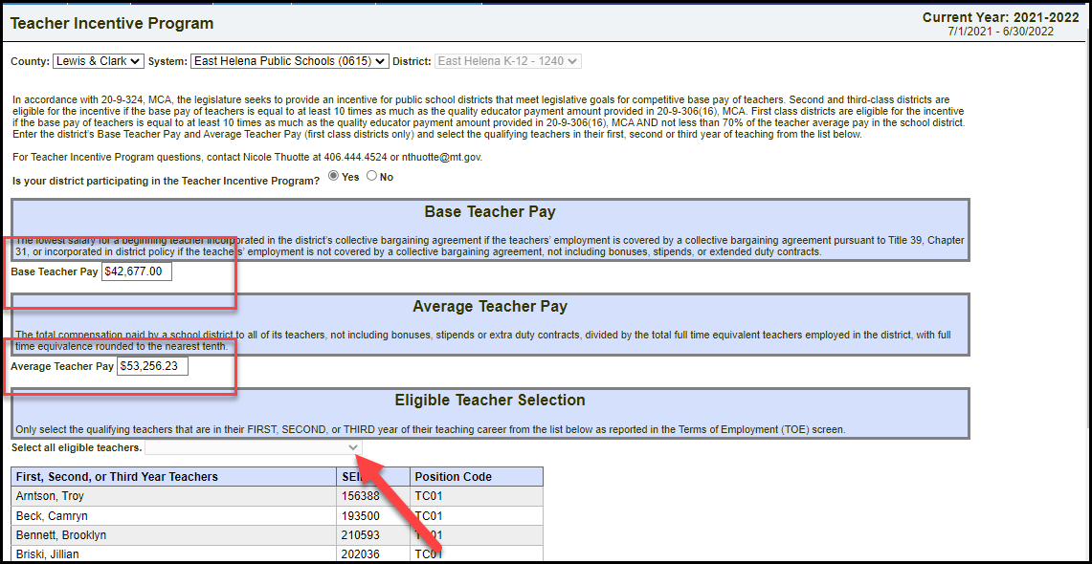
HB 143 Teacher Base pay
Data Entry in TEAMS
Class 1 Districts – Question 3: Base Teacher Pay and Average Teacher Pay

Slide 13
HB 143 Teacher Base pay
Data Entry in TEAMS
The list of eligible teachers includes the following position codes:
Position Code | Description
TC01 | Teacher – General Education
TC02 | Teacher – Title I
TC03 | Teacher – Special Education
TC07 | Supervising Teacher
TC11 | Teacher – Gifted and Talented
SP21 | School Counselor, General Education
SP22 | Library Media Specialist
SP23 | School Psychologist, General Education
SP24 | School Psychologist, Special Education
SP27 | School Counselor, Special Education

Slide 14
HB 143 Teacher Base pay
Data Entry in TEAMS
The program does validate on licensure type;
The program does includes the FTE in an included position code;
The program does not validate the number of years of teaching.

Slide 15
HB 143 Teacher Base pay
Three years includes (“in the first three years of the teacher’s teaching career”)
Time spent in an instructional position requiring licensure:
Private school (grades K-12)
Class 5 Licensure prior to full licensure
Emergency Authorization in a teaching position
Out of state teaching
Teaching in another district
*does not include preschool (PK) unless the position requires licensure (e.g., special education preschool) or higher education

Slide 16
HB 143 Teacher Base pay
Where does the money go?
Quality Educator Component line item in your budget:

Slide 17
HB 143 Teacher Base pay
Where does the money go?
There is no difference between the QEC for Teacher Incentive and the normal QEC
No restrictions on spending
This is an incentive provided to the district and is not required to be a stipend for specific teachers

Slide 18
HB 143 Teacher Base pay
Reports
Developing an additional page on the Preliminary Quality Educator Report to show the educators claimed for the Teacher Pay Incentive Program
Teacher information will need to be verified before the close of TEAMS in December

Slide 19
HB 143 Teacher Base pay
QUESTIONS?

Slide 20
HB 233 19 & 20 ANB Eligible
HB 233 revises the definition of pupil and adds eligibility for ANB:
Pupil means, “…an individual who is admitted by the board of trustees pursuant to 20-5-101…”; and
“…eligibility of pupils and calculations for average number belonging are governed by 2-9-311.”
20-1-101 (16), MCA

Slide 21
HB 233 19 & 20 ANB Eligible
Section 20-5-101, MCA was unchanged by HB 233:
“(3) The trustees may at their discretion assign and admit a child to a school in the district who is under 5 years of age or an adult who is 19 years of age or older if there are exceptional circumstances that merit waiving the age provision of this section.”

Slide 22
HB 233 19 & 20 ANB Eligible
Section 20-9-311 (7)(c-d), MCA is new:
“(c) A pupil with disabilities who is over 19 years of age and has not yet reached 21 years of age by September 10 of the school year and who is receiving special education services from a school district pursuant to 20-7-411(4)(a) may be included in the ANB calculations if:

Slide 23
HB 233 19 & 20 ANB Eligible
the student has not graduated;
the student is eligible for special education services and is likely to be eligible for adult services for individuals with developmental disabilities due to the significance of the student’s disability; and
The student’s individualized education program has identified transition goals that focus on preparation for living and working in the community following high school graduation since age 16 or the student’s disability has increased in significance after age 16.

Slide 24
HB 233 19 & 20 ANB Eligible
(d) A school district providing special education services pursuant to subsection (7)(c) is encouraged to collaborate with agencies and programs that serve adults with developmental disabilities in meeting the goals of a student’s transition plan.”

Slide 25
HB 233 19 & 20 ANB Eligible
Takeaways:
HB 233 is optional for school districts.
School districts are not required by any part of the law to open enrollment to 19-year-old students. It is at the discretion of the board of trustees.

Slide 26
HB 233 19 & 20 ANB Eligible
Student Age – which student is “19”?
Information taken from a scrambled test site – not real students

Slide 27
HB 233 19 & 20 ANB Eligible
Cade turned 19 on April 4 – he was 18 on September 10
Linda will turn 20 on June 30 – she was 19 on September 10
Information taken from a scrambled test site – not real students

Slide 28
HB 233 19 & 20 ANB Eligible
Claiming Students for ANB
YES: Students who were 19 on or before Sept 10
NO: Students who turned 21 before Sept 10

Slide 29
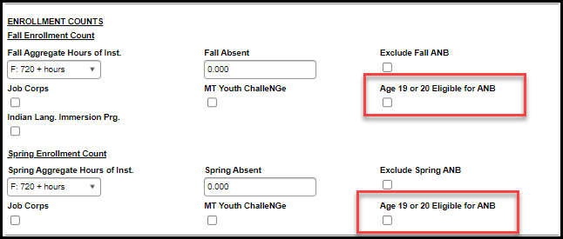
HB 233 19 & 20 ANB Eligible
Students are not automatically included for ANB (19-year-old students are automatically excluded, unless):

Slide 30
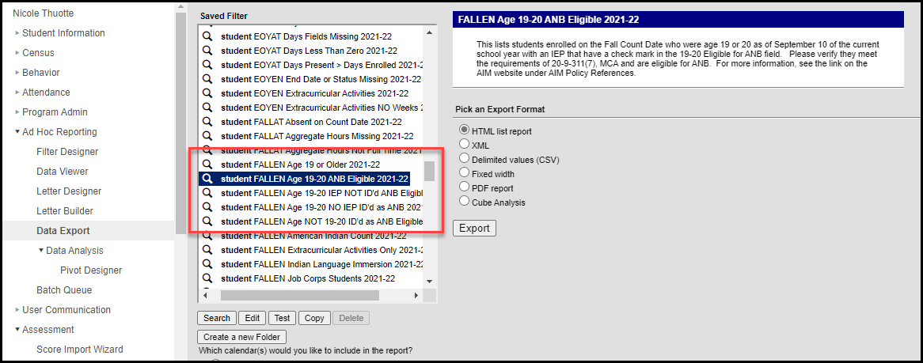
HB 233 19 & 20 ANB Eligible
AIM Ad Hoc reports available to show both students included for ANB and excluded from ANB:

Slide 31
HB 233 19 & 20 ANB Eligible
Total Student – Includes ALL students:

Slide 32
HB 233 19 & 20 ANB Eligible
Other Student Counts for ANB excludes students 19 or older and includes 19/20 eligible for ANB:

Slide 33
HB 233 19 & 20 ANB Eligible
Calculation:
Fall – 3,117 students; 6 - 18 Year Olds; 5 - 19+ Eligible for ANB
3,117 – 6 + 5 = 3,116 included in ANB
Spring – 2,988 students; 5 - 18 Year Olds; 5 - 19+ Eligible for ANB
2,988 – 5 + 5 = 2,988 included in ANB

Slide 34
HB 233 19 & 20 ANB Eligible
QUESTIONS?

Slide 35
SB 72 Extracurricular participation
There were two bills in the 2021 legislative session dealing with extracurricular participation by homeschool or private school students:
SB 72 – provides a mechanism for claiming student for ANB (claiming students for ANB is optional)
SB 157 – mandates that schools allow homeschool or private school students to participate (does not affect ANB eligibility)

Slide 36
SB 72 Extracurricular participation
SB 72 says (20-9-311(13)(a), MCA), “A district may, for ANB purposes, include in the October and February enrollment counts an individual who is otherwise eligible under this title and who during the prior school year: (i) resided in the district; (ii) was not enrolled in the district or was not enrolled full time; and (iii) completed an extracurricular activity with a duration of at least 6 weeks.”

Slide 37
SB 72 Extracurricular participation
What is an “extracurricular activity” (20-9-311(13)(c), MCA)?
“… a sport or activity sanctioned by an organization having jurisdiction over interscholastic activities, contests, and tournaments; an approved career and technical student organization, pursuant to 20-7-306; or a school theater production.”

Slide 38
SB 72 Extracurricular participation
How much ANB do I get (20-9-311(13)(b), MCA)?
“(i)… each completed extracurricular activity under subsection (13)(a) may be counted as one-sixteenth enrollment for the individual, but under this subsection the individual may not be counted as more than one full-time enrollment for ANB purposes. (ii) Each completed extracurricular activity lasting longer than 18 weeks may be counted as one-eighth enrollment.”

Slide 39
SB 72 Extracurricular participation
Completed Activities:
ANB Extracurricular Guidance on SB 72 (002).pdf (mt.gov)
This term “completed” is not defined in the legislation. School districts must use the same standard to determine whether a full-time enrolled student, part-time enrolled student, or non-enrolled student completed an extracurricular activity.
A student cannot be given partial credit for completing more than six weeks but less than the full duration of the extracurricular activity.

Slide 40
SB 72 Extracurricular participation
Examples:
Description | Completed
A student is participating in basketball and is injured and unable to play. The student continues to attend practices, games, and mandatory team meetings as required to participate as an injured team member, as required. | Yes
A student is participating in wrestling, becomes ill, is unable to participate, and withdraws from the team. | No
The student is participating in an extracurricular activity lasting nineteen weeks. The student stops participating at week twelve. | No

Slide 41
SB 72 Extracurricular participation
How does this work?
2021-22 Year Extracurricular Enrollment in AIM
2022-23 Year Extracurricular ANB included in Fall and Spring
2023-24 Year
Extracurricular ANB included in Budget

Slide 42
SB 72 Extracurricular participation
In Infinite Campus – separate calendars for extracurricular participation:

Slide 43
SB 72 Extracurricular participation
Step 1: Create an AIM enrollment in the Extracurricular Calendar

Slide 44
SB 72 Extracurricular participation
What’s important in this enrollment?
Service Type: Must be S: Partial;
Start Date: May be anytime during the selected school year (may be entered at any time during the year); and
Start Status: Transfer from home school or private school (End Status is transfer back to the same)

Slide 45
SB 72 Extracurricular participation
Step 2: Mark the enrollment Extracurricular Activities Only

Slide 46
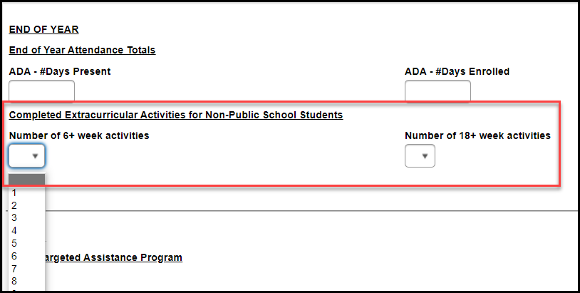
SB 72 Extracurricular participation
Step 3: At the end of year – enter the Number of Completed Activities

Slide 47
SB 72 Extracurricular participation
Special Circumstance – Dual Enrollment
Student is taking one MT Digital Academy course and is participating in extracurricular activities

Slide 48
SB 72 Extracurricular participation
Special Circumstance – Dual Enrollment
Create one enrollment for the MT Digital Academy course
Regular school calendar
S: Partial Service Type
Indicate Aggregate Hours for ANB
Create second enrollment for Extracurricular Activities
Extracurricular school calendar
S: Partial Service Type
Mark enrollment as Extracurricular Activities Only

Slide 49
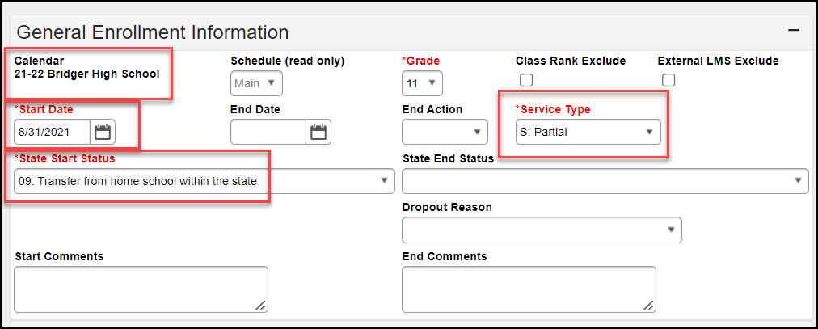
SB 72 Extracurricular participation
MT Digital Academy Enrollment

Slide 50
SB 72 Extracurricular participation
Extracurricular Enrollment

Slide 51
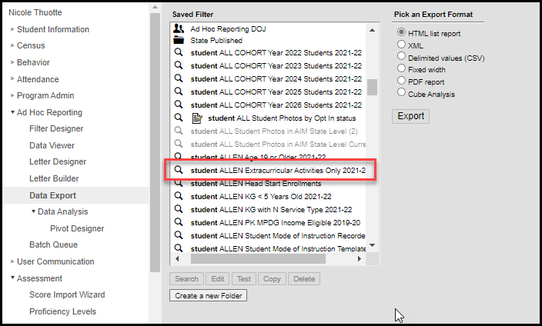
SB 72 Extracurricular participation
AIM Ad Hoc Report available for verification of student counts

Slide 52
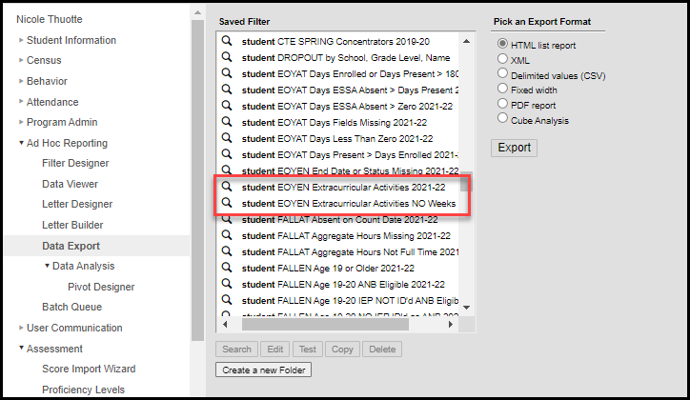
SB 72 Extracurricular participation
AIM Ad Hoc Report available for end of year information

Slide 53
SB 72 Extracurricular participation
Data Entry Timeline
2021-22 School Year
Enter students who are participating in extracurricular activities
By June 30, 2022
Enter the number of completed activities for every student
October 2022 and February 2023
Student counts will be included on the district and school ANB summaries

Slide 54
SB 72 Extracurricular Participation
QUESTIONS?

Slide 55
Contact Information
Nicole Thuotte
nthuotte@mt.gov
(406) 444-4524 work
(406) 202-1759 cell

