Slide 1
Indirect Cost Rates
MASBO Summer Conference 2022

Slide 2
Introduction Indirect Cost Rate
An indirect cost rate is a means of determining, in a reasonable manner, the percentage of allowable general administrative expense that each Federal grant should bear.
An indirect cost rate is the ratio of total indirect costs to total direct and unallowable costs, exclusive of any extraordinary or distorting expenditures such as capital outlay, debt service, and food costs that are not associated with salary or benefits.

Slide 3
Introduction Indirect Cost Rate
Indirect Cost Rates awarded are intended to defray the costs associated with implementation of grant programs housed within the district.
Indirect Cost Rates Do NOT increase your grant amount.
A district is not required to apply for or apply IDC’s to grants received.

Slide 4
Delegation Agreement with the USED
Montana receives authorization from the USED to approve Indirect Cost Rate (IDC) agreements.
The method is approved by the USED and applies to restricted federal grants and may also apply to state grants.
The OPI holds this approval authority for the 400 public districts and the 21 special education cooperatives.

Slide 5
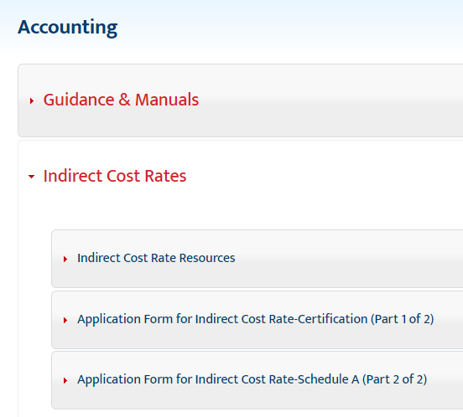
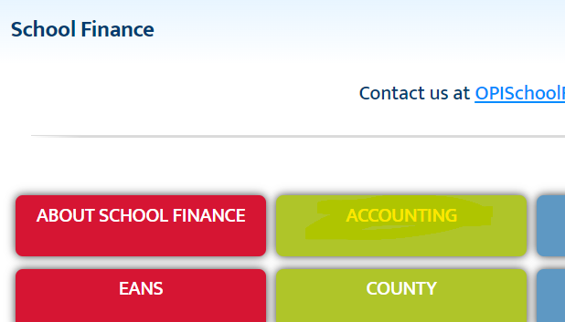
Locating Indirect Cost Rate Information
https://opi.mt.gov/

Slide 6
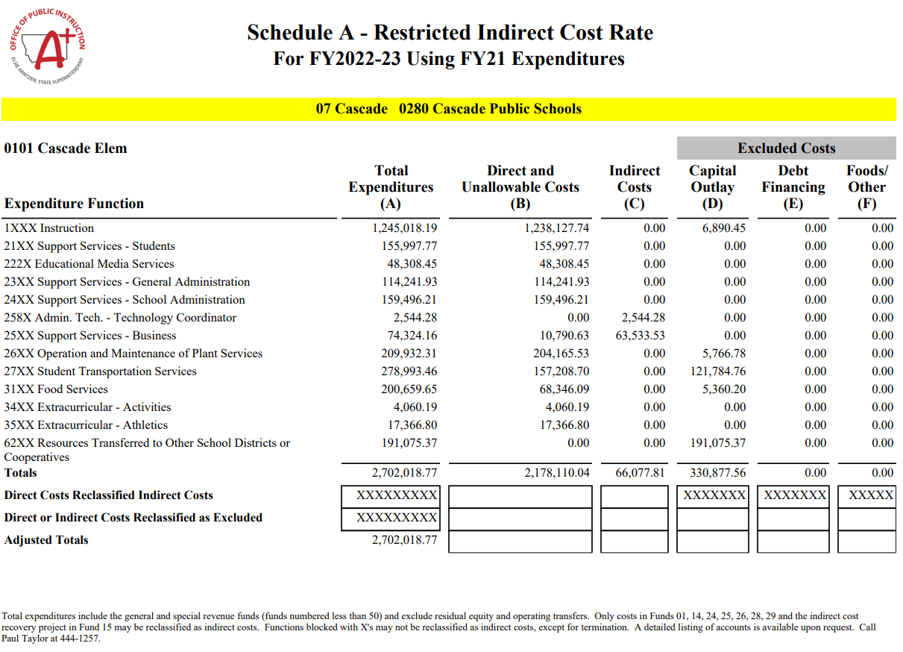
Total Funds <50 and Object not in (‘910’,’911’, ’912’, ’913’,’971’)

Slide 7
Total Funds <50 and Object not in (‘910’,’911’, ’912’, ’913’,’971’)
Direct
Step 1: Fund <50 Function Not In ('25XX','28XX','4XXX','52XX','62XX') Object Not In ('7XX','710','715','720','725','73X','74X' ,'971','910')
Step 2:Fund<50, Function 62XX, Object 940
Step 3: Funds NOT in ('01','14','24','25','26','28','29') And <"50", "25XX"Function, Object Not in ('7XX','710','715','720','725','73X','74X','971','910’) Step 4: Function Not in (‘31XX‘ AND Not Object '1XX','2XX')
Summed then minus Indirect Step 2

Slide 8
Total Funds <50 and Object not in (‘910’,’911’, ’912’, ’913’,’971’)
Direct
Step 1: Fund <50 Function Not In ('25XX','28XX','4XXX','52XX','62XX') Object Not In ('7XX','710','715','720','725','73X','74X' ,'971','910')
Step 2:Fund<50, Function 62XX, Object 940
Step 3: Funds NOT in ('01','14','24','25','26','28','29') And <"50", "25XX"Function, Object Not in ('7XX','710','715','720','725','73X','74X','971','910’) Step 4: Function Not in (‘31XX‘ AND Not Object '1XX','2XX')
Summed then minus Indirect Step 2
Indirect
Step 1: Funds In ('01','14','24','25','26','28','29'), Function "25XX", Object Not In ('7XX','710','715','720','725','73X','74X',’971’,’910’)
Step 2: Fund "15", Program Like "1**" Or "271", Function "25XX", Object Not In ('7XX','710','715','720','725','73X','74X')

Slide 9
Total Funds <50 and Object not in (‘910’,’911’, ’912’, ’913’,’971’)
Direct
Step 1: Fund <50 Function Not In ('25XX','28XX','4XXX','52XX','62XX') Object Not In ('7XX','710','715','720','725','73X','74X' ,'971','910')
Step 2:Fund<50, Function 62XX, Object 940
Step 3: Funds NOT in ('01','14','24','25','26','28','29') And <"50", "25XX"Function, Object Not in ('7XX','710','715','720','725','73X','74X','971','910’) Step 4: Function Not in (‘31XX‘ AND Not Object '1XX','2XX')
Summed then minus Indirect Step 2
Indirect
Step 1: Funds In ('01','14','24','25','26','28','29'), Function "25XX", Object Not In ('7XX','710','715','720','725','73X','74X',’971’,’910’)
Step 2: Fund "15", Program Like "1**" Or "271", Function "25XX", Object Not In ('7XX','710','715','720','725','73X','74X')
Capital Outlay
Step 1: Funds <50, Objects In ('7XX','710','715','720','725','73X','74X')
Step 2: Funds <50 Function 62XX, Object <>940
Step 3: Funds <50, Function 4XXX, Object Not In ('7XX','710','715','720','725','73X','74X')

Slide 10
Total Funds <50 and Object not in (‘910’,’911’, ’912’, ’913’,’971’)
Direct
Step 1: Fund <50 Function Not In ('25XX','28XX','4XXX','52XX','62XX') Object Not In ('7XX','710','715','720','725','73X','74X' ,'971','910')
Step 2:Fund<50, Function 62XX, Object 940
Step 3: Funds NOT in ('01','14','24','25','26','28','29') And <"50", "25XX"Function, Object Not in ('7XX','710','715','720','725','73X','74X','971','910’) Step 4: Function Not in (‘31XX‘ AND Not Object '1XX','2XX')
Summed then minus Indirect Step 2
Indirect
Step 1: Funds In ('01','14','24','25','26','28','29'), Function "25XX", Object Not In ('7XX','710','715','720','725','73X','74X',’971’,’910’)
Step 2: Fund "15", Program Like "1**" Or "271", Function "25XX", Object Not In ('7XX','710','715','720','725','73X','74X')
Debt Service
Fund <50, Function '52XX'
Capital Outlay
Step 1: Funds <50, Objects In ('7XX','710','715','720','725','73X','74X')
Step 2: Funds <50 Function 62XX, Object <>940
Step 3: Funds <50, Function 4XXX, Object Not In ('7XX','710','715','720','725','73X','74X')

Slide 11
Total Funds <50 and Object not in (‘910’,’911’, ’912’, ’913’,’971’)
Direct
Step 1: Fund <50 Function Not In ('25XX','28XX','4XXX','52XX','62XX') Object Not In ('7XX','710','715','720','725','73X','74X' ,'971','910')
Step 2:Fund<50, Function 62XX, Object 940
Step 3: Funds NOT in ('01','14','24','25','26','28','29') And <"50", "25XX"Function, Object Not in ('7XX','710','715','720','725','73X','74X','971','910’) Step 4: Function Not in (‘31XX‘ AND Not Object '1XX','2XX')
Summed then minus Indirect Step 2
Indirect
Step 1: Funds In ('01','14','24','25','26','28','29'), Function "25XX", Object Not In ('7XX','710','715','720','725','73X','74X',’971’,’910’)
Step 2: Fund "15", Program Like "1**" Or "271", Function "25XX", Object Not In ('7XX','710','715','720','725','73X','74X')
Other
Fund <50, Function '31XX' all Objects Not '1XX','2XX')
Debt Service
Fund <50, Function '52XX'
Capital Outlay
Step 1: Funds <50, Objects In ('7XX','710','715','720','725','73X','74X')
Step 2: Funds <50 Function 62XX, Object <>940
Step 3: Funds <50, Function 4XXX, Object Not In ('7XX','710','715','720','725','73X','74X')

Slide 12
(A) Total
Funds General and Special Revenue funds Excludes Operating and Residual Equity Transfers
(B) Direct Funds General and Special Revenue funds
(Step 1) All Functions but not: 25XX Support Services - Business 28XX Reserved (Historical) 4XXX Facilities Acquisition and Construction Services) 52XX Capital Leases or Long Tern Notes with Board of Investments 62XX Resource Transfers
All Object but not: 971 Residual Transfers 910 Operating Transfers 7XX Capital Outlay 710 Cap Out Land 715 Cap Out Land Improve 720 Cap Out Purchase Existing Building 725 Major Construction 73X Major Equipment New 74X Major Equipment Replacement
(Step 2) Funds General and Special Revenue funds in : 62XX Resource Transfers and 940 Indirect Costs (Step 3) All Funds but not: 01 General Fund 14 Retirement Fund 24 Metal Mines Fund 25 State Mining Impact Fund 26 Impact Aid Fund 28 Technology Fund 29 Flexibility Fund And all funds less than fund 50 and in……
25XX Support Services - Business and, Object Not in
971 Residual Transfers 910 Operating Transfers 7XX Capital Outlay 710 Cap Out Land 715 Cap Out Land Improve 720 Cap Out Purchase Existing Building 725 Major Construction 73X Major Equipment New 74X Major Equipment Replacement
(Step 4) Function 31XX School Foods Objects 1XX Salary & 2XX Benefits are included all other Function 31XX & Objects are excluded.
Summed then minus Indirect Step 2
(C) Indirect (Step 1) Funds In 01 General Fund 14 Retirement Fund 24 Metal Mines Fund 25 State Mining Impact 26 Impact Aid Fund 28 Technology Fund 29 Flexibility Fund And all funds less than fund 50 and in…… 25XX Support Services - Business and, Object Not in
7XX Capital Outlay 710 Cap Out Land 715 Cap Out Land Improve 720 Cap Out Purch Building 725 Major Const 73X Major Equipt. New 74X Major Equipt. Replace
(Step 2) Fund 15 Misc Program Fund in Programs Like 1** All Regular Programs Or 271 Indirect Costs, and Function 25XX Support Services - Business, Object Not In ('7XX','710','715','720','725','73X','74X') see above
(D) Capital Outlay (Step 1) Funds General and Special Revenue funds Objects In 7XX Capital Outlay 710 Cap Out Land 715 Cap Out Land Improve 720 Cap Out Purchase Existing Building 725 Major Construction 73X Major Equipment New 74X Major Equipment Replacement
(Step 2) 62XX Resource Transfers but not in 940 Indirect Costs
(Step 3) 4XXX Facilities Acquisition and Construction Services) But Object Not In :
7XX Capital Outlay 710 Cap Out Land 715 Cap Out Land Improve 720 Cap Out Purchase Existing Building 725 Major Construction 73X Major Equipment New 74X Major Equipment Replacement
(E) Debt
Funds General and Special Revenue funds
52XX Capital Leases or Long Tern Notes with Board of Investments
(F) Other
Funds General and Special Revenue funds
31XX School Foods not Objects
1XX Salary 2XX Benefits

Slide 13
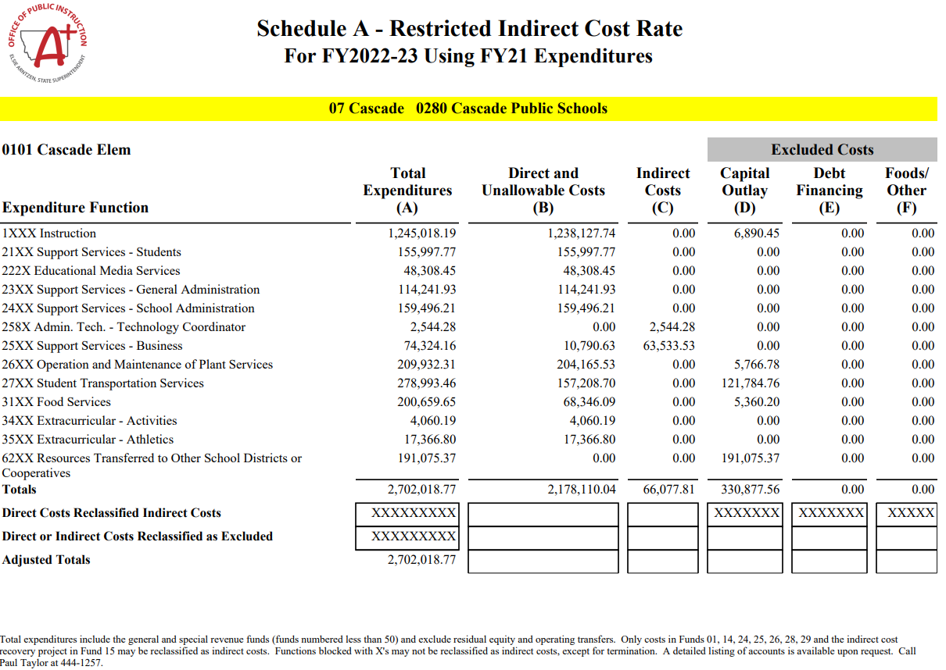
Schedule A

Slide 14
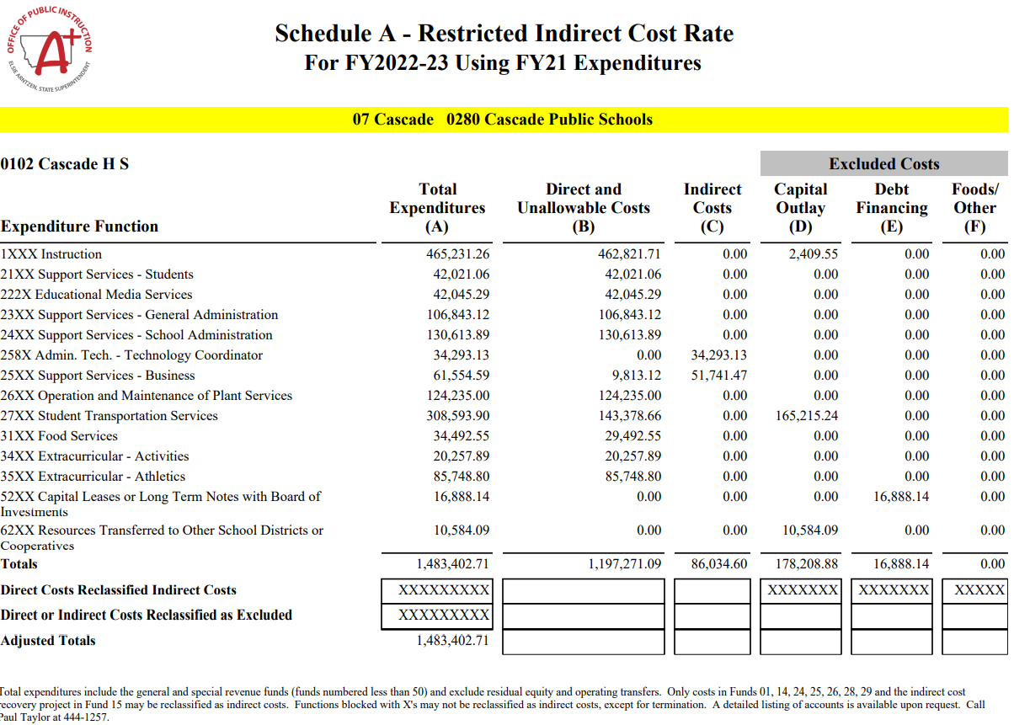
Schedule A

Slide 15
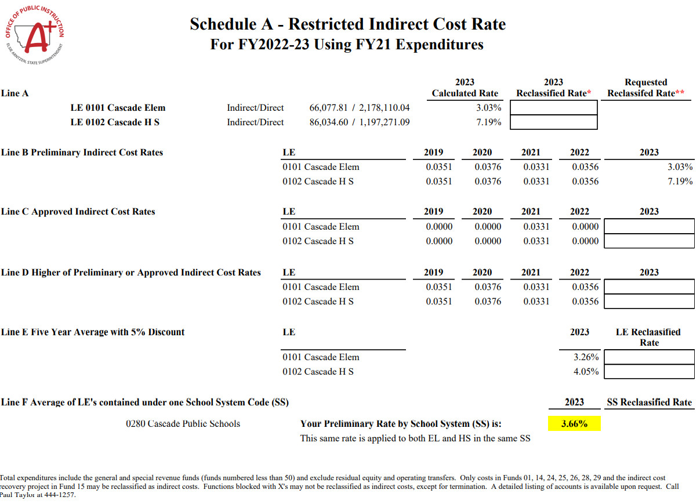

Slide 27
Current Delegation Agreement Requirement
Expenditures for school districts that exceed 2,600 enrolled students must reclassify expenditures associated with the business manager to the base for approval of an indirect cost rate.
2600 enrolled students on the fall enrollment count of the year of the TFS expenditures being used for determining the IDC rate.
The count is by School System.
Reported expenditures to OPI include some business manager expenditures coded to function 25XX.
Ex. $700 business to function 25XX.
OPI calculates these expenditures as Indirect Costs when determining calculated rates.
Ex. $700 included in indirect.
Indirect 5,000 Direct 13,000
When the district applies for a new IDC rate the requestor needs to redirect these costs to Direct and Unallowable Costs (Base).
Indirect 5,000- $700 ₌ 4,300 Direct 13,000+$700 13,700

Slide 28
Reclassification of Costs
Indirect costs as those that are incurred for a common or joint purpose benefiting more than one cost objective. In addition, indirect costs cannot be readily identified as benefiting a particular cost objective. Examples of indirect costs include the salaries and expenses for the following:
Data Processing
Accounting
Personnel
Purchasing
Indirect costs are normally charged to federal programs through the indirect cost rate. Grantees must be consistent in treating costs as direct or indirect under federal awards. Once a cost is treated as direct or indirect, it should be treated that way for all projects and activities, regardless of the source of funding.

Slide 29
Reclassification of Costs
Salaries and Expenditures for:
Accounting, Budgeting, Payroll,
Personnel management,
Purchasing,
Labor negotiation contracts,
Mailrooms,
Computer networks, or data processing operations
are examples of costs which typically benefit several activities and programs. These types of costs may be allocated to federal programs by means of an indirect cost rate.
Federal regulations allow auditing costs for districts spending over $750,000 of federal funds to be classified as an indirect cost.

Slide 30
Reclassification of Costs
Once a determination has been made as to what will be reclassified (using caution not to double count expenditures the OPI has already determined to be considered indirect) The OPI has created an Indirect Cost Calculator for your use located at:
Indirect Cost Rate Reclassification Calculator FY2023

Slide 31
Certification

Slide 32
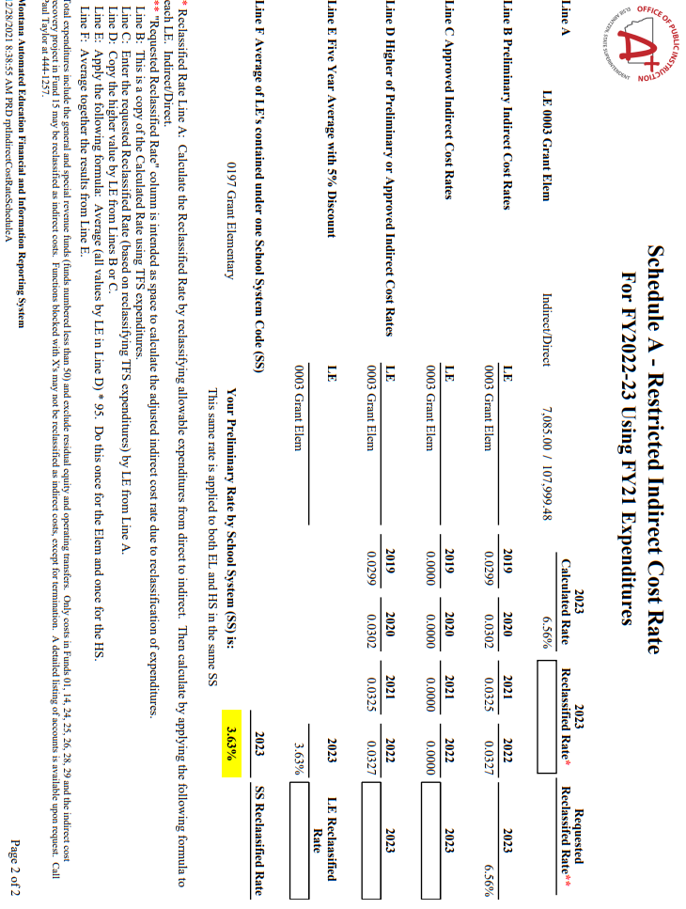
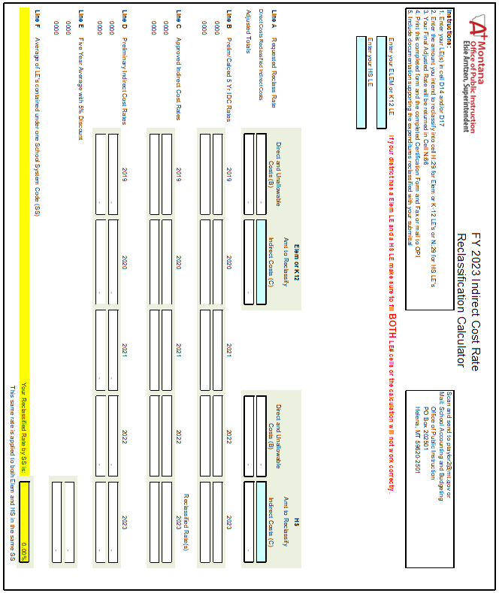
Applications Should Include
1. Certification
2. Schedule A preliminary rate page
3. Reclassification Calculation
4. Cover Letter on letterhead listing and explaining the purpose of reclassification

Slide 33
References
Federal “Green Guide” or Cost Allocation Guide for State and Local Governments
http://www.ed.gov/about/offices/list/ocfo/fipao/icgindex.html
Montana OPI Indirect Cost Rate Information Page
School Finance Accounting

