Slide 1

ESSA Per Pupil expenditure reporting
Nicole Thuotte - School Finance Specialist

Slide 2
What is essa per pupil expenditure reporting?
Every Student Succeeds Act (ESSA) requires all states to begin school-based expenditure reporting. This guidance is designed to help districts comply with statewide uniformity to fulfill the federal requirement created in 34 CFR (Code of Federal Regulations) § 200.35.United States Code (Federal Law)
PART A—IMPROVING BASIC PROGRAMS OPERATED BY LOCAL EDUCATIONAL AGENCIES
Subpart 1—Basic Program Requirements
SEC. 1111. (20 U.S.C. 6311) STATE PLANS.
(h) REPORTS
(C) Minimum requirements Each State report card required under this subsection shall include the following information:
(i) A clear and concise description of the State’s accountability system…
including:
(x) The per-pupil expenditures of Federal, State, and local funds, including actual personnel expenditures and actual non-personnel expenditures of Federal, State, and local funds, disaggregated by source of funds, for each local educational agency and each school in the State for the preceding fiscal year.

Slide 3
What is essa per pupil expenditure reporting?
Per Pupil Expenditure reporting is combined with other data to create a report card for each school in the state. Other data elements include:
State Assessment Data
School Improvement Plans
Student Achievement by Subgroup
High School Graduation Rates
Civil Rights Data Collection Information
Post Secondary Enrollment Data
Educator Qualifications

Slide 4
Financial Data
Two Components
1. Expenditures allocated by SC
2. Expenditures shared with another LE or entity (Funds 12, 15, 82)

Slide 5
Expenditures allocated by SC
Who reports by SC?
Every LE with more than 1 SC
Regardless of:
Size
Address
Location

Slide 6
Expenditures allocated by SC
Augusta Public Schools
SS 0625
August EL
LE 0502
Augusta Elementary
SC 0676
Augusta 7-8
SC 1722
Augusta HS
LE 0503
Augusta HS
SC 0677
Townsend K-12 Schools LE 0055
Cecelia Hazelton School SC 0076
Townsend 7-8
SC 1671
Broadwater HS
SC 0081
Cohagen EL
LE 0387
Cohagen Elementary SC 0520

Slide 7
Expenditures allocated by SC
If I have only one SC am I off the hook?
NO: Must still account for expenditures in Funds 12, 15 and 82

Slide 8
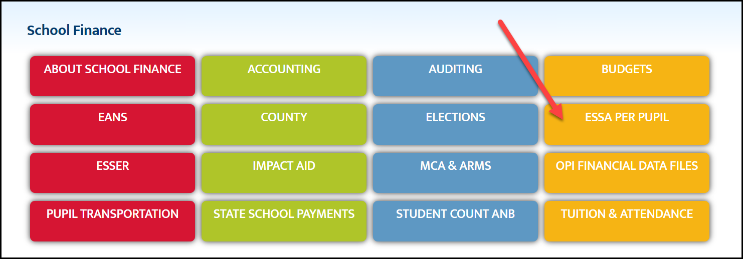
Expenditures allocated by sc
How do I know what to code to a SC?
ESSA Per Pupil Expenditure Reporting

Slide 9
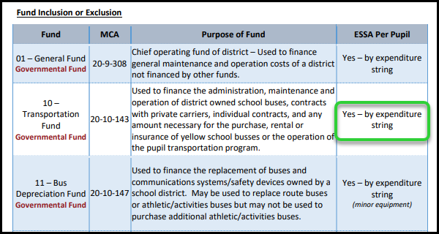
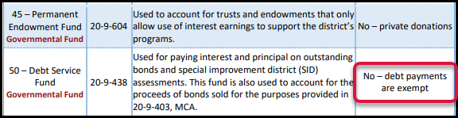
Expenditures allocated by sc
First: Is the Fund Included?

Slide 10
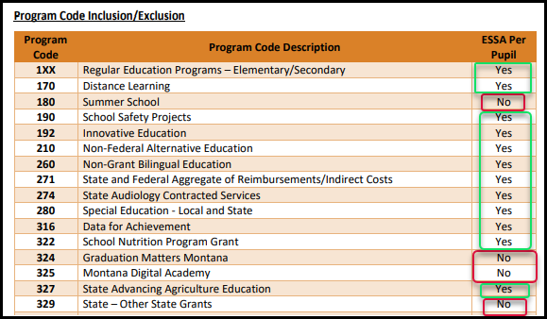
Expenditures allocated by sc
Second: Is the Program Code Included?

Slide 11
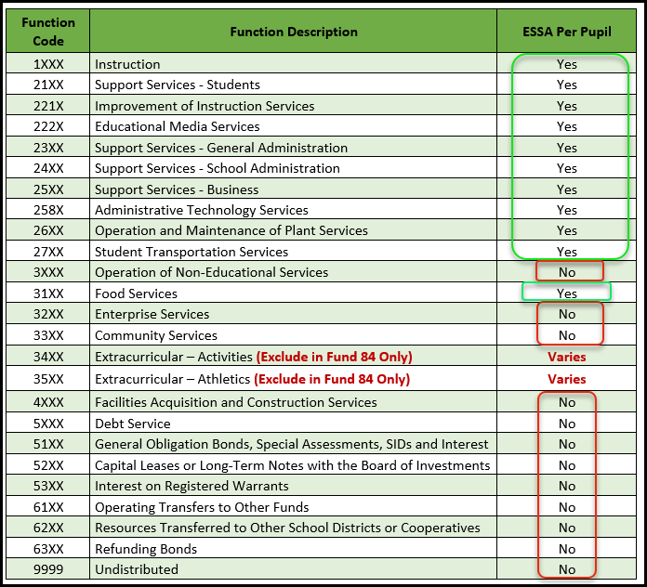
Expenditures allocated by sc
Third: Is the Function Code Included?

Slide 12
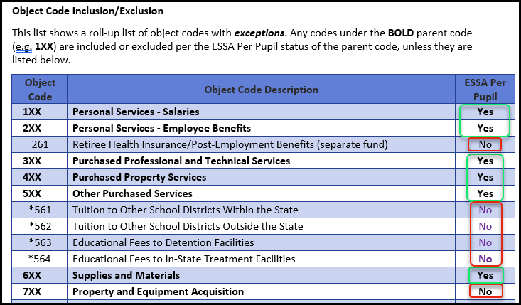
Expenditures allocated by sc
Fourth: Is the Object Code Included?

Slide 13
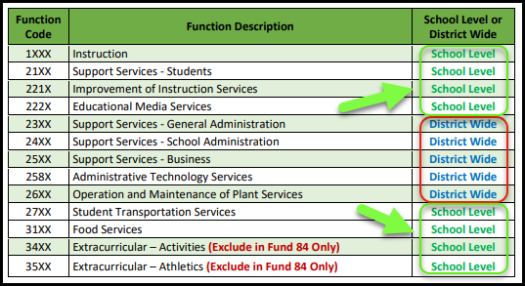
Expenditures allocated by sc
If all of these are “yes” the Function Code determines whether it is reported by SC or left district-wide (no SC, divided by enrollment)

Slide 14
FTE Allocation
Elementary SC 0001
A=Teacher .25 FTE
Cost to Elementary 0001 $18,750
Middle School SC 0002
A=Teacher .25 FTE
Cost to Middle School $18,750
High School SC 0003
A=Teacher .50 FTE
Cost to High School $37,500
Employee A is employed by a K-12 district. Employee A is assigned to the elementary, middle and high school. Employee A makes $75,000 per year. Employee A costs will be distributed to each School based on FTE Hours.

Slide 15
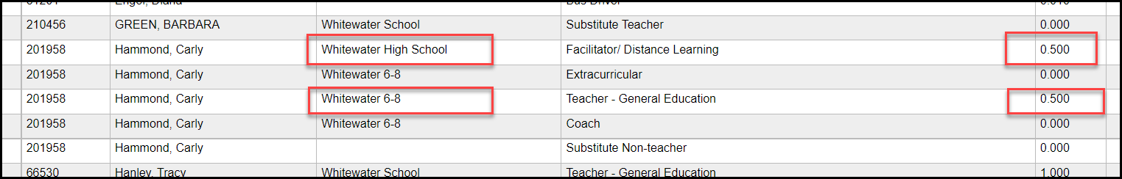
Fte allocation
Use the TOE screens in TEAMS to find the FTE for each staff member.

Slide 16
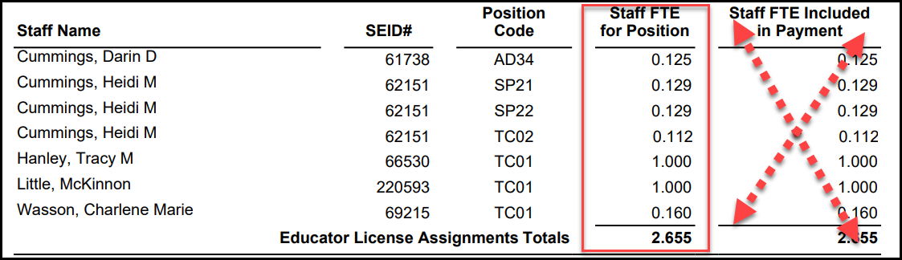
FTE Allocation
Use the Preliminary Quality Educator Report – lists all FTE by school (don’t worry about the “Included in Payment” column – that’s eligibility for QEC)

Slide 17
Fund 12, 15, 82 expenditures
There are three “shared” funds (funds in which a district may combine with another district or entity to share expenditures)
School Food Services Fund (12)
Miscellaneous Programs Fund (15)
Interlocal Agreement Fund (82)
The district that is collecting the revenues and making expenditures for the member districts is the Prime applicant
The Prime applicant reports all revenues and expenditures in the appropriate fund(s) in the TFS (Step 7 Expenditures)
Additionally, the Prime applicant reports expenditures made for member districts (or entities) in Step 9 ESSA LE Per Pupil Exp Reporting

Slide 18
Fund 12, 15, 82 expenditures
Instructions for PRIME agency:
Report all expenditures in Step 7 expenditures
Expenditures for the LE should be assigned a SC, where applicable
Expenditures made for member LE’s should not be assigned to a SC
Report expenditures for member districts in Step 9 – and assign a LE and SC where possible (if a non-school entity, leave LE and SC blank)

Slide 19
Fund 12, 15, 82 expenditures
Instructions for MEMBER agency:
Run the report ESSA Expenditures from Other Districts (Reports/TFS/ESSA Expenditures from Other Districts)
Verify that the correct expenditures have been assigned
If there is a discrepancy, contact the Prime applicant to make adjustments

Slide 20
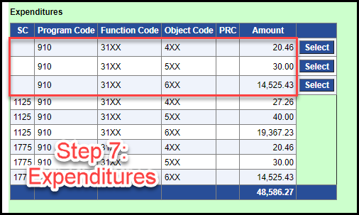
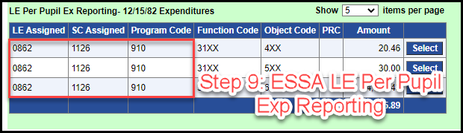
Fund 12, 15, 82 expenditures new pictures saying step 7 and step 9

Slide 21
ESSA PER pupil expenditure
Due Date:
With the TFS in AUGUST.
*Minor corrections may be made through the December 10th deadline for TFS changes.
Districts should verify their school code allocations prior to submission of the initial TFS/Budget

Slide 22
ESSA PER pupil expenditure
Data Verification
Views>ESSA>
Per Pupil Expenditure View
Rollup ESSA Reporting LE Expenditures
Reports>TFS>
ESSA Expenditures from Other Districts

Slide 23
CONTACTS:
General School Finance Email
opischoolfinance@mt.gov
Nicole Thuotte (406) 444-4524
nthuotte@mt.gov
Andrea Mohammadi (406) 444-1960
Andrea.Mohammadi@mt.gov

