Slide 1
Features of Your Online Account
Notes:
MKTG-218-0422
Speaker notes:
Today, we will be covering different features of your Online Account. Please keep in mind, this will be an overview but if you would like a more in-depth review, please let me know. We will be able to set-up a time that works for you with myself or one of my colleagues guiding you through the process. But for Today, I will show you how to manage user information, update preferences, reconcile your bill, manage employees, download election forms, update you address, upload census files and review sick pay reports.

Slide 2
Managing User Information
Notes:
MKTG-218-0422
Speaker notes:
The first topic we would like to explain is how to manage authorized sub-users within your online account.

Slide 3
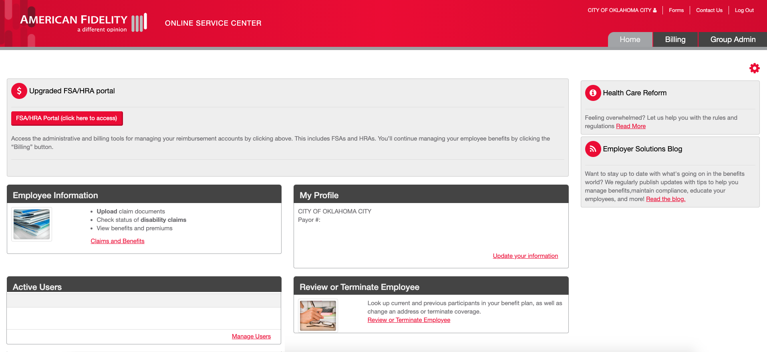
Manage Users
Click on Manage Users in the Active Users box.
Notes:
MKTG-218-0422
Speaker notes:
If you have multiple personnel who may need online account access to manage bills or other functions, setting up additional users is helpful, and you can create those sub-accounts.
On your home page you will see 3 tabs-Home, Billing and Group Admin. On your home tab, you will see an active Users box. Inside that box on the right-hand side, you will see Manage Users. When clicking on this, Manage Authorized Users will open.

Slide 4
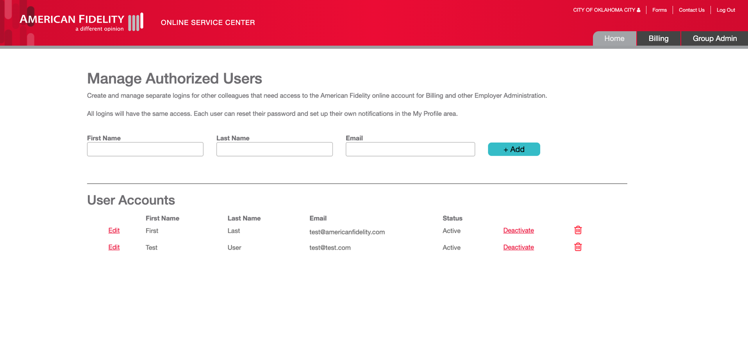
Manage Users
Enter the user’s full name and email address, then click the Add button.
Notes:
MKTG-218-0422
Speaker notes:
From the Manage Authorized Users screen, please enter the authorized user's first and last name and email address. Once complete, the sub-user will receive an email to finalize setting up their account.
All logins currently have the same access levels. Each user added can reset their password and set up their own notifications in the My Profile center. The Admin is in complete control of these sub-accounts. You can delete or add anyone you need.

Slide 5
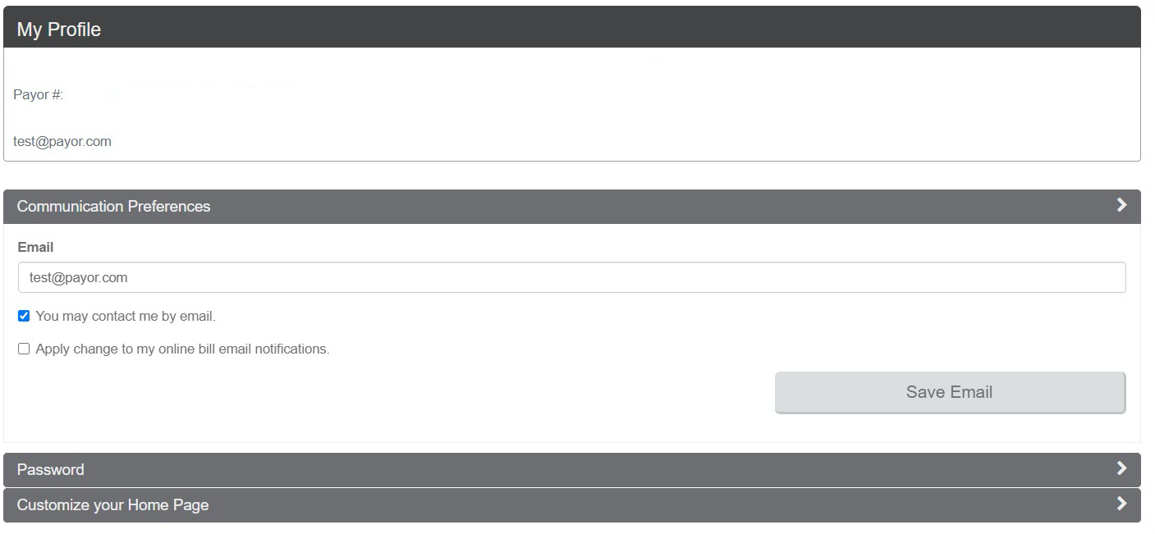
Update Your Information
Employer Name:
Select Update Your Information link.
Notes:
MKTG-218-0422
Speaker notes:
To update your admin email address, select the Update Your Information link on the home screen-in the My Profile box. The admin email would be the owner of the account or the main point of contact, whether it be your clerk, payroll specialist or business manager. Ensuring your email address is current helps you manage password resets in the future.

Slide 6
Managing Billing Preferences
Notes:
MKTG-218-0422
Speaker notes:
The second topic we would like to explain is how to manage your billing preferences.

Slide 7
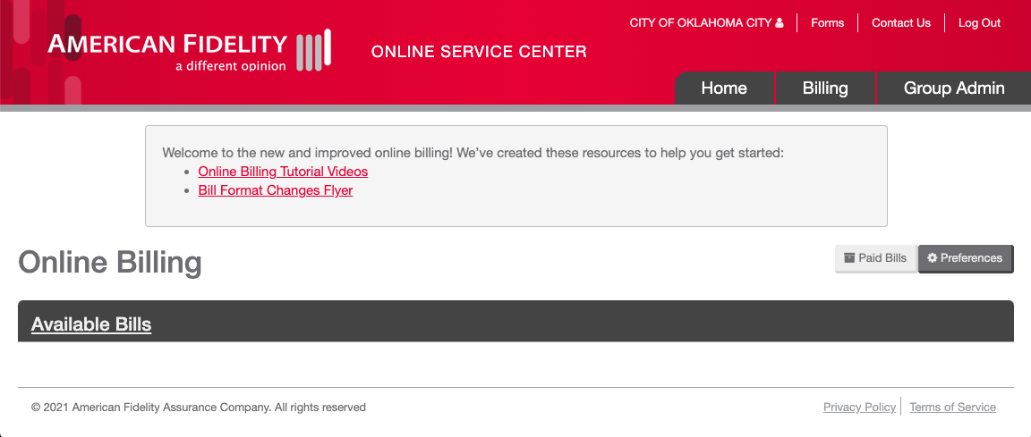
Managing Billing Preferences
Select the Billing tab at the top of the screen. Select the Preferences button next to the Paid Bills button.
Notes:
MKTG-218-0422
Speaker notes:
To begin managing preferences, select the Billing tab at the top of the screen. Next, select the Preferences button next to the Paid Bills button in dark grey.

Slide 8
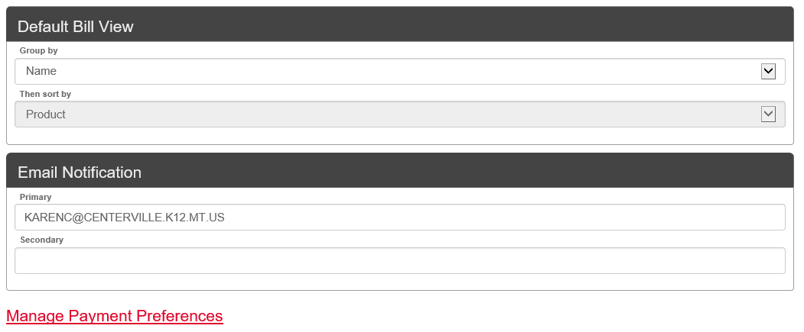
Managing Billing Preferences
Under the Default Bill View you can update how your bills are sorted.
You can also update your email notifications and payment preferences from this screen.
Notes:
MKTG-218-0422
Speaker notes:
Under the Default Bill View, you can update your preferences on how to sort your bills. You can also update your email notifications and payment preferences from this screen.
By updating your email address here, you will receive billing notifications. These notifications can be sent to 2 accounts. To update payment preferences, select the Manage Payment Preferences link.

Slide 9
Managing Payment Preferences
Select the Add account button or link to add or update your bank information to have payments withdrawn from your designated account.
Notes:
MKTG-218-0422
Speaker notes:
After selecting the Manage Payment Preferences link, you can add or update your bank information to have your payment withdrawn from a designated account. This information will be saved and you would not need to do this every time to pay bills.
One thing to note that EFT funds must be withdrawn from the designated bank account within 14 calendar days. When paying an invoice, the system will require you to select a date within 14 days from the day you select Finish on the payment screen.

Slide 10
Managing Your Bill
Notes:
MKTG-218-0422
Speaker notes:
Next, we’ll discuss how to manage and reconcile your bills.

Slide 11
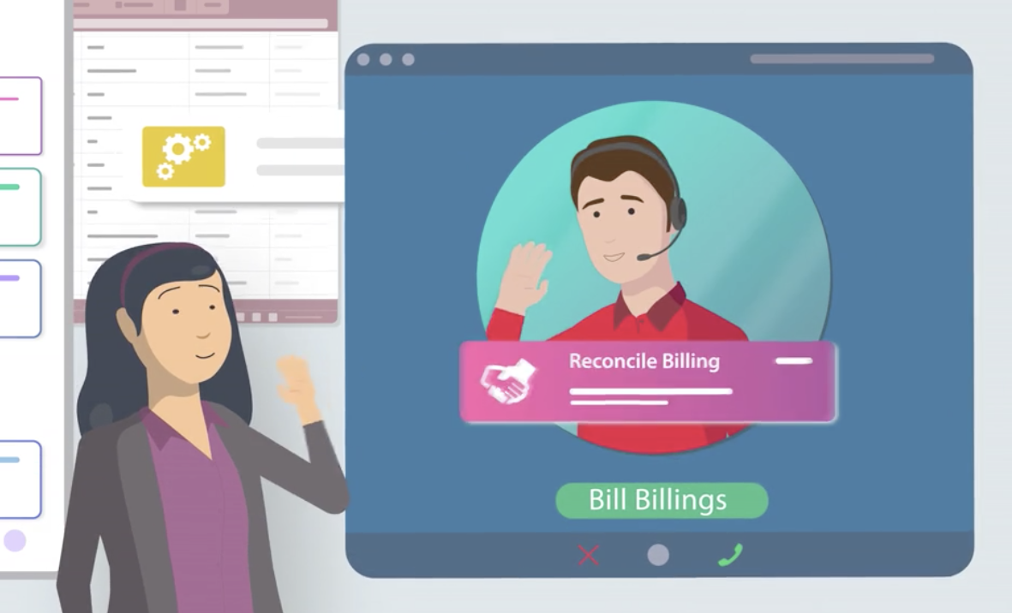
Ways to Reconcile Your Bills
There are multiple ways you can reconcile your bills with American Fidelity.
Assisted Billing
Manual Online Billing
Manual Paper Billing
Notes:
MKTG-218-0422
Speaker notes:
There are multiple ways you can reconcile your bills with American Fidelity.
Assisted Billing
You can send us your premium deduction file through your online account. The file does not have to be appropriately formatted, but we prefer an Excel file. Then, after processing, we’ll review the discrepancies with you and help you complete your monthly billing cycle.
Manual Online Billing
We provide a bill online listing the premium due each month. Then, you can log in and make changes to reflect the premium deductions that need to be made before payment.
Manual Paper Billing
We provide a bill online listing the premium due each month. Then, you can log in, download the bill, make changes to reflect the premium deductions that need to be made, and re-upload through their online account for us to review.

Slide 12
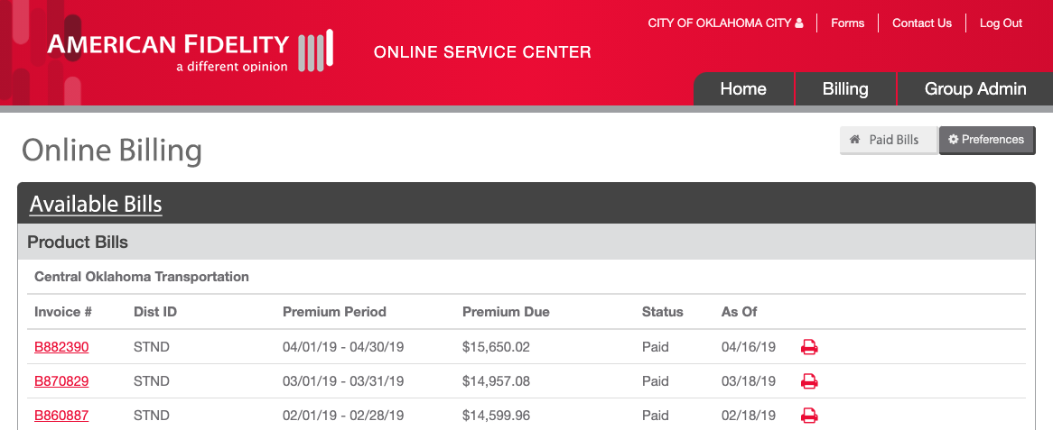
Assisted Billing
B12345
B23458
B12346
Select the Invoice # of the bill you would like to process.
Notes:
MKTG-218-0422
Speaker notes:
First, we will discuss the assisted billing method.
Select the invoice number of the bill you would like to process. It is very important to select the correct invoice. When the file is received at American Fidelity, it will include the invoice number to reconcile against the correct bill.
The bills automatically generate based on their schedule. All bills have a generic billing schedule based on specific criteria. If you need your bill on a specific day, please inquire with us. We can adjust your bill generation schedule to meet your needs.

Slide 13
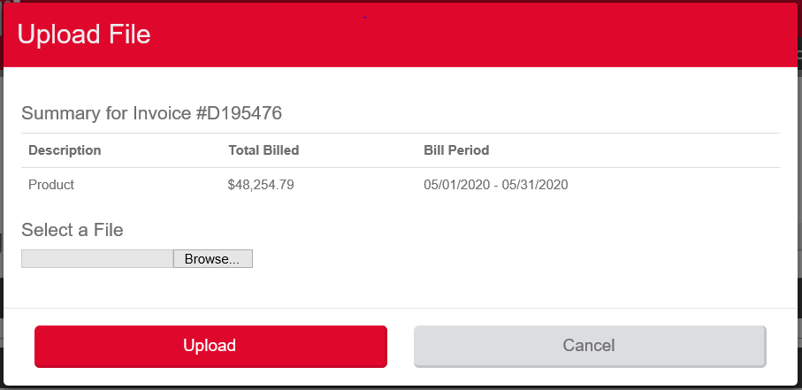
Assisted Billing
Next, select the Upload Premium Deductions button. Select the Browse button to locate your premium deduction file on your hard drive. Click on the red Upload button when you have located the file.
Notes:
MKTG-218-0422
Speaker notes:
Next, you can upload your premium deduction files through a secure upload feature. Select the Upload Premium Deductions button. Select the Browse button to locate your premium deduction file on your hard drive. Once the file is selected, you can now select the red Upload button. Once you have uploaded your premium deduction file, you will be ready to make payment. A big thing to note is your deduction registers must match amount paid.
When your premium deduction files are uploaded, we will reconcile the data to our invoice and then provide you with a discrepancy report of any lines that cannot be updated, changed, or require further information.

Slide 14
Premium Deduction File Best Practices
The following fields are required when uploading your premium deduction file:
Employee Full Name
Employee SSN
Premium Deduction Amount by Account Type
Important: Indicate termination or cancellations each month.
View Sample File
Notes:
MKTG-218-0422
Speaker notes:
Here are some best practices for your premium deduction files before moving forward.
The following fields are required when uploading your premium deduction file:
•Employee Full Name
•Employee SSN
•Premium Deduction Amount by Account Type
We also recommend you indicate termination or cancellations when necessary.
On-screen is an example of how to format your Excel file. Excel is the preferred file format as it requires less manual intervention to convert the data to a usable format.
You can upload a separate file for each product that is deducted from your employees. You can also upload one file and have the products separated into tabs in the spreadsheet.

Slide 15
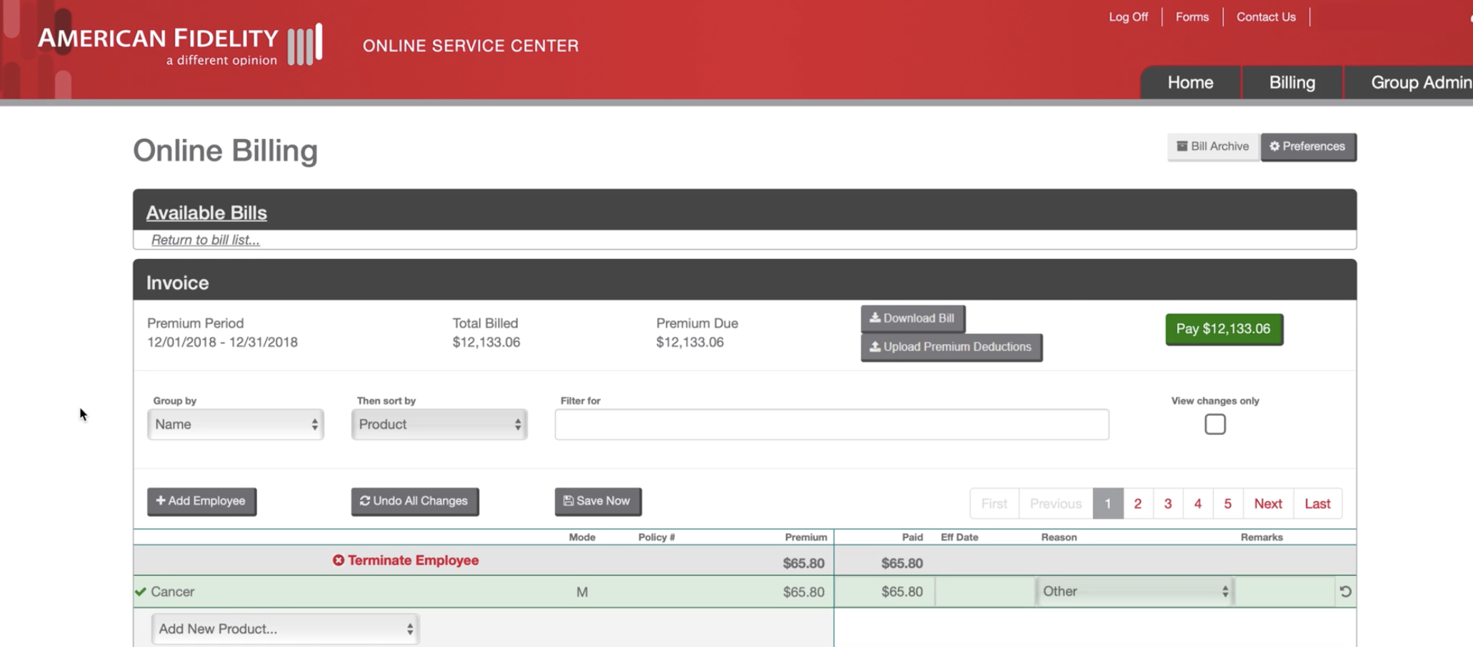
Manual Online Billing
You may also reconcile your bill online. Select the Invoice # of the bill you would like to process.
Next, make changes directly on this screen.
Notes:
MKTG-218-0422
Speaker notes:
You may also reconcile your bill online manually. Click on the invoice number of the bill you would like to reconcile. Here are a few things you can do through online reconciling:
• To change the amount paid on an employees' coverage, click in the box under the paid column and enter the new dollar amount. As you make changes, the total amount for that employee will automatically update, as will the payment amount at the top of the invoice (Green Box).
• Next, you can enter the effective date and choose a reason for the change from the dropdown menu under the reason column.
• You may also add additional remarks in the last column. For instance, you may include instructions on how to handle discrepancies in money, such as "Send Refund" or "Will pay less on next bill."
Your changes will automatically save and be highlighted in green. If there is an error, your changes will highlight in red.

Slide 16
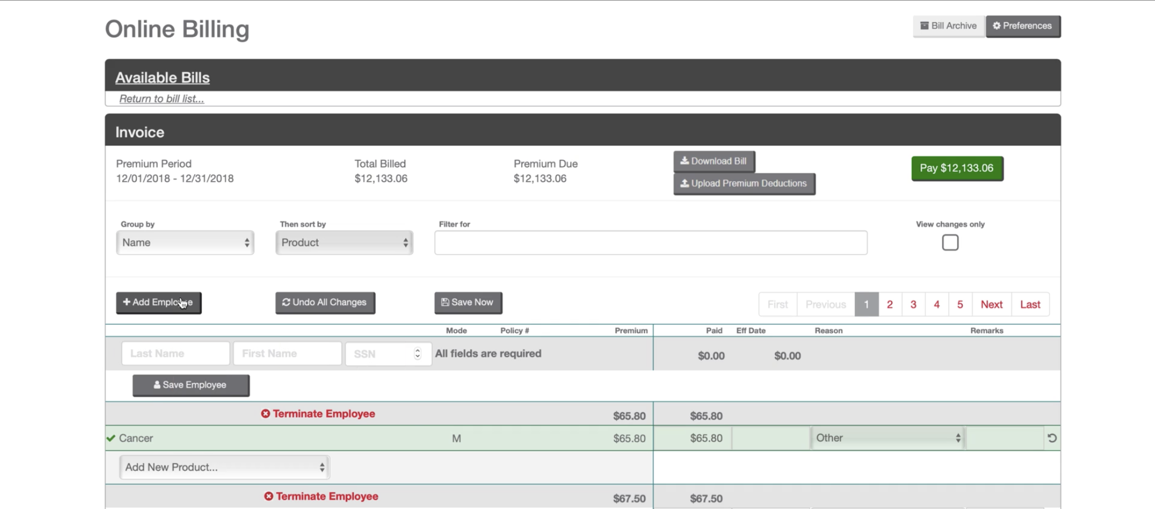
Manual Online Billing
To add an employee, click on the Add Employee button.
Then enter the required fields and click on the Save Employee button.
Notes:
MKTG-218-0422
Speaker notes:
To add an employee, click on the Add Employee button. Then enter the required fields and click on the Save Employee button.
Be sure that you are not adding dashes to the social security number when adding employees.

Slide 17
Manual Online Billing
To terminate an employee, click on the red Terminate Employee link next to the employee you would like to terminate and enter the pop-up box’s requested information. Then click on the Terminate button.
Notes:
MKTG-218-0422
Speaker notes:
To terminate an employee, click on the Red Terminate Employee link next to the employee you would like to terminate and enter the pop-up box's requested information. Then click on the terminate button. The employees paid column will automatically update, and the reason will populate.

Slide 18
Manual Online Billing
To add a new product to an employee, choose the product
from the dropdown menu located at the bottom of that employee’s section.
Notes:
MKTG-218-0422
Speaker notes:
To add a new product to an employee, choose the product from the dropdown menu located at the bottom of that employees' section, add the correct amount under the paid column and choose a reason for the addition from the dropdown menu.
If you would like to review your changes, you can filter your invoice by selecting the view changes only checkbox.

Slide 19
Manual Paper Billing
Select the Download Bill button. Reconcile offline and then reupload through the Premium Deduction File method.
Notes:
MKTG-218-0422
Speaker notes:
The Manual Paper Billing method allows you to download a copy of your monthly bill into Excel and reconcile offline. Then you can upload your reconciled file back through your online account.
This is a convenient option for employers who prefer to work within Excel or by paper. This is something we do recommend for larger school districts. Our system may time out within an hour or so. This option allows you reconcile on your own time.
The first step to using the offline method is to download the bill after selecting the invoice you want to work on. This option allows you to download the bill into an Excel format to reconcile. After you reconcile, you can upload the reconciled bill in the same manner that you upload a premium deduction file.

Slide 20
Payment Best Practices
Pay On Time Timely payment helps prevent lapses and discrepancies. If late payments are due to bill generation timing issues, we can adjust the bill generation date.
Match Documents Your total remittance and billing documentation must match each month.
Ensure Your Payment Is Applied Correctly If you send a paper check, include your customer number and invoice number on or with your check and mail to the correct billing address. Billing addresses can be found on americanfidelity.com/billing or through your payment screens.
Notes:
MKTG-218-0422
Speaker notes:
Here are some payment best practices.
Pay On Time
Timely payment helps prevent lapses and discrepancies. If late payments are due to bill generation timing issues, we can adjust the bill generation date to accommodate your pay schedule. An out-of-balance payment may delay the processing of your monthly bill. Reconciled changes are not processed until the payment is received and finally posted.
Match Documents
Your total remittance and billing documentation must match each month. If they don't, send us documentation about why your payment does not match your reconciled bill amount or the amount on your uploaded premium deduction file. Your payment must match the changes for all methods of reconciliation. If changes occur outside of completing the reconciliation, we need documentation of changes when the payment is sent.
Ensure Your Payment is Applied Correctly
If you send a paper check, please include your customer number and invoice number on or with your check and mail to the correct billing address. We want to encourage you to use the payment screens within your online account when you are working on your invoice, as it will show you the correct address and the customer number and invoice number you need to include on the check. Also, going through those payment screens indicates that you are done reconciling your bill.

Slide 21
Additional Features of Your Online Account
Notes:
MKTG-218-0422
Speaker notes:
Lastly, we’d like to highlight additional features of your online account.

Slide 22
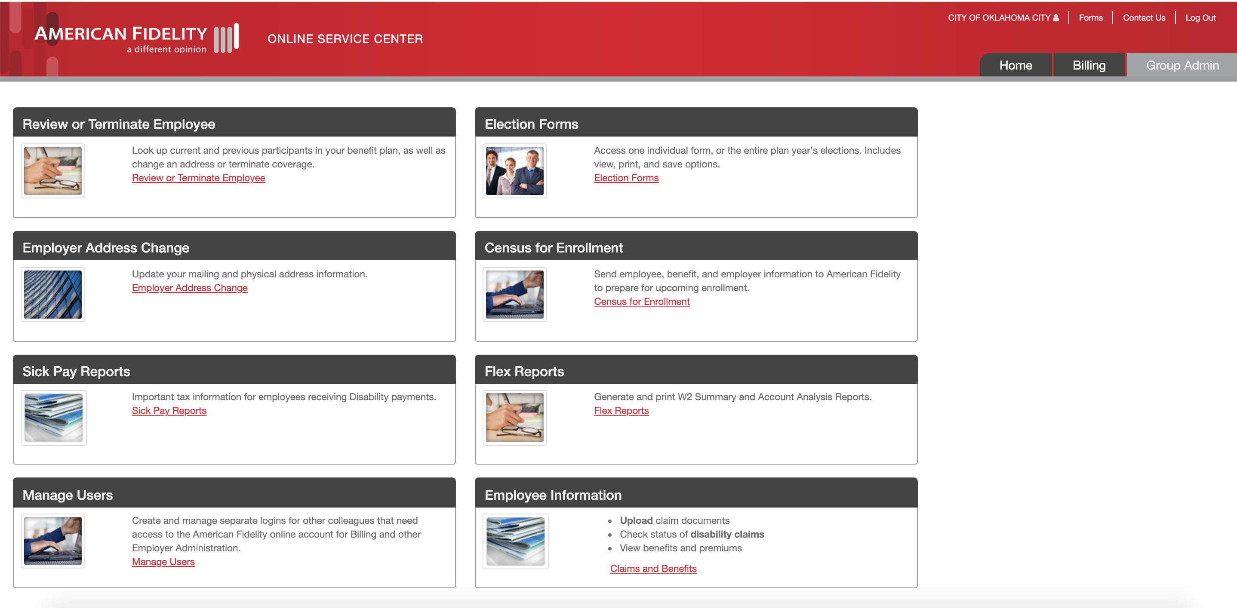
Additional Features
Select the Group Admin tab.
Notes:
MKTG-218-0422
Speaker notes:
To take advantage of your online account's additional features, select the Group Admin tab at the top of your screen. From this screen, you can manage employees, view Section 125 election forms, update your mailing and physical address information, access your sick pay reports, and more.

Slide 23
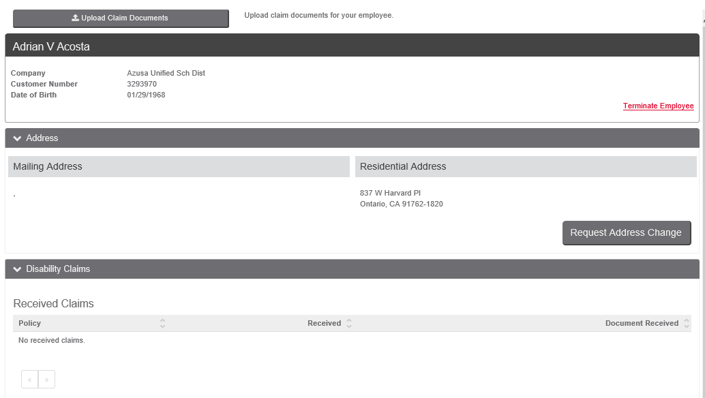
Manage Employees
To update an employee’s address, upload claim documentation for an employee or terminate a specific employee select the Review or Terminate Employee link.
Enter an employee’s last name and then click the Search button.
Notes:
MKTG-218-0422
Speaker notes:
To update an employee’s address, upload claim documentation for an employee or terminate a specific employee, select the Review or Terminate Employee link on the Group Admin screen.
Enter an employee’s last name and then click the Search button. If you would like to review all employees, do not enter the last name before selecting the Search button.
Currently, the changes submitted are manually processed, but we are working on adding automation as we continue to enhance our systems and processing.
Our goal is to have changes processed within 5-7 business days; however, as our workloads fluctuate, it may take longer for the changes to be processed.
The terminate employee from the bill function in this area will only apply to your product invoice. We recommend also including this information when you reconcile your bill as well.

Slide 24
Disability Claims
Quickly see if any employees have Incomplete Disability Claims. Incomplete claims cannot be processed until all required documentation has been received.
View Incomplete Claims to see a list of employees and forms received. If the Employer Form is “Not Received”, please complete and upload it.
Notes:
MKTG-218-0422
Speaker notes:
Another great feature within your online account is the ability to view received and not received disability claim forms for your employees. To access this, click Review or Terminate Employee link on the Group Admin screen, select the View Incomplete Disability Claims button next to the location the employee is connected to. Then a screen will appear, allowing you to see the disability claim form status. You can upload the employer disability claim forms if that form is not submitted by selecting the Upload Claim Documents button.
Employers can upload any documents for an employee for their disability claims. This is simply a feature that allows them to upload what they have for a specific employee.

Slide 25
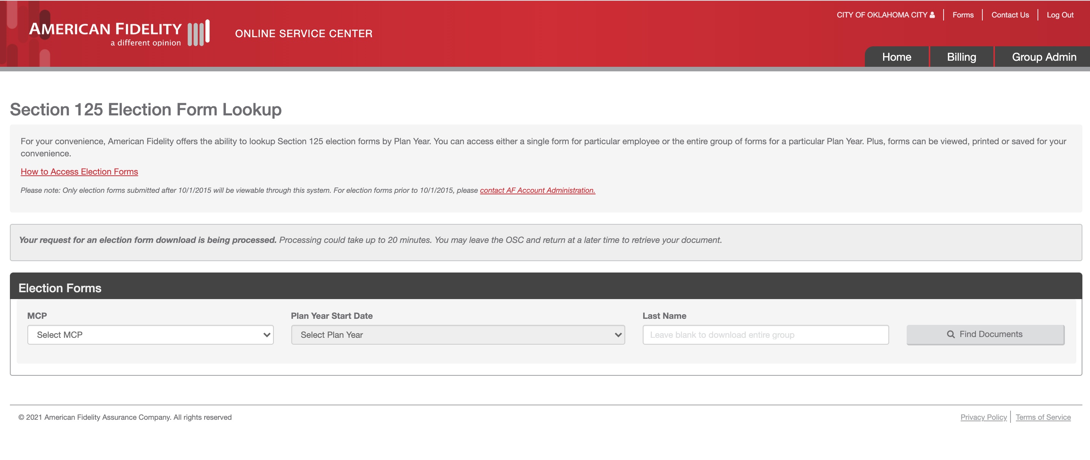
Section 125 Election Forms
Select your desired location through the MCP drop down menu and Plan Year,
enter the employee’s last name and select the Find Documents button.
Notes:
MKTG-218-0422
Speaker notes:
To view your Section 125 election forms:
1. Select the Election Forms link on the Group Admin screen.
2. Select your desired location through the MCP drop-down menu and Plan Year.
3. Enter the employee's last name and select the Find Documents button.
This is the process you can take if you need an individual form. Leave the last name field blank if you would like to view all Section 125 election forms for a certain location. When viewing the full Plan Year election forms, a maximum of 500 records are viewable online. If you have more than 500 forms, you can choose the Download Entire Plan Year button for a zip file download.

Slide 26
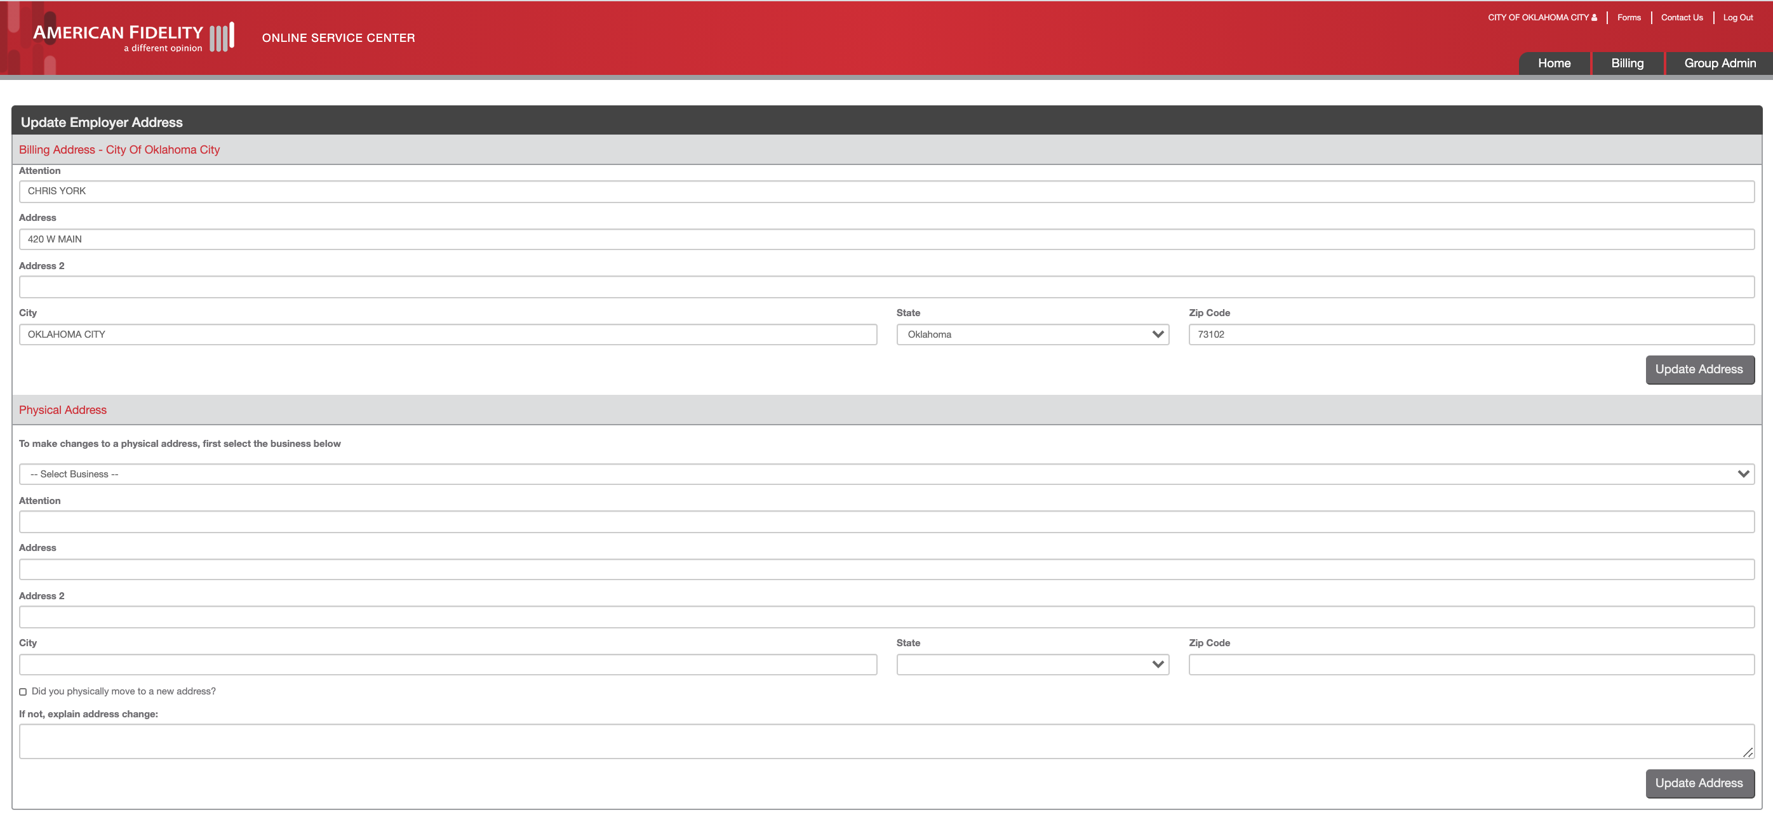
Employer Address Change
To change your mailing or physical address select the Employer Address Change link on the Group Admin screen. Enter the requested information and select the Updated Address button.
Notes:
MKTG-218-0422
Speaker notes:
To change your mailing or physical address, select the Employer Address Change link on the Group Admin screen. Enter the requested information and select the Updated Address button.

Slide 27
Upload Census Files
To upload a census file, select the Census for Enrollment link on the Group Admin screen.
Select the Choose Files button to find the file that you want to upload.
Notes:
MKTG-218-0422
Speaker notes:
To upload a census file, select the Census for Enrollment link on the Group Admin screen. Select the Choose Files button to find the census file you want to upload from your hard drive. An Upload File button will appear when you choose a file. Use this feature to provide your census and benefits file for open enrollment. This is a secure way to upload your employees' data.

Slide 28
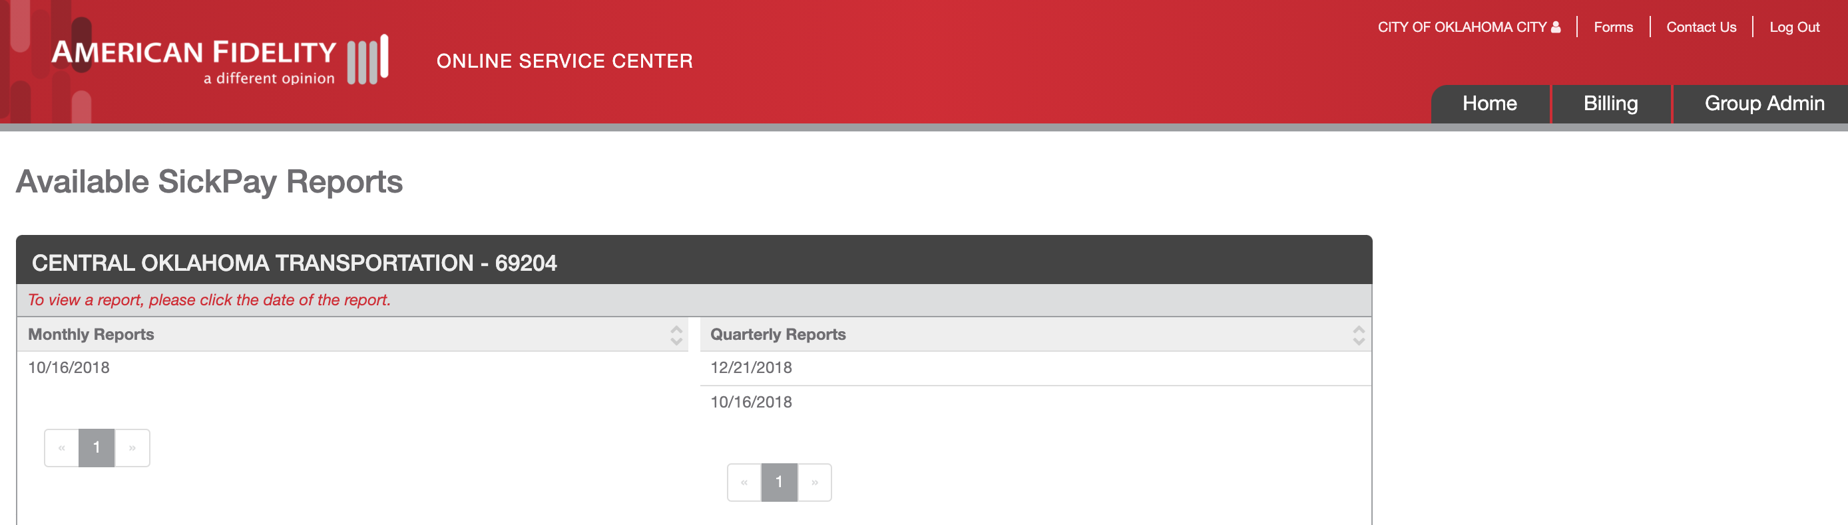
Sick Pay Reports
To view your sick pay reports, select the Sick Pay Reports link on the Group Admin screen.
From this screen you can view monthly or quarterly reports for all locations associated with your online account. Select the report date you would like to view.
Notes:
MKTG-218-0422
Speaker notes:
To view your sick pay reports, select the Sick Pay Reports link on the Group Admin screen. You can view monthly or quarterly reports for all locations associated with your online account from this screen. Select the report date you would like to view.

Slide 29
Questions? Phone: 1-800-662-1113 Email: billing-western@americanfidelity.com Web: americanfidelity.com/billing
Notes:
MKTG-218-0422
Speaker notes:
Thank you for your time today. We hope this presentation will help you in your daily tasks with American Fidelity. We are here to support you. On the screen are two options to receive support or contact your dedicated billing specialist. If you are unaware of who your billing specialist is, please call 1-800-662-1113 to inquire.

Slide 30
Jacob Bautista Sr. Account Relations Coordinator Email:Jacob.Bautista@americanfidelity.com Phone: 986-200-4969
Notes:
MKTG-218-0422
Speaker notes:
Thank you for your time today. We hope this presentation will help you in your daily tasks with American Fidelity. We are here to support you. On the screen are two options to receive support or contact your dedicated billing specialist. If you are unaware of who your billing specialist is, please call 1-800-662-1113 to inquire.

