Slide 1
Welcome New School Business Officials
MASBO Resources for New School Business Officials
September 2022

Slide 2
Agenda
8:30 - 9:30 Welcome and Introductions and Online Resources
9:30 - 10:30 Governmental Accounting and School Finance
10:30 - 10:45 BREAK
10:45 - 11:45 Payroll and Employee Onboarding Basics
11:45 - 12:30 LUNCH
12:30 - 1:30 Compensated Expenditure Report, TOE/TEAMS, and
other OPI reporting requirements
1:30 - 2:30 Board meeting and minute laws
2:30 - 2:45 BREAK
2:45 - 3:30 Transfers Between Funds, Recoding, and Q&A time
Notes:
Bathrooms, WIFI link etc.

Slide 3
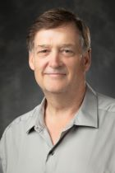
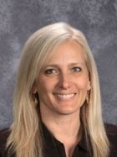
The Montana Association of School Business Officials Team
Shelley Turner
Executive Director
Sturner@masbo.com
(406) 461-3659
Steve Hamel
Interim Services & Training
Shamel@masbo.com
(406) 431-0124
Marie Roach
Association Coordinator
Mroach@masbo.com
(406) 461-8804
Notes:
Introduce self, years in the industry, and one word that describes your journey.

Slide 4
Who is MASBO?
Please Share with Us!
Name
School District
When did your journey start?
One (1) word that describes your MASBO journey so far?
Notes:
YOU ARE!!!

Slide 5
Notes:
Poll Title: Do not modify the notes in this section to avoid tampering with the Poll Everywhere activity. More info at polleverywhere.com/support What word best describes what you want to learn today? https://www.polleverywhere.com/free_text_polls/0itrkc3J6wZeKjvc7YBC7

Slide 6
Feeling Stretched Thin? Where Do You Even Start?
Notes:
You are a professional and doing so requires more than a typical position.

Slide 7
Organize
Make your office feel like home.
Start a Calendar and create a “to do list” that can be easily accessed and edited.
Outlook To Do
Google Tasks
Rocket Book
Pen & Paper…
Review your job description and ask questions.
Understand your school meeting schedules.
Review your school policies related to your position.
Read prior year audits.
Notes:
Know yourself and your work style. Make it feel comfortable as you may be there awhile…

Slide 8
Connect
Superintendent
MASBO Clerk/Superintendent Duty List
Board Chair
What are the expectations of the Board?
Committees
Treasurer’s Office
Key Staff
Other Administration
Principals
Front office and attendance
Athletic Directors and Coaches
Maintenance Supervisors
Union President
Special Education
Support Staff
Notes:
Communicate your work style to those you work with.

Slide 9
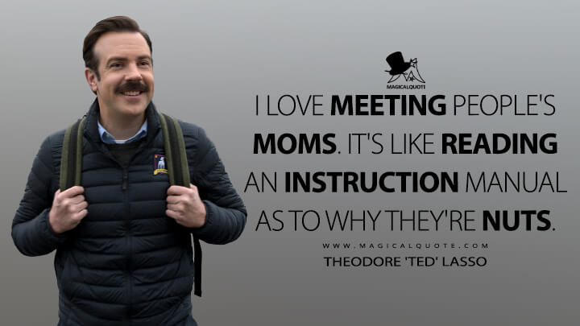
Connect
Committees you may serve on.
Contractors, Suppliers, and Benefit Administrators
MASBO Mentor
Attend Professional Development
Local Meetings
State Meetings and/or Trainings
Community
PTF/PTA
Boosters

Slide 10
Know your WHY!
Notes:
No matter how busy you are know the reason you are there. The students! Walk around the school and get to know the students and staff. You may not be excited about the cost of a project, but when you see the students learning it makes a difference in your mindset.

Slide 11
MASBO Super Heroes
Super Heroes have super powers!!!!
Super PATIENCE for yourself & others.
Super EMPATHY for your students, team, community and colleagues.
Super STRENGTH in taking on incredible tasks.
Super TOOLS & RESOURCES to get the job done right.

Slide 12
Building Your Toolbox
MASBO
OPI
MCA
ARM
MASBO Partners
TRS
PERS

Slide 13
MASBO
Calendar
Member Directory
Professional Development
Certification
Services
Publications
Resources
Presentations
Elections
Legislative
Software Users
Discussion Forum

Slide 14
Office of Public Instruction
Leadership
School Finance
Access
Accounting
Budgets/MAEFAIRS
Elections
ESSER
Transportation
Payments
Student Count ANB
Tuition
E-Grants
E-grants staff
School Nutrition
Accreditation/TEAMS
Compass
CSCT
Notes:
Note the general email for school finance.

Slide 15
Montana Code Annotated (MCA)
Title 20. Education
Title 2. Government Structure and Administration
Title 13. Elections
Montana Administrative Rules (ARM)
Chapter 10 Education

Slide 16
MASBO Partners
Association of School Business Officials (ASBO)
Montana School Board Association (MTSBA)
Montana Quality Education Coalition (MQEC)
Montana Rural Education Association (MREA)
School Administrators of Montana (SAM)
Montana Small Schools Alliance (MSSA)
Montana Federation of Public Employees (MFPE)

Slide 17
State Retirement Plans
Teacher Retirement System
Fact sheets
Wage & Contribution Page
Forms
Annual Reports- GASB Reports
Public Employee Retirement System
Employer education
ERIC
Forms
Annual Reports- GASB Reports

Slide 18
Overview
Organize
Connect
Know Your Why
Fill Your Toolbox

