Slide 1
New SBO Employee Onboarding & Payroll
September 2022

Slide 2
The Montana Association of School Business Officials Team
Shelley Turner
Executive Director
Sturner@masbo.com
(406) 461-3659
Steve Hamel
Interim Services & Training
Shamel@masbo.com
(406) 431-0124
Marie Roach
Association Coordinator
Mroach@masbo.com
(406) 461-8804
Notes:
Introduce self, years in the industry, and one word that describes your journey.

Slide 3
Onboarding Staff and Payroll Basics
Onboarding
Administrative Roles
Job Descriptions
Recruitment
Applications
Screening
Contracts
Types of Employees
Employment Packets
Payroll
Payroll Setup & Processing
Leave Types
Payroll Reporting- Monthly, Quarterly, & Yearly
Final Payroll
Record Maintenance
Record Retention
Audits
Remember that you won’t remember it all!
You can find resources at the MASBO website.
Notes:
Employees are a resource. First Impression of your organization.

Slide 5
Notes:
Poll Title: Do not modify the notes in this section to avoid tampering with the Poll Everywhere activity. More info at polleverywhere.com/support Who has the authority to hire and/or terminate employment within the District? https://www.polleverywhere.com/multiple_choice_polls/wo9wdW2p6LI6oLE2fEdXe?display_state=chart&activity_state=closed&state=closed&flow=Instructor&onscreen=persist

Slide 6
Administrative Roles
The Board of Trustees
Hires and evaluates the Superintendent
Approves ALL Hires
Approves ALL Terminations
A member may serve on the hiring committee (check your school policy)
The Superintendent
Makes recommendations to hire
Makes recommendations to terminate
Properly evaluates all staff
**District Clerk may be evaluated by either the Board, the Superintendent, or a combination. Check job description/contract for details.

Slide 7
Job Descriptions
Need to be created by the Trustees and evaluated regularly for ALL employees of the District. ARM 10.55.701
Adjusting job descriptions for certified staff covered by a collective bargaining agreement may require negotiations.
Essential functions of the job
Duties performed by staff in the position
Evaluations are based on the job description

Slide 8
Recruitment
Advertisement should include:
Essential duties & minimum qualifications
Application packet requirements
Is a pre-employment physical or drug testing required?
Notice of background checks requirements and re-dissemination.
Veteran’s preference and an equal employment/non discrimination statement
Advertisement is not required by law. Emergencies may require hiring without advertisement. Consistency is key to avoid legal issues.
Check school policy, collective bargaining documents, MTSBA or other legal examples, and your liability insurance provider for more information.
Notes:
Advertising is best practice. If you are accused of discriminatory hiring practices, the burden of proof is on the employer to prove their actions were consistent and not discriminatory. If you follow the same process for each hire, and document times when circumstances required a change in the process, it will help you in worst case scenario. Non discriminatory statement basics: race, religion, gender, age, national origin, disability, or martial status (usda statement: race, color, national origin, religion, sex, gender identity (including gender expression), sexual orientation, disability, age, marital status, family/parental status, income derived from a public assistance program, political beliefs, or reprisal or retaliation for prior civil rights activity, in any program or activity conducted or funded by USDA (not all bases apply to all programs).)

Slide 9
Applications Packets
Classified and Certified Application Forms- Standardized
Letter of Interest
Resume
Transcripts
Letters of Reference
Forms Required
Clear and concise request for information
Public Document
Consider Applicant Frustrations
Notes:
Check with legal for standardized legal requirements of applications- veteran’s preference, personal information etc. Public Document. Call legal if a records request takes place. Pre-employment Physical: It is permissible for a school district to require, as a condition of
employment, that the applicant chosen for a position undergo a physical examination, the
purpose of which is to determine whether the applicant can perform the essential functions
of the position. However, compliance with the ADA requires that only the applicant chosen
for the position may be subjected to a physical examination. Accordingly, the successful
applicant for the identified employment position would be offered the position contingent
upon successful completion of the pre-employment physical.

Slide 10
Screening
Hiring Committee
Open Meeting Laws
Committee notes
Delegation of Duties
Scheduling and Noticing
Reference Checks
Background Checks
Other Screening- physicals, drug testing, etc.
Removal of Equal Employment Opportunity Survey filed separately
Appropriate Interview Questions and Conduct
Notify all candidates of process- requirement of background checks and Board approval prior to contract and official offer of employment.
Notes:
* Check policy/CBA on who is required for hiring committee. Committee members need to know the time frame and committee to the process, understand the laws and the agree on questions and who is asking them, the order, etc. in advance. Contract is a property right. Appropriate questions/comments- I think my sister went to school with you- age, education. After reading the job description- can you meet the essential duties of this position. If physician provides reasonable accommodation suggestions, do it.

Slide 11
Notes:
Poll Title: Do not modify the notes in this section to avoid tampering with the Poll Everywhere activity. More info at polleverywhere.com/support Background checks are required for all school staff. https://www.polleverywhere.com/multiple_choice_polls/fQhX93b2yrVt7w0F7mYRm?state=opened&flow=Default&onscreen=persist

Slide 12
Background Checks
Substitutes and Bus Drivers required by Montana administrative rule. ARM 10-55-716 and 10-64-201
Best Practices to require a background check for all staff who have unsupervised access to students including volunteers.
Who can view a background check.
Training- Criminal Records Identification Service Section (CRISS)
E-mail: dojcriss@mt.gov Phone: (406) 444-3625

Slide 13
Best Practices
Prior to Board Approval
Background check completed (closed session?)
Pre-employment screens are complete (closed session?)
Hiring Committee and Superintendent are ready to make recommendation
The candidate is aware of the Board meeting and discussion
Is any Board member related to the candidate.
4th degree of consanguinity or affinity of the 2nd degree
MCA 2-2-302
Publish 15 days notice.
Relative abstains.
ALL remaining trustees must vote in favor of the hire.

Slide 14
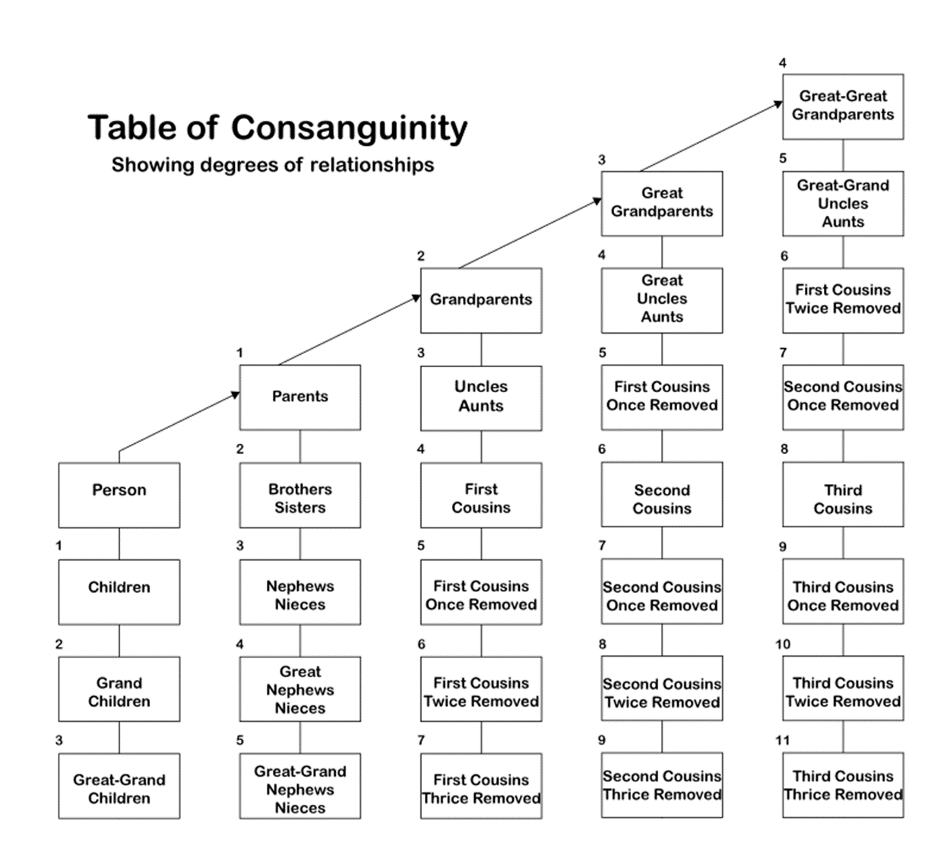

Slide 15
Contracts
Clear beginning and ending dates
Signed & dated by employee, Board Chair, and District Clerk
Rate of pay & other compensation
Leave accrual rate
Principals & Teachers- Automatically renewed if Board does not take action and notify that employee prior to June 1st. MCA 20-4-205
Superintendents- Contracts can be 3 years or less. Second and subsequent contracts are automatically renewed for one year if Board does not take action prior to February 1^{st.} MCA 20-4-401
No contract required for Subs working less than 35 consecutive days
Board approved Substitute List

Slide 16
Exempt vs. Non-Exempt
Exempt Employee
Employee exempt from the overtime provisions of the Fair Labor Standards Act (FLSA). Salaried employee with a flat rate of pay, regardless of hours worked. 2022 salary threshold for exempt status is $35,578.
29 CFR 541.303(b) defines Teachers as exempt employees regardless of salary threshold.
Non Exempt
An individual who is not exempt from the overtime provisions of the FLSA and is therefore entitled to overtime pay for all hours worked beyond 40 in a workweek (as well as any state overtime provisions). Nonexempt employees may be paid on a salary, hourly or other basis.
Notes:
Typically noted in the job description

Slide 17
Types of Employees
Administrative
Serve in a supervisory capacity and make decisions which affect the management of the District. These are contracted employees, who may have different benefits from other employees. Their work year extends past the regular school year. It is important to use State Wage and Hour law to appropriately categorize these employees for your District. Generally, administrative employees are exempt from overtime. In larger districts, there may be certain supervisory personnel (i.e. maintenance, food service, curriculum supervisors or technology coordinators) who meet criteria for exemption from overtime
Certified
Teachers, librarians, counselors, specialists, and nurses. Also typically exempt. Typically covered by a collective bargaining agreement.
Classified
Paraprofessionals, bus drivers, food services, custodians, support office personnel. Typically non exempt. May also be covered by a collective bargaining agreement

Slide 18
Notes:
Poll Title: Do not modify the notes in this section to avoid tampering with the Poll Everywhere activity. More info at polleverywhere.com/support A substitute teacher must be licensed and provided a contract if working in the same position for more than 35 consecutive days. https://www.polleverywhere.com/multiple_choice_polls/L97iMlCtzw1ehDOUAD4Zk?state=opened&flow=Default&onscreen=persist

Slide 19
Types of Employees (continued)
Substitutes
May or may not be certificated. (Montana law does not require certification for substitutes.) Rate of pay may be hourly or daily and different rates may apply for certified vs. non-certified subs. Licensed long term substitutes, who have substituted in the same position for more than 35 consecutive teaching days, shall be placed under contract. ARM 10.55.716
Temporary Employees and Extra Duty
Positions that are required as needed. Check school policy for specific requirements including benefit status. Typically non exempt.
Student Employees
A student who is employed by a school and is regularly enrolled and regularly attending classes is excepted from FICA (Social Security and Medicare) taxes. See IRC Section 3121(b)(10) (Student FICA Exception). Exclusion is only valid during school attendance (not during summer break unless enrolled in summer break). Full-time students working at and attending the same public school are also excluded from Montana Public Employees Retirement System (MPERA). Students are exempt from unemployment if they are regularly enrolled and regularly attending classes, but not exempt during the summer.

Slide 20
Types of Employees (continued)
Foreign Employees
For the purposes of payroll tax reporting, these teachers are “nonresident aliens”, under a J-1 visitor’s visa.
For the first two years of their employment, they are subject to state taxes only. The third year, foreign teachers will be subject to FICA, Federal and State taxes.
Foreign teachers are required to enroll in TRS. Foreign employees will be able to withdraw their TRS contributions and may receive a tax exemption on them, when their employment ends.
Foreign teachers are subject to workers compensation, but non unemployment.
Per U.S. Department of State requirements, you must have insurance coverage that meets specific guidelines. Many school’s/school districts’ insurance policies do not meet the Department of State requirements. A supplemental insurance plan is available that will meet the Department of State requirements.

Slide 21
Employment Packets
Form I-9
Montana New Hire
W4
Montana W4
Direct Deposit forms
TRS or PERS forms
Health Insurance, Flex, HSA
Benefit Enrollment information- 403B, supplemental insurance, EAP programs, wellness programs, etc.
Deduction acknowledgment- union dues, benefit expenses, etc.
Payroll Schedule/Time card submission requirements
Beneficiaries
Notes:
Knowing the type of employee will define the items required in your employment packet

Slide 22
Employment Packets
Acknowledgment of Employee Handbook and Policies
Acknowledgment of Collective Bargaining Agreement (if applicable)
Acceptable Technology Use and Facility Use notification or forms
Job description and copy of contract if available
School Calendar
Safety Notifications
Be sure to coordinate with the Superintendent, Principal, Plant Manager, IT staff, and others that ensure the onboarding of new staff is successful.
Notes:
This can be overwhelming.

Slide 23
Now that your staff is hired…
Know your school payroll policy
Collective Bargaining requirements
Know your login information
Talk to your benefit administrator
Professional development with your software provider

Slide 24
Notes:
Poll Title: Do not modify the notes in this section to avoid tampering with the Poll Everywhere activity. More info at polleverywhere.com/support Which is greater, the Montana Minimum Wage or the Federal Minimum Wage https://www.polleverywhere.com/multiple_choice_polls/gbu9ydBz31dleYEOPDFVg?state=opened&flow=Default&onscreen=persist

Slide 25
Set up and Processing
Review staff contracts
Review an internal documents including payroll manuals etc.
MASBO payroll manual
Connect with your county treasurer regarding deadlines
Calendar enough time to complete all tasks
Create a monthly checklist and a quarterly checklist
Keep notations that you can review regularly

Slide 26
Import Your Data Into Your Software
Wages, Salaries, Stipends, Special Pay (election judges, etc.)
Pay types and time types and coding
Hours
Know when the work week starts and ends in cases of overtime
Leave
Sick leave, personal, vacation, etc.
Deductions
Taxes
Health insurance
Flex/HAS
TRS/PERS and supplemental retirements
Union dues
Garnishments
REVIEW ALL ENTRIES BEFORE YOUR PROCESS

Slide 27
Stipends
Stipends such as travel stipends are taxable wages for purposes of FICA, federal taxes and state taxes.
Classified staff:
paid at least minimum wage for the hours worked for the stipend
paid overtime if the hours worked for the regular job and the stipend exceed 40 in one work week
If overtime is earned, an hourly rate must be determined for the stipend and overtime pay calculation

Slide 28
Multiple Positions
When a person holds multiple positions, please consider the following:
Are positions TRS or PERS or both
Different pay rates
Coding
Different Worker Compensation levels
Overtime calculations

Slide 29
Overtime Example with Different Pay
One week an employee works 36 hours entering data into the computer data base for which $7.60 per hour is paid. The employee then spends 6 hours preparing payroll for which $8 per hour is paid. This same worker performs janitorial services in the evenings for the employer and is paid $6 per hour for those 4 hours worked per week.
36 hours x $7.60 per hour = $273.60
6 hours x $8.00 per hour = $ 48.00
4 hours x $6.00 per hour = $ 24.00
46 hrs worked = $345.60 regular earnings
$345.60 ÷ 46 hrs = regular rate = $7.51 per hr
$7.51 ÷ 2 = ½ time rate = $3.76 per hour
$3.76 x 6 overtime hrs = $22.56 ot earnings
$345.60 + $22.56 = $368.16 total due

Slide 30
Regular Leave Types
Superintendent | At a minimum, per state law 2-18-601, 2-18-612 MCA. Individual contract may provide additional benefits.
Administrative (certified) | Per individual contracts. Often receives the same benefits as teachers, plus an administrative package.
Administrative (other) | At a minimum, per state law 2-18-601, 2-18-612 MCA. Individual contracts may provide additional benefits.
Certified employees | Per master agreement or individual contracts.
Classified employees | At a minimum, per state law 2-18-601, 2-18-612 MCA and per master agreement, if applicable.
Notes:
Knowing this ensures you are deduction leave correctly for each employee

Slide 31
Additional Leave Types
Bereavement
Extended Leave of Absence
FMLA (Family Medical Leave)
Jury Duty
Leave Without Pay
Maternity/Paternity
Military
Check your policies for more information

Slide 32
Print Checks &/or Submit Electronic Transfers
Know your bank and Treasurer’s Office deadlines
Consider Pre-Notes prior to electronic transfers
Track any checks that misprinted for audit records
Use your reports to ensure you are balanced prior to sending reports
Note any issues that need to be addressed in future months

Slide 33
And now the real fun begins….. Submitting Payroll Reports & Payments
Monthly
Quarterly
Annually
Financial Year Quarter Calendar Year Quarter
Q1 June, July, August Q1 Jan, Feb, March
Q2 Sept, Oct, November Q2 April, May, June
Q3 Dec, Jan, March Q3 July, Aug, Sept
Q4 April, May June Q4 Oct, Nov, Dec

Slide 34
Monthly Contributions
Fed Tax- Electronic Federal Tax Payment System (EFTPS)
Know your tax deposit schedule
Deposits include Federal withholdings, Social Security, and Medicare
State Tax
TAP or a paper check
Health Insurance, Dental, Vision, Life
Union Dues
TRS/PERS
Supplemental Retirement
Other- Auto insurance, deductions to multiple bank accounts, garnishments, child support, tax withholdings, etc.

Slide 35
Monthly Contributions (continued)
HSA-
Employee owned
Funds roll over from year to year and can be transferred
2022 limit $3650 for individual
Limited to those with a high deductible health insurance plan
Less flexible on what you can use funds for
Flex –
Employer owned
Depending on plan funds maybe use or lose and are not transferred if you sever employment
2022 limit $2850 for individual
Open to all individuals
More flexible, can be used for child care,

Slide 36
Quarterly Reporting
941- paper submittal with Schedule B
Worker’s Compensation- purchased through a private provider, MSGIA, or the State of Montana.
Collect Independent Contractor Exemption Certificate (ICEC) or proof of insurance from all contracted service providers.
Unemployment- State of Montana or Montana State Unemployment Insurance Program
Both Work Comp and Unemployment rates may be adjusted annually and may be subject to additional audits

Slide 37
Yearly Reports
Check with your software provider for seasonal trainings and guidance
W2’s
Due to employees by January 31st
Balance with Quarterly reports
Be sure items on W2 are identified properly
Submitted electronically through the Business Service Online (BSO) portal of Social Security
Do not hesitate to obtain enrollment, the process takes several weeks
W3- submitted electronically at BSO portal
1099
non-incorporated individual, partnership, or business (independent contractor) for payment of services rendered for $600 or more.
submitted to IRS through FIRE portal
MW3- Montana TAP website: 1099 and W2 data

Slide 38
Yearly Reports (continued)
Affordable Care Act
1094-C Transmittal of Employer- Provided Health Insurance Offer and Coverage Information Returns
Must be submitted electronically if more than 250 employees
Submitted to the IRS
1095-C Employer-Provided Health Insurance Offer and Coverage
Required for each fulltime employee
Submitted to the IRS and to the employee
Both are due by February 28th if filing by paper and March 31st if filing electronically
Fines for not filing correctly
Notes:
Link to IRS site

Slide 39
Notes:
Poll Title: Do not modify the notes in this section to avoid tampering with the Poll Everywhere activity. More info at polleverywhere.com/support Terminated employees will receive 100% of vacation leave in their final paycheck https://www.polleverywhere.com/multiple_choice_polls/DKTNW6JRtm6QpxvnqzH6M?display_state=instructions&activity_state=opened&state=opened&flow=Instructor&onscreen=persist

Slide 40
Termination Pay
When to Pay
Check your policy: maximum date for final pay – either next regular pay day or 15 calendar days from separation, whichever is earlier
If no policy, employee should be paid immediately
25% of accrued sick leave
100% of accrued vacation leave
Severance paid based on Collective Bargaining or Board Policy
COBRA- contact health insurance and FLEX provider
TRS/PERS- each retirement program has different standards. See provider website for more information. Resignation vs retirement needs to be noted for accurate payout calculations.

Slide 41
Record Maintenance
Keep files locked with limited access
Types of files:
Personnel File- Original application, transcripts, certification (licenses, CPR/first aid, teaching certificate, paraprofessional certificate), placement file, original contracts, evaluations, disciplinary or commendation letters, fingerprint/background check report cover page, extended leave of absence requests (if no medical information is provided), change of job assignment, hours or pay, signed acknowledgement of Employee Handbook and other key policies.
Restriction of access is important. This file will contain Birth Date and other information, allowing for the possibility of age discrimination claims. Federal law for age discrimination pertains to age 40 and older, but Montana law has no limit on age discrimination.

Slide 42
Record Maintenance (continued)
Employee Payroll File- W-4 / Montana W-4, MPERA/TRS membership forms, time cards/sheets, copy of the contract, New Hire Reporting Form, garnishments, child support agreement or garnishment, payroll deduction forms. FLEX, health insurance enrollment forms, family medical leave act requests, and leave request forms can be included if they contain no medical information.
Health File- Medical release to work, worker’s compensation injury form and related information, ADA accommodation, & veteran’s preference form. FLEX, health insurance enrollment, Family Medical Leave Act (FMLA) request, and leave request forms must be included if they contain any medical information (HIPAA). These files should be kept in a separate filing cabinet with a separate key from all other payroll/personnel records.
I9 File
Payroll reports

Slide 43
Retention Schedule
Montana Record Retention Schedule- Schools
This document will guide you with all law regarding retention requirements’

Slide 44
Audit Preparation
Compensated Absences Calculations
Approved Collective Bargaining Agreement, Salary Schedules or Minutes approving wage rates
Monthly or Quarterly PERS, TRS, Work Comp, Unemployment, 941 and W2 reports
Payroll Registers
Time Cards
Ensuring you have payroll records organized will help you get through your Audit successfully

Slide 45
You Survived!

