Slide 1
New School Business Official Grant Close Outs
Montana Association of School Business Officials
September 2022

Slide 2
E-Grant Resources
E-Grants
E-Grants Staff Directory
Amendments Guide
MT State and Federal Grants Handbook

Slide 3
Grant Management
Be diligent in tracking grants throughout the year
Reconcile monthly
This will help eliminate a mad scramble at the end of the year
OPI has a handy spreadsheet for a limited number of funds
Misc Fund Worksheet
Create your own spreadsheet
Use these spreadsheets for auditors, for balancing purposes, and to create supporting documents for cash requests and as additional checks and balances
Work closely with the county Treasure to correct errors as soon as they are identified

Slide 4
Closing Out Grants
Monthly tracking and reporting should make closing out grants fairly easy
Make sure you know the grant end date and close out date
If the project year ends June 30: Obligations existing at June 30 must be liquidated within 30 days following the end of the project year (i.e., by July 31). Submit the final expenditure report and final program report, if required, to the OPI no later than August 10
If the project year ends September 30: Obligations existing at September 30 must be liquidated within 30 days following the end of the project year (i.e., by October 31). Submit the final expenditure report and final program report, if required, to the OPI no later than November 10

Slide 5
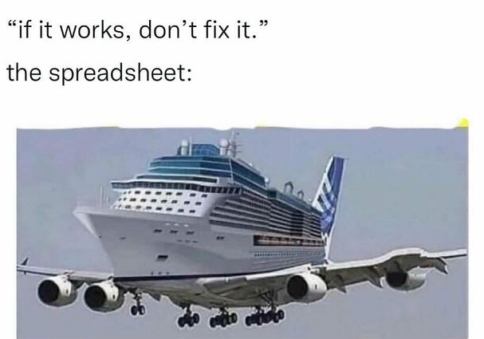
Closing Out Grants
Submitted online in the e-grants system
Select an approved application or amendment from the Project / Year you wish to closeout
Click the Payments button
Click the ‘View Summary Expenditure / Documentation of Expense Reports’ button
Select the program you wish to Closeout from the drop down (if working with a consolidated application)
Create Expense Report

Slide 6
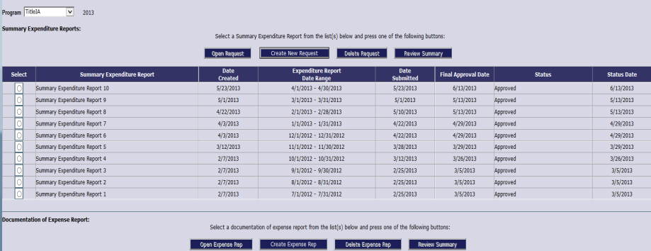
Closing Out Grants

Slide 7
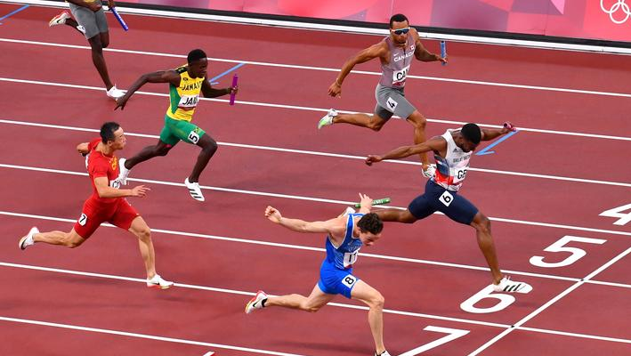
You Win!
You may need to file an amendment with OPI if need to move funds from one object code to another
Ensure your internal reports match your submission to OPI
You can submit at any time you’ve expended your funds or you’ve submitted your last cash request and it’s been approved
Carry overs will not show on the new year application until prior year expense reports are submitted and approved

