Slide 1
Board Meeting and Minute Laws
New School Business Official Workshop
September 2022

Slide 2
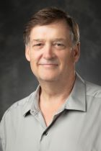
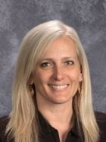
The Montana Association of School Business Officials Team
Shelley Turner
Executive Director
Sturner@masbo.com
(406) 461-3659
Steve Hamel
Interim Services & Training
Shamel@masbo.com
(406) 431-0124
Marie Roach
Association Coordinator
Mroach@masbo.com
(406) 461-8804
Notes:
Introduce self, years in the industry, and one word that describes your journey.

Slide 3
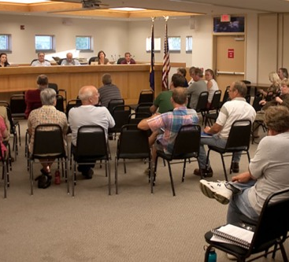
Board Meetings and Minutes
MT Constitution & Laws
School Policies
Public Notice
Agenda Components
Board Packets
Public Comment
Best Practices at a Meeting
Closed Sessions
Minutes

Slide 4
MT Constitution & Laws
Article II, Section 9. Right to know
No person shall be deprived of the right to examine documents or to observe the deliberations of all public bodies or agencies of state government and its subdivisions, except in cases in which the demand of individual privacy clearly exceeds the merits of public disclosure.
Article II, Section 8. Right of participation
The public has the right to expect governmental agencies to afford such reasonable opportunity for citizen participation in the operation of the agencies prior to the final decision as may be provided by law.
Section 2-3-203, MCA, meetings of public agencies and certain associations of public agencies to be open to public

Slide 5
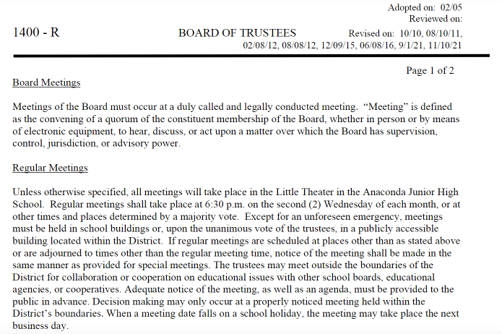
Check Your School Policies
If you use your district utilized the MTSBA model policies, the 1000 series pertains to School Boards
1400 Meetings
1420 Procedures
1420 F Notice – Public Comment
1441Audience Participation
1402- School Board Email
School Policy
Notes:
When does your meeting take place. Make sure you can be there

Slide 6
Notes:
Poll Title: Do not modify the notes in this section to avoid tampering with the Poll Everywhere activity. More info at polleverywhere.com/support Public notice is required for trustee committee meetings https://www.polleverywhere.com/multiple_choice_polls/BzpbHJaRDShfT5MixRLrz?state=opened&flow=Default&onscreen=persist

Slide 7
Public Notice REQUIRED
Public notice required for all board meetings & committees where discussion or action takes place- the Agenda
Regular & Special Meetings
Committee meeting INCLUDING hiring committee meetings
Notice must include
Where the meeting is located- If remote- how to access the meeting
When the meeting will take place
What will be discussed
Notices must be posted no later than 48 hours prior to the meeting
Those who will be discussed must also be notified in person or by mail so that they can be present at the meeting
Must be posted in a reasonable location. Consistency is key. Front door, staff room, news paper, website, calendar, etc.
Notes:
No changes to the agenda after the 48 hour mark and best practices is no changes after the posting

Slide 8
What does all that boil down to?
Trustees must conduct school business in a clear and transparent manner and allow for the public to participate and observe discussion
Law automatically triggered in a quorum
Quorum- Oxford Dictionary definition:
the minimum number of members of an assembly or society that must be present at any of its meetings to make the proceedings of that meeting valid
Do you have to have a Quorum?
Nope. Any time trustees hear, discuss or act on school business matters it triggers open meeting law, even if not all are physically present (email & phone conversations)
No reply all emails
Avoid discussing school business when not in a meeting session

Slide 9
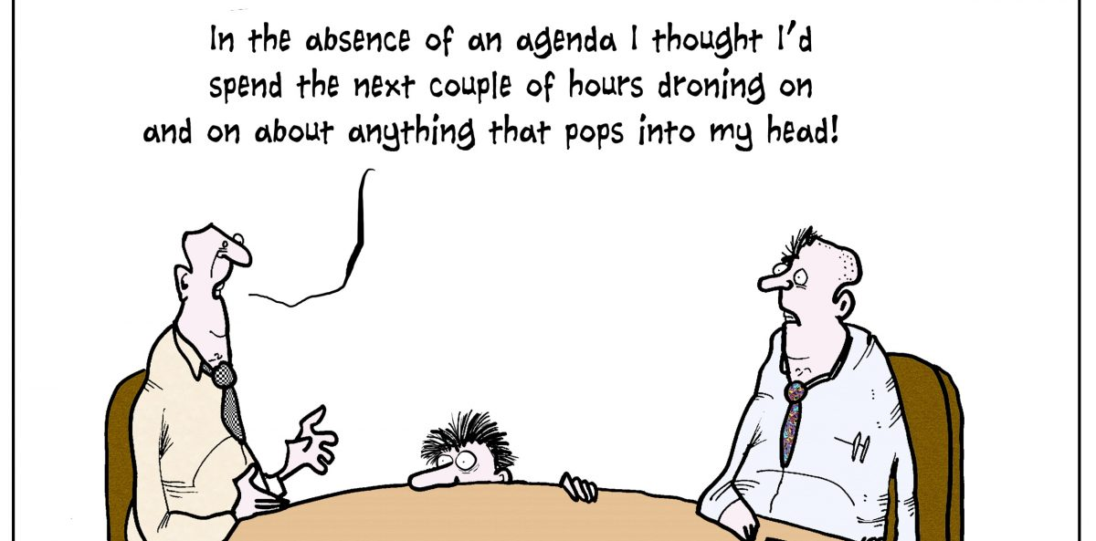
Who Creates Agenda Items
Typically the Board Chair and the Superintendent- check school policy
Topics requested by the public must be approved by Board Chair

Slide 10
What’s in an Agenda?
Date, time, and location of the meeting
How to attend remotely if applicable
Who to contact for more information or a Board Packet
Outline of the Meeting that will take place
The Board Chair is authorized to adjust the order of agenda items to accommodate scheduling needs of interested parties.
Clear & succinct phrases
Reasonable person test
Possible closed session notation required
(Possible Closed Session in accordance with Section, 2-3-203 MCA)

Slide 11
Additional Agenda Best Practices
REQUIRED: Public Comment- clear guidelines, timer etc.
Exp: Citizens may comment on items appearing on the agenda when invited to participate during that agenda item by the Board Chair. Citizens may comment on items related to School District business not appearing on this agenda during the public comment portion of the meeting as noted in the public comment form. (policy 1420F)
Make sure all action items are clearly identified
No indication of a predetermined conclusion
Wording is important
No changes after posting

Slide 12
Notes:
Poll Title: Do not modify the notes in this section to avoid tampering with the Poll Everywhere activity. More info at polleverywhere.com/support Consent agendas are not allowed by law for public board of trustee meeting agendas. https://www.polleverywhere.com/multiple_choice_polls/p2eJVjyuTcQASz9pt4ZnK?state=opened&flow=Default&onscreen=persist

Slide 13
Consent Agendas
Consent Agenda (if used)
Also clearly listed
Routine monthly business- expedite the meeting
Claims & Payroll
Approval of prior meeting minutes
Sub Lists (if no one is related to a Board Member)
No discussion of these items
If something requires discussion, a board member should request it be removed from the consent agenda and moved to regular businesses prior to consent agenda motion

Slide 14
Board Packets
Delivered to the Board members & public who request it
Electronic or Physical- conversation with the Board
48 hours prior to the meeting
What to include
Agenda
Prior meeting minutes
Claims approval list
Any reports
Supporting Documentation
Consider if there is any information that discloses private information

Slide 15
Notes:
Poll Title: Do not modify the notes in this section to avoid tampering with the Poll Everywhere activity. More info at polleverywhere.com/support Monthly Board of Trustee meetings are required for all schools. https://www.polleverywhere.com/multiple_choice_polls/jkLs4FcdgEwx8PHem4tb7?state=opened&flow=Default&onscreen=persist

Slide 16
Required Board Meetings
MCA 20-3-322 Meetings & Quorums
Organization Meeting- May
Final Budget Meeting- August
1st Class Elementary District must meet monthly, others quarterly
First Class District – Population of 6,500 or more
Second Class District – Population of 1,000 or more but less than 6,500
Third Class District – Population less than 1,000
OPI Classification and Board make-up guidance
OPI Classification Report

Slide 17
During the Meeting
Board Chair leads the meeting
Loosely follows parliamentary procedure
Public Comment
Board Chair has authority to govern public comment portion
May not comment in a overly rude or aggressive manner
May not address matters of student or employee privacy
Public contain discussion to matters within the purview of the Board
May not discuss items on agenda
No action may be taken on a public comment item
Public comment must be included in the minutes
Each member of the public may address the board once.
Discussion of items on agenda to be held during that items portion of the meeting

Slide 18
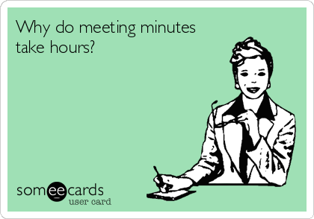
The Minutes
20-3-323 MCA details what is to be included in Board Meeting Minutes:
Wording of motions
Voting records of each trustee present
No abstaining unless related to someone or affecting the board members business.
Detailed statement of all expenditures
Must be available in draft form five days after the meeting

Slide 19
Meeting Minute Contents
Other pertinent information
What members are attending and which ones are not, if there is a quorum
Did anyone attend remotely
What time late members arrive
Names of other attendees
Location of meeting
Time the meeting was called to order and adjourned
Time the Board went into and came out of closed session, if any.
Public Comment
Other regular “pertinent information” you include

Slide 20
Discussion Detail
Each agenda item
Brief statement of each action taken by the board
Brief explanation of the rationale for the decision
In cases of extensive arguments include substance of the arguments
Be objective
Avoid inflammatory remarks
Avoid personal observations
Avoid adjectives and adverbs when possible

Slide 21
The Highlights
Summarize discussion, don’t record them word-for-word
DO record motions word-for-word
Exact wording
Who made the motion and the second
Do NOT include your emotions
DO NOT be afraid to ask questions
If your Board uses voice votes, ask for a roll-call vote if not unanimous

Slide 22
Closed Sessions
To discuss litigation strategy
The District’s attorney must be present in some fashion- in person, phone or web.
When individual rights of privacy clearly exceed the public’s right to know
Chair must clearly state the following and it must be noted word for word in minutes:
The next matter to come before the Board for consideration is a personal matter and in this connection it has been determined as follows: (1) that the matter of individual privacy is involved, (2) that such privacy demands protection of the individual for the sake of reputation and otherwise that little, if anything could be gained by publicly disclosing the information to be discussed, & (3) that the demand of individual privacy, in this matter clearly exceeds the merits of public disclosure.” (Direct guests from the room)
Chair can move to closed session even if a parent does not wish to
Note the time the board moves to closed session in the minutes
Post on the door to the room and site the MCA

Slide 23
Within Closed Session- The Gray Area
The Clerk does not necessarily need to be in the closed sessions but a board member must then be asked to handle notes on the Clerk’s behalf.
ARM 10.55.910 Provides that “when a local board of trustees takes disciplinary action against a student, the board must take minutes of the action taken, with detailed explanation, even if the disciplinary action is decided during a closed session.”
Section 2-3-212, MCA, “Any time a presiding officer closes a public meeting pursuant to 2-3-203, the presiding officer shall ensure that minutes…are kept of the closed portion of the meeting. The minutes from the closed portion of the meeting may not be made available for inspection except pursuant to a court order.”

Slide 24
Closed Session Minutes
Those in attendance
Summary of discussion
The board may not vote in closed session but may draft a possible motion to be made when returning to open session
Once notes are complete the notes should be passed to all parties in room for “approval”
Once consensus on notes accuracy is obtained notes need to be placed in an envelope
Collect any notes the Board has made personally and place in envelope.
Seal envelope

Slide 25
Notes:
Poll Title: Do not modify the notes in this section to avoid tampering with the Poll Everywhere activity. More info at polleverywhere.com/support A classified staff member is requesting an increase in wages. They would like to request a closed session as to the reasons why they deserve a raise. Is it allowed? https://www.polleverywhere.com/multiple_choice_polls/2UVVh9T5WKKjcAfa2GkMI?state=opened&flow=Default&onscreen=persist

Slide 26
Closed Sessions (continued)
Remove notice from door and allow public to reenter room
Board chair officially reopens the meeting- Note time in minutes
Someone makes motion, second, and vote. No discussion.
What is NOT considered closed session:
Pay increases
Non renewals
Negotiations
Hiring Committees

Slide 27
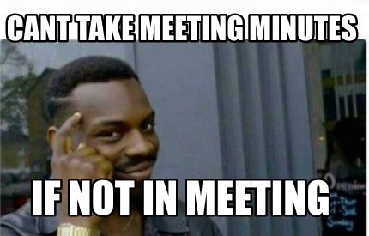
Minute taking Templates
No “right way” to take minute notes.
You can hand-write your notes.
You can type your notes.
Do whatever works for you.
Have a backup plan if you can’t be there and a sub to take notes.

Slide 28
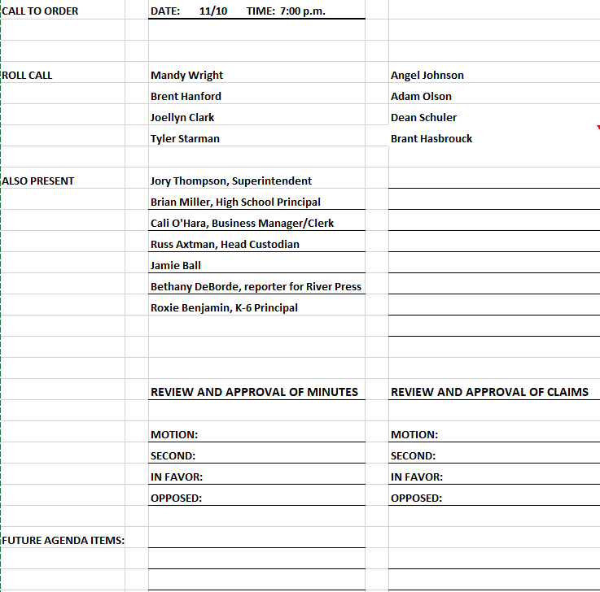

Slide 29
BUSINESS:
MOTION:__________
SECOND:__________
DISCUSSION
IN FAVOR:
OPPOSED:
BUSINESS:
MOTION:__________
SECOND:__________
DISCUSSION
IN FAVOR:
OPPOSED:

Slide 30
Sunburst Schools’ Template Thank you Peggy

Slide 31
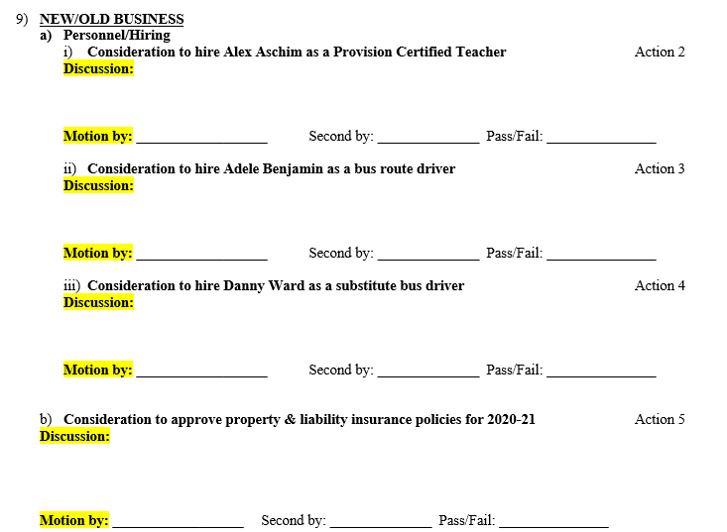

Slide 32
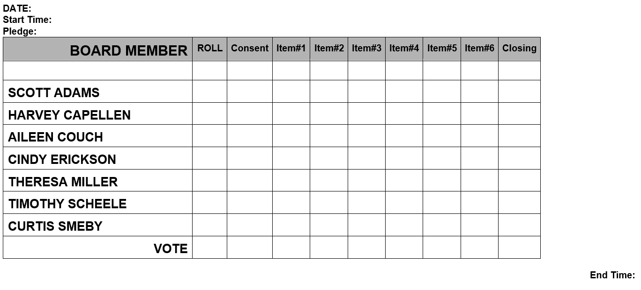
You can use a grid to record votes

Slide 33
Special Ed Co-op Minutes
Regular Meeting of the Trustees
Any Special Services Cooperative
Tuesday, November 33, 2525
A regular meeting of the Board of Trustees of the Any Special Services Cooperative was held Tuesday, November 33, 2525, via Zoom. The meeting was called to order by Chair John Kennedy at 11:00 a.m.
Members present: Nathan Elder – Joe Schmoe Schools; I.B. Rude – Jellystone Schools; John Kennedy – Red Acres Schools; Axle Rose – Nirvana Schools: Phillip Williams – West Weasel Schools; and Richard Harris – Camelot. Members absent: Bobby Fischer – Checkerboard. A quorum was present.
Director Dean Martin and Clerk Jerry Lewis were present for the entire meeting.
Also present: Will Smith
Correspondence
None.
Consent Agenda
A motion was made by Richard Harris, seconded by Phillip Williams to approve the minutes of September 8th , 2020 and to approve the bills for payment. Motion passed unanimously.

Slide 34
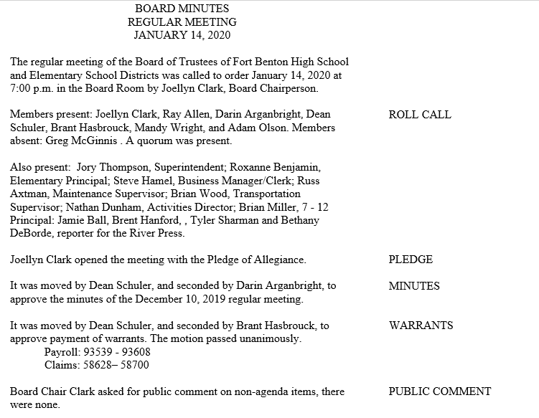

Slide 35
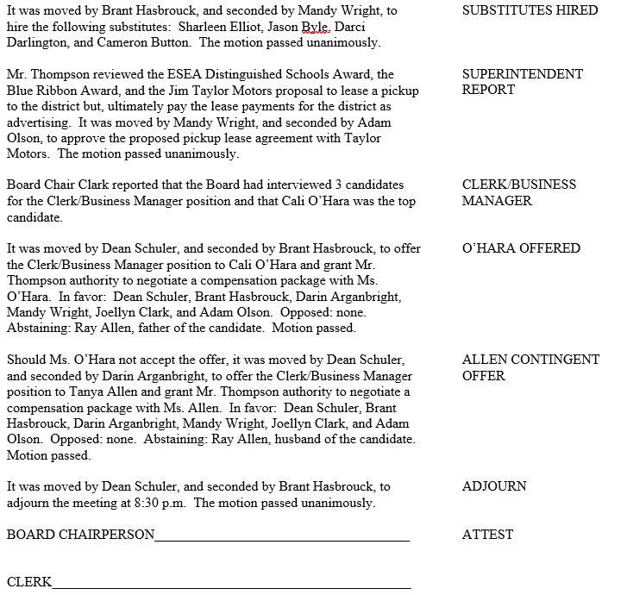

Slide 36
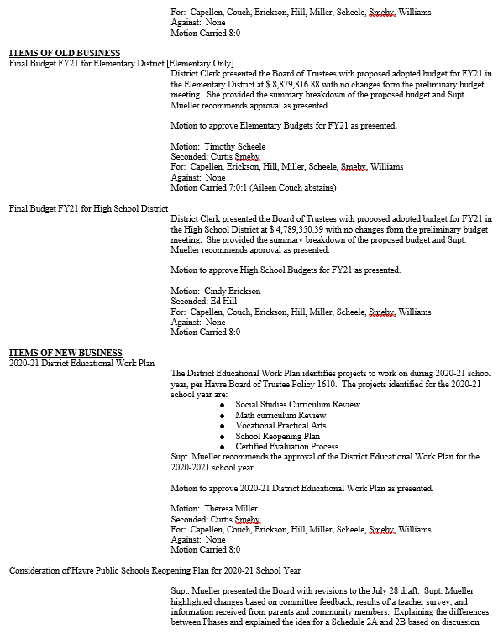

Slide 37
Best Practices
If you are an MTSBA member
Montana Education Law Review
Professional development
Designed for new Board Members but a good tool for anyone in school administration.
Attend Other Board Meetings
Review prior month and year agendas
Keep a file of yearly item timelines (tickler file)
Election items
Budget
Reorganization
Policy Reviews
Evaluations
Disposal resolutions
Sports Seasons

Slide 38
Best Practices (continued)
Ensure the public can easily find Board and Superintendent contact information
Ensure your minutes and agendas are also easily accessible
Talk to your Board Chair and Superintendent about preferences and prior procedures
Where was notice posted previously
Packet format and content
Meeting room layout
Meeting organization
Minute content preferred

Slide 39
You’ve Got This!

