Slide 1



Communicating Budget Documents to Your Community
MCEL 2022
Thursday, October 20, 2022
2:00 – 2:50 pm

Slide 2
The Who, What, When, Where, Why of School Budget Information
Every good story follows "The 5Ws"
Who, What, Where, When and Why
How do you make your school budget story unique and interesting?
Who is the target audience? Who needs to understand? Who is it about? Who is affected? Who benefits? Who loses?
What budget information should be shared?
Where is this taking place? Where can people go to learn more?
When should it be shared? When will the effects be felt?
Why share budget information? Why is this important in the big picture? Why should people care?
This presentation will cover the 5 W’s along with “How” Great Falls Public Schools addresses budget information?

Slide 3
Questions
What questions are asked regarding District budgeting/spending or operations?
What financial information do you need to access periodically?

Slide 4
Who
Trustees and Administration
Public
  Parents
  Community Leaders
  Voters (20%)
  Legislators

Slide 5
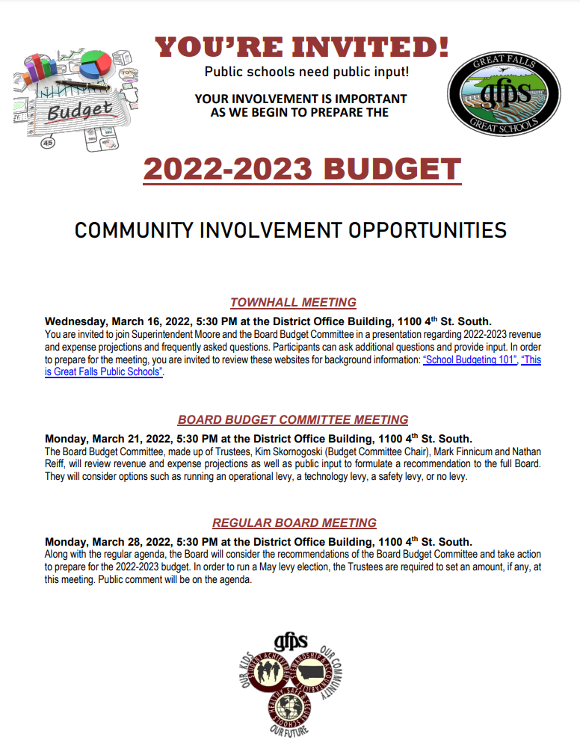
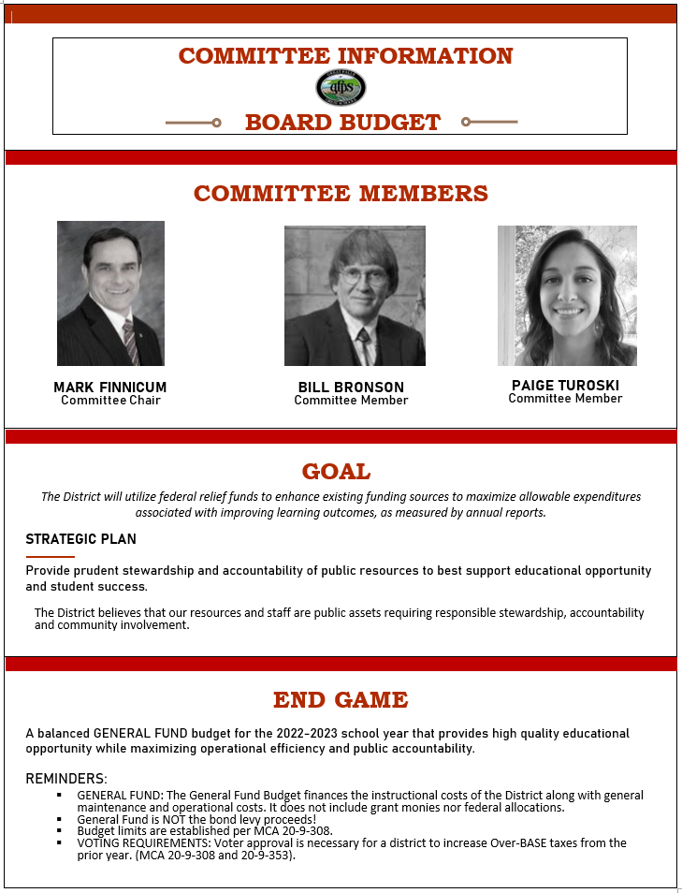

Slide 6
What & When
What budget information needs to be shared?
Public school – Public Money
When – does information become available?
  Two Count Dates
  Legislative Session
  Budgeted Funds – required to be adopted in August each year
  Permissive Levies before March 31st
  Mill levy option each May
All Funds

Slide 7

Rome wasn’t built in a day.

Slide 8
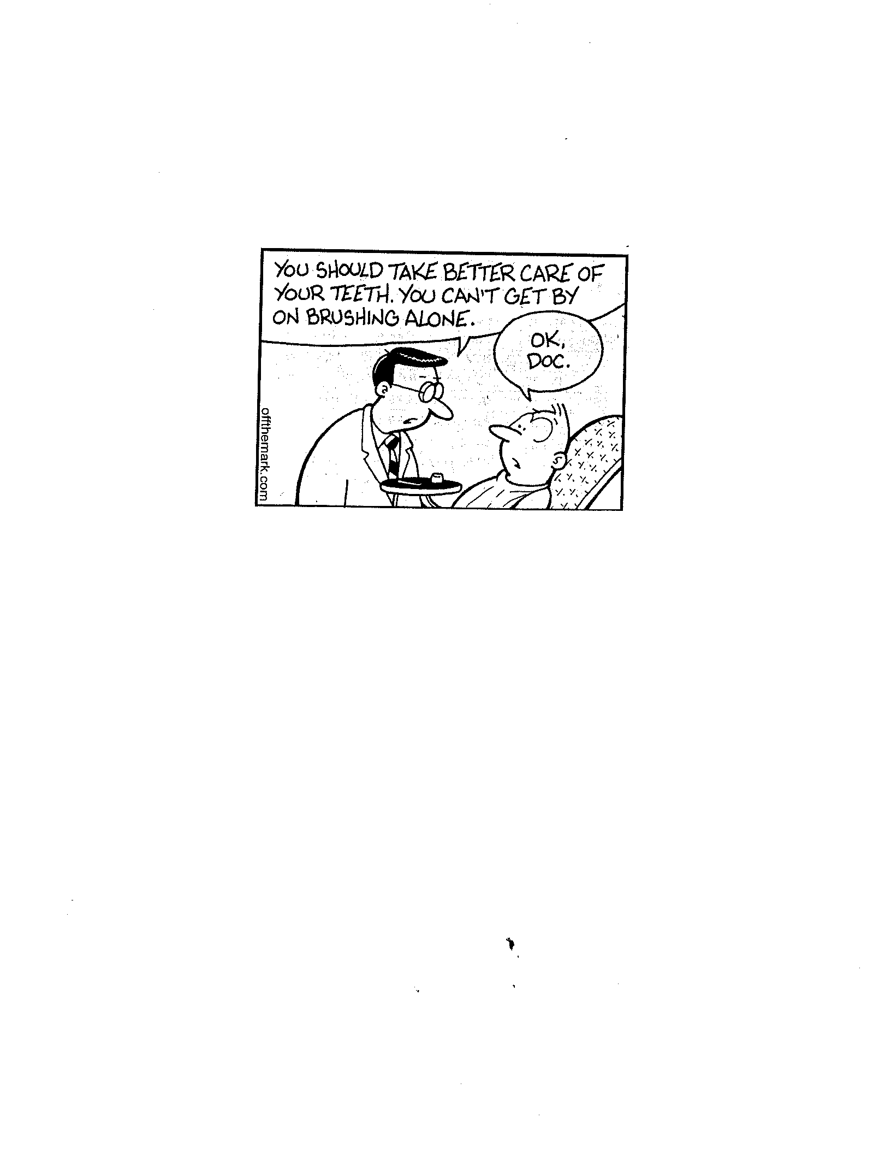
What we hear

Slide 9
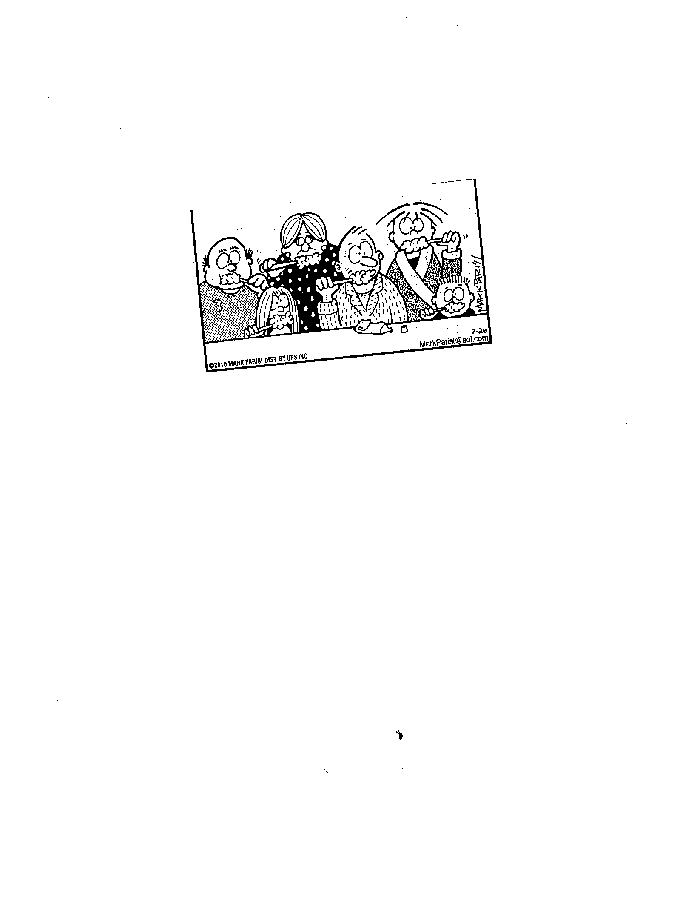
What we do

Slide 10
Goals and Thoughts
Goals
Thoughts . . .
Accurate information to board and community
Increased Accountability
Easy to read and interpret (charts/trends)
Goals (Strategic Plan) of the District tied to money
Individual Fund Budget Information
  Description
  Montana Law (reference)
  Legislative changes
History teacher – Superintendent - Clerk
My reference guide for the year
Reference additional information
Economize space
Trend information provides good perspective
Board adopts all budgeted funds – required by law

Slide 11
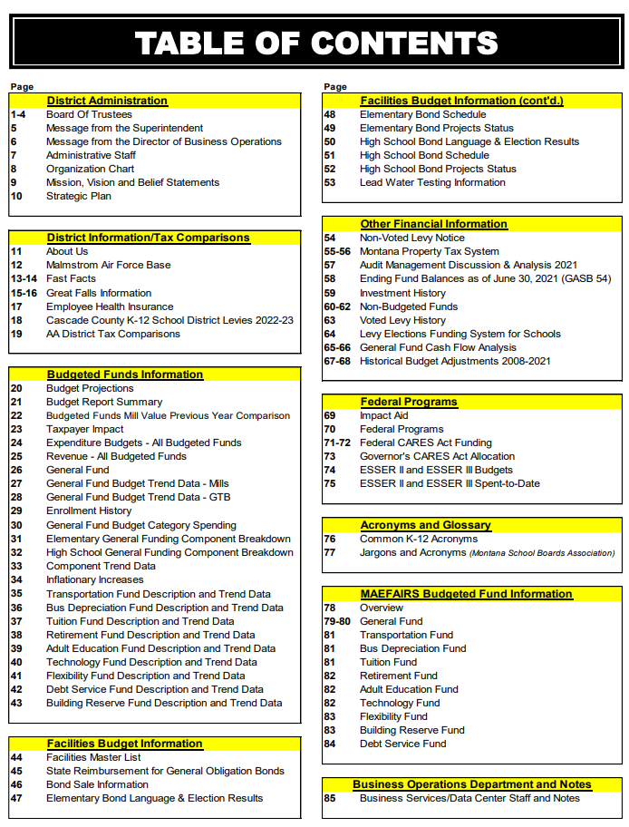
District Administration
Organizational Chart – Meeting Schedule
Strategic Plan
District Information/Tax Comparisons
Health Insurance
Budgeted Funds Information
Budget Descriptions – trend history
Facilities Budget Information
$98.8 million Bond 2016
Lead Water Testing
Other Financial Information
Non Voted Levy Notice
Non Budgeted Funds
Voted Levy History
Historical Budget Adjustments (Reductions)
Federal Programs
Title & ESSER
Impact Aid
Acronyms and Glossary
MAEFAIRS Budgeted Fund Information

Slide 12
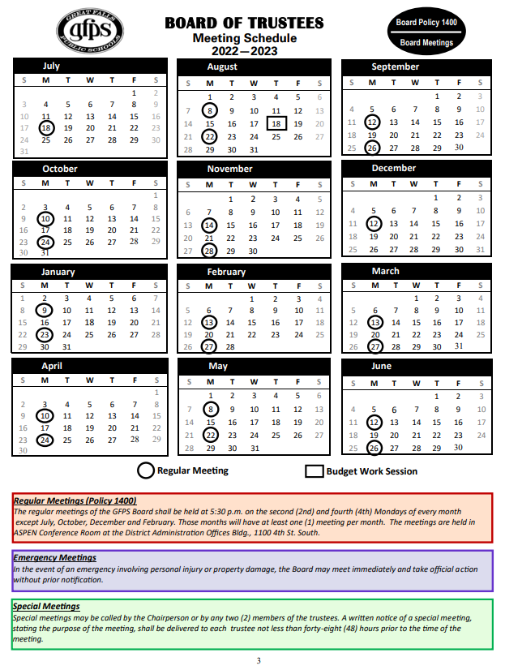
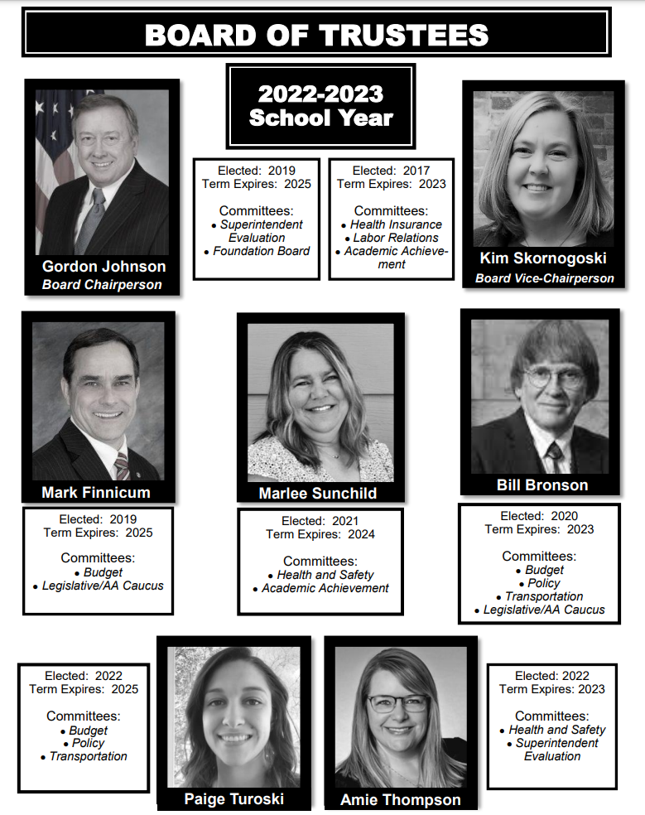

Slide 13
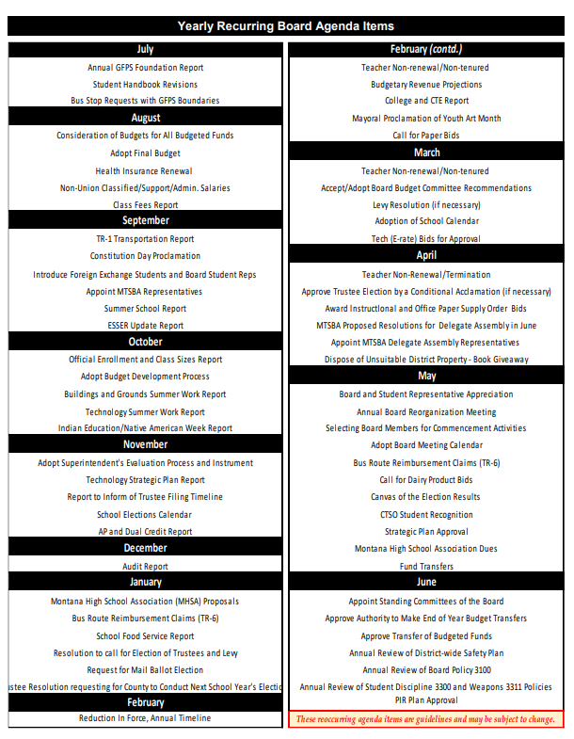
Yearly
Recurring Board Agenda Items

Slide 14
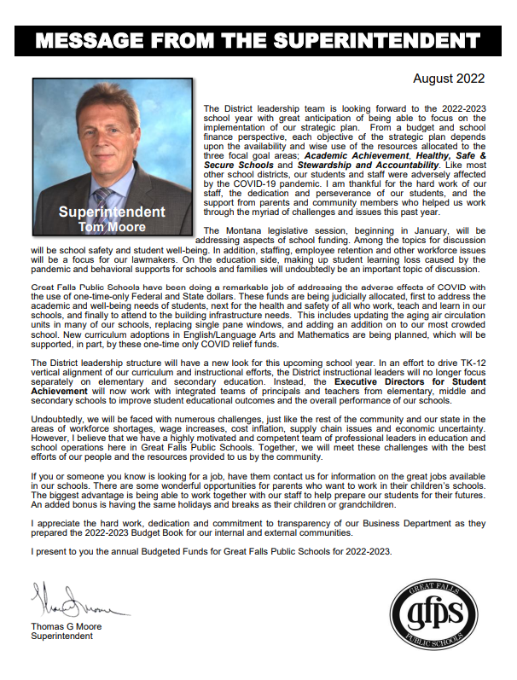
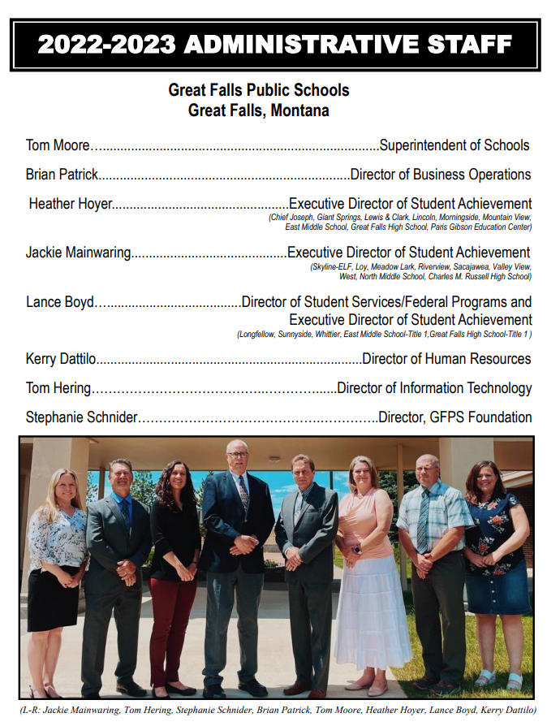

Slide 15

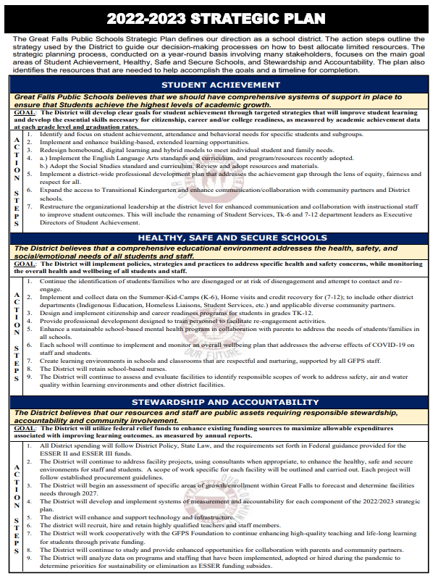

Slide 16
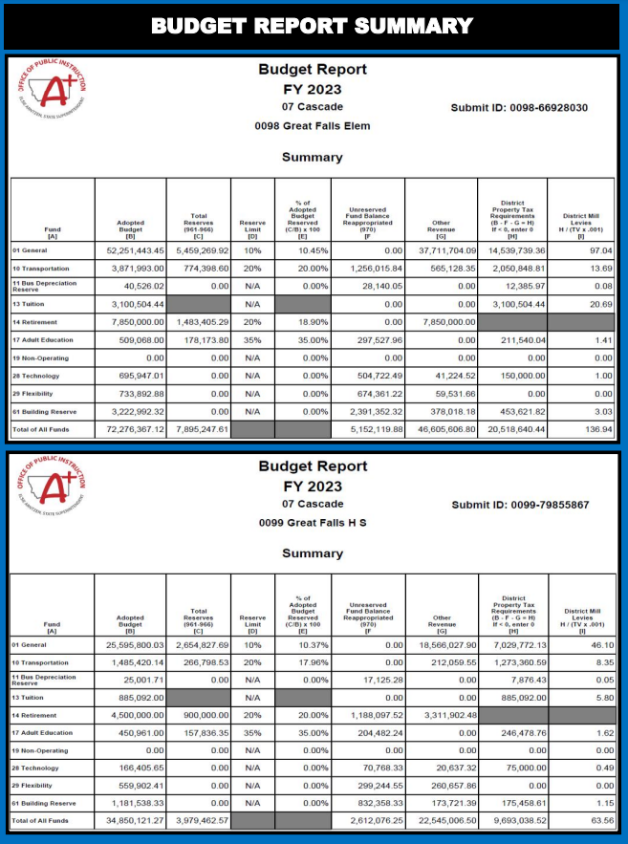
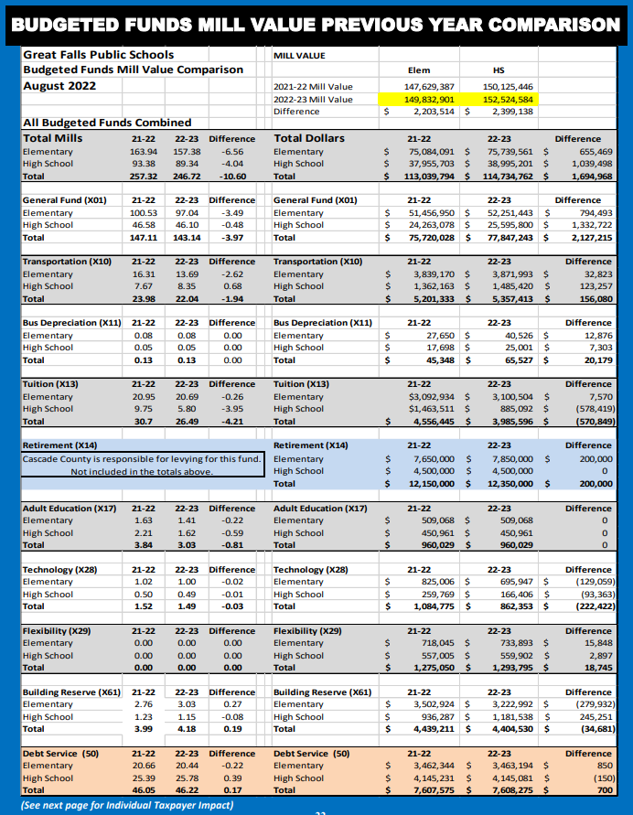
Mill Value
Total All Funds
General Fund
Transportation
Bus Depreciation
Tuition
Retirement
Adult Ed.
Technology
Flexibility
Building
Reserve
Debt Service

Slide 17
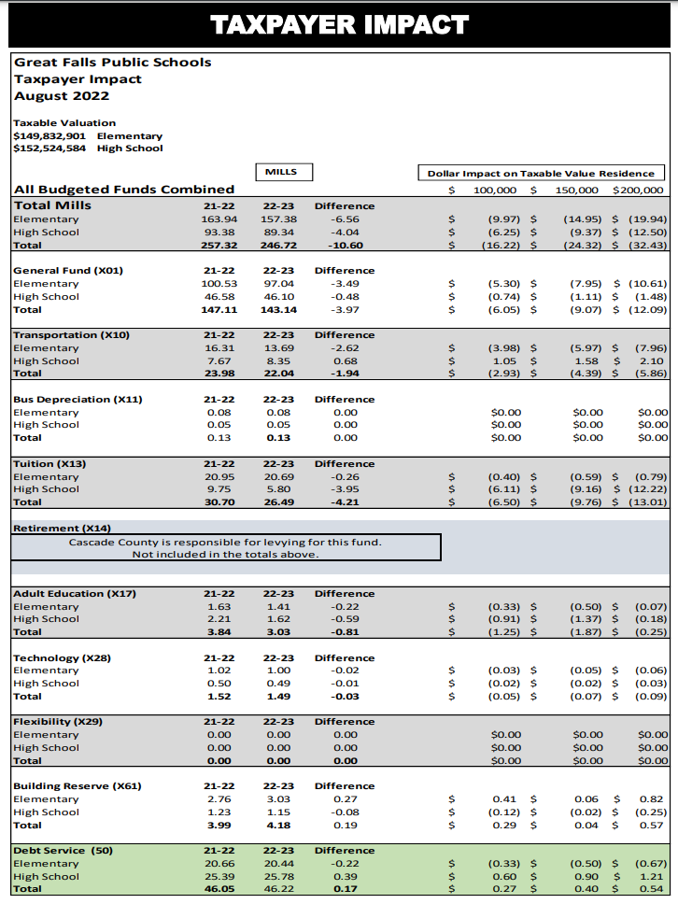

Slide 18
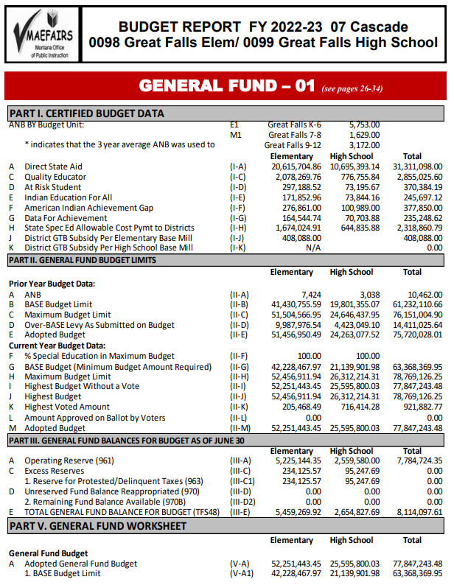

Slide 19
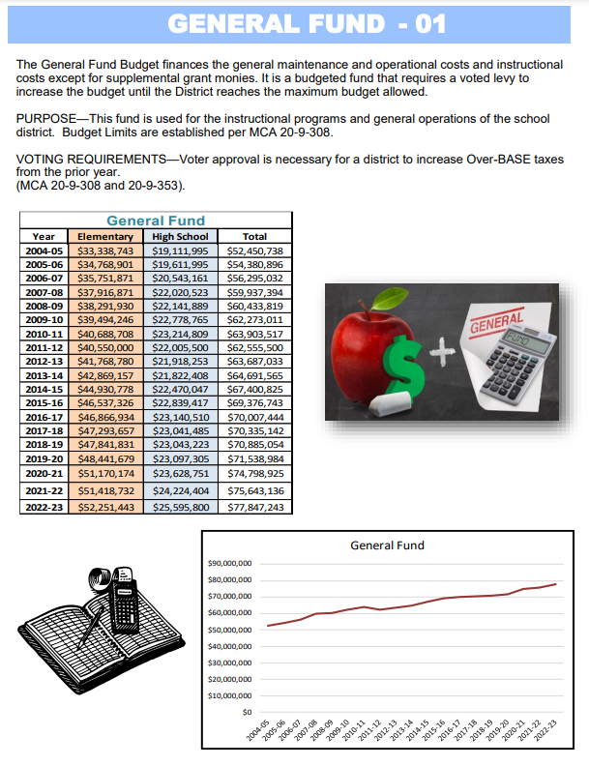
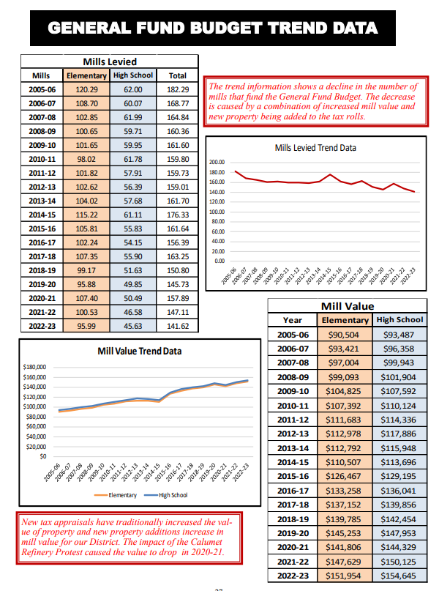

Slide 20
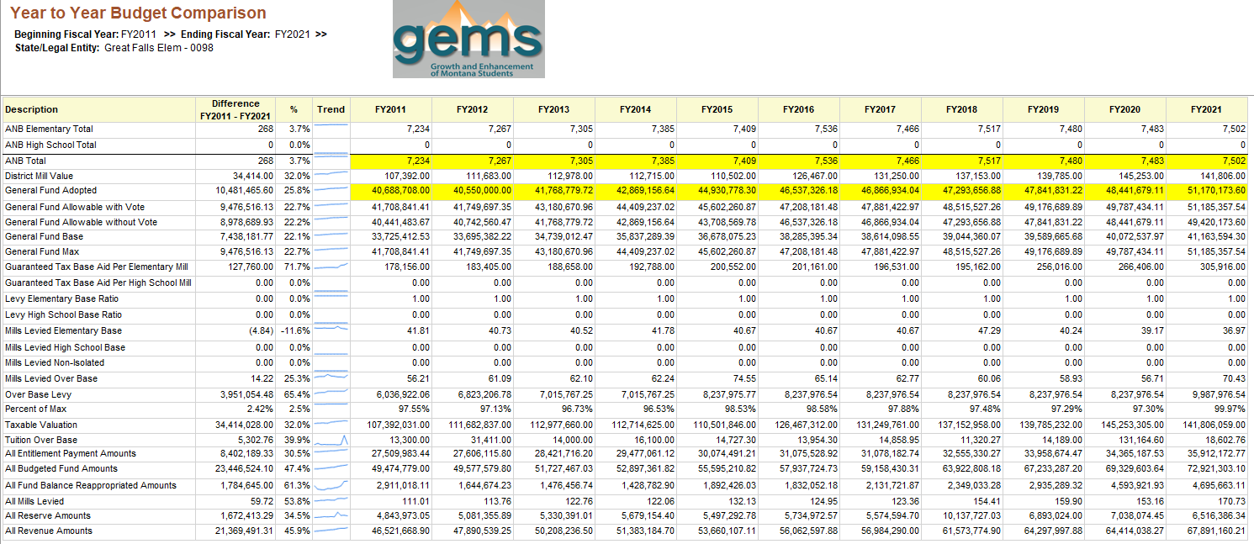

Slide 21
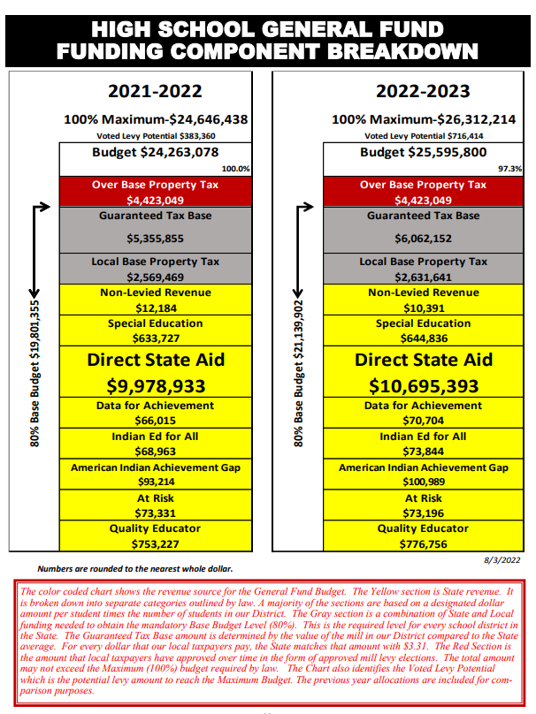

Yellow- State Funded
Gray – District & State Funded
Red- Local Taxpayers
Red text = Interpretation of
data presented.

Slide 22
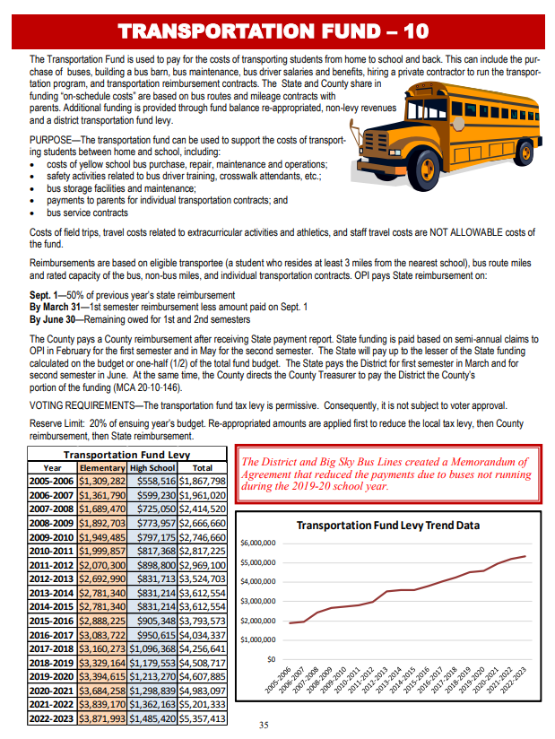

Slide 23
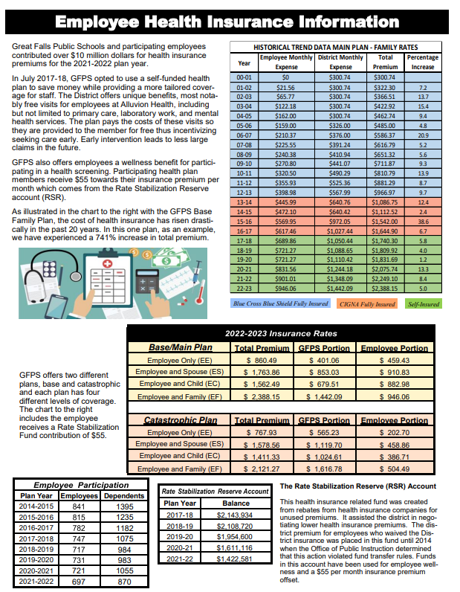

Slide 24
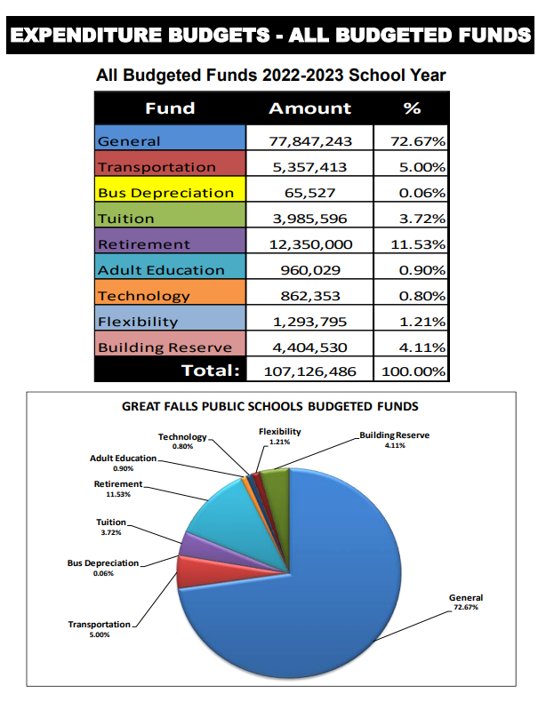

Slide 25
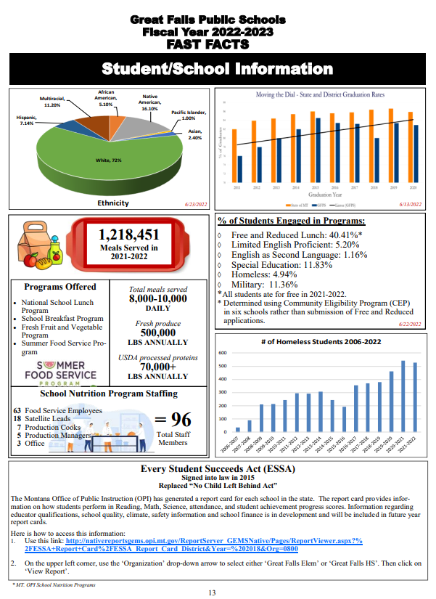
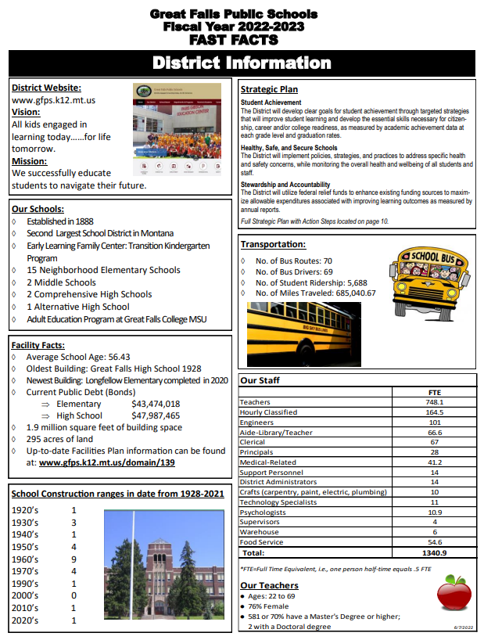

Slide 26

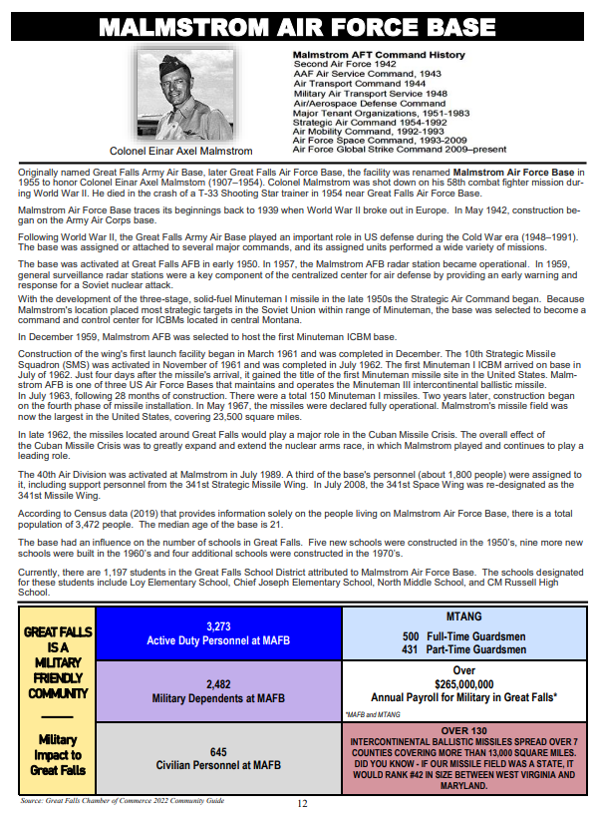

Slide 27
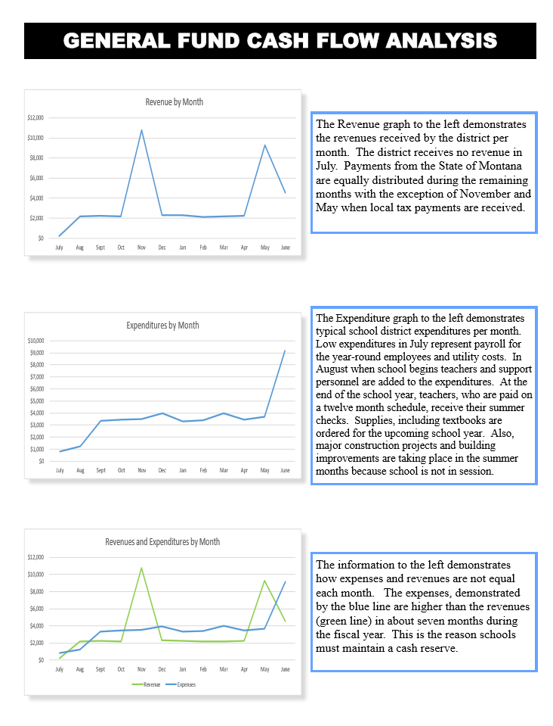
Why does the District need Reserves?

Slide 28
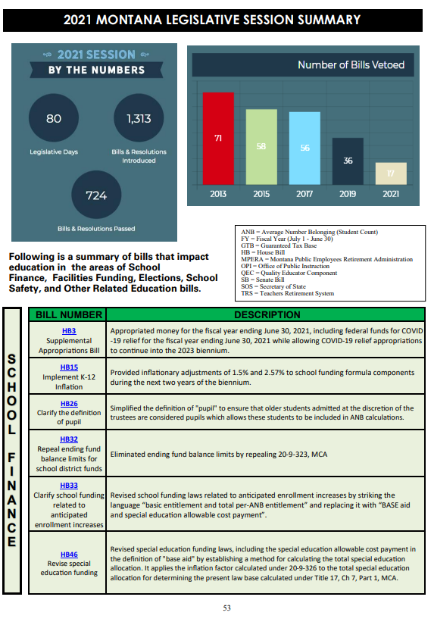
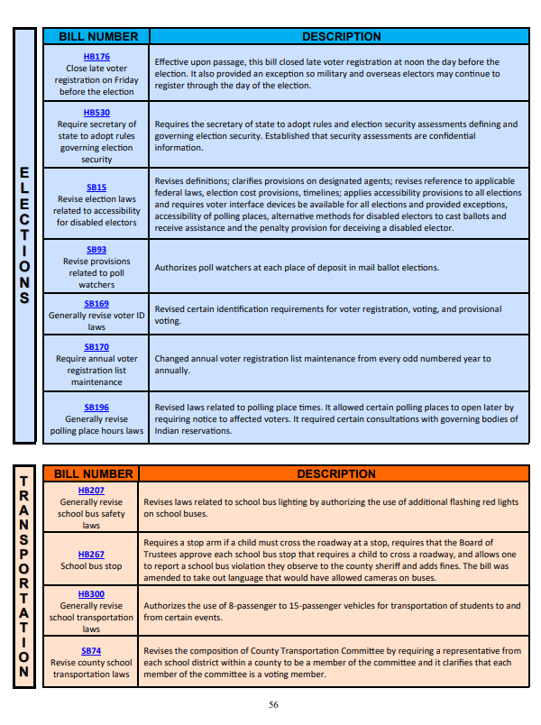

Slide 29
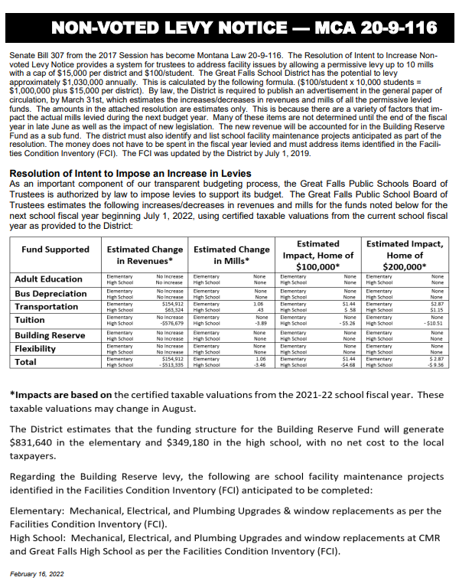
Senate Bill 307
Permissive Levies
March 31st Ad Date

Slide 30
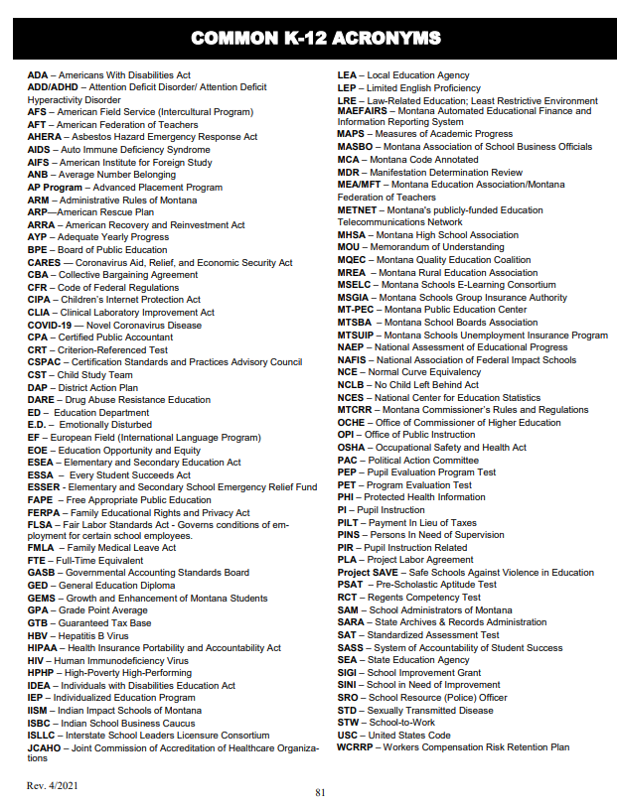
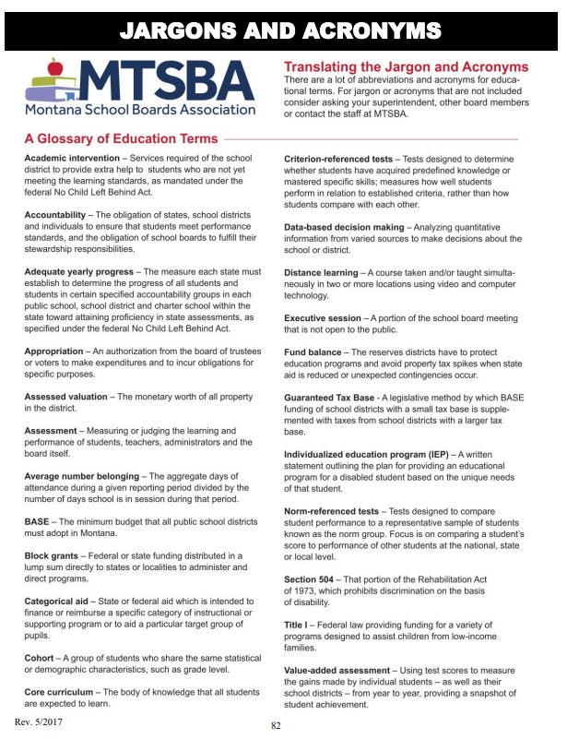

Slide 31
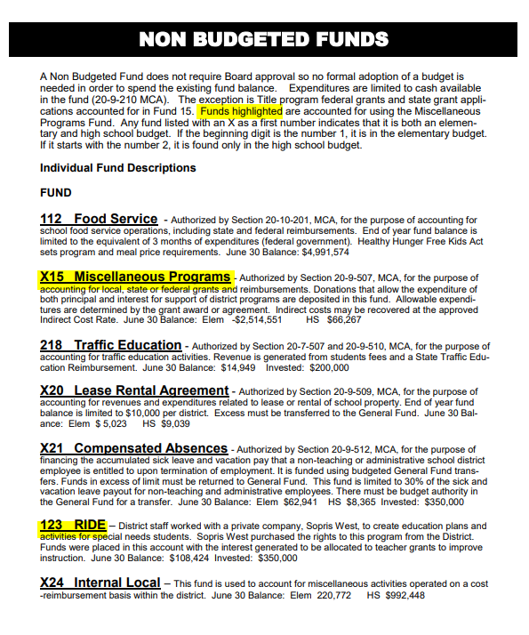
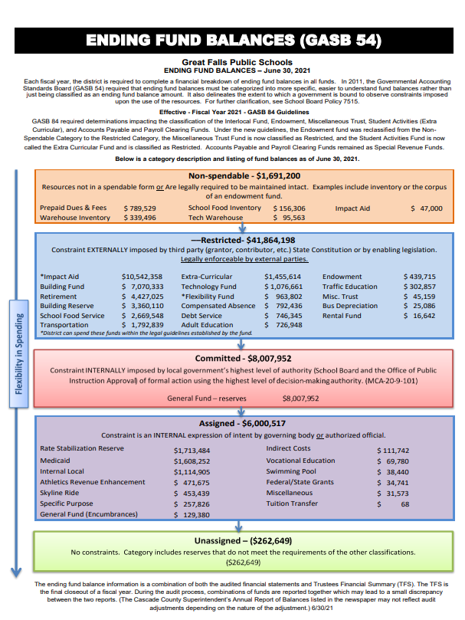

Slide 32
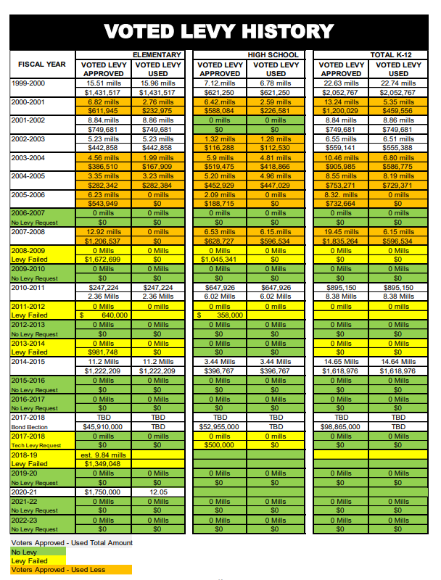
Green = No Levy
Yellow = Failed Levy
White = Approved Levy
Orange = Approved Levy – Did not use total amount
Approved Levies since 2010
2010-11 $895,150 (Elem & HS)
2014-15 $1,618,976 (Elem & HS)
2017-18 $98,865,000 (Bond)
2020-21 $1,750,000 (Elem)
No Levy Requested
2006-07
2009-10
2012-13
2015-16
2016-17
2019-20
2021-22
2022-23
Failed Levies
2011-12 $998,000 (Elem.)
2017-18 $500,000 (Tech Levy)
2018-19 $1,349,048 (Elem.)

Slide 33
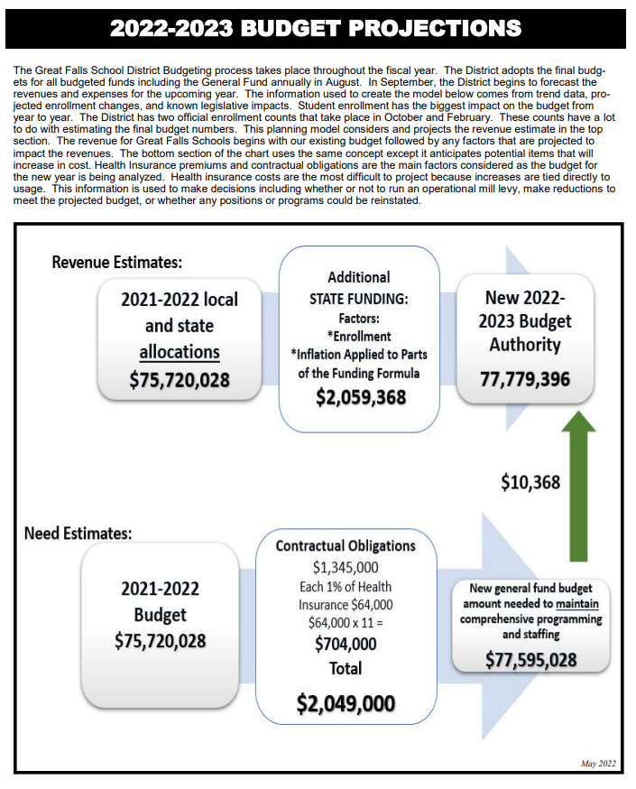

Slide 34
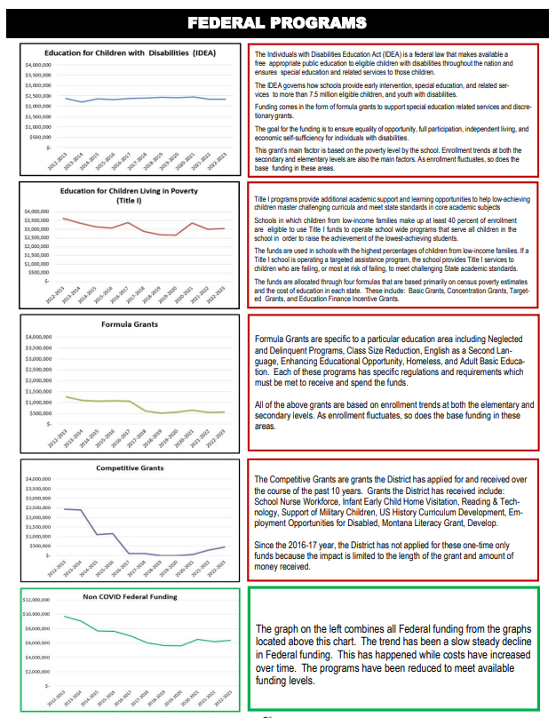
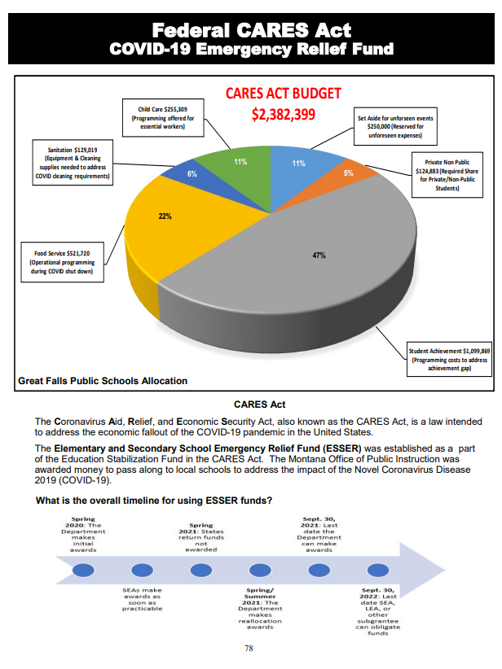

Slide 35
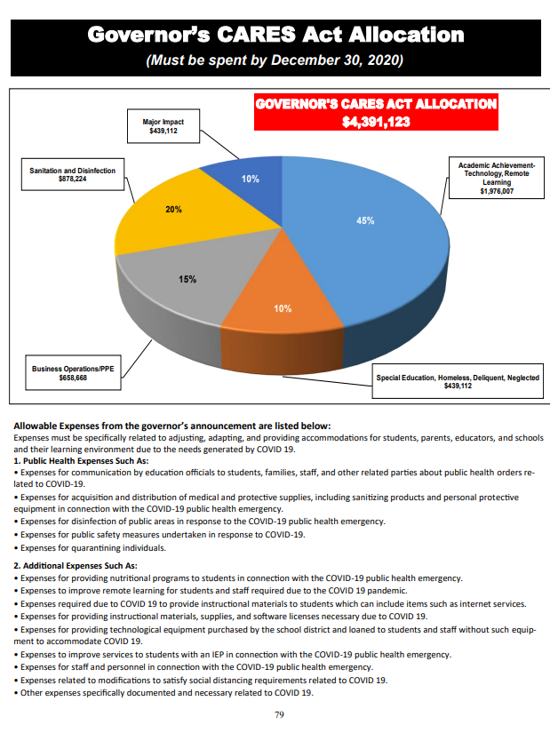
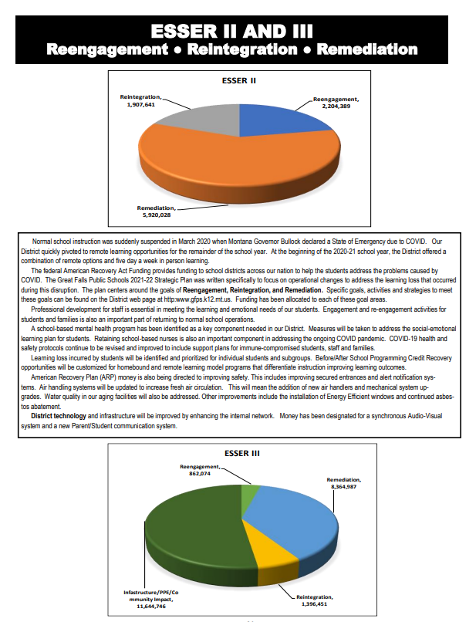

Slide 36
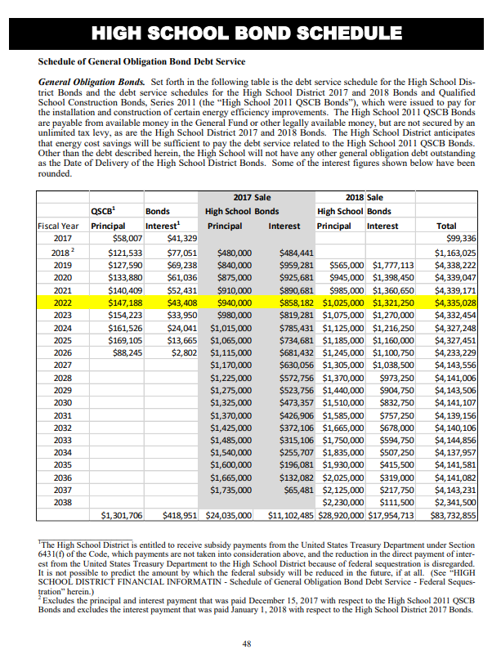
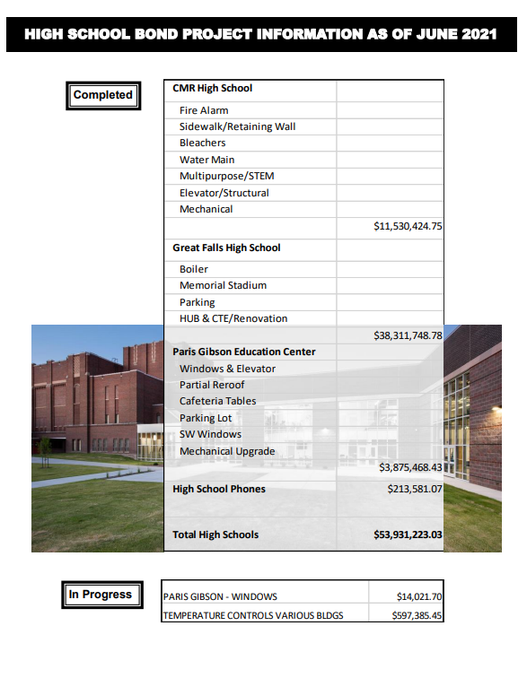

Slide 37
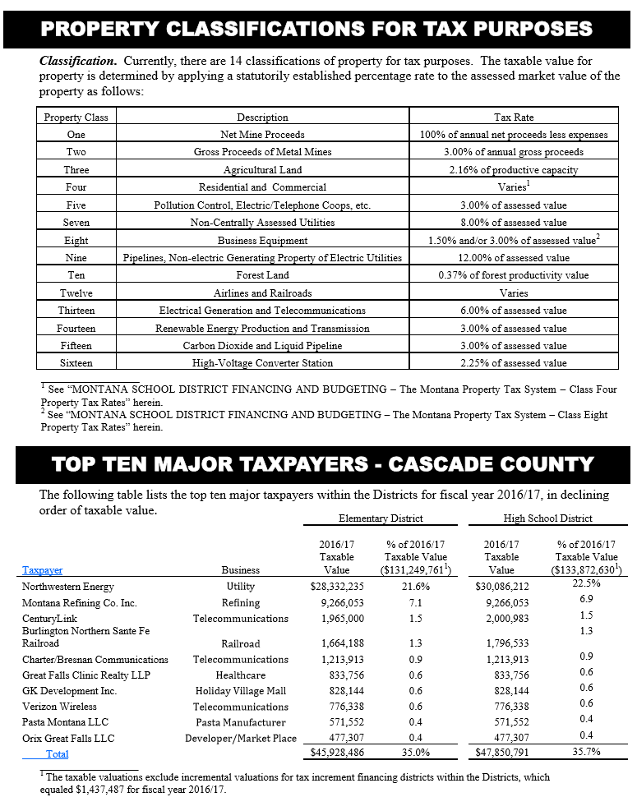

Slide 38
Where
Public Meetings
Web Page
Social Media
Community Groups
Board Inservice

Slide 39
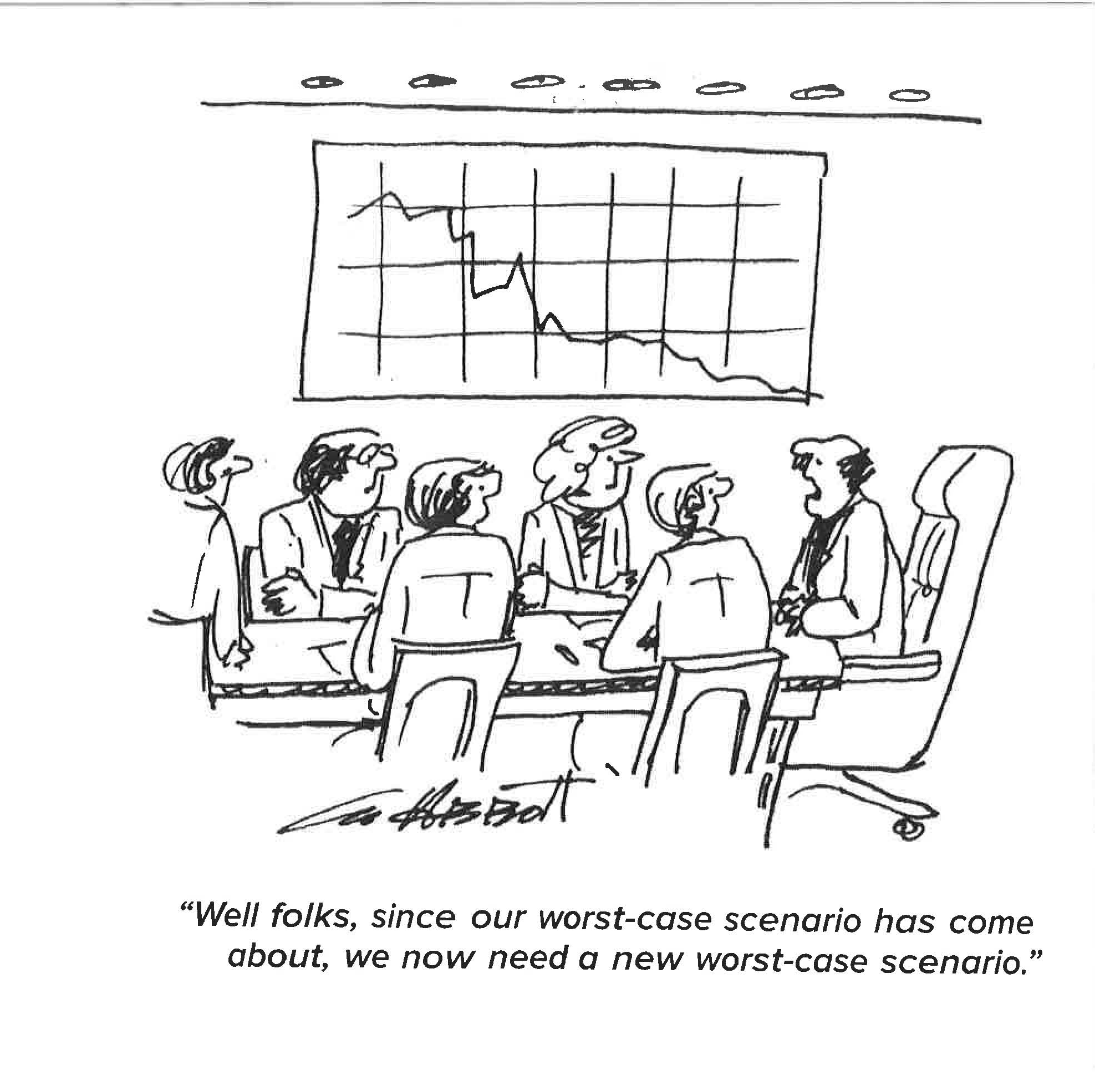

Slide 40
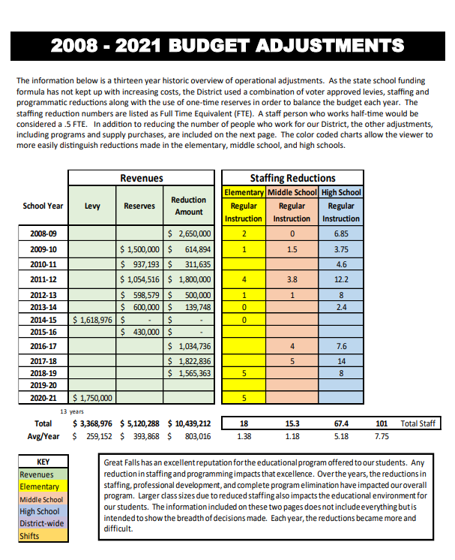
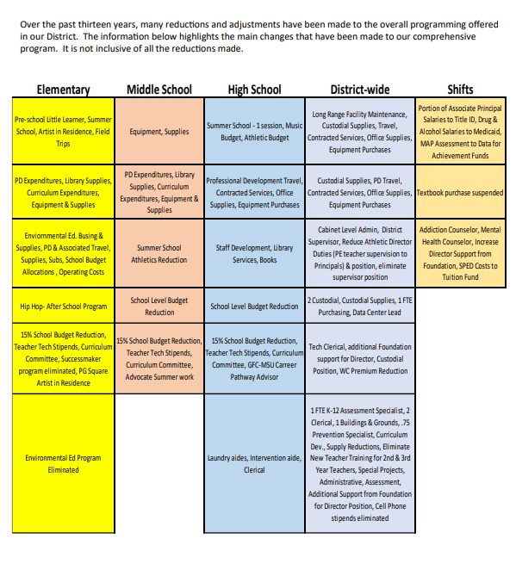

Slide 41
Questions??

Slide 42
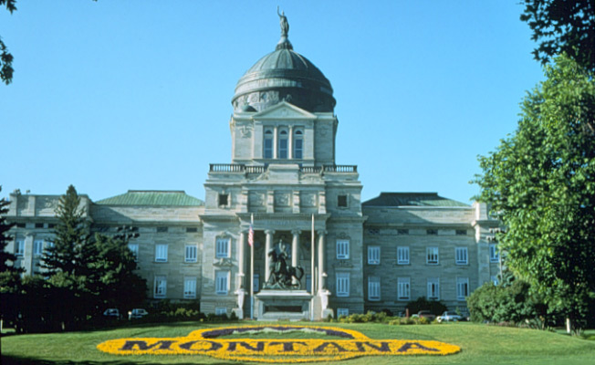
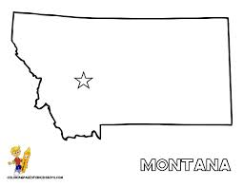



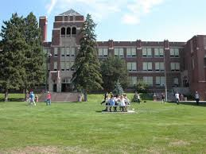
Notes:
School funding decisions are made every two years at the legislature in Helena. Over time, all of these items have had an influence on school funding. It is the legislatures job to ensure equalized funding for the biggest schools in the State to the smallest.

