Slide 1
Notes:
Poll Title: Do not modify the notes in this section to avoid tampering with the Poll Everywhere activity. More info at polleverywhere.com/support WELCOME! WHAT WOULD YOU LIKE TO LEARN TODAY https://www.polleverywhere.com/free_text_polls/N98ncYEXG21IEmcBaTO6x

Slide 2
Fiscal Flexibility
Montana Conference of Education Leadership 2022
Presented by Shelley Turner & Steve Hamel
Montana Association of School Business Officials (MASBO) with additional slide information provided by the Montana School Board Association (MTSBA)

Slide 3
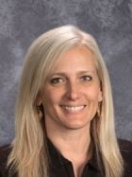
The Montana Association of School Business Officials Team
Shelley Turner
Executive Director
Sturner@masbo.com
(406) 461-3659
Steve Hamel
Interim Services & Training
Shamel@masbo.com
(406) 431-0124
Marie Roach
Association Coordinator
Mroach@masbo.com
(406) 461-8804

Slide 4
Fiscal Flexibilities
Setting Your District Up for Success
Teamwork & Discussions
Policies
Proficiency Based ANB
Transfers and Permissive Non Voted Levies
Transportation Fund Levies
Tuition Fund Options
Adult Education Possibilities
Flex Fund- Transformational Learning
Building Reserve- Safety, Security, & Major Maintenance
Multi District Agreements
Transfer of Levy Authority
Other Flexibilities

Slide 5
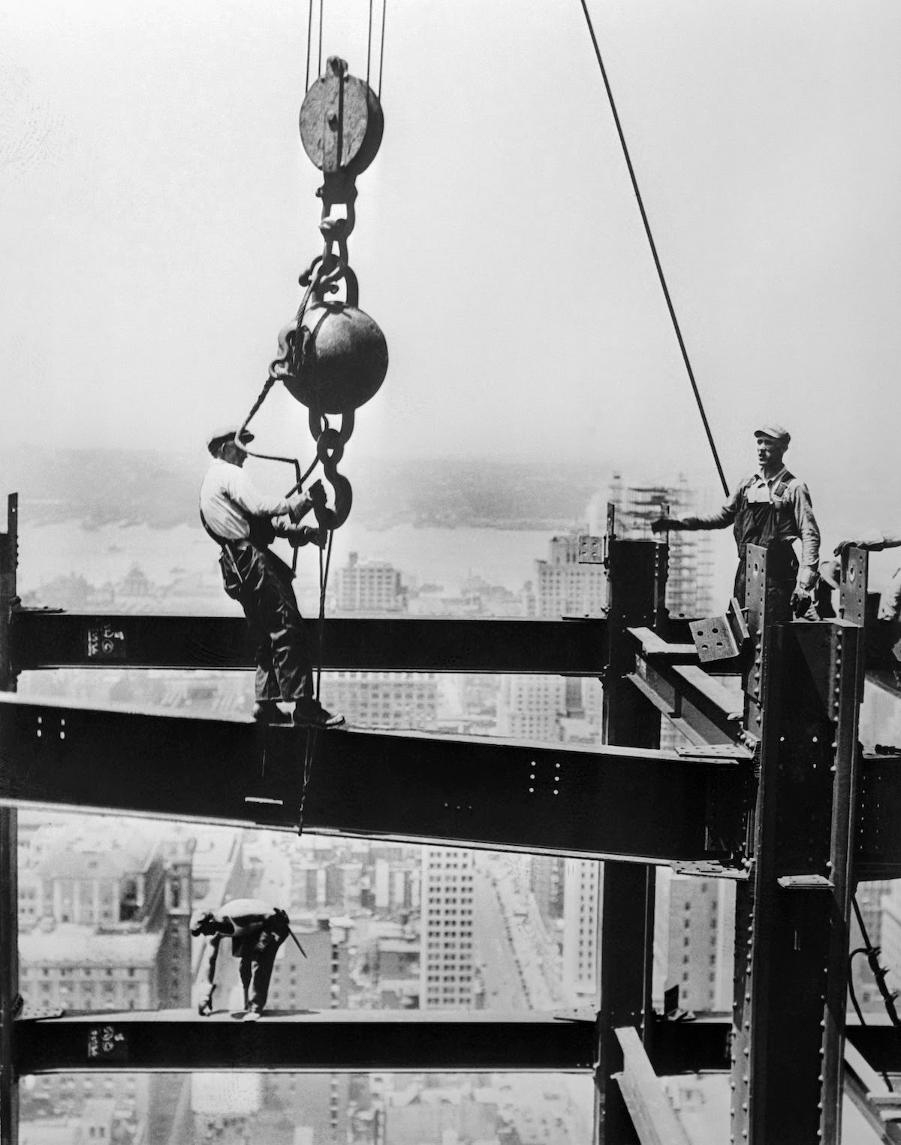
Ensure you have the proper framework
School Board, Administrator, & Stakeholder Discussions
Current challenges
Analysis of current practices
What is working well?
Inefficiencies, Redundancies, Missing the Mark
Staffing
Technology
Upcoming challenges to be faced
Where can we excel in our community?
Required commitment to evaluate on a regular basis

Slide 6
Commitment to Collaboration
As exceptions and caveats continue to develop in legislative decisions impacting school finances:
Regular meetings between administrative parties to evaluate current budgets as well as future budgets
Crosstrain staff to continue fiscal operations
Maintain easily accessible and understandable records for continuation of programs
Develop a password system to ease employment transitions
Consider implications of not using flexibilities and be able to communicate these decisions to the public
Do not lose site of your focus:
“To develop the full educational protentional of each individual.”

Slide 7
Notes:
Poll Title: Do not modify the notes in this section to avoid tampering with the Poll Everywhere activity. More info at polleverywhere.com/support YOUR DISTRICT HAS A SYSTEM IN PLACE IF KEY PERSONELLE NEED TO LEAVE IMMEDIATELY. https://www.polleverywhere.com/multiple_choice_polls/LYkKEXXjM032u65MeLSto?state=opened&flow=Default&onscreen=persist

Slide 8
Are the right policies in place?
Montana School Board Association
Facilitated Board work sessions and strategic planning
1000FE Flexibility and Efficiency Series:
Provide a framework for continued discussions- SMaC Plan
Proficiency Based ANB
School Safety Transfers
Multi District Agreements
Exceptional Circumstances Enrollment
Permissive IDEA levy
and more……

Slide 9
Proficiency Based ANB
Section 20-9-311(4)(d), MCA and ARM 10.20.102 – eliminates seat time restrictions for students who gain proficiency using district assessments.
ARM 10.55.906 – The Board of Public Education specifically allows a board of trustees to meet accreditation standards and grant credit without meeting the 8100 minute seat time requirements.
Model Definition of Proficiency:
“For purposes of this policy, the term “proficiency” means a degree of mastery of the underlying content for a course that is reflective of a final grade, in the professional opinion of the teacher of record, of not less than a “B”. The determination of proficiency by a teacher must not require seat time as a condition or other element of determining proficiency. The determination of proficiency for a pupil enrolled in a course shall be made not earlier than the deadline for submitting the final grade for the course. The determination of proficiency for a pupil not enrolled in a course shall be based on the pupil’s mastery of the underlying content of the course, demonstrated through completion of a final exam designed by the teacher of record for the applicable course with a minimum grade of a “B”.
MTSBA Model Policy 1005FE

Slide 10
Understanding General Fund Allowable Transfers
Compensated Absences, 20-9-512, MCA
Limited to 30% of compensated absences liability for administrative & classified staff
Transfers from General (01) allowed if within adopted budget
If fund is over the 30% limitation, funds must be transferred General (01)
Lease Rental Agreements, 20-9-509, MCA
If the ending cash balance of fund is greater than $10,000 (or $20,000 for K-12 district) must be transferred to General (01)

Slide 11
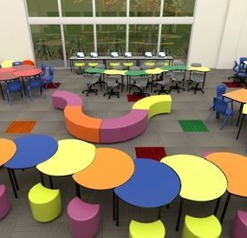
Understanding General Fund Allowable Transfers
Litigation Reserve, 20-9-515(2), MCA
Transfers from General (01) allowed if within adopted budget
Once settled, transfer remaining dollars to General (01) & used to reduce the BASE levy
Multi District Agreements, 20-3-363, MCA
Flexibility Transformational Learning Match, OPI link
Building Reserve, 20-9-502, MCA, 20-9-236, MCA

Slide 12
Permissive Non Voted Levies
Montana public schools are permitted to impose non-voted (permissive) levies to support school budgets in the above noted areas, as long as a notice of intent in published prior to March 31st each year.

Slide 13
Notice of Intent to Increase Non Voted Levies
20-9-116, MCA & 20-9-502, MCA
March 31st deadline
When in doubt, include it, even with zero anticipated change
Fund Supported | Estimated Change in Revenues* | Estimated Change in Mills* | Estimated Impact, Home of $100,000* | Estimated Impact, Home of $200,000*
Adult Education | $ increase/decrease | $ increase/decrease | $ increase/decrease | $ increase/decrease
Bus Depreciation | $ increase/decrease | $ increase/decrease | $ increase/decrease | $ increase/decrease
Transportation | $ increase/decrease | $ increase/decrease | $ increase/decrease | $ increase/decrease
Tuition | $ increase/decrease | $ increase/decrease | $ increase/decrease | $ increase/decrease
Building Reserve | $ increase/decrease | $ increase/decrease | $ increase/decrease | $ increase/decrease
Flexibility | $ increase/decrease | $ increase/decrease | $ increase/decrease | $ increase/decrease
Total | $ increase/decrease | $ increase/decrease | $ increase/decrease | $ increase/decrease

Slide 14
Transportation Fund (10)
Are you utilizing your non-voted permissive levy authority?
Costs of maintaining a bus system
Bus barn and other transportation facility maintenance
Salaries and Benefits
Superintendent
Business Manager &/or Assistant Staff
Transportation Manager
Crossing Guards
Bus Aides

Slide 15
Tuition Fund (13)
Non voted levy for excess IDEA costs under Section 20-5-324(5)(iii), MCA:
(iii) In addition to use of a tuition levy to pay tuition for out-of-district attendance of a resident pupil, a school district may also include in its tuition levy an amount necessary to pay for the full costs of providing a free appropriate public education, as defined in Section 20-7-401, MCA, the district to any child with a disability who lives in the district.
The amount of the levy imposed for the costs associated with educating each child with a disability must be limited to the actual cost of service under the child's individualized education program minus:
the student's state special education payment;
the student's federal special education payment;
the student's per-ANB amount;
the prorated portion of the district's basic entitlement for each qualifying student; and
the prorated portion of the district's general fund payments in 20-9-327 through 20-9-330 for each qualifying student.
OPI In District Permissive Levy Calculator
Provide these calculations for your audit.

Slide 16
Notes:
Poll Title: Do not modify the notes in this section to avoid tampering with the Poll Everywhere activity. More info at polleverywhere.com/support TRUE OR FALSE? THE TUITION FUND PERMISSIVE LEVY CAN ONY BE LEVIED AFTER COSTS HAVE BEEN ACCRUED. https://www.polleverywhere.com/multiple_choice_polls/pYTIvtLIk9UQ4ktniRT6n?state=opened&flow=Default&onscreen=persist

Slide 17
Adult Education (17)
Instruction of persons 16 or older who are not regularly enrolled, full-time pupils (salaries/supplies) or Advanced Opportunity Program expenditures.
The Board of Trustees authorizes the establishment of an adult education program. The course offerings in such program may include but shall not necessarily be limited to instruction in basic skills, such as reading, writing, arithmetic, and other skills required to function in society, and/or any subject normally offered in the basic high school curricula of the school district.
Advanced Opportunity Program- any qualifying pupil (enrolled in grades 6-12)
At least 60% of funds used to address student/family out-of-pocket costs for dual credit tuition
exam fees (AP, ACT, SAT, CLEP, etc.
fees for work-based learning or for obtaining any
industry-recognized credential/license
remaining funds for any K-12 CTE courses

Slide 18
Innovative Uses of Adult Education
Bozeman Public Schools- Parent Instruction on early learning literacy. Focused on providing parents resources and skills to introduce literacy for students prior to entering Kindergarten.
Other Adult Education Ideas
Technology Literacy and Safety
Budgeting and other Financial Life Skills
Nutritional Life Skills
Language Studies
Study Skills to Support Education
Retraining communities faced with economic hardship

Slide 19
Flexibility Fund (29)
Transformational Learning Aid Program & Advanced Opportunity Act program
Fund balance limit is 150% of the Max General Fund budget.
Excess remitted to the state.
Transformational Learning- application through OPI
50% of prior year quality ed payment X FTE quality educators assigned to program
Permissive levy to match
May transfer state/local revenues from any fund (except Debt Service or Retirement) to support, transfers not held against budget authority
Advanced Opportunity Act- application through OPI
Board of Publication approved plan
OPI pays “advanced opportunity aid”
District can match up to 25% of Advanced Opportunity Aid using Adult Education
Fund non-voted levy (see Adult Education Fund (17)

Slide 20
Building Reserve Fund (61)
611- School Safety & Security Sub Fund- transfers from other funds (not debt service or retirement) Any transfers not spent/encumbered within 2 fiscal years must be transferred back to the originating fund. District may impose a voted levy (up to perpetual) for improvements to school and student safety and security. 20-9-236, MCA
Must have a current plan pursuant to 20-1-401, MCA
school safety plan or emergency operations plan-Must certify your plan to OPI
Any fund other than Debt Service or Retirement Fund, doesn’t county against budget authority.
Planning for improvements to and maintenance of school and student safety
Staffing for school resource officers, counselors
Hiring architects, engineers, consultants
Programs: active shooter training, threat assessments, restorative justice
Updating locking mechanisms at access points
Bullet-resistant windows/barriers
Emergency response systems

Slide 21
Building Reserve Fund (61)
613- Permissive Sub Fund- permissive levy of no more than 10 mills (20 mills for K-12 districts) for the purposes of raising revenue for identified school major maintenance. 20-9-502, MCA
School Major Maintenance Amount (SMMA)
Max annual contribution amount from ALL sources
(budget limit ANB x $110) + $15,000
ANB | Max Annual Contribution
100 | $ 26,000 (100 x $110) + $15,000*)
500 | $ 70,000 (500 x $110) + $15,000*)
1000 | $125,000 (1000 x $110) + $15,000*)
*$30,000 for a K-12 district

Slide 22
Multi District Agreements (82)
20-3-363, MCA
Two or more school districts or coterminous high school and elementary districts, may create a multidistrict cooperative to
Perform any services, activities and undertakings, and
Provide for joint funding and operation and maintenance of all participating districts
Terms and conditions of agreement
Must be approved by trustees of all participating districts
Must include how a district may enter or exit
May be for a period up to 3 years
Designate the prime agency- Prime agency establishes Interlocal Cooperative Fund (82)
OPI Multidistrict Agreement FAQ’s

Slide 23
Multi District Agreements (82)
Transfers allowed from
General Fund (01) up to the amount supported by Direct State Aid (DSA)
Budgeted funds, except Retirement (14) and Debt Service (50)
Non-budgeted funds, except Compensated Absences (21), and as limited by federal law for federal funds
Transfers from budgeted funds count against adopted budget
Transfer of funds raised by non-voted levy can’t be restored in the originating fund in the next year

Slide 24
Notes:
Poll Title: Do not modify the notes in this section to avoid tampering with the Poll Everywhere activity. More info at polleverywhere.com/support I WANT TO TRANSFER MONEY TO A MULTI DISTRICT AGREEMENT. I CAN USE THE FOLLOWING: https://www.polleverywhere.com/multiple_choice_polls/IH4nWPXk1D7B1xwFUOy8s?state=opened&flow=Default&onscreen=persist

Slide 25
Other Transfer Constraints
Do not transfer federal funds unless the grant specifically identifies the ability to do so
Always discuss and obtain Board Approval for best practices
Impact Aid (26) – up to 25% of annual allocation can be transferred to Debt Service (50) for bond repayment 20-9-437 (2), MCA
Monies approved by the voters or raised by a non-voted permissive levy
Transfer must be within or directly related to the purpose for which the funds were raised
Trustees must hold hearing to accept public comment
Transfer must be approved by voters for the purpose approved on the ballot
Transfer of funds raised by non-voted (permissive) levy can’t be restored in the originating fund in the next year

Slide 26
Transfer of Levy Authority
Section 20-9-308, MCA. MTSBA Model Policy 1008FE
Increases in over-base levy authority without a vote through decreases in other non-voted levies
Provided that budget limitations otherwise specified in law are not exceeded, the Board of Trustees may in its discretion increase the District's over-base budget levy without a vote if the Board reduces non-voted property tax levies authorized by law to be imposed by action of the Board by at least as much as the amount by which the over-BASE budget levy is increased. The ongoing authority for any non-voted increase in the over-BASE budget levy imposed must be decreased in future years to the extent the Board imposes any increase in other non-voted property tax levies.

Slide 27
Other Funding Flexibilities
Early enrollment under exceptional circumstances
Schools are obligated to provide FAPE to IDEA qualified children ages 3-5
Not pre-school, pursuant to Section 20-7-117(2), MCA, which prohibits the use of state equalization aid for preschool. MTSBA Model Policy 1010FE/3100 is intended for use to enroll students under the age of 5 when statutory criteria are met.
Option A, Student-Specific Exceptional Circumstances: To be used when the board of trustees wants to define exceptional circumstances specific to the individual characteristics of each student or sub-group of students.
Option B, Exceptional Circumstances Present in the Community: To be used only for in-district students or homeless students under the McKinney Homeless Assistance Act when the board of trustees wants to define exceptional circumstances applicable to the community’s characteristics, as opposed to the individual characteristics of a particular student or sub-group of students.
*Information Provided by MTSBA

Slide 28
Other Funding Flexibilities
ESSER Funding- OPI Link
Prepare for, Prevent, and Respond to the effects of Covid-19 including circumstances exacerbated by Covid: Create a reasonable narrative
Examples:
School security
Improving drinking water including lead remediation
Servicing or upgrading HVAC systems
Technology
Repairing windows and/or doors so they can open to let fresh air in
Outdoor learning areas- fencing & playground equipment
Professional Development
Curriculum, text books/online, remote learning
Field trips

Slide 29
Other Funding Flexibilities
Cooperative Purchasing- MTSBA Model Policy 1011FE
For supplies or services
Meets bidding requirements if cooperative
has a publicly available master list of items and pricing available
provides opportunity at least twice yearly for any vendor to compete, based on a lowest responsible bidder standard.
MREA Montana Cooperative Services

Slide 30
Questions

Slide 31
For More Information
MASBO
Shelley Turner, Director
406-461-3659
Sturner@Masbo.com
Steve Hamel, Interim Services
406-431-0124
Shamel@Masbo.com
Mike Waterman, MCSBO Bozeman Public Schools
406-522-6097
Mike.waterman@bsd7.org
MTSBA
OPI

