Slide 1
ESSER - October Funding Update – Navigation Tips Prepare, Prevent, and Respond
October 21, 2022

Slide 2
PRESENTERS & System of Support
Notes:
Are there any questions from this presentation?

Slide 3
Resources for Future Assistance
OPI Website just updated ESSER Tab on right
District Plans
District allocation and Balances
ESSER Compass combined
ESSER FAQ Dept of Education
Guidance webinars and pdf
Lost Instructional Time guide
Amendments & Cash Requests
MASBO
Calendar
Member Directory
Professional Development
Certification
Services
Publications
Resources
Presentations
Elections
Legislative
Software Users
Discussion Forum

Slide 4
Goals For This Session
Overview of Funds
Allocation
Compliance (plans, reports, allowable/reasonable use)
Tips
Processing – Amendments, Cash Requests,..
Tips

Slide 5
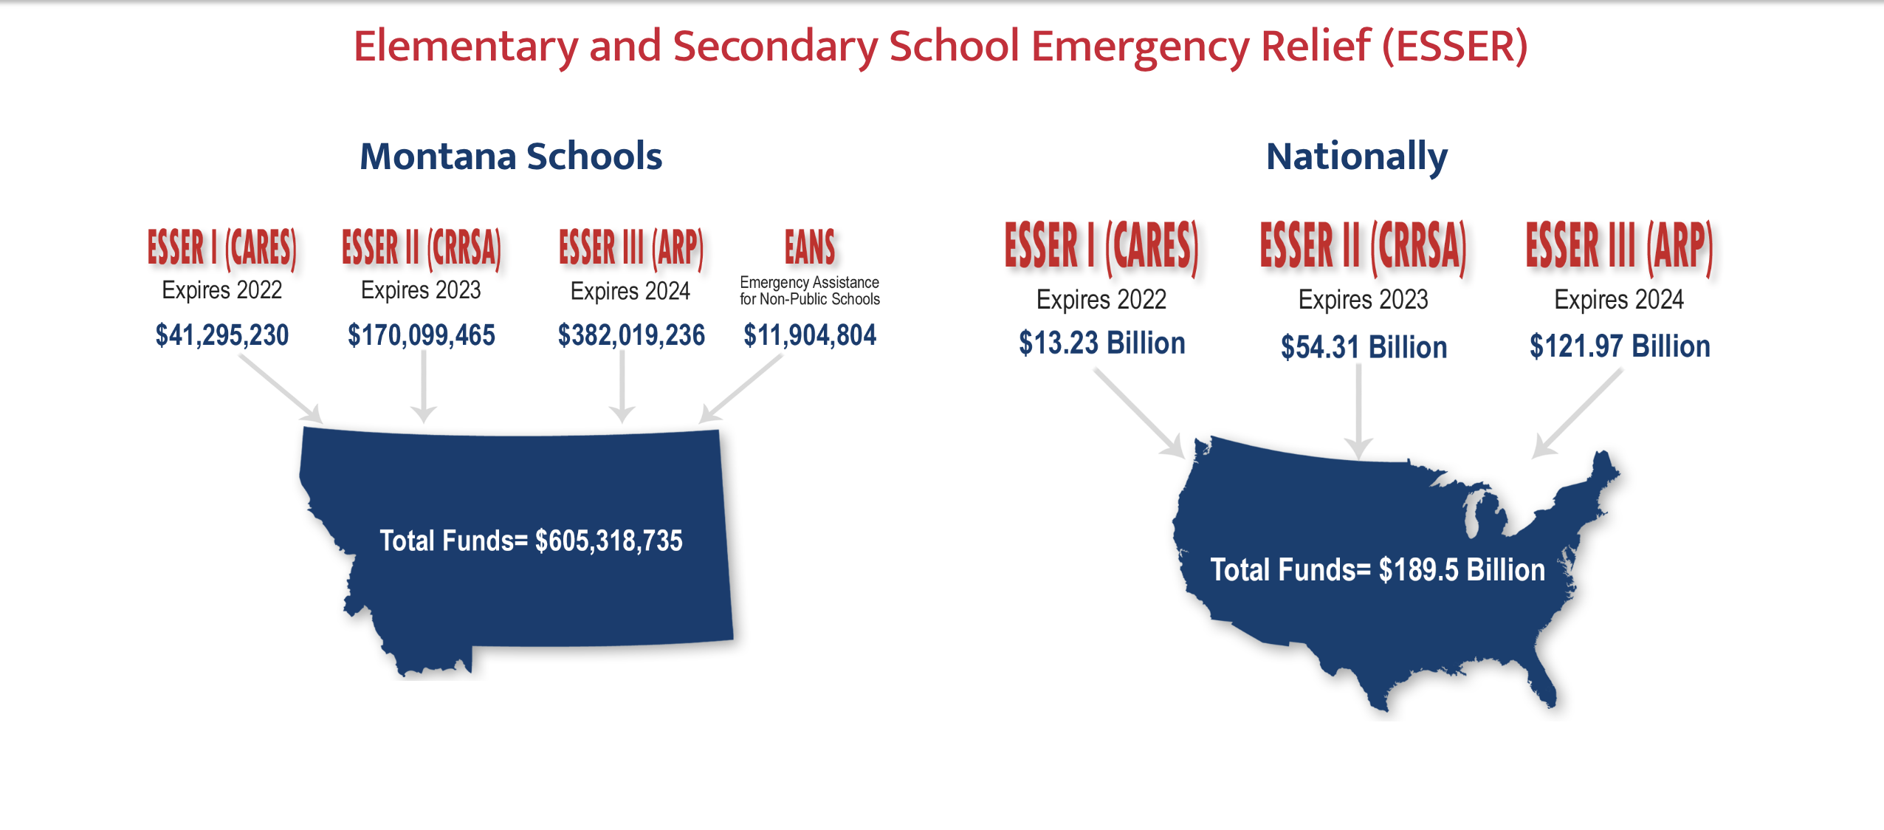
Grant Cycle - high level summary
DOE administers money > States per
Title I type school formula
State distributes funds to districts
Districts develop a plan for use of funds and begin to spend funds
Districts continue to spend, track…
ESSER I, II and III
CARES, CRRSA, and ARP… CSIP
After/Summer, Homeless, … ESSER funds
Safe Return Plans
ARP ESSER Plans
Data Collection Portals
Amendments, Cash Requests

Slide 6
Significance of Funding Formula Title I and ESSER Connection
Title I and ESSER allocations and use are very similar
Funds awarded based on Title I guidelines/proportions
CSIP report temporarily replaced with ESSER Plan
Student count matters
Similar use of funds – braid not blend
HB630 funds to help offset enrollment changes
school district BASE, supplemental, special needs, school district targeted and supplemental targeted
HB632 funds to target learning loss/lost instructional time
Several funding ‘buckets’ – think checking accounts

Slide 7
Compliance: spending, planning, …
Spend funds under Prepare, Prevent, Respond – Student Gain
Track funds to enable annual reporting and data collection
Review spending against allocated and balances
Update ARP Plans – Amendments anchored PPR and Student Gain
Safe Return and ARP ESSER (and 2022/23 CSIP plans)
Review/update twice a year (recommended May and November)
Meaningful Consultation - Engage community, public, stakeholders in Plan

Slide 8
Compliance (continued): Reporting, …repeat
Pivot to embrace online, innovative, and learning environments
Schools focused on attendance campaigns
Programming focused intentionally on:
Intensive academic intervention (math & reading)
Health targeted efforts to address the whole student wellness
Recruitment and retention to retain valued education workforce
Track expenditures in excel/sheets – braid not blend
Clearly identify student gains/outcomes
Review expenditures at least quarterly
Engage the public
Promote and share out to build support
1st Annual
^{2nd} Annual
3rd Annual

Slide 9
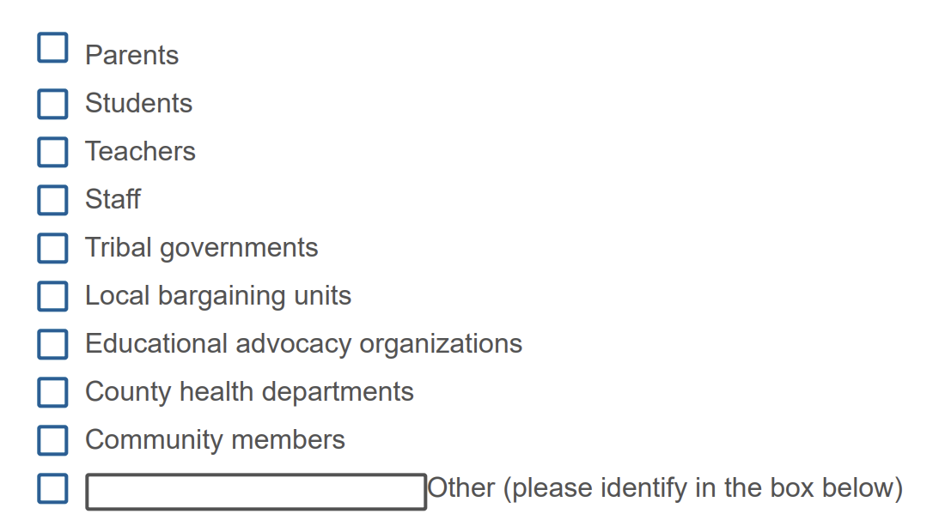
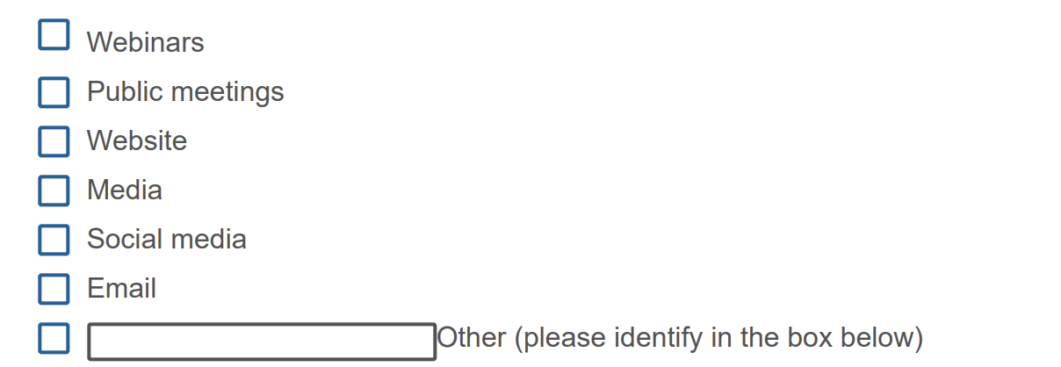
Tip – Meaningful Consultation
Guidance document for Plans
Template
FAQ (page 14, 17…)
Meaningful Consultation
Apollo 13 square peg round hole

Slide 10
Tips – Engage Community (continued)
Engage the public
Promote and share out to build support
Why are teachers all not being paid more? | We use a salary scale based on degree attained which does not take into account experience. That leaves fewer dollars for schools with junior teachers. We’re eager to engage with our teachers/community about options that might work better for teachers and students.
There is a lot being spent on _______. Why? | Looking at the district’s expenses reveals some noteworthy patterns. We’re eager to engage with our community to explore how to best deploy our limited funds to do the most for all the district’s students.
If the school is so small, why is it so expensive per student? | The district does deploy more dollars to its smaller (or under-enrolled) schools, leaving fewer dollars for all other schools. Given the limited resources, it may be time to explore how we can construct a budget that better serves all our students where they are. The district applied for and received 3 grants to pilot programing efforts in math, reading, and music. The district believed piloting these programs at one school first would provide valuable insight necessary for considering broader implementation. Given the outcomes of these pilots, we are eager to engage with our community to explore further roll out gains and funding sources.

Slide 11
Tip - Focus on Student Gains – Outcomes
Department of Education– Federal Grant
ESSER, costs must be reasonable and necessary to meet the overall purpose of the program, which is “to prevent, prepare for, and respond to” COVID-19 including those circumstances that were exacerbated by Covid. (See 2 CFR §§ 200.403-200.404.)
Tracking and reporting - outcome of funds
National, State, Districts, Public, etc.
Comprehensive Center Network – Edunomics Lab
School Budgets/Expenditure Data – OPI
ESSA & Per-Pupil Expenditures - OPI

Slide 12
Allowable and Reasonable
Examples of allowable = Student Gains:
Allowable under what circumstances:
Outdoor learning space with presentation tent
Field trips
Lap tops
Provide workshops for 4-H and other community partners to develop mentoring fall programming around animal care
Provide experienced coaches to guide teachers in the delivery of content.
Establish mentoring and/or tutoring program for students.
Establish a collaborative team of district personnel and stakeholders to create, implement, and review action plans around system preparedness.

Slide 13
Background – What is ESSER Used For?
Various ED guidance documents state that addressing challenges that existed before the pandemic can be a reasonable response to the pandemic.
ESSER and GEER FAQs May 2021
diverse needs arising from or exacerbated by the COVID-19 pandemic, or to emerge stronger post-pandemic, including responding to students’ social, emotional, mental health, and academic needs …p. 9
Implementing or expanding art programs, sports programs, or clubs. C-3
Improving existing data systems. C-12
Sustaining and maximizing enrollment in existing summer programs. C-25
Continuing to pay existing employees and contractors. D-3
ED says SEAs and LEAs can use ESSER funds for mental health services and supports for students that were experiencing trauma before the pandemic. C-14
Curriculum, including related professional development. (ARP Public Safety Guidance, pp.5-6)

Slide 14
Spending: Know what you want and how it relates to student gains and PPR
Amendment: 5 steps
Connect Budget, Amendment, Cash Request
Create Amendment
Unlock Pages
Update Budget Pages
Write Amendment Description
Submit

Slide 15
Amendment Timeline
Desired fast turn around – approval
If it is easy to ‘fully’ understand the desired change, the approval will be easier/quicker
Using the template makes it much simpler to approve
Points of confusion or needed clarification are likely to result in a “returned for changes”
See feedback on the amendment – call us if you need help/clarification
After amendment is approved, Cash Requests can be submitted for those items
Cash Requests must be submitted by the 25th of each month, in order to be paid by the 10th of the next month.
If you miss the 25th deadline, the Cash Request will be processed during the next month
Submit CR on Sept 15th fastest turn around Oct 10th
Submit CR on Sept 24th fastest turn around Oct 10th
Submit CR on Sept 25th fastest turn around Oct 10th
Submit CR on Sept 27th fastest turn around Nov 10th
Submit CR on Sept 31st fastest turn around Nov 10th

Slide 16
1. Create New Amendment
E-Grants Access Select menu…
Select correct Fiscal Year
ESSER I is in 2020
ESSER II & III are in 2021
ARP Summer & ARP Afterschool are in 2021
Click “Amend” button next to the correct Grant

Slide 17
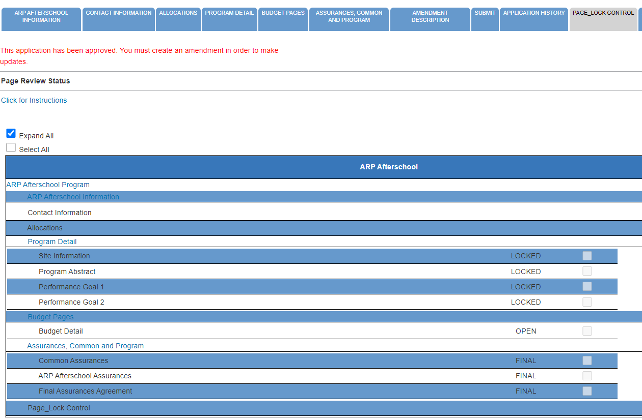
2. Unlock Page
Click on the “Page_Lock Control” tab at the top of the screen
Select “Expand All” to see every page in the grant
Select “Select All” to unlock all pages
Select “Save” at bottom of the screen

Slide 18
3. Update Budget Pages – ESSER II and III
Different Budget Page for each Program
In the top right-hand side of the application page, there is a drop-down menu where you can find your different budget pages

Slide 19
3. Update Budget Pages – ESSER I, ARP Summer, ARP Afterschool
In these grants, there is a blue tab at the top named “Budget Pages”

Slide 20
4. Amendment Description
Click the “Amendment Description” tab
Type in description of what was changed
Use Amendment Template! (See next slide)
You only get 500 characters, so you must keep it short and succinct

Slide 21
4. Amendment Description – E-Grants Amendment Template
PPR
Specifically, how does it relate to student gains?
From category/$amount to category/$amount for the purpose of/to purchase xxx in response to/to prevent/to prepare for (how does it relate to student gains).
A good Amendment example could look like this:
“From 100/Salaries/$10k and 200/Benefits/$2k to 600/$12k to purchase laptops for students, responding to the need for online learning to prevent further loss of learning/attendance due to covid-19”
Cash Requests will need to use the same language as your Budget / Amendments, so make sure you are consistent!
For Capital Expenditure projects we recommend using a Project Scope/Word Document to keep all your information in, and then copy-and-paste from that into your Budget/Amendment/Cash Requests.

Slide 22
Amendment Exercise
We need to increase the supplies line to include the purchase of a pottery wheel
Reallocation of funds from benefits to instructional supplies
We amended $2329 for SEL Curriculum for the 2022-2023
Remove the old existing carpet and replacing it with a linoleum/tile
We will build a small multipurpose room which will provide another dedicated area for students
to spread out to eat their lunches & clean up afterward, rather than eating at their desks
Updated budget detail to reflect expenditures and cash requests

Slide 23
4. Amendment Description – E-Grants Amendment Template
If you are moving to/from more than one budget category, you can use this “and” format:
From category/$amount and category/$amount
to category/$amount and category/$amount
for the purpose of…etc

Slide 24
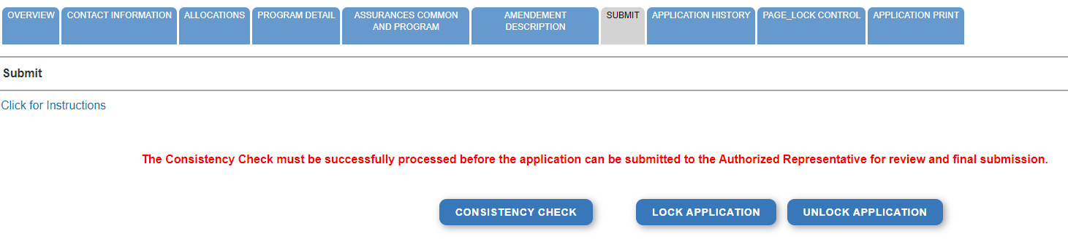
5. Submit
Select the “Submit” tab at the top of the application
Run a Consistency Check – look for error messages
Submit to AR (Submitted for Local Review)
AR Submits to OPI

Slide 25
Where is My Amendment in the Workflow?
These are Status options you may see when in the E-Grants Access Select page:
Not Submitted – you haven’t submitted it yet
Submitted for Local Review – Application has been submitted to AR
Submitted to OPI – OPI is reviewing
Final Approved – OPI has approved and returned
Returned for Changes – OPI has returned for you to edit and resubmit

Slide 26
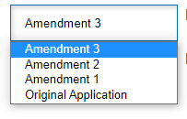
View Previous and Current Amendments
In the “E-Grants Access Select” page, you can see all grants within the fiscal year
Click on the box next to desired grant
This is a drop-down menu which shows all amendments
Select desired amendment
Select “Open” button to view amendment

Slide 27
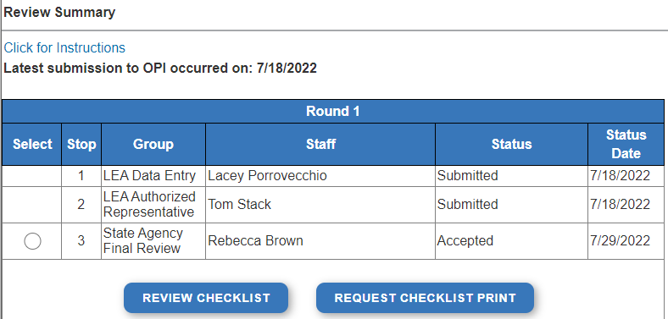
View the History Within an Amendment
In the “E-Grants Access Select” page, select either Original Application or the correct Amendment in the drop-down
Click on “Review Summary” next to the grant
This will open the “Review Summary” page where you can see who has interacted with the grant

Slide 28
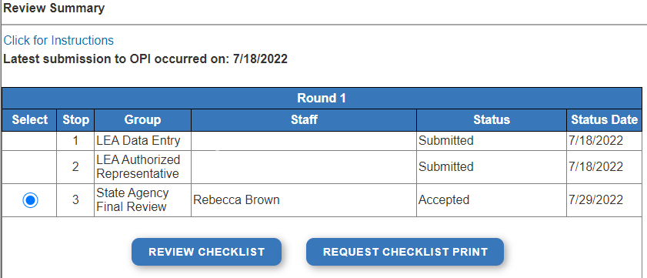
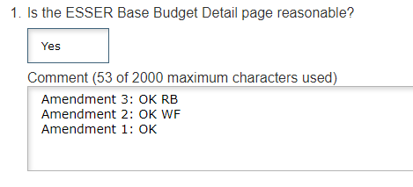
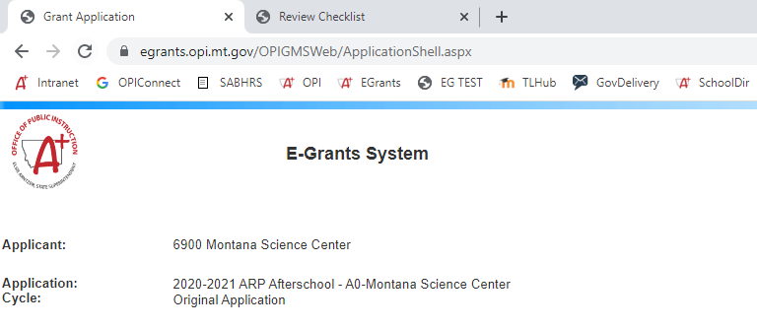
Finding the Feedback from OPI
In the “Review Summary” page, select the circle next to the SEA Review
Then select the blue “Review Checklist” button below
E-Grants will open a second tab in your browser – this only works if your pop-up blocker is turned off
Within the “Review Checklist” page that opens, you will be able to see our comments in the text box

Slide 29
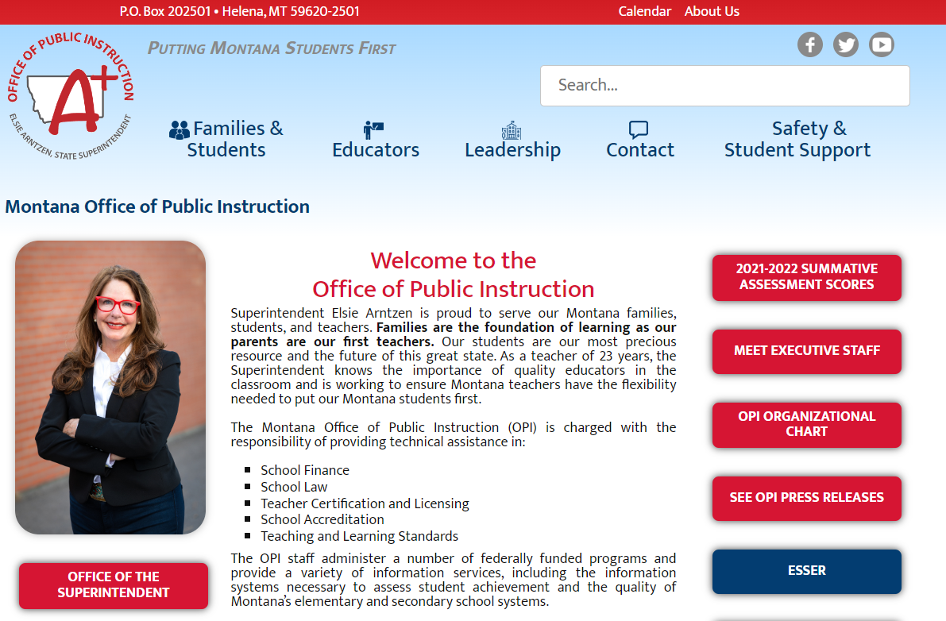
Resources at OPI.MT.GOV

Slide 30
Q & A
Feel free to ask questions!
Wendi Fawns, ESSER/EANS Director
wendi.fawns@mt.gov or 406-437-8595
Rebecca Brown, ESSER Program Manager
rebecca.brown@mt.gov or 406-444-0783
Notes:
Are there any questions from this presentation?

Slide 31
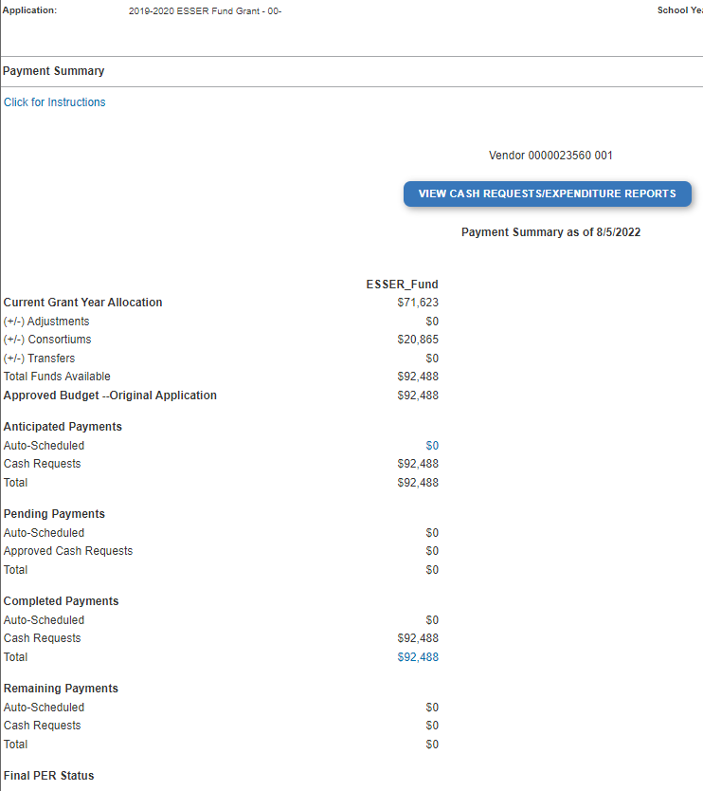
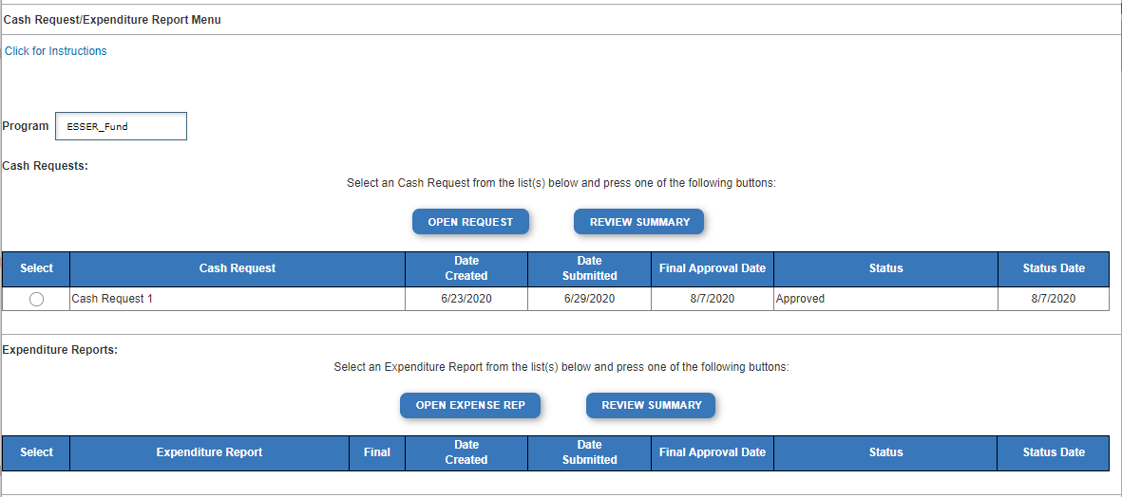
How do I find existing Cash Requests?
E-Grants Access Select page…
Click “Payments” button next to desired grant to see the Payment Summary menu
Click “View Cash Requests/Expenditure Reports” button to see all cash requests for that grant

Slide 32
How do I find existing Cash Requests?
To view the specifics for individual cash requests…
Select the Cash Request you want to look at
Click “Open Request” button to see expenditure info

Slide 33
How do I create new Cash Requests?
Cash Request/Expenditure Report menu…
ESSER II or III: Select desired Program (Budget Page) to request out of
ESSER I, ARP Summer, ARP Afterschool don’t have pages to select from
Click “Create New Request” button to start a new Cash Request

Slide 34
How do I create new Cash Requests?
In your new Cash Request…
Create line items for the expenditures you wish to purchase
Enter “End Period Expense” date
Select “Calculate Totals” at bottom
Upload receipt/paystubs
Select “Save Page”

Slide 35
How do I Submit new Cash Requests?
After Cash Request is filled out…
Select “Submit” tab at top of screen
Click “Consistency Check”
Look for error messages
Click “Submit” button
Business Manager / Clerk submits to Authorized Representative (AR)
AR submits to OPI
OPI will review

Slide 36
Cash Request Expenditure Descriptions
Cash Request Language in the “Expenditure Description and Itemization” Must Match Descriptions in the Grant
Both Budget and Amendments
Audit Trail – an auditor needs to be able to see direct connections from Budget → Amendment → Cash Request

Slide 37
E-grant Cash Request Template
From [category] / [$$amount]
For the purpose of/to purchase [xx]
This must connect to what is already in the grant budget/amendments
In response to [xx related to covid]
To prevent [xx related to covid]
To prepare for [xx related to covid]
Specifically, how does it relate to student gains?
Again, this must match what is already in the grant budget/amendments!

Slide 38
E-Grant Cash Request Template
See in this example how the Budget and Cash Request language is the same!
Budget:
Cash Request:

Slide 39
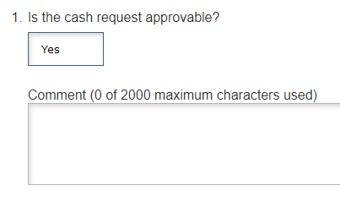
Finding the Feedback from OPI
In the “Cash Request/Expenditure Report” page, select the circle next to the desired Cash Request
Then select the blue “Review Checklist” button above
E-Grants will open a second tab in your browser – this only works if your pop-up blocker is turned off
Within the “Review Checklist” page that opens, you will be able to see our comments in the text box

Slide 40
Cash Requests – Deleting a Cash Request
Only Cash Requests which are in progress, not yet submitted to OPI, can be deleted.
Why would you delete a Cash Request?
You created it on accident
No longer want/need to make the request
How do you Delete it?
In the Cash Requests/Expenditures page, select the unwanted Cash Request
Then select the blue “Delete Request” button
This button will not be displayed if the Request has already been submitted

Slide 41
Budget Pages
ESSER II and III
Different Budget Page for each Program
In the top right-hand side of the application page, there is a drop-down menu where you can find your different budget pages
ESSER I, ESSER Related Services, ARP Summer, ARP Afterschool
In these grants, there is a blue tab at the top named “Budget Pages”

Slide 42
Budget Pages – Use of Funds
Pay specific attention to the “Use of Funds” category in your budget items.
Accountants are unable to approve a cash request when the Final Approved Budget mistakenly reflects $0.
The “Use of Funds” in the Cash Request MUST match what is in the current Budget.
This is the MOST COMMON ERROR in submitting Cash Requests

Slide 43
Example: Incorrectly Submitted Cash Request
Notice the Final Approved Budget reflects an available balance of $0. Supplemental Learning was incorrectly selected differing from this District’s current OPI-approved budget. This results in showing $0 balance available to the District to draw allocated monies from.
The District’s Budget Detail Sheet indicates Supplemental Services was approved by OPI and should have been properly selected for the Use of Funds.

Slide 44
Example: Correctly Submitted Cash Request
Cash Request:
District’s Final Approved Budget Detail:
All the required fields match including the Expenditure and Itemization Description!

Slide 45
Cash Request Timeline
Hundreds of cash requests are submitted monthly from 400+ Montana school districts and agencies. These take time to process!
If it is easy to ‘fully’ understand the Cash Request, the approval will be easier/quicker
Using the template makes it much simpler to approve
Points of confusion or needed clarification are likely to result in a “returned for changes”
See feedback on the Cash Request – call us if you need help/clarification
Cash Requests must be submitted by the 25th of each month, in order to be paid by the 10th of the next month.
Cash requests rejected and sent back to a district for modifications can still be processed after the 25th.
If you miss the 25th deadline, the Cash Request will be processed during the next month
Submit CR on Sept 15th fastest turn around Oct 10th
Submit CR on Sept 24th fastest turn around Oct 10th
Submit CR on Sept 25th fastest turn around Oct 10th
Submit CR on Sept 27th fastest turn around Nov 10th
Submit CR on Sept 31st fastest turn around Nov 10th

