Slide 1


Compensation Expenditure Report
New Clerk Academy Tour
September 27, 28, and 29 2022
Steve Hamel and Shelley Turner, MASBO

Slide 2



The Montana Association of School Business Officials Team
Shelley Turner
Executive Director
Sturner@masbo.com
(406) 461-3659
Steve Hamel
Interim Services & Training
Shamel@masbo.com
(406) 431-0124
Marie Roach
Association Coordinator
Mroach@masbo.com
(406) 461-8804
Notes:
Introduce self, years in the industry, and one word that describes your journey.

Slide 3

AGENDA
OVERVIEW OF THE REPORT
RELATIONSHIP TO TEAMS
IMPORTING A FILE
MAUALLY ENTERING A FILE
FIXING ERRORS/VALIDATIONS
QUESTIONS

Slide 4

Compensation Expenditure Report
2021-2022 Salary and benefit report for each employee.
The report is part of MAEFAIRS.
Due December 10, 2022
Works in conjunction with the TEAMS and Teach MT sites.
  Make sure you have a log in for each and have the correct user roles.
  Needed to create/research State Employee Identifier(SEID) numbers and to create TOE record for each employee
  TEAMS SECURITY FORM
  Your Superintendent assigns you access to the Teach MT site.

Slide 5
TEAMS REPORT ?????
Terms of Employment, Accreditation, and Master Schedule
A Report done every fall that lists every employee, their job type, accreditation (certified staff), and the district’s schedule.
New employees hired after the TEAMS report is submitted must also be added before they can be recognized by the compensation expenditures report. New employees cannot be added between November 1 and March 30.
Notes:
You will be logging into this years’ TEAM’s page but entering employees hired after October 30 of 2020…..if they haven’t already been entered.

Slide 6
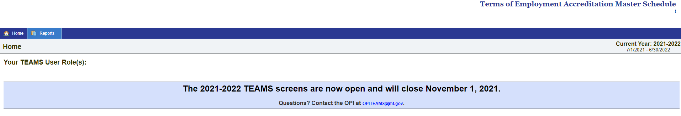
If you have questions on how to enter the TOE or SEID numbers into the TEAMS System, there are helpful tools on the TEAMS Help page.
Quick Links:
TEAMS Security Form
TEAMS Help Page
Notes:
If the FY23 TEAMS report is due before the compensation expenditures report, why are we focusing on it instead of TEAMS? OPI will be doing extensive training on the FY23 TEAMS (see next slide). We are mentioning TEAMS because the FY22 TOE portion of TEAMS needs to be updated with post FY22 submission hires before the compensation expenditures report will work.

Slide 7
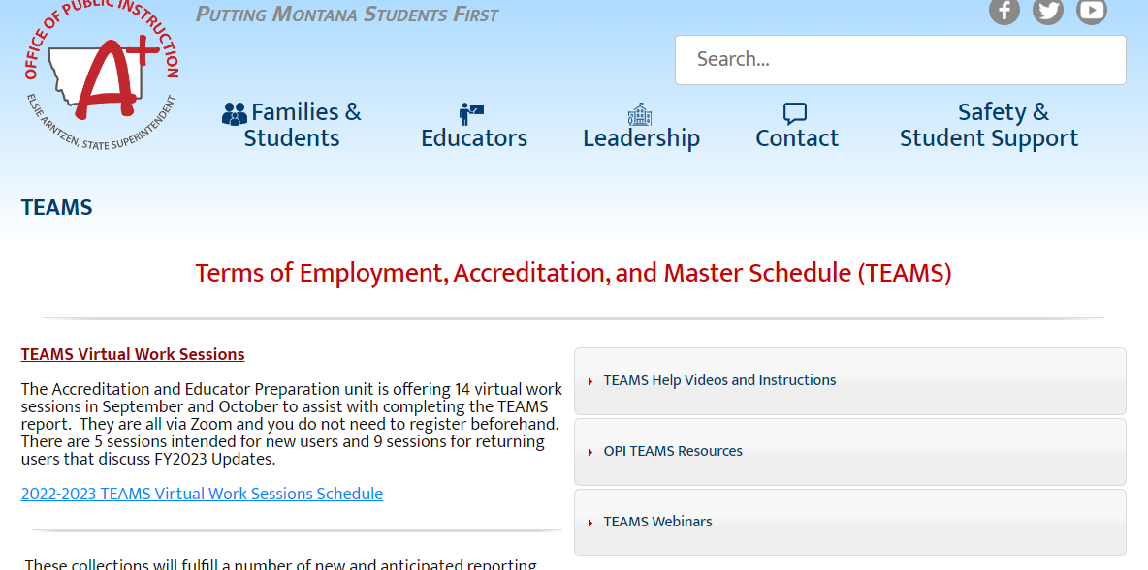
OPI TEAMS TRAINING SESSIONS
Here is a link to the training sessions.
There are several specific for new users.

Slide 8


Slide 9
Entering the Compensation Expenditure Report Data
Two Options:
  Upload a file
  Manually enter the data (usually done by smaller schools, especially those with no dedicated accounting software)

Slide 10

UPLOADING A FILE
VERY similar to uploading date into the Trustees Financial Summary

Slide 11
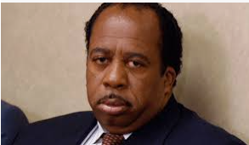
Notes:
2 types of Data entry.
File Import
Manual

Slide 12
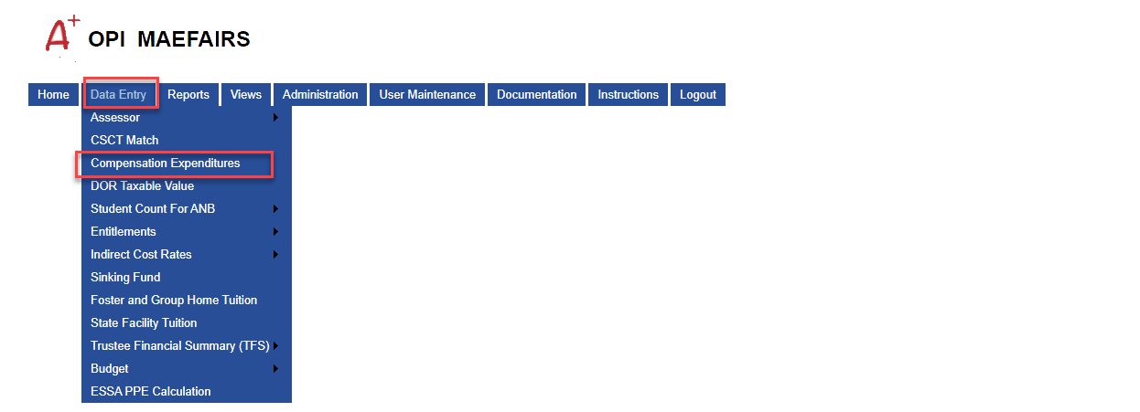

OPI/LEADERSHIP/SCHOOL FINANCE/MAEFAIRS/DATA ENTRY/COMPENSATION EXPENDITURES

Slide 13
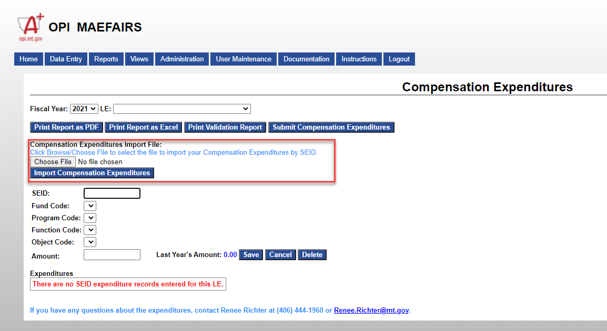

Slide 14
Manual Entry of Data
Fine for districts:
  With relatively few employees
  That do not have a dedicated school accounting software
    Tyler
    Black Mountain
    C & C Accounting (Foxie Lady)

Slide 16
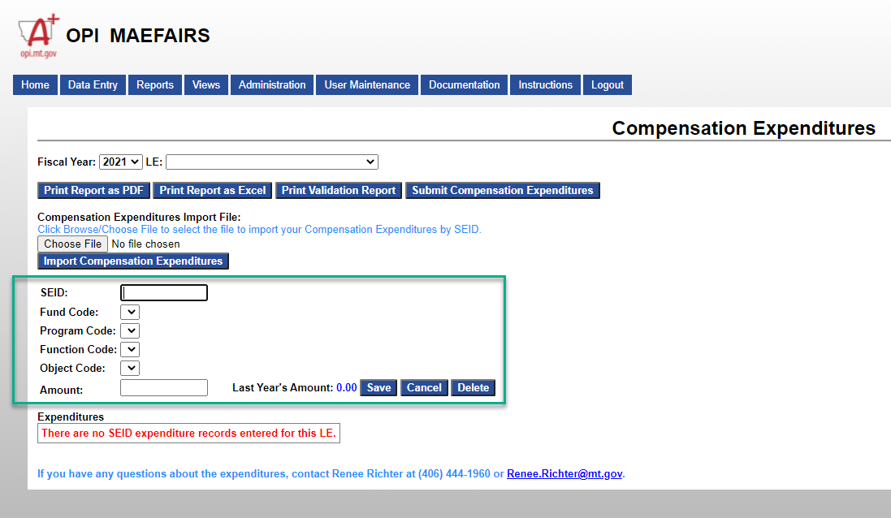

Slide 17
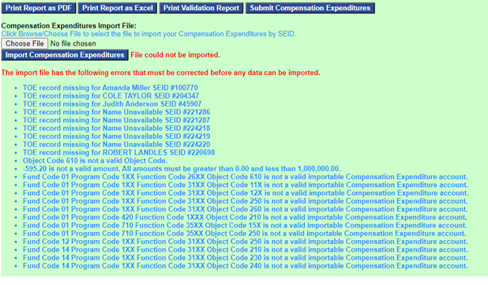
Possible Issues that arise for those uploading, or, let’s put the cart before the horse
Notes:
Only 1XX and 2XX object codes should be in this report. Delete the 610.

Slide 18
ERROR MESSAGES REGARDING MISSING TOE RECORDS
If you have error messages regarding missing TOE records for employees you recognize, log into the TEAMS system. Once in, navigate to the Compensation Expenditure TOE screen. The screen can be found by hovering over the “System” menu and clicking on the “2021-2022 Compensation Expenditure TOE” menu (now located at the bottom of the menu).
If you do not know who the employee is, you, or your predecessor, have entered a wrong SEID number for an employee, and it is pulling up an actual person with that SEID number.
  Do a search on your software to determine what employee has the wrong number and fix the error, It is usually just 1 digit that is wrong
    Black Mountain: Reports | OPI Compensation Survey | Position Setup Report – includes an OPI # column which is the SEID # entered on the employee maintenance file.
    Tyler Technology: Employee Maintenance has a grid of employees with an SEID column
    C & C : Employee Reports

Slide 19
TERMS OF EMPLOYMENT (TOE)
TOE Record Fields
School
SEID
Position Code
Employment Start Date
Employment End Date
Employment FTE
Employment Hours Code (full time or part time)
Itinerant Employee Flag (yes or no)

Slide 20
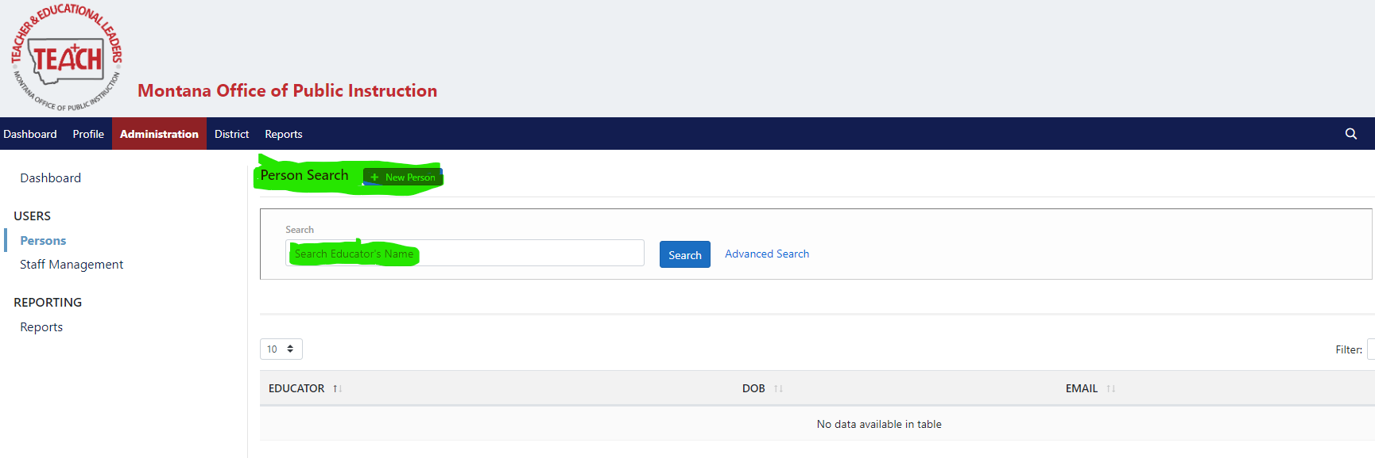
HOW TO CREATE/FIND AN SEID NUMBER
IN THE NEW “TEACH MONTANA” SITE

Slide 21
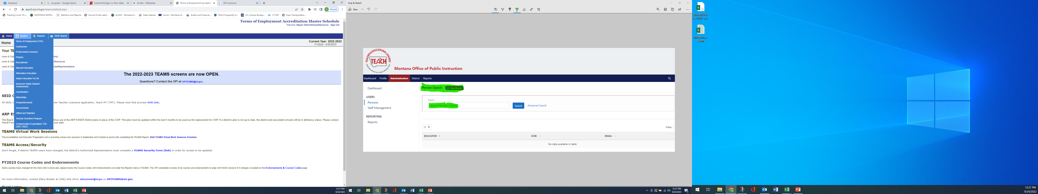
This is the TEAMS home screen for inputting your compensation expenditure TOE records.

Slide 22
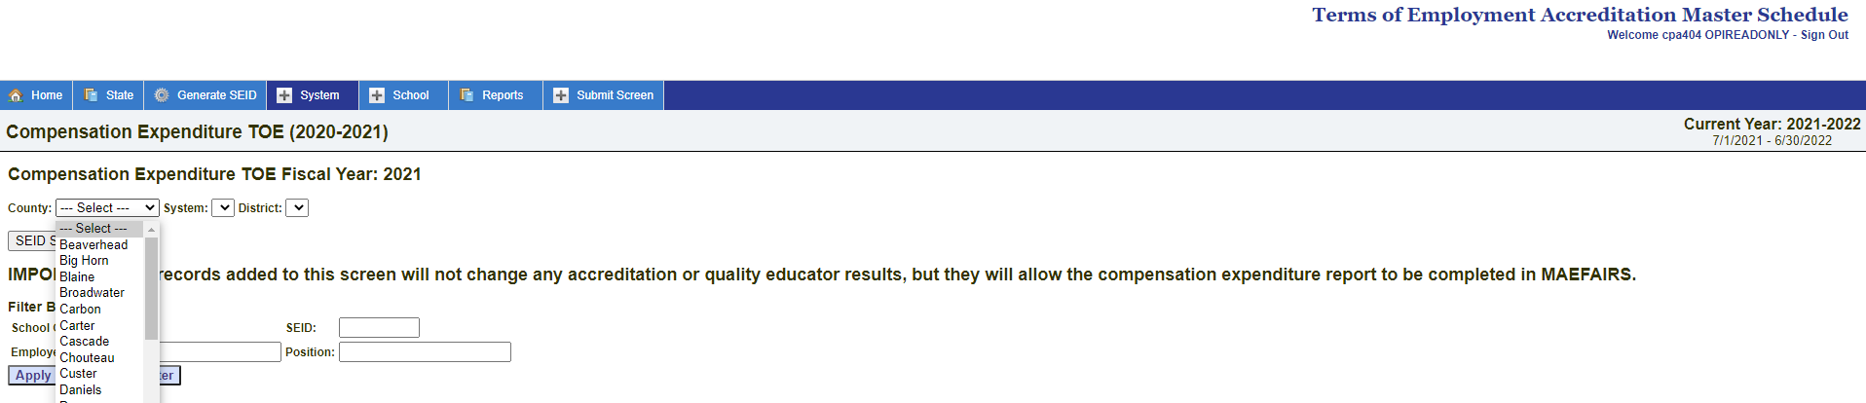
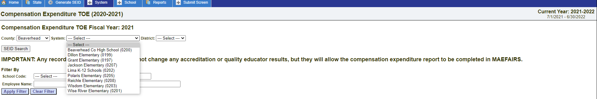

Slide 23
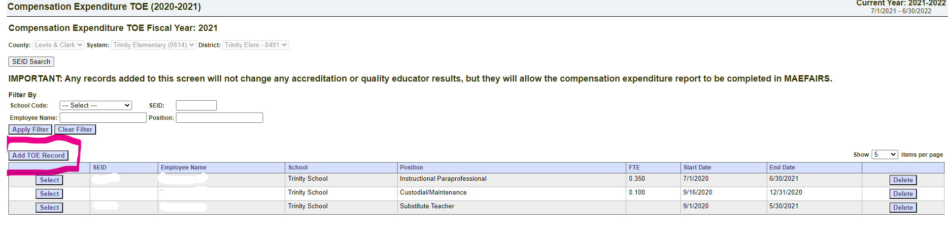
Click on “Add TOE Record”

Slide 24
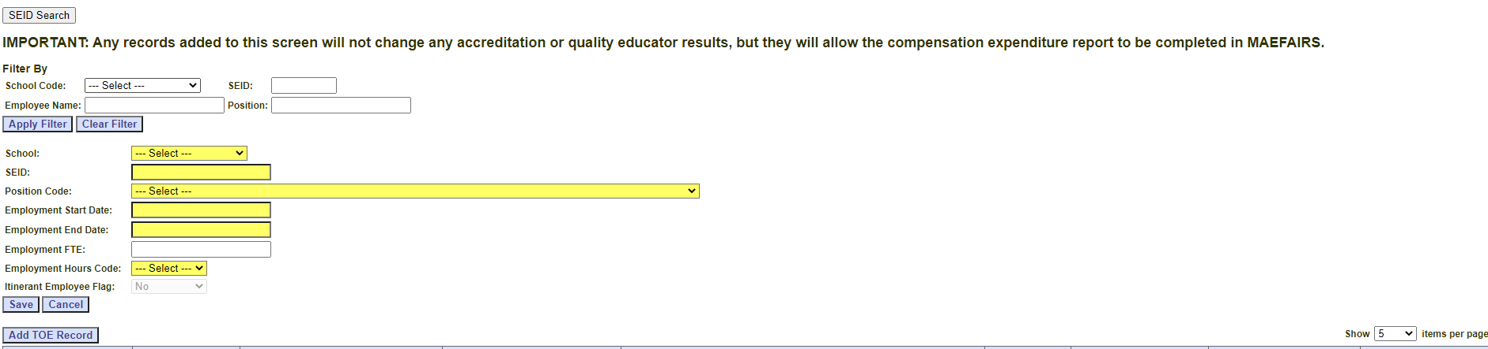
Enter the individual’s info here

Slide 25
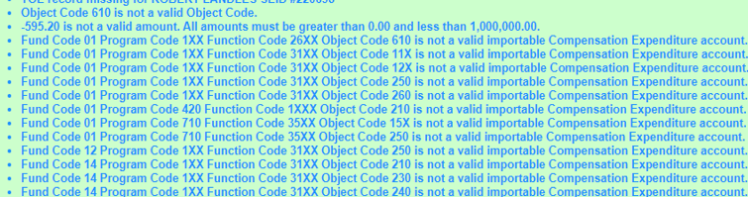
Dealing with coding issues

Slide 26
CHECK WITH YOUR SOFTWARE VENDOR
C & C (Foxie Lady) has a tab on the file creation page that will allow you to make changes.
Black Mountain, not aware of a change area
Tyler, crosswalk feature??
OR

Slide 27
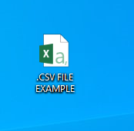
MAKE CHANGES ON THE FILE YOU ARE UPLOADING
IN .CSV FORMAT
IN EXCEL

Slide 28
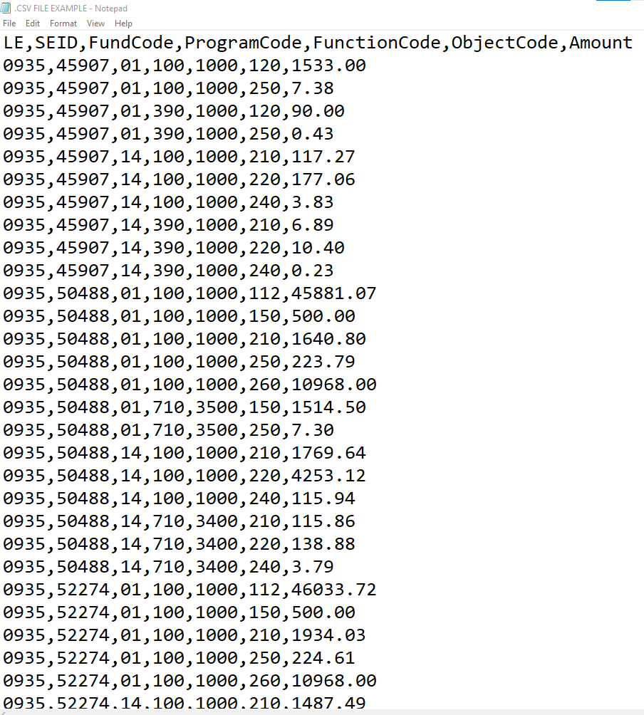
COMPARISON
.CSV - EXCEL
OPENED IN .CSV FILE FORMAT
OPENED IN EXCEL FORMAT
LE | SEID | FundCode | ProgramCode | FunctionCode | ObjectCode | Amount
935 | 45907 | 1 | 100 | 1000 | 120 | 1533
935 | 45907 | 1 | 100 | 1000 | 250 | 7.38
935 | 45907 | 1 | 390 | 1000 | 120 | 90
935 | 45907 | 1 | 390 | 1000 | 250 | 0.43
935 | 45907 | 14 | 100 | 1000 | 210 | 117.27
935 | 45907 | 14 | 100 | 1000 | 220 | 177.06
935 | 45907 | 14 | 100 | 1000 | 240 | 3.83
935 | 45907 | 14 | 390 | 1000 | 210 | 6.89
935 | 45907 | 14 | 390 | 1000 | 220 | 10.4
935 | 45907 | 14 | 390 | 1000 | 240 | 0.23
935 | 50488 | 1 | 100 | 1000 | 112 | 45881.07
935 | 50488 | 1 | 100 | 1000 | 150 | 500
935 | 50488 | 1 | 100 | 1000 | 210 | 1640.8
935 | 50488 | 1 | 100 | 1000 | 250 | 223.79
935 | 50488 | 1 | 100 | 1000 | 260 | 10968
935 | 50488 | 1 | 710 | 3500 | 150 | 1514.5
935 | 50488 | 1 | 710 | 3500 | 250 | 7.3
935 | 50488 | 14 | 100 | 1000 | 210 | 1769.64
935 | 50488 | 14 | 100 | 1000 | 220 | 4253.12
935 | 50488 | 14 | 100 | 1000 | 240 | 115.94
935 | 50488 | 14 | 710 | 3400 | 210 | 115.86
935 | 50488 | 14 | 710 | 3400 | 220 | 138.88
935 | 50488 | 14 | 710 | 3400 | 240 | 3.79
935 | 52274 | 1 | 100 | 1000 | 112 | 46033.72
935 | 52274 | 1 | 100 | 1000 | 150 | 500
935 | 52274 | 1 | 100 | 1000 | 210 | 1934.03
935 | 52274 | 1 | 100 | 1000 | 250 | 224.61
935 | 52274 | 1 | 100 | 1000 | 260 | 10968
935 | 52274 | 14 | 100 | 1000 | 210 | 1487.49

Slide 29
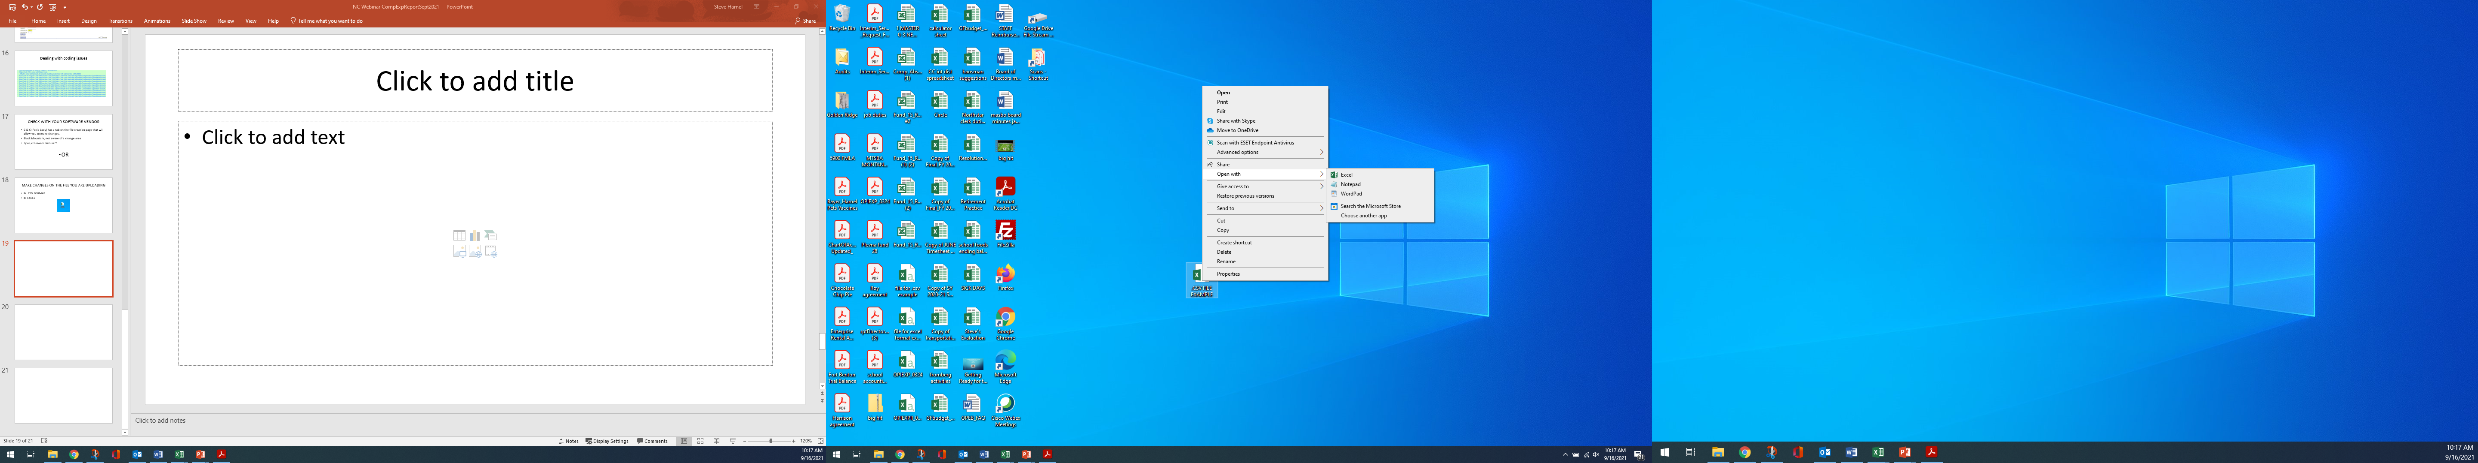
For .csv format:
CLICK ON THE ICON ONCE WITH YOUR RIGHT MOUSE BUTTON
CLICK ON “OPEN WITH”
CLICK ON “NOTEPAD”

Slide 30
For excel format
Double click the icon!!

Slide 31

The 1** amounts entered into the TFS (49,291.80) for LE XXXX, are different from the 1** amounts entered into the compensation expenditures (38,568.88) by more than 10%. (CE-W01)
The 2** amounts entered into the TFS (10,453.18) for LE XXXX, are different from the 2** amounts entered into the compensation expenditures (14,481.07) by more than 10%. (CE-W02).

Slide 32
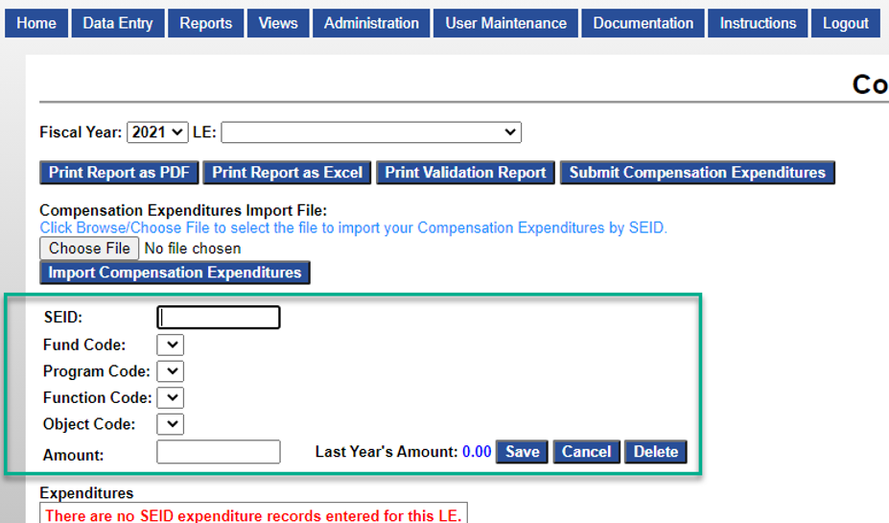
Adding Work Comp and/or Unemployment paid by claims

Slide 33


Slide 34

QUESTIONS

