Slide 1
Governmental Accounting
New Clerk – September 2022
Originally written by Denise Williams
Presented by Steve Hamel

Slide 2
FUND ACCOUNTING
What is a fund?
self-balancing set of accounts
Cash and other financial resources
Liabilities
Residual equities or fund balances
segregated for the purpose of carrying on specific activities or attaining certain objectives
in accordance with special regulations, restrictions, or limitations (GAAP, state law, GASB)

Slide 3
TYPES OF FUNDS
Governmental Fiduciary
General - Trust
Special revenue - Custodial
Permanent
Debt Service
Capital Projects
Proprietary
Enterprise
Internal Service
Fund Codes have 3 digits (XXX)
First digit is the school structure:
1 = elementary district
2 = K-12 or high school district
3 = special education cooperative
Next two digits = fund number

Slide 4
BUDDGETED FUNDS | FUND # | FUND NAME | FUND TYPE
 | 01 | General | General
 | 10 | Transportation | Special Revenue
 | 11 | Bus Depreciation | Special Revenue
 | 13 | Tuition | Special Revenue
 | 14 | Retirement | Special Revenue
 | 17 | Adult Education | Special Revenue
 | 19 | Non-Operating | Special Revenue
 | 28 | Technology | Special Revenue
 | 29 | Flexibility | Special Revenue
 | 50 | Debt Service | Debt Service
 | 61 | Building Reserve | Capital Projects

Slide 5
NON-BUDDGETED FUNDS | FUND # | FUND NAME | FUND TYPE
 | 12 | School Foods | Special Revenue
 | 15 | Miscellaneous Programs | Special Revenue
 | 18 | Traffic Education | Special Revenue
 | 20 | Lease Rental Agreement | Special Revenue
 | 21 | Compensated Absences | Special Revenue
 | 24 | Metal Mines Tax Reserve | Special Revenue
 | 25 | State Mining Impact | Special Revenue
 | 26 | Impact Aid | Special Revenue
 | 27 | Litigation Reserve | Special Revenue
 | 45 | Permanent Endowment | Permanent
 | 60 | Building | Capital Projects
 | 70-72 | Enterprise | Proprietary
 | 73-79 | Internal Service | Proprietary
 | 82 | Interlocal Cooperative | Fiduciary or General
 | 81-85 | Other Trust Funds | Fiduciary

Slide 6
Fiduciary Funds X82 and X84
The activity in these funds will typically be reported on the financial statements as governmental activity (not fiduciary)
X82 Interlocal Agreement Fund
multi-district agreements
special education cooperatives
consortiums
X84 Student Activity Fund
Focus on who has control over the money and how it is spent

Slide 7
FUND ACCOUNTING
Account:
an accounting record of increases and decreases in a specific asset, liability, revenue, expenditure or fund balance item
In its simplest form an account consists of 3 items:
TITLE
Debit side
Credit side

Slide 8
Example
CASH
Debit side
Credit side
The type and title of an account will dictate how transactions are recorded

Slide 9
ACCOUNT TYPES
Assets – what is owned
Cash and investments
Taxes Receivable
Due From Other Governments
Liabilities – what is owed or has been received but not recorded as revenue yet
Accounts payable
Due to Other Governments
Deferred Inflows

Slide 10
ACCOUNT TYPES
Revenue – resources coming in during fiscal year
Direct State Aid and other state funding
Property taxes
Interest earnings
Expenditures – resources paid out during the fiscal year
Salaries and benefits
Supplies, utility bills, insurance, repairs

Slide 11
BASIC FINANCIAL STATEMENTS
Balance Sheet (ongoing balances as of a given date)
Assets
Liabilities
Fund Balance (equity)
Revenues, Expenditures & Changes in Fund Balance (activity for a fiscal year)
Revenues
Expenditures
Difference in revenues vs. expenditures is “closed out” to fund balance

Slide 12
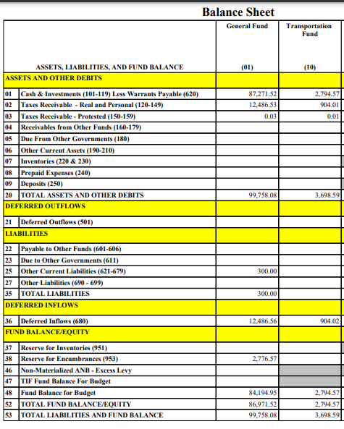

Slide 13
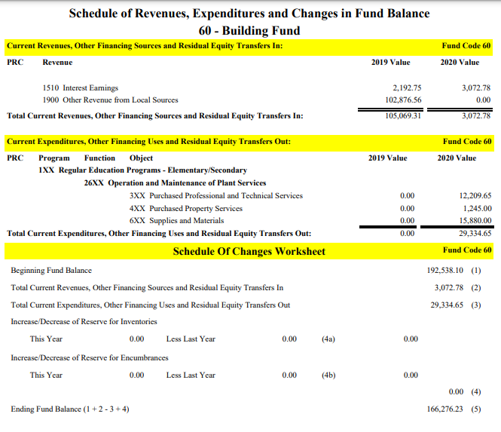

Slide 14
Recording Transactions
Account:
an accounting record of increases and decreases in a specific asset, liability, revenue, expenditure or fund balance item
In its simplest form an account consists of 3 items:
TITLE
Debit side
Credit side

Slide 15
Recording Transactions
Accounts that normally have Debit Balances
Assets
Expenditures
Accounts that normally have Credit Balances
Liabilities
Fund Balance
Revenues

Slide 16
Recording Transactions
Account Type | Normal Balance | Effect of a Debit entry | Effect of a Credit Entry
ASSET | Debit | Increase | Decrease
LIABILITY | Credit | Decrease | Increase
FUND BALANCE | Credit | Decrease | Increase
REVENUE | Credit | Decrease | Increase
EXPENDITURE | Debit | Increase | Decrease

Slide 17
Recording Transactions
ASSET
*Debit side
(increase)
Credit side
(decrease)
LIABILITY
Debit side
(decrease)
*Credit side
(increase)
*normal balance

Slide 18
Recording Transactions
REVENUE
Debit side
(decrease)
*Credit side
(increase)
EXPENDITURE
*Debit side
(increase)
Credit side
(decrease)
*normal balance

Slide 19
Recording Revenue
Transaction 1
Received Direct State Aid from OPI: $200,000
CASH
Debit side
(increase)
$200,000
REVENUE
Credit side
(increase)
$200,000

Slide 20
Recording Expenditures
Transaction 2-A
Enter a utility bill $5,000
ACCOUNTS PAYABLE
Credit side
(increase)
$5,000
EXPENDITURE
Debit side
(increase)
$5,000

Slide 21
Recording Expenditures
Transaction 2-B
Write warrant for the utility bill $5,000
CASH
Credit side
(decrease)
$5,000
ACCOUNTS PAYABLE
Debit side
(decrease)
$5,000

Slide 22
Recording Transactions
CASH
Transaction 1
$200,000
Transaction 2-B
$5,000
Balance = $195,000
ACCOUNTS PAYABLE
Transaction 2-A
$5,000
Transaction 2-B
$5,000
Balance = .00

Slide 23
Recording Transactions
REVENUE
Transaction 1
$200,000
Balance = $200,000
EXPENDITURE
Transaction 2-A
$5,000
Balance = $5,000

Slide 24
Recording Transactions
Journalizing the transactions
Date of the transaction
Accounts and amounts to be debited and credited
Brief explanation of the transaction
Each transaction must balance debits to credits (double entry accounting)

Slide 25
Journalizing the Transactions
Transaction 1:
Account Debit Credit
Cash $200,000
Revenue $200,000
Received Direct State Aid from OPI

Slide 26
Journalizing the Transactions
Transaction 2-A:
Account Debit Credit
Expenditure $5,000
Accounts Payable $5,000
Record utility bill claim $5,000

Slide 27
Journalizing the Transactions
Transaction 2-B:
Account Debit Credit
Cash $5,000
Accounts Payable $5,000
Paid utility bill claim $5,000

Slide 28
Journalizing the Transactions
Transaction 1:
Account Debit Credit
101-101 Cash $200,000
101-3110 Direct State Aid $200,000
Received Direct State Aid from OPI

Slide 29
Journalizing the Transactions
Transaction 2-A:
Account Debit Credit
101-100-2600-410 Utilities $5,000
101-621 Accounts Payable $5,000
Record utility bill claim $5,000

Slide 30
Journalizing the Transactions
Transaction 2-B:
Account Debit Credit
101-101 Cash $5,000
101-621 Accounts Payable $5,000
Paid utility bill claim $5,000

Slide 31
SUMMARY OF CODE STRUCTURES
Balance Sheet: XXX – XXX - PRC
X X X X X X
District/Fund Account
Revenue/Other Financing: XXX – XXXX - PRC
X X X X X X X X X X
District/Fund Source Project Reporter
Expenditure/Other Financing Uses: XXX – XXX – XXXX – XXX - PRC
X X X X X X X X X X X X X X X X
District/Fund Program Function Object Project Reporter

Slide 32
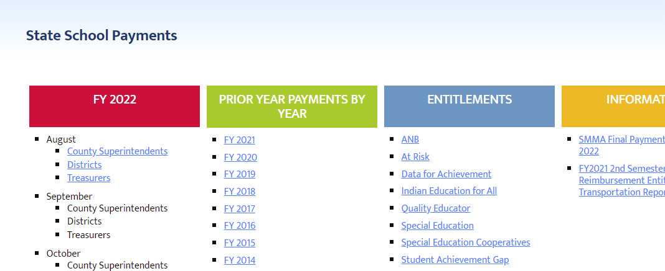
EXAMPLE – Recording Revenue
OPI State School Payments
Leadership/School Finance/State School Payments/FY2022
Current Fiscal Year by Month and in PDF files by County

Slide 33
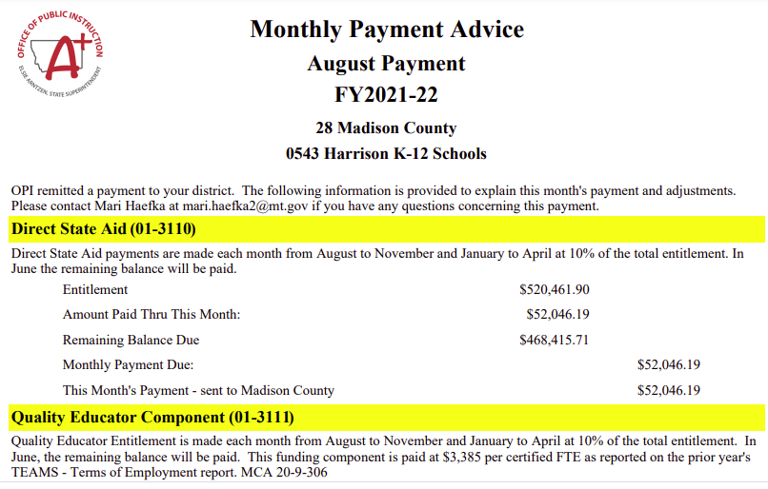
Fund and revenue codes provided

Slide 34
EXAMPLE – Recording Revenue
Record August state payments from OPI
Account Debit Credit
201-101 Cash $58,924.49
201-3110 DSA $52,046.19
201-3111 Quality Educator $ 4,204.17
201-3112 At Risk Student $ 288.33
201-3113 Indian Education for All $ 227.00
201-3116 Data for Achievement $ 217.30
201-3114 Amer. Indian Achievement Gap $ 22.30
201-3115 Special Education $ 1,919.20

Slide 35
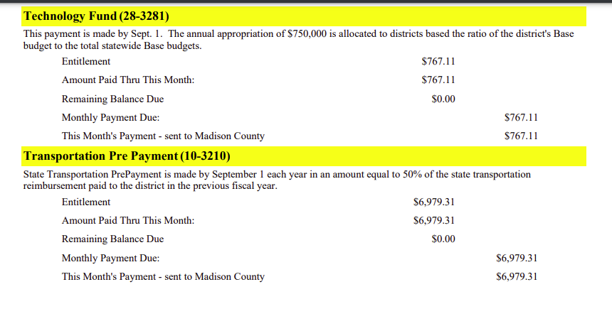

Slide 36
EXAMPLE – Recording Revenue
Record August state payments from OPI
Account Debit Credit
228-101 Cash $767.11
228-3281 State Technology Aid $ 767.11
210-101 Cash $6,979.31
210-3210 State Transp. Reimb. $ 6,979.31

Slide 37
EXAMPLE – Recording Revenue
Account Debit Credit
201-101 Cash $58,924.49
201-3110 DSA $52,046.19
201-3111 Quality Educator $ 4,204.17
201-3112 At Risk Student $ 288.33
201-3113 Indian Education for All $ 227.00
201-3116 Data for Achievement $ 217.30
201-3114 Amer. Indian Achievement Gap $ 22.30
201-3115 Special Education $ 1,919.20
210-101 Cash $6,979.31
210-3210 State Transp. Reimb. $ 6,979.31
228-101 Cash $767.11
228-3281 State Technology Aid $ 767.11

Slide 38
EXAMPLES – Recording Expenditures
Ordered supplies for regular, special education and Title I classrooms
Total order: $20,300.00
Regular $13,200.00
Special education $ 6,100.00
Title I $ 1,000.00

Slide 39
EXAMPLE – Recording Expenditures
Ordered supplies for regular, special education and Title I classrooms
Account Debit Credit
101-100-1000-610 Supplies $13,200.00
101-280-1000-610 Supplies $ 6,100.00
101-621 Accounts Payable $19,300.00
115-420-1000-610-123 Supplies $ 1,000.00
115-621 Accts Pay. $ 1,000.00

Slide 40
EXAMPLES – Recording Expenditures
Items are received, packing slip matches order and invoice and you’re ready to issue a warrant for payment.
Total invoice: $20,300.00
Regular $13,200.00
Special education $ 6,100.00
Title I $ 1,000.00

Slide 41
EXAMPLE – Recording Expenditures
Issue a warrant for items received
Account Debit Credit
101-621 Accounts Payable $19,300.00
101-101 Cash $19,300.00
115-621 Accounts Payable $ 1,000.00
115-101 Cash $ 1,000.00

