Slide 1
Great Falls Public Schools
District Budget Book Presentation

Slide 2
Questions
What questions have you or your Superintendent been asked by a member of the public regarding District budgeting/spending or operations?
What financial information do you access periodically?

Slide 4
How to find the budget book on line
https://www.gfps.k12.mt.us/

Slide 5
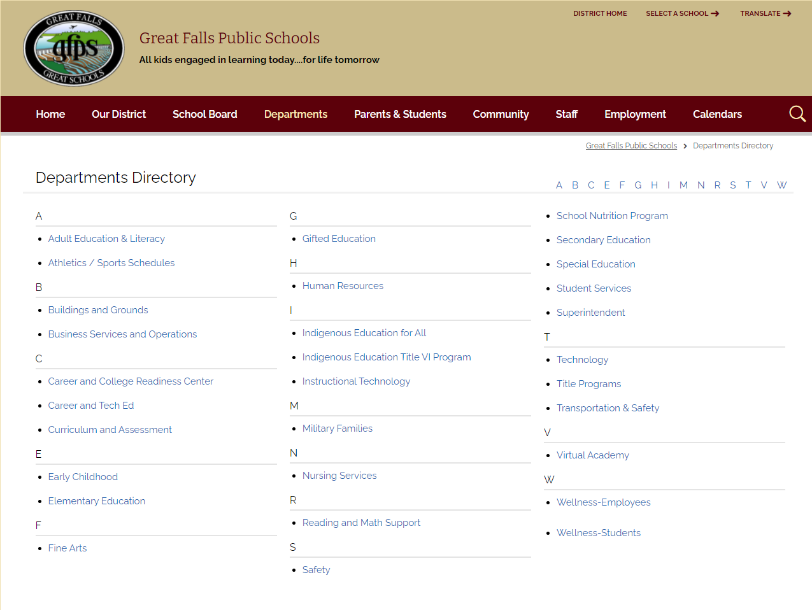
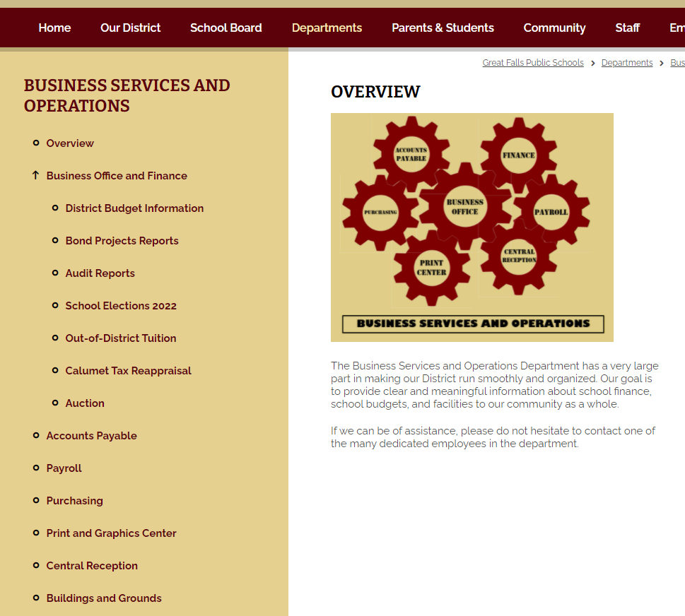

Slide 6
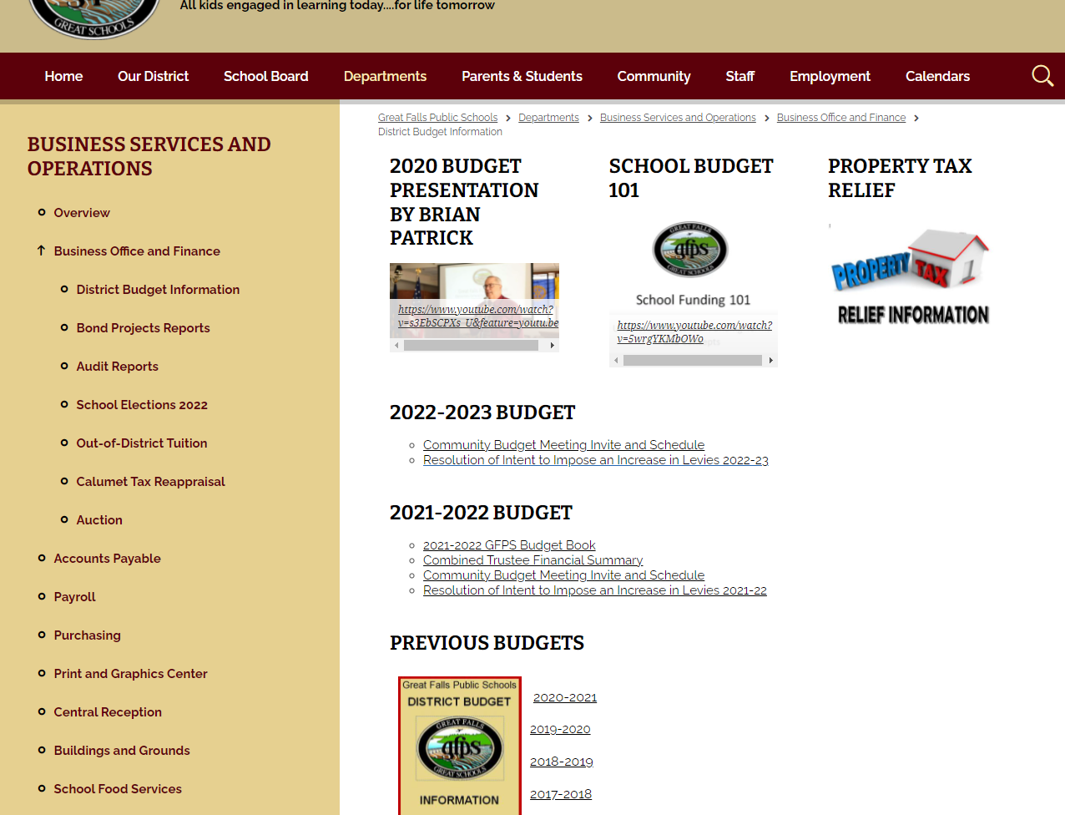

Slide 7
Goals and Thoughts
Goals
Thoughts . . .
Accurate information to board and community
Increased Accountability
Easy to read and interpret (charts/trends)
Goals (Strategic Plan) of the District tied to money
Individual Fund Budget Information
Description
Montana Law (reference)
Legislative changes
History teacher – Superintendent - Clerk
My reference guide for the year
Reference additional information
Economize space
Trend information provides good perspective
Board adopts all budgeted funds – required by law

Slide 8
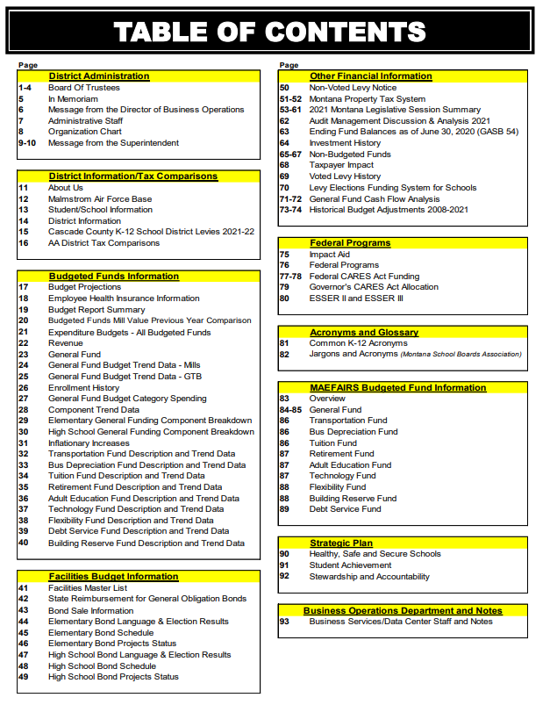
District Administration Organizational Chart – Meeting Schedule
District Information/Tax Comparisons
Budgeted Funds Information Budget Projections Health Insurance
Facilities Budget Information $98.8 million dollar Bond 2016
Other Financial Information Non Voted Levy Notice Non Budgeted Funds Voted Levy History
Historical Budget Adjustments (Reductions)
Federal Programs Title & ESSER
Acronyms and Glossary
MAEFAIRS Budgeted Fund Information
Strategic Plan

Slide 9
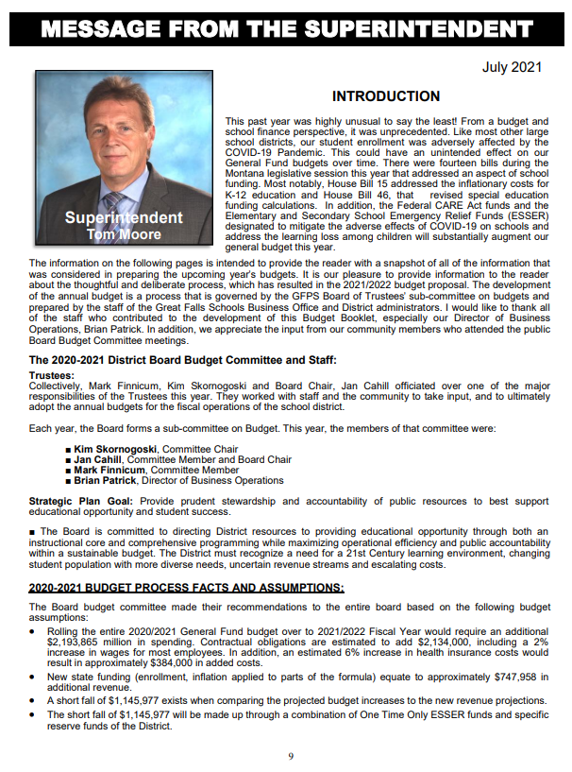
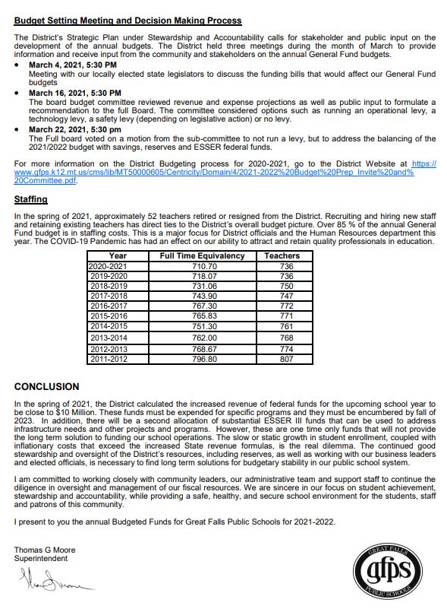

Slide 10
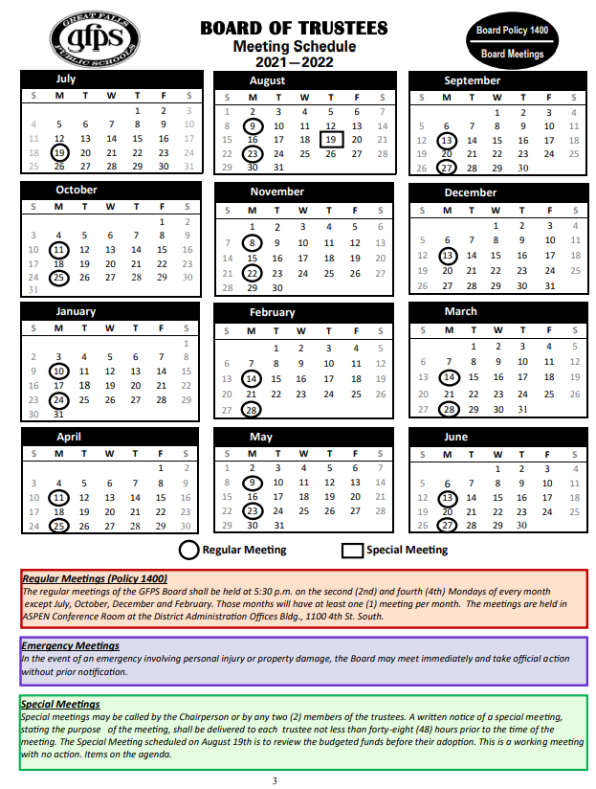

Slide 11
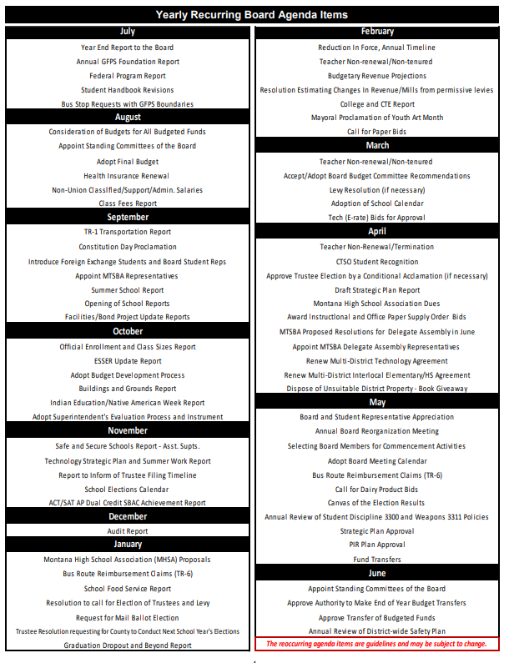

Slide 12
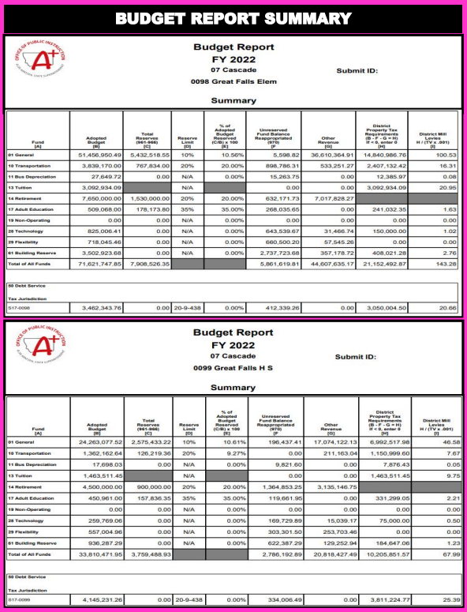
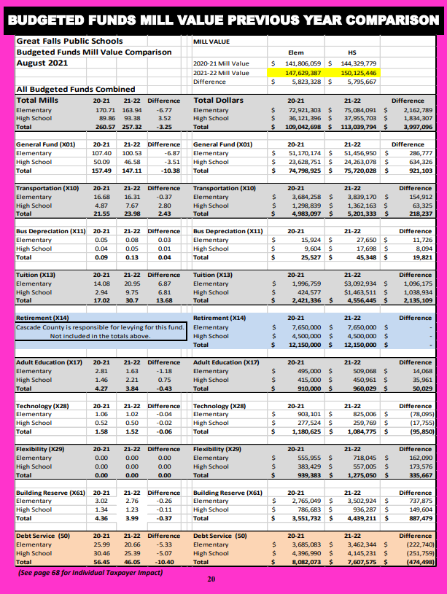

Slide 13
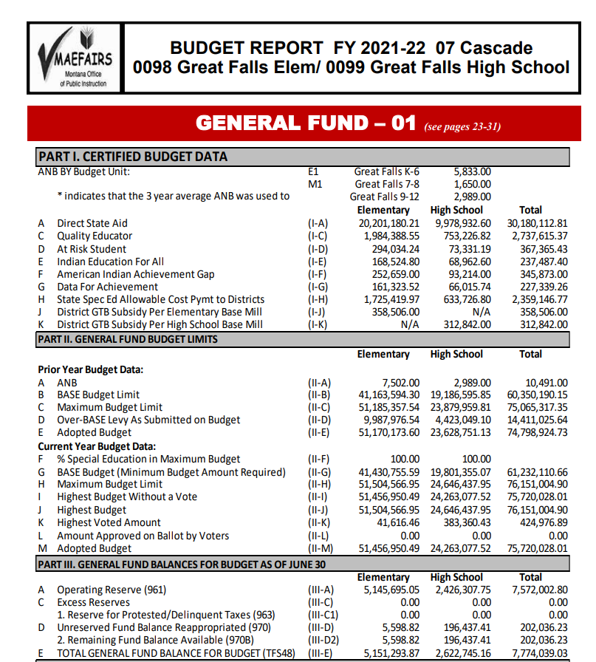

Slide 14
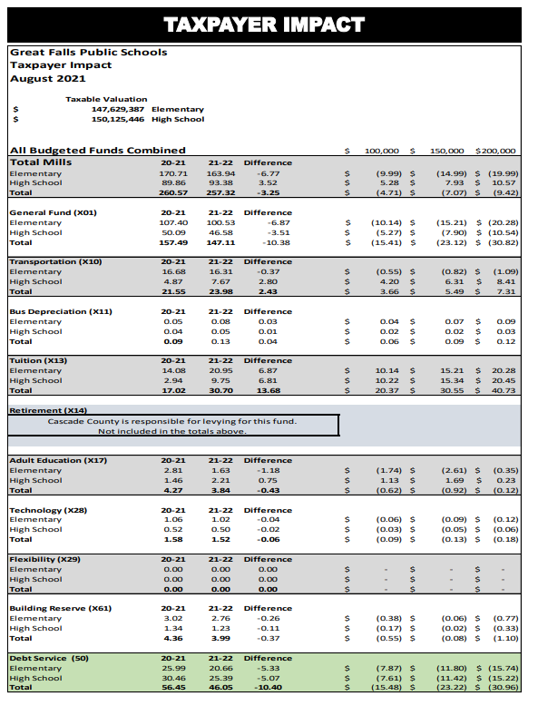

Slide 15
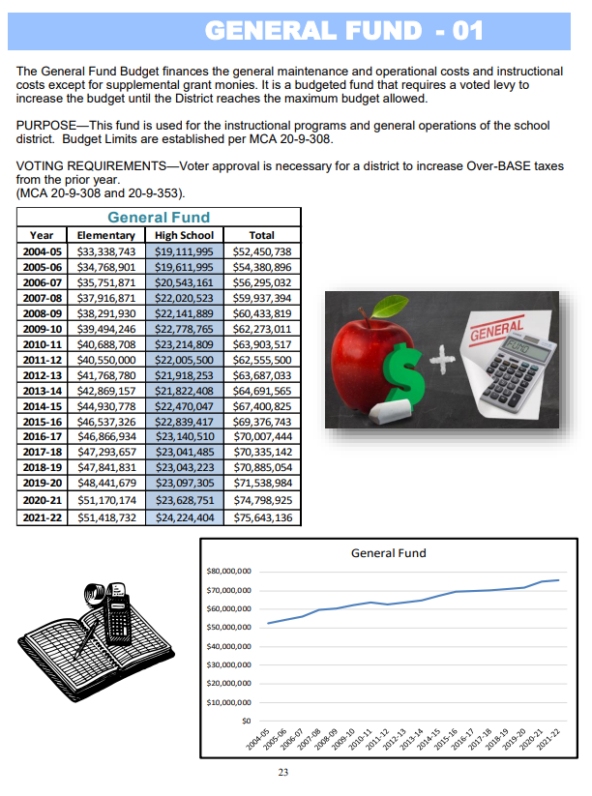
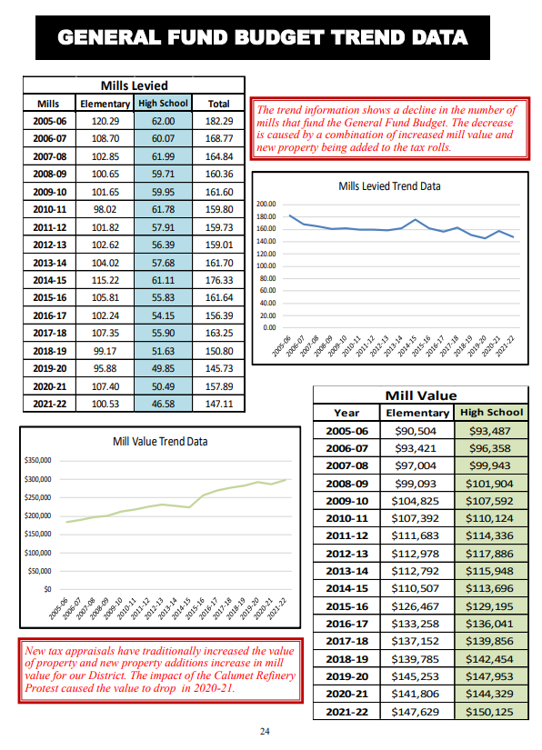

Slide 16
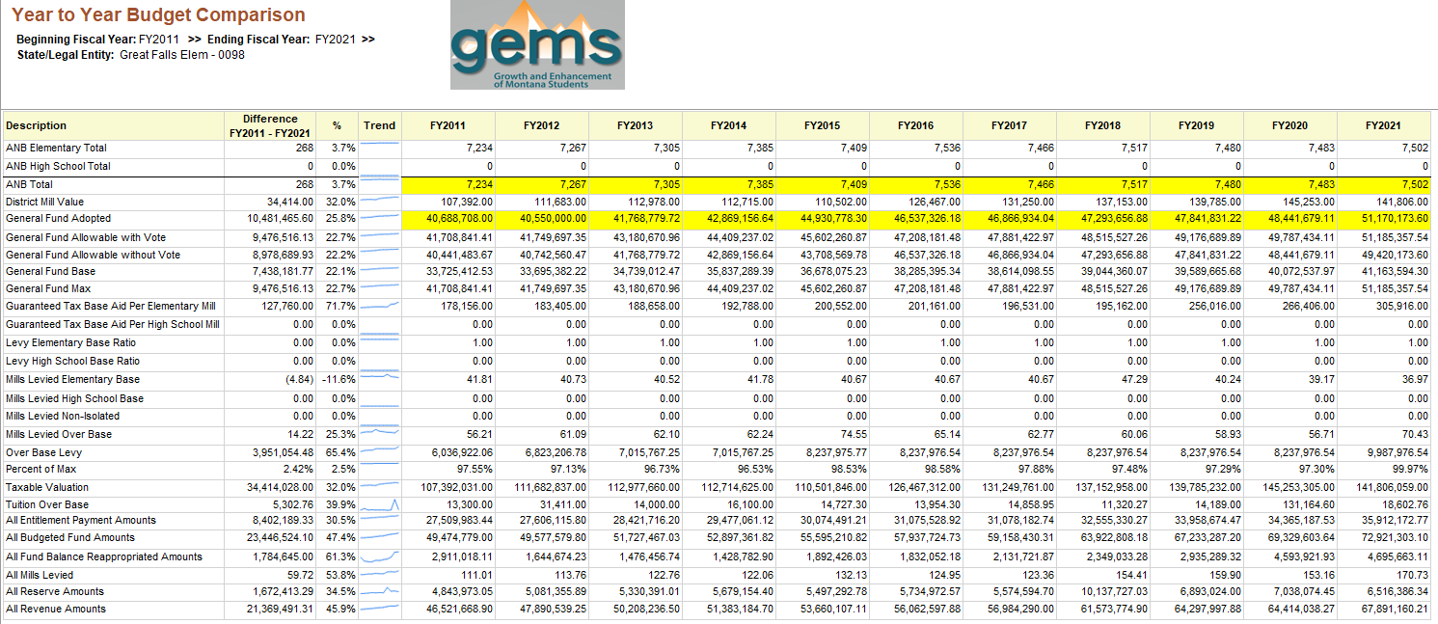

Slide 17
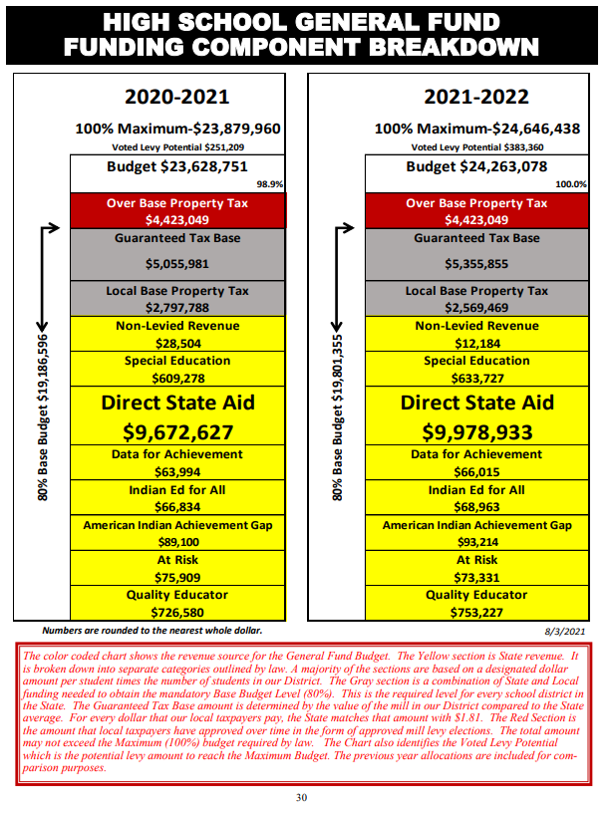
Yellow- State Funded
Gray – District & State Funded
Red- Local Taxpayers
Red text = Interpretation of data presented.

Slide 18
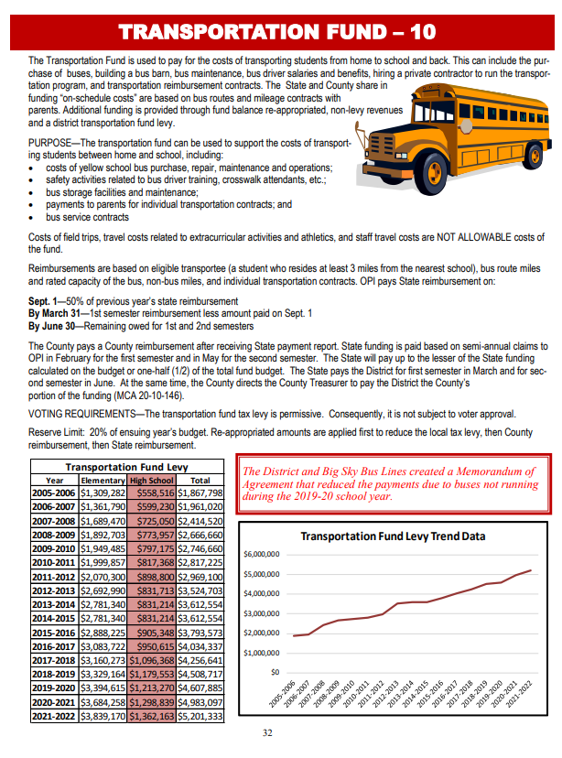

Slide 19
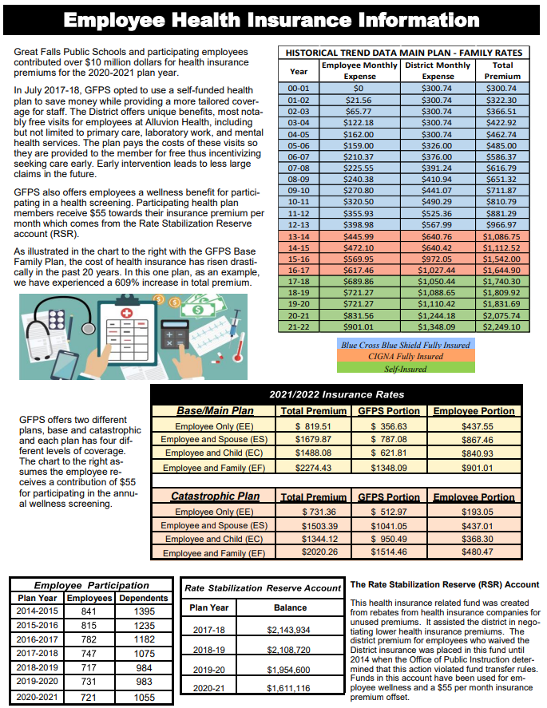

Slide 20
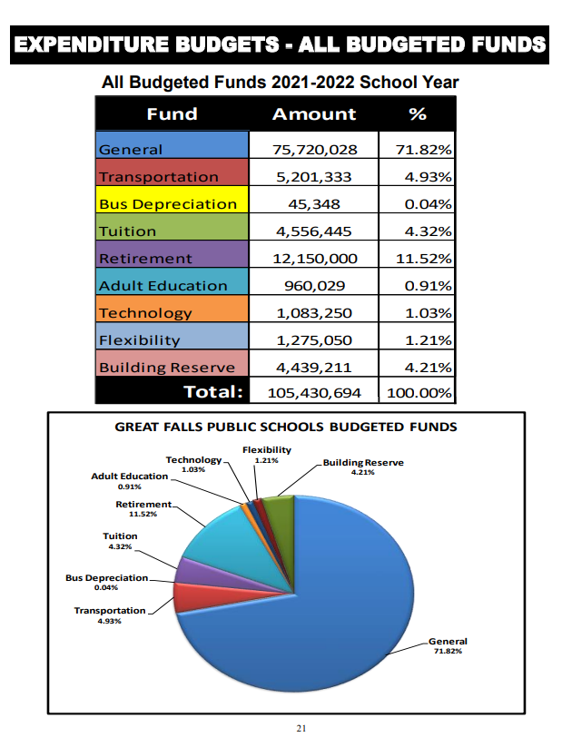

Slide 21
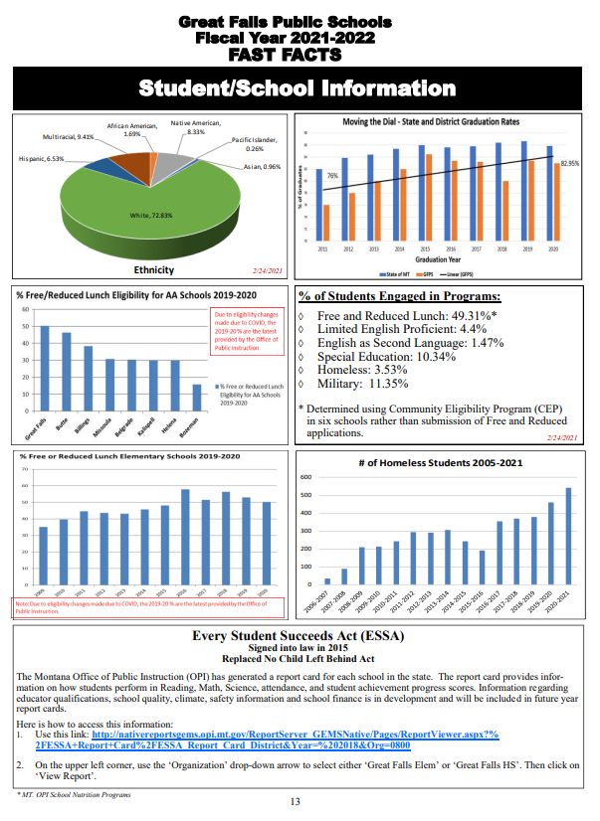

Slide 22
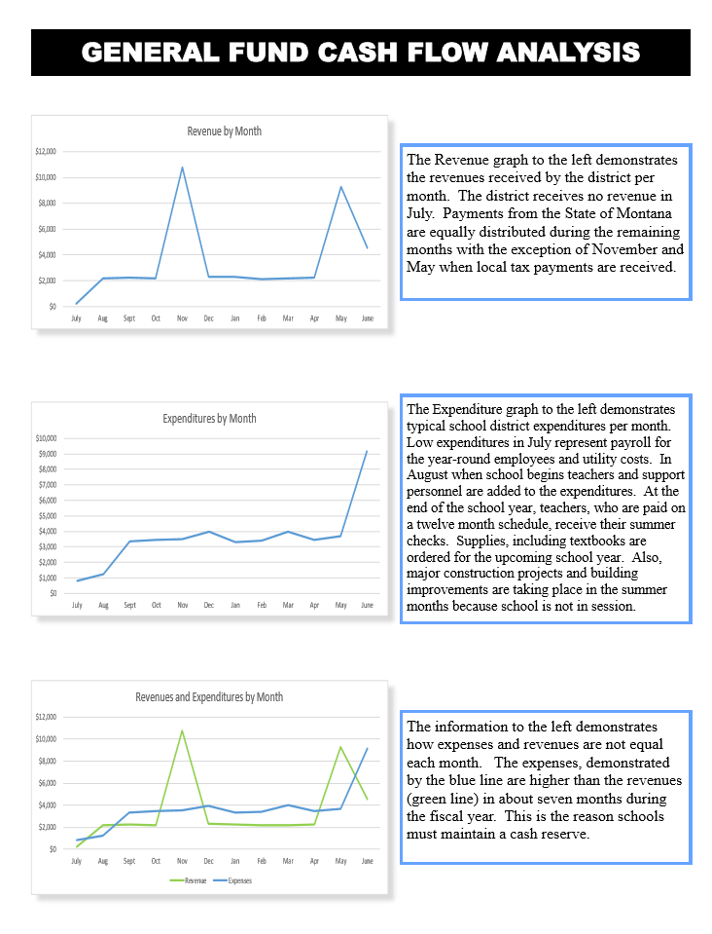

Slide 23
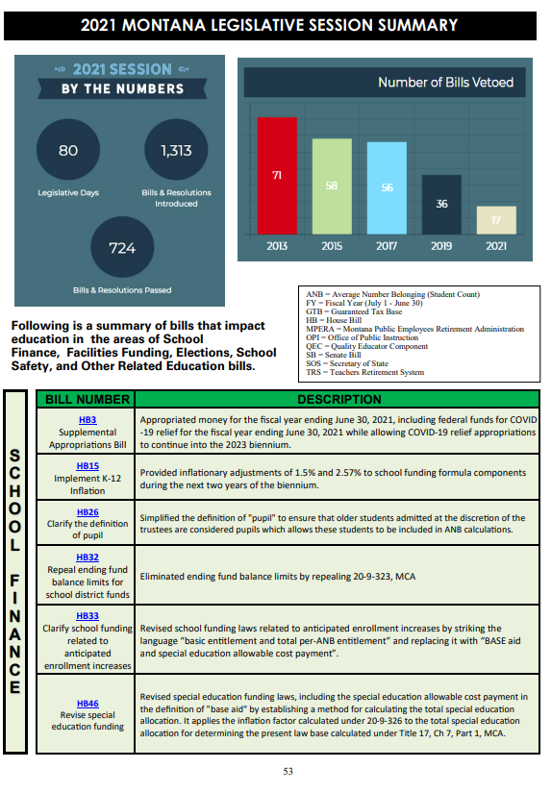
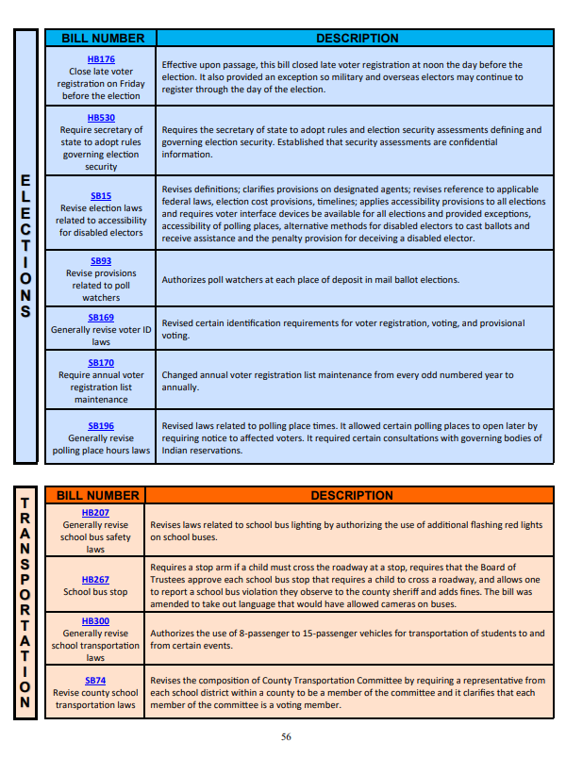

Slide 24
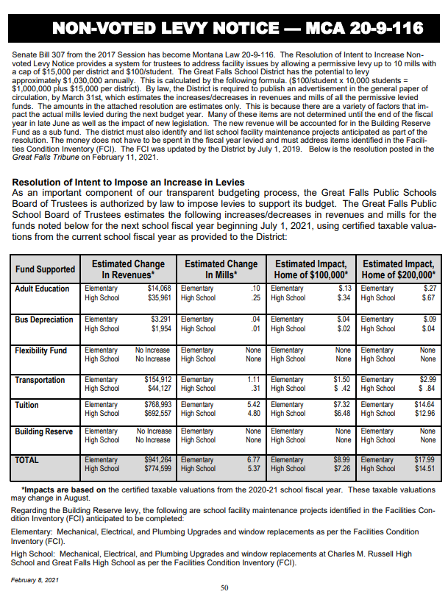

Slide 25
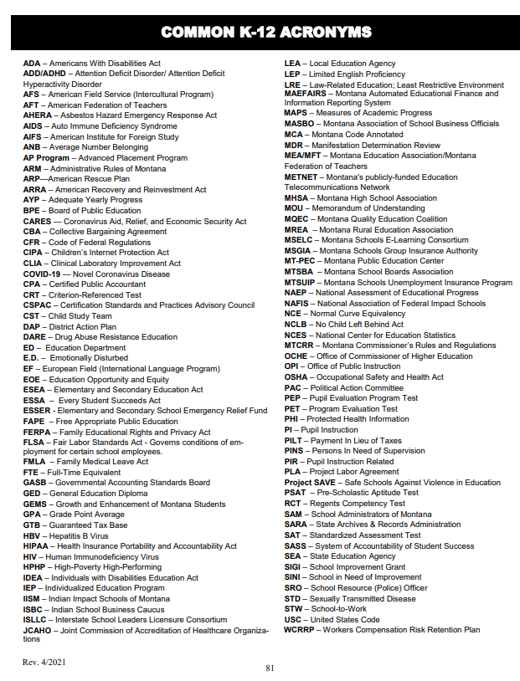
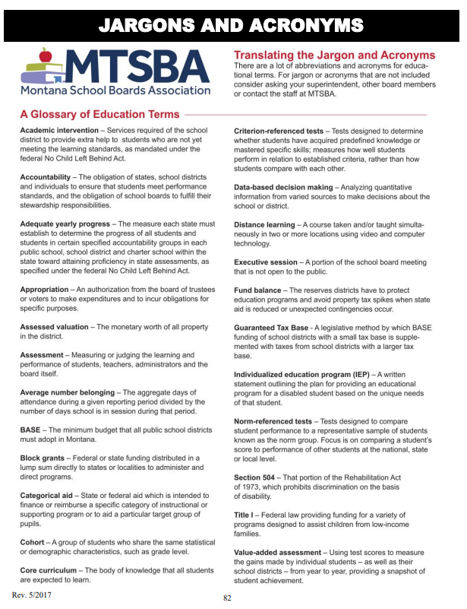

Slide 26
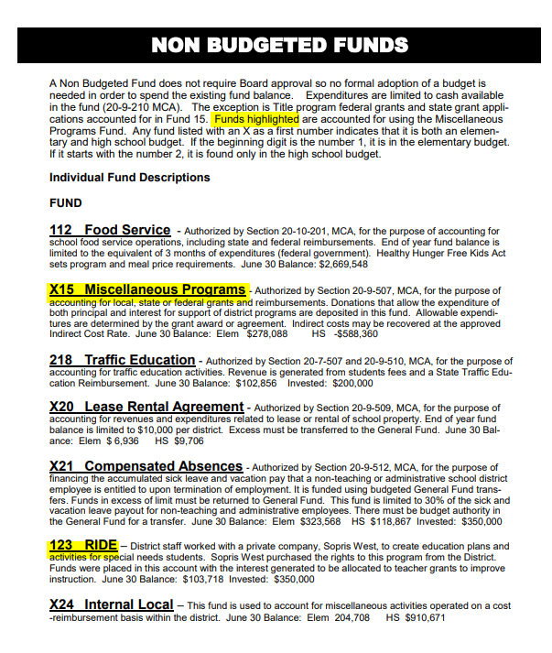
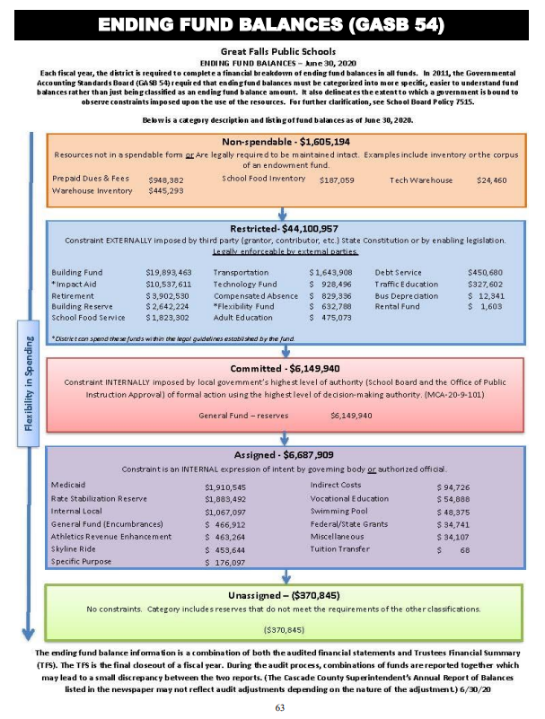

Slide 27
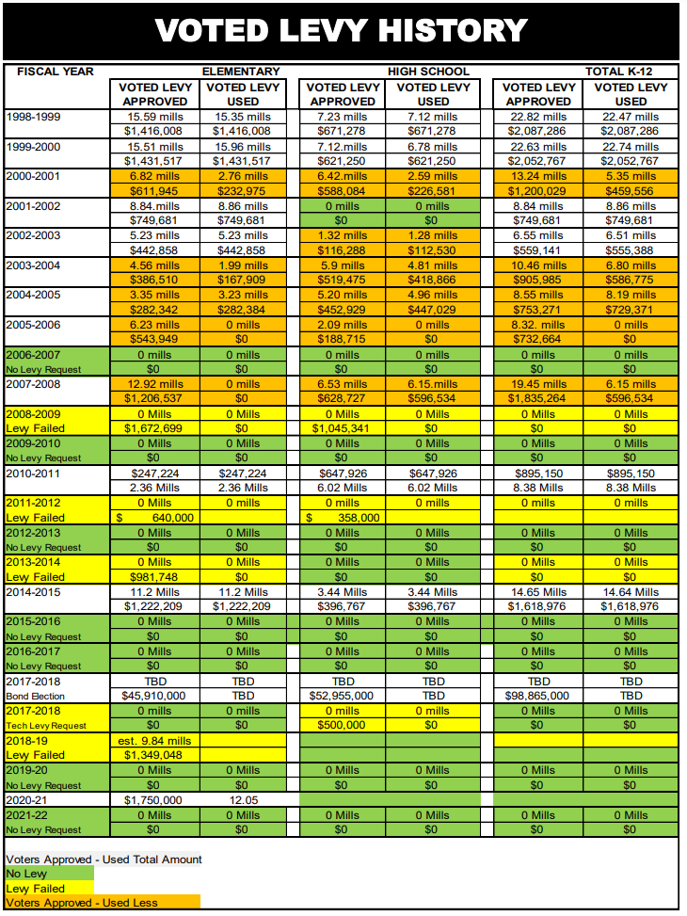
Green = No Levy Yellow = Failed Levy
White = Approved Levy
Orange = Approved Levy – Did not use total amount
Approved Levies since 2010
2010-11 $895,150 (Elem & HS)
2014-15 $1,618,976 (Elem & HS)
2017-18 $98,865,000 (Bond)
2020-21 $1,750,000 (Elem)
No Levy Requested
2006-07
2009-10
2012-13
2015-16
2016-17
2019-20
2021-22
Failed Levies
2011-12 $998,000 (Elem.)
2017-18 $500,000 (Tech Levy)
2018-19 $1,349,048 (Elem.)

Slide 28
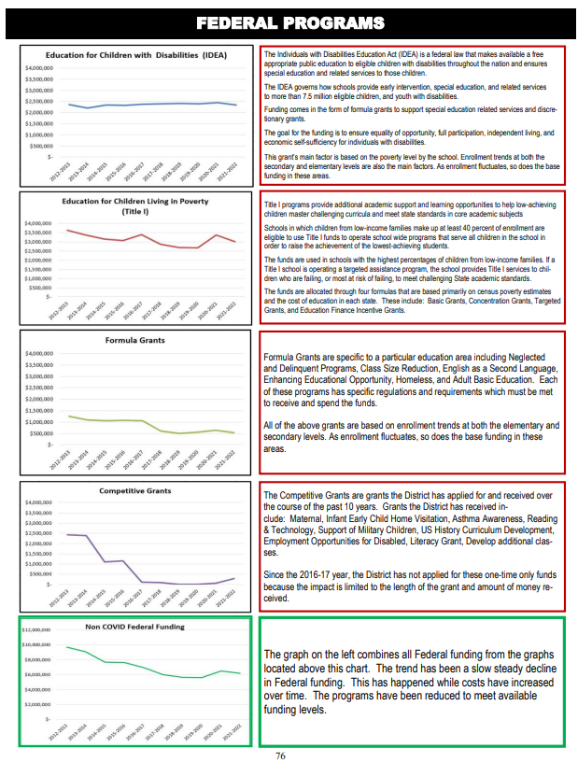
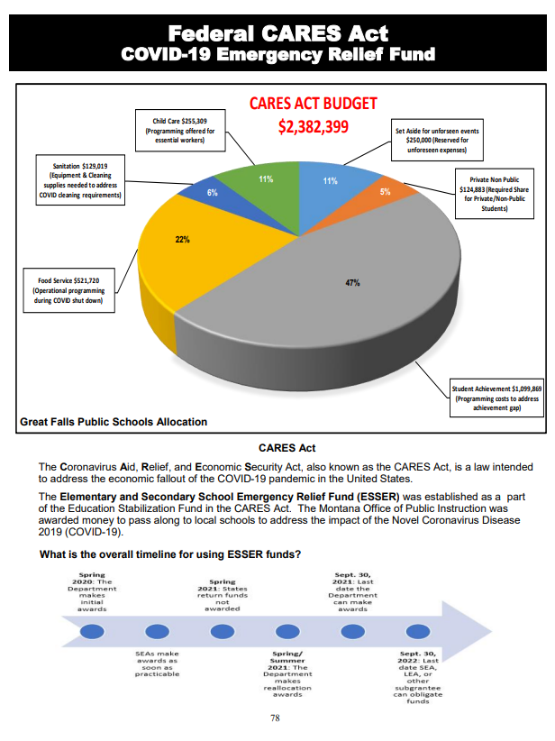

Slide 29
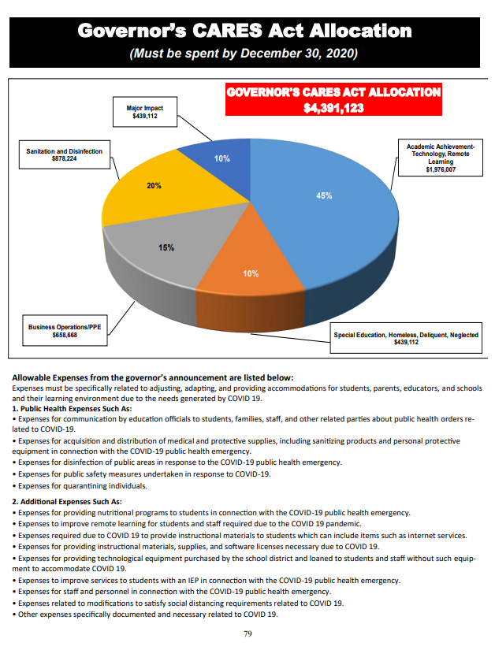
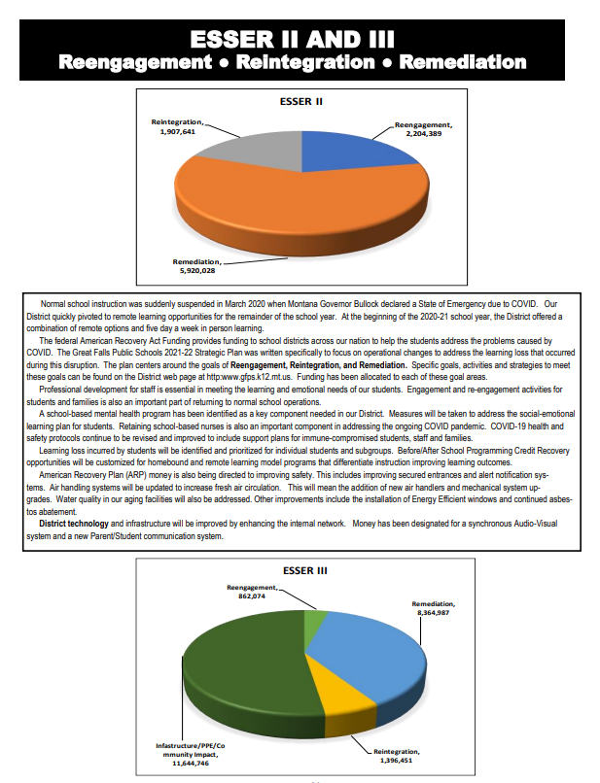

Slide 30
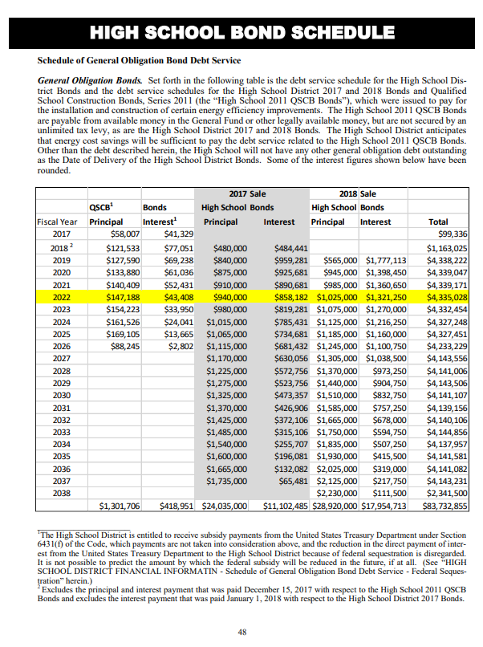
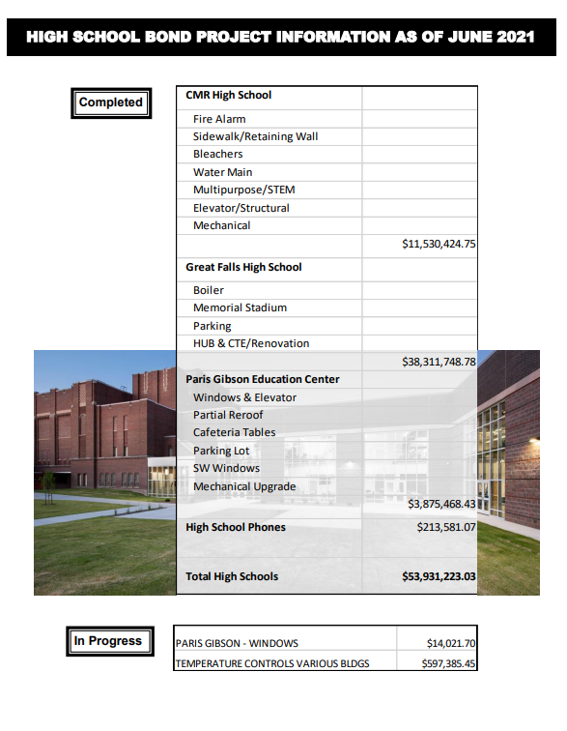

Slide 31
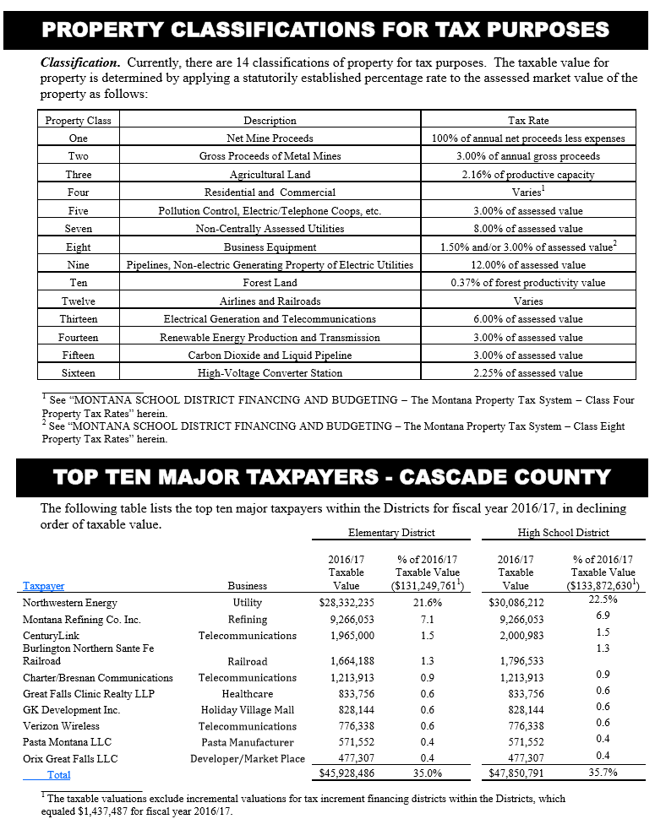

Slide 33
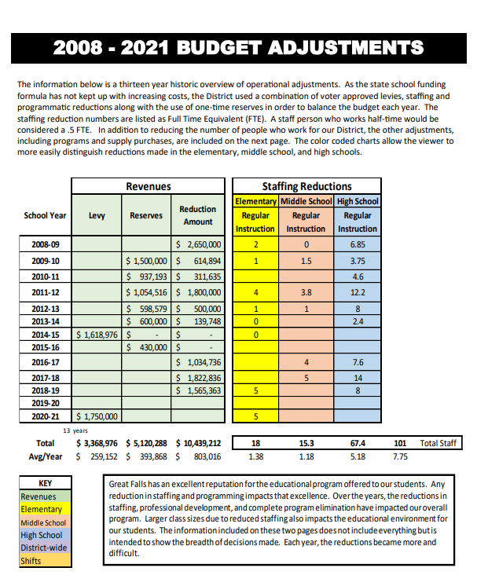
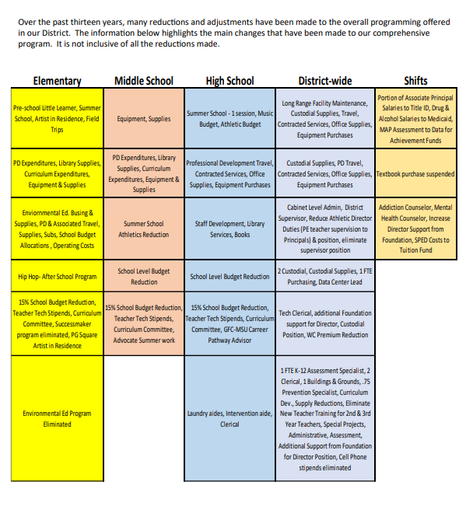

Slide 34
What we hear

Slide 35
What we do

Slide 36
Questions??

