Slide 1
Audit awareness
OPI School Finance

Slide 2
Opi in your business?
OPI has statutory obligations to ensure reports are completed.
§2‑7‑503, Montana Code Annotated (MCA) Financial reports and audits of local government entities. The superintendent of public instruction shall prescribe the reporting requirements for school districts.
§2‑7‑514, MCA Filing of audit report and financial report. The state superintendent of public instruction shall file with the department a list of school districts subject to audit under §2‑7‑503(3).

Slide 3
Local government services
§7‑6‑611, MCA Role of department of administration.
The department of administration shall prescribe for all local governments:
general methods and details of accounting in accordance with generally accepted accounting principles as provided in §2-7-504;
uniform internal and interim reporting systems as part of the uniform reporting systems provided for in §2-7-503;
the form of the annual financial report as provided in §2-7-503; and
general methods and details of accounting for the annual financial report as provided in §2-7-513.
Local governments shall file with the department of administration:
an annual financial report within 6 months of the fiscal yearend; and
an audit report within 12 months of the end of the audited period.

Slide 4
Local government services
§7‑6‑611, MCA Role of department of administration. (cont’d)
The governing body of each county or municipality shall notify the department of administration in writing, on a form prescribed by the department of administration, of the creation, dissolution, combination, or other legal alteration of any special purpose district within the county or municipality.
Each special purpose district shall obtain a permanent mailing address and notify the department of administration of the address and of any subsequent changes of the district's address.

Slide 5
Corrective Action Plans or CAPS
Corrective action plans (CAPS) address audit findings or recommendations when an audit has been completed.
MCA 2-7-515 (1) requires an audited local government entity to review the audit report and, within 30 days of receipt, submit a corrective action plan detailing what action or actions the entity plans to take on any findings or recommendations contained in the audit report.
MCA 2-7-515 (2) requires the department to notify the entity of the acceptance or rejection of the corrective measures. If the department and entity fail to agree on corrective measures, a conference will be held.
MCA 2-7-515 (3) failure to resolve significant findings or implement corrective measures must result in the withholding of financial assistance in accordance with rules adopted by the department pending resolution or compliance.
Notes:
A CAP addresses audit findings or recommendations presented in your audit report.
MCA specifically references CAPS in 2-7-515(1) and addresses the consequences of no resolution in 2-7-515(3). If the local government fails to resolve the significant finding or implement corrective measures, the department must withhold financial assistance in accordance with adopted administrative rules pending resolution or compliance.
Responses to audit findings can be submitted with the audit report or separately within 30 days of the entity’s receipt of the audit.

Slide 6
Corrective Action Plans or CAPS
Why is LGSB following up on CAPs?
To prevent withholding of financial assistance per MCA 2-7-513 and claims under MCA 2-7-523, MCA 7-6-4038 or SB302 (2019 Legislative Session).
A person may file a claim with the Department of Administration (DOA), alleging noncompliance for a period of 2 years following the applicable deadlines outlined in MCA, with the following statutory obligations:
Adoption or submission of annual operating budget;
Submission of an annual financial report;
Completion and submission of an audit or financial review report; or
Resolution of significant audit findings or implementation of corrective measures.
Notes:
Why is LGSB following up on CAPs?
To prevent claims under MCAs 2-7-523 or 7-6-4038 (or SB302 from the 2019 Legislature) which states an entity that fails to file an AFR, audit, financial review, budget, or resolve significant findings or implement corrective measures as required in MCA 2-7-515(3) within two years of the applicable deadline may have action taken against them.
The action could be filed in district court and in addition to any other penalty, the court may award court costs and reasonable attorney fees to the person/persons that filed the claim against the government.

Slide 7
Corrective Action Plans or CAPS
Findings will be reviewed by LGSB and determined to be significant or other.
Significant findings are related to
Cash,
Budgets,
and going concern.
Other finding categories, that if material, may be considered significant include:
Related to grant funds,
Reporting deadlines,
County Collections,
Charges for Services,
Debt and long-term debt,
Disclaimers or adverse opinions from the auditor,
Number of findings,
Related to fraud or abuse,
Related to custodial funds, or
Prior period adjustments.
Notes:
When LGSB reviews your audit report, the audit findings will be reviewed and classified.
Significant findings are generally related to cash, budgets and going concern of the entity.
The department has determined the significant findings related to doubtful going concern, and risk to the public interest per administrative rule 2.4.409 (5).
Other findings, as listed on the slide, may be considered as significant if they are material.
Not all audit findings are considered significant – examples may include: segregation of duties and auditor prepared financial statements, these are not considered significant.
However, we encourage you to address these findings and find alternative ways to reduce risk exposure.

Slide 8
Corrective Action Plans or CAPS
Your Corrective Action Plan should address the four W’s.
Why did the deficiency occur?
What is being done to correct the deficiency?
Who is responsible for correcting the deficiency?
When will the corrective measures be implemented?
Notes:
What is Local Government Services looking for in a CAP?
The CAP should be responsive to the audit findings and will address the 4 W’s listed on this slide.
Why – did the deficiency occur?
What is being done to correct the deficiency?
Who is responsible for correcting the deficiency?
When will the corrective measures be implemented?
Our review of the CAP will look for responses to the 4 W’s and if it doesn’t meet the criteria in the W’s we may need additional information to accept the CAP.
An accountant with local governments services will provide notification if the CAP is accepted or if additional information is necessary.
If a resolution can’t be reached – a conference will be scheduled to discuss the audit findings.
The best proof of implementation of a CAP is a finding that isn’t repeated on the next year’s audit.
Our overall goal when working on the CAPS is to help you eliminate repeat findings, especially those that fall into the significant category.
We hope to prevent significant repeat audit findings and SB302 claims against local governments.

Slide 9
Risk Assessments
Process
As of Fiscal Year 2017, Reviews and State Audits are included in the annual risk assessment. Prior only Federal Audits are included.
Audits are reviewed by OPI and the findings are entered into the Risk Assessment spreadsheet.
The OPI reviews the results, and prepares summaries containing school information, recent history, seriousness of findings, and auditor recommendations.
Committee of Finance Department personnel will then review auditor recommendations, add or subtract and a consensus is reached.
OPI auditor then meets with the Superintendent and Deputies and explain and review our recommendations.
Notes:
Process
As of Fiscal Year 2017 Federal Audits and State Audits are included in the annual risk assessment.
Audits are reviewed by OPI and then the findings are entered into the Risk Assessment spreadsheet.
OPI reviews the results, and then writes summaries of the school, recent history, seriousness of findings and auditor recommendations.
Committee of Finance Department personnel will then review auditor recommendations, add or subtract and a consensus is reached.
OPI auditor then meets with the Superintendent and Deputies and explain and review our recommendations.
When all has been reviewed and the final decisions have been made, letters are sent.
The letters will inform the district that they have been placed on either “High Risk” status or “Watch” status.
Prior to the letters being sent to the school Board Chairperson, efforts are made to contact the district clerks and inform them of their status.
From this point on, OPI auditor will visit each location that is “High Risk” or on “Watch” status. The purpose being to determine what corrective actions are needed and/or what assistance can OPI give to help the district make the improvements required.

Slide 10
Risk Assessments
Process
When the review is completed and final decisions have been made, audit letters are sent.
The audit letters inform the district of either “High Risk” status or “Watch” status.
Before letters are sent to the school Board Chairperson, the OPI attempts to contact district clerks to inform them of their status.
Following these steps, an OPI auditor will be in contact with each location with “High Risk” or “Watch” status, to determine corrective actions and/or what assistance OPI can provide to help the district make the required improvements.
Notes:
Process
As of Fiscal Year 2017 Federal Audits and State Audits are included in the annual risk assessment.
Audits are reviewed by OPI and then the findings are entered into the Risk Assessment spreadsheet.
OPI reviews the results, and then writes summaries of the school, recent history, seriousness of findings and auditor recommendations.
Committee of Finance Department personnel will then review auditor recommendations, add or subtract and a consensus is reached.
OPI auditor then meets with the Superintendent and Deputies and explain and review our recommendations.
When all has been reviewed and the final decisions have been made, letters are sent.
The letters will inform the district that they have been placed on either “High Risk” status or “Watch” status.
Prior to the letters being sent to the school Board Chairperson, efforts are made to contact the district clerks and inform them of their status.
From this point on, OPI auditor will visit each location that is “High Risk” or on “Watch” status. The purpose being to determine what corrective actions are needed and/or what assistance can OPI give to help the district make the improvements required.

Slide 11
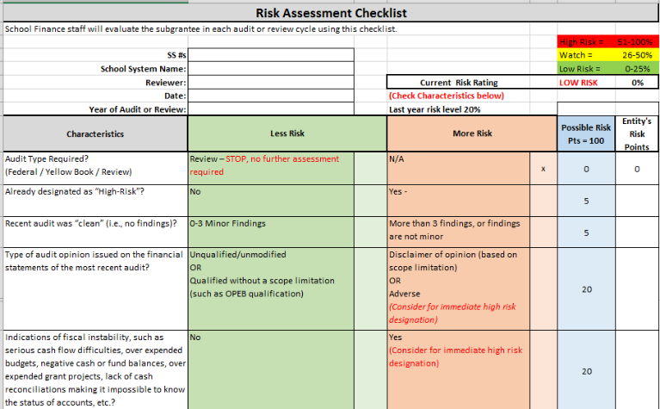

Slide 12
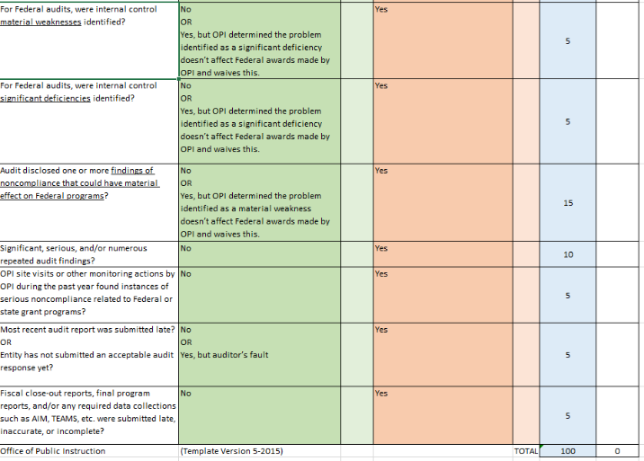

Slide 13
Most Common Audit Findings FY-2020
Audit Findings
Inadequate Segregation of Duties | 25
SAS-115 Preparation of Financial Statements | 32
OPEB-GASB 45 Not Recorded/ Incorrect | 19
Extracurricular Accounting | 39
Fixed Asset records not correct | 33
Cash related and reconciliations | 39
Year-end accruals, expenditures/revenue | 40
Payroll, all findings | 16
Budget authority or negative balances | 19
School Lunch-all findings | 4
Enrollment ANB/ over or understated | 17

Slide 14
Doa – local government services
Training or information updates resource:
http://sfsd.mt.gov/LGSB
How do I know the audit criteria for schools?
School district compliance supplements:
http://sfsd.mt.gov/LGSB/Forms/AuditReviewProgram/4_Compliance Supplement/4_SchoolDistricts

Slide 15
Audit thresholds
Type of Audit or Review Required: | Threshold | Contractor | Term | Comments:
(State law) Review Due June 30 | *REVENUES (All Funds) $750,000 or less | By contracted auditor The OPI or Dept. of Administration will notify district. Contract must be done through the Dept. of Administration as 3rd party | One year at a time with a rotating 4-year schedule. | A review of procedures, especially for recording and reporting revenues and expenditures.
(State Law) Regular (Yellowbook Audit) Due June 30 | *REVENUES (All Funds) More than $750,000 | By contracted auditor Dept. of Administration has standard contracts and a roster of authorized auditors | Usually Annual | May be for two years, if approved by Department of Administration.
(Federal Law) Federal Audit Due March 31 | FEDERAL EXPENDITURES (Including USDA Commodities) $750,000 or more | By contracted auditor Department of Administration has standard contracts and a roster of authorized auditors. | Annual | Regular audit, plus additional procedures to review and report on federal programs.

Slide 16
Opi resources
http://opi.mt.gov/Leadership/Finance-Grants/School-Finance/School-Finance-Auditing
Audit requirements
Audit processes
News
Information to schools
Information to auditors

Slide 17
Questions?
Call the OPI Auditor for help:
Dan Moody, 444-0721, Dan.Moody@mt.gov
Call the OPI School Finance staff:
Barbara Quinn 444-3249, Barbara.Quinn@mt.gov
Call the auditor on contract with your school or district.
Be mindful that auditors are often limited to contractual obligations and stipulations.

