Slide 1
School elections – Masbo region 1 Spring workshop
Nicole Thuotte
Office of Public Instruction – Finance Specialist

Slide 2
School Elections
What is a school election? 20-1-101, MCA
School election means the regular school election or any election conducted by a district or community college district for authorizing taxation, authorizing the issuance of bonds by an elementary, high school or K-12 district, or accepting or rejecting any proposition that may be presented to the electorate in accordance with the provisions of this title.

Slide 3
School Elections
Who administers school elections? 13-1-101, MCA
Election administrator means, except as provided in subsection 14(b), the county clerk and recorder or the individual designated by a county governing body to be responsible for all election administration duties, except that with regard to school elections not administered by the county, the term means the school district clerk.

Slide 4
School Elections
Except – 14(b)
As used in chapter 2 regarding voter registration, the term means the county clerk and recorder or the individual designated by a county governing body to be responsible for all election administration duties even if the school election is administered by the school district clerk.

Slide 5
School Elections
When are school elections held? 20-20-105, MCA
…the first Tuesday after the first Monday in May of each year is the regular school election day.

Slide 6
School Elections
What elections must be held on regular school election day?
School trustees (20-3-301, MCA)
General fund levy (20-20-105, MCA)
* except in years where the legislature meets in regular session or a special session that affects school funding

Slide 7
School Elections
Other elections may be held at other times
Bond elections
Levy elections
Propositions
Real property

Slide 8
School Elections
Bond Elections (20-9-428, MCA)
If the election is held by mail ballot OR in conjunction with a primary or general election a simple majority vote is required for passage
If the election is held at the regular school election or another special election weighted majority is required for passage (based on number of registered electors voting)

Slide 9
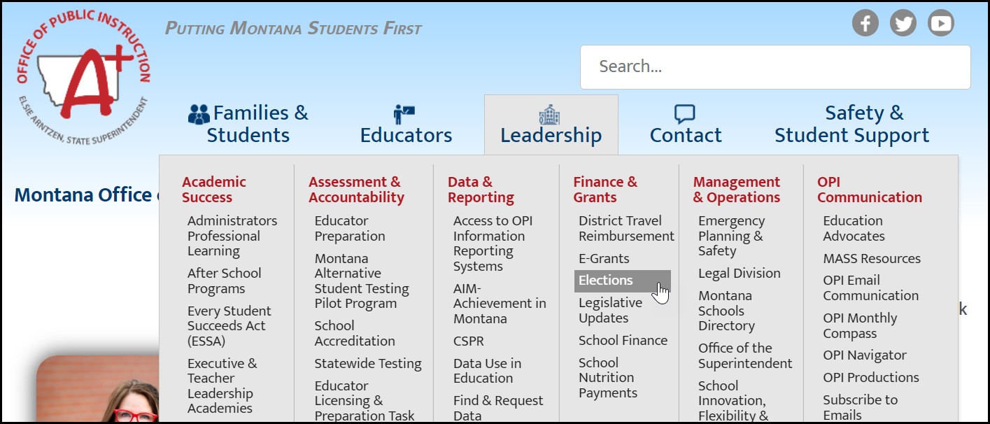
School elections
Election Webpage:
Elections (mt.gov)

Slide 10
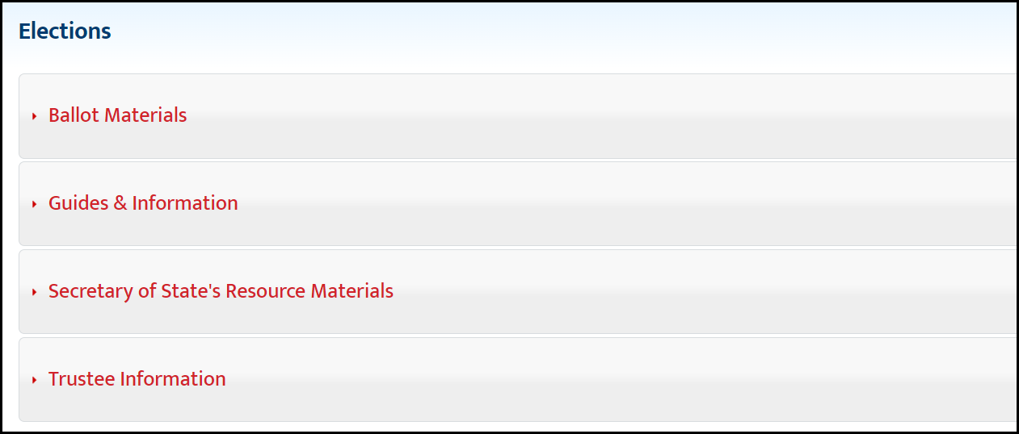
School elections
Election Webpage:

Slide 11
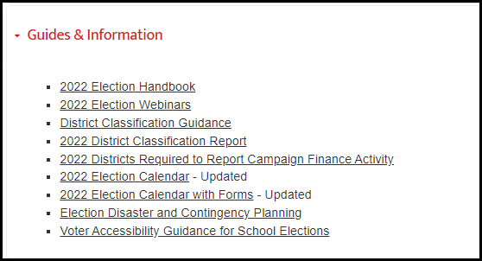
School elections
Election Webpage/Guides & Information:

Slide 12
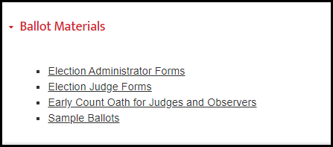
School elections
Election Webpage/Ballot Materials:

Slide 13
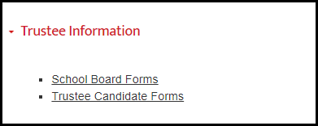
School elections
Election Webpage/Trustee Information:

Slide 14
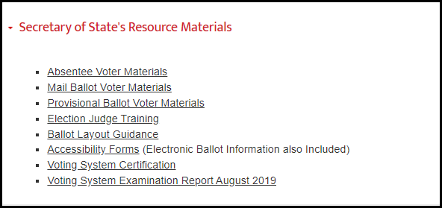
School elections
Election Webpage/Secretary of State:

Slide 15
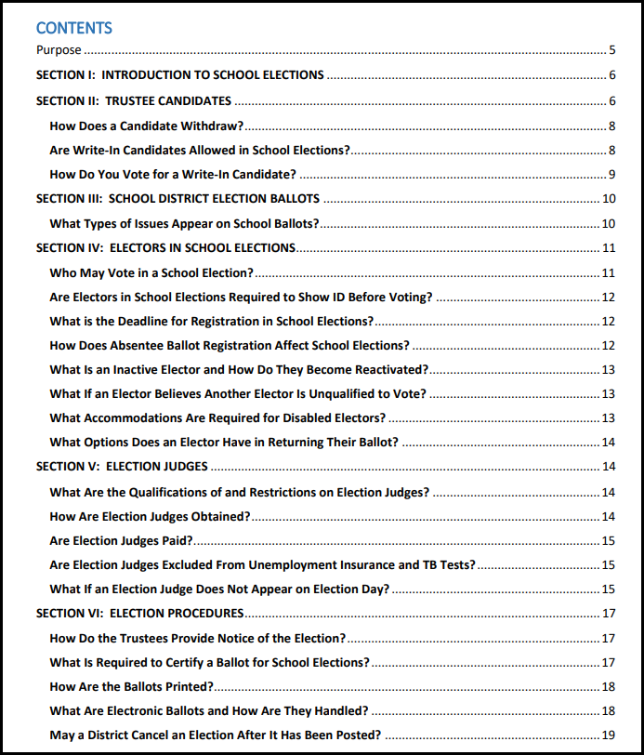
School elections
School Election Handbook:

Slide 16
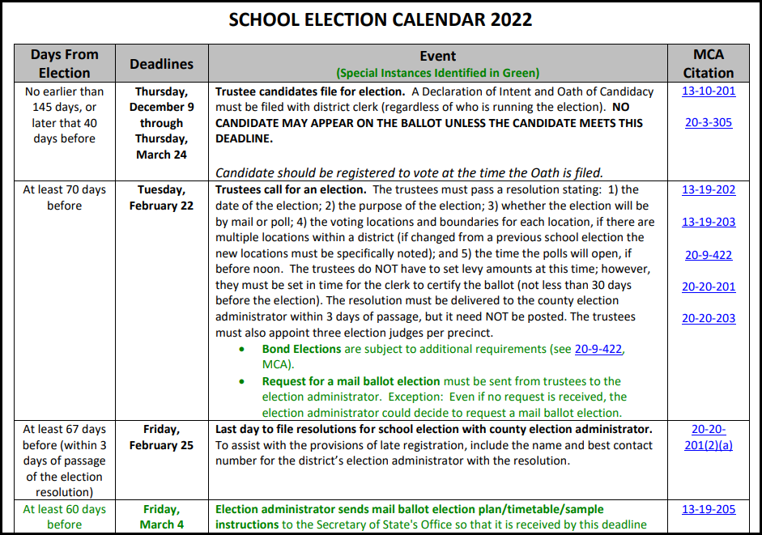
School elections
School Election Calendar:

Slide 17
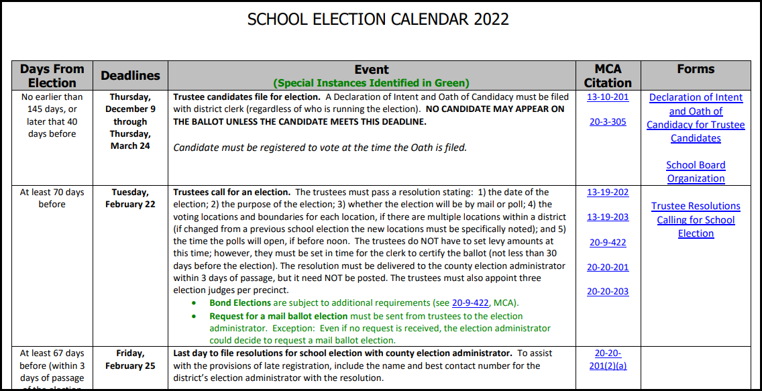
School elections
School Election Calendar with Forms:

Slide 18
School elections
Did You Know?
If you are running an election on a date outside of the regular school election date, the OPI will create a custom election calendar for your election!

Slide 19
School Trustees
The mystery of trustees unraveled:
Number of trustee dependent upon 3 factors
District classification
District choice
Additional representatives
* With the exception of a county high school

Slide 20
School Trustees
The mystery of trustees unraveled:
All trustees are elementary only – and represent both the elementary and high school where the elementary is located – unless the outlying elementary requests additional representation or the high school is a county high school.

Slide 21
School Trustees
District Classification (20-6-201, MCA)
First Class – population 6,500 or more
Second Class – population 1,000-6,499
Third Class – population under 1,000

Slide 22
School Trustees
District Classification (20-3-341, MCA)
First Class – 7 trustees
Second Class – 5 trustees
Third Class – 3 trustees

Slide 23
School Trustees
District Choice (20-3-341, MCA)
First Class – 7 trustees – no choice
Second Class – 5 trustees – board can vote to go to 7
Third Class – 3 trustees – board can vote to go to 5

Slide 24
School Trustees
District Choice
Going up requires action by the board of trustees and notice of the action published by the district clerk by January 1 in the year the election will take place
Going down requires a petition from at least 10 qualified electors and action by the board of trustees

Slide 25
School Trustees
Additional Representatives (20-3-352, MCA)
Outlying districts without representation on the high school board may request representation by sending a resolution of the board of trustees to the county superintendent (superintendent may not act until a majority of these outlying districts request representation).
Comparison of taxable valuation of the elementary to the taxable valuation of the unrepresented outlying high school area determines the number of additional representatives

Slide 26
School Trustees
Additional Representatives
Additional representatives may not exceed 4 in a first or second class district or 2 in a third class district
The county superintendent determines the boundaries from where those representatives are elected – usually based on elementary boundaries (20-3-353, MCA)

Slide 27
School District Trustees
County High Schools (20-3-356, MCA)
Seven (7) trustees
4 from the elementary district where the HS is located; and
3 from the outlying areas – determined by the county superintendent – usually based on elementary boundaries

Slide 28
School District electors
Who gets what ballot?
EXAMPLE: Unified EL/HS
One EL trustee position
One HS trustee position
One EL levy
One HS levy

Slide 29
School District electors
One EL trustee position:
Voters within the boundaries of the EL
One HS trustee position:
Voters in the area from which the representative is to be elected
One EL levy:
Voters within the boundaries of the EL
One HS levy:
All voters within the boundaries of both the EL and the HS

Slide 30
May 2022 Elections
What’s new?
SB 15 (2021):
Voter interface device available for both mail ballot and poll elections
* exception: fewer than 200 electors
Polling location site survey

Slide 31
May 2022 Elections
What’s new?
SB 15 (2021) – not specific to the bill, but now applies:
Performance testing and certification of voting system (not more than 30 days before) 13-17-212, MCA
Publication of information concerning voting system (between 2 and 10 days before) 13-17-203, MCA

Slide 32
May 2022 Elections
What’s new?
Performance Testing (13-17-212, MCA)
Ensure that the ballots are properly configured
Ensure that ballot marking works as expected
Does not have to be a formal process – but should be public (note the date and time for official records)

Slide 33
May 2022 Elections
What’s new?
Publication of Information Concerning Voting System (13-17-203, MCA)
Diagram of the voting system and sample ballot*
Location where voting systems are on public display
Instructions on how to vote

Slide 34
May 2022 Elections
What’s new?
Publication of Information Concerning Voting System
Radio or television
Newspaper of general circulation in the county*
*Diagram of voting system and sample ballot only required if the notice is published in the newspaper

Slide 35
May 2022 Elections
What’s new?
Not required, but should note that an Expressvote is available at all voting locations
*should not advertise this as an ADA device – the Expressvote should be available to all electors
Expressvote should be in an accessible location and set up so that it may be used by a disabled elector with the same privacy as any other elector would have

Slide 36
May 2022 Elections
What’s new?
Polling Location Site Survey
If the district is using a site other than one used for primary or general elections check with the county election official to see if a site survey has been done
If a site survey has not been completed, use the form on the Secretary of State’s site:
SITE SURVEY

Slide 37
May 2022 Elections
What’s new?
It is highly recommended that you use the information on the site survey for ALL voting locations – mail or poll
How is an elector going to access your site?
What barriers may prevent them from reaching you?
How can you make your election more accessible?

Slide 38
May 2022 Elections
What’s new?
Poll watchers for mail ballot elections
Who has already returned ballots
May use that information to contact electors who have not returned ballots

Slide 39
May 2022 Elections
Where are we now?
Election by acclamation (April 1)
Trustee candidates less than or equal to the number of open positions
Cancel an election, not a race
Issue certificates of election after the canvas (as if you had an actual election)

Slide 40
May 2022 Elections
Where are we now?
Regular registration closed April 4/Late registration began April 5
Notice of Election (between March 24 and April 23)
Absentee ballots available (April 13)
Mail ballots mailed (April 13 – April 18)
*mail on the date stated in the mail ballot plan

Slide 41
May 2022 Elections
Where are we now?
Absentee/mail ballot counting notice (April 23 – May 1)
Polling location accessibility notice (April 23 – May 1)
Publication of information concerning voting systems (April 23 – May 1)
Deadline for absentee ballot requests (May 2 by noon)
Late registration deadline (May 2 by noon)

Slide 42
May 2022 Elections
Where are we now?
Election Day (May 3)
Provisional ballot counting (not earlier than 3:00 pm on May 9)
Canvas the election/organizational meeting (by May 27)
Deadline to request the county conduct elections for the following year (June 1)

Slide 43
May 2022 Elections
Common Election Issues
Ballot issues
Mistake on the ballot
No ballot in the envelope
More than one ballot in an envelope
Elector wants a replacement ballot
Official ballot stamp

Slide 44
May 2022 Elections
Common Election Issues
Returned ballots
Ballot returned undeliverable
Return envelope with no signature/signature doesn’t match
Return envelope with two signatures
Return envelope with one signature and two ballots

Slide 45
May 2022 Elections
Election Judges
Election judges must be registered electors within the school district
Law was changed that allow within the county – but that does not apply to school elections
Election judges required to be trained – should be trained in the use of the ExpressVote

Slide 46
May 2022 Elections
Getting Help
Election webinars every other Friday through the election:
April 8 – Election Notices/Early Voting
April 22 – Preparing for Election Day
May 6 – Election Wrap Up

Slide 47
Contact information
Nicole Thuotte
(406) 444-4524 (work)
(406) 202-1759 (cell) – call anytime on Election Day

