Slide 1
ESSER Grant Maintenance & Audit
Jacklyn Young
Retired Fairview School Districts Clerk
Past MASBO President
April 22, 2022
Region 3 & 6 Workshop

Slide 3
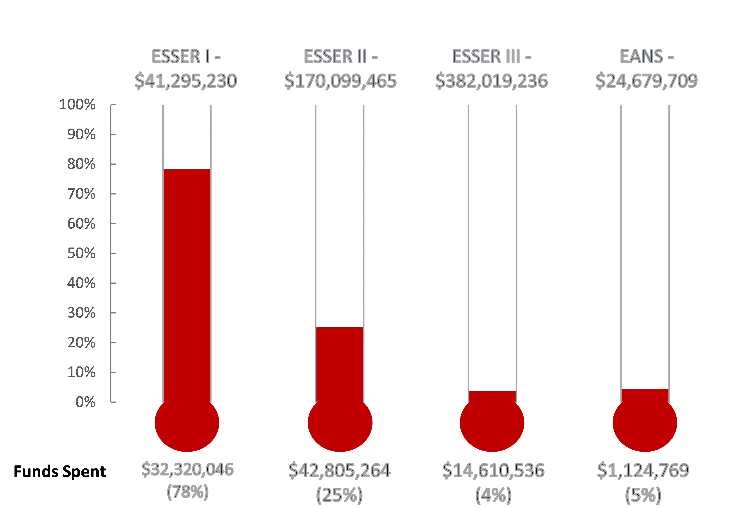
As of March 7, 2022

Slide 4
Spend by Dates:
CARES – CRF 6/30/21
(Governor’s Money)
CARES – ESSER I 11/10/22
CRSSA – ESSER II 11/10/23
ARP – ESSER III 11/10/24

Slide 5
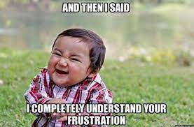
Who do I talk to?
Jeff Kirksey – moved to the “NEW” Workforce & Talent Senior Manager
Wendi Fawns wendi.fawns@mt.gov
1-406-437-8595
Help Desk ESSER-OPI@mt.gov

Slide 6
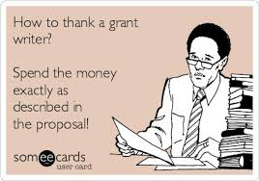
ESSER Consolidated Guidance Document –
11 pages of coding ---must follow

Slide 7
ESSER III REMINDERS:
REQUIRES 20% be used to address learning loss through summer school, enrichment, after school programs or extended school year.
Can pay salaries and benefits for staff IF:
*Incur overtime as a direct result of COVID19
*Awarded extra pay for added duties due to COVID19
*Change of duties because of COVID19. The portion of time spent on COVID related work can be paid.
*Hired substitutes for staff who are ill from COVID19.
*Salaries of those not working due to COVID19 (i.e. maintain full employment during school closures)
Construction projects require pre-approval from OPI. Projects OPI has stated will be approved:
*Upgrade HVAC system
*Repair windows and doors so can open to let fresh air in
*Install or upgrade air quality tools like filters, purification, fan control systems
*Roof repairs
*Mold, radon and asbestos remediation
*Creating outdoor space for learning, other activities like eating lunch.
*Replace carpet with easier to clean flooring
*Renovation to facilitate physical distancing
*Constructing new school when renovation would not be cost effective

Slide 8
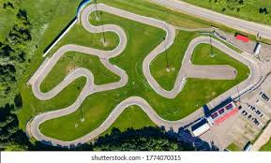
Grant Tracking

Slide 9
Nothing in life is ever free.
You end up paying for that “free” thing in the end.

Slide 10
Federal Data Collection
FIRST COLLECTION REPORT ~~ due March 18, 2022
Grant expenditures 10/1/20 to9/30/21
Problems?
Report broken down by LEA even though if you are 2 LEA’s and the money comes into 1
SECOND COLLECTION REPORT ~~ due ???????
Grant expenditures 10/1/21 to 9/30/22 ???????
Just be prepared a second collection report will happen!

Slide 11
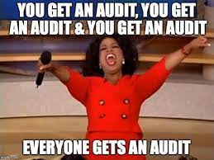
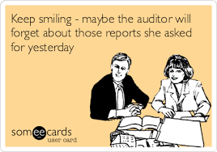
Preparing for a DESK AUDIT

Slide 12
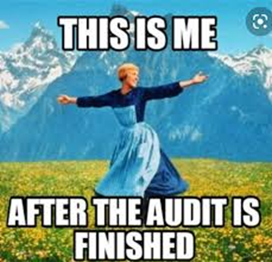

Slide 13
ARP ESSER Plan
US Department of Education (USED) requires OPI to support and monitor each school district’s use of ARP ESSER funds, including:
implementation of evidence- based interventions;
address the student groups specifically that were disproportionately impacted by the pandemic; and
Identify, reengage, and support students who have experienced the impact of lost instructional time.
The Plan will ask:
What would you like to achieve before the funding ends September 2024?
What goals will need to be established in order to get there?
LASTLY:
1. Make sure the ARP ESSER Plan aligns with the EGrant budget and narratives.
2. Post the Plan on your school website.
3. The Plan must be reviewed every six months and documented on the website that this has happened.

Slide 14
Additional CARES Grant Money!
Available to designated entities.
Montana After School Grant (75 programs are eligible) may not be the school.
Glendive
Lame Deer
Miles City
Sidney
Homeless Children & Youth Grant (Going to the school)
Brockton
Glendive
Lame Deer
Lustre
Miles City
Plentywood
Poplar
Sidney

Slide 15
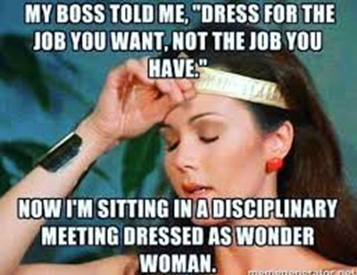
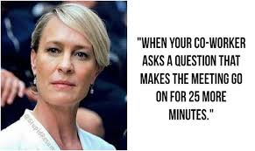
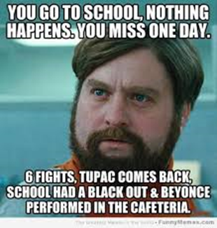
REMINDER ~~~~Indirect Cost Application due April 30, 2022
The trials of a Clerk!!

