Slide 1
Cross Training & Succession Planning
OR

Slide 2
Which would be best for your district?

Slide 3
EASY WAY –
Clerk announces to the Board, she/he is leaving/retiring on …… a date long into the future.
Clerk suggests they hire an Assistant Clerk, who she/he will teach all she/he knows!
Board agrees with a sigh of relief.
Clerk trains Assistant to be a mini me clone of her/him.
Clerk walks away proud of her/his accomplishment.
Board and Superintendent celebrate, OLD Clerk is gone!
HARD WAY –
Someone breaks clerks last straw (could be Superintendent, Principal, Board, Union, Head Custodian, IT Director, Auditor, the list goes on and on…….)
Superintendent arrives one morning to keys on the desk, grandkids pictures gone, snack drawer is empty and favorite pens are missing.
Superintendent calls MASBO or fellow Super’s and says “What do I do now??”

Slide 4
Cross Training within the office and Succession Plans have the same end goal. **MORE people able to do the same job in case of an emergency, or planned event.

Slide 5
The Battle is Real
Twenty Percent of most western countries' workforce is over 55 years old.
As a District you have many challenges.
How Many Superintendents, Clerks, Principals and even Teachers are over 55? We’ll call them Senior Staff.
Is your District facing 1-2 retirements per year?
Do you have senior staff who are preventing talent from rising to the top?
Do you have talented senior staff leaving the organization?
Do you have senior staff sandbagging till they retire?
Do you have senior staff taking time off for health reasons?
We Love the Elephant in the Room
If we just looked at the those who are over 55, you may be facing at least a 20% turnover per year of your senior staff. The cost to the organization is massive and the areas with the most pain are:
1. Loss of district/education/history…. knowledge
2. Costly recruitment processes
3. 3-6 lead months for the new staff to come up to speed. (In the clerk world, make that 1+ years)
4. Perceived drop in professionalism and service levels to the district and community

Slide 6
The Fact:
Staff turnover is a fact of life; however, lack of planning is setting you and your team up for failure, or just more hours to be worked and more criticism of not getting on the front foot.
As a business manager, we are tasked with being able to foresee the challenges ahead and mitigate risks ahead to smooth out the path for our team to follow.
Successful execution in succession planning enables your new team members to feel supported and engaged day one on the job.
Numbers Tell the Truth:
If you have 2 senior staff leaving after ten years of service you are losing 33,000 hours of experience out of your organization. What’s the math when there is over 20 years of service?
If the 2 new staff, you hire take 6 months to get up to speed at a cost of $50,000 per annum salary. You are now $50,000 cash out-of-pocket.
You are 6 months behind on expectations of the district.
If it takes 12 weeks to recruit and you spend $10,000 with recruitment companies/HR consultants, you are now $20,000 out-of-pocket.

Slide 7
Investing prior to staff leaving is critical:
The Objective:
To document and capture as much knowledge from senior staff as possible. This is aimed at maximizing district/educational/budgetary knowledge in order to aid in the process of onboarding new staff, with minimal disruption in the day to day business operations.
The Approach:
Include the following for each staff member involved:
Projects-
Future Projects – (i.e. the Board’s Strategic Plan)
Current Projects
Status and Progress for both
Project Risks – (document and explain everything the new staff will need to know)
Opportunities for change/ Improvements – (there could be a new idea that will work better)
Services-
Current Services provided– (day to day responsibilities)
Service risks – (what bogs you down each day?)
Opportunities for change/Improvements- (what could be done better/different?)
Position Role & Responsibilities – (does this position have a job description?)

Slide 8
Current role:
Current responsibilities
Current duties & tasks
Assumed / undocumented responsibilities in your current role
Location of key documents and files (electronic and copy)

Slide 9
POINTERS: * Share your goals (short term & long term) with the Superintendent, Board and Assistant.
* Build confidence in employees. * Empower the employees to prepare for an emergency. * Get rid of “that’s not my job” mentality.
* Don’t underestimate an employee’s capability to learn something new.

Slide 10
RECOMMEND TO DO:
1. Review the MASBO Acronyms list
2. Review the Clerk & Superintendent Duty List
(MASBO>Publications>MASBO Publication)
Make sure everyone understands who is responsible for which tasks.
This list will give insight into where training will be needed.
DO NOT LET THE LIST OVERWHELM!!!!!!!!!

Slide 11
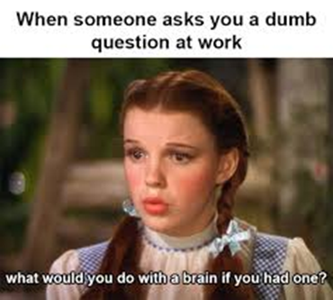
3. Set up common share drives
One Drive
Google
Calendar
4. Clerks Monthly Tickle File
5. Write down the directions for tasks done once a year.
6. Start with small tasks and increase gradually.
7. Can’t say it enough…. Don’t Overwhelm… Don’t Overwhelm

Slide 12
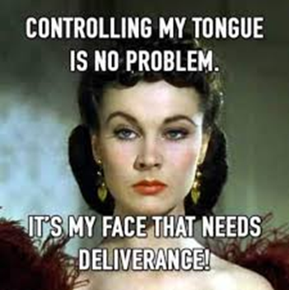
Dear God, please grant:
Patience for the person training and Patience for the person learning.

Slide 13
Farewell from departing Clerks,
Remember that your first responsibility is to the children. This is their one and only chance to get an education. Many in “education” lose sight of this.
Know the policies and laws which govern your District; make sure others learn them as well.
Serve with integrity, respect and honesty.
Take every opportunity to learn from others; no one knows everything there is to know.
Don't be afraid to admit if you make a mistake; own it, no one is perfect!
Share what you have learned with others. Be a mentor.

Slide 14
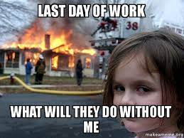
Jacklyn Young
Retired Fairview Schools Business Manager/Clerk
Past MASBO President
April 22, 2022

