Slide 1
Comprehensive School & Community Treatment (CSCT)
Region 1 Spring Workshop
April 6, 2022
Denise Williams, Kalispell Public Schools

Slide 2
Comprehensive School & Community Treatment (CSCT)
Background information
Methodologies used for meeting match requirements
20-9-240, MCA Funding For School-Based Medical Services
Terminology
Process as we understand it today
Other issues to consider
Q&A

Slide 3
Background
Medicaid pays for covered services provided to:
Medicaid-enrolled children and adolescents
Children who have an IEP (Individual Education Plan) under the IDEA (Individuals with Disabilities Education Act) or children who do not have an IEP
CSCT is one of several school-based health service programs eligible for federal Medicaid reimbursement
CSCT is for school based mental health services
School districts provide the services, typically through contracts with providers such as AWARE, Altacare, Shodair, Intermountain Children’s Home, Yellowstone Boys & Girls Ranch, etc.
Usually, a room or rooms at the school building(s) is designated solely for this purpose
Likely involves school district special education staff (manage IEPs, arrange for services, etc.)

Slide 4
Background
Medicaid reimbursements are administered through Montana DPHHS (Dept. of Public Health and Human Services)
Montana DPHHS’ plan is approved by CMS (Centers for Medicare & Medicaid Services – U.S. Dept. of Health & Human Services)
Several rules involved in receiving FFP (federal financial participation), including but not limited to:
Schools, providers in schools or school-based health centers must meet federal and state requirements for Medicaid providers
LEA (local education agency, i.e. school) must contribute non-federal dollars to help meet the full cost of the services. This is referred to as the local match.
DPHHS’ plan must include the methodology used for demonstrating the local match

Slide 5
Background
How do schools meet the local match requirement?
Prior to June 30, 2020 – referred to as “soft match”
DPHHS sent school a COM (Certification of Match) cover letter with instructions on how certify their local match requirement for the previous fiscal year
Schools accessed CSCT Match module in MAEFAIRS to enter key information
# of CSCT students
Match requirement amount (calculated and provided by DPHHS in the COM)
Square feet of CSCT room
Square feet of entire building
Using TFS expenditure data, a schedule of Eligible Non-Federal Expenditures for CSCT Match is generated

Slide 6
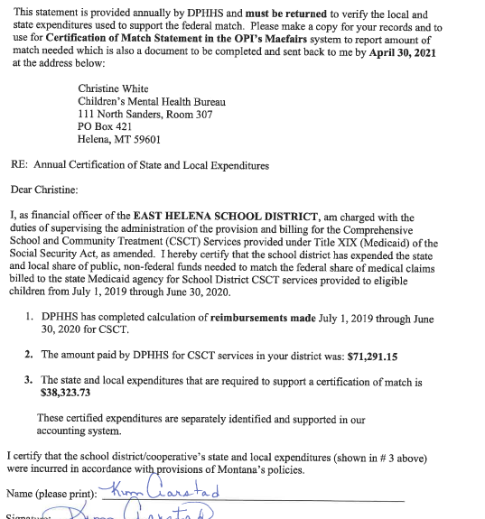
FFP Medicaid funding is roughly 65% of total costs
Local match is roughly 35% of total costs

Slide 7
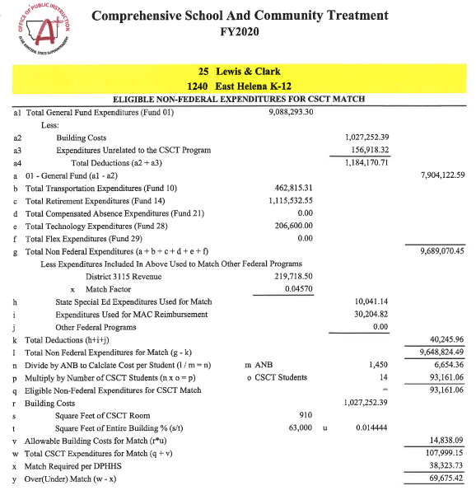
Calculation of local match

Slide 8
Background
Issues
The GAO (U.S. Government Accountability Office) and the OIG (Health and Human Services Office of Inspector General raised concerns about Medicaid billing for school-based services, including CSCT
CMS had to update its guidance and oversight
In 2016, CMS disallowed Montana DPHHS’ methodology for the local match
DPHHS appealed CMS’ ruling and received forbearance up until CMS stood firm. “Soft match” methodology ended June 30, 2020
DPHHS had its own state funds and used them as a “hard match” to keep the program running for FY 2021

Slide 9
Methodologies used for meeting match requirements
Certified Public Expenditure (CPE) – “soft match”
a statutorily recognized Medicaid financing approach by which a governmental entity, including a governmental provider (e.g., LEA), incurs an expenditure eligible for FFP under the state’s approved Medicaid state plan (§1903(w)(6) of the Social Security Act, 42 CFR 433.51)
LEA certifies that the funds expended are public funds used to support the full cost of providing the Medicaid-covered service or the administrative activity
Based on this certification, the state (DPHHS) is able to claim the federal share of these costs

Slide 10
Methodologies used for meeting match requirements
Certified Public Expenditure (CPE)
CPE-based financing must recognize actual costs incurred
CMS requires providers to use a CMS-approved cost reporting methodology to document the actual cost of providing the services determined through:
a CMS-approved statistically valid time study,
periodic cost reporting, and
reconciliation of any interim payments to actual incurred cost.
For qualifying school-based administrative activities, the amount of time that school staff members spend on Medicaid-related activities is typically determined based on time studies;
LEAs do an annual reconciliation of their actual local costs to req’d amount
Risk of “claw back” (refund to feds) for any excess federal funds received

Slide 11
Methodologies used for meeting match requirements
Intergovernmental Transfer (IGT) - “hard match”
a transfer of funds from a governmental entity (e.g., a school district or other state agency) to the Medicaid agency (DPHHS) before a Medicaid payment is made
when these funds are used as the non-federal share of a Medicaid expenditure, they are eligible for federal matching funds
Basic process:
School district submits claims for services provided in schools to the DPHHS, which will in turn calculate the non-federal share
School districts sends non-federal share to state
Claims paid by the DPHHS
full amount (federal and non-federal share)
paid to the school district that provided the service
Third-party provider (mental health center or other contractor) usually submits the claim to DPHHS on behalf of the school district

Slide 12
Methodologies used for meeting match requirements
Intergovernmental (IGT)
In use since FY2020
DPHHS used funds available within its budget until July 1, 2021
Bridge funding used July 1, 2021 – December 28, 2021
Memorandum of Understanding (MOU) outlines the IGT process effective January 1, 2022
Certified Public Expenditure (CPE)
No longer in use, but still an allowable option
State’s plan with CMS must be amended; approval may take up to 18 months
Involves time studies, etc.
Risk of claw-back of funds after the fiscal year is over

Slide 13
20-9-240, MCA Funding For School-Based Medical Services (HB671 - Bedey)
Includes the following provisions related to CSCT:
OPI and DPHHS charged with collaborating to find a solution
Legislative intent is to minimize administrative burden on school districts
DPHHS must provide technical support to OPI
Training
Establishment of provider rates
Coordination with CMS to ensure federal reimbursement for eligible services
OPI must provide technical support to school districts
Training
Accounting guidance
Collaboration with DPHHS in communicating with school districts

Slide 14
20-9-240, MCA Funding For School-Based Medical Services (HB671 - Bedey)
Created a school-based services account in the state special revenue fund
Receives matching funds from school districts
Fulfills financial requirements of the CMS for Medicaid reimbursement
HB2 appropriated approx. $2.2 million as bridge funding, beginning July 1, 2021
OPI and DPHHS worked on IGT (Intergovernmental Transfer) process
District sends local match to OPI
OPI verifies, administers collection of the $$, then transfers matching funds to DPHHS
DPHHS distributes CSCT reimbursement to school districts
School district deposits in Fund X15 Miscellaneous Programs

Slide 15
Terminology
Provider – the school district; also referred to as LEA
LEA – Local Education Agency
Mental Health Service Provider – the organization that the school district contracts with to provide mental health services, such as YBGR, AWARE, Altacare, ICH, etc.
DPHHS – Montana Dept. of Public Health & Human Services
CHMB – Children’s Mental Health Bureau (within DPHHS)
OPI – Office of Public Instruction
CMS - Centers for Medicare & Medicaid Services – U.S. Dept. of Health & Human Services
SPA – State Plan Amendment; agreement between the state (DPHHS) and CMS

Slide 16
Terminology
IGT – Intergovernmental Transfer; method by which a provider meets the local match requirement to obtain federal Medicaid funding; also referred to as “hard match”
CPE – Certified Public Expenditure; method by which a provider meets the local match requirement to obtain federal Medicaid funding; also referred to as “soft match” or “in-kind match”
MMIS – Medicaid Management Information Services; claims for CSCT reimbursement are submitted and processed in this system. The state and local match for claims that meet the criteria are calculated in the MMIS.
NPI - National Provider Identifier; number identifying a provider
ICN – Internal Control Number; a number identifying a claim
Suspended claim – a claim that has met all the criteria and is suspended for payment until the state match is received

Slide 17
IGT Process as we understand it today
Requirements:
MOU – signed by DPHHS, OPI and Provider (school district); send completed CSCT MOU to Christine White at chwhite@mt.gov
Monthly match payment
MMIS system calculates based on claims submitted
DPHHS notifies OPI
OPI notifies school district of amount
School district pays via paper check or ACH (Access.gov)
Monthly CSCT Certification Form
Certifies the match payment is from a non-federal source
Signed by the district’s authorized representative

Slide 18
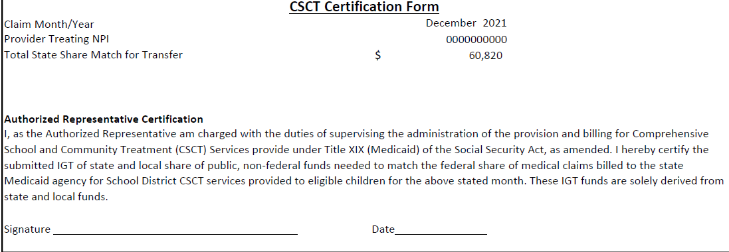

Slide 19
Other Issues to Consider
MOU
get it signed and sent to Christine White at chwhite@mt.gov
Effective date is now Jan. 1, 2022 (Section 3)
Contains provision that CSCT reimbursement funds may not be used for future CSCT match payments (Section 6)
Double-indemnity language added (Section 8)
Contracts with Mental Health Service Providers
the contract rate seems to be around $62.40 (65% of the approved rate of $96)
Contact DPHHS (Meghan Peel) to discuss
Sending Match Payment to the OPI
OPI plans to accept electronically through an online system called Access.gov
Can submit a paper check if your county treasurer doesn’t allow ACH

Slide 20
Other Issues to Consider
Accounting Guidance
Feb. 8 version posted on OPI website has concerning language:
Reimbursement (page 2) – refers to “program income” and the last sentence: “The school district is required to return any program income to DPHHS”.
At the Dec. 29 meeting, DPHHS made it very clear, they do not expect funds to be returned to them under the IGT process.
Flow Chart (page 4) – in the far right-hand column, last green box, it’s labeled “District Returns Overpayment to DPHHS”. Might need to be removed if item above is resolved.

Slide 21
Other Issues to Consider
Accounting Guidance
Accounting entries

Slide 22
Other Issues to Consider
Frequently Asked Questions (FAQ)
Q9. OPI recommends a school district have identified CSCT program costs that meet the required match amount.
Initial documentation of CSCT program costs as a requirement to receiving the monthly federal reimbursement payment has been lifted.
Q24. The board of trustees can determine other uses of the funds.
Refers to CSCT federal reimbursement funds received by the district and deposited to Fund X15. After MHC bill is paid, what can be done with the remaining funds. Can’t be spent on future match payments.

Slide 23
Other Issues to Consider
Frequently Asked Questions (FAQ)

Slide 24
Comprehensive School & Community Treatment (CSCT)
INFORMATION ON THE OPI WEBSITE:
Go to the OPI Home Page
Hover cursor on Families & Students, then click on Suicide Prevention
Scroll down until you find this
Which takes you to the Medicaid Services page
Past CSCT Meeting Information
Accounting Guidance [OPI working on updates]
IGT Overview and CSCT Monthly IGT Timeline for State FY2022
Match Expenditure Detail Form [OPI working on updates]
Provider Monthly Report [OPI working on updates]
click on it

Slide 25
Questions, Comments, Concerns

