Slide 1
Chart of Accounts Updated September 2021
Barbara Quinn, CPA
School Finance Senior Manager

Slide 2
History on the Update
The older Montana state chart of accounts was dated 2012.
November 2014 began a major update of the chart of accounts. With the final version being published in July 2020 (FY2021).
The latest update to the Chart of Accounts is September 2021 (FY2022).
The introductory page describes the most recent changes and notable updates.

Slide 3
Revisions to the Chart of Accounts
The FY2021 revision included updates based on the most recent version of the Federal Chart of Accounts.
Montana OPI models its chart of accounts as closely as possible to the Federal Chart of Accounts.
Since November 2020 the largest change:
Revenue codes (7000’s) and program codes (700’s) for CRRSA – Coronavirus Response and Relief Supplemental Appropriations, referred to as ESSER II and ARP – American Rescue Plan Act, referred to as ESSER III.

Slide 4
3.1 Types of Funds
Governmental Funds
Used to account for most governmental functions
Proprietary Funds
Used to account for a government’s ongoing activities such as those often found in the private sector
Fiduciary Funds
Used to account for assets held by a government in a trustee capacity or as an agent for individuals, private organizations, or other governmental units

Slide 5
3.5A Fund Structures – Governmental
Governmental Funds:
Fund Numbers
General Fund 01 Special Revenue Funds 10-29, 84 Permanent Funds 45-49 Debt Service Funds 50-59 Capital Projects Funds 60-69
Extracurricular Fund (84) is considered a special revenue fund per GASB 84

Slide 6
3.5B Fund Structures – Proprietary
Proprietary Funds:
Enterprise Funds 70-72 Internal Service Funds 73-79

Slide 7
3.5C Fund Structure – Fiduciary
Fiduciary Funds:
Trust Funds 81-83 & 85 Custodial Funds 86-95

Slide 8
3.5 Chart of Accounts, Fund classifications by type

Slide 9
3.6 Fund Definitions
General Fund. This fund is the chief operating fund of the school district. It is used to account for all financial resources of the school district except for those required to be accounted for in another fund. A district may have only one general fund.
3.7 Account Structure

Slide 10
3.8 Balance Sheet Account Structure
Balance sheet accounts are based upon five principal groups, which are:
100 - 399 Assets and Other Debits
400 - 499 Budgeting/Nominal Accounts-Revenue Control
600 - 699 Liabilities, Deferred Inflow, and Other Credits
800 - 899 Budgeting/Nominal Accounts-Expenditure Control
900 - 999 Equity

Slide 11
3.9 Revenue/Other Financing Account Structure
1000 Revenue from Local Sources
2000 Revenue from County Sources
3000 Revenue from State Sources
4000 Revenue from Federal Sources
5000 Other Financing Sources
6000 Adjustments to Beginning Fund Balance
7000 Emergency Federal Sources

Slide 12
Balance Sheet Accounts:
Assets, Liabilities, and Fund Equity Accounts:
X X X X X X X X X
District/Fund Balance Sheet Account Project Reporter Code-Optional
(Not used in MAEFAIRS)
Statement of Operational Accounts (Revenues and Expenditures):
Revenue Accounts:
X X X X X X X X X X
District/Fund Subsidiary Source Project Reporter Code-Optional For Most Funds
Expenditure Accounts:
X X X X X X X X X X X X X X X X X X X X X X X
District/Fund Subfund School Code Program Function Object PRC
Fund 61 Building Reserve

Slide 13
Revenue Updates
A review of all revenues used in MAEFAIRS was completed in FY2021 and some revenue codes were discontinued/expired.
Revised and opened revenue codes include this partial list: 3720 Delivering Local Assistance Grant (Dept of Commerce) 3760 Transformational Learning Grant 3770 Advanced Opportunities Grant 3283 State Major Maintenance Aid 3250 Mt Digital Academy (Deposited to Fund 15 NOT 82, GASB) 7600 CARES – Federal Stabilization Aid 7650 CARES – State School Emergency Relief Fund 7700 CARES – Governor’s Emergency Education Relief Fund

Slide 14
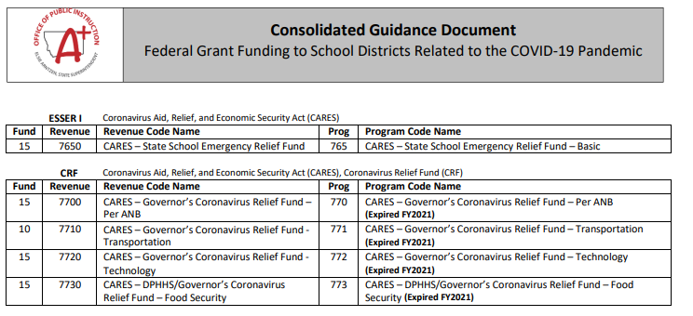
Consolidated Guidance Document

Slide 15
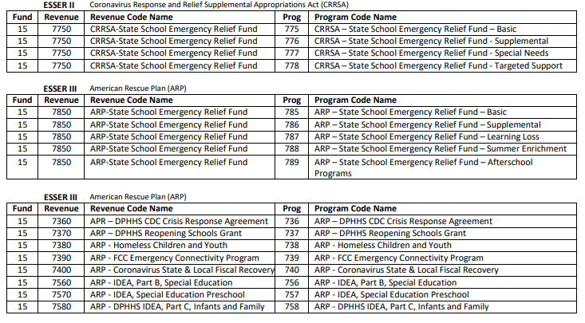

Slide 16
Program Code Updates
Updates for program codes are similar to what we saw for revenues:
Certain unused programs were closed
Names were modified to the federal ESSA names
Names were changed to match the corresponding revenue names
Some programs were opened/closed in incorrect/changed funds
Language was updated in the chart of accounts, most of it to comply with the federal chart of accounts.

Slide 17
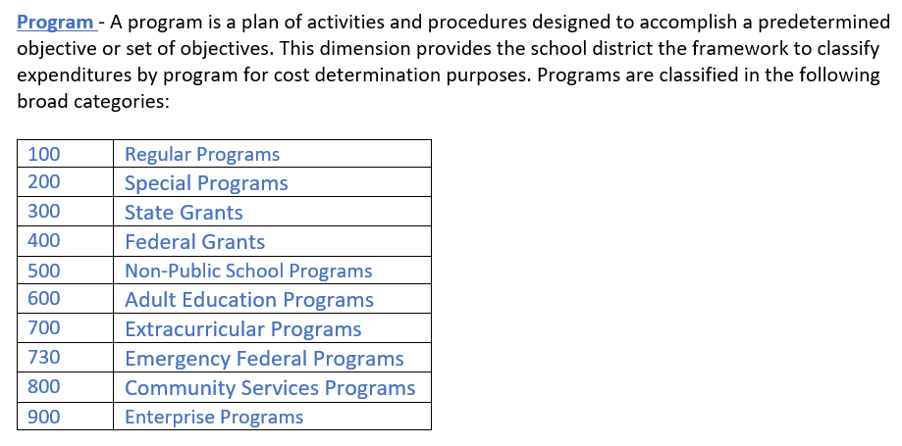

Slide 18
Function Updates
Changes were minimal:
Function descriptions were changed to better align with the language used in the most recent federal guidance.

Slide 19
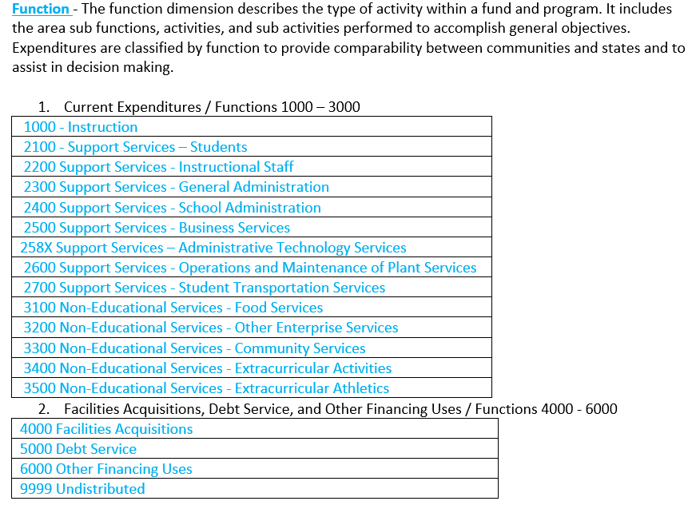

Slide 20
Object Updates
Minimal changes
Object descriptions were changed to better align with the language used in the most recent federal guidance.

Slide 21
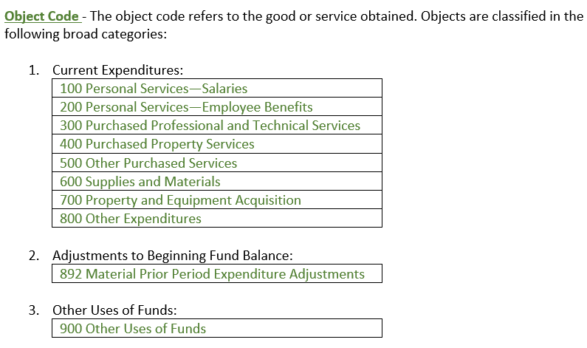

Slide 22
3.14 Project Reporter Codes (PRC)
Project reporter codes allow a district to identify levels of expenditures and revenues to meet reporting requirements for local, state, and federal levels. A unique project reporter code should be assigned to link the revenue and expenditure accounts for each state and federal grant or project.
The PRC is required in the Miscellaneous Fund (15).

Slide 24
Project Reporter Codes – in MAEFAIRS
PROJECT REPORTER CODE (PRC): Enter a unique, three-digit PRC (e.g.,123).
Reserved for OPI use 000 or 900-999.
Title: Select a project name from the dropdown list OR enter the grant or project name (e.g., IDEA-B). Selecting from the dropdown list will pre-fill the Title, CFDA Number and Type, if applicable.
Type: Select Federal, State or Local from the dropdown list.
Project Number: Enter the complete grant or project number, as assigned by the OPI or the grantor.

Slide 25
Reasons to use a PRC
Designed for state and federal grants for tracking
Permits the user to tie expenditures and revenues
A tool to be used in your accounting system and in MAEFAIRS
Use the PRC filters to find errors and reconcile

Slide 26
Requested of You
If you find that we expired or don’t have one of your PRC names, revenues, or program codes, PLEASE contact us with your requested changes.

Slide 27
Plans for the Future:
Annual updates with a summary of changes in the introduction.
Chart of accounts are in effect immediately.
As this is a living document, feel free to contact the OPI regarding this publication and the topics discussed.
OPISchoolFinance@mt.gov

Slide 28
Questions? Comments Barbara.Quinn@mt.gov 406.444.3249

